Slide 1

St. Joseph's College of Engineering · ECE
EMPLOYABILITY ENHANCEMENT COURSE · SD0212 RTL DESIGN AND VERIFICATION
RTL Design and Verification of a 32-bit Ripple Carry Adder
Structural modeling in Verilog, simulated on EDA Playground
Tavin Santo Ananth T · Thanka Winston Babu B G · Tharun Kumar P · Vasanth V · Vedhaswaruban S
Supervisor: Dr. P. Latha, Associate Professor · November 2026

Slide 2
Project overview
A ripple carry adder (RCA) adds two binary numbers by chaining one full adder per bit; each carry “ripples” to the next stage. It is the basic arithmetic block in ALUs, processors and DSP datapaths.
32
160
1010
bit operands plus carry-in, giving a 32-bit sum and carry-out
primitive gates: 64 XOR, 64 AND, 32 OR
test vectors checked: 10 directed and 1000 random, 0 failures
Purely combinational design: no clock, no reset.

Slide 3
Where this fits: RTL design and verification
1
2
3
4
5
Design entry
Testbench
Simulation
Debug
Synthesis
Structural Verilog: full adder + 32-stage chain
Self-checking, directed + random vectors
EDA Playground, Icarus Verilog 12.0
Corner cases, waveform review in EPWave
Yosys turns the RTL into a gate netlist
Errors found at RTL level are far cheaper to fix than after physical design.

Slide 4
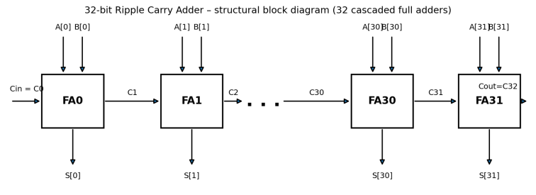
How the ripple carry adder works
Each stage
Sum = A ⊕ B ⊕ Cin
Cout = (A · B) + (Cin · (A ⊕ B))
Carry chain
C0 = Cin, C(i+1) = Cout of stage i, Cout = C32
{Cout, Sum[31:0]} = A + B + Cin
Figure: structural block diagram, FA0 to FA31
Example: FFFFFFFF + 00000001 gives sum 00000000 and Cout = 1. The carry passes through all 32 stages, the longest path in the adder.

Slide 5
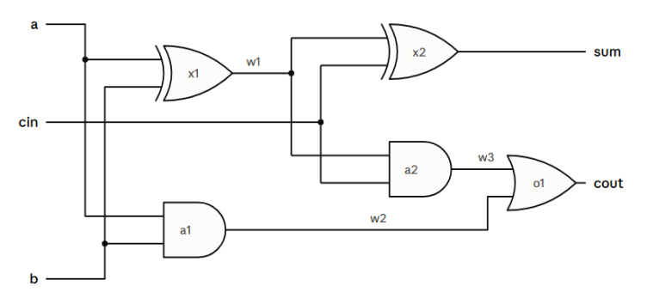
The building block: a gate-level full adder
Gate | Per FA | In 32-bit
XOR | 2 | 64
AND | 2 | 64
OR | 1 | 32
Total | 5 | 160
First XOR forms A ⊕ B; the second gives the sum. One AND forms A · B, the other Cin · (A ⊕ B), and the OR joins them to make Cout.
Worst-case delay grows linearly with word length: the lowest area, but slower than carry-lookahead or carry-select.

Slide 6
RTL design in Verilog
module full_adder (input wire a, b, cin,
output wire sum, cout);
wire axb, ab, cin_axb;
xor (axb, a, b); xor (sum, axb, cin);
and (ab, a, b); and (cin_axb, cin, axb);
or (cout, ab, cin_axb);
endmodule
module rca32 (input wire [31:0] a, b, input wire cin,
output wire [31:0] sum, output wire cout);
wire [32:0] c;
assign c[0] = cin; assign cout = c[32];
genvar i;
generate for (i = 0; i < 32; i = i + 1) begin : FA_STAGE
full_adder fa (.a(a[i]), .b(b[i]), .cin(c[i]),
.sum(sum[i]), .cout(c[i+1]));
end endgenerate
endmodule
Structural only
Gate primitives and module instances; no “+” operator in the design.
generate-for
Places 32 stages, linked by the 33-bit carry vector c[32:0].
Combinational
No clock, reset or registers.

Slide 7
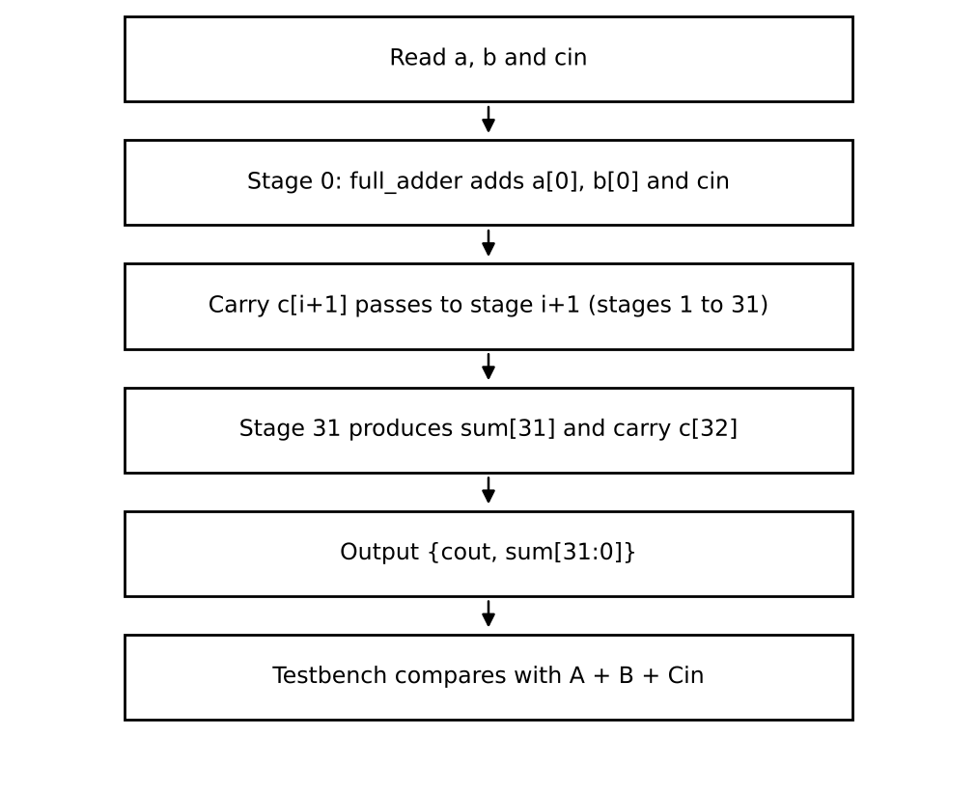
Verification strategy
Self-checking testbench rca32_tb
Applies inputs, waits 5 ns, computes expected = A + B + Cin
Compares {cout, sum} with expected using !==, so unknown values also fail
Counts errors and prints operands on a mismatch
Coverage
10 directed cases: zero, carry-in only, max values, AAAAAAAA + 55555555, 7FFFFFFF + 1
Full-word carry propagation: FFFFFFFF + 1
1000 random vectors using $random

Slide 8
Simulation results: directed cases
Test | A | B | Cin | Sum | Cout | Status
1 | 00000000 | 00000000 | 0 | 00000000 | 0 | PASS
3 | FFFFFFFF | 00000000 | 1 | 00000000 | 1 | PASS
4 | FFFFFFFF | FFFFFFFF | 1 | FFFFFFFF | 1 | PASS
5 | AAAAAAAA | 55555555 | 0 | FFFFFFFF | 0 | PASS
6 | AAAAAAAA | 55555555 | 1 | 00000000 | 1 | PASS
7 | 12345678 | 87654321 | 0 | 99999999 | 0 | PASS
8 | 7FFFFFFF | 00000001 | 0 | 80000000 | 0 | PASS
10 | FFFFFFFF | 00000001 | 0 | 00000000 | 1 | PASS
1010 / 1010
checks passed, 0 failures
Key cases: 7FFFFFFF + 1 stops at bit 31 (Cout 0). FFFFFFFF + 1 ripples through all 32 stages (Cout 1).
Showing 8 of the 10 directed cases; all 10 passed.

Slide 9
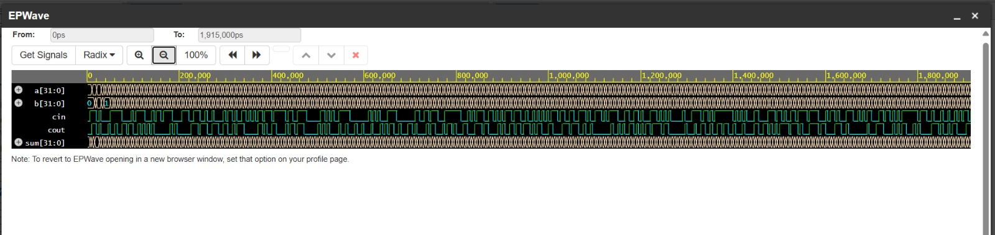
Waveforms and logical synthesis
EPWave
Shows a, b, cin, sum and cout. Each check lasts 5 ns, so the run ends at 5050 ns.
Yosys synthesis
160 cells before and after optimization (64 XOR, 64 AND, 32 OR originally), remapped to a mix of XOR, XNOR, ANDNOT, NAND and NOR. No timing, power or area was measured.

Slide 10
Conclusion and future scope
What we showed
Next steps
A 1-bit gate-level full adder repeated 32 times forms a correct 32-bit adder
All 1010 checks passed, including full-length carry ripple
Trade-off: smallest and simplest, but delay grows with word length
Compare with carry-lookahead, carry-select and Kogge-Stone adders
Synthesize for FPGA or ASIC and run timing analysis
Add assertions, coverage and a parameterized width
Thank you

