Slide 1
MySQL Beginner to Pro
Vasanth S

Slide 2
What is a Database?

Slide 3
“A database is an organized collection of structured information, or data”

Slide 4
Why Database?
Databases can store very large numbers of records efficiently (they take up little space).
It is easy to add new data and to edit or delete old data.
Data can be searched easily.
Data can be sorted easily.

Slide 5
Types of Database

Slide 6
Relational Database
A relational database is one that stores data in tables. Example
SQL
SQL databases use structured query language and have a pre-defined schema for defining and manipulating data.
It a safe choice for many use cases.
It’s perfect for complex queries.

Slide 7
Non- Relational Database
A non-relational database is any database that does not use the tabular schema of rows and columns like in relational databases.
NoSQL
NoSQL databases are non-tabular databases and store data differently than relational tables.
NoSQL databases come in a variety of types based on their data model.
The main types are document, key-value, wide-column, and graph

Slide 8
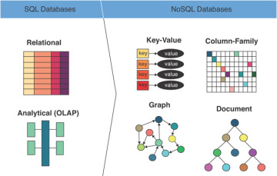

Slide 9

MySQL

Slide 10
Why MySQL?
It is open source, reliable, compatible with all major hosting providers, cost-effective, and easy to manage.
Many organizations are leveraging the data security and strong transactional support offered by MySQL to secure online transactions and enhance customer interactions

Slide 11
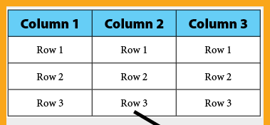
Key Terms
Table / Schema
Rows / Records
Columns / Fields

Slide 12
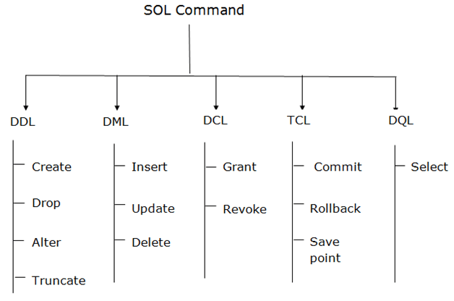

Slide 13
DDL – Data Definition Language
DDL changes the structure of the table like creating a table, deleting a table, altering a table, etc.
All the command of DDL are auto-committed that means it permanently save all the changes in the database.
Here are some commands that come under DDL:
CREATE
ALTER
DROP
TRUNCATE

Slide 14
CREATE
MySQL allows us to create a table into the database by using the CREATE TABLE command.
Syntax:
CREATE TABLE table_name(
column_definition1,
column_definition2,
........,
table_constraints
);

Slide 15
ALTER
MySQL ALTER statement is used when you want to change the name of your table or any table field. It is also used to add or delete an existing column in a table.
The ALTER statement is always used with "ADD", "DROP" and "MODIFY" commands according to the situation.

Slide 16
CONSTRAINTS
SQL constraints are used to specify rules for the data in a table.
Constraints are used to limit the type of data that can go into a table.
The following constraints are commonly used in SQL:
NOT NULL - Ensures that a column cannot have a NULL value
UNIQUE - Ensures that all values in a column are different
PRIMARY KEY - A combination of a NOT NULL and UNIQUE. Uniquely identifies each row in a table
FOREIGN KEY - Prevents actions that would destroy links between tables
DEFAULT - Sets a default value for a column if no value is specified

Slide 17
Primary Key
The PRIMARY KEY constraint uniquely identifies each record in a table.
Primary keys must contain UNIQUE values, and cannot contain NULL values.
A table can have only ONE primary key; and in the table, this primary key can consist of single or multiple columns (fields).

Slide 18
Foreign Key
The FOREIGN KEY constraint is used to prevent actions that would destroy links between tables.
A FOREIGN KEY is a field (or collection of fields) in one table, that refers to the PRIMARY KEY in another table.
CREATE TABLE Orders ( OrderID int NOT NULL PRIMARY KEY, OrderNumber int NOT NULL, PersonID int FOREIGN KEY REFERENCES Persons(PersonID) );

Slide 19
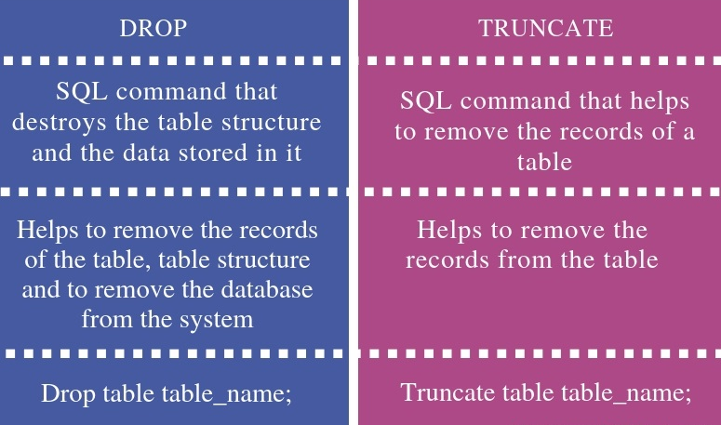
DROP vs TRUNCATE

Slide 20
DML – Data Manipulation Language
DML commands are used to modify the data in the database.
The command of DML is not auto-committed that means it can't permanently save all the changes in the database. They can be rollback.
Here are some commands that come under DML:
INSERT
UPDATE
DELETE

Slide 21
INSERT
MySQL INSERT statement is used to store or add data in MySQL table within the database. We can perform insertion of records in two ways using a single query in MySQL:
Insert record in a single row
Insert record in multiple rows
INSERT INTO table_name VALUES
( value1, value2,...valueN ),
( value1, value2,...valueN ),
...........
( value1, value2,...valueN );

Slide 22
UPDATE
MySQL UPDATE query is a DML statement used to modify the data of the MySQL table within the database.
The UPDATE statement is used with the SET and WHERE clauses. The SET clause is used to change the values of the specified column. We can update single or multiple columns at a time.
UPDATE table_name
SET column_name1 = new-value1,
column_name2=new-value2, ...
[WHERE Clause]

Slide 23
DELETE
MySQL DELETE statement is used to remove records from the MySQL table that is no longer required in the database.
Once we delete the records using this query, we cannot recover it.
DELETE FROM table_name WHERE condition;

Slide 24
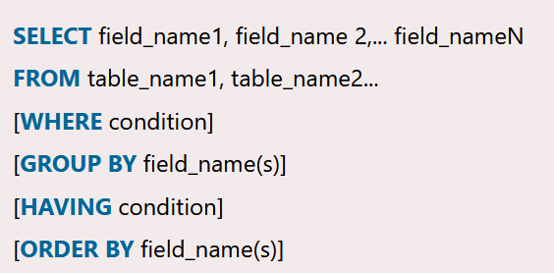
DQL – Data Query Language
The SELECT statement in MySQL is used to fetch data from one or more tables.
We can retrieve records of all fields or specified fields that match specified criteria using this statement.

Slide 25
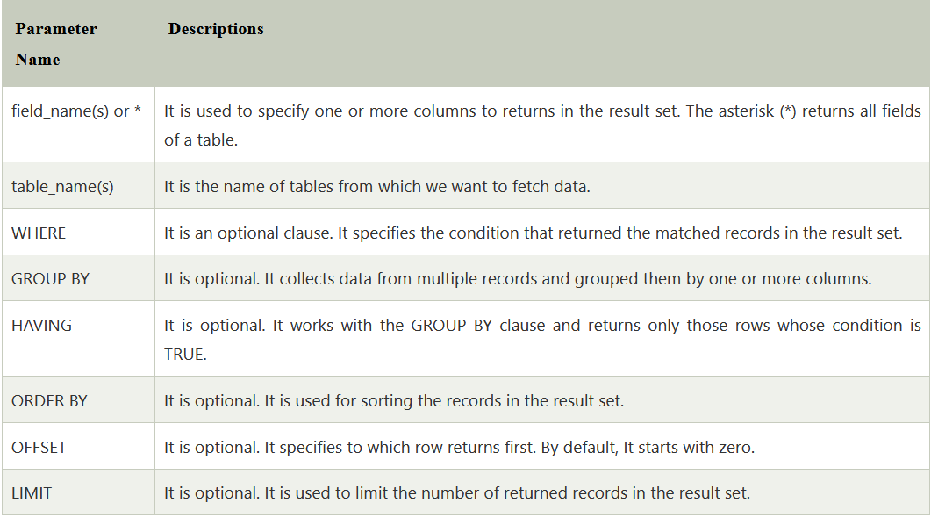
SELECT Statement

Slide 26
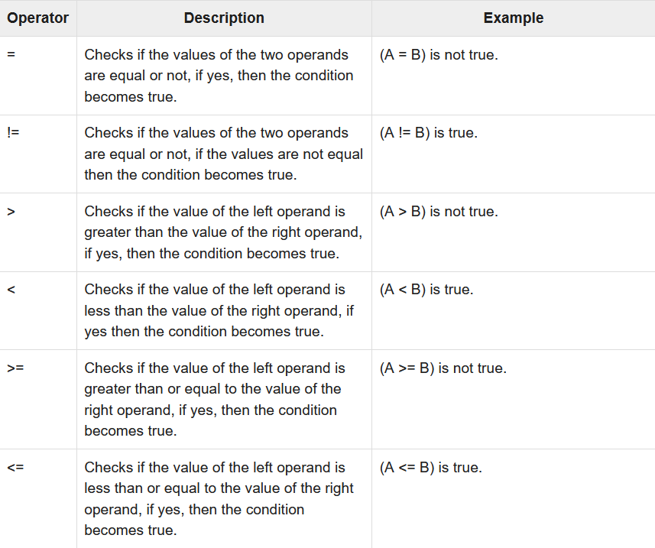
WHERE Conditions - Operators

Slide 27
WHERE Clauses – AND, OR, NOT
The AND and OR operators are used to filter records based on more than one condition:
The AND operator displays a record if all the conditions separated by AND are TRUE.
The OR operator displays a record if any of the conditions separated by OR is TRUE.
The NOT operator displays a record if the condition(s) is NOT TRUE.

Slide 28
LIKE Operator
The LIKE operator is used in a WHERE clause to search for a specified pattern in a column.
There are two wildcards often used in conjunction with the LIKE operator:
The percent sign (%) represents zero, one, or multiple characters
The underscore sign (_) represents one, single character
SELECT column1, column2, ... FROM table_name WHERE columnN LIKE pattern;

Slide 29
IN Operator
The IN operator allows you to specify multiple values in a WHERE clause.
The IN operator is a shorthand for multiple OR conditions.
SELECT column_name(s) FROM table_name WHERE column_name IN (value1, value2, ...);

Slide 30
BETWEEN Operator
The BETWEEN operator selects values within a given range. The values can be numbers, text, or dates.
The BETWEEN operator is inclusive: begin and end values are included.
SELECT column_name(s) FROM table_name WHERE column_name BETWEEN value1 AND value2;

Slide 31
ORDER BY Keyword
The ORDER BY keyword is used to sort the result-set in ascending or descending order.
The ORDER BY keyword sorts the records in ascending order by default. To sort the records in descending order, use the DESC keyword.

Slide 32
LIMIT Keyword
MySQL Limit query is used to restrict the number of rows returns from the result set, rather than fetching the whole set in the MySQL database.
SELECT column_list
FROM table_name
LIMIT count;

Slide 33
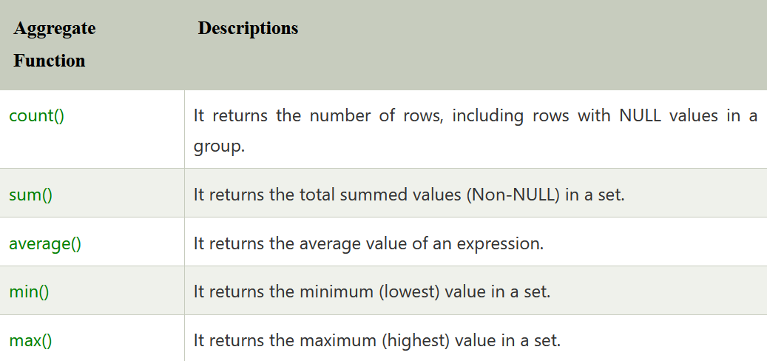
AGGREGATE FUNCTIONS
MySQL's aggregate function is used to perform calculations on multiple values and return the result in a single value

Slide 34
SUM Function
The MySQL sum() function is used to return the total summed value of an expression. It returns NULL if the result set does not have any rows.
Syntax:
SELECT SUM(aggregate_expression)
FROM tables
[WHERE conditions];

Slide 35
COUNT Function
MySQL count() function is used to returns the count of an expression. It allows us to count all rows or only some rows of the table that matches a specified condition.
Syntax:
SELECT COUNT (aggregate_expression)
FROM table_name [WHERE conditions];

Slide 36
AVG Function
The MySQL avg() is an aggregate function used to return the average value of an expression in various records.
SELECT AVG(aggregate_expression)
FROM tables
[WHERE conditions];

Slide 37
MIN() and MAX() functions
The MIN() function in MySQL is used to return the minimum value
in a set of values from the table.
Similarly, the MAX() function.
SELECT MIN ( DISTINCT aggregate_expression)
FROM table_name(s)
[WHERE conditions];

Slide 38
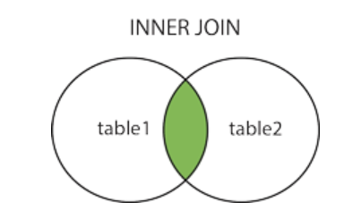
INNER JOIN
The INNER JOIN keyword selects records that have matching values in both tables.
SELECT column_name(s) FROM table1 INNER JOIN table2 ON table1.column_name = table2.column_name;

Slide 39
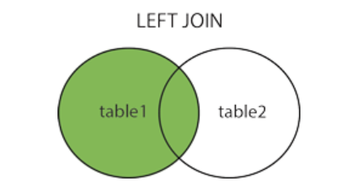
LEFT JOIN
The LEFT JOIN keyword returns all records from the left table (table1), and the matching records from the right table (table2).
SELECT column_name(s) FROM table1 LEFT JOIN table2 ON table1.column_name = table2.column_name;

Slide 40
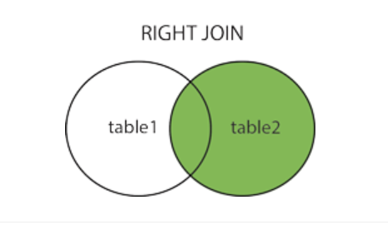
RIGHT JOIN
The RIGHT JOIN keyword returns all records from the right table (table2), and the matching records from the left table (table1).
SELECT column_name(s) FROM table1 RIGHT JOIN table2 ON table1.column_name = table2.column_name;

Slide 41
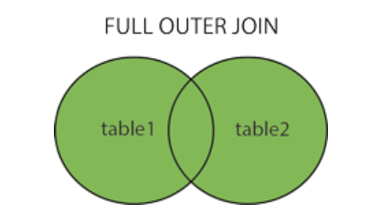
FULL JOIN
The FULL OUTER JOIN keyword returns all records when there is a match in left (table1) or right (table2) table records.
SELECT column_name(s) FROM table1 FULL OUTER JOIN table2 ON table1.column_name = table2.column_name WHERE condition;

Slide 42
SELF JOIN
A self join is a regular join, but the table is joined with itself.
SELECT column_name(s) FROM table1 T1, table1 T2 WHERE condition;

