Slide 1
Lesson 1: Getting Started with JavaScript Testing
1.1 Overview of testing in JavaScript
1.2 Getting started with Jest
1.3 Writing and running a test
1.4 Organizing tests into suites
1.5 Using ECMAScript modules

Slide 2
Lesson 1: Getting Started with JavaScript Testing
1.1 Overview of Testing in JavaScript

Slide 3
The Need for Testing
Testing is an essential element in software development
All code can contain bugs
If you don't test your code, you won't detect these bugs
But your users will…

Slide 4
The Traditional Approach to Testing in JavaScript
Traditionally, developers used to take a manual approach to testing in JavaScript
Look at the web page to see if it looks right
Or call alert() to display messages indicating variables, etc.
What's wrong with these approaches?

Slide 5
A Better Approach to Testing
Here's a better approach to testing:
Write a formal test
Run the test to verify successful outcome
Keep test code as well as "real" code, so you can run again later

Slide 6
Types of Test
Unit tests
Verify the correct behavior of your code artifacts in isolation
E.g., test all the paths through each function
End-to-end (e2e) tests
Automated tests that simulate user interactions with the web app
E.g., simulate the user pressing a button, and verify the web app does all the resultant processing correctly

Slide 7
JavaScript Test Frameworks
There are several test frameworks available for JavaScript, including:
Jest
Jasmine
Mocha
QUnit
We'll use Jest for most examples

Slide 8
Lesson 1: Getting Started with JavaScript Testing
1.2 Getting Started with Jest

Slide 9
Overview
In this section we'll see how to install Jest on your local development computer
You can use either of the following package managers to install Jest:
Node Package Manager (npm)
Yarn
We'll see both techniques…

Slide 10
Using npm to Install Jest
If you want to use npm to install Jest…
First install Node.js from here:
https://nodejs.org/en/
Node.js incorporates npm, so you can now use npm to install Jest as follows:
npm install --global jest

Slide 11
Using yarn to Install Jest
If you want to use yarn to install Jest…
First install yarn as follows:
You can now use yarn to install Jest: as follows:
npm install --global yarn
yarn global add jest

Slide 12
Verifying Jest is Installed
To verify Jest is installed, run the following command:
If Jest is installed properly, you should see the Jest version number (e.g., 27.5.1)
jest --version

Slide 13
Lesson 1: Getting Started with JavaScript Testing
1.3 Writing and running a test

Slide 14
Overview
In this section we'll see how to:
Write some simple JavaScript code
Write a simple Jest test
Run the Jest test

Slide 15
Writing Some Simple JavaScript Code
Here's some simple JavaScript code to test:
Technically, this file is a CommonJS module
module.exports exports symbols, so, they can be imported elsewhere
This is how you share symbols across modules in Jest (and in Node.js)
function add(a, b) {
return a + b;
}
module.exports = add;
Example1/example.js

Slide 16
Writing a Simple Jest Test
Here's a simple Jest test for the code we just saw:
require()
Imports symbols from another module
test()
Defines a test for Jest to run
Alternatively, you can use it()
const add = require('./example');
test('adds 1 + 2 to be 3', () => {
expect(add(1, 2)).toBe(3);
});
const add = require('./example');
test('adds 1 + 2 to be 3', () => {
expect(add(1, 2)).toBe(3);
});
const add = require('./example');
test('adds 1 + 2 to be 3', () => {
expect(add(1, 2)).toBe(3);
});
Example1/example.test.js
Example1/example.test.js
Example1/example.test.js

Slide 17
Writing a Simple Jest Test
Let's take a closer look at the test() function:
test() takes 2 parameters:
A free-format string that describes the test
A function that specifies the test to do
const add = require('./example');
test('adds 1 + 2 to be 3', () => {
expect(add(1, 2)).toBe(3);
});
const add = require('./example');
test('adds 1 + 2 to be 3', () => {
expect(add(1, 2)).toBe(3);
});
const add = require('./example');
test('adds 1 + 2 to be 3', () => {
expect(add(1, 2)).toBe(3);
});
Example1/example.test.js
Example1/example.test.js
Example1/example.test.js

Slide 18
Writing a Simple Jest Test
Let's take a closer look at how you formulate a test:
expect()
Specifies the operation you want to test
toBe()
Indicates what the result should be
const add = require('./example');
test('adds 1 + 2 to be 3', () => {
expect(add(1, 2)).toBe(3);
});
const add = require('./example');
test('adds 1 + 2 to be 3', () => {
expect(add(1, 2)).toBe(3);
});
const add = require('./example');
test('adds 1 + 2 to be 3', () => {
expect(add(1, 2)).toBe(3);
});
Example1/example.test.js
Example1/example.test.js
Example1/example.test.js

Slide 19
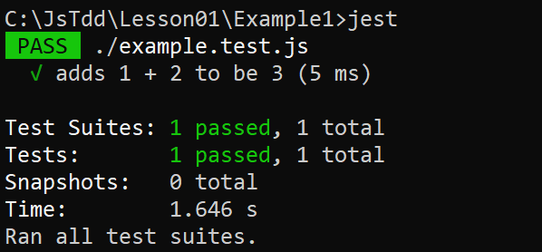
Running a Jest Test
You can run a Jest test as follows:
This runs all tests in the current folder
Displays the following result:
jest

Slide 20
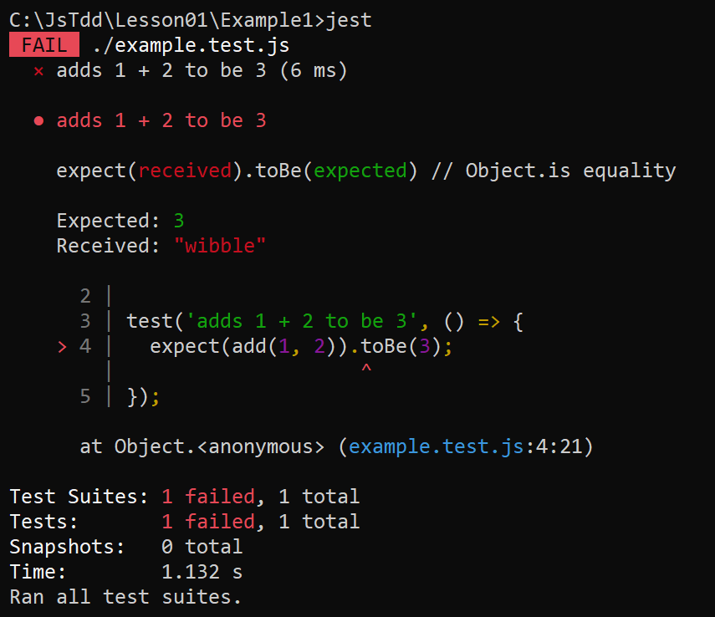
Running a Jest Test
If a test fails, you'll see an error message like this:

Slide 21
Defining a Script to Run Jest Tests
It's commonplace to define a script in package.json as follows, to run Jest scripts:
You can now run tests using either of the following commands:
{
"scripts": {
"test": "jest"
}
}
Example1/package.json
yarn test
npm run test

Slide 22
Lesson 1: Getting Started with JavaScript Testing
1.4 Organizing tests into suites

Slide 23
Defining Multiple Functions
Your JavaScript code will typically define many functions, all of which need to be tested. For example:
function add(a, b) { … }
function subtract(a, b) { … }
function multiply(a, b) { … }
function divide(a, b) { … }
module.exports = {
add,
subtract,
multiply,
divide
}
Example2/example.js

Slide 24
Grouping Tests into Suites
You can group related tests into suites as follows:
describe() takes 2 parameters:
A free-format string that describes the suite
A function that contains tests for that suite
describe("additive functions", () => {
// Define tests for add() and subtract() here.
});
describe("multiplicative functions", () => {
// Define tests for multiply() and divide() here.
});
describe("additive functions", () => {
// Define tests for add() and subtract() here.
});
describe("multiplicative functions", () => {
// Define tests for multiply() and divide() here.
});
describe("additive functions", () => {
// Define tests for add() and subtract() here.
});
describe("multiplicative functions", () => {
// Define tests for multiply() and divide() here.
});
Example2/example.test.js
Example2/example.test.js
Example2/example.test.js

Slide 25
Running All Tests
To run all tests, run one of the following commands:
yarn test
npm run test

Slide 26
Running Tests in Selective Suites
To run tests in selective suites, use the -t option and specify a partial suite descriptor. For example:
Note the -- syntax when using npm
Indicates -t additive are arguments to the test command, not to the npm command
yarn test -t additive
npm run test -- -t additive

Slide 27
Lesson 1: Getting Started with JavaScript Testing
1.5 Using ECMAScript modules

Slide 28
Recap of How to Use CommonJS Modules
In the examples so far, we've seen how to export/import symbols in CommonJs modules:
function add(a, b) {
return a + b;
}
module.exports = add;
Example1/example.js
const add = require('./example');
test('adds 1 + 2 to be 3', () => {
expect(add(1, 2)).toBe(3);
});
Example1/example.test.js

Slide 29
Using ECMAScript Modules
Another way to organize code is to use ECMAScript modules, which uses a different syntax to export/import symbols:
export function add(a, b) {
return a + b;
}
Example3/example.js
import {add} from './example';
test('adds 1 + 2 to be 3', () => {
expect(add(1, 2)).toBe(3);
});
Example3/example.test.js

Slide 30
Supporting ECMAScript Modules with Jest
To support ECMAScript modules with Jest, you must specify a couple of development dependencies:
Install using either of these commands:
{
"scripts": {
"test": "jest"
},
"devDependencies": {
"@babel/preset-env": "^7.15.8",
"babel-jest": "^27.2.5"
}
}
Example3/package.json
yarn install
npm install

Slide 31
Supporting ECMAScript Modules with Jest
You must also configure Babel as follows:
This tells Babel to compile JavaScript code to ECMAScript 2015
This is a baseline version of JavaScript, which all tools and browsers understand
{
"presets": [
"@babel/preset-env"
]
}
Example3/babel.config.json

Slide 32
Running Tests
You can now run tests as normal, using either of the following commands:
yarn test
npm run test

