Slide 1
Lesson 4: Testing Asynchronous Operations
4.1 Testing callback functions
4.2 Testing errors from callback functions
4.3 Specifying a timeout for tests
4.4 Understanding promises
4.5 Testing promises
4.6 Using the async and await keywords
4.7 Getting started with RxJs
4.8 Going further with RxJs

Slide 2
Lesson 4: Testing Asynchronous Operations
4.1 Testing Callback Functions

Slide 3
Overview
Asynchronous processing is commonplace in JavaScript
E.g., make an Ajax call to a REST service
One way to process the result of a long-running function is to use callbacks:
Pass a callback into a long-running function
The function invokes the callback when ready
In this section we'll see:
How to define a long-running function
How to test the callback is invoked properly

Slide 4
Example Long-Running Function
Here's a simple example of a long-running function
See the TestingCallbacks folder
Note the following points:
The function receives a callback
The function simulates a slow operation by invoking setTimeout()
After the timeout, the function invokes the callback with a result
function slowOperation(callback) {
setTimeout(() => callback(42), 2_000)
}
function slowOperation(callback) {
setTimeout(() => callback(42), 2_000)
}
function slowOperation(callback) {
setTimeout(() => callback(42), 2_000)
}
function slowOperation(callback) {
setTimeout(() => callback(42), 2_000)
}
operations.js

Slide 5
Testing the Function - Incorrect Approach
Consider the following test, which attempts to test the long-running function (but is incorrect):
Note the following points:
The test invokes the long-running operation, passing a callback as a parameter
The callback tests if the result is correct
const ops = require('./operations');
test('test slow operation, incorrect technique', () => {
function testResult(result) {
expect(result).toBe(42);
}
ops.slowOperation(testResult);
});
const ops = require('./operations');
test('test slow operation, incorrect technique', () => {
function testResult(result) {
expect(result).toBe(42);
}
ops.slowOperation(testResult);
});
const ops = require('./operations');
test('test slow operation, incorrect technique', () => {
function testResult(result) {
expect(result).toBe(42);
}
ops.slowOperation(testResult);
});
operations.test.js

Slide 6
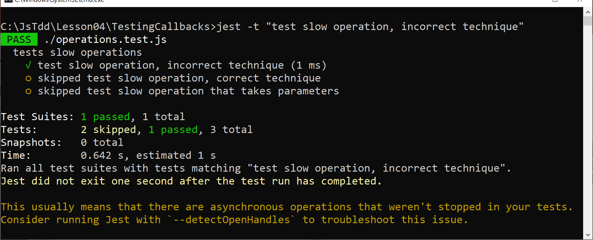
Testing the Function - Incorrect Approach
Run the test as follows:
To understand the problem, run the test again with --detectOpenHandles
jest -t "test slow operation, incorrect technique"

Slide 7
Testing the Function - Correct Approach
Now consider the following test, which tests the long-running function correctly:
Note the following points:
The test function receives a done arg, which is a callback into Jest itself
Jest will wait until we call done() before finishing the test
const ops = require('./operations');
test('test slow operation, correct technique', done => {
function testResult(result) {
expect(result).toBe(42);
done();
}
ops.slowOperation(testResult);
});
const ops = require('./operations');
test('test slow operation, correct technique', done => {
function testResult(result) {
expect(result).toBe(42);
done();
}
ops.slowOperation(testResult);
});
const ops = require('./operations');
test('test slow operation, correct technique', done => {
function testResult(result) {
expect(result).toBe(42);
done();
}
ops.slowOperation(testResult);
});
const ops = require('./operations');
test('test slow operation, incorrect technique', ()=>{
function testResult(result) {
expect(result).toBe(42);
}
ops.slowOperation(testResult);
});
const ops = require('./operations');
test('test slow operation, incorrect technique', ()=>{
function testResult(result) {
expect(result).toBe(42);
}
ops.slowOperation(testResult);
});
operations.test.js

Slide 8
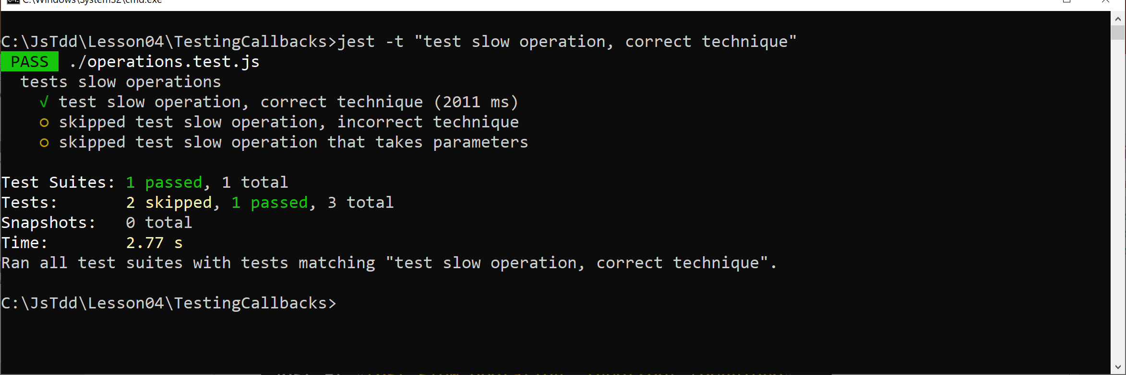
Testing the Function - Correct Approach
Run the test as follows:
jest -t "test slow operation, correct technique"

Slide 9
Lesson 4: Testing Asynchronous Operations
4.2 Testing Errors from Callback Functions

Slide 10
Overview
In a realistic application, errors can occur
It's important that you cater for these errors in your tests
In this section we'll see how to manage errors correctly when dealing with callback functions
How to propagate errors
How to test for errors
See the examples in this folder:
TestingCallbacks_Errors

Slide 11
Propagating Errors - Incorrect Approach
Here's a long-running function that throws an error:
This technique won't work
The code that runs within setTimeout() is not enclosed in a try/catch block
function slowOperationWithError_bad(a, b, callback) {
setTimeout(
() => {
if (b === 0) {
throw new Error('Cannot divide by 0')
}
else {
callback(a / b)
}
},
2_000
)
}
operations.js

Slide 12
Propagating Errors - Incorrect Approach
Here's a naïve attempt to test the long-running function:
The function call is in a try/catch
But this won't catch the error thrown within the setTimeout() call
test('test - incorrect technique', done => {
try {
ops.slowOperationWithError_bad(10, 0, null);
}
catch (err) {
expect(err).toBe('Cannot divide by 0');
}
done();
});
test('test - incorrect technique', done => {
try {
ops.slowOperationWithError_bad(10, 0, null);
}
catch (err) {
expect(err).toBe('Cannot divide by 0');
}
done();
});
operations.test.js

Slide 13
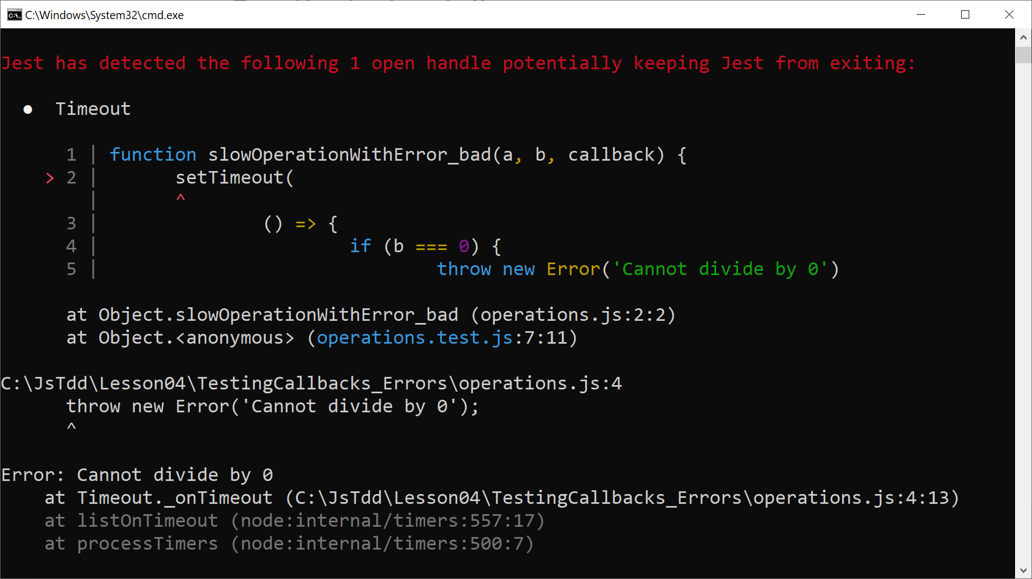
Propagating Errors - Incorrect Approach
Run the test as follows:
jest -t "test - incorrect technique" --detectOpenHandles

Slide 14
Propagating Errors - Correct Approach
The correct way to propagate errors from a long-running function is via a separate "error" callback:
function slowOperationWithError_good(a, b,
resultCallback,
errorCallback) {
setTimeout(
() => {
if (b == 0) {
errorCallback('Cannot divide by 0')
}
else {
resultCallback(a / b)
}
},
2_000
)
}
operations.js

Slide 15
Propagating Errors - Correct Approach
Here's the correct way to test that the long-running function produces an error when expected:
Note:
The function call specifies an error callback
The error callback verifies the error message
test('test - correct technique', done => {
function testError(error) {
expect(error).toBe('Cannot divide by 0');
done();
}
ops.slowOperationWithError_good(10, 0, null, testError);
});
test('test - correct technique', done => {
function testError(error) {
expect(error).toBe('Cannot divide by 0');
done();
}
ops.slowOperationWithError_good(10, 0, null, testError);
});
test('test - correct technique', done => {
function testError(error) {
expect(error).toBe('Cannot divide by 0');
done();
}
ops.slowOperationWithError_good(10, 0, null, testError);
});
operations.test.js

Slide 16
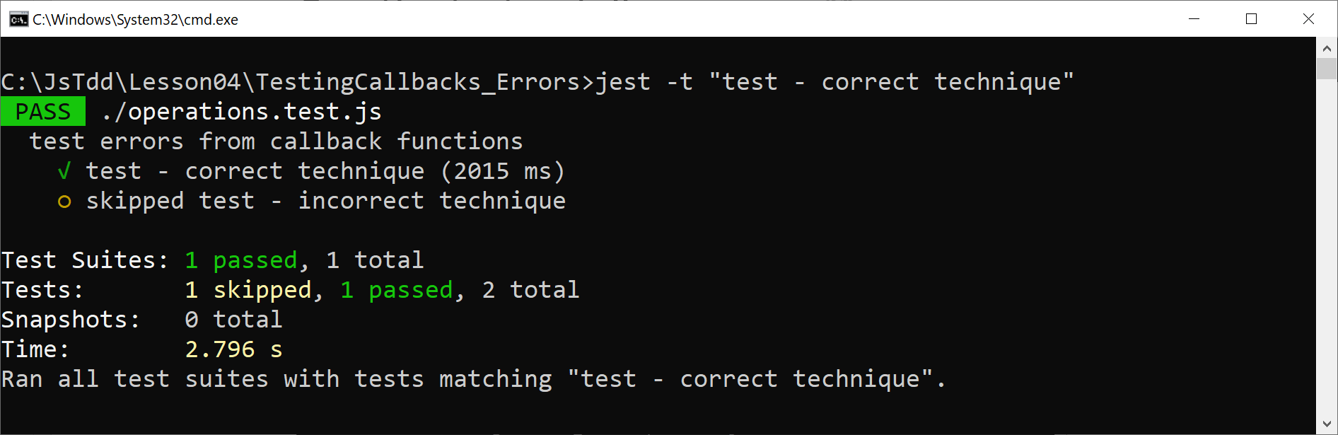
Propagating Errors - Correct Approach
Run the test as follows:
jest -t "test - correct technique"

Slide 17
Lesson 4: Testing Asynchronous Operations
4.3 Specifying a Timeout for Tests

Slide 18
Overview
By default, Jest imposes a maximum timeout of 5 seconds for a test to complete
This is a reasonable timeout for most unit-testing scenarios
If you want to test code that takes longer than 5 seconds to complete:
You can specify a longer timeout for your Jest test(s)
See the examples in this folder:
TestingCallbacks_Timeouts

Slide 19
Example Function
Here's a function that takes longer than 5 seconds to complete:
function verySlowOperation(callback) {
setTimeout(
() => callback(42),
8_000
)
}
operations.js

Slide 20
Testing the Function Using the Default Timeout
Consider the following test, which uses the default timeout:
test('test using default timeout', done => {
function testResult(result) {
expect(result).toBe(42);
done();
}
ops.verySlowOperation(testResult);
});
operations.test.js

Slide 21
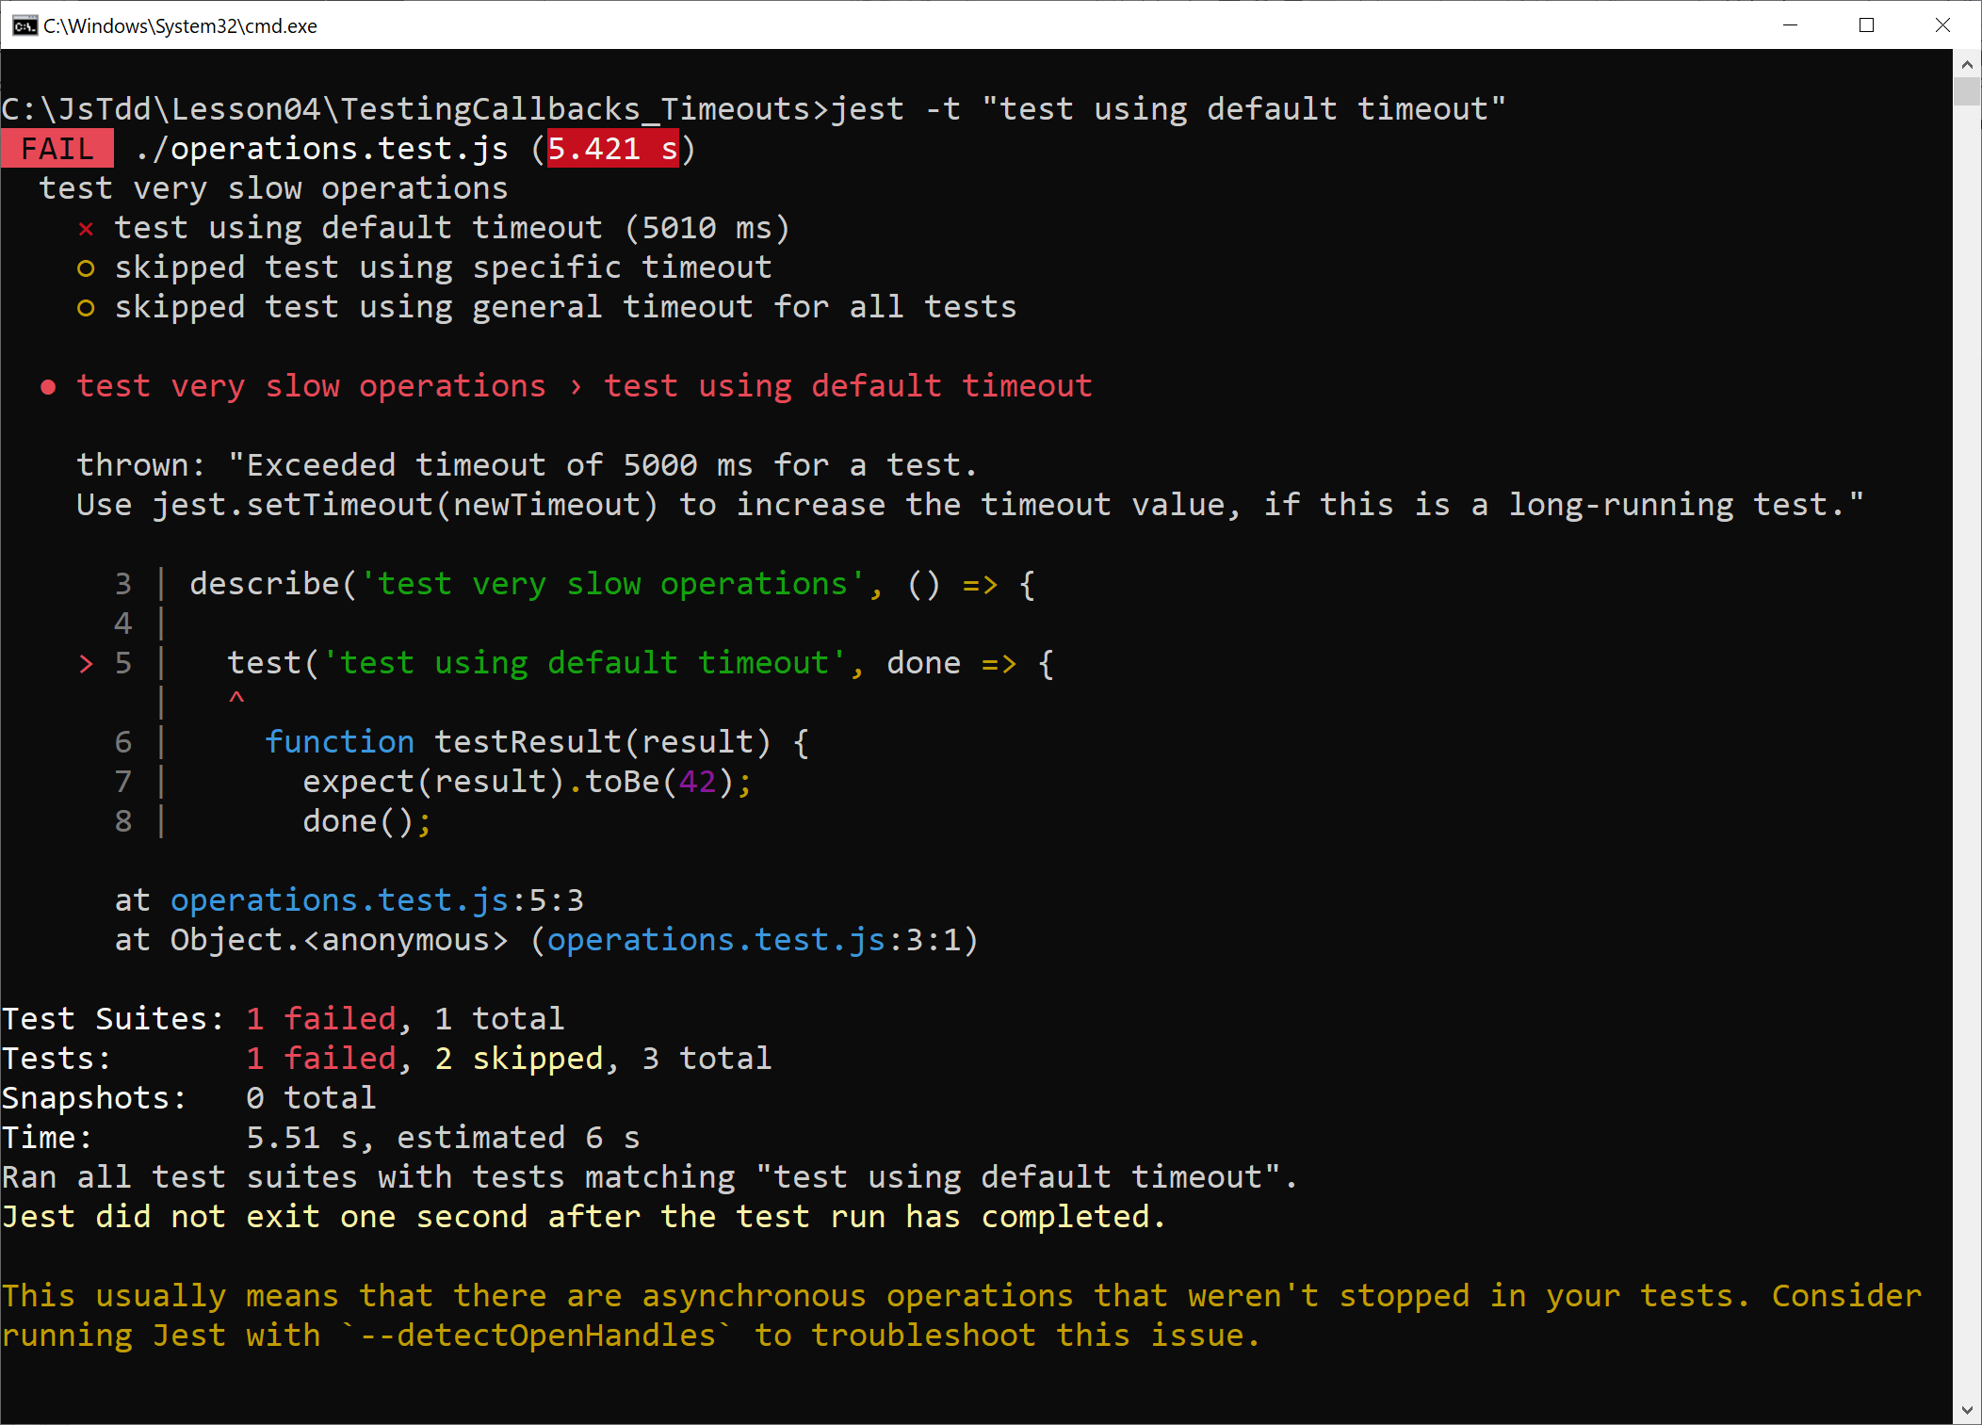
Testing the Function Using the Default Timeout
Run the test as follows:
jest -t "test using default timeout"

Slide 22
Specifying a Timeout for a Test
You can specify a timeout for a test
Pass the timeout as the 3rd parameter to test()
test('test using specific timeout', done => {
function testResult(result) {
expect(result).toBe(42);
done();
}
ops.verySlowOperation(testResult);
}, 10_000);
operations.test.js

Slide 23
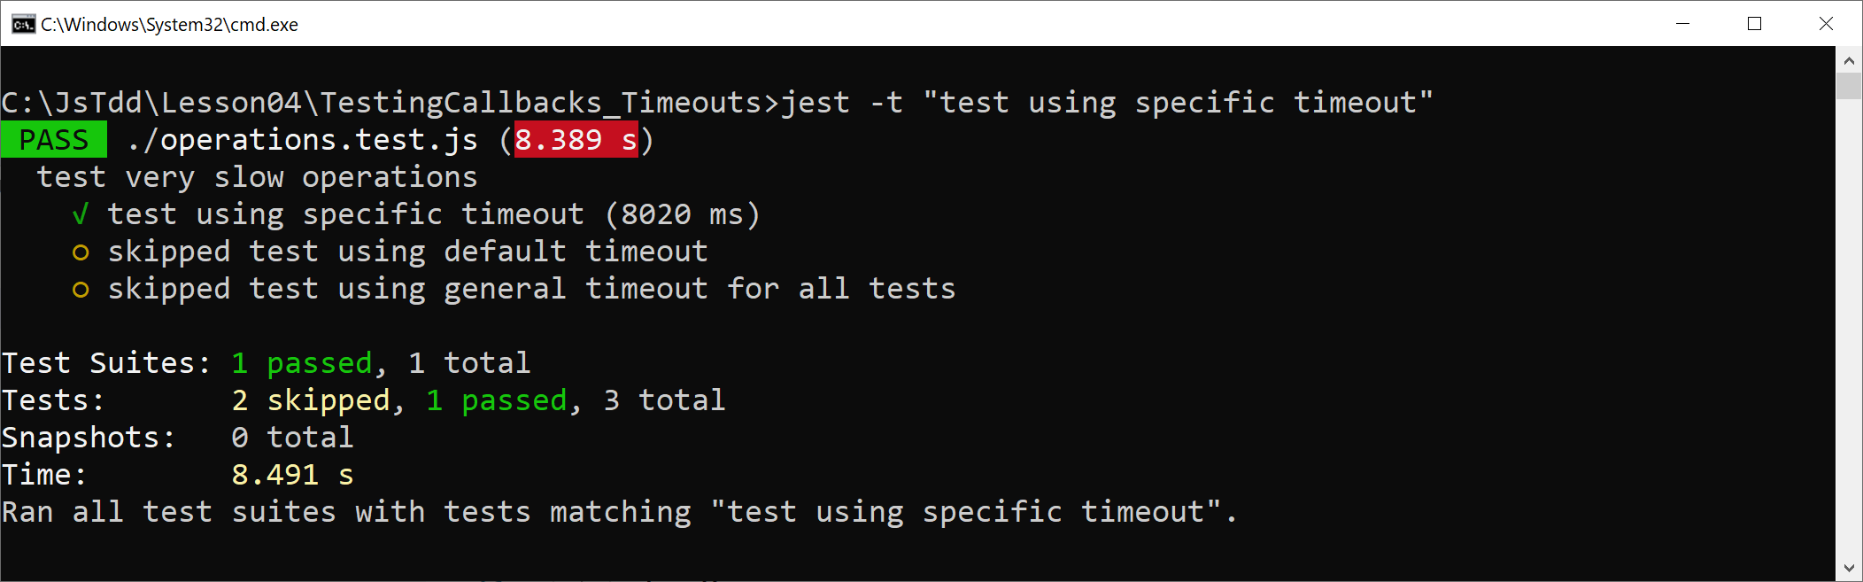
Specifying a Timeout for a Test
Run the test as follows:
jest -t "test using specific timeout"

Slide 24
Specifying a Timeout for all Tests
You can specify a timeout for all tests, if you like
Define the timeout in a setup file:
Register the setup file as follows:
jest.setTimeout(10_000);
setupTests.js
module.exports = {
setupFilesAfterEnv: ["./setupTests.js"]
};
jest.config.js

Slide 25
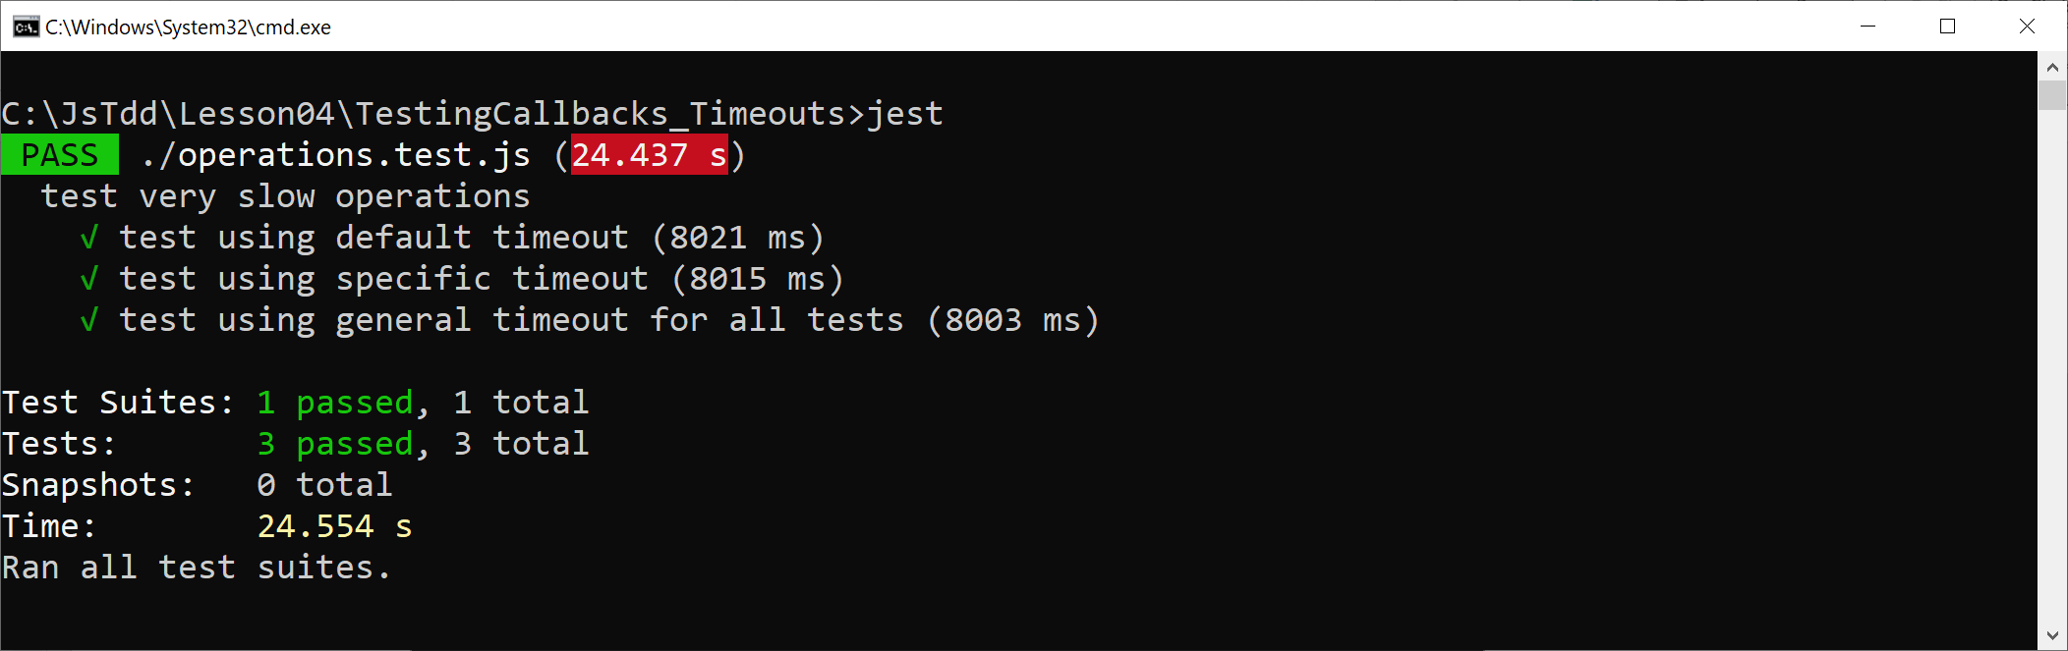
Specifying a Timeout for all Tests
Run all tests as follows:
jest

Slide 26
Lesson 4: Testing Asynchronous Operations
4.4 Understanding Promises

Slide 27
Overview
Promises are an alternative to callbacks for long-running tasks
A Promise object represents a future value (or error)
In this section:
We'll see how to use promises in a web app
In the next section:
We'll see how to test promises by using Jest
See the examples in this folder:
TestingPromises

Slide 28
Creating a Promise
Here's how to create a Promise object:
Notes:
Pass a function to the Promise constructor
In the function, do some long-running task
If successful, invoke the resolve callback
Otherwise, invoke the reject callback
var aPromise = new Promise((resolve, reject) => {
// Some long-running task …
if (success)
resolve(someResult)
else
reject(someError)
});
var aPromise = new Promise((resolve, reject) => {
// Some long-running task …
if (success)
resolve(someResult)
else
reject(someError)
});
var aPromise = new Promise((resolve, reject) => {
// Some long-running task …
if (success)
resolve(someResult)
else
reject(someError)
});
var aPromise = new Promise((resolve, reject) => {
// Some long-running task …
if (success)
resolve(someResult)
else
reject(someError)
});
var aPromise = new Promise((resolve, reject) => {
// Some long-running task …
if (success)
resolve(someResult)
else
reject(someError)
});

Slide 29
Consuming a Promise
Client code can pin handlers on a Promise object
Call then() to handle "on resolved"
Call catch() to handle "on rejected"
There's also a then() that takes 2 functions:
The 1st function handles "on resolved"
The 2nd function handles "on rejected"
aPromise.then(result => {…})
.catch(error => {…})
aPromise.then(result => {…},
error => {…})

Slide 30
Chaining Promises
then() and catch() return a Promise object
So, you can chain many calls to then() and catch()
This is one of the main benefits of using promises
Cleaner than using traditional callbacks, which can lead to tricky nested handlers
aPromise.then(onResolved1)
.then(onResolved2)
.then(onResolved3)
.catch(onRejected)

Slide 31
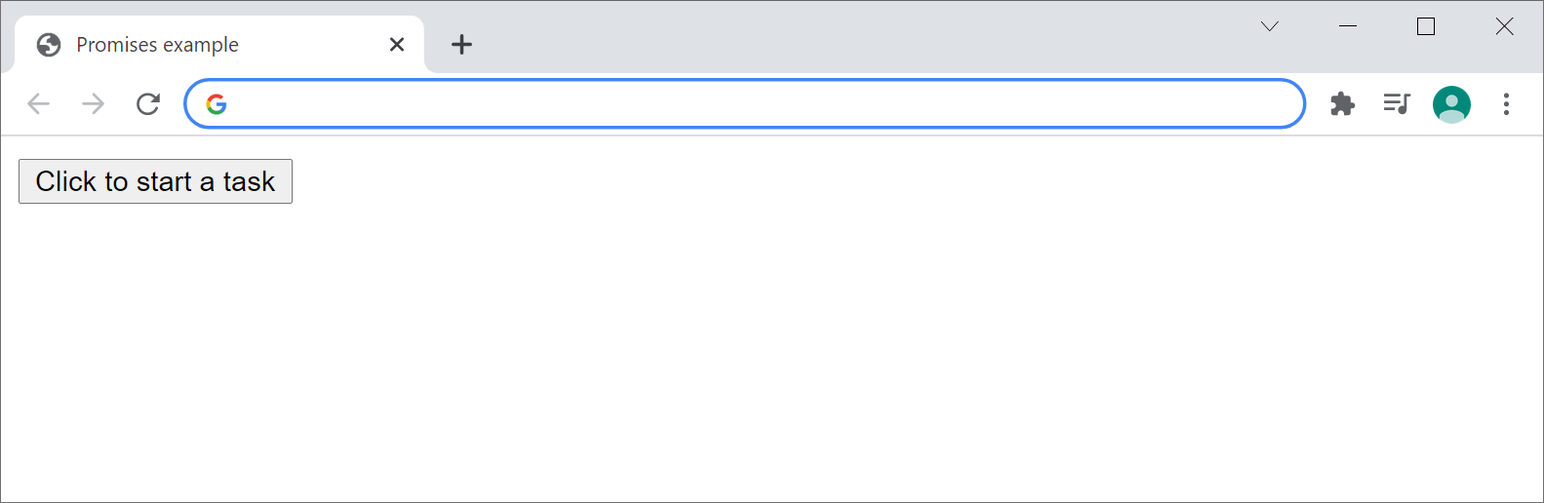
Example
Let's see an example of how to use promises
See the TestingPromises folder
Open index.html in a browser

Slide 32
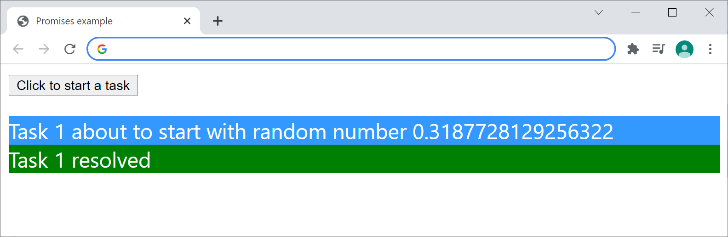
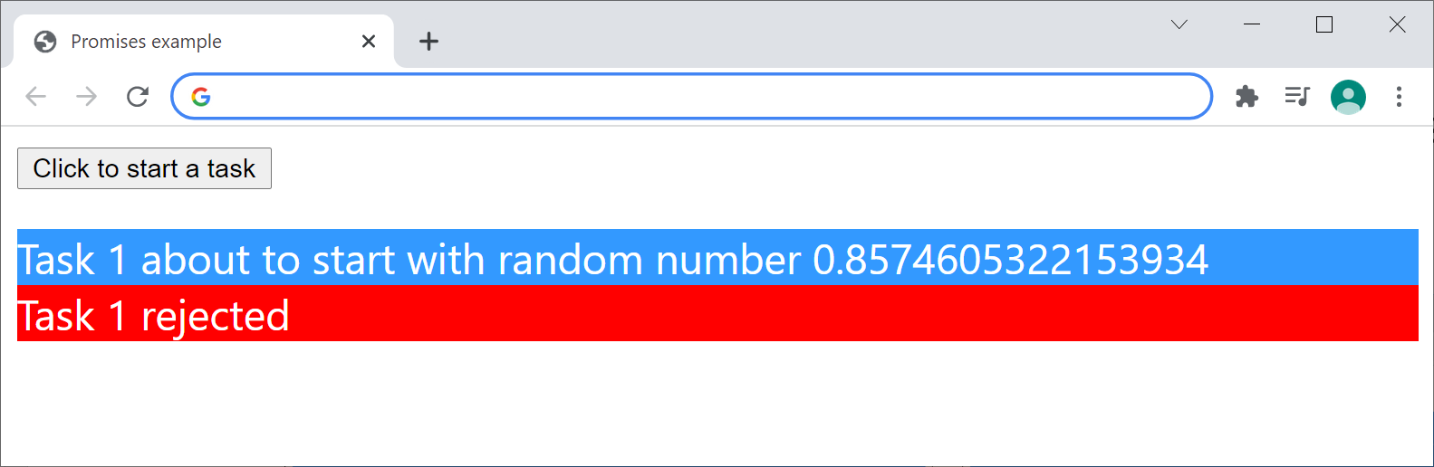
Resolving/Rejecting a Promise
When you click the button, the on-click handler runs
Generates a random number between 0 and 1
Sets up a timer, which waits for a random period
When the time is up, the code resolves or rejects the promise

Slide 33
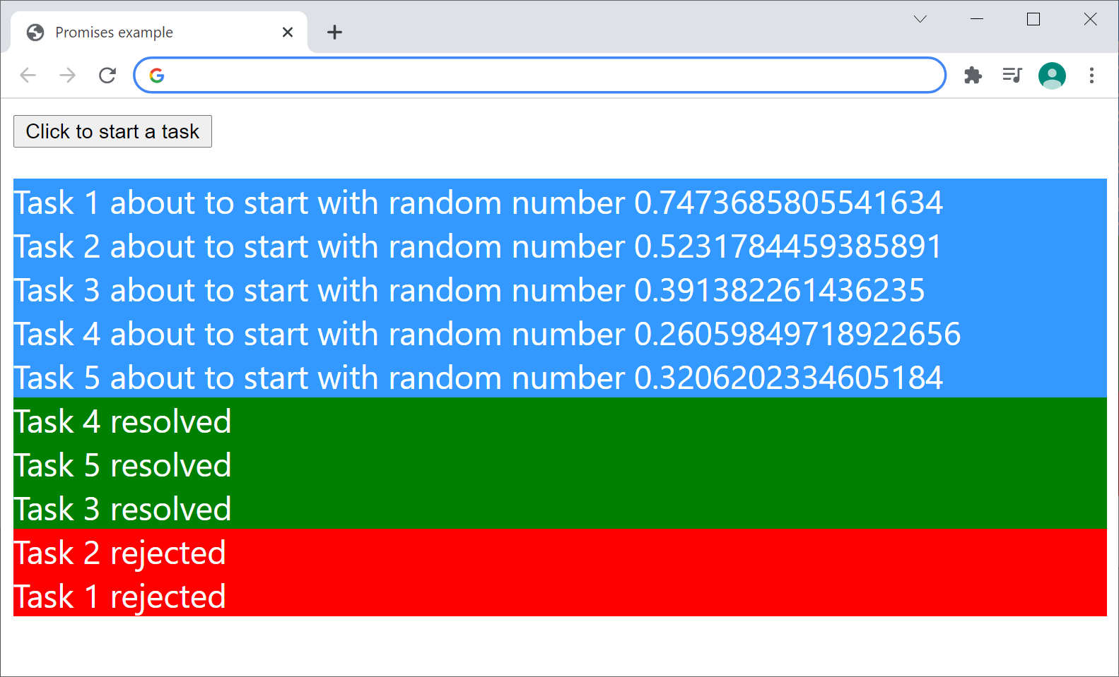
Resolving/Rejecting Many Promises
Click the button several times in rapid succession
A new Promise object is created on each click
When each Promise is settled, it will "resolve" or "reject"

Slide 34
Understanding the Code
Let's take a look at the code in the example…
For the code that performs a long-running task and yields a Promise object:
See task.js
For the code that consumes the Promise object and displays results:
See ui.js

Slide 35
Lesson 4: Testing Asynchronous Operations
4.5 Testing Promises

Slide 36
Overview
In this section we'll see how to test the following code
See the TestingPromises folder
function doTask(taskNumber, randomNumber) {
return new Promise(function (resolve, reject) {
setTimeout(() => {
if (randomNumber < 0.5)
resolve(`Task ${taskNumber} resolved`);
else
reject(`Task ${taskNumber} rejected`);
}, randomNumber * 5000);
});
}
task.js

Slide 37
Testing a Promise Resolves
In Jest, this is how to test that a Promise object "resolves":
Notes:
Invoke the function-under-test, which returns a Promise object
Call then() on the Promise object and verify the "resolved" result is correct
Return the Promise object from the test so Jest can wait for its completion
test('task resolves if value < 0.5', () => {
return doTask(1, 0.3).then(data => {
expect(data).toBe('Task 1 resolved');
});
});
test('task resolves if value < 0.5', () => {
return doTask(1, 0.3).then(data => {
expect(data).toBe('Task 1 resolved');
});
});
test('task resolves if value < 0.5', () => {
return doTask(1, 0.3).then(data => {
expect(data).toBe('Task 1 resolved');
});
});
test('task resolves if value < 0.5', () => {
return doTask(1, 0.3).then(data => {
expect(data).toBe('Task 1 resolved');
});
});
task.test.js

Slide 38
Testing a Promise Rejects
In Jest, this is how to test that a Promise object "rejects":
Notes:
Call expect.assertions(1) to tell Jest that 1 assertion must occur
Invoke the function-under-test
Call catch() and verify the error
Return the Promise object from the test
test('task rejects if value >= 0.5', () => {
expect.assertions(1);
return doTask(1, 0.5).catch(err => {
expect(err).toBe('Task 1 rejected');
});
});
test('task rejects if value >= 0.5', () => {
expect.assertions(1);
return doTask(1, 0.5).catch(err => {
expect(err).toBe('Task 1 rejected');
});
});
test('task rejects if value >= 0.5', () => {
expect.assertions(1);
return doTask(1, 0.5).catch(err => {
expect(err).toBe('Task 1 rejected');
});
});
test('task rejects if value >= 0.5', () => {
expect.assertions(1);
return doTask(1, 0.5).catch(err => {
expect(err).toBe('Task 1 rejected');
});
});
test('task rejects if value >= 0.5', () => {
expect.assertions(1);
return doTask(1, 0.5).catch(err => {
expect(err).toBe('Task 1 rejected');
});
});
task.test.js

Slide 39
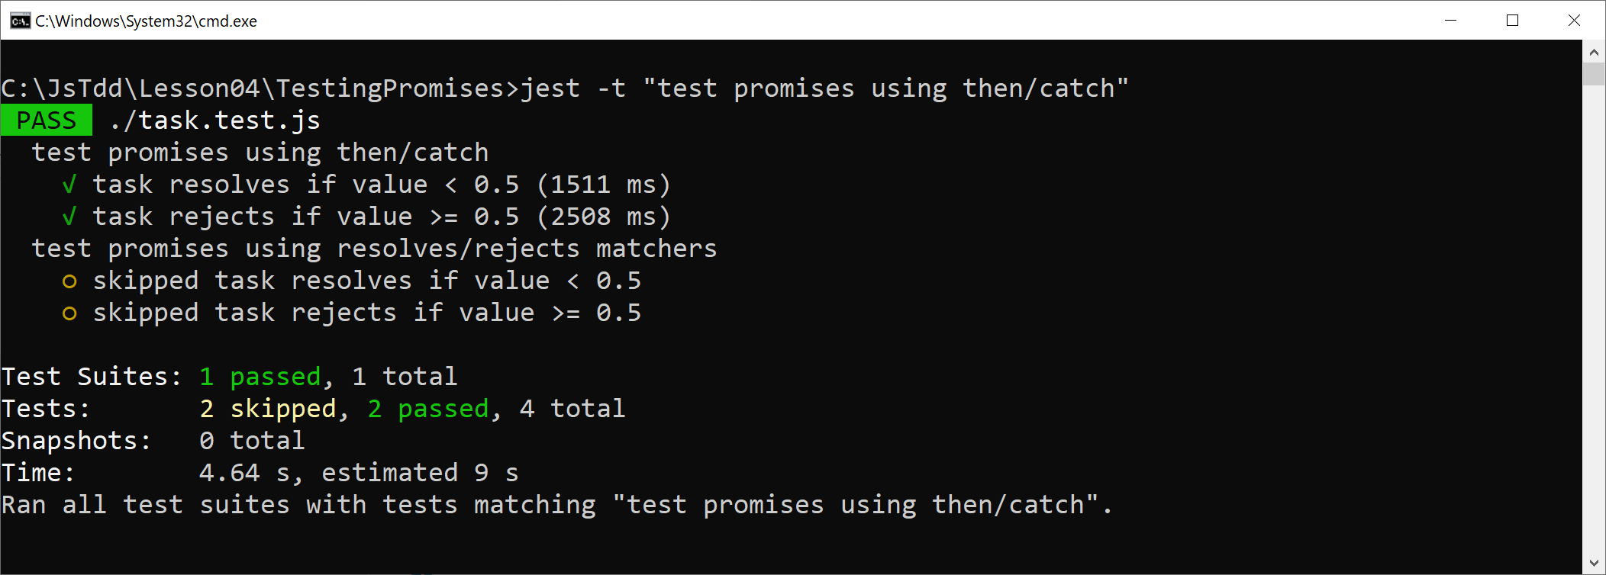
Running the Tests
Run the tests as follows:
jest -t "test promises using then/catch"

Slide 40
Using the Resolves and Rejects Matchers
Jest defines resolves and rejects matchers, which you can use to test the outcome of a Promise:
test('task resolves if value < 0.5', () => {
return expect(doTask(1, 0.3))
.resolves
.toBe('Task 1 resolved');
});
test('task rejects if value >= 0.5', () => {
return expect(doTask(1, 0.5))
.rejects
.toBe('Task 1 rejected');
});
task.test.js

Slide 41
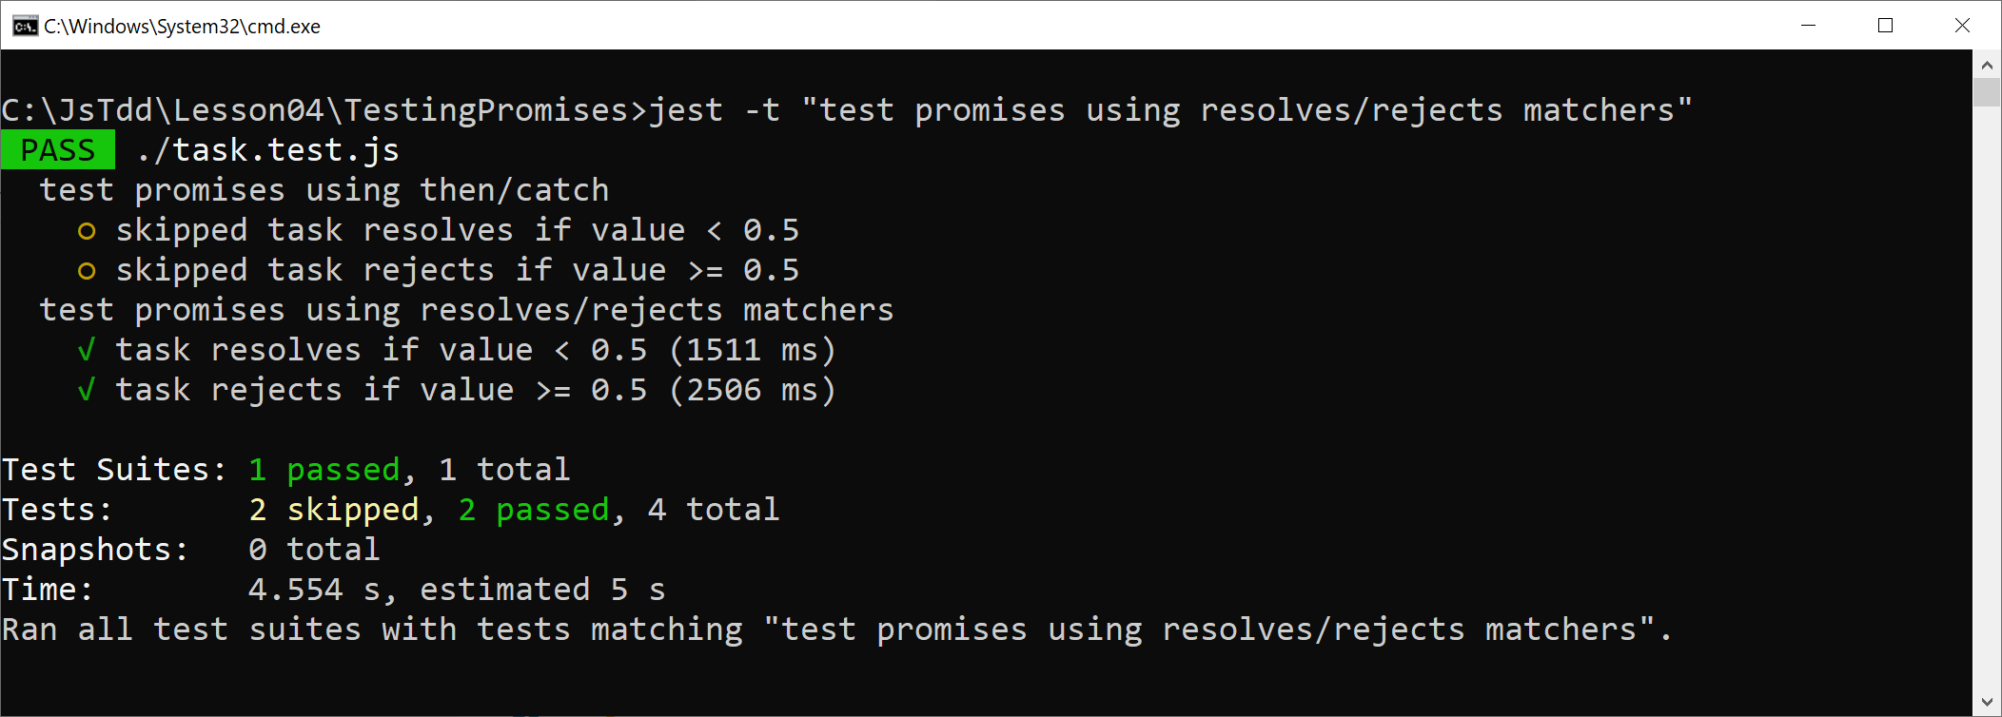
Running the Tests
Run the tests as follows:
jest -t "test promises using resolves/rejects matchers"

Slide 42
Lesson 4: Testing Asynchronous Operations
4.6 Using the async and await Keywords

Slide 43
Overview
The async and await keywords are quite new in JavaScript
They simplify how you deal with Promise objects
In this section we'll see how to:
Use async/await in web app code
Use async/await in Jest tests
See the examples in this folder:
TestingPromises_AsyncAwait

Slide 44
Understanding the async/await Keywords
Understanding the await keyword:
When you call a function that returns a Promise, you can prefix the call with the await keyword
The remainder of the code in the calling function is automatically moved into a “then” callback
Understanding the async keyword:
If you use an await expression in a function, you must prefix the function declaration with the async keyword

Slide 45
Using async/await in Web App Code
Here's a reminder of the doTask() function in our web app, which returns a Promise object:
We can use async/await when we call the function, to handle the Promise object:
function doTask(taskNumber, randomNumber) {
return new Promise(function (resolve, reject) {…})
}
task.js
async function handleButtonClick() {
…
try {
val = await doTask(thisPromiseCount, randomNumber);
displayMessage('resolved', val)
}
catch (reason) {
displayMessage('rejected', reason)
}
}
ui.js

Slide 46
Using async/await in Jest Tests
We can use async/await to simplify how we handle Promise objects in our test code:
test('task resolves if value < 0.5', async () => {
const data = await doTask(1, 0.3);
expect(data).toBe('Task 1 resolved');
});
test('task rejects if value >= 0.5', async () => {
expect.assertions(1);
try {
await doTask(1, 0.5);
}
catch(err) {
expect(err).toBe('Task 1 rejected');
}
});
task.test.js

Slide 47
Using async/await in Jest Tests
We can also use async/await in conjunction with the resolves/rejects matchers:
test('task resolves if value < 0.5', async () => {
await expect(doTask(1, 0.3))
.resolves
.toBe('Task 1 resolved');
});
test('task rejects if value >= 0.5', async () => {
await expect(doTask(1, 0.5))
.rejects
.toBe('Task 1 rejected');
});
task.test.js

Slide 48
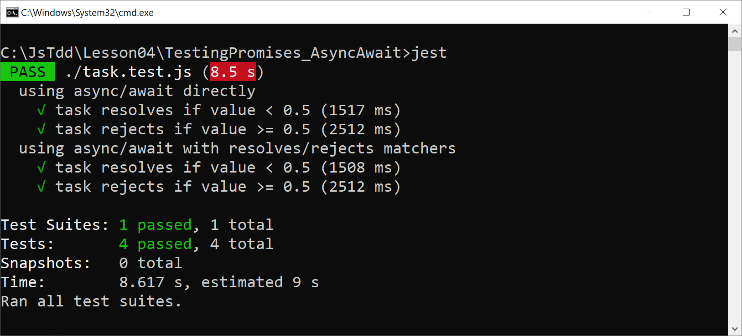
Running the Tests
Run all the tests as follows:
jest

Slide 49
Lesson 4: Testing Asynchronous Operations
4.7 Getting Started with RxJs

Slide 50
Overview
RxJs is the Reactive Extensions library for JavaScript
Enables you to subscribe to an observable stream of data
In this section we'll see how to:
Create a simple observable stream
Subscribe to the stream
Test the stream
See the examples in this folder:
TestingRxJs

Slide 51
Specifying Dependencies for RxJs
We've defined the following dependencies in package.json:
Note:
@babel/node is a tool for running our sample JavaScript code
"dependencies": {
"rxjs": "~7.4.0",
"@babel/node": "7.14.7"
}
package.json

Slide 52
Creating an Observable Object
The Observable class is at the heart of RxJs
Represents an observable stream of data from a source
RxJs has many factory functions for creating an Observable object
E.g., of() creates an Observable object that emits a single value
const rxjs = require('rxjs');
function emitSingleValue() {
return rxjs.of(42);
}
code.js

Slide 53
Subscribing to an Observable Object
The Observable class has a subscribe() function
Enables you to subscribe to values, errors, and completion
General usage:
anObservable.subscribe({
next: data => { … process next emitted value … } ,
error: err => { … process emitted error … },
complete: () => { … process completion signal … }
});

Slide 54
Subscribing to an Observable Object
Let's see a complete (simple) example…
Reminder of code that returns an Observable:
Code that subscribes to the Observable:
const rxjs = require('rxjs');
function emitSingleValue() {
return rxjs.of(42);
}
code.js
const code = require('./code');
const observable = code.emitSingleValue();
observable.subscribe({
next: data => console.log(data)
});
main.js

Slide 55
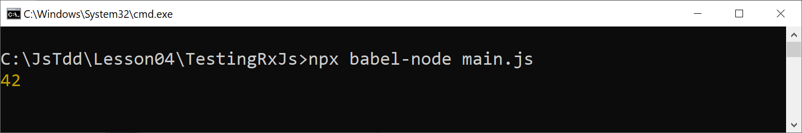
Running the Sample Code
You can run the sample code as follows:
npx babel-node main.js

Slide 56
Testing an Observable Object
Here's how you can test the Observable object returned by the function-under-test:
const code = require('./code');
test('test Observable that emits single value', done => {
const observable = code.emitSingleValue();
observable.subscribe({
next: data => {
expect(data).toBe(42);
done();
}
})
});
test.js

Slide 57
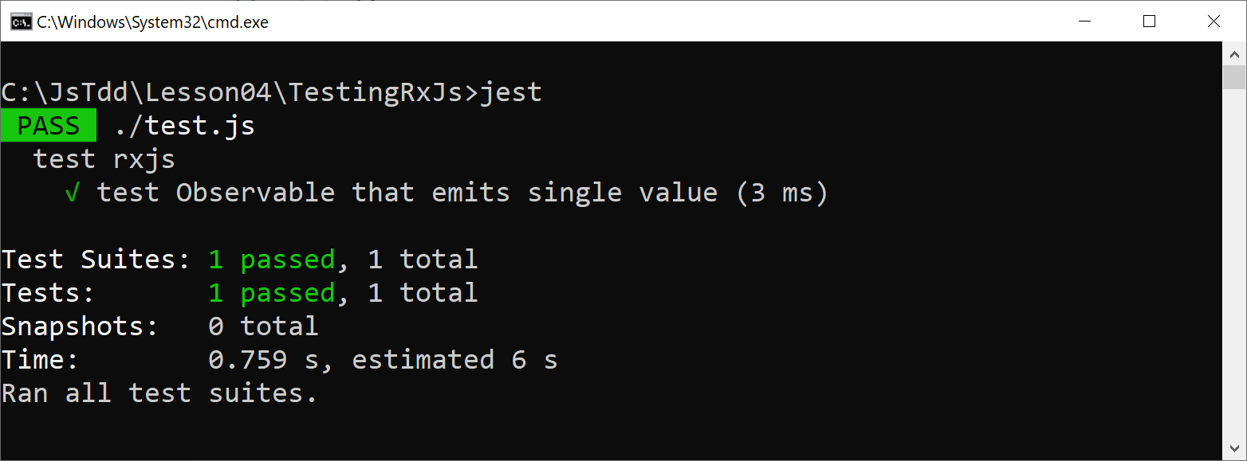
Running the Test
Run the test as follows:
jest

Slide 58
Lesson 4: Testing Asynchronous Operations
4.8 Going Further with RxJs

Slide 59
Overview
In this section we'll investigate additional RxJs techniques:
Creating and testing a multi-value Observable object
Creating and testing errors from an Observable object
See the examples in this folder:
TestingRxJs_Techniques

Slide 60
Creating and Testing a Multi-Value Observable
Here's how to create a simple multi-value Observable:
Here's how to test the Observable:
function emitStream1() {
const arr = [100, 200, 300, 400, 500]
return rxjs.from(arr);
}
code.js
test('test emitStream1', done => {
const observable = code.emitStream1();
let expected = 100;
observable.subscribe({
next: data => {
expect(data).toBe(expected);
expected += 100;
},
complete: () => done()
})
});
test.js

Slide 61
Creating and Testing a Multi-Value Observable
Here's a more realistic multi-value Observable:
Here's how to test the Observable:
function emitStream2(len) {
const arr = Array.from(
{length: len},
() => Math.floor(Math.random() * 101)
)
return rxjs.from(arr);
}
code.js
test('test emitStream2', done => {
const observable = code.emitStream2(5);
observable.subscribe({
next: data => {
expect(data >= 0 && data < 100).toBeTruthy();
},
complete: () => done()
})
});
test.js

Slide 62
Managing Errors
Here's an Observable that emits an error:
Here's how to test the Observable:
function emitStream3(len) {
if (len <= 0) {
return rxjs.throwError(() => new Error('Bad length'))
}
…
}
code.js
test('test emitStream3', done => {
const observable = code.emitStream3(0);
observable.subscribe({
error: err => {
expect(err.message).toBe('Bad length');
done();
}
})
});
test.js

Slide 63
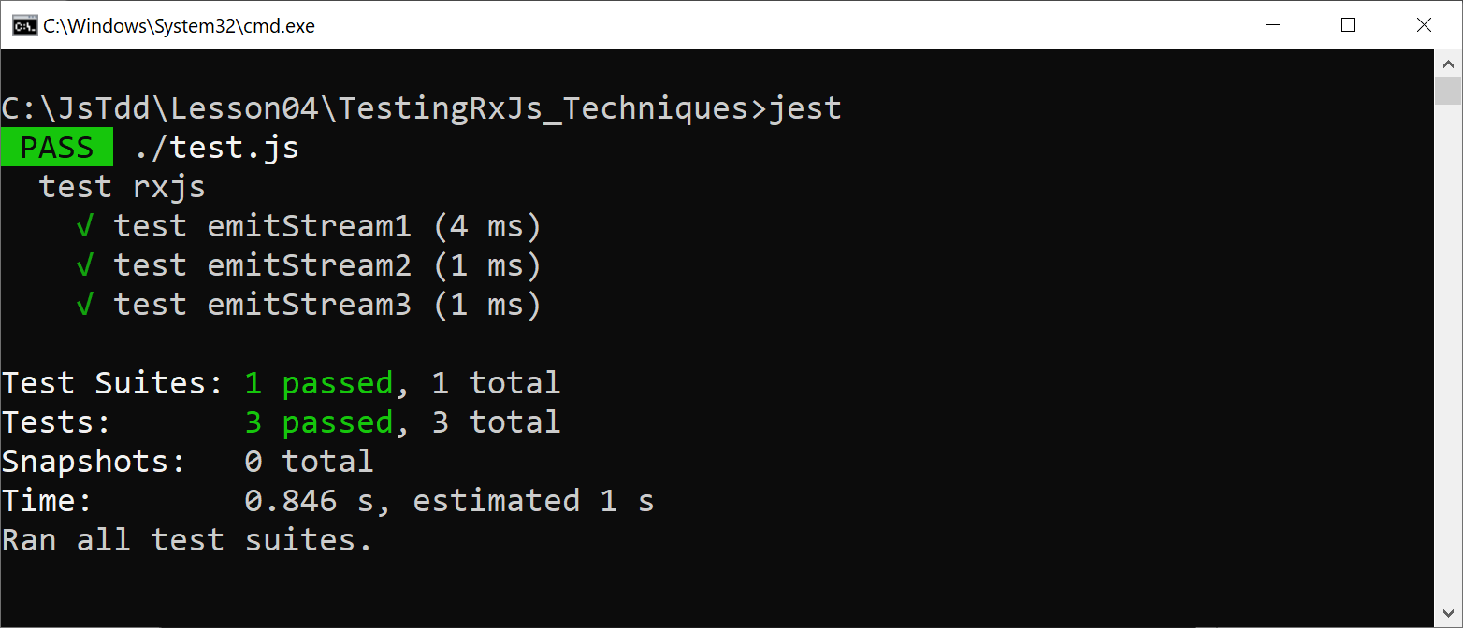
Running all the Tests
Run all the tests as follows:
jest

