Slide 1
Lesson 5: Mocking
5.1 Creating and using a mock function
5.2 Understanding the .mock property
5.3 Using mock functions to mock an API
5.4 Mocking modules
5.5 Mocking promises
5.6 Mocking REST calls

Slide 2
Lesson 5: Mocking
5.1 Creating and Using a Mock function

Slide 3
Problem Statement
The code in a web application typically involves lots of interacting functions and/or objects
E.g., function 1 calls function 2 to calculate a value
E.g., object 1 invokes methods on object 2 to fulfill a task
Unit testing focuses on the behavior of a single function/object
How do you test one function/object if it depends on others that have their own complexities?

Slide 4
Solution
The solution in Jest is to use mock functions
An artificial replacement for another function
You can create a mock function as follows:
You can invoke the mock function as normal:
const mockf1 = jest.fn();
const result = mockf1();

Slide 5
Example of Using Mock Functions
Consider this code in the MockFunctions_Intro folder:
Let's see how to mock these functions…
function f1() {
// Do something
}
function f2(a, b, c) {
// Do something
}
function f3() {
// Do something
return 42
}
module.exports = {
f1, f2, f3
};
operations.js

Slide 6
Using a Simple Mock Function
Here's an example of how to create and use a mock function:
The mock function:
Remembers info about calls, params, etc.
Returns undefined, by default
test('using a simple mock function', () => {
const mockf1 = jest.fn();
const result = mockf1();
expect(mockf1).toHaveBeenCalledTimes(1);
expect(result).toBeUndefined();
});
test('using a simple mock function', () => {
const mockf1 = jest.fn();
const result = mockf1();
expect(mockf1).toHaveBeenCalledTimes(1);
expect(result).toBeUndefined();
});
test('using a simple mock function', () => {
const mockf1 = jest.fn();
const result = mockf1();
expect(mockf1).toHaveBeenCalledTimes(1);
expect(result).toBeUndefined();
});
operations.test.js

Slide 7
Using a Mock Function that Takes Parameters
Here's a mock function that takes parameters:
test('using a mock function that takes parameters', () => {
const mockf2 = jest.fn();
const result = mockf2(10, 20, 30);
expect(mockf2).toHaveBeenCalledTimes(1);
expect(mockf2).toHaveBeenCalledWith(10, 20, 30);
expect(result).toBeUndefined();
});
operations.test.js

Slide 8
Using a Mock Function that Returns a Value
Here's a mock function that returns a value:
test('using a mock function that returns a value', () => {
const mockf3 = jest.fn(() => 42);
const result = mockf3();
expect(mockf3).toHaveBeenCalledTimes(1);
expect(result).toBe(42);
});
operations.test.js

Slide 9
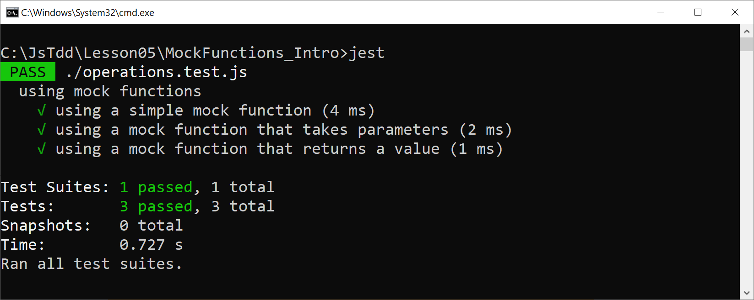
Running the Tests
Run the tests as follows:
jest

Slide 10
Lesson 5: Mocking
5.2 Understanding the .mock Property

Slide 11
Accessing Mock Info via the .mock Property
Mock functions have a .mock property
Returns an object, containing info about usage of the mock function
Consider the following simple test:
Let's see what information is available via the .mock property…
test('accessing the .mock property', () => {
const mockf1 = jest.fn();
let mockObj = mockf1.mock;
console.log(Object.keys(mockObj));
});
test('accessing the .mock property', () => {
const mockf1 = jest.fn();
let mockObj = mockf1.mock;
console.log(Object.keys(mockObj));
});
MockFunctions_MockProperty/operations.test.js

Slide 12
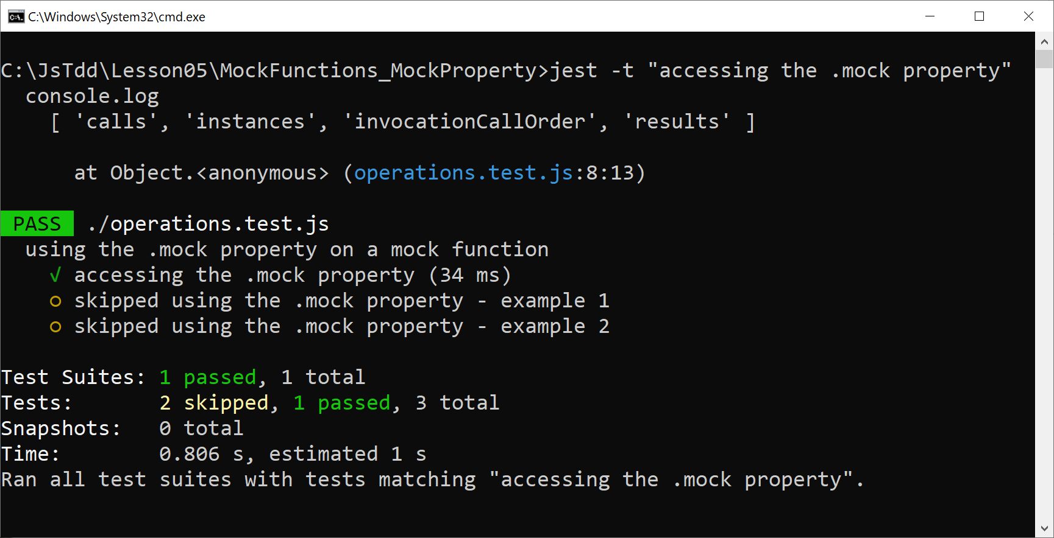
Accessing Mock Info via the .mock Property
Run the test as follows:
jest -t "accessing the .mock property"

Slide 13
Using the .calls Property
The .calls property gives info about calls to a mock function:
calls[0] - call 0
calls[1] - call 1
Etc.
You can see each parameter for each call:
calls[0][0] - call 0, param 0
calls[0][1] - call 0, param 1
calls[1][0] - call 1, param 0
calls[1][1] - call 1, param 1
Etc.

Slide 14
Using the .results Property
The .results property gives info about the result value from each call to a mock function:
results[0].value - result value from call 0
results[1].value - result value from call 1
Etc.

Slide 15
Accessing Call and Result Info - Example 1
Consider the following trivial function, which we'd like to mock:
Let's use a mock function and get usage info:
function add(a, b) {
return a + b;
}
operations.js
test('accessing call and result info - ex 1', () => {
const mockAdd = jest.fn(() => 30);
let result = mockAdd(10, 20);
expect(mockAdd.mock.calls.length).toBe(1);
expect(mockAdd.mock.calls[0][0]).toBe(10);
expect(mockAdd.mock.calls[0][1]).toBe(20);
expect(mockAdd.mock.results[0].value).toBe(30);
});
test('accessing call and result info - ex 1', () => {
const mockAdd = jest.fn(() => 30);
let result = mockAdd(10, 20);
expect(mockAdd.mock.calls.length).toBe(1);
expect(mockAdd.mock.calls[0][0]).toBe(10);
expect(mockAdd.mock.calls[0][1]).toBe(20);
expect(mockAdd.mock.results[0].value).toBe(30);
});
test('accessing call and result info - ex 1', () => {
const mockAdd = jest.fn(() => 30);
let result = mockAdd(10, 20);
expect(mockAdd.mock.calls.length).toBe(1);
expect(mockAdd.mock.calls[0][0]).toBe(10);
expect(mockAdd.mock.calls[0][1]).toBe(20);
expect(mockAdd.mock.results[0].value).toBe(30);
});
operations.test.js

Slide 16
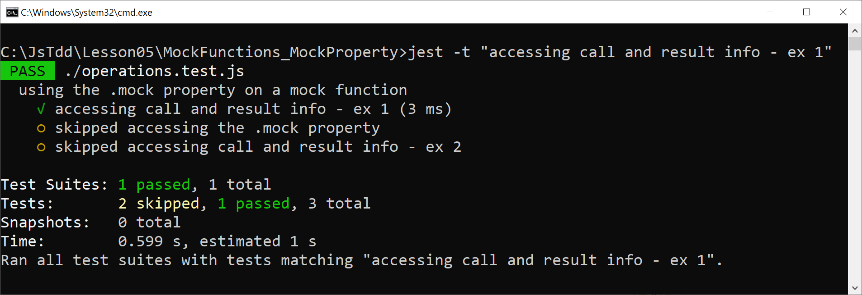
Accessing Call and Result Info - Example 1
Run the test as follows:
jest -t "accessing call and result info - ex 1"

Slide 17
Accessing Call and Result Info - Example 2
Consider the following function:
The function receives a callback, and invokes it for each element in an array
Let's see how to test processArray(), supplying a mock function for the callback
function processArrayarr, op) {
for (val of arr) {
op(val)
}
}
function processArray(arr, op) {
for (val of arr) {
op(val)
}
}
operations.js

Slide 18
Accessing Call and Result Info - Example 2
Consider the following test code:
Notes:
We use a mock function for the callback
We verify the mock function is called correctly
test('accessing call and result info - ex 2', () => {
const mockOp = jest.fn(i => i * i);
ops.processArray([10, 20, 30], mockOp);
expect(mockOp.mock.calls.length).toBe(3);
expect(mockOp.mock.calls[0][0]).toBe(10);
expect(mockOp.mock.results[0].value).toBe(100);
expect(mockOp.mock.calls[1][0]).toBe(20);
expect(mockOp.mock.results[1].value).toBe(400);
expect(mockOp.mock.calls[2][0]).toBe(30);
expect(mockOp.mock.results[2].value).toBe(900);
});
test('accessing call and result info - ex 2', () => {
const mockOp = jest.fn(i => i * i);
ops.processArray([10, 20, 30], mockOp);
expect(mockOp.mock.calls.length).toBe(3);
expect(mockOp.mock.calls[0][0]).toBe(10);
expect(mockOp.mock.results[0].value).toBe(100);
expect(mockOp.mock.calls[1][0]).toBe(20);
expect(mockOp.mock.results[1].value).toBe(400);
expect(mockOp.mock.calls[2][0]).toBe(30);
expect(mockOp.mock.results[2].value).toBe(900);
});
test('accessing call and result info - ex 2', () => {
const mockOp = jest.fn(i => i * i);
ops.processArray([10, 20, 30], mockOp);
expect(mockOp.mock.calls.length).toBe(3);
expect(mockOp.mock.calls[0][0]).toBe(10);
expect(mockOp.mock.results[0].value).toBe(100);
expect(mockOp.mock.calls[1][0]).toBe(20);
expect(mockOp.mock.results[1].value).toBe(400);
expect(mockOp.mock.calls[2][0]).toBe(30);
expect(mockOp.mock.results[2].value).toBe(900);
});
operations.test.js

Slide 19

Accessing Call and Result Info - Example 2
Run the test as follows:
jest -t "accessing call and result info - ex 2"

Slide 20
Lesson 5: Mocking
5.3 Using Mock Functions to Mock an API

Slide 21
Overview
In this section we'll see how to use Jest mock functions to mock an entire API
This is one of the main reasons for using mocking
We'll see how to:
Define an API to access HTML5 Local Storage
Write code that uses the API
Write tests that mock the API
See this folder:
MockFunctions_Api

Slide 22
Defining an API to Access Local Storage
Here's a simple API to access Local Storage - we'll mock this API:
function isLocalStorageSupported() {
return typeof(Storage) !== void(0)
}
function getNumber(propertyName, defaultValue) {
let value = Number(window.localStorage[propertyName])
if (isNaN(value)) {
return defaultValue
}
else {
return value
}
}
function saveNumber(propertyName, value) {
window.localStorage[propertyName] = value
}
module.exports = {
isLocalStorageSupported, getNumber, saveNumber
};
localStorageApi.js

Slide 23
Writing Code that Uses the API
Here's some code that uses the API:
const ls = require('./localStorageApi');
function incrementLikes() {
if (ls.isLocalStorageSupported()) {
let likes = ls.getNumber('likes', 0);
likes++;
ls.saveNumber('likes', likes);
}
}
module.exports = {
incrementLikes
};
operations.js

Slide 24
Writing Tests that Mock the API - Test 1
Here's the first test in our test suite:
Notes:
We import the API module
We define mock functions for the API
We verify the mock functions are called correctly
const ls = require('./localStorageApi')
test('local storage not supported', () => {
ls.isLocalStorageSupported = jest.fn(() => false)
ls.getNumber = jest.fn(() => {})
ls.saveNumber = jest.fn(() => {})
ops.incrementLikes()
expect(ls.isLocalStorageSupported).toHaveBeenCalled()
expect(ls.getNumber).not.toHaveBeenCalled()
expect(ls.saveNumber).not.toHaveBeenCalled()
});
const ls = require('./localStorageApi')
test('local storage not supported', () => {
ls.isLocalStorageSupported = jest.fn(() => false)
ls.getNumber = jest.fn(() => {})
ls.saveNumber = jest.fn(() => {})
ops.incrementLikes()
expect(ls.isLocalStorageSupported).toHaveBeenCalled()
expect(ls.getNumber).not.toHaveBeenCalled()
expect(ls.saveNumber).not.toHaveBeenCalled()
});
const ls = require('./localStorageApi')
test('local storage not supported', () => {
ls.isLocalStorageSupported = jest.fn(() => false)
ls.getNumber = jest.fn(() => {})
ls.saveNumber = jest.fn(() => {})
ops.incrementLikes()
expect(ls.isLocalStorageSupported).toHaveBeenCalled()
expect(ls.getNumber).not.toHaveBeenCalled()
expect(ls.saveNumber).not.toHaveBeenCalled()
});
const ls = require('./localStorageApi')
test('local storage not supported', () => {
ls.isLocalStorageSupported = jest.fn(() => false)
ls.getNumber = jest.fn(() => {})
ls.saveNumber = jest.fn(() => {})
ops.incrementLikes()
expect(ls.isLocalStorageSupported).toHaveBeenCalled()
expect(ls.getNumber).not.toHaveBeenCalled()
expect(ls.saveNumber).not.toHaveBeenCalled()
});
operations.test.js

Slide 25
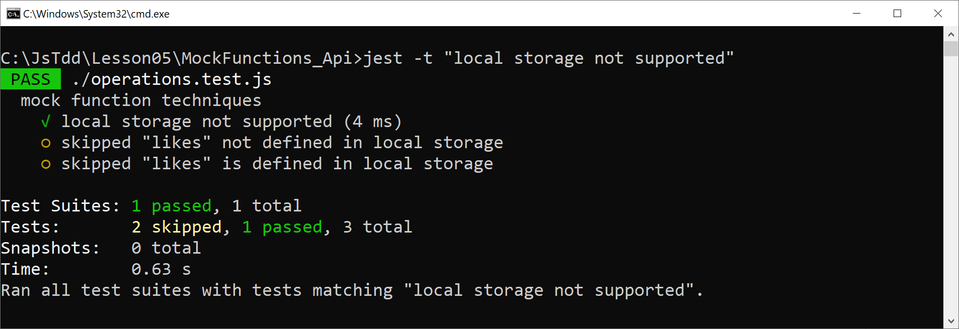
Writing Tests that Mock the API - Test 1
Run the test as follows:
jest -t "local storage not supported"

Slide 26
Writing Tests that Mock the API - Test 2
Here's the second test in our test suite:
Notes:
isLocalStorageSupported() returns true
getNumber() returns 0
saveNumber() should receive 1
test('"likes" not defined in local storage', () => {
ls.isLocalStorageSupported = jest.fn(() => true)
ls.getNumber = jest.fn(() => 0)
ls.saveNumber = jest.fn(() => {})
ops.incrementLikes()
expect(ls.isLocalStorageSupported).toHaveBeenCalled()
expect(ls.getNumber).toHaveBeenCalledWith('likes', 0)
expect(ls.saveNumber).toHaveBeenCalledWith('likes', 1)
});
test('"likes" not defined in local storage', () => {
ls.isLocalStorageSupported = jest.fn(() => true)
ls.getNumber = jest.fn(() => 0)
ls.saveNumber = jest.fn(() => {})
ops.incrementLikes()
expect(ls.isLocalStorageSupported).toHaveBeenCalled()
expect(ls.getNumber).toHaveBeenCalledWith('likes', 0)
expect(ls.saveNumber).toHaveBeenCalledWith('likes', 1)
});
test('"likes" not defined in local storage', () => {
ls.isLocalStorageSupported = jest.fn(() => true)
ls.getNumber = jest.fn(() => 0)
ls.saveNumber = jest.fn(() => {})
ops.incrementLikes()
expect(ls.isLocalStorageSupported).toHaveBeenCalled()
expect(ls.getNumber).toHaveBeenCalledWith('likes', 0)
expect(ls.saveNumber).toHaveBeenCalledWith('likes', 1)
});
test('"likes" not defined in local storage', () => {
ls.isLocalStorageSupported = jest.fn(() => true)
ls.getNumber = jest.fn(() => 0)
ls.saveNumber = jest.fn(() => {})
ops.incrementLikes()
expect(ls.isLocalStorageSupported).toHaveBeenCalled()
expect(ls.getNumber).toHaveBeenCalledWith('likes', 0)
expect(ls.saveNumber).toHaveBeenCalledWith('likes', 1)
});
operations.test.js

Slide 27
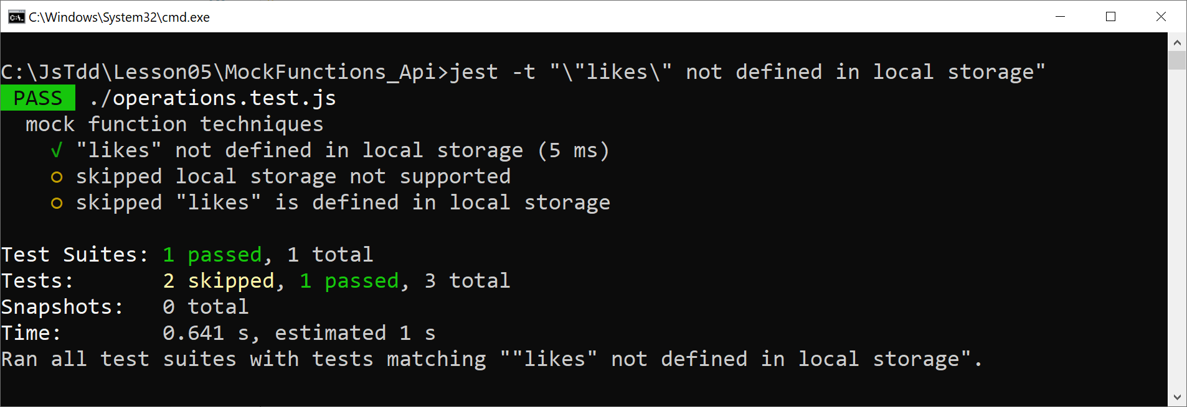
Writing Tests that Mock the API - Test 2
Run the test as follows:
jest -t "\"likes\" not defined in local storage"

Slide 28
Writing Tests that Mock the API - Test 3
Here's the third and final test in our test suite:
Notes:
isLocalStorageSupported() returns true
getNumber() returns 42
saveNumber() should receive 43
test('"likes" is defined in local storage', () => {
ls.isLocalStorageSupported = jest.fn(() => true)
ls.getNumber = jest.fn(() => 42)
ls.saveNumber = jest.fn(() => {})
ops.incrementLikes()
expect(ls.isLocalStorageSupported).toHaveBeenCalled()
expect(ls.getNumber).toHaveBeenCalledWith('likes', 0)
expect(ls.saveNumber).toHaveBeenCalledWith('likes', 43)
});
test('"likes" is defined in local storage', () => {
ls.isLocalStorageSupported = jest.fn(() => true)
ls.getNumber = jest.fn(() => 42)
ls.saveNumber = jest.fn(() => {})
ops.incrementLikes()
expect(ls.isLocalStorageSupported).toHaveBeenCalled()
expect(ls.getNumber).toHaveBeenCalledWith('likes', 0)
expect(ls.saveNumber).toHaveBeenCalledWith('likes', 43)
});
test('"likes" is defined in local storage', () => {
ls.isLocalStorageSupported = jest.fn(() => true)
ls.getNumber = jest.fn(() => 42)
ls.saveNumber = jest.fn(() => {})
ops.incrementLikes()
expect(ls.isLocalStorageSupported).toHaveBeenCalled()
expect(ls.getNumber).toHaveBeenCalledWith('likes', 0)
expect(ls.saveNumber).toHaveBeenCalledWith('likes', 43)
});
test('"likes" is defined in local storage', () => {
ls.isLocalStorageSupported = jest.fn(() => true)
ls.getNumber = jest.fn(() => 42)
ls.saveNumber = jest.fn(() => {})
ops.incrementLikes()
expect(ls.isLocalStorageSupported).toHaveBeenCalled()
expect(ls.getNumber).toHaveBeenCalledWith('likes', 0)
expect(ls.saveNumber).toHaveBeenCalledWith('likes', 43)
});
operations.test.js

Slide 29
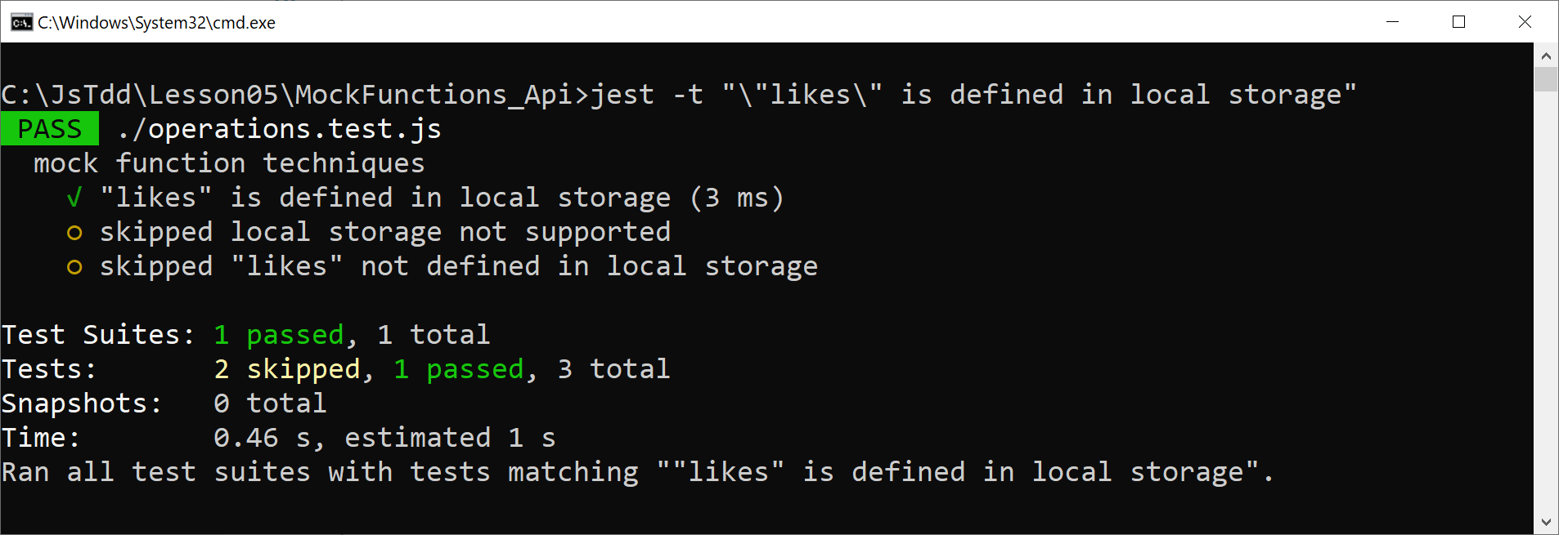
Writing Tests that Mock the API - Test 3
Run the test as follows:
jest -t "\"likes\" is defined in local storage"

Slide 30
Lesson 5: Mocking
5.4 Mocking Modules

Slide 31
Recap of Mocking Individual Functions
We've seen how to define a mock function via jest.fn()
E.g., to mock an individual function:
E.g., to mock several functions from a module:
const mockAdd = jest.fn(() => 30)
const ls = require('./localStorageApi')
…
ls.isLocalStorageSupported = jest.fn(() => false)
ls.getNumber = jest.fn(() => {})
ls.saveNumber = jest.fn(() => {})

Slide 32
Mocking a Module
It's also possible to mock an entire module via jest.mock()
This is how it works:
Specify the name of the module to mock
Jest creates mock functions for all the functions in the module
By default, each mock function:
Has an empty implementation
Returns undefined
Let's see an example…

Slide 33
Defining an API in a Module
Here's an API defined in a module - we'll mock this entire API:
function isLocalStorageSupported() {
return typeof(Storage) !== void(0)
}
function getNumber(propertyName, defaultValue) {
let value = Number(window.localStorage[propertyName])
if (isNaN(value)) {
return defaultValue
}
else {
return value
}
}
function saveNumber(propertyName, value) {
window.localStorage[propertyName] = value
}
module.exports = {
isLocalStorageSupported, getNumber, saveNumber
};
Mocking_Modules/localStorageApi.js

Slide 34
Using the API Module
Here's some code that uses the API module:
const ls = require('./localStorageApi');
function incrementLikes() {
if (ls.isLocalStorageSupported()) {
let likes = ls.getNumber('likes', 0);
likes++;
ls.saveNumber('likes', likes);
}
}
module.exports = {
incrementLikes
};
operations.js

Slide 35
Writing Tests that Mock the API Module
Here's how to write a test that mocks the API module:
Notes:
We import the API module, then mock it
We can augment specific mock function(s)
The other mock functions are defaulted
const ls = require('./localStorageApi')
jest.mock('./localStorageApi.js')
test('local storage not supported', () => {
ls.isLocalStorageSupported.mockReturnValueOnce(false);
ops.incrementLikes();
expect(ls.getNumber).not.toHaveBeenCalled();
expect(ls.saveNumber).not.toHaveBeenCalled();
});
const ls = require('./localStorageApi')
jest.mock('./localStorageApi.js')
test('local storage not supported', () => {
ls.isLocalStorageSupported.mockReturnValueOnce(false);
ops.incrementLikes();
expect(ls.getNumber).not.toHaveBeenCalled();
expect(ls.saveNumber).not.toHaveBeenCalled();
});
const ls = require('./localStorageApi')
jest.mock('./localStorageApi.js')
test('local storage not supported', () => {
ls.isLocalStorageSupported.mockReturnValueOnce(false);
ops.incrementLikes();
expect(ls.getNumber).not.toHaveBeenCalled();
expect(ls.saveNumber).not.toHaveBeenCalled();
});
const ls = require('./localStorageApi')
jest.mock('./localStorageApi.js')
test('local storage not supported', () => {
ls.isLocalStorageSupported.mockReturnValueOnce(false);
ops.incrementLikes();
expect(ls.getNumber).not.toHaveBeenCalled();
expect(ls.saveNumber).not.toHaveBeenCalled();
});
operations.test.js

Slide 36
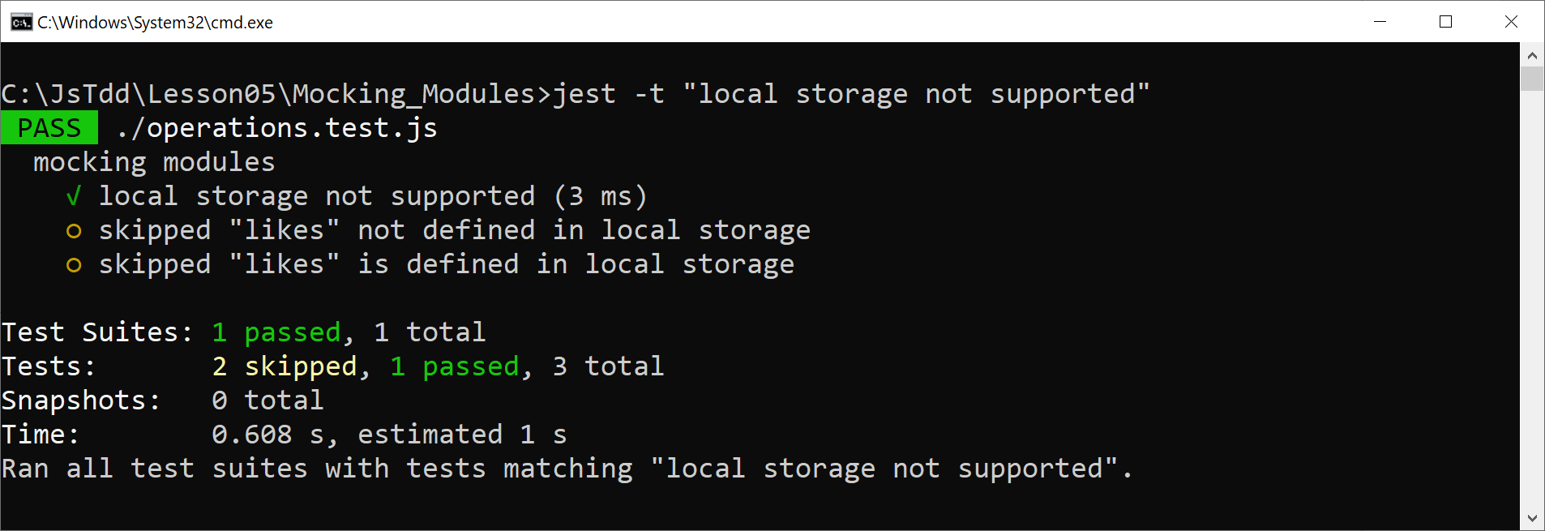
Writing Tests that Mock the API Module
Run the test as follows:
jest -t "local storage not supported"

Slide 37
Writing Additional Tests
Let's see the remaining tests in our test suite:
test('"likes" not defined in local storage', () => {
ls.isLocalStorageSupported.mockReturnValueOnce(true);
ls.getNumber.mockReturnValueOnce(0);
ops.incrementLikes();
expect(ls.getNumber).toHaveBeenCalledWith('likes', 0);
expect(ls.saveNumber).toHaveBeenCalledWith('likes', 1);
});
test('"likes" is defined in local storage', () => {
ls.isLocalStorageSupported.mockReturnValueOnce(true);
ls.getNumber.mockReturnValueOnce(42);
ops.incrementLikes();
expect(ls.getNumber).toHaveBeenCalledWith('likes', 0);
expect(ls.saveNumber).toHaveBeenCalledWith('likes', 43);
});
operations.test.js

Slide 38
Writing Additional Tests
Run the tests as follows:
jest -t "\"likes\" not defined in local storage"
jest -t "\"likes\" is defined in local storage"

Slide 39
Lesson 5: Mocking
5.5 Mocking Promises

Slide 40
Overview
Client-side web apps typically invoke REST services to get and modify data at the server
The code that invokes REST services is typically asynchronous
i.e., it returns a Promise that will be resolved or rejected some time later
In this section we'll see how to mock functions that return a Promise

Slide 41
How to Mock a Promise Result
Imagine you have a function that returns a Promise:
Let's mock the entire module:
We can specify that a mock function should resolve or reject to a value:
function someFunction() {
return new Promise(…);
}
someModule.js
const m = require('./someModule')
jest.mock('./someModule');
some.test.js
m.someFunction.mockResolvedValue(someResult);
m.someFunction.mockRejectedValue(someError);
some.test.js

Slide 42
Example Scenario
Consider the following simple REST client API:
Note:
Both functions return a Promise object
const axios = require('axios');
const baseUrl = 'https://example.com/api/products';
function getAllProducts() {
return axios.get(baseUrl)
.then(response => response.data);
}
function getProductById(id) {
return axios.get(`${baseUrl}/${id}`)
.then(response => response.data);
}
const axios = require('axios');
const baseUrl = 'https://example.com/api/products';
function getAllProducts() {
return axios.get(baseUrl)
.then(response => response.data);
}
function getProductById(id) {
return axios.get(`${baseUrl}/${id}`)
.then(response => response.data);
}
Mocking_Promises/restClient.js

Slide 43
Example Scenario
Here's some code that makes use of the REST client API:
const rc = require('./restClient');
function getStockCount() {
const productsPromise = rc.getAllProducts();
return productsPromise
.then(products =>
products.map(p => p.stock)
.reduce((total, next) => total + next, 0.0)
)
.catch(_ => 0)
}
function getStockValue() {
const productsPromise = rc.getAllProducts();
return productsPromise
.then(products =>
products.map(p => p.price * p.stock)
.reduce((total, next) => total + next, 0.0)
)
.catch(_ => 0)
}
operations.js

Slide 44
Writing Tests that Mock a Promise Result
Here's how we set up our tests:
Notes:
We import the REST client API module
We mock the REST client API module
We specify a mock function resolves to a result
const rc = require('./restClient')
const products = [
{description: 'Skis', price: 500, stock: 10},
{description: 'Boots', price: 200, stock: 5},
{description: 'Goggles', price: 100, stock: 3},
];
jest.mock('./restClient');
rc.getAllProducts.mockResolvedValue(products);
const rc = require('./restClient')
const products = [
{description: 'Skis', price: 500, stock: 10},
{description: 'Boots', price: 200, stock: 5},
{description: 'Goggles', price: 100, stock: 3},
];
jest.mock('./restClient');
rc.getAllProducts.mockResolvedValue(products);
const rc = require('./restClient')
const products = [
{description: 'Skis', price: 500, stock: 10},
{description: 'Boots', price: 200, stock: 5},
{description: 'Goggles', price: 100, stock: 3},
];
jest.mock('./restClient');
rc.getAllProducts.mockResolvedValue(products);
const rc = require('./restClient')
const products = [
{description: 'Skis', price: 500, stock: 10},
{description: 'Boots', price: 200, stock: 5},
{description: 'Goggles', price: 100, stock: 3},
];
jest.mock('./restClient');
rc.getAllProducts.mockResolvedValue(products);
operations.test.js

Slide 45
Writing Test 1
Here's our first test:
Notes:
We call a function-under-test
We verify the function-under-test has called a REST client API function
We verify the function-under-test resolves to the correct stock count
test('mock a promise that resolves', () => {
const result = ops.getStockCount();
expect(rc.getAllProducts).toHaveBeenCalled();
expect(result).resolves.toBe(18);
});
test('mock a promise that resolves', () => {
const result = ops.getStockCount();
expect(rc.getAllProducts).toHaveBeenCalled();
expect(result).resolves.toBe(18);
});
test('mock a promise that resolves', () => {
const result = ops.getStockCount();
expect(rc.getAllProducts).toHaveBeenCalled();
expect(result).resolves.toBe(18);
});
test('mock a promise that resolves', () => {
const result = ops.getStockCount();
expect(rc.getAllProducts).toHaveBeenCalled();
expect(result).resolves.toBe(18);
});
operations.test.js

Slide 46
Writing Test 2
Here's our second test:
Notes:
We call a function-under-test
We verify the function-under-test has called a REST client API function
We verify the function-under-test resolves to the correct stock value
test('mock another promise that resolves', () => {
const result = ops.getStockValue();
expect(rc.getAllProducts).toHaveBeenCalled();
expect(result).resolves.toBe(6300);
});
test('mock another promise that resolves', () => {
const result = ops.getStockValue();
expect(rc.getAllProducts).toHaveBeenCalled();
expect(result).resolves.toBe(6300);
});
test('mock another promise that resolves', () => {
const result = ops.getStockValue();
expect(rc.getAllProducts).toHaveBeenCalled();
expect(result).resolves.toBe(6300);
});
test('mock another promise that resolves', () => {
const result = ops.getStockValue();
expect(rc.getAllProducts).toHaveBeenCalled();
expect(result).resolves.toBe(6300);
});
operations.test.js

Slide 47
Writing Test 3
Here's our third and final test:
Notes:
We specify a REST API mock function rejects with an error
We call a function-under-test
We verify the function-under-test calls the REST API mock function, and handles the Promise rejection properly
test('mock a promise that rejects', () => {
rc.getAllProducts.mockRejectedValue(new Error('error'));
const result = ops.getStockValue();
expect(rc.getAllProducts).toHaveBeenCalled();
expect(result).resolves.toBe(0);
});
test('mock a promise that rejects', () => {
rc.getAllProducts.mockRejectedValue(new Error('error'));
const result = ops.getStockValue();
expect(rc.getAllProducts).toHaveBeenCalled();
expect(result).resolves.toBe(0);
});
test('mock a promise that rejects', () => {
rc.getAllProducts.mockRejectedValue(new Error('error'));
const result = ops.getStockValue();
expect(rc.getAllProducts).toHaveBeenCalled();
expect(result).resolves.toBe(0);
});
test('mock a promise that rejects', () => {
rc.getAllProducts.mockRejectedValue(new Error('error'));
const result = ops.getStockValue();
expect(rc.getAllProducts).toHaveBeenCalled();
expect(result).resolves.toBe(0);
});
operations.test.js

Slide 48
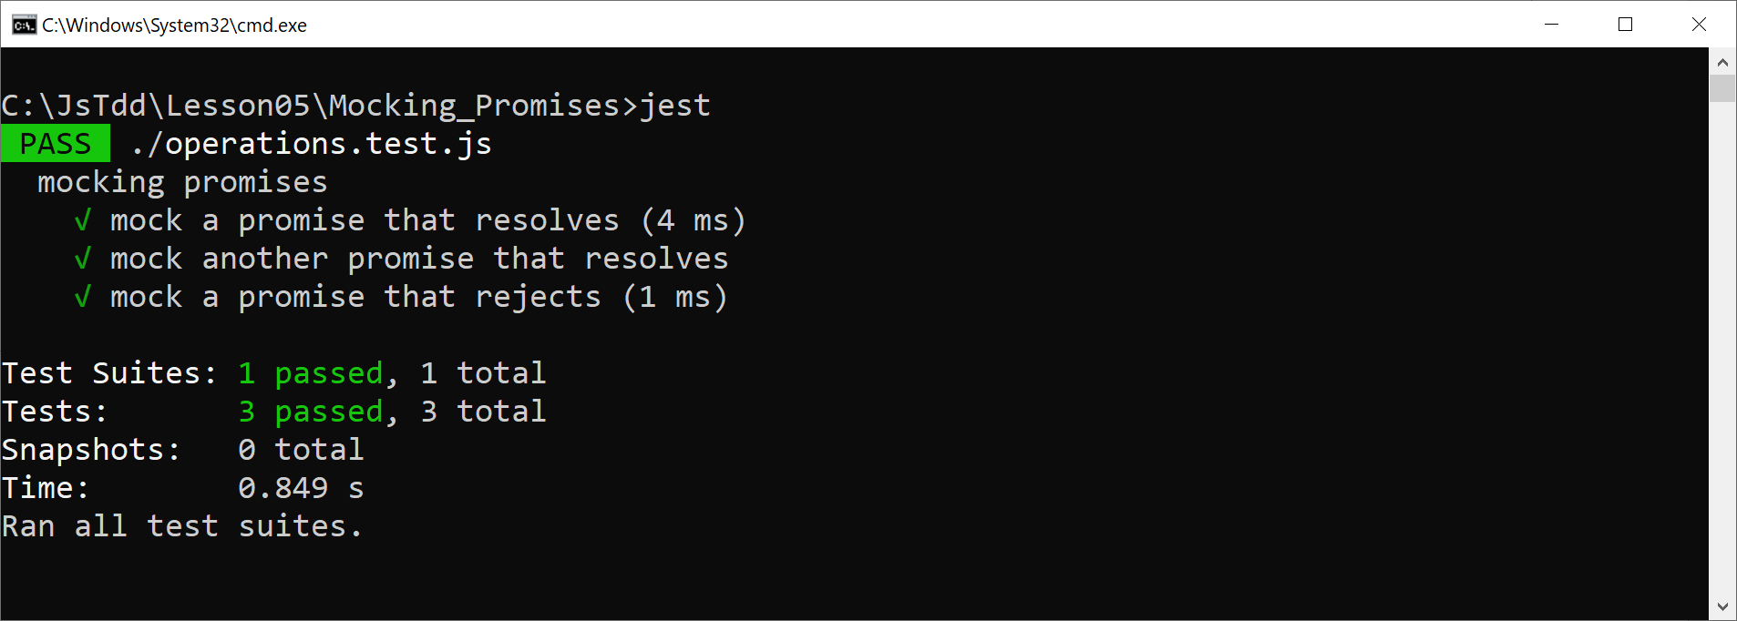
Running all the Tests
Run all the tests as follows:
jest

Slide 49
Lesson 5: Mocking
5.6 Mocking REST Calls

Slide 50
Defining a REST Client API
Consider the following REST client API, which uses Axios to invoke REST service functions on the server:
Let's see how to unit-test this REST client API
We'll need to mock the axios module…
const axios = require('axios');
const baseUrl = 'https://example.com/api/products';
function getAllProducts() {
return axios.get(baseUrl)
.then(response => response.data);
}
function getProductById(id) {
return axios.get(`${baseUrl}/${id}`)
.then(response => response.data);
}
Mocking_RestCalls/restClient.js

Slide 51
Mocking the Axios Module
Here's how we can mock the Axios module in our test code:
const axios = require('axios');
jest.mock('axios');
restClient.test.js

Slide 52
Writing Test 1
Here's our first unit test for the REST client API:
Notes:
We specify axios.get resolves to a result
We call the REST client API and test all is fine
const rc = require('./restClient');
const products = [ … mock data … ];
test('get all products', () => {
const response = {data: products};
axios.get.mockResolvedValueOnce(response);
rc.getAllProducts()
.then(data => expect(data).toEqual(products));
expect(axios.get).toHaveBeenCalledWith(
'https://example.com/api/products');
});
const rc = require('./restClient');
const products = [ … mock data … ];
test('get all products', () => {
const response = {data: products};
axios.get.mockResolvedValueOnce(response);
rc.getAllProducts()
.then(data => expect(data).toEqual(products));
expect(axios.get).toHaveBeenCalledWith(
'https://example.com/api/products');
});
const rc = require('./restClient');
const products = [ … mock data … ];
test('get all products', () => {
const response = {data: products};
axios.get.mockResolvedValueOnce(response);
rc.getAllProducts()
.then(data => expect(data).toEqual(products));
expect(axios.get).toHaveBeenCalledWith(
'https://example.com/api/products');
});
restClient.test.js

Slide 53
Writing Test 2
Here's our second unit test for the REST client API:
Notes:
We specify axios.get resolves to a result
We call the REST client API and test all is fine
const rc = require('./restClient');
const products = [ … mock data … ];
test('get one products', () => {
const response = {data: products[1]};
axios.get.mockResolvedValueOnce(response);
rc.getProductById(1)
.then(data => expect(data).toEqual(products[1]));
expect(axios.get).toHaveBeenCalledWith(
'https://example.com/api/products/1');
});
const rc = require('./restClient');
const products = [ … mock data … ];
test('get one products', () => {
const response = {data: products[1]};
axios.get.mockResolvedValueOnce(response);
rc.getProductById(1)
.then(data => expect(data).toEqual(products[1]));
expect(axios.get).toHaveBeenCalledWith(
'https://example.com/api/products/1');
});
const rc = require('./restClient');
const products = [ … mock data … ];
test('get one products', () => {
const response = {data: products[1]};
axios.get.mockResolvedValueOnce(response);
rc.getProductById(1)
.then(data => expect(data).toEqual(products[1]));
expect(axios.get).toHaveBeenCalledWith(
'https://example.com/api/products/1');
});
restClient.test.js

Slide 54
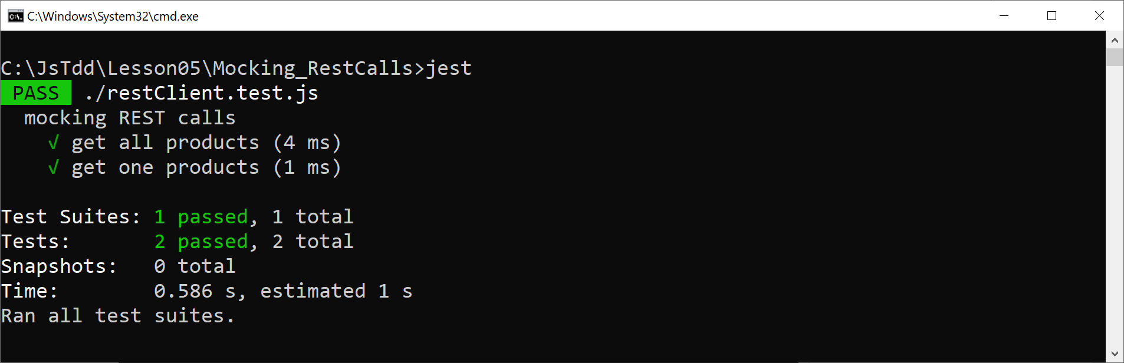
Running all the Tests
Run all the tests as follows:
jest

