Slide 1
Lesson 6: Additional Mocking Techniques
6.1 Spying on functions
6.2 Defining a mock implementation for a spy
6.3 Mocking timers
6.4 Mocking timers - additional techniques
6.5 Introduction to ES6 classes
6.6 Defining automatic mocks for ES6 classes
6.7 Defining manual mocks for ES6 classes

Slide 2
Lesson 6: Additional Mocking Techniques
6.1 Spying on Functions

Slide 3
Overview
We've already seen how to define a mock function:
We've also seen how to mock an entire module:
It's also possible to spy on a function:
The spy detects and records calls to a function
The original function is still called as normal
const mockf1 = jest.fn()
const someModule = require('./someModule.js')
jest.mock('./someModule.js')
const someModule = require('./someModule.js')
const someFuncMock = jest.spyOn(someModule, 'someFunc')

Slide 4
Example Scenario
Consider this example in the Mocking_SpyOn folder:
add()
info()
subtract()
warn()
multiply()
error()
divide()
messaging.js
We can define spies to detect calls to these functions
operations.js

Slide 5
Defining Functions to be Spied Upon
Here are the functions we're going to spy upon:
const dt = require('./datetime')
function info(message) {
return `[${dt.nowString()}] INFO: ${message}`;
}
function warn(message) {
return `[${dt.nowString()}] WARNING: ${message}`;
}
function error(message) {
return `[${dt.nowString()}] ERROR: ${message}`;
}
messaging.js

Slide 6
Calling Functions that are Spied Upon
Here's some code that calls the functions that are spied upon:
const msg = require('./messaging');
function add(a, b) {
console.log(msg.info(`In add(${a}, ${b})`));
return a + b;
}
function subtract(a, b) {
console.log(msg.info(`In subtract(${a}, ${b})`));
return a / b;
}
function multiply(a, b) {
console.log(msg.info(`In multiply(${a}, ${b})`));
return a * b;
}
function divide(a, b) {
if (b === 0)
console.log(msg.warn(`In divide(${a}, ${b})`));
else
console.log(msg.info(`In divide(${a}, ${b})`));
return a / b;
}
operations.js

Slide 7
Setting up Spies in our Test Code
In our test code, we set up spies on functions of interest:
Notes:
Import the messaging module
Define spies on functions of interest
After each test, clear all info accrued by spies
const msg = require('./messaging')
const infoMock = jest.spyOn(msg, 'info');
const warnMock = jest.spyOn(msg, 'warn');
const errorMock = jest.spyOn(msg, 'error');
…
afterEach(() => {
jest.clearAllMocks();
});
const msg = require('./messaging')
const infoMock = jest.spyOn(msg, 'info');
const warnMock = jest.spyOn(msg, 'warn');
const errorMock = jest.spyOn(msg, 'error');
…
afterEach(() => {
jest.clearAllMocks();
});
const msg = require('./messaging')
const infoMock = jest.spyOn(msg, 'info');
const warnMock = jest.spyOn(msg, 'warn');
const errorMock = jest.spyOn(msg, 'error');
…
afterEach(() => {
jest.clearAllMocks();
});
const msg = require('./messaging')
const infoMock = jest.spyOn(msg, 'info');
const warnMock = jest.spyOn(msg, 'warn');
const errorMock = jest.spyOn(msg, 'error');
…
afterEach(() => {
jest.clearAllMocks();
});
operations.test.js

Slide 8
Writing Test 1
Here's our first test:
Notes:
Invoke the function-under-test
Verify it called info() correctly
Verify it didn't call warn() or error()
test('spying on a function - example 1', () => {
ops.divide(10, 20);
expect(infoMock).toHaveBeenCalledWith('In divide(10,20)');
expect(warnMock).not.toHaveBeenCalled();
expect(errorMock).not.toHaveBeenCalled();
});
test('spying on a function - example 1', () => {
ops.divide(10, 20);
expect(infoMock).toHaveBeenCalledWith('In divide(10,20)');
expect(warnMock).not.toHaveBeenCalled();
expect(errorMock).not.toHaveBeenCalled();
});
test('spying on a function - example 1', () => {
ops.divide(10, 20);
expect(infoMock).toHaveBeenCalledWith('In divide(10,20)');
expect(warnMock).not.toHaveBeenCalled();
expect(errorMock).not.toHaveBeenCalled();
});
test('spying on a function - example 1', () => {
ops.divide(10, 20);
expect(infoMock).toHaveBeenCalledWith('In divide(10,20)');
expect(warnMock).not.toHaveBeenCalled();
expect(errorMock).not.toHaveBeenCalled();
});
operations.test.js

Slide 9
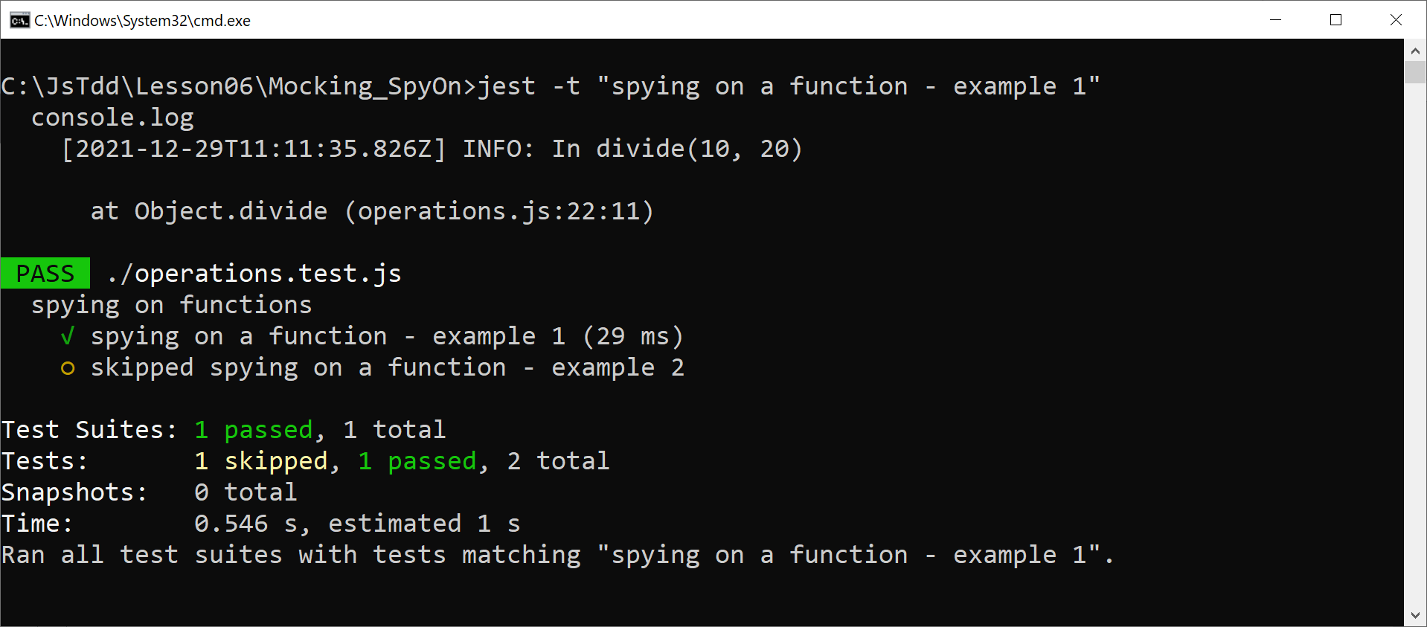
Running Test 1
Run test 1 as follows:
jest -t "spying on a function - example 1"

Slide 10
Writing Test 2
Here's our second test:
Notes:
Invoke the function-under-test
Verify it called warn() correctly
Verify it didn't call info() or error()
test('spying on a function - example 2', () => {
ops.divide(10, 0);
expect(warnMock).toHaveBeenCalledWith('In divide(10, 0)');
expect(infoMock).not.toHaveBeenCalled();
expect(errorMock).not.toHaveBeenCalled();
});
test('spying on a function - example 2', () => {
ops.divide(10, 0);
expect(warnMock).toHaveBeenCalledWith('In divide(10, 0)');
expect(infoMock).not.toHaveBeenCalled();
expect(errorMock).not.toHaveBeenCalled();
});
test('spying on a function - example 2', () => {
ops.divide(10, 0);
expect(warnMock).toHaveBeenCalledWith('In divide(10, 0)');
expect(infoMock).not.toHaveBeenCalled();
expect(errorMock).not.toHaveBeenCalled();
});
test('spying on a function - example 2', () => {
ops.divide(10, 0);
expect(warnMock).toHaveBeenCalledWith('In divide(10, 0)');
expect(infoMock).not.toHaveBeenCalled();
expect(errorMock).not.toHaveBeenCalled();
});
operations.test.js

Slide 11
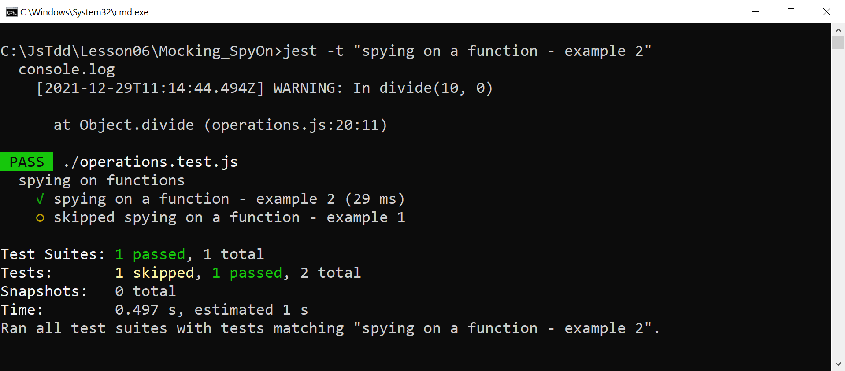
Running Test 2
Run test 2 as follows:
jest -t "spying on a function - example 2"

Slide 12
Lesson 6: Additional Mocking Techniques
6.2 Defining a Mock Implementation for a Spy

Slide 13
Overview
We've seen how to define a spy on a function:
The spy intercepts calls to the original function
The original function is still called as normal
You can define a mock implementation for a spy:
const someModule = require('./someModule.js')
const someFuncMock = jest.spyOn(someModule, 'someFunc')
const someModule = require('./someModule.js')
const someFuncMock = jest.spyOn(someModule, 'someFunc')
.mockImplementation(() => … … … )

Slide 14
Example Scenario
Consider this example in the Mocking_SpyOn_Impl folder:
add()
info()
nowString()
subtract()
warn()
datetime.js
multiply()
error()
We can define a spy for this function and define a mock implementation
divide()
messaging.js
operations.js

Slide 15
Writing the Code to be Tested
Here's the function we're going to spy upon (and re-implement):
We call the function from the messaging module:
function nowString() {
return new Date().toISOString();
}
datetime.js
const dt = require('./datetime')
function info(message) {
return `[${dt.nowString()}] INFO: ${message}`;
}
function warn(message) {
return `[${dt.nowString()}] WARNING: ${message}`;
}
function error(message) {
return `[${dt.nowString()}] ERROR: ${message}`;
}
messaging.js

Slide 16
Writing the Code to be Tested
Here's the top-level code in our example:
const msg = require('./messaging');
function add(a, b) {
console.log(msg.info(`In add(${a}, ${b})`));
return a + b;
}
function subtract(a, b) {
console.log(msg.info(`In subtract(${a}, ${b})`));
return a / b;
}
function multiply(a, b) {
console.log(msg.info(`In multiply(${a}, ${b})`));
return a * b;
}
function divide(a, b) {
if (b === 0)
console.log(msg.warn(`In divide(${a}, ${b})`));
else
console.log(msg.info(`In divide(${a}, ${b})`));
return a / b;
}
operations.js

Slide 17
Setting up Spies in our Test Code
In our test code, we set up spies on functions of interest:
Notes:
Before each test, create and implement a spy on the nowString() function
After each test, clear all accrued spy info
const msg = require('./messaging')
const dt = require('./datetime')
const infoMock = jest.spyOn(msg, 'info');
beforeEach(() => {
jest.spyOn(dt, 'nowString')
.mockImplementation(() => '2021-12-03T08:00:00.123Z');
});
afterEach(() => {
jest.clearAllMocks();
});
const msg = require('./messaging')
const dt = require('./datetime')
const infoMock = jest.spyOn(msg, 'info');
beforeEach(() => {
jest.spyOn(dt, 'nowString')
.mockImplementation(() => '2021-12-03T08:00:00.123Z');
});
afterEach(() => {
jest.clearAllMocks();
});
const msg = require('./messaging')
const dt = require('./datetime')
const infoMock = jest.spyOn(msg, 'info');
beforeEach(() => {
jest.spyOn(dt, 'nowString')
.mockImplementation(() => '2021-12-03T08:00:00.123Z');
});
afterEach(() => {
jest.clearAllMocks();
});
operations.test.js

Slide 18
Writing Simple Tests
This test calls nowString() directly:
This test calls nowString() indirectly, via a call to msg.info():
test(simple tests - example 1', () => {
expect(dt.nowString()).toBe('2021-12-03T08:00:00.123Z');
});
operations.test.js
test(simple tests - example 2', () => {
const str = msg.info('Hi!');
expect(str).toBe('[2021-12-03T08:00:00.123Z] INFO: Hi!');
});
operations.test.js

Slide 19
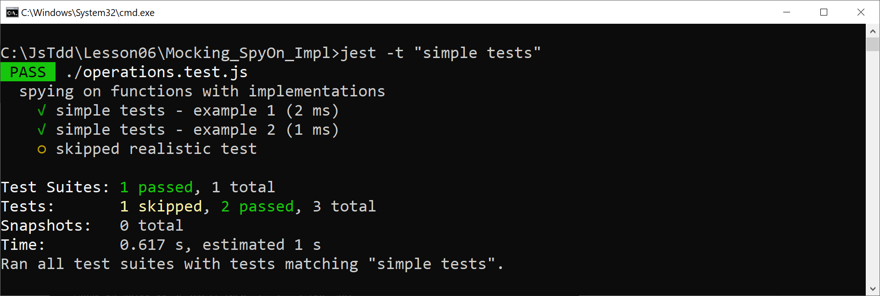
Running the Simple Tests
Run the simple tests as follows:
jest -t "simple tests"

Slide 20
Writing a Realistic Test
Here's a realistic test that calls nowString() indirectly:
Notes:
Call a top-level function, which causes nowString() to be called
Check the mocked functions were called, and verify the overall result is correct
test('realistic test', () => {
ops.divide(10, 20);
expect(infoMock).toHaveBeenCalledWith('In divide(10,20)');
expect(infoMock.mock.results.length).toBe(1);
expect(infoMock.mock.results[0].value).toBe(
'[2021-12-03T08:00:00.123Z] INFO: In divide(10, 20)');
});
test('realistic test', () => {
ops.divide(10, 20);
expect(infoMock).toHaveBeenCalledWith('In divide(10,20)');
expect(infoMock.mock.results.length).toBe(1);
expect(infoMock.mock.results[0].value).toBe(
'[2021-12-03T08:00:00.123Z] INFO: In divide(10, 20)');
});
test('realistic test', () => {
ops.divide(10, 20);
expect(infoMock).toHaveBeenCalledWith('In divide(10,20)');
expect(infoMock.mock.results.length).toBe(1);
expect(infoMock.mock.results[0].value).toBe(
'[2021-12-03T08:00:00.123Z] INFO: In divide(10, 20)');
});
operations.test.js

Slide 21
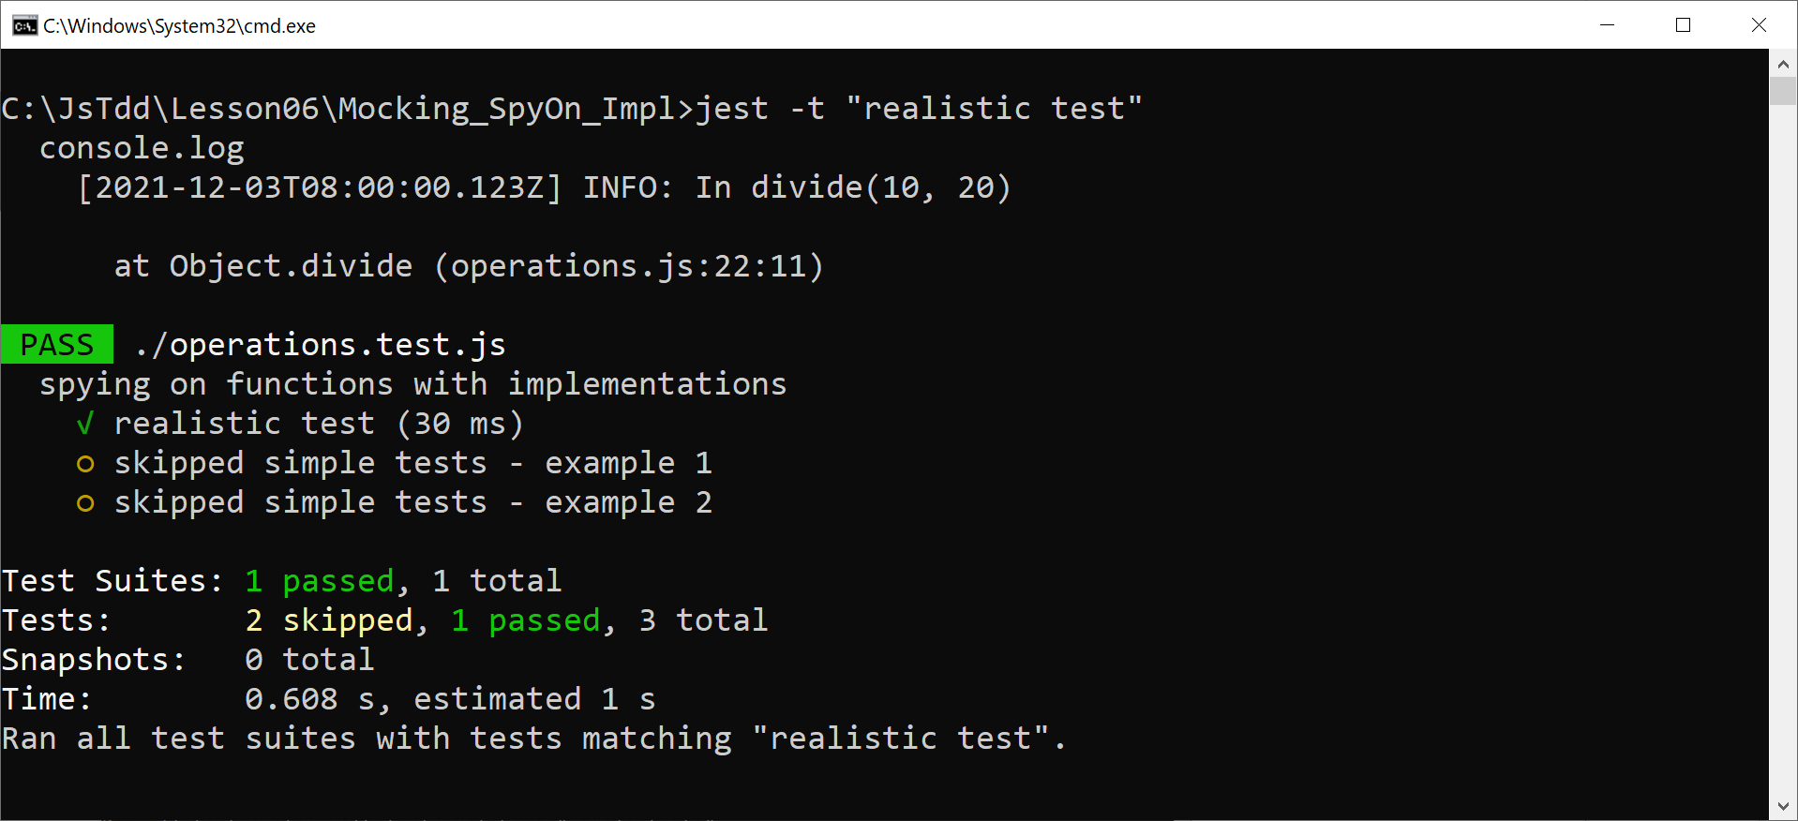
Running the Test
Run the test as follows:
jest -t "realistic test"

Slide 22
Lesson 6: Additional Mocking Techniques
6.3 Mocking Timers

Slide 23
Overview
If a test involves a timer, it will probably be quite slow
This is bad!
Unit tests are meant to be fast, so you can run them often
Jest provides an API for mocking timers
Enables you to avoid delays in your tests
See this folder for examples:
Mocking_Timers

Slide 24
Example that Uses a Real Timer
Let's see an example that uses a real timer first…
Here's our code - it invokes a callback after a specified timeout:
Here's our test:
function countdown(callback, seconds) {
setTimeout(
() => callback(`${seconds} seconds countdown complete`),
seconds * 1000
);
}
operations.js
test('use real timers [default behaviour]', done => {
function callback(msg) {
expect(msg).toBe('4 seconds countdown complete');
done();
}
ops.countdown(callback, 4);
});
operations.test.js

Slide 25
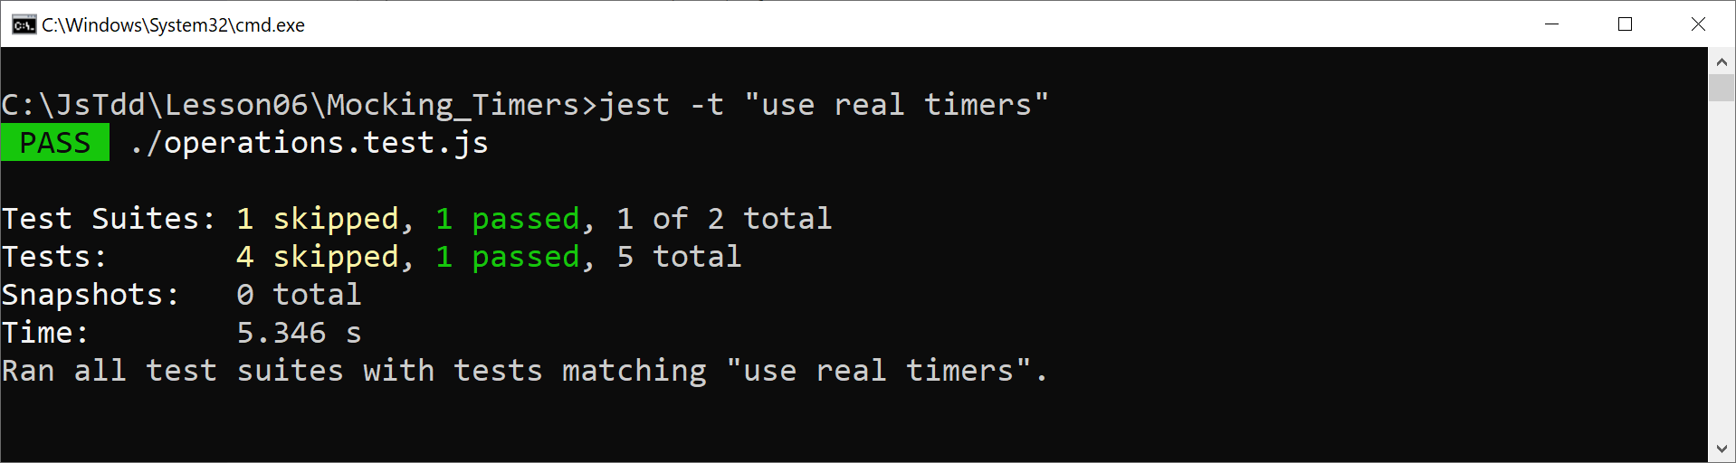
Running the Test
Run the test as follows:
jest -t "use real timers"

Slide 26
Defining Fake Timers
You can tell Jest to use fake timers as follows:
This causes Jest to mock the following functions:
setTimeout
clearTimeout
setInterval
clearInterval
You can reinstate real timers as follows:
jest.useFakeTimers();
jest.useRealTimers();

Slide 27
Example of Using Fake Timers
afterEach(() => {
jest.useRealTimers();
});
test('using fake timers', () => {
jest.useFakeTimers();
const spy = jest.spyOn(global, 'setTimeout');
ops.countdown(() => {}, 4);
expect(spy).toHaveBeenCalledTimes(1);
expect(spy).toHaveBeenLastCalledWith(expect.any(Function),
4_000);
spy.mockRestore();
});
operationWithFakeTimers.test.js

Slide 28
Example of Using Fake Timers
afterEach(() => {
jest.useRealTimers();
});
test('using fake timers', () => {
jest.useFakeTimers();
const spy = jest.spyOn(global, 'setTimeout');
ops.countdown(() => {}, 4);
expect(spy).toHaveBeenCalledTimes(1);
expect(spy).toHaveBeenLastCalledWith(expect.any(Function),
4_000);
spy.mockRestore();
});
First, we start using fake timers
operationWithFakeTimers.test.js

Slide 29
Example of Using Fake Timers
afterEach(() => {
jest.useRealTimers();
});
test('using fake timers', () => {
jest.useFakeTimers();
const spy = jest.spyOn(global, 'setTimeout');
ops.countdown(() => {}, 4);
expect(spy).toHaveBeenCalledTimes(1);
expect(spy).toHaveBeenLastCalledWith(expect.any(Function),
4_000);
spy.mockRestore();
});
We also set up a spy on setTimeout, so we can detect calls to this function
operationWithFakeTimers.test.js

Slide 30
Example of Using Fake Timers
afterEach(() => {
jest.useRealTimers();
});
test('using fake timers', () => {
jest.useFakeTimers();
const spy = jest.spyOn(global, 'setTimeout');
ops.countdown(() => {}, 4);
expect(spy).toHaveBeenCalledTimes(1);
expect(spy).toHaveBeenLastCalledWith(expect.any(Function),
4_000);
spy.mockRestore();
});
Invoke a function-under-test, which calls the mocked setTimeout()
operationWithFakeTimers.test.js

Slide 31
Example of Using Fake Timers
afterEach(() => {
jest.useRealTimers();
});
test('using fake timers', () => {
jest.useFakeTimers();
const spy = jest.spyOn(global, 'setTimeout');
ops.countdown(() => {}, 4);
expect(spy).toHaveBeenCalledTimes(1);
expect(spy).toHaveBeenLastCalledWith(expect.any(Function),
4_000);
spy.mockRestore();
});
Verify setTimeout has been called, with the correct parameters
operationWithFakeTimers.test.js

Slide 32
Example of Using Fake Timers
afterEach(() => {
jest.useRealTimers();
});
test('using fake timers', () => {
jest.useFakeTimers();
const spy = jest.spyOn(global, 'setTimeout');
ops.countdown(() => {}, 4);
expect(spy).toHaveBeenCalledTimes(1);
expect(spy).toHaveBeenLastCalledWith(expect.any(Function),
4_000);
spy.mockRestore();
});
Clear the spy (this clears all info accrued, and removes the mock implementation)
operationWithFakeTimers.test.js

Slide 33
Example of Using Fake Timers
afterEach(() => {
jest.useRealTimers();
});
test('using fake timers', () => {
jest.useFakeTimers();
const spy = jest.spyOn(global, 'setTimeout');
ops.countdown(() => {}, 4);
expect(spy).toHaveBeenCalledTimes(1);
expect(spy).toHaveBeenLastCalledWith(expect.any(Function),
4_000);
spy.mockRestore();
});
After each test, reinstate real timers
operationWithFakeTimers.test.js

Slide 34
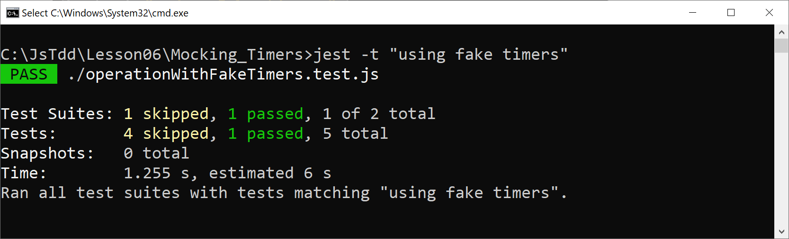
Running the Test
Run the test as follows:
jest -t "using fake timers"

Slide 35
Using Real Timers Again
Subsequent tests will use real timers again:
test('using real timers again', done => {
function callback(msg) {
expect(msg).toBe('4 seconds countdown complete');
done();
}
ops.countdown(callback, 4);
});
operationWithFakeTimers.test.js

Slide 36
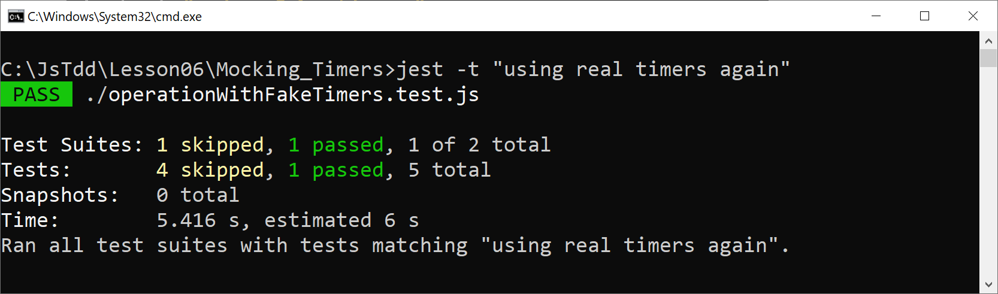
Running the Test
Run the test as follows:
jest -t "using real timers again"

Slide 37
Lesson 6: Additional Mocking Techniques
6.4 Mocking Timers - Additional Techniques

Slide 38
Overview
In this section we'll explore a couple of mock timer techniques…
First, we'll see how to run all timers to completion:
Then we'll see how to advance timers artificially by a specified timespan:
See this folder for examples:
Mocking_Timers_Techniques
jest.runAllTimers();
jest.advanceTimersByTime(milliseconds);

Slide 39
Running all Timers to Completion
Consider the following function:
Consider how to test the following scenario:
Call countdown()
Verify the callback hasn't been called initially
Artificially run timers to completion
Verify the callback has now been called
function countdown(callback, seconds) {
setTimeout(
() => callback(`${seconds} seconds countdown complete`),
seconds * 1000
);
}
operations.js

Slide 40
Running all Timers to Completion
Here's how to write a test for such a scenario:
test('running all timers to completion', () => {
jest.useFakeTimers();
const dummyCallback = jest.fn();
ops.countdown(dummyCallback, 4);
expect(dummyCallback).not.toBeCalled();
jest.runAllTimers();
expect(dummyCallback).toBeCalled();
expect(dummyCallback).toHaveBeenCalledTimes(1);
});
operationWithFakeTimers.test.js

Slide 41
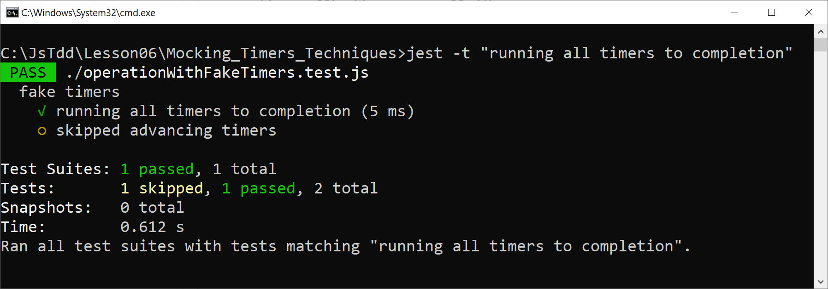
Running the Test
Run the test as follows:
jest -t "running all timers to completion"

Slide 42
Artificially Advancing Timers by a Timespan
This test shows how to artificially advance timers by a timespan:
test('advancing timers', () => {
jest.useFakeTimers();
const dummyCallback1 = jest.fn();
const dummyCallback2 = jest.fn();
const dummyCallback3 = jest.fn();
ops.countdown(dummyCallback1, 10);
ops.countdown(dummyCallback2, 20);
ops.countdown(dummyCallback3, 30);
expect(dummyCallback1).not.toBeCalled();
expect(dummyCallback2).not.toBeCalled();
expect(dummyCallback3).not.toBeCalled();
jest.advanceTimersByTime(10_000);
expect(dummyCallback1).toHaveBeenCalledTimes(1);
expect(dummyCallback2).not.toBeCalled();
expect(dummyCallback3).not.toBeCalled();
…
});
operationWithFakeTimers.test.js

Slide 43
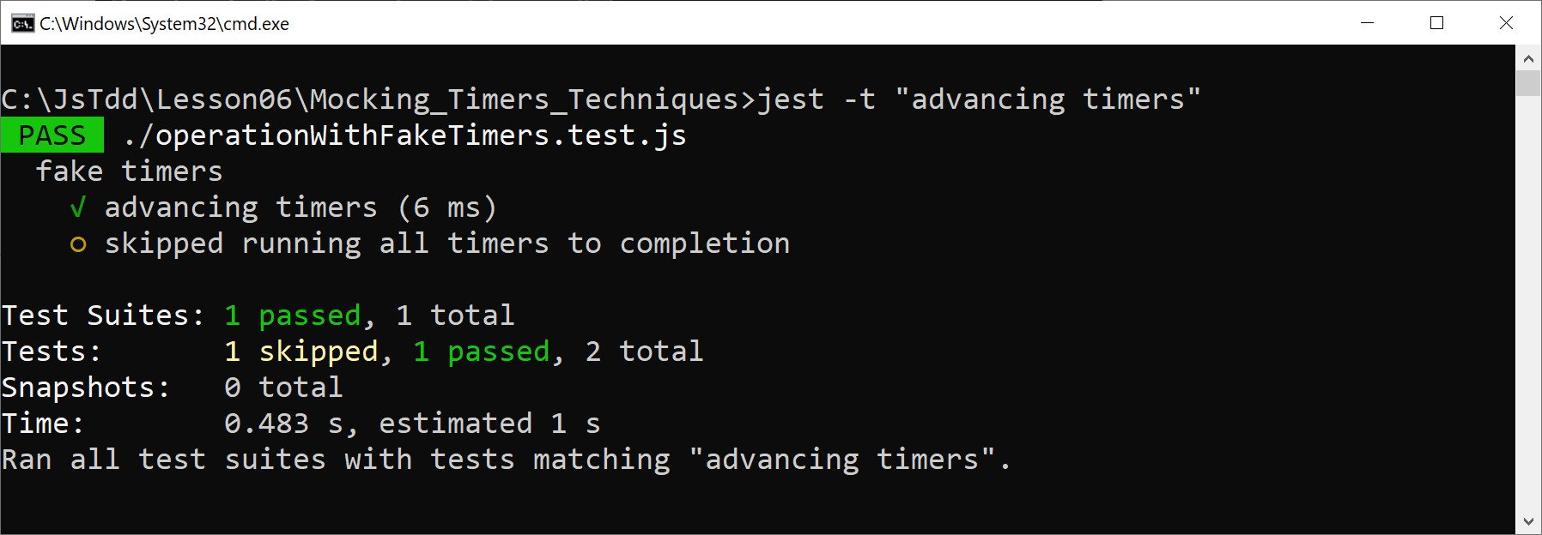
Running the Test
Run the test as follows:
jest -t "advancing timers"

Slide 44
Lesson 6: Additional Mocking Techniques
6.5 Introduction to ES6 Classes

Slide 45
Overview
ECMAScript 6 introduced full support for object orientation
Classes and objects
Inheritance
In this section:
We'll review the basic syntax for classes
In the next section:
We'll see how to test classes in Jest

Slide 46
Defining a Class
Here's a simple class definition in ES6:
class Account {
constructor(name, balance) {
this.name = name;
this.balance = balance;
}
deposit(amt) {
this.balance += amt;
}
withdraw(amt) {
this.balance -= amt;
}
}

Slide 47
Creating and Using Objects
Here's how to create and use objects in ES6:
var acc1 = new Account('Peter', 5000)
acc1.deposit(200);
acc1.withdraw(50);
console.log(acc1.balance);

Slide 48
Important Points about Classes in ES6
ES6 classes are similar to other languages, but:
You don't define data members explicitly…
You add properties to the object in the constructor
You don't define members as public/private
Members in a class are implicitly public
Under the covers, ES6 classes are transpiled to ES5 constructors and prototypes

Slide 49
Complete Example
For a complete example of ES6 classes, see this folder:
Mocking_Classes_IntroES6Classes
There are 2 classes:
RestClient
ProductManager
Let's take a look at these classes…

Slide 50
Lesson 6: Additional Mocking Techniques
6.6 Defining Automatic Mocks for ES6 Classes

Slide 51
Overview
In the Mocking_Classes_AutoMocks folder, take a look at the following classes:
RestClient
ProductManager
Note the ProductManager class uses the RestClient class
To unit test ProductManager, we can define mocks for RestClient

Slide 52
Defining Automatic Mocks for a Class
The easiest way to mock a class is via automatic mocking...
Call jest.mock() to mock the module that contains the class you want to mock:
Jest automatically creates mock functions for:
The class constructor
All the methods in the class
const rc = require('./restClient');
jest.mock('./restClient');

Slide 53
Mocking a Class - Example 1
This first test shows how to mock the RestClient class:
const rc = require('./restClient');
jest.mock('./restClient');
afterEach(() => {
jest.clearAllMocks();
});
test('call the RestClient constructor directly', () => {
const restClient = new rc.RestClient();
expect(rc.RestClient).toHaveBeenCalledTimes(1);
expect(rc.RestClient.mock.instances[0]).not.toBeUndefined();
});
productManager.test.js

Slide 54
Mocking a Class - Example 1
This first test shows how to mock the RestClient class:
Import the restClient module, and then mock the entire module - this creates mock functions for the constructor and all methods
const rc = require('./restClient');
jest.mock('./restClient');
afterEach(() => {
jest.clearAllMocks();
});
test('call the RestClient constructor directly', () => {
const restClient = new rc.RestClient();
expect(rc.RestClient).toHaveBeenCalledTimes(1);
expect(rc.RestClient.mock.instances[0]).not.toBeUndefined();
});
productManager.test.js

Slide 55
Mocking a Class - Example 1
This first test shows how to mock the RestClient class:
Create a RestClient object - this calls the RestClient mock constructor
const rc = require('./restClient');
jest.mock('./restClient');
afterEach(() => {
jest.clearAllMocks();
});
test('call the RestClient constructor directly', () => {
const restClient = new rc.RestClient();
expect(rc.RestClient).toHaveBeenCalledTimes(1);
expect(rc.RestClient.mock.instances[0]).not.toBeUndefined();
});
productManager.test.js

Slide 56
Mocking a Class - Example 1
This first test shows how to mock the RestClient class:
Check the RestClient mock constructor has been called once, and also check that 1 RestClient instance has been created
const rc = require('./restClient');
jest.mock('./restClient');
afterEach(() => {
jest.clearAllMocks();
});
test('call the RestClient constructor directly', () => {
const restClient = new rc.RestClient();
expect(rc.RestClient).toHaveBeenCalledTimes(1);
expect(rc.RestClient.mock.instances[0]).not.toBeUndefined();
});
productManager.test.js

Slide 57
Mocking a Class - Example 1
This first test shows how to mock the RestClient class:
Clear all mocks after each test - this clears the .calls, .instances, and .results properties of all mock functions
const rc = require('./restClient');
jest.mock('./restClient');
afterEach(() => {
jest.clearAllMocks();
});
test('call the RestClient constructor directly', () => {
const restClient = new rc.RestClient();
expect(rc.RestClient).toHaveBeenCalledTimes(1);
expect(rc.RestClient.mock.instances[0]).not.toBeUndefined();
});
productManager.test.js

Slide 58
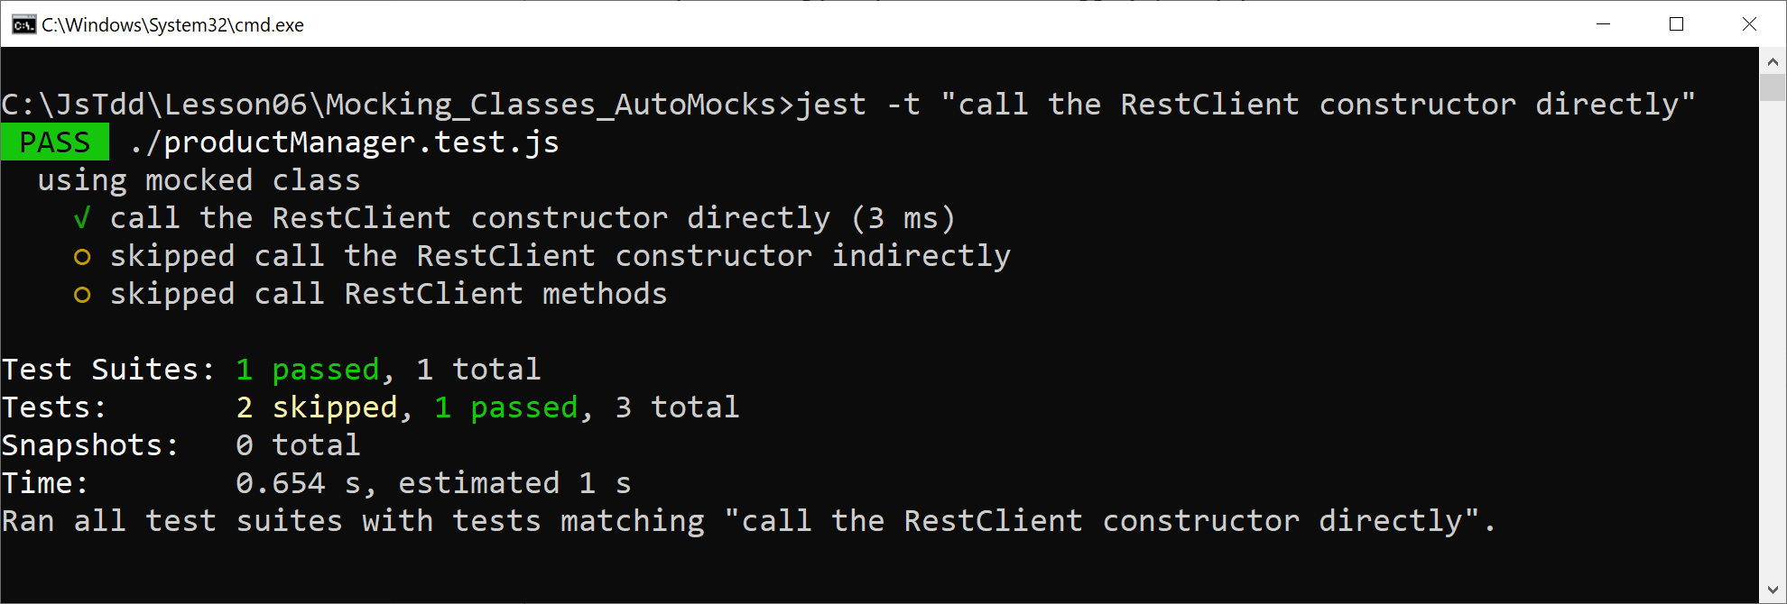
Running the Test
Run the test as follows:
jest -t "call the RestClient constructor directly"

Slide 59
Mocking a Class - Example 2
In this test, a RestClient object is created indirectly:
const pm = require('./productManager');
const rc = require('./restClient');
jest.mock('./restClient');
afterEach(() => {
jest.clearAllMocks();
});
test('call the RestClient constructor indirectly', () => {
const productManager = new pm.ProductManager();
expect(rc.RestClient).toHaveBeenCalledTimes(1);
expect(rc.RestClient.mock.instances[0]).not.toBeUndefined();
});
productManager.test.js

Slide 60
Mocking a Class - Example 2
In this test, a RestClient object is created indirectly:
Create a ProductManager object, which creates a RestClient object indirectly
const pm = require('./productManager');
const rc = require('./restClient');
jest.mock('./restClient');
afterEach(() => {
jest.clearAllMocks();
});
test('call the RestClient constructor indirectly', () => {
const productManager = new pm.ProductManager();
expect(rc.RestClient).toHaveBeenCalledTimes(1);
expect(rc.RestClient.mock.instances[0]).not.toBeUndefined();
});
productManager.test.js

Slide 61
Mocking a Class - Example 2
In this test, a RestClient object is created indirectly:
Check the RestClient mock constructor has been called once, and also check that 1 RestClient instance has been created
const pm = require('./productManager');
const rc = require('./restClient');
jest.mock('./restClient');
afterEach(() => {
jest.clearAllMocks();
});
test('call the RestClient constructor indirectly', () => {
const productManager = new pm.ProductManager();
expect(rc.RestClient).toHaveBeenCalledTimes(1);
expect(rc.RestClient.mock.instances[0]).not.toBeUndefined();
});
productManager.test.js

Slide 62
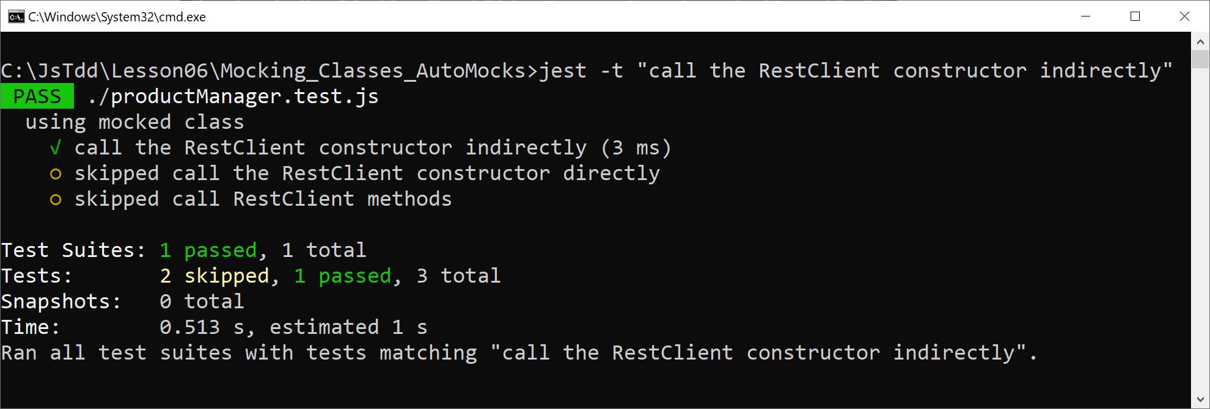
Running the Test
Run the test as follows:
jest -t "call the RestClient constructor indirectly"

Slide 63
Investigating Calls to Mock Methods
Consider the following code in our application:
When we call removeProducts(), how can we verify that it calls delete() correctly on the RestClient instance?
class ProductManager {
constructor() {
this.restClient = new rc.RestClient(…);
}
removeProducts(...IDs) {
IDs.forEach(id => this.restClient.delete(id))
}
…
}
class ProductManager {
constructor() {
this.restClient = new rc.RestClient(…);
}
removeProducts(...IDs) {
IDs.forEach(id => this.restClient.delete(id))
}
…
}

Slide 64
Investigating Calls to Mock Methods
Here's how we can investigate calls to a mock method:
test('call RestClient methods', () => {
const productManager = new pm.ProductManager();
expect(rc.RestClient).toHaveBeenCalledTimes(1);
productManager.removeProducts(101, 102, 103);
const restClientInstance = rc.RestClient.mock.instances[0];
const deleteMethod = restClientInstance.delete;
expect(deleteMethod.mock.calls.length).toBe(3);
expect(deleteMethod.mock.calls[0][0]).toBe(101);
expect(deleteMethod.mock.calls[1][0]).toBe(102);
expect(deleteMethod.mock.calls[2][0]).toBe(103);
});
productManager.test.js

Slide 65
Investigating Calls to Mock Methods
Here's how we can investigate calls to a mock method:
Create a ProductManager object, and verify that the RestClient constructor has been called once
test('call RestClient methods', () => {
const productManager = new pm.ProductManager();
expect(rc.RestClient).toHaveBeenCalledTimes(1);
productManager.removeProducts(101, 102, 103);
const restClientInstance = rc.RestClient.mock.instances[0];
const deleteMethod = restClientInstance.delete;
expect(deleteMethod.mock.calls.length).toBe(3);
expect(deleteMethod.mock.calls[0][0]).toBe(101);
expect(deleteMethod.mock.calls[1][0]).toBe(102);
expect(deleteMethod.mock.calls[2][0]).toBe(103);
});
productManager.test.js

Slide 66
Investigating Calls to Mock Methods
Here's how we can investigate calls to a mock method:
Call removeProducts() and specify three products to be removed
test('call RestClient methods', () => {
const productManager = new pm.ProductManager();
expect(rc.RestClient).toHaveBeenCalledTimes(1);
productManager.removeProducts(101, 102, 103);
const restClientInstance = rc.RestClient.mock.instances[0];
const deleteMethod = restClientInstance.delete;
expect(deleteMethod.mock.calls.length).toBe(3);
expect(deleteMethod.mock.calls[0][0]).toBe(101);
expect(deleteMethod.mock.calls[1][0]).toBe(102);
expect(deleteMethod.mock.calls[2][0]).toBe(103);
});
productManager.test.js

Slide 67
Investigating Calls to Mock Methods
Here's how we can investigate calls to a mock method:
Get access to the RestClient instance, and then get access to the delete mock method for this instance
test('call RestClient methods', () => {
const productManager = new pm.ProductManager();
expect(rc.RestClient).toHaveBeenCalledTimes(1);
productManager.removeProducts(101, 102, 103);
const restClientInstance = rc.RestClient.mock.instances[0];
const deleteMethod = restClientInstance.delete;
expect(deleteMethod.mock.calls.length).toBe(3);
expect(deleteMethod.mock.calls[0][0]).toBe(101);
expect(deleteMethod.mock.calls[1][0]).toBe(102);
expect(deleteMethod.mock.calls[2][0]).toBe(103);
});
productManager.test.js

Slide 68
Investigating Calls to Mock Methods
Here's how we can investigate calls to a mock method:
Check info on the delete mock method, to verify delete was called as expected
test('call RestClient methods', () => {
const productManager = new pm.ProductManager();
expect(rc.RestClient).toHaveBeenCalledTimes(1);
productManager.removeProducts(101, 102, 103);
const restClientInstance = rc.RestClient.mock.instances[0];
const deleteMethod = restClientInstance.delete;
expect(deleteMethod.mock.calls.length).toBe(3);
expect(deleteMethod.mock.calls[0][0]).toBe(101);
expect(deleteMethod.mock.calls[1][0]).toBe(102);
expect(deleteMethod.mock.calls[2][0]).toBe(103);
});
productManager.test.js

Slide 69
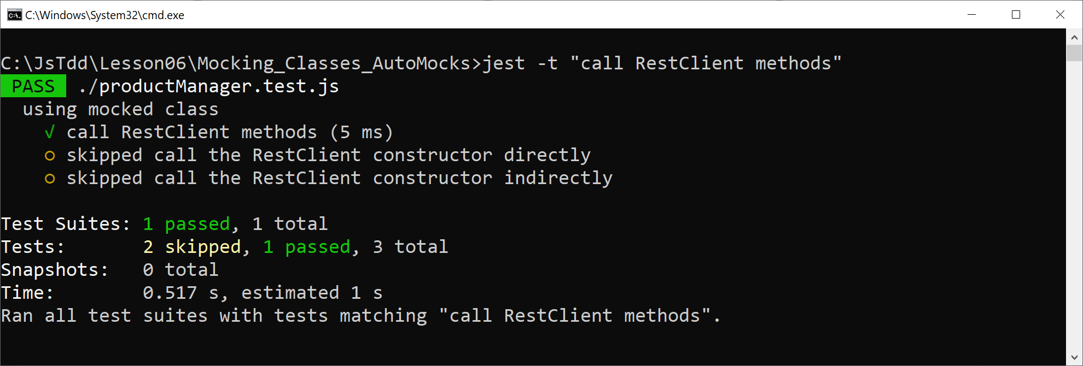
Running the Test
Run the test as follows:
jest -t "call RestClient methods"

Slide 70
Lesson 6: Additional Mocking Techniques
6.7 Defining Manual Mocks for ES6 Classes

Slide 71
Recap of Automatic Mocks
We've seen how to tell Jest to mock a module:
Jest automatically generates mock functions for all functions in the module:
Free functions
Class constructors
Methods in classes
const m = require('someModule');
jest.mock('someModule');

Slide 72
Defining Manual Mocks
An alternative technique is for you to define manual mocks
Create a folder named __mocks__
Implement mock (stub) functions, etc., as appropriate
In your test code, tell Jest to mock the module via jest.mock()
Jest will use your manual mocks, rather than real functions or empty mocks

Slide 73
Example
In the Mocking_Classes_ManualMocks folder, take a look at the following modules:
restClient.js
productManager.js
Now see the __mocks__ subfolder
Contains a manual mock implementation of the restClient.js module
Let's see how to use the manual mock in our Jest tests…

Slide 74
Using Manual Mocks in a Test - Example 1
Here's a simple example of how to use manual mocks in a test:
Notes:
We mock the restClient module - Jest will detect and use our manual mock
We create a ProductManager object, which creates a RestClient object internally
const pm = require('./productManager');
const rc = require('./restClient')
jest.mock('./restClient');
test('check ProductManager can be created', () => {
const productManager = new pm.ProductManager();
});
const pm = require('./productManager');
const rc = require('./restClient')
jest.mock('./restClient');
test('check ProductManager can be created', () => {
const productManager = new pm.ProductManager();
});
const pm = require('./productManager');
const rc = require('./restClient')
jest.mock('./restClient');
test('check ProductManager can be created', () => {
const productManager = new pm.ProductManager();
});
productManager.test.js

Slide 75
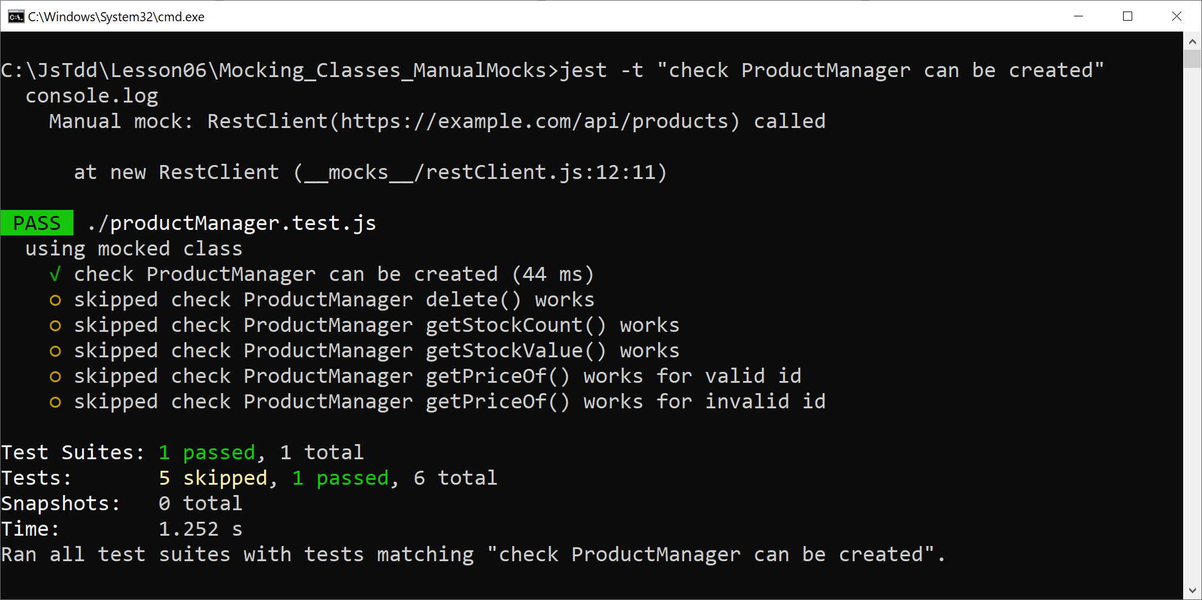
Running the Test
Run the test as follows:
jest -t "check ProductManager can be created"

Slide 76
Using Manual Mocks in a Test - Example 2
This example causes a method in our mock class to be called:
Notes:
We call removeProducts() on a ProductManager object
This causes delete() to be called 3 times on our RestClient mock
test('check ProductManager delete() works', () => {
const productManager = new pm.ProductManager();
productManager.removeProducts(101, 102, 103);
});
test('check ProductManager delete() works', () => {
const productManager = new pm.ProductManager();
productManager.removeProducts(101, 102, 103);
});
productManager.test.js

Slide 77
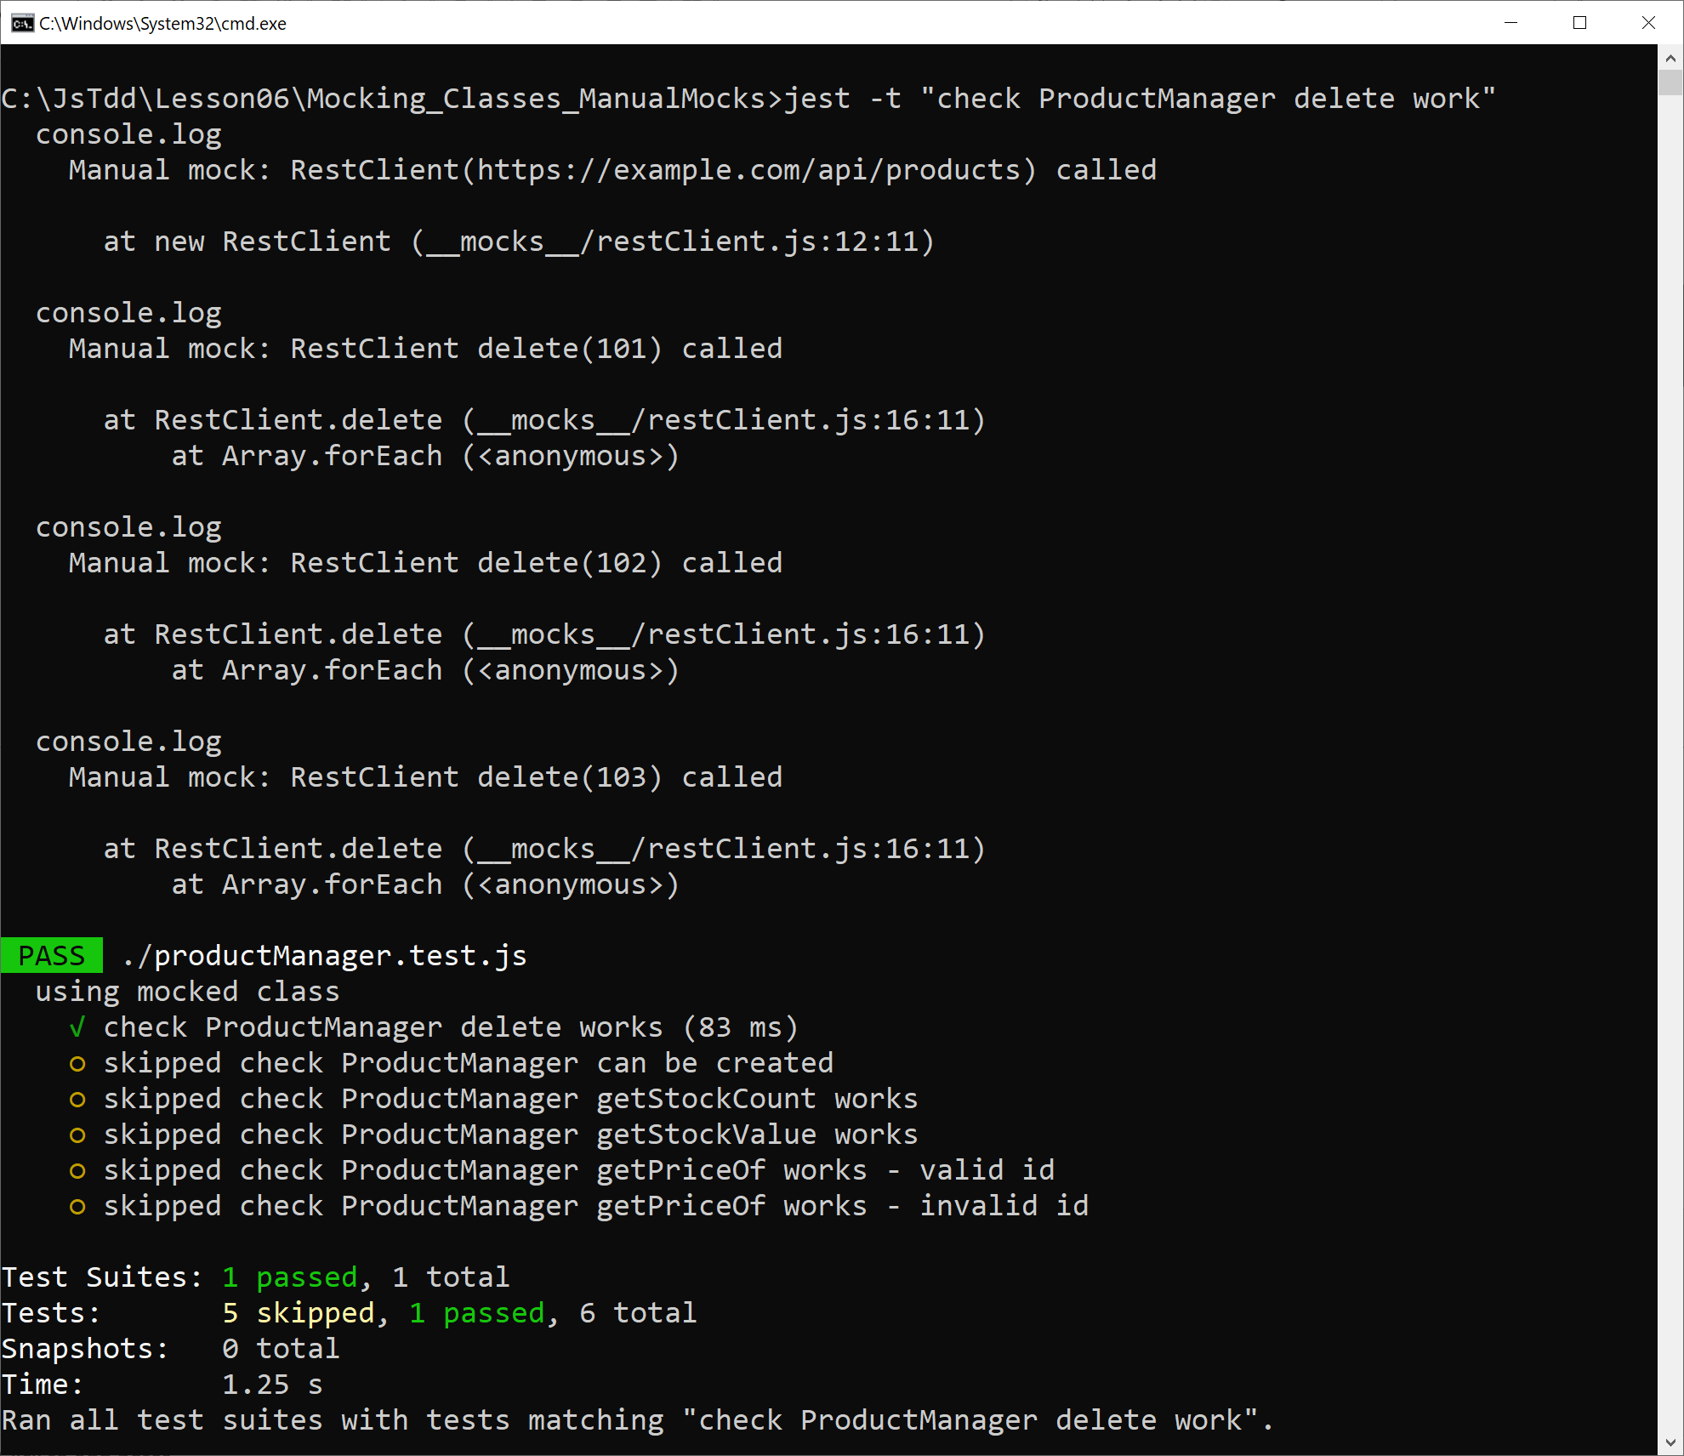
Running the Test
Run the test as follows:
jest -t "check ProductManager delete work"

Slide 78
Using Manual Mocks in a Test - Example 3
This example calls a mock method that returns a fixed result:
Notes:
We call getStockCount() on a ProductManager object
This calls getAll() on the RestClient mock, which returns a hard-coded array
We verify the calculated stock count is correct for this array
test('check ProductManager getStockCount works', () => {
const productManager = new pm.ProductManager();
const result = productManager.getStockCount();
expect(result).resolves.toBe(18);
});
test('check ProductManager getStockCount works', () => {
const productManager = new pm.ProductManager();
const result = productManager.getStockCount();
expect(result).resolves.toBe(18);
});
test('check ProductManager getStockCount works', () => {
const productManager = new pm.ProductManager();
const result = productManager.getStockCount();
expect(result).resolves.toBe(18);
});
productManager.test.js

Slide 79
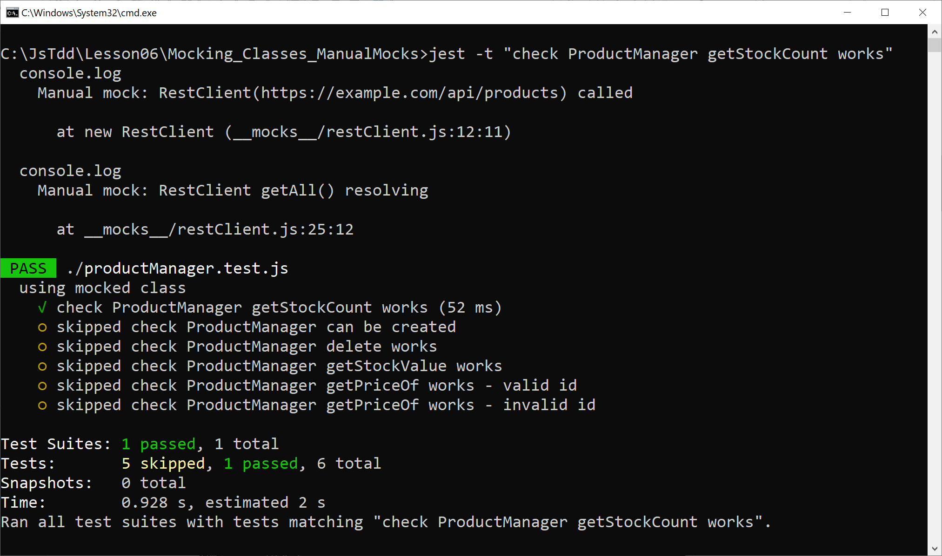
Running the Test
Run the test as follows:
jest -t "check ProductManager getStockCount works"

Slide 80
Additional Tests
There are 3 additional tests in our test suite:
Let's take a look at these tests…
test('check ProductManager getStockValue works', () => {
…
});
test('check ProductManager getPriceOf works - valid id', () => {
…
});
test('check ProductManager getPriceOf works - invalid id', () => {
…
});
productManager.test.js

