Slide 1
Lesson 7: Effective Test-Driven Development (TDD)
7.1 Overview of TDD
7.2 TDD walkthrough
7.3 Refactoring
7.4 Refactoring with inheritance
7.5 Additional techniques

Slide 2
Lesson 7: Effective Test-Driven Development (TDD)
7.1 Overview of TDD

Slide 3
Code-First Development
Most developers are familiar with a code-first approach
Write code first
Then write all the tests afterwards
Tests are often an afterthought!
"If there's time" / leave to testers

Slide 4
Problems with Code-First Development
High level of defects
Lengthy testing phase after a release is frozen
Cost of fixing a bug discovered at that stage is far higher than if the bug was caught when introduced into code
Poor maintainability
Legacy spaghetti code that "works"
Can't be touched – fear of breaking

Slide 5
Test Driven Development (TDD)
TDD is a simple concept
You write the tests first, before you write the code
The tests act as a specification for the new functionality you're about to implement

Slide 6
TDD Process
First write a test
Design the API for the JavaScript code to be implemented
Using an API (in tests) is the best way to evaluate its design
Write just enough code for the test to pass
Minimizes code bloat
Focus on satisfying the test requirement
Refactor the code
Rearrange the code, don't change intent

Slide 7
TDD Benefits
Build up a library of tests that protect against regression bugs
Tests act as developer documentation
Extensive code coverage
No code without a test, no superfluous code
Almost completely eliminates debugging
More than offsets time spent developing tests
Confidence in the quality of the code
Confidence to refactor

Slide 8
TDD Strategies
Fake it
Return a constant
Gradually replace constants with variables
Obvious implementation
If a quick, clean solution is obvious, use it
Triangulation
Generalize code that appears in 2 or more tests
Work in small increments
Code a little, test a little

Slide 9
Lesson 7: Effective Test-Driven Development (TDD)
7.2 TDD Walkthrough

Slide 10
Overview
The best way to understand TDD is to do a walkthrough
See the folder Tdd_Walkthrough
Contains a simple BankAccount class
The BankAccount class is empty initially
See ba0.js
We'll add more functionality step-by-step
As needed to satisfy the tests we identify

Slide 11
Writing a Test Plan
You should begin by writing a test plan
Identify the tests you envisage will be needed
How to do it:
Identify simple tests first
Identify edge conditions
Identify possible error conditions

Slide 12
Implementing BankAccount via TDD
Let's identify tests for the BankAccount class…

Slide 13
Implementing BankAccount via TDD
Step 1:
See ba1.test.js and ba1.js, and run the test as follows:
test('account created, zero balance initially', … );
jest -t "example 1"

Slide 14
Implementing BankAccount via TDD
Step 2:
See ba2.test.js and ba2.js, and run the tests as follows:
test('account created, zero balance initially', … );
test('single deposit, balance is correct', … );
jest -t "example 2"

Slide 15
Implementing BankAccount via TDD
Step 3:
See ba3.test.js and ba3.js, and run the tests as follows:
test('account created, zero balance initially', … );
test('single deposit, balance is correct', … );
test('multiple deposits, balance is cumulative', … );
jest -t "example 3"

Slide 16
Implementing BankAccount via TDD
Step 4:
See ba4.test.js and ba4.js, and run the tests as follows:
test('account created, zero balance initially', … );
test('single deposit, balance is correct', … );
test('multiple deposits, balance is cumulative', … );
test('withdrawal within limit, balance is reduced', … );
jest -t "example 4"

Slide 17
Implementing BankAccount via TDD
Step 5:
See ba5.test.js and ba5.js, and run the tests as follows:
test('account created, zero balance initially', … );
test('single deposit, balance is correct', … );
test('multiple deposits, balance is cumulative', … );
test('withdrawal within limit, balance is reduced', … );
test('withdrawal just up to limit, balance is zero', … );
jest -t "example 5"

Slide 18
Implementing BankAccount via TDD
Step 6:
See ba6.test.js and ba6.js, and run the tests as follows:
test('account created, zero balance initially', … );
test('single deposit, balance is correct', … );
test('multiple deposits, balance is cumulative', … );
test('withdrawal within limits, balance is reduced', … );
test('withdrawal just up to limit, balance is zero', … );
test('withdrawal exceeds limit, error occurs', … );
jest -t "example 6"

Slide 19
Lesson 7: Effective Test-Driven Development (TDD)
7.3 Refactoring

Slide 20
Overview
Refactoring is an often overlooked aspect of TDD…
After each iteration through the test-code-pass cycle, you should refactor your code
Step back and see if you can reorganize your code
For example:
Eliminate duplication
Restructure inheritance
Etc.

Slide 21
Examples of Refactoring
We'll explore various refactoring techniques in this section
See the Refactoring folder
There are 2 subfolders:
Original - original code
Refactored - refactored code
We'll use Visual Studio Code to help us do the refactoring

Slide 22
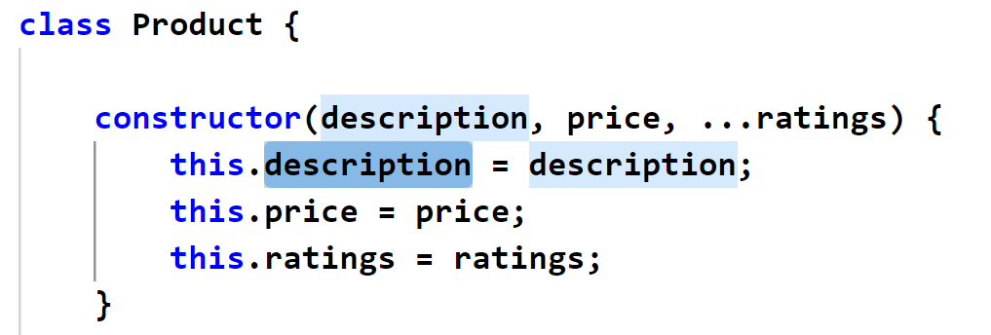
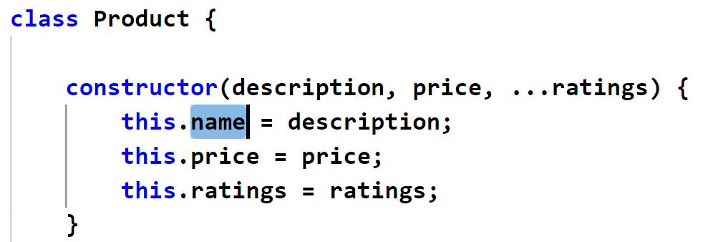
Renaming an Artifact
You can rename most things (variables, functions, classes, etc.)
E.g., select a variable name
Right-click and select Rename Symbol
Type the new name, then ENTER

Slide 23
Extracting a Constant
Magic numbers are nearly always a bad idea
Difficult to understand, hard to maintain, etc.
Extract a magic number into a const variable
Right-click the magic number
Click Refactor | Extract to constant …
Type a name for the constant, then ENTER

Slide 24
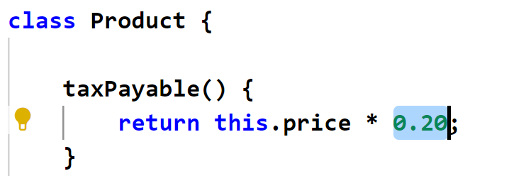
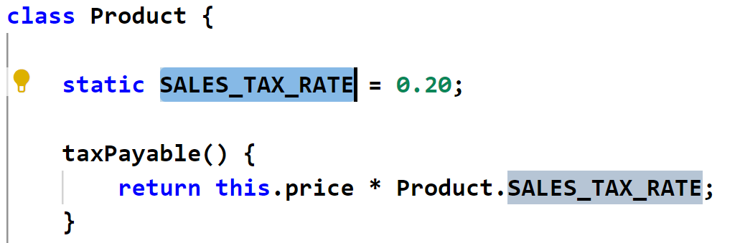
Extracting a Constant
If you have a class, an alternative way to extract a constant is to define a static class member

Slide 25
Extracting Code to a Method
If a method is long, extract some code into a new method
Select and right-click the code you want to extract
Click Refactor
Click Extract to method …
Type a name for the method, then ENTER
Let's see an example…

Slide 26
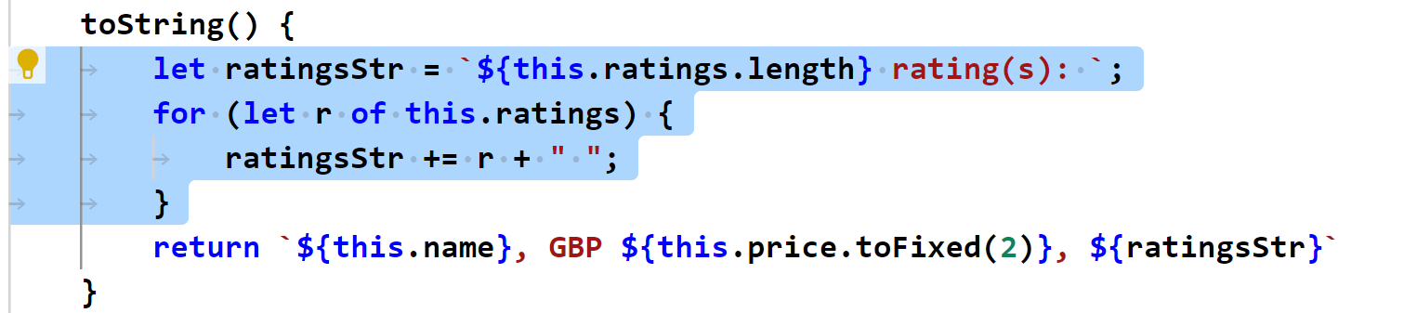
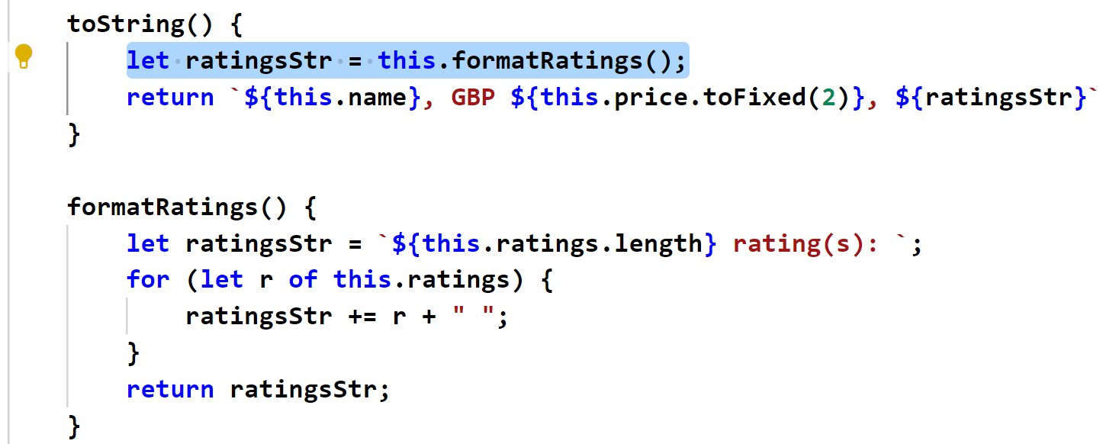
Extracting Code to a Method

Slide 27
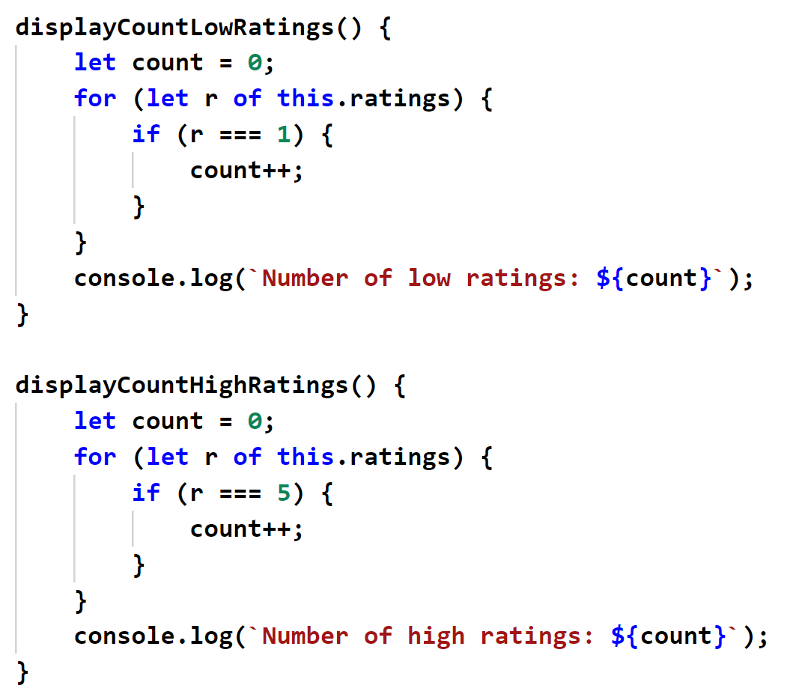
Avoiding Duplication
Code duplication is bad - it's difficult to maintain!
E.g., consider the following code in Product:
very similar

Slide 28
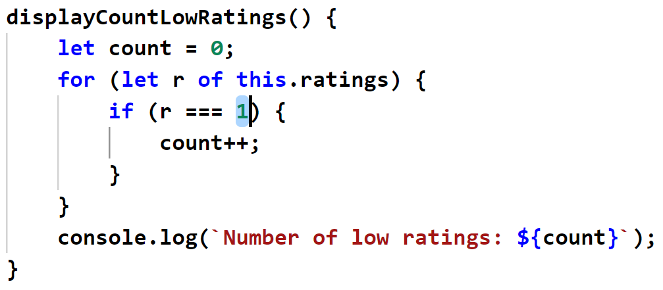
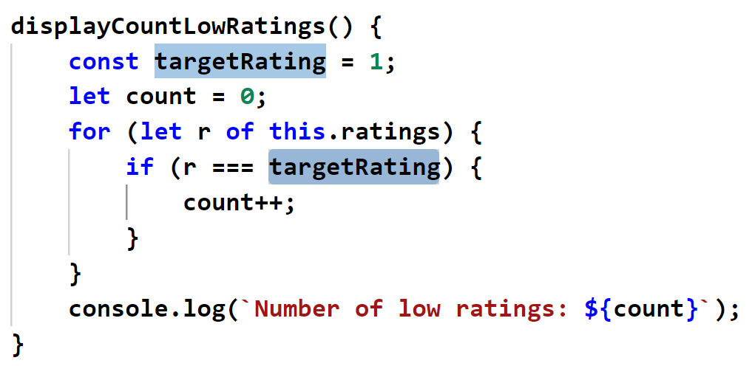
Avoiding Duplication
To refactor, first extract differing values into local variables:

Slide 29
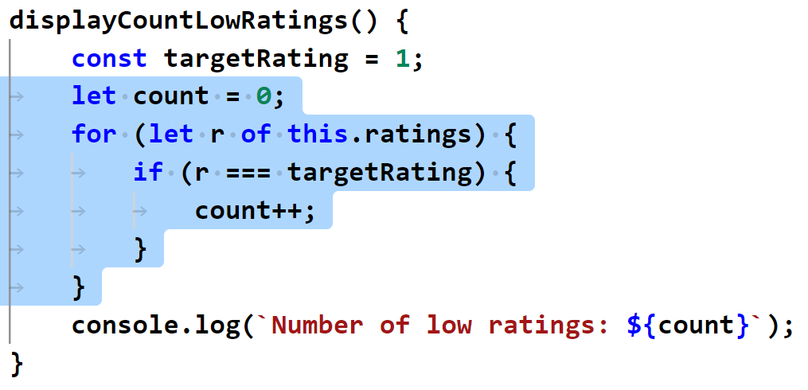
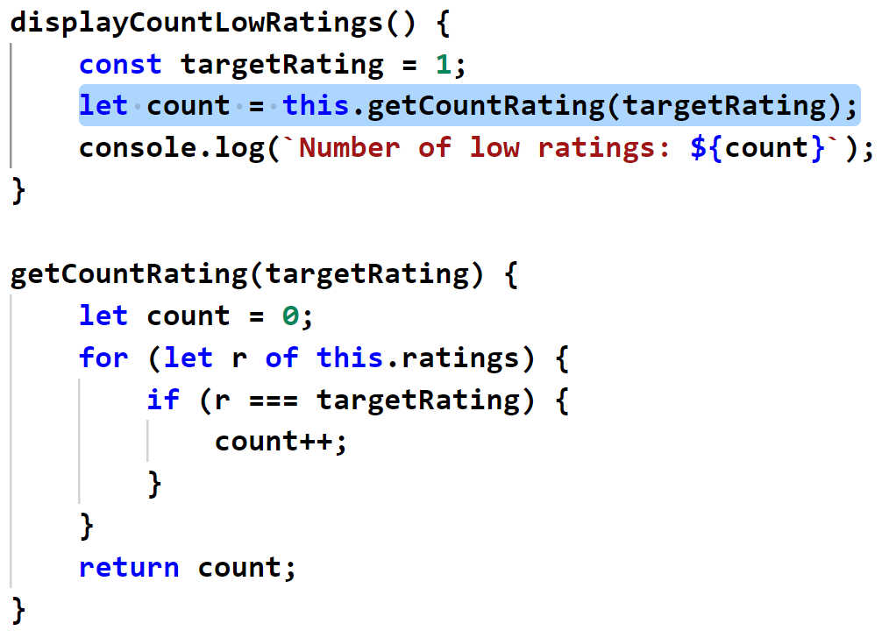
Avoiding Duplication
Then extract common code into a method:

Slide 30
Lesson 7: Effective Test-Driven Development (TDD)
7.4 Refactoring with Inheritance

Slide 31
Overview
When you take a TDD approach to development, classes tend to evolve independently
You define and refine classes on a test-by-test basis
After a while, you might notice similarities between some of your classes
Similar properties
Similar methods
Similar getters/setters

Slide 32
Example
Take a look at the following folder:
Refactoring_Inheritance/Original
There are 2 classes, which are very similar…
Basket
Catalog
Also see the test file, and run the tests:
example.test.js

Slide 33
Extracting a Superclass
You can extract duplicate features into a superclass
Manually define a new class, e.g., ProductCollection
Modify Basket and Catalog, so they inherit from it
Move common members into the superclass
Take a look at the code and tests in the following folder:
Refactoring_Inheritance/Refactored

Slide 34
Other Common Refactorings
Placement of methods in an inheritance hierarchy…
Push a method up to a superclass
Pull a method down from a superclass
Extract a method into an interface (in TypeScript)
Replace inheritance with delegation…
Rather than inheriting for convenience, delegate to an associated object
Apply the "is a" vs. "has a" rule of thumb

Slide 35
Lesson 7: Effective Test-Driven Development (TDD)
7.5 Additional Techniques

Slide 36
Resulting State Tests
All the tests we've seen so far are "resulting state" tests
Test the result from the method-under-test
Typically, you only have a single assert per test
If you have multiple asserts, and one of them fails…
It throws an exception and skips the other asserts…
So, you're not actually exercising all asserts
Sometimes it's handy to define a custom assertion method
If it's complicated to determine if a method succeeded…
Put complex assertions into a custom assertion method

Slide 37
Guard Tests
A guard test is like a precondition
An assert at the start of the test method…
Ensures an object is in a known initial state
Your test then invokes the method-under-test, as normal
Your test concludes with a "resulting state" test, which is effectively a postcondition
Tests the final state of the object
Ensures the object has transitioned from a known initial state to a known final state

Slide 38
Delta Tests
A delta test measures the difference in state
Useful if you're interested in the relative change of an object…
Rather than the absolute final state of the object
Example: performance testing in an integration test
Record the start time
Call the method-under-test
Record the end time
Calculate the time delta, to verify adequate performance

