Slide 1
Lesson 8: Testing the User Interface
8.1 DOM essentials
8.2 Introduction to JSDOM
8.3 Accessing content using JSDOM
8.4 Loading an HTML file in a test
8.5 Testing JS code that accesses HTML content
8.6 Testing event handlers
8.7 Introduction to Testing Library
8.8 Types of query available in Testing Library
8.9 A closer look at the query API in Testing Library
8.10 Using companion libraries with Testing Library

Slide 2
Lesson 8: Testing the User Interface
8.1 DOM Essentials

Slide 3
Overview
In this lesson, we're going to see how to test JavaScript code that runs in the context of a web page, in a browser
We'll investigate the following techniques:
Using the Document Object Model (DOM)
Using JSDOM to replicate the DOM in your tests
Using Jest-Dom to simplify JSDOM testing

Slide 4
Understanding DOM
DOM is the Document Object Model
An object graph built by a browser, when you load a web page
The DOM API provides programmatic access to content in the page
You'll use the DOM API in your tests to:
Access elements
Handle events
Set element values
Verify element values
Etc.

Slide 5
Example HTML Page
Consider this HTML page in the DomEssentials folder:
<html>
<head>
<title>Simple page</title>
<script type="text/javascript" src="./script.js"></script>
</head>
<body onload="init()">
<h1>Greetings &#128526;</h1>
<p id="helloPara">This paragraph says <b>hello</b></p>
<p id="byePara">This paragraph says <i>bye</i></p>
</body>
</html>
index.html
document node
<html>
<head>
<body>
<title>
<script>
<h1>
<p>
<p>
<b>
<i>

Slide 6
Using the DOM API to Access HTML Content
This JavaScript code runs after the page has loaded:
Notes:
Get the "document" node in the web page
Display info about the node
function init() {
display('document', document);
…
}
function display(msg, node) {
console.log('\n--------------------------');
console.log(`Node info for: ${msg}`);
console.log(`nodeType: ${node.nodeType}`);
console.log(`nodeName: ${node.nodeName}`);
console.log(`innerHTML: ${node.innerHTML}`);
console.log(`innerText: ${node.innerText}`);
}
function init() {
display('document', document);
…
}
function display(msg, node) {
console.log('\n--------------------------');
console.log(`Node info for: ${msg}`);
console.log(`nodeType: ${node.nodeType}`);
console.log(`nodeName: ${node.nodeName}`);
console.log(`innerHTML: ${node.innerHTML}`);
console.log(`innerText: ${node.innerText}`);
}
function init() {
display('document', document);
…
}
function display(msg, node) {
console.log('\n--------------------------');
console.log(`Node info for: ${msg}`);
console.log(`nodeType: ${node.nodeType}`);
console.log(`nodeName: ${node.nodeName}`);
console.log(`innerHTML: ${node.innerHTML}`);
console.log(`innerText: ${node.innerText}`);
}
script.js

Slide 7
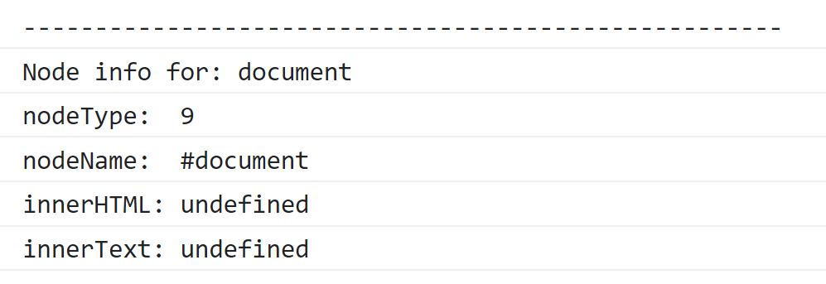
Using the DOM API to Access HTML Content
Here's the info for the "document" node:
For a full list of the DOM node types, see:
https://developer.mozilla.org/docs/Web/API/Node/nodeType

Slide 8
Additional DOM Techniques
To access the "document element" (i.e., root element):
const docElem = document.documentElement;
display('document.documentElement', docElem);
for (i = 0; i < docElem.childNodes.length; i++)
display(`documentElement child[${i}]`, docElem.childNodes[i]);
const helloPara = document.getElementById('helloPara');
display('helloPara', helloPara);
const byePara = document.querySelector('#byePara');
display('byePara', byePara);
index.html
document node
<html>
<head>
<body>
<title>
<script>
<h1>
<p>
<p>
<b>
<i>

Slide 9
Additional DOM Techniques
To access the child nodes for a node:
const docElem = document.documentElement;
display('document.documentElement', docElem);
for (i = 0; i < docElem.childNodes.length; i++)
display(`documentElement child[${i}]`, docElem.childNodes[i]);
const helloPara = document.getElementById('helloPara');
display('helloPara', helloPara);
const byePara = document.querySelector('#byePara');
display('byePara', byePara);
index.html
document node
<html>
<head>
<body>
<title>
<script>
<h1>
<p>
<p>
<b>
<i>

Slide 10
Additional DOM Techniques
To get an element by its id attribute:
const docElem = document.documentElement;
display('document.documentElement', docElem);
for (i = 0; i < docElem.childNodes.length; i++)
display(`documentElement child[${i}]`, docElem.childNodes[i]);
const helloPara = document.getElementById('helloPara');
display('helloPara', helloPara);
const byePara = document.querySelector('#byePara');
display('byePara', byePara);
index.html
document node
<html>
<head>
<body>
<title>
<script>
<h1>
<p>
<p>
<b>
<i>

Slide 11
Additional DOM Techniques
To get an element by a CSS selector:
const docElem = document.documentElement;
display('document.documentElement', docElem);
for (i = 0; i < docElem.childNodes.length; i++)
display(`documentElement child[${i}]`, docElem.childNodes[i]);
const helloPara = document.getElementById('helloPara');
display('helloPara', helloPara);
const byePara = document.querySelector('#byePara');
display('byePara', byePara);
index.html
document node
<html>
<head>
<body>
<title>
<script>
<h1>
<p>
<p>
<b>
<i>

Slide 12
Lesson 8: Testing the User Interface
8.2 Introduction to JSDOM

Slide 13
Overview
JSDOM is a pure-JavaScript implementation of HTML and DOM
An emulation library that mimics a subset of browser capabilities
JSDOM helps you to test JavaScript code that would ordinarily run in a browser
JSDOM provides a document object and supports DOM
You can load HTML content into the document object
Your JavaScript code can use the DOM API to access content
Your JavaScript tests can use the DOM API to verify content

Slide 14
Using JSDOM with Jest
Jest includes the JSDOM library already
So, you can easily use JSDOM in your Jest tests
The default Jest test environment is node (for Node.js)
For testing server-side JavaScript code
You can set the Jest test environment to jsdom
For testing client-side JavaScript code
See the following folder for examples:
JsDom_Intro

Slide 15
Trying to use JSDOM in Jest - Attempt 1
Consider the following test, which tries to use JSDOM
It tries to access the DOM document object
This example won't work!
The default test environment is Node.js, not JSDOM
Therefore, Jest doesn't create a document object for our test
describe('Example 1', () => {
test('try to access document node', () => {
expect(document).toBeTruthy();
});
});
example1.test.js

Slide 16
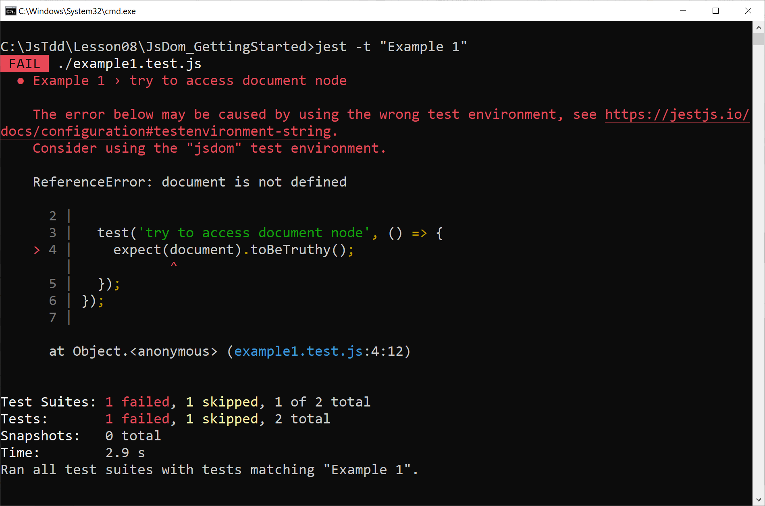
Trying to use JSDOM in Jest - Attempt 1
Run the test as follows:
jest -t "Example 1"

Slide 17
Trying to use JSDOM in Jest - Attempt 2
Now consider the following test, which uses JSDOM correctly
Via the @jest-environment doc-block at the top of the file
This example will work!
We've set the test environment to jsdom
So, Jest creates a document object for us!
/**
* @jest-environment jsdom
*/
describe('Example 2', () => {
test('try to access document node', () => {
expect(document).toBeTruthy();
});
});
example1.test.js

Slide 18
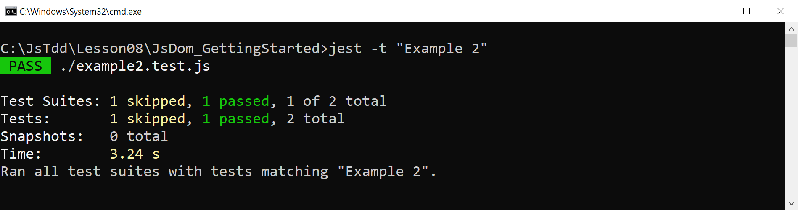
Trying to use JSDOM in Jest - Attempt 2
Run the test as follows:
jest -t "Example 2"

Slide 19
Configuring the Jest Environment for all Tests
You can configure the Jest environment for all tests as follows
(This code is commented out initially)
module.exports = {
testEnvironment: "jsdom"
};
jest.config.js

Slide 20
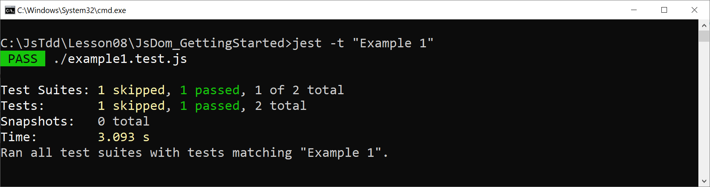
Configuring the Jest Environment for all Tests
Let's try running the first test again:
jest -t "Example 1"

Slide 21
Lesson 8: Testing the User Interface
8.3 Accessing Content using JSDOM

Slide 22
Overview
When you configure the Jest test environment to use JSDOM:
Jest creates a document object
You can use the DOM API to access the document object
We'll see examples in this folder:
JSDom_AccessingContent
Note:
See jest.config.js
We've specified the JSDOM test environment

Slide 23
Accessing the Default Content in the Document
Here's how to access the default content in the document, as generated by JSDOM:
test('access document node', () => {
expect(document).toBeTruthy();
});
test('access document element', () => {
const docElem = document.documentElement;
expect(docElem).not.toBeUndefined();
expect(docElem.nodeName).toMatch(/html/i);
});
test('access head and body elements', () => {
const docElem = document.documentElement;
expect(docElem.querySelector('head')).not.toBeUndefined();
expect(docElem.querySelector('body')).not.toBeUndefined();
});
document node
<html>
<head>
<body>
example1.test.js

Slide 24
Accessing the Default Content in the Document
Here's how to access the default content in the document, as generated by JSDOM:
test('access document node', () => {
expect(document).toBeTruthy();
});
test('access document element', () => {
const docElem = document.documentElement;
expect(docElem).not.toBeUndefined();
expect(docElem.nodeName).toMatch(/html/i);
});
test('access head and body elements', () => {
const docElem = document.documentElement;
expect(docElem.querySelector('head')).not.toBeUndefined();
expect(docElem.querySelector('body')).not.toBeUndefined();
});
document node
<html>
<head>
<body>
example1.test.js

Slide 25
Accessing the Default Content in the Document
Here's how to access the default content in the document, as generated by JSDOM:
test('access document node', () => {
expect(document).toBeTruthy();
});
test('access document element', () => {
const docElem = document.documentElement;
expect(docElem).not.toBeUndefined();
expect(docElem.nodeName).toMatch(/html/i);
});
test('access head and body elements', () => {
const docElem = document.documentElement;
expect(docElem.querySelector('head')).not.toBeUndefined();
expect(docElem.querySelector('body')).not.toBeUndefined();
});
document node
<html>
<head>
<body>
example1.test.js

Slide 26
Accessing the Default Content in the Document
Here's how to access the default content in the document, as generated by JSDOM:
test('access document node', () => {
expect(document).toBeTruthy();
});
test('access document element', () => {
const docElem = document.documentElement;
expect(docElem).not.toBeUndefined();
expect(docElem.nodeName).toMatch(/html/i);
});
test('access head and body elements', () => {
const docElem = document.documentElement;
expect(docElem.querySelector('head')).not.toBeUndefined();
expect(docElem.querySelector('body')).not.toBeUndefined();
});
document node
<html>
<head>
<body>
example1.test.js

Slide 27
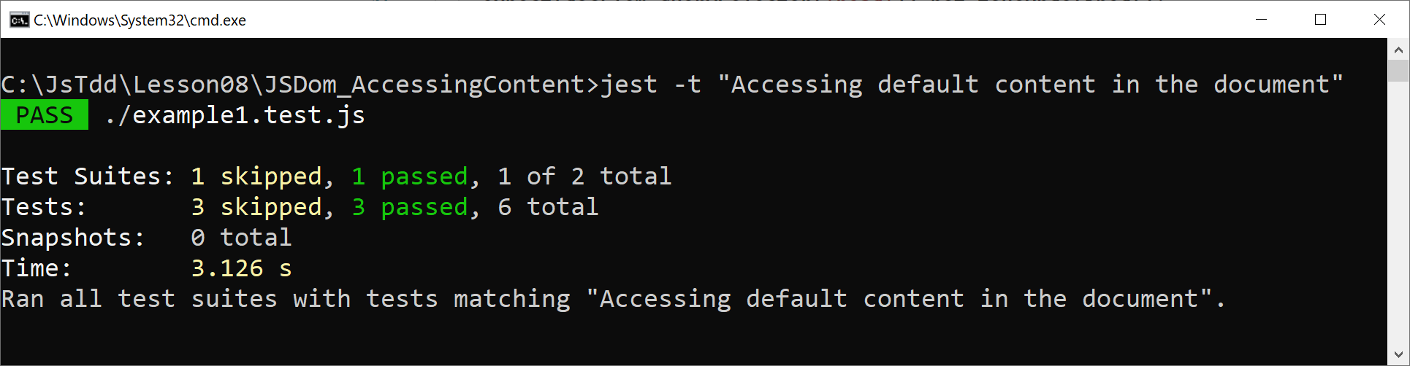
Running the Tests
Run the tests as follows:
jest -t "Accessing default content in the document"

Slide 28
Creating New DOM Content in a Test
You can create new DOM content in your test, which you can then refer to in your JavaScript code
E.g., you can create a standalone element:
test('create an element', () => {
const element = document.createElement('div');
element.innerHTML = 'Hello';
expect(element).not.toBeNull();
expect(element.innerHTML).toBe('Hello');
});
example2.test.js

Slide 29
Creating New DOM Content in a Test
This example uses the DOM API to create content and add it to the document body:
test('add content to document via the DOM API', () => {
const div = document.createElement('div');
div.innerHTML = 'Hi';
div.id = 'mydiv';
document.body.appendChild(div);
elementFound = document.getElementById('mydiv');
expect(elementFound).not.toBeNull();
expect(elementFound.innerHTML).toBe('Hi');
});
example2.test.js

Slide 30
Creating New DOM Content in a Test
This example creates content as a string of HTML, and assigns it directly to the innerHTML property of the document body:
test('add content to document as a string of HTML', () => {
document.body.innerHTML = `
<ul>
<li>Skis</li>
<li>Boots</li>
<li>Goggles</li>
</ul>`;
const lis = document.querySelectorAll('li');
expect(lis.length).toBe(3);
expect(lis[0].innerHTML).toBe('Skis');
expect(lis[1].innerHTML).toBe('Boots');
expect(lis[2].innerHTML).toBe('Goggles');
});
example2.test.js

Slide 31
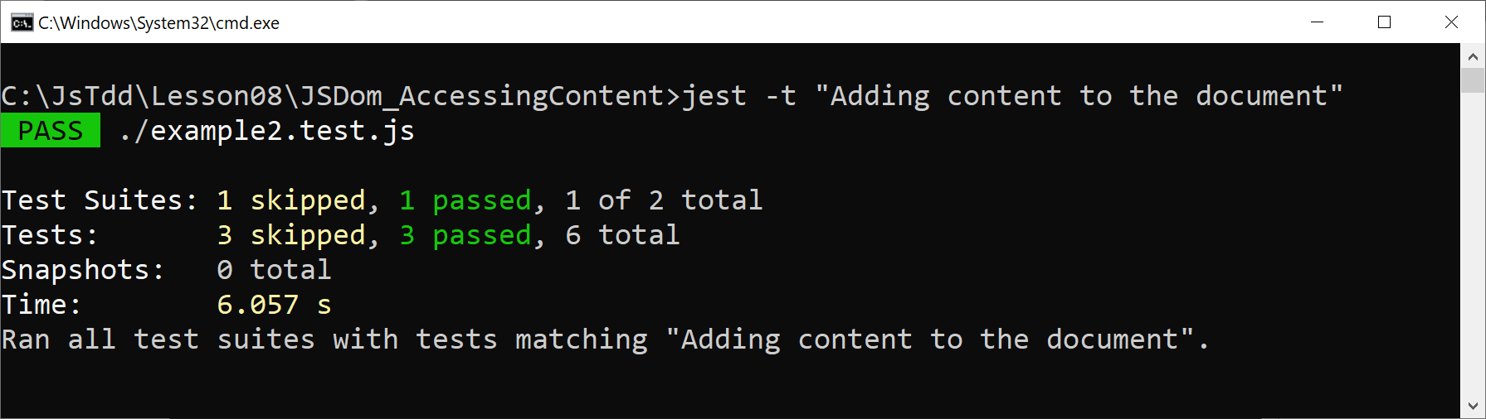
Running the Tests
Run the tests as follows:
jest -t "Adding content to the document"

Slide 32
Lesson 8: Testing the User Interface
8.4 Loading an HTML File in a Test

Slide 33
Overview
We've seen how a test can create HTML content via DOM:
We've also seen how a test can create a literal HTML string:
Now we'll see how to load an existing HTML file
See the folder JsDom_LoadingHtml
const div = document.createElement('div');
div.innerHTML = 'Hi';
div.id = 'mydiv';
document.body.appendChild(div);
document.body.innerHTML = `
<ul>
<li>Skis</li>
<li>Boots</li>
<li>Goggles</li>
</ul>`;

Slide 34
Example HTML File
Consider this example HTML file:
<html>
<head>
<title>Simple page</title>
</head>
<body>
<h1>Greetings &#128526;</h1>
<p id="p1">This para says <b>hi</b></p>
<p id="p2">This para says <i>bye</i></p>
</body>
</html>
index.html

Slide 35
Loading an HTML File in a Test
Here's how to load an HTML file in a test, and then assign the content to the test's DOM document:
const fs = require("fs");
const html = fs.readFileSync("./index.html");
…
beforeEach(() => {
document.documentElement.innerHTML = html.toString();
});
example.test.js

Slide 36
Accessing Document Content
Once you've loaded the HTML document, you can access the content as normal:
document node
<html>
test('document node exists', () => {
expect(document).not.toBeUndefined();
});
test('document element exists', () => {
const docElem = document.documentElement;
expect(docElem).not.toBeUndefined();
expect(docElem.nodeName).toMatch(/html/i);
});
test('access element by id', () => {
const p1 = document.getElementById('p1');
expect(p1.innerHTML).toBe('This para says <b>hi</b>');
});
test('access element by CSS selector', () => {
const p2 = document.querySelector('#p2');
expect(p2.innerHTML).toBe('This para says <i>bye</i>');
});
<head>
<body>
<title>
<h1>
<p>
<p>
<b>
<i>
example.test.js

Slide 37
Accessing Document Content
Once you've loaded the HTML document, you can access the content as normal:
document node
<html>
test('document node exists', () => {
expect(document).not.toBeUndefined();
});
test('document element exists', () => {
const docElem = document.documentElement;
expect(docElem).not.toBeUndefined();
expect(docElem.nodeName).toMatch(/html/i);
});
test('access element by id', () => {
const p1 = document.getElementById('p1');
expect(p1.innerHTML).toBe('This para says <b>hi</b>');
});
test('access element by CSS selector', () => {
const p2 = document.querySelector('#p2');
expect(p2.innerHTML).toBe('This para says <i>bye</i>');
});
<head>
<body>
<title>
<h1>
<p>
<p>
<b>
<i>
example.test.js

Slide 38
Accessing Document Content
Once you've loaded the HTML document, you can access the content as normal:
document node
<html>
test('document node exists', () => {
expect(document).not.toBeUndefined();
});
test('document element exists', () => {
const docElem = document.documentElement;
expect(docElem).not.toBeUndefined();
expect(docElem.nodeName).toMatch(/html/i);
});
test('access element by id', () => {
const p1 = document.getElementById('p1');
expect(p1.innerHTML).toBe('This para says <b>hi</b>');
});
test('access element by CSS selector', () => {
const p2 = document.querySelector('#p2');
expect(p2.innerHTML).toBe('This para says <i>bye</i>');
});
<head>
<body>
<title>
<h1>
<p>
<p>
<b>
<i>
example.test.js

Slide 39
Accessing Document Content
Once you've loaded the HTML document, you can access the content as normal:
document node
<html>
test('document node exists', () => {
expect(document).not.toBeUndefined();
});
test('document element exists', () => {
const docElem = document.documentElement;
expect(docElem).not.toBeUndefined();
expect(docElem.nodeName).toMatch(/html/i);
});
test('access element by id', () => {
const p1 = document.getElementById('p1');
expect(p1.innerHTML).toBe('This para says <b>hi</b>');
});
test('access element by CSS selector', () => {
const p2 = document.querySelector('#p2');
expect(p2.innerHTML).toBe('This para says <i>bye</i>');
});
<head>
<body>
<title>
<h1>
<p>
<p>
<b>
<i>
example.test.js

Slide 40
Accessing Document Content
Once you've loaded the HTML document, you can access the content as normal:
document node
<html>
test('document node exists', () => {
expect(document).not.toBeUndefined();
});
test('document element exists', () => {
const docElem = document.documentElement;
expect(docElem).not.toBeUndefined();
expect(docElem.nodeName).toMatch(/html/i);
});
test('access element by id', () => {
const p1 = document.getElementById('p1');
expect(p1.innerHTML).toBe('This para says <b>hi</b>');
});
test('access element by CSS selector', () => {
const p2 = document.querySelector('#p2');
expect(p2.innerHTML).toBe('This para says <i>bye</i>');
});
<head>
<body>
<title>
<h1>
<p>
<p>
<b>
<i>
example.test.js

Slide 41
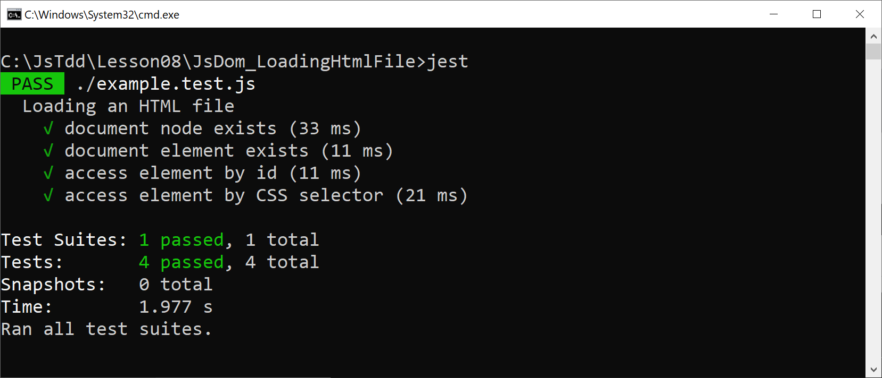
Running the Tests
Run the tests as follows:
jest

Slide 42
Lesson 8: Testing the User Interface
8.5 Testing JavaScript Code that Accesses HTML Content

Slide 43
Overview
In this section we'll test JavaScript code that accesses this HTML content - see the folder JsDom_LoadingHtmlAndJs:
<html>
<head>
<title>Products</title>
</head>
<body>
<table id='productsTable'>
<tr>
<td class='description'>Skis</td>
<td class='price'>800</td>
</tr>
<tr>
<td class='description'>Boots</td>
<td class='price'>300</td>
</tr>
<tr>
<td class='description'>Goggles</td>
<td class='price'>100</td>
</tr>
</table>
</body>
</html>
index.html

Slide 44
Example JavaScript Code
Here's the JavaScript code we're going to test:
Note this is an ECMAScript module rather than a CommonJs module
It uses the export keyword rather than a module.exports statement
export function calculateTotalPrice() {
const table = document.getElementById('productsTable');
const priceElems = table.querySelectorAll('td.price');
let total = 0.0;
for (let priceElem of priceElems) {
const price = Number(priceElem.innerHTML);
total += price;
}
return total;
}
export function calculateTotalPrice() {
const table = document.getElementById('productsTable');
const priceElems = table.querySelectorAll('td.price');
let total = 0.0;
for (let priceElem of priceElems) {
const price = Number(priceElem.innerHTML);
total += price;
}
return total;
}
myscript.js

Slide 45
Supporting ECMAScript Modules with Jest
To support ECMAScript modules with Jest, you must specify a couple of development dependencies:
Install using either of these commands:
{
"scripts": {
"test": "jest"
},
"devDependencies": {
"@babel/preset-env": "^7.15.8",
"babel-jest": "^27.2.5"
}
}
package.json
yarn install
npm install

Slide 46
Supporting ECMAScript Modules with Jest
You must also configure Babel as follows:
This tells Babel to compile JavaScript code to ECMAScript 2015
This is a baseline version of JavaScript, which all tools and browsers understand
{
"presets": [
"@babel/preset-env"
]
}
babel.config.json

Slide 47
Loading the HTML and JavaScript Files in a Test
Here's how to load the HTML and JavaScript files in a test, and then assign the HTML content to the test's DOM document:
const fs = require("fs");
const html = fs.readFileSync("./index.html");
import {calculateTotalPrice} from './myscript'
…
beforeEach(() => {
document.documentElement.innerHTML = html.toString();
});
example.test.js

Slide 48
Testing the JavaScript Code
Here's how to test the JavaScript code:
test('calculate total price', () => {
const totalPrice = calculateTotalPrice();
expect(totalPrice).toBe(1200);
}
example.test.js

Slide 49
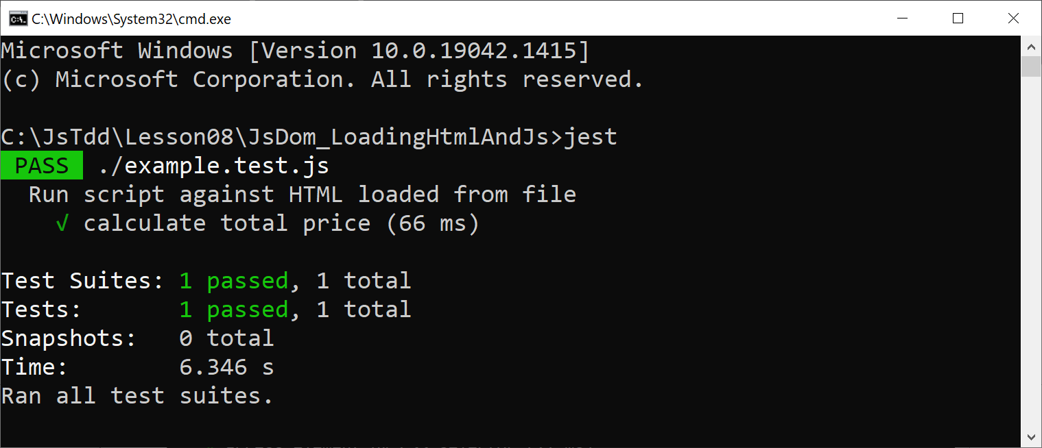
Running the Test
Run the test as follows:
jest

Slide 50
Lesson 8: Testing the User Interface
8.6 Testing Event Handlers

Slide 51
Overview
In this section we'll test JavaScript code that handles events
Consider this HTML file in the folder JsDom_EventHandlers:
…
<h1>Products</h1>
<p>
<label for='description'>Description:</label>
<input id='description' type='text'>
</p>
<p>
<label for='price'>Price:</label>
<input id='price' type='number'>
</p>
<p>
<button id='add'>Add Product</button>
</p>
<table id='products'></table>
index.html

Slide 52
Example JavaScript Code
Here's the JavaScript code we're going to test
It adds a new row to the products table, based on the data entered by the user
export function addProduct() {
const d = document.getElementById('description').value;
const tdDescription = document.createElement('td');
tdDescription.innerHTML = d;
const p = document.getElementById('price').value;
const tdPrice = document.createElement('td');
tdPrice.innerHTML = p;
const tr = document.createElement('tr');
tr.appendChild(tdDescription);
tr.appendChild(tdPrice);
const table = document.getElementById('products');
table.appendChild(tr);
}
myscript.js

Slide 53
Setting up the Test
Here's the "setup" code in our test suite:
Notes:
Read the HTML file and load into DOM
Import the JavaScript module
Hook up the button click event
const fs = require("fs");
const html = fs.readFileSync("./index.html");
import {addProduct} from './myscript'
beforeEach(() => {
document.documentElement.innerHTML = html.toString();
document.getElementById('add').onclick = addProduct;
});
const fs = require("fs");
const html = fs.readFileSync("./index.html");
import {addProduct} from './myscript'
beforeEach(() => {
document.documentElement.innerHTML = html.toString();
document.getElementById('add').onclick = addProduct;
});
const fs = require("fs");
const html = fs.readFileSync("./index.html");
import {addProduct} from './myscript'
beforeEach(() => {
document.documentElement.innerHTML = html.toString();
document.getElementById('add').onclick = addProduct;
});
const fs = require("fs");
const html = fs.readFileSync("./index.html");
import {addProduct} from './myscript'
beforeEach(() => {
document.documentElement.innerHTML = html.toString();
document.getElementById('add').onclick = addProduct;
});
example.test.js

Slide 54
Testing the JavaScript Code
Here's how to test the JavaScript code to 'add a product':
test('add product', () => {
document.getElementById('description').value = 'Skis';
document.getElementById('price').value = '800';
document.getElementById('add').click();
const table = document.getElementById('products');
const trs = table.getElementsByTagName('tr');
expect(trs.length).toBe(1);
const td0 = trs[0].getElementsByTagName('td')[0];
expect(td0.innerHTML).toBe('Skis');
const td1 = trs[0].getElementsByTagName('td')[1];
expect(td1.innerHTML).toBe('800');
});
example.test.js

Slide 55
Testing the JavaScript Code
Here's how to test the JavaScript code to 'add a product':
Mimic user input and a button click
test('add product', () => {
document.getElementById('description').value = 'Skis';
document.getElementById('price').value = '800';
document.getElementById('add').click();
const table = document.getElementById('products');
const trs = table.getElementsByTagName('tr');
expect(trs.length).toBe(1);
const td0 = trs[0].getElementsByTagName('td')[0];
expect(td0.innerHTML).toBe('Skis');
const td1 = trs[0].getElementsByTagName('td')[1];
expect(td1.innerHTML).toBe('800');
});
example.test.js

Slide 56
Testing the JavaScript Code
Here's how to test the JavaScript code to 'add a product':
Verify <tr> has been added to <table>
test('add product', () => {
document.getElementById('description').value = 'Skis';
document.getElementById('price').value = '800';
document.getElementById('add').click();
const table = document.getElementById('products');
const trs = table.getElementsByTagName('tr');
expect(trs.length).toBe(1);
const td0 = trs[0].getElementsByTagName('td')[0];
expect(td0.innerHTML).toBe('Skis');
const td1 = trs[0].getElementsByTagName('td')[1];
expect(td1.innerHTML).toBe('800');
});
example.test.js

Slide 57
Testing the JavaScript Code
Here's how to test the JavaScript code to 'add a product':
Verify <td> 0 contains description
test('add product', () => {
document.getElementById('description').value = 'Skis';
document.getElementById('price').value = '800';
document.getElementById('add').click();
const table = document.getElementById('products');
const trs = table.getElementsByTagName('tr');
expect(trs.length).toBe(1);
const td0 = trs[0].getElementsByTagName('td')[0];
expect(td0.innerHTML).toBe('Skis');
const td1 = trs[0].getElementsByTagName('td')[1];
expect(td1.innerHTML).toBe('800');
});
example.test.js

Slide 58
Testing the JavaScript Code
Here's how to test the JavaScript code to 'add a product':
Verify <td> 1 contains price
test('add product', () => {
document.getElementById('description').value = 'Skis';
document.getElementById('price').value = '800';
document.getElementById('add').click();
const table = document.getElementById('products');
const trs = table.getElementsByTagName('tr');
expect(trs.length).toBe(1);
const td0 = trs[0].getElementsByTagName('td')[0];
expect(td0.innerHTML).toBe('Skis');
const td1 = trs[0].getElementsByTagName('td')[1];
expect(td1.innerHTML).toBe('800');
});
example.test.js

Slide 59
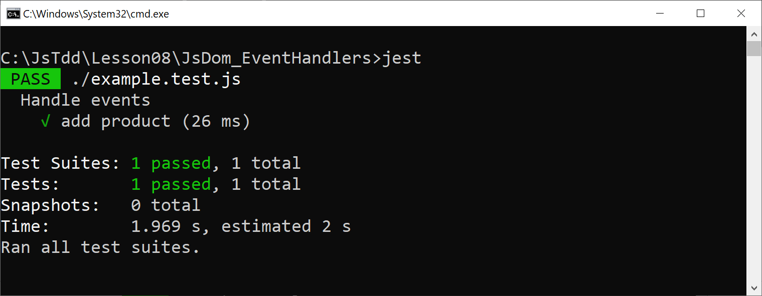
Running the Test
Run the test as follows:
jest

Slide 60
Lesson 8: Testing the User Interface
8.7 Introduction to Testing Library

Slide 61
Overview
Testing Library is a library that helps you test JavaScript code
It helps you to locate elements in the DOM
Testing Library has a user-centric approach to locating content
E.g., locate a button by its text
E.g., locate a text box by its label
E.g., locate a div by its tooltip (title)
The ethos of Testing Library:
The more your tests resemble the way your software is used, the more confidence they can give you

Slide 62
Supporting Testing Library
To support Testing Library, specify the following dependency:
Install using either of these commands:
{
"scripts": {
"test": "jest"
},
"devDependencies": {
"@babel/preset-env": "^7.15.8",
"babel-jest": "^27.2.5",
"@testing-library/dom": "^8.11.1"
}
}
package.json
yarn install
npm install

Slide 63
Locating Elements by using Testing Library
Testing Library provides an API to locate elements in the DOM
E.g., getByText() gets an element that has the specified text
There are 2 ways to call the API functions:
getByText(someContainerElement, "someText");
screen.getByText("someText");
screen is pre-bound to document.body

Slide 64
Example
Here's a simple example of how to use Testing Library:
import {getByText, screen} from '@testing-library/dom'
describe('Intro to Testing Library', () => {
beforeEach(() => {
document.body.innerHTML = "<div>Hello</div";
});
test('Get element in explicit container', () => {
const elem = getByText(document, "Hello");
expect(elem.innerHTML).toBe("Hello");
});
test('Get element in implicit container', () => {
const elem = screen.getByText("Hello");
expect(elem.innerHTML).toBe("Hello");
});
});
example.test.js

Slide 65
Example
Here's a simple example of how to use Testing Library:
Import Testing Library artifacts
import {getByText, screen} from '@testing-library/dom'
describe('Intro to Testing Library', () => {
beforeEach(() => {
document.body.innerHTML = "<div>Hello</div";
});
test('Get element in explicit container', () => {
const elem = getByText(document, "Hello");
expect(elem.innerHTML).toBe("Hello");
});
test('Get element in implicit container', () => {
const elem = screen.getByText("Hello");
expect(elem.innerHTML).toBe("Hello");
});
});
example.test.js

Slide 66
Example
Here's a simple example of how to use Testing Library:
Add some simple content to the DOM
import {getByText, screen} from '@testing-library/dom'
describe('Intro to Testing Library', () => {
beforeEach(() => {
document.body.innerHTML = "<div>Hello</div";
});
test('Get element in explicit container', () => {
const elem = getByText(document, "Hello");
expect(elem.innerHTML).toBe("Hello");
});
test('Get element in implicit container', () => {
const elem = screen.getByText("Hello");
expect(elem.innerHTML).toBe("Hello");
});
});
example.test.js

Slide 67
Example
Here's a simple example of how to use Testing Library:
Get an element in an explicit container
import {getByText, screen} from '@testing-library/dom'
describe('Intro to Testing Library', () => {
beforeEach(() => {
document.body.innerHTML = "<div>Hello</div";
});
test('Get element in explicit container', () => {
const elem = getByText(document, "Hello");
expect(elem.innerHTML).toBe("Hello");
});
test('Get element in implicit container', () => {
const elem = screen.getByText("Hello");
expect(elem.innerHTML).toBe("Hello");
});
});
example.test.js

Slide 68
Example
Here's a simple example of how to use Testing Library:
Get an element in an implicit container
import {getByText, screen} from '@testing-library/dom'
describe('Intro to Testing Library', () => {
beforeEach(() => {
document.body.innerHTML = "<div>Hello</div";
});
test('Get element in explicit container', () => {
const elem = getByText(document, "Hello");
expect(elem.innerHTML).toBe("Hello");
});
test('Get element in implicit container', () => {
const elem = screen.getByText("Hello");
expect(elem.innerHTML).toBe("Hello");
});
});
example.test.js

Slide 69
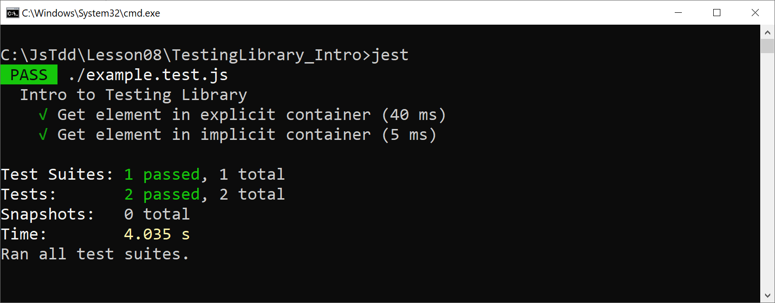
Running the Tests
Run the tests as follows:
jest

Slide 70
Lesson 8: Testing the User Interface
8.8 Types of Query Available in Testing Library

Slide 71
Types of Query Functions in Testing Library
getByXxx()
Returns a single matching node
Throws an error if no match, or if many matches
queryByXxx()
Returns matching node, or null if no match
Throws an error if many matches
findByXxx()
Returns a Promise
Resolves if 1 match, rejects otherwise

Slide 72
Finding All Matching Nodes
If you want to find all matches rather than a single match, you can use these functions:
getAllByXxx()
queryAllByXxx()
findAllByXxx()

Slide 73
Specifying a Text Match
For all the query functions available in Testing Library, there are 3 ways to specify a text match:
A string that must match exactly
A regular expression
A callback function that returns true if an element matches your test

Slide 74
Examples
Let's take a look at the techniques we've just described
See the folder TestingLibrary_TypesOfQuery
We'll see how to use these types of query:
getByXxx()
queryByXxx()
findByXxx()
We'll also see all the different ways to perform text matching

Slide 75
Using getByXxx()
These tests show how to use getByXxx() functions:
beforeEach(() => {
document.body.innerHTML = "<div>Hello</div>";
});
test('Get element via a string text match', () => {
const elem = screen.getByText("Hello");
expect(elem.innerHTML).toBe("Hello");
});
test('Get element via a regexp text match', () => {
const elem = screen.getByText(/h...o/i);
expect(elem.innerHTML).toBe("Hello");
});
test('Get element via a functional text match', () => {
const elem = screen.getByText((c, e) => {
return e.tagName.toLowerCase() == 'div' && c.length == 5
});
expect(elem.innerHTML).toBe("Hello");
});
usingGetBy.test.js

Slide 76
Using getByXxx()
These tests show how to use getByXxx() functions:
Add some simple content to the DOM
beforeEach(() => {
document.body.innerHTML = "<div>Hello</div>";
});
test('Get element via a string text match', () => {
const elem = screen.getByText("Hello");
expect(elem.innerHTML).toBe("Hello");
});
test('Get element via a regexp text match', () => {
const elem = screen.getByText(/h...o/i);
expect(elem.innerHTML).toBe("Hello");
});
test('Get element via a functional text match', () => {
const elem = screen.getByText((c, e) => {
return e.tagName.toLowerCase() == 'div' && c.length == 5
});
expect(elem.innerHTML).toBe("Hello");
});
usingGetBy.test.js

Slide 77
Using getByXxx()
These tests show how to use getByXxx() functions:
Get an element whose text is an exact string
beforeEach(() => {
document.body.innerHTML = "<div>Hello</div>";
});
test('Get element via a string text match', () => {
const elem = screen.getByText("Hello");
expect(elem.innerHTML).toBe("Hello");
});
test('Get element via a regexp text match', () => {
const elem = screen.getByText(/h...o/i);
expect(elem.innerHTML).toBe("Hello");
});
test('Get element via a functional text match', () => {
const elem = screen.getByText((c, e) => {
return e.tagName.toLowerCase() == 'div' && c.length == 5
});
expect(elem.innerHTML).toBe("Hello");
});
usingGetBy.test.js

Slide 78
Using getByXxx()
These tests show how to use getByXxx() functions:
Get an element whose text matches a regexp
beforeEach(() => {
document.body.innerHTML = "<div>Hello</div>";
});
test('Get element via a string text match', () => {
const elem = screen.getByText("Hello");
expect(elem.innerHTML).toBe("Hello");
});
test('Get element via a regexp text match', () => {
const elem = screen.getByText(/h...o/i);
expect(elem.innerHTML).toBe("Hello");
});
test('Get element via a functional text match', () => {
const elem = screen.getByText((c, e) => {
return e.tagName.toLowerCase() == 'div' && c.length == 5
});
expect(elem.innerHTML).toBe("Hello");
});
usingGetBy.test.js

Slide 79
Using getByXxx()
These tests show how to use getByXxx() functions:
Get an element that succeeds a callback test
beforeEach(() => {
document.body.innerHTML = "<div>Hello</div>";
});
test('Get element via a string text match', () => {
const elem = screen.getByText("Hello");
expect(elem.innerHTML).toBe("Hello");
});
test('Get element via a regexp text match', () => {
const elem = screen.getByText(/h...o/i);
expect(elem.innerHTML).toBe("Hello");
});
test('Get element via a functional text match', () => {
const elem = screen.getByText((c, e) => {
return e.tagName.toLowerCase() == 'div' && c.length == 5
});
expect(elem.innerHTML).toBe("Hello");
});
usingGetBy.test.js

Slide 80
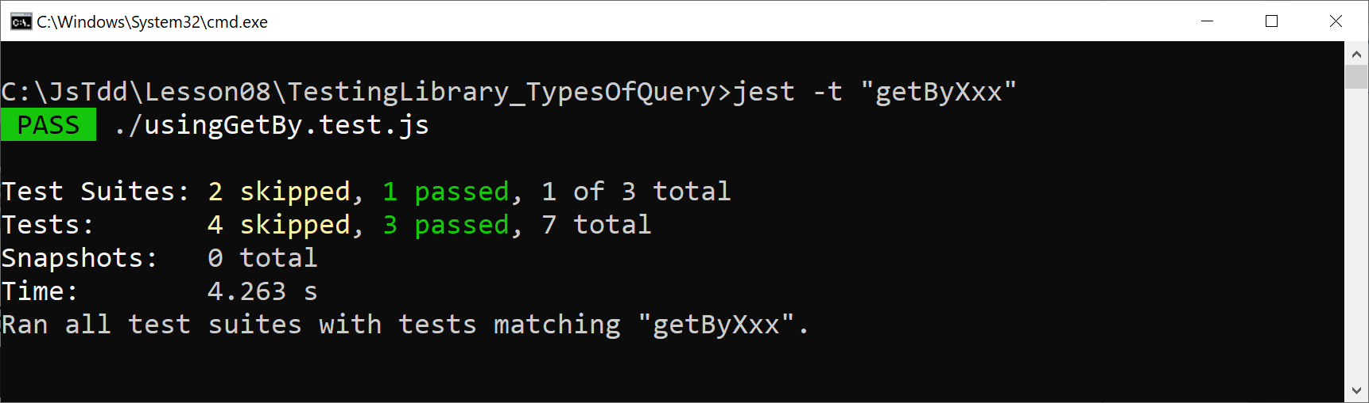
Running the Tests
Run the tests as follows:
jest -t "getByXxx"

Slide 81
Using queryByXxx()
These tests show how to use queryByXxx() functions:
beforeEach(() => {
document.body.innerHTML = "<div>Hello</div>";
});
test('Query for element successfully', () => {
const elem = screen.queryByText(/h...o/i);
expect(elem).not.toBeNull();
});
test('Query for element unsuccessfully', () => {
const elem = screen.queryByText(/wibble/i);
expect(elem).toBeNull();
});
usingQueryBy.test.js

Slide 82
Using queryByXxx()
These tests show how to use queryByXxx() functions:
Query for an element successfully
Returns the matching element
beforeEach(() => {
document.body.innerHTML = "<div>Hello</div>";
});
test('Query for element successfully', () => {
const elem = screen.queryByText(/h...o/i);
expect(elem).not.toBeNull();
});
test('Query for element unsuccessfully', () => {
const elem = screen.queryByText(/wibble/i);
expect(elem).toBeNull();
});
usingQueryBy.test.js

Slide 83
Using queryByXxx()
These tests show how to use queryByXxx() functions:
Query for an element unsuccessfully
Returns null
beforeEach(() => {
document.body.innerHTML = "<div>Hello</div>";
});
test('Query for element successfully', () => {
const elem = screen.queryByText(/h...o/i);
expect(elem).not.toBeNull();
});
test('Query for element unsuccessfully', () => {
const elem = screen.queryByText(/wibble/i);
expect(elem).toBeNull();
});
usingQueryBy.test.js

Slide 84
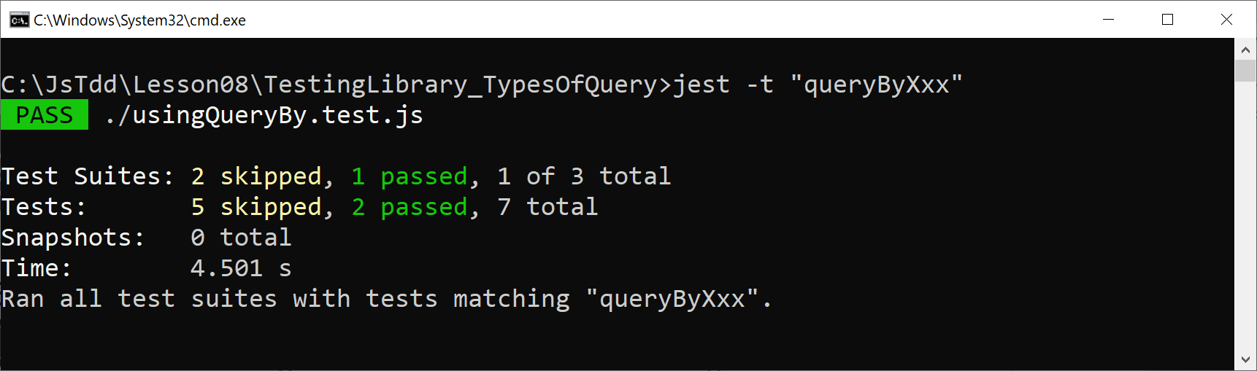
Running the Tests
Run the tests as follows:
jest -t "queryByXxx"

Slide 85
Using findByXxx()
These tests show how to use findByXxx() functions:
beforeEach(() => {
document.body.innerHTML = "<div>Hello</div>";
});
test('Find element successfully', done => {
screen.findByText(/h...o/i)
.then(elem => {
expect(elem.innerHTML).toBe("Hello");
done();
});
});
test('Find element unsuccessfully', done => {
screen.findByText(/wibble/i)
.catch(err => {
expect(err instanceof Error).toBeTruthy();
done();
});
});
usingFindBy.test.js

Slide 86
Using findByXxx()
These tests show how to use findByXxx() functions:
Find an element successfully
Returns a Promise that resolves
beforeEach(() => {
document.body.innerHTML = "<div>Hello</div>";
});
test('Find element successfully', done => {
screen.findByText(/h...o/i)
.then(elem => {
expect(elem.innerHTML).toBe("Hello");
done();
});
});
test('Find element unsuccessfully', done => {
screen.findByText(/wibble/i)
.catch(err => {
expect(err instanceof Error).toBeTruthy();
done();
});
});
usingFindBy.test.js

Slide 87
Using findByXxx()
These tests show how to use findByXxx() functions:
Find an element unsuccessfully
Returns a Promise that rejects
beforeEach(() => {
document.body.innerHTML = "<div>Hello</div>";
});
test('Find element successfully', done => {
screen.findByText(/h...o/i)
.then(elem => {
expect(elem.innerHTML).toBe("Hello");
done();
});
});
test('Find element unsuccessfully', done => {
screen.findByText(/wibble/i)
.catch(err => {
expect(err instanceof Error).toBeTruthy();
done();
});
});
usingFindBy.test.js

Slide 88

Running the Tests
Run the tests as follows:
jest -t "findByXxx"

Slide 89
Lesson 8: Testing the User Interface
8.9 A Closer Look at the Query API in Testing Library

Slide 90
Overview
In this section we'll take a closer look at the query API in Testing Library
See the folder TestingLibrary_QueryApi
We'll see how Testing Library favors a user-centric approach to locating content
E.g., locate a button by its text
E.g., locate a text box by its label
E.g., locate a div by its tooltip (title)

Slide 91
Testing Library Functions Available
Testing Library provides the following functions:
getByRole()
getByLabelText()
getByPlaceholderText()
getByText()
getByDisplayValue()
getByAltText()
getByTitle()
getByTestId()
Plus queryBy, findBy, and All functions

Slide 92
Using getByRole()
getByRole() gets a node that matches an ARIA role
ARIA = Accessible Rich Internet Applications
ARIA roles describe the intent of elements, as described here:
https://developer.mozilla.org/docs/Web/Accessibility/ARIA/Roles
Example ARIA roles:
heading
form, input, button, checkbox
table, row, cell
Etc.

Slide 93
Using getByRole()
Here's a simple example of using getByRole():
test('getByRole - example 1', () => {
document.body.innerHTML = `
<button>Submit form</button>
`;
const el = screen.getByRole('button', {name: /submit/i});
expect(el).toBeTruthy();
expect(el.innerHTML).toBe('Submit form');
});
example.test.js

Slide 94
Using getByRole()
Here's another example of using getByRole():
test('getByRole - example 2', () => {
document.body.innerHTML = `
<table>
<caption>Products table</caption>
<tr><td>Skis</td><td>800</td></tr>
<tr><td>Boots</td><td>300</td></tr>
<table>
`;
const el = screen.getByRole('table', {name: /products/i});
expect(el.getElementsByTagName('tr').length).toBe(2);
});
example.test.js

Slide 95
Using getByLabelText()
Here's an example of using getByLabelText():
test('getByLabelText', () => {
document.body.innerHTML = `
<label for="price">Price:</label>
<input id="price" value="300">
`;
const el = screen.getByLabelText(/price:/i);
expect(el.value).toBe('300');
});
example.test.js

Slide 96
Using getByPlaceholderText()
Here's an example of using getByPlaceholderText():
test('getByPlaceholderText', () => {
document.body.innerHTML = `
<label for="price">Price:</label>
<input id="price" placeholder="Enter price" value="25">
`;
const el = screen.getByPlaceholderText(/enter price/i);
expect(el.value).toBe('25');
});
example.test.js

Slide 97
Using getByText()
Here's an example of using getByText():
test('getByText', () => {
document.body.innerHTML = `
<div>Wales win the World Cup in 2022</div>
`;
const el = screen.getByText(/2022/i);
expect(el.innerHTML).toMatch(/wales/i);
});
example.test.js

Slide 98
Using getByDisplayValue()
Here's an example of using getByDisplayValue():
test('getByDisplayValue', () => {
document.body.innerHTML = `
<input type="text" value="Wales in 2022">
`;
const el = screen.getByDisplayValue(/2022/i);
expect(el.value).toMatch(/wales/i);
});
example.test.js

Slide 99
Using getByAltText()
Here's an example of using getByAltText():
test('getByAltText', () => {
document.body.innerHTML = `
<img src="image123.jpg" alt="image123">
`;
const el = screen.getByAltText(/image123/i);
expect(el.src).toMatch(/image123.jpg/i);
});
example.test.js

Slide 100
Using getByTitle()
Here's an example of using getByTitle():
test('getByTitle', () => {
document.body.innerHTML = `
<div title="World Cup winners 2022">Wales</div>
`;
const el = screen.getByTitle(/2022/i);
expect(el.innerHTML).toBe('Wales');
});
example.test.js

Slide 101
Using getByTestId()
Here's an example of using getByTestId():
test('getByTestId', () => {
document.body.innerHTML = `
<div data-testid="fifa2022winners">Wales</div>
`;
const el = screen.getByTestId(/2022/i);
expect(el.innerHTML).toBe('Wales');
});
example.test.js

Slide 102
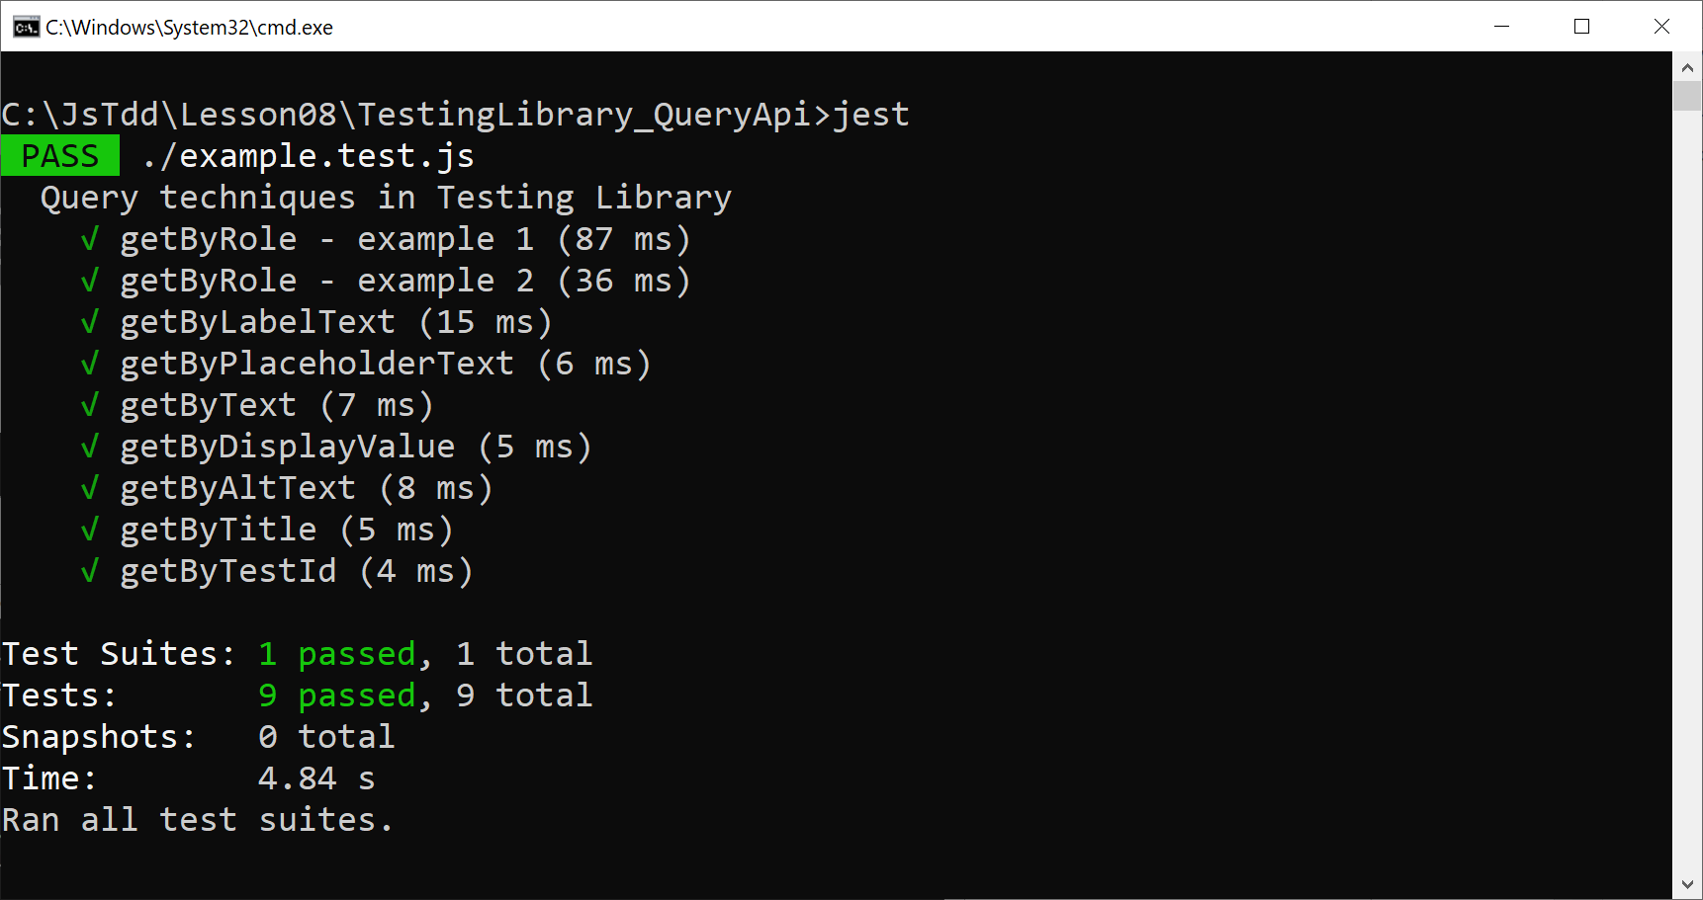
Running the Tests
Run all the tests as follows:
jest

Slide 103
Lesson 8: Testing the User Interface
8.10 Using Companion Libraries with Testing Library

Slide 104
Overview
In this section we'll see how to use two companion libraries that accompany and augment Testing Library…
user-event
API to simulate browser events
jest-dom
Custom DOM element matchers for Jest
See example in this folder:
TestingLibrary_CompanionLibraries

Slide 105
Supporting the Companion Libraries
To support the companion libraries, specify these dependencies:
Install using either of these commands:
{
"scripts": {
"test": "jest"
},
"devDependencies": {
"@babel/preset-env": "^7.15.8",
"babel-jest": "^27.2.5",
"@testing-library/dom": "^8.11.1",
"@testing-library/user-event": "^13.5.0",
"@testing-library/jest-dom": "^5.16.1"
}
}
package.json
yarn install
npm install

Slide 106
Using the user-event Companion Library
You can use the user-event companion library to simulate a browser event
E.g., to simulate the click event for some button:
import userEvent from '@testing-library/user-event'
…
userEvent.click(someButton);

Slide 107
Using the jest-dom Companion Library
You can use the jest-dom companion library to simplify assertions in Jest tests
Here are some examples:
For details, see:
https://github.com/testing-library/jest-dom
import '@testing-library/jest-dom'
…
expect(someElement).toBeEnabled();
expect(someElement).toBeDisabled();
expect(someElement).toBeValid();
expect(someElement).toBeInvalid();
expect(someElement).toContainElement(someElement2);
expect(someElement).toContainHtml(someHtml);
…

Slide 108
Example
Let's take a look at a complete and realistic example
See the following files:
myscript.js
example.test.js

