Slide 1
Lesson 9: Getting Started with Testing React Applications
9.1 Getting started with React
9.2 Creating a simple React app
9.3 Creating a complete React app
9.4 Understanding React components
9.5 Testing a React app

Slide 2
Lesson 9: Getting Started with Testing React Applications
9.1 Getting Started with React

Slide 3
Overview of React
React is a lightweight client-side framework from Facebook
Gives you a logical way to construct your user interface
React allows you to create apps for:
Web browsers (we'll cover this)
iOS and Android native apps (via React Native)

Slide 4
React supports JavaScript and TypeScript
You can use either JavaScript or TypeScript to create React apps
In either case, you'll benefit from using modern language features such as:
Interpolated strings
Arrow functions
Classes and inheritance
Destructuring
The spread operator
Array mapping and filtering

Slide 5
Managing React Packages
React has quite a small number of packages, i.e., libraries
You need to manage these packages in your application
There are two ways to manage React packages:
Download directly from https://unpkg.com/
Use Yarn or Node Package Manager (npm)
We'll investigate both techniques, and then see how to test the apps

Slide 6
Lesson 9: Getting Started with Testing React Applications
9.2 Creating a Simple React Application

Slide 7
Overview
In this section we'll show how to create a simple React app
The app will demonstrate how to:
Download React packages from a Content Delivery Network site
Display a simple user interface
See the Example1 folder
Open index.html in a browser

Slide 8
Defining an HTML Target Element
A React web app has a single top-level HTML element
React renders the UI into this element
You typically define the element as a <div>
Give it an id, so you can refer to it in your code
For example:
<div id='root'></div>

Slide 9
Downloading React Packages
To use React in a web page, you must download 2 packages:
react - Creates views
react-dom - Renders views in the web browser
The following code downloads these packages directly from the https://unpkg.com Content Delivery Network site:
<script src="https://unpkg.com/react@17/umd/react.development.js"></script>
<script src="https://unpkg.com/react-dom@17/umd/react-dom.development.js"></script>

Slide 10
Downloading Babel
Babel is a tool that performs two useful tasks:
Transpiles modern JavaScript code into traditional JavaScript
Transpiles JSX into pure JavaScript (we'll discuss JSX shortly…)
The following code downloads Babel:
<script src="https://unpkg.com/babel-standalone@6.26.0/babel.min.js"></script>

Slide 11
What is JSX?
JSX is a combination of JavaScript code and XML
You use JavaScript code to define your application logic
You use XML to define your user interface
You embed JSX code in a Babel script tag as follows:
<script src="…URL for Babel on unpkg.com…"></script>
<script type="text/babel">
… Put your JSX code here …
</script>

Slide 12
Defining a Component
A component is a function or class that returns XML to React
The XML tells React what web content to render
Here's a simple functional component:
<script type="text/babel">
function ItemsList() {
return (
<div>
<h1>Greetings!</h1>
<ul>
<li>Hello</li>
<li>Bonjour</li>
</ul>
</div>
)
}
…
</script>

Slide 13
Creating and Rendering a Component
Here's how to create and render a component:
Note:
Create the component by using an XML tag
Pass the component to ReactDOM.render()
<script type="text/babel">
…
ReactDOM.render(
<ItemsList />,
document.getElementById('root')
)
</script>

Slide 14
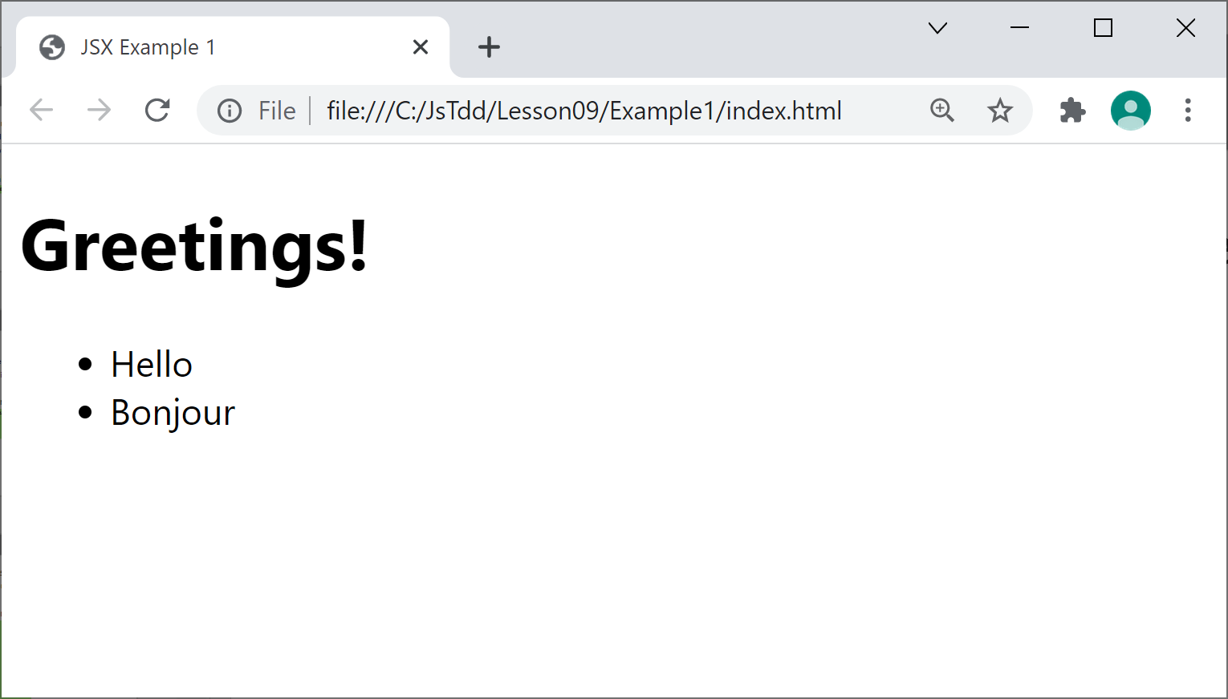
Viewing the Web Page
Here's a reminder of how the web page looks in a browser:

Slide 15
Lesson 9: Getting Started with Testing React Applications
9.3 Creating a Complete React App

Slide 16
Overview
In this section we'll see how to create a complete React app
The app will demonstrate how to:
Use the Create React App tool to create a React app in TypeScript
Download React packages using Yarn or npm
Organize code and UI artifacts properly
See the Example2 folder

Slide 17
Creating a React Application
There are various tools available to create a React app
We're going to use Create React App
See https://create-react-app.dev/
You can create a React app in TypeScript as follows:
Creates a React app in TypeScript
Downloads the React packages to the node_modules folder
npx create-react-app demo-app --template typescript

Slide 18
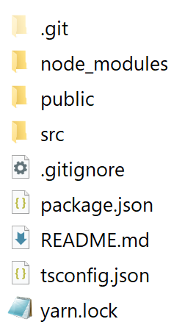
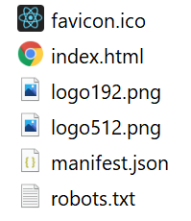
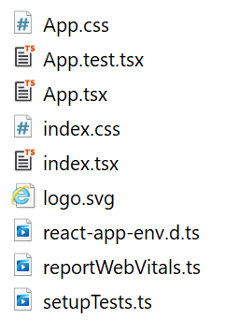
Reviewing the React App
Let's take a look at the structure of the generated React app:
public folder
src folder

Slide 19
The Home Page
The application home page is public/index.html
<!DOCTYPE html>
<html lang="en">
<head>
<title>React App</title>
…
</head>
<body>
<div id="root"> </div>
</body>
</html>
<!DOCTYPE html>
<html lang="en">
<head>
<title>React App</title>
…
</head>
<body>
<div id="root"> </div>
</body>
</html>
This is where your React content will be rendered
public/index.html

Slide 20
The Source Code Entry Point
The source code entry point is src/index.tsx
Note: for info about "strict mode", see:
https://reactjs.org/docs/strict-mode.html
import React from 'react';
import ReactDOM from 'react-dom';
import './index.css';
import App from './App';
…
ReactDOM.render(
<React.StrictMode>
<App />
</React.StrictMode>,
document.getElementById('root')
);
import React from 'react';
import ReactDOM from 'react-dom';
import './index.css';
import App from './App';
…
ReactDOM.render(
<React.StrictMode>
<App />
</React.StrictMode>,
document.getElementById('root')
);
This creates an App component (see next slide)
src/index.tsx

Slide 21
The App Component
App is a functional component
Returns HTML (XML) to be rendered by React
import React from 'react';
import './App.css';
…
function App() {
return (
<div className="App">
<header className="App-header">
<img src={logo} className="App-logo" alt="logo" />
… … … …
</header>
</div>
);
}
export default App;
src/App.tsx

Slide 22
Running the Application
You can run the application as follows:
Builds the app in memory
Starts a server to host the app on http://localhost:3000
Opens a browser to view the app
yarn start

Slide 23
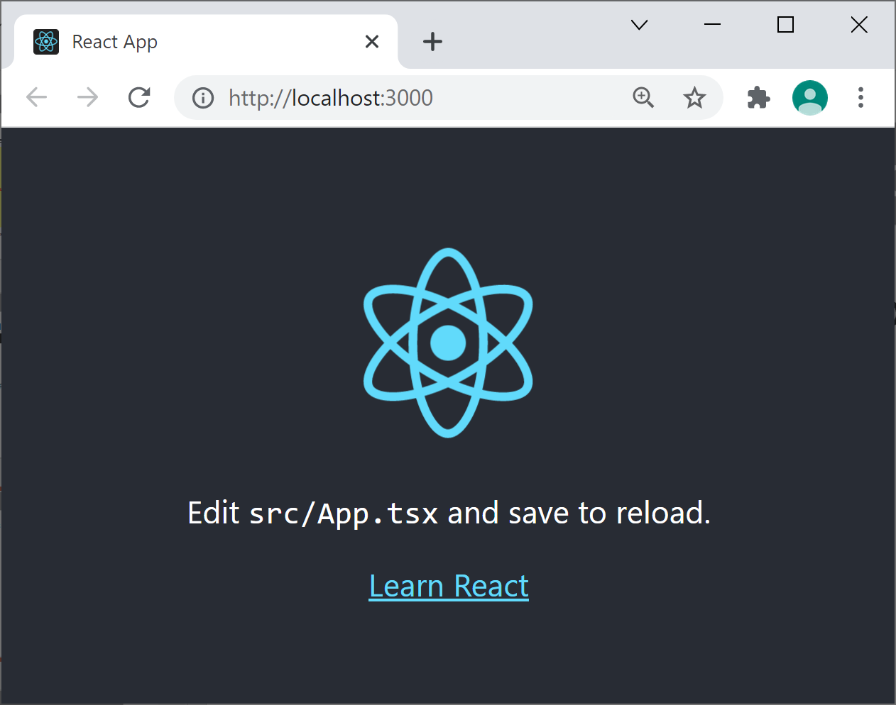
Viewing the Web App
Here's how the web app appears in a browser:

Slide 24
Lesson 9: Getting Started with Testing React Applications
9.4 Understanding React Components

Slide 25
Overview
In this section we'll investigate an app with multiple components
The app demonstrates how to:
Define a root component named <App>
Define additional components to render portions of HTML
Pass parameters into components
Work with complex data
See the Example3 folder

Slide 26
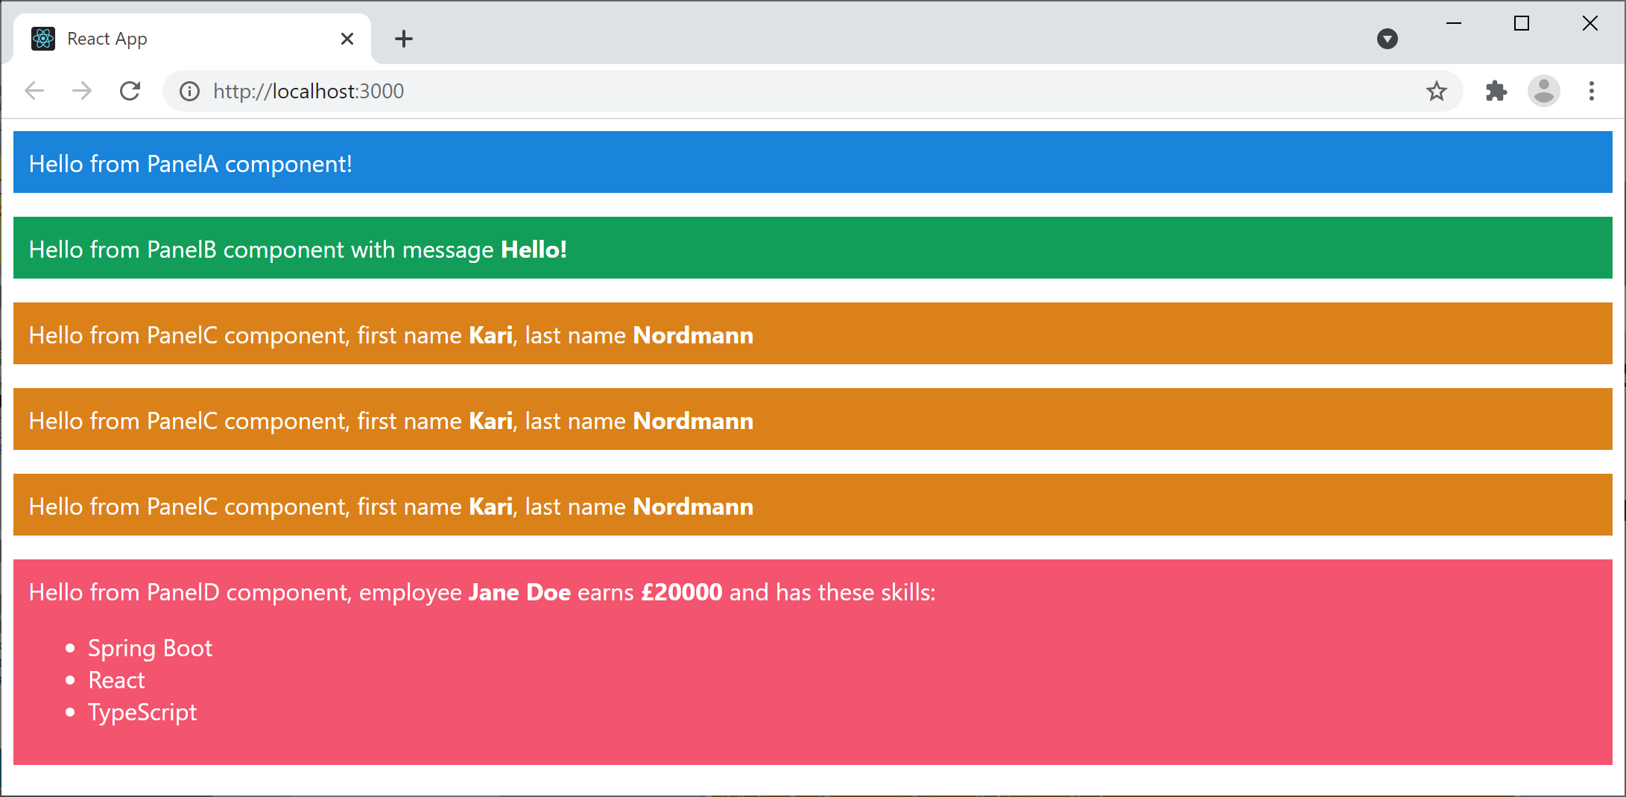
Building and Running the Application
You can build and run the application as normal:
yarn start

Slide 27
Defining and Instantiating a Component
PanelA is a simple component:
We instantiate the component as follows:
export default function PanelA() {
return (
<div className="panelA">
Hello from PanelA component!
</div>
);
}
PanelA.tsx
export default function App() {
return (
<React.Fragment>
<PanelA />
… … … …
</React.Fragment>
);
}
App.tsx

Slide 28
Receiving a Property in a Component
PanelB shows how a component can receive a property:
This is how to pass a property to a component:
export default function PanelB(props: any) {
const msg = props.msg
return (
<div className="panelB">
Hello from PanelB component with message <b>{msg}</b>
</div>
);
}
PanelB.tsx
<PanelB msg="Hello!" />
App.tsx

Slide 29
Receiving Many Properties in a Component
PanelC shows how to receive many properties:
This is how to pass many properties:
export default function PanelC(props: any) {
const fname = props.fname
const lname = props.lname
return (
<div className="panelC">
Hello from PanelC component,
first name <b>{fname}</b>, last name <b>{lname}</b>
</div>
);
}
PanelC.tsx
<PanelC fname="Kari" lname="Nordmann" />
App.tsx

Slide 30
Receiving Many Properties in a Component
PanelC shows how to receive many properties:
Here's another way to pass many properties:
export default function PanelC(props: any) {
const fname = props.fname
const lname = props.lname
return (
<div className="panelC">
Hello from PanelC component,
first name <b>{fname}</b>, last name <b>{lname}</b>
</div>
);
}
PanelC.tsx
const person = {fname: 'Kari', lname: 'Nordmann'}
<PanelC fname={person.fname} lname={person.lname} />
App.tsx

Slide 31
Receiving Many Properties in a Component
PanelC shows how to receive many properties:
And here's another way to pass many properties:
export default function PanelC(props: any) {
const fname = props.fname
const lname = props.lname
return (
<div className="panelC">
Hello from PanelC component,
first name <b>{fname}</b>, last name <b>{lname}</b>
</div>
);
}
PanelC.tsx
const person = {fname: 'Kari', lname: 'Nordmann'}
<PanelC {...person} />
App.tsx

Slide 32
Working with Complex Data
PanelD shows how to work with complex data:
export default function PanelD({name, salary, skills}: any) {
return (
<div className="panelD">
Hello from PanelD component,
employee <b>{name}</b>
earns <b>&pound;{salary}</b>
and has these skills:
<ul>
{skills.map((skill: string, i: number) =>
<li key={i}>{skill}</li>
)}
</ul>
</div>
);
}
PanelD.tsx
const employee = {
name: 'Jane Doe',
salary: 20_000,
skills: ['Spring Boot', 'React', 'TypeScript']
}
<PanelD {...employee} />
App.tsx

Slide 33
Lesson 9: Getting Started with Testing React Applications
9.5 Testing a React App

Slide 34
Overview
In this section we'll see how testing works in a React app
We'll see how to test an app created via the Create React App tool as follows:
See the Example4 folder
npx create-react-app demo-app --template typescript

Slide 35
The Testing Environment
package.json includes various test dependencies:
package.json also defines a script to run tests:
"dependencies": {
"@testing-library/jest-dom": "^5.11.4",
"@testing-library/react": "^11.1.0",
"@testing-library/user-event": "^12.1.10",
"@types/jest": "^26.0.15",
…
}
package.json
"scripts": {
"test": "react-scripts test",
…
}
package.json

Slide 36
Importing jest-dom Custom Matchers
The jest-dom package defines custom Jest matchers
Make it easier to test content in DOM nodes
For example:
The jest-dom package is imported into the React app as follows:
expect(element).toHaveTextContent(/hello world/i)
import '@testing-library/jest-dom';
src/setupTests.ts

Slide 37
Writing Tests in a React App
It's commonplace to define a separate test file for each component in a React app
For example:
App.tsx - component definition
App.test.tsx - component tests
Let's take a look at the tests in App.test.tsx

Slide 38
Reviewing the Auto-Generated Test Code
Create React App generated the following test code for our App component:
import React from 'react';
import { render, screen } from '@testing-library/react';
import App from './App';
test('renders learn react link', () => {
render(<App />);
const linkElement = screen.getByText(/learn react/i);
expect(linkElement).toBeInTheDocument();
});
src/App/test.tsx

Slide 39
Reviewing the Auto-Generated Test Code
Create React App generated the following test code for our App component:
render() renders the App component into a container, i.e., a virtual web page
import React from 'react';
import { render, screen } from '@testing-library/react';
import App from './App';
test('renders learn react link', () => {
render(<App />);
const linkElement = screen.getByText(/learn react/i);
expect(linkElement).toBeInTheDocument();
});
src/App/test.tsx

Slide 40
Reviewing the Auto-Generated Test Code
Create React App generated the following test code for our App component:
screen gives you access to the content that's rendered in the document.body
import React from 'react';
import { render, screen } from '@testing-library/react';
import App from './App';
test('renders learn react link', () => {
render(<App />);
const linkElement = screen.getByText(/learn react/i);
expect(linkElement).toBeInTheDocument();
});
src/App/test.tsx

Slide 41
Reviewing the Auto-Generated Test Code
Create React App generated the following test code for our App component:
expect() is a Jest assertion that can use custom Jest matchers, for simplicity
import React from 'react';
import { render, screen } from '@testing-library/react';
import App from './App';
test('renders learn react link', () => {
render(<App />);
const linkElement = screen.getByText(/learn react/i);
expect(linkElement).toBeInTheDocument();
});
src/App/test.tsx

Slide 42
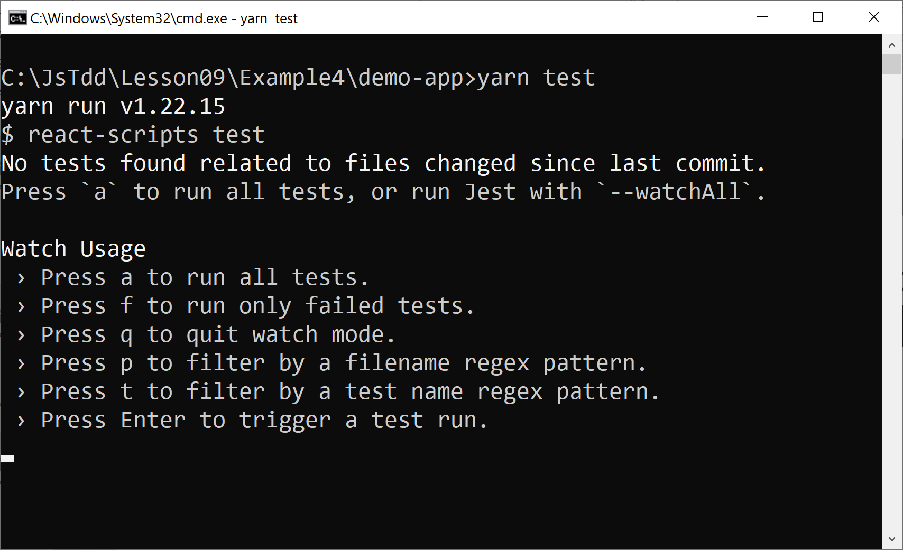
Running Tests
You can run all tests in the app as follows:
yarn test

Slide 43
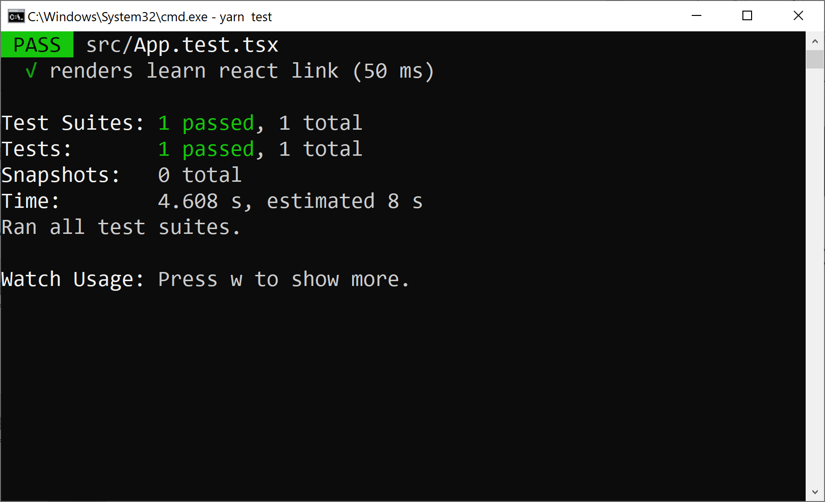
Viewing Test Results
Here are the test results for our React app:

