Slide 1
Lesson 10: Going Further with Testing React Applications
10.1 Sample React application
10.2 Introduction to Enzyme
10.3 Shallow rendering in Enzyme
10.4 Full DOM rendering in Enzyme
10.5 Static rendering in Enzyme
10.6 Simulating events in Enzyme
10.7 Testing React state in Enzyme
10.8 Testing React effect hooks in Enzyme
10.9 Using React Testing Library

Slide 2
Lesson 10: Going Further with Testing React Applications
10.1 Sample React Application

Slide 3
Overview
In this lesson we'll see how to use two different libraries for testing React applications…
Enzyme
Test a component's implementation details
E.g., properties, state, effect hooks, etc.
React Testing Library
Test a component's overall effect
No access to implementation details

Slide 4
Sample Application
All the tests in this lesson will be based on the same sample React application, for consistency
The sample application is located here:
SampleApplication/demo-app
Install packages and start the application:
npm install
npm start

Slide 5
Understanding the Code
File | Description
ProductItem.ts | Defines a simple class to hold product data

Slide 6
Understanding the Code
File | Description
ProductItem.ts | Defines a simple class to hold product data
App.tsx | Root component

Slide 7
Understanding the Code
File | Description
ProductItem.ts | Defines a simple class to hold product data
App.tsx | Root component
ProductList.tsx | Component that renders a list of products

Slide 8
Understanding the Code
File | Description
ProductItem.ts | Defines a simple class to hold product data
App.tsx | Root component
ProductList.tsx | Component that renders a list of products
Product.tsx | Component that renders a single product

Slide 9
Understanding the Code
File | Description
ProductItem.ts | Defines a simple class to hold product data
App.tsx | Root component
ProductList.tsx | Component that renders a list of products
Product.tsx | Component that renders a single product
TotalValue.tsx | Component that displays total value of products

Slide 10
Lesson 10: Going Further with Testing React Applications
10.2 Introduction to Enzyme

Slide 11
Overview
Enzyme is a popular React testing library from Airbnb
Integrates very smoothly with Jest
Enzyme helps you to unit-test components
You can test component implementation details
E.g., properties, state, effect hooks, etc.
Let's see how to get started with Enzyme…
See the folder Enzyme_Intro/demo-app

Slide 12
Supporting Enzyme
To support Enzyme, specify the following dependencies:
"dependencies": {
"enzyme": "^3.11.0",
"@types/enzyme": "^3.10.11",
"@wojtekmaj/enzyme-adapter-react-17": "^0.6.6",
…
},
package.json

Slide 13
Supporting Enzyme
To support Enzyme, specify the following dependencies:
enzyme
The core library for Enzyme
"dependencies": {
"enzyme": "^3.11.0",
"@types/enzyme": "^3.10.11",
"@wojtekmaj/enzyme-adapter-react-17": "^0.6.6",
…
},
package.json

Slide 14
Supporting Enzyme
To support Enzyme, specify the following dependencies:
@types/enzyme
Defines Enzyme type info
Required if you're using TypeScript
"dependencies": {
"enzyme": "^3.11.0",
"@types/enzyme": "^3.10.11",
"@wojtekmaj/enzyme-adapter-react-17": "^0.6.6",
…
},
package.json

Slide 15
Supporting Enzyme
To support Enzyme, specify the following dependencies:
@wojtekmaj/enzyme-adapter-react-17
Unofficial adapter for React 17, correct at time of writing
For all available adapters:
Go to https://www.npmjs.com/
Search for enzyme-adapter-react
"dependencies": {
"enzyme": "^3.11.0",
"@types/enzyme": "^3.10.11",
"@wojtekmaj/enzyme-adapter-react-17": "^0.6.6",
…
},
package.json

Slide 16
What is the Enzyme Adapter?
The Enzyme Adapter is a layer between Enzyme and React
There's a different Enzyme Adapter for each version of React
This enables Enzyme to be independent of your React version
Enzyme
Enzyme
Adapter
for
React 17
Enzyme
Adapter
for
React 16
Enzyme
Adapter
for
React 15
. . .
React 17
React 16
React 15
. . .

Slide 17
Configuring Enzyme
You must configure Enzyme so that it knows which Enzyme Adapter to use:
import '@testing-library/jest-dom';
import Enzyme from 'enzyme';
import Adapter from '@wojtekmaj/enzyme-adapter-react-17';
Enzyme.configure({ adapter: new Adapter() });
setupTests.ts

Slide 18
Rendering Components by Using Enzyme
Enzyme provides 3 ways to render a component in a test:
import { shallow, mount, render } from 'enzyme';
// Shallow rendering:
const wrapper = shallow(<SomeComponent/>);
// Full DOM rendering:
const wrapper = mount(<SomeComponent/>);
// Static rendering:
const wrapper = render(<SomeComponent/>);

Slide 19
Rendering Components by Using Enzyme
Enzyme provides 3 ways to render a component in a test:
Shallow rendering
Renders a component, but not its children
Ideal for unit-testing a component
import { shallow, mount, render } from 'enzyme';
// Shallow rendering:
const wrapper = shallow(<SomeComponent/>);
// Full DOM rendering:
const wrapper = mount(<SomeComponent/>);
// Static rendering:
const wrapper = render(<SomeComponent/>);

Slide 20
Rendering Components by Using Enzyme
Enzyme provides 3 ways to render a component in a test:
Full DOM rendering
Renders a component and all its descendants
Ideal for testing DOM interaction
import { shallow, mount, render } from 'enzyme';
// Shallow rendering:
const wrapper = shallow(<SomeComponent/>);
// Full DOM rendering:
const wrapper = mount(<SomeComponent/>);
// Static rendering:
const wrapper = render(<SomeComponent/>);

Slide 21
Rendering Components by Using Enzyme
Enzyme provides 3 ways to render a component in a test:
Static rendering
Renders a component to static HTML
Ideal for analyzing static HTML structure
import { shallow, mount, render } from 'enzyme';
// Shallow rendering:
const wrapper = shallow(<SomeComponent/>);
// Full DOM rendering:
const wrapper = mount(<SomeComponent/>);
// Static rendering:
const wrapper = render(<SomeComponent/>);

Slide 22
Example Test
Here's a simple example of how to use Enzyme in a test:
Notes:
render() renders a component and returns a wrapper object
The wrapper object provides an API that enables us to locate child content
import { render } from 'enzyme';
…
describe('Our test suite', () => {
it('renders the App component', () => {
const wrapper = render(<App/>);
expect(wrapper.find('.App')).toBeDefined();
});
});
import { render } from 'enzyme';
…
describe('Our test suite', () => {
it('renders the App component', () => {
const wrapper = render(<App/>);
expect(wrapper.find('.App')).toBeDefined();
});
});
import { render } from 'enzyme';
…
describe('Our test suite', () => {
it('renders the App component', () => {
const wrapper = render(<App/>);
expect(wrapper.find('.App')).toBeDefined();
});
});
App.test.tsx

Slide 23
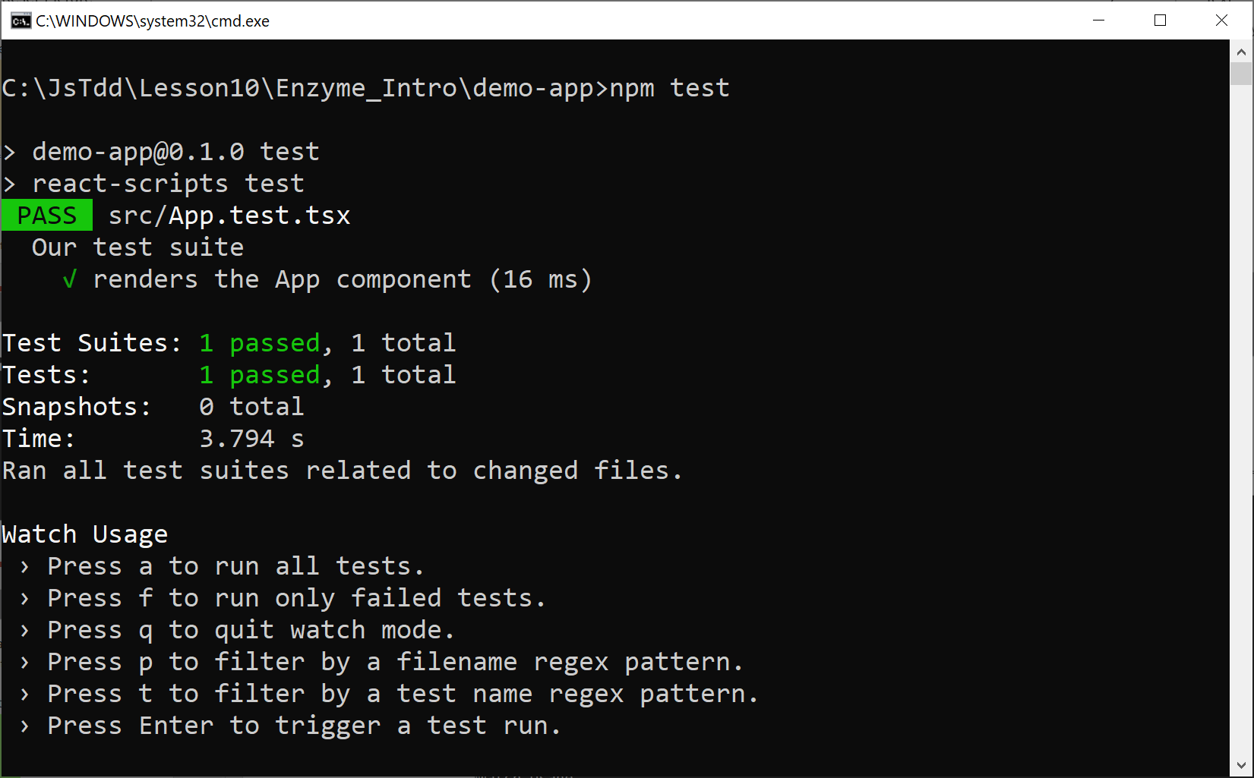
Running the Test
Run the test as follows:
npm test

Slide 24
Lesson 10: Going Further with Testing React Applications
10.3 Shallow Rendering in Enzyme

Slide 25
Overview
In this section we'll investigate shallow rendering in Enzyme:
Shallow rendering:
Renders a component, but not its children
Ideal for unit-testing a component
Our example is located here:
Enzyme_Shallow/demo-app
const wrapper = shallow(<SomeComponent/>);

Slide 26
Understanding Shallow Rendering
shallow() returns a ShallowWrapper, which has many functions you can use to locate content in a component:
find(selector)
children()
first(), last(), at(index)
props(), prop(key)
Etc.
For full details, see:
https://enzymejs.github.io/enzyme/docs/api/shallow.html

Slide 27
Example Test 1
Here's our first test:
it('No products', () => {
const wrapper = shallow(<ProductList products={[]} />)
expect(wrapper.find('h1').length).toBe(1);
expect(wrapper.find('h1').first().text()).
toBe('No products in stock');
expect(wrapper.find(Product).length).toBe(0);
expect(wrapper.find(TotalValue).length).toBe(0);
});
ProductList.test.tsx

Slide 28
Example Test 1
Here's our first test:
Render the ProductList component, with an empty product list
it('No products', () => {
const wrapper = shallow(<ProductList products={[]} />)
expect(wrapper.find('h1').length).toBe(1);
expect(wrapper.find('h1').first().text()).
toBe('No products in stock');
expect(wrapper.find(Product).length).toBe(0);
expect(wrapper.find(TotalValue).length).toBe(0);
});
ProductList.test.tsx

Slide 29
Example Test 1
Here's our first test:
Verify the ProductList component has an <h1> with the correct text
it('No products', () => {
const wrapper = shallow(<ProductList products={[]} />)
expect(wrapper.find('h1').length).toBe(1);
expect(wrapper.find('h1').first().text()).
toBe('No products in stock');
expect(wrapper.find(Product).length).toBe(0);
expect(wrapper.find(TotalValue).length).toBe(0);
});
ProductList.test.tsx

Slide 30
Example Test 1
Here's our first test:
Verify the ProductList component doesn't have descendant components Product or TotalValue
it('No products', () => {
const wrapper = shallow(<ProductList products={[]} />)
expect(wrapper.find('h1').length).toBe(1);
expect(wrapper.find('h1').first().text()).
toBe('No products in stock');
expect(wrapper.find(Product).length).toBe(0);
expect(wrapper.find(TotalValue).length).toBe(0);
});
ProductList.test.tsx

Slide 31
Example Test 2
Here's our second test:
it('Populated products', () => {
const wrapper = shallow(
<ProductList products={products} />)
expect(wrapper.find('h1').length).toBe(1);
expect(wrapper.find('h1').first().text())
.toBe('3 product(s) in stock');
expect(wrapper.find(Product).length).toBe(3);
expect(wrapper.find('div.productItem').length).toBe(0);
expect(wrapper.find(TotalValue).length).toBe(1);
expect(wrapper.find('div.totalValue').length).toBe(0);
});
ProductList.test.tsx

Slide 32
Example Test 2
Here's our second test:
Render the ProductList component, with an array of 3 products
it('Populated products', () => {
const wrapper = shallow(
<ProductList products={products} />)
expect(wrapper.find('h1').length).toBe(1);
expect(wrapper.find('h1').first().text())
.toBe('3 product(s) in stock');
expect(wrapper.find(Product).length).toBe(3);
expect(wrapper.find('div.productItem').length).toBe(0);
expect(wrapper.find(TotalValue).length).toBe(1);
expect(wrapper.find('div.totalValue').length).toBe(0);
});
ProductList.test.tsx

Slide 33
Example Test 2
Here's our second test:
Verify the ProductList component has an <h1> with the correct text
it('Populated products', () => {
const wrapper = shallow(
<ProductList products={products} />)
expect(wrapper.find('h1').length).toBe(1);
expect(wrapper.find('h1').first().text())
.toBe('3 product(s) in stock');
expect(wrapper.find(Product).length).toBe(3);
expect(wrapper.find('div.productItem').length).toBe(0);
expect(wrapper.find(TotalValue).length).toBe(1);
expect(wrapper.find('div.totalValue').length).toBe(0);
});
ProductList.test.tsx

Slide 34
Example Test 2
Here's our second test:
Verify the ProductList component has 3 (unexpanded) Product components
it('Populated products', () => {
const wrapper = shallow(
<ProductList products={products} />)
expect(wrapper.find('h1').length).toBe(1);
expect(wrapper.find('h1').first().text())
.toBe('3 product(s) in stock');
expect(wrapper.find(Product).length).toBe(3);
expect(wrapper.find('div.productItem').length).toBe(0);
expect(wrapper.find(TotalValue).length).toBe(1);
expect(wrapper.find('div.totalValue').length).toBe(0);
});
ProductList.test.tsx

Slide 35
Example Test 2
Here's our second test:
Verify the ProductList component has 1 (unexpanded) TotalValue component
it('Populated products', () => {
const wrapper = shallow(
<ProductList products={products} />)
expect(wrapper.find('h1').length).toBe(1);
expect(wrapper.find('h1').first().text())
.toBe('3 product(s) in stock');
expect(wrapper.find(Product).length).toBe(3);
expect(wrapper.find('div.productItem').length).toBe(0);
expect(wrapper.find(TotalValue).length).toBe(1);
expect(wrapper.find('div.totalValue').length).toBe(0);
});
ProductList.test.tsx

Slide 36
Example Test 3
Here's our third and final test:
it('Access component properties', () => {
const wrapper = shallow(
<ProductList products={products} />)
expect(
wrapper.find(TotalValue)
.first()
.prop('products')
.length).toBe(3);
});
ProductList.test.tsx

Slide 37
Example Test 3
Here's our third and final test:
Render the ProductList component, with an array of 3 products
it('Access component properties', () => {
const wrapper = shallow(
<ProductList products={products} />)
expect(
wrapper.find(TotalValue)
.first()
.prop('products')
.length).toBe(3);
});
ProductList.test.tsx

Slide 38
Example Test 3
Here's our third and final test:
Verify the first (only) TotalValue component has a products property (an array actually), which has a length of 3
it('Access component properties', () => {
const wrapper = shallow(
<ProductList products={products} />)
expect(
wrapper.find(TotalValue)
.first()
.prop('products')
.length).toBe(3);
});
ProductList.test.tsx

Slide 39
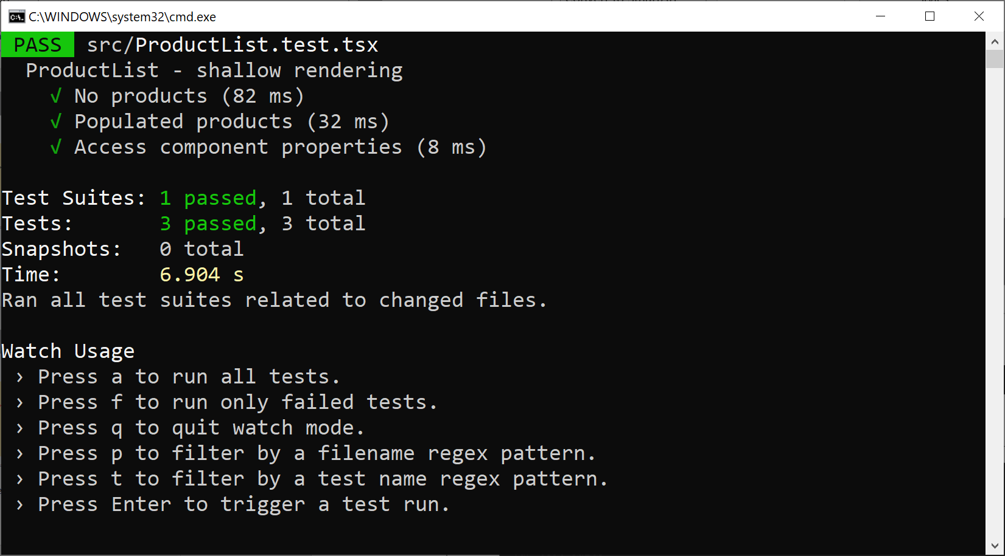
Running the Tests
Run all the tests as follows:
npm test

Slide 40
Lesson 10: Going Further with Testing React Applications
10.4 Full DOM Rendering in Enzyme

Slide 41
Overview
In this section we'll investigate full DOM rendering in Enzyme:
Full DOM rendering:
Renders a component and all its descendants
Ideal for testing DOM interaction
Our example is located here:
Enzyme_FullDom/demo-app
const wrapper = mount(<SomeComponent/>);

Slide 42
Understanding Full DOM Rendering
mount() returns a ReactWrapper, which has functions similar to ShallowWrapper:
find(selector)
children()
first(), last(), at(index)
props(), prop(key)
Etc.
For full details, see:
https://enzymejs.github.io/enzyme/docs/api/mount.html

Slide 43
Example Test 1
Here's our first test:
it('No products', () => {
const wrapper = mount(<ProductList products={[]} />)
expect(wrapper.find('h1').length).toBe(1);
expect(wrapper.find('h1').first().text())
.toBe('No products in stock');
expect(wrapper.find(Product).length).toBe(0);
expect(wrapper.find(TotalValue).length).toBe(0);
});
ProductList.test.tsx

Slide 44
Example Test 1
Here's our first test:
Render the ProductList component, with an empty product list
it('No products', () => {
const wrapper = mount(<ProductList products={[]} />)
expect(wrapper.find('h1').length).toBe(1);
expect(wrapper.find('h1').first().text())
.toBe('No products in stock');
expect(wrapper.find(Product).length).toBe(0);
expect(wrapper.find(TotalValue).length).toBe(0);
});
ProductList.test.tsx

Slide 45
Example Test 1
Here's our first test:
Verify the ProductList component has an <h1> with the correct text
it('No products', () => {
const wrapper = mount(<ProductList products={[]} />)
expect(wrapper.find('h1').length).toBe(1);
expect(wrapper.find('h1').first().text())
.toBe('No products in stock');
expect(wrapper.find(Product).length).toBe(0);
expect(wrapper.find(TotalValue).length).toBe(0);
});
ProductList.test.tsx

Slide 46
Example Test 1
Here's our first test:
Verify the ProductList component doesn't have descendant components Product or TotalValue
it('No products', () => {
const wrapper = mount(<ProductList products={[]} />)
expect(wrapper.find('h1').length).toBe(1);
expect(wrapper.find('h1').first().text())
.toBe('No products in stock');
expect(wrapper.find(Product).length).toBe(0);
expect(wrapper.find(TotalValue).length).toBe(0);
});
ProductList.test.tsx

Slide 47
Example Test 2
Here's our second test (partial listing):
it('Populated products', () => {
const wrapper = mount(
<ProductList products={products} />)
…
expect(wrapper.find(Product).length).toBe(3);
expect(wrapper.find('div.productItem').length).toBe(3);
const p0 = wrapper.find('div.productItem').at(0);
expect(p0.find('h2').first().text()).toBe('Skis');
expect(p0.find('p').at(0).text()).toBe('Price: 1000');
expect(p0.find('p').at(1).text()).toBe('In stock: 5');
…
expect(wrapper.find(TotalValue).length).toBe(1);
expect(wrapper.find('div.totalValue').length).toBe(1);
expect(wrapper.find('div.totalValue').text())
.toBe('Total value: 7000');
});
ProductList.test.tsx

Slide 48
Example Test 2
Here's our second test (partial listing):
Render the ProductList component, with an array of 3 products
it('Populated products', () => {
const wrapper = mount(
<ProductList products={products} />)
…
expect(wrapper.find(Product).length).toBe(3);
expect(wrapper.find('div.productItem').length).toBe(3);
const p0 = wrapper.find('div.productItem').at(0);
expect(p0.find('h2').first().text()).toBe('Skis');
expect(p0.find('p').at(0).text()).toBe('Price: 1000');
expect(p0.find('p').at(1).text()).toBe('In stock: 5');
…
expect(wrapper.find(TotalValue).length).toBe(1);
expect(wrapper.find('div.totalValue').length).toBe(1);
expect(wrapper.find('div.totalValue').text())
.toBe('Total value: 7000');
});
ProductList.test.tsx

Slide 49
Example Test 2
Here's our second test (partial listing):
Verify the Product component is fully rendered 3 times (once per product)
it('Populated products', () => {
const wrapper = mount(
<ProductList products={products} />)
…
expect(wrapper.find(Product).length).toBe(3);
expect(wrapper.find('div.productItem').length).toBe(3);
const p0 = wrapper.find('div.productItem').at(0);
expect(p0.find('h2').first().text()).toBe('Skis');
expect(p0.find('p').at(0).text()).toBe('Price: 1000');
expect(p0.find('p').at(1).text()).toBe('In stock: 5');
…
expect(wrapper.find(TotalValue).length).toBe(1);
expect(wrapper.find('div.totalValue').length).toBe(1);
expect(wrapper.find('div.totalValue').text())
.toBe('Total value: 7000');
});
ProductList.test.tsx

Slide 50
Example Test 2
Here's our second test (partial listing):
Verify the first Product component renders exactly the correct content (etc.)
it('Populated products', () => {
const wrapper = mount(
<ProductList products={products} />)
…
expect(wrapper.find(Product).length).toBe(3);
expect(wrapper.find('div.productItem').length).toBe(3);
const p0 = wrapper.find('div.productItem').at(0);
expect(p0.find('h2').first().text()).toBe('Skis');
expect(p0.find('p').at(0).text()).toBe('Price: 1000');
expect(p0.find('p').at(1).text()).toBe('In stock: 5');
…
expect(wrapper.find(TotalValue).length).toBe(1);
expect(wrapper.find('div.totalValue').length).toBe(1);
expect(wrapper.find('div.totalValue').text())
.toBe('Total value: 7000');
});
ProductList.test.tsx

Slide 51
Example Test 2
Here's our second test (partial listing):
Verify the TotalValue component renders exactly the correct content
it('Populated products', () => {
const wrapper = mount(
<ProductList products={products} />)
…
expect(wrapper.find(Product).length).toBe(3);
expect(wrapper.find('div.productItem').length).toBe(3);
const p0 = wrapper.find('div.productItem').at(0);
expect(p0.find('h2').first().text()).toBe('Skis');
expect(p0.find('p').at(0).text()).toBe('Price: 1000');
expect(p0.find('p').at(1).text()).toBe('In stock: 5');
…
expect(wrapper.find(TotalValue).length).toBe(1);
expect(wrapper.find('div.totalValue').length).toBe(1);
expect(wrapper.find('div.totalValue').text())
.toBe('Total value: 7000');
});
ProductList.test.tsx

Slide 52
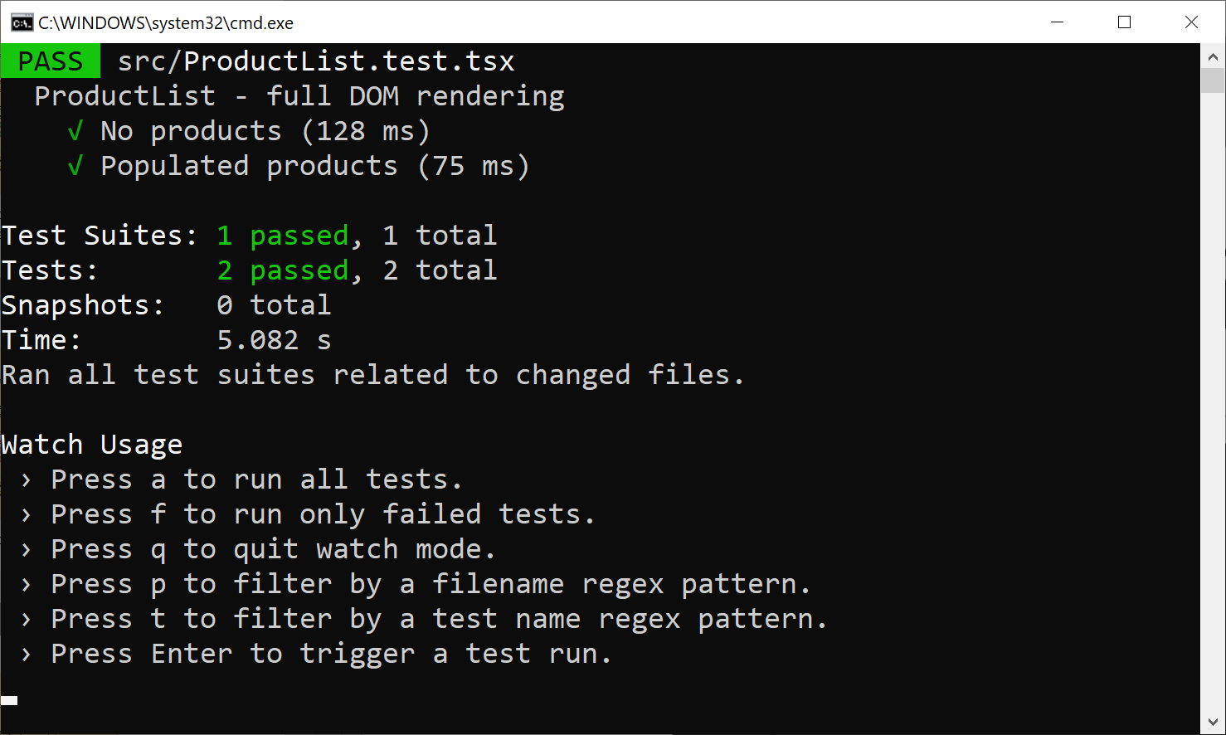
Running the Tests
Run all the tests as follows:
npm test

Slide 53
Lesson 10: Going Further with Testing React Applications
10.5 Static Rendering in Enzyme

Slide 54
Overview
In this section we'll investigate static rendering in Enzyme:
Static rendering:
Renders a component to static HTML
Ideal for analyzing static HTML structure
Our example is located here:
Enzyme_Static/demo-app
const wrapper = render(<SomeComponent/>);

Slide 55
Understanding Static Rendering
render() returns a CheerioWrapper, which has classes similar to the DOM API:
Document
Element
Node
For full details, see:
https://cheerio.js.org/

Slide 56
Example Test 1
Here's our first test:
it('No products', () => {
const wrapper = render(<ProductList products={[]} />)
expect(wrapper.find('h1').length).toBe(1);
const h1ElementNode = wrapper.find('h1')[0] as any;
const h1TextNode = h1ElementNode.firstChild;
expect(h1TextNode.data).toBe('No products in stock');
expect(wrapper.find('Product').length).toBe(0);
expect(wrapper.find('div.productItem').length).toBe(0);
expect(wrapper.find('TotalValue').length).toBe(0);
expect(wrapper.find('div.totalValue').length).toBe(0);
});
ProductList.test.tsx

Slide 57
Example Test 1
Here's our first test:
Render the ProductList component, with an empty product list
it('No products', () => {
const wrapper = render(<ProductList products={[]} />)
expect(wrapper.find('h1').length).toBe(1);
const h1ElementNode = wrapper.find('h1')[0] as any;
const h1TextNode = h1ElementNode.firstChild;
expect(h1TextNode.data).toBe('No products in stock');
expect(wrapper.find('Product').length).toBe(0);
expect(wrapper.find('div.productItem').length).toBe(0);
expect(wrapper.find('TotalValue').length).toBe(0);
expect(wrapper.find('div.totalValue').length).toBe(0);
});
ProductList.test.tsx

Slide 58
Example Test 1
Here's our first test:
Verify the ProductList component has an <h1> with the correct text
it('No products', () => {
const wrapper = render(<ProductList products={[]} />)
expect(wrapper.find('h1').length).toBe(1);
const h1ElementNode = wrapper.find('h1')[0] as any;
const h1TextNode = h1ElementNode.firstChild;
expect(h1TextNode.data).toBe('No products in stock');
expect(wrapper.find('Product').length).toBe(0);
expect(wrapper.find('div.productItem').length).toBe(0);
expect(wrapper.find('TotalValue').length).toBe(0);
expect(wrapper.find('div.totalValue').length).toBe(0);
});
ProductList.test.tsx

Slide 59
Example Test 1
Here's our first test:
Verify the ProductList component doesn't have descendant components Product or TotalValue
it('No products', () => {
const wrapper = render(<ProductList products={[]} />)
expect(wrapper.find('h1').length).toBe(1);
const h1ElementNode = wrapper.find('h1')[0] as any;
const h1TextNode = h1ElementNode.firstChild;
expect(h1TextNode.data).toBe('No products in stock');
expect(wrapper.find('Product').length).toBe(0);
expect(wrapper.find('div.productItem').length).toBe(0);
expect(wrapper.find('TotalValue').length).toBe(0);
expect(wrapper.find('div.totalValue').length).toBe(0);
});
ProductList.test.tsx

Slide 60
Example Test 2
Here's our second test (partial listing):
it('Populated products', () => {
const wrapper = render(
<ProductList products={products} />)
…
expect(wrapper.find('Product').length).toBe(0);
expect(wrapper.find('div.productItem').length).toBe(3);
const prod0 = wrapper.find('div.productItem')[0] as any;
const h2TextNode = prod0.children[0].firstChild;
expect(h2TextNode.data).toBe('Skis');
});
ProductList.test.tsx

Slide 61
Example Test 2
Here's our second test (partial listing):
Render the ProductList component, with an array of 3 products
it('Populated products', () => {
const wrapper = render(
<ProductList products={products} />)
…
expect(wrapper.find('Product').length).toBe(0);
expect(wrapper.find('div.productItem').length).toBe(3);
const prod0 = wrapper.find('div.productItem')[0] as any;
const h2TextNode = prod0.children[0].firstChild;
expect(h2TextNode.data).toBe('Skis');
});
ProductList.test.tsx

Slide 62
Example Test 2
Here's our second test (partial listing):
Static rendering just gives us the final HTML, it doesn't give us the React components!
it('Populated products', () => {
const wrapper = render(
<ProductList products={products} />)
…
expect(wrapper.find('Product').length).toBe(0);
expect(wrapper.find('div.productItem').length).toBe(3);
const prod0 = wrapper.find('div.productItem')[0] as any;
const h2TextNode = prod0.children[0].firstChild;
expect(h2TextNode.data).toBe('Skis');
});
ProductList.test.tsx

Slide 63
Example Test 2
Here's our second test (partial listing):
Verify the static HTML rendered for the first product
it('Populated products', () => {
const wrapper = render(
<ProductList products={products} />)
…
expect(wrapper.find('Product').length).toBe(0);
expect(wrapper.find('div.productItem').length).toBe(3);
const prod0 = wrapper.find('div.productItem')[0] as any;
const h2TextNode = prod0.children[0].firstChild;
expect(h2TextNode.data).toBe('Skis');
});
ProductList.test.tsx

Slide 64
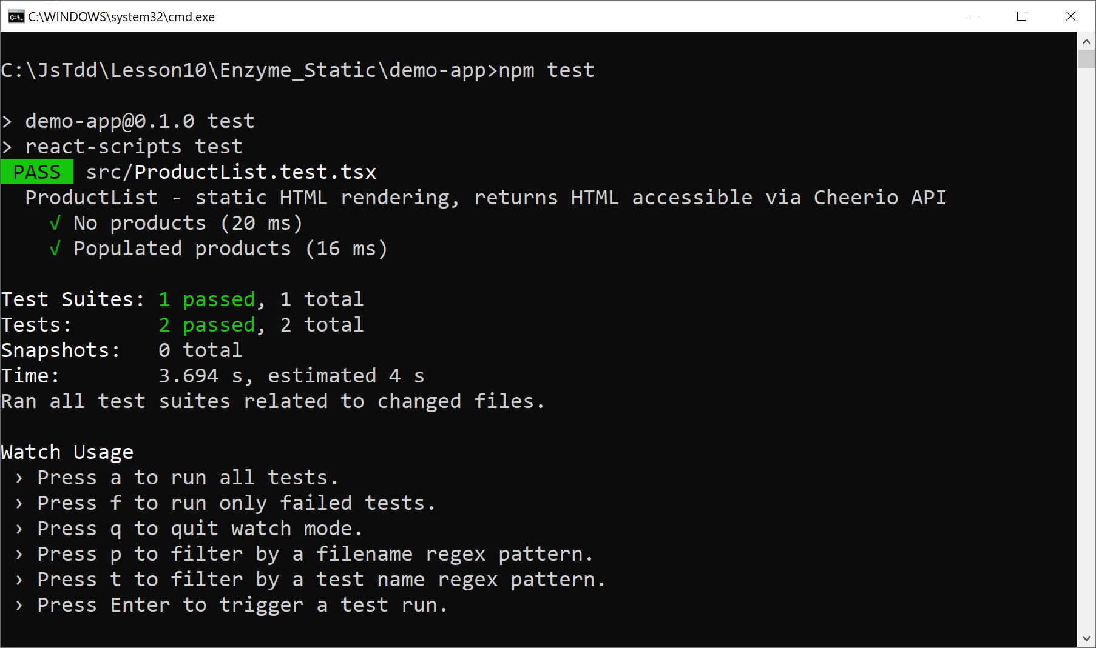
Running the Tests
Run all the tests as follows:
npm test

Slide 65
Lesson 10: Going Further with Testing React Applications
10.6 Simulating Events in Enzyme

Slide 66
Overview
In this section we'll see how to simulate events in Enzyme
Supported if you're using shallow or full DOM rendering
Not supported if you're using static rendering
Why simulate events?
To mimic user interaction
To verify your React component reacts accordingly

Slide 67
Example Application
We have an embellished example application, located here:
Enzyme_Events/demo-app
Install packages and start the application:
The application has min/max text boxes
The user can filter products by price range
npm install
npm start

Slide 68
How to Simulate an Event in Enzyme
This is how to simulate an event in Enzyme:
E.g., find a text box whose id is 'min' and simulate a 'change' event: :
Note the event argument…
The target property identifies the text box
The text box has a value property
aWrapper.simulate('someEvent', eventArgs);
wrapper.find('#min').simulate(
'change',
{ target: { value: '101' } }
);
wrapper.find('#min').simulate(
'change',
{ target: { value: '101' } }
);
wrapper.find('#min').simulate(
'change',
{ target: { value: '101' } }
);
wrapper.find('#min').simulate(
'change',
{ target: { value: '101' } }
);

Slide 69
Example Test 1
Here's our first test (partial listing):
it('simulate "min" change event', () => {
const wrapper = mount(<ProductList products={products} />)
expect(wrapper.find(Product).length).toBe(3);
wrapper.find('#min').simulate(
'change', { target: { value: '101' }});
expect(wrapper.find(Product).length).toBe(2);
…
});
ProductList.test.tsx

Slide 70
Example Test 1
Here's our first test (partial listing):
Render the ProductList component, with an array of 3 products, and verify all 3 products are rendered
it('simulate "min" change event', () => {
const wrapper = mount(<ProductList products={products} />)
expect(wrapper.find(Product).length).toBe(3);
wrapper.find('#min').simulate(
'change', { target: { value: '101' }});
expect(wrapper.find(Product).length).toBe(2);
…
});
ProductList.test.tsx

Slide 71
Example Test 1
Here's our first test (partial listing):
Simulate the user entering a min value, and verify only products >= min price are rendered
it('simulate "min" change event', () => {
const wrapper = mount(<ProductList products={products} />)
expect(wrapper.find(Product).length).toBe(3);
wrapper.find('#min').simulate(
'change', { target: { value: '101' }});
expect(wrapper.find(Product).length).toBe(2);
…
});
ProductList.test.tsx

Slide 72
Example Test 2
Here's our second test (partial listing):
it('simulate "max" change event', () => {
const wrapper = mount(<ProductList products={products} />)
expect(wrapper.find(Product).length).toBe(3);
wrapper.find('#max').simulate(
'change', { target: { value: 999' }});
expect(wrapper.find(Product).length).toBe(2);
…
});
ProductList.test.tsx

Slide 73
Example Test 2
Here's our second test (partial listing):
Render the ProductList component, with an array of 3 products, and verify all 3 products are rendered
it('simulate "max" change event', () => {
const wrapper = mount(<ProductList products={products} />)
expect(wrapper.find(Product).length).toBe(3);
wrapper.find('#max').simulate(
'change', { target: { value: 999' }});
expect(wrapper.find(Product).length).toBe(2);
…
});
ProductList.test.tsx

Slide 74
Example Test 2
Here's our second test (partial listing):
Simulate the user entering a max value, and verify only products <= max price are rendered
it('simulate "max" change event', () => {
const wrapper = mount(<ProductList products={products} />)
expect(wrapper.find(Product).length).toBe(3);
wrapper.find('#max').simulate(
'change', { target: { value: 999' }});
expect(wrapper.find(Product).length).toBe(2);
…
});
ProductList.test.tsx

Slide 75
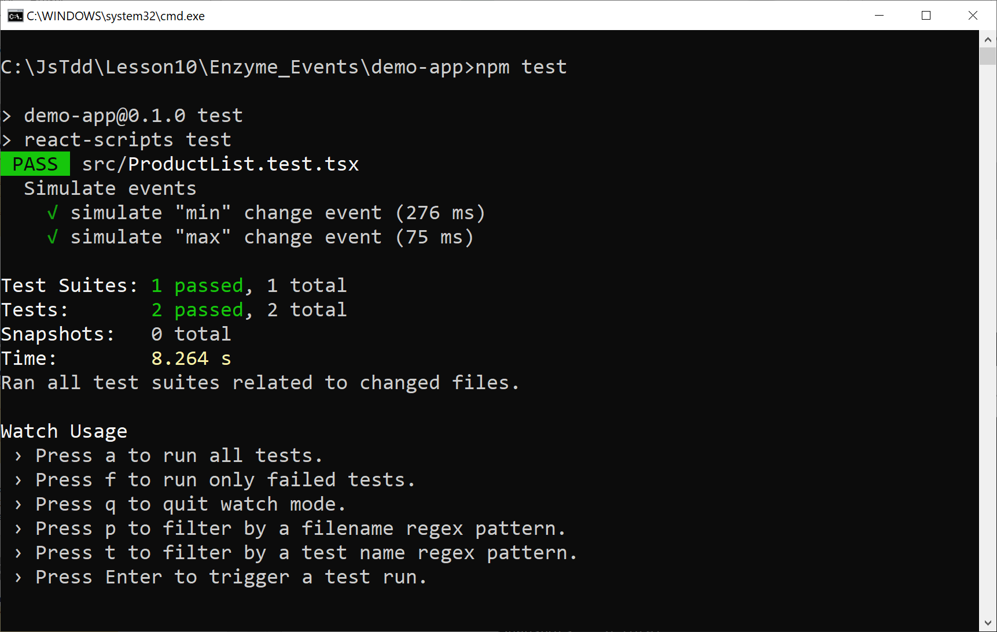
Running the Tests
Run all the tests as follows:
npm test

Slide 76
Lesson 10: Going Further with Testing React Applications
10.7 Testing React State in Enzyme

Slide 77
Overview of React State
A component can store and modify "state" during its lifetime
In a functional component, you do this via a state hook
To initialize state when a component is first rendered:
Call React.useState(initState)
Returns [stateVar,updateFunc]
To access state:
Use stateVar
To modify state (and trigger a re-render):
Call updateFunc(newState)

Slide 78
Example Application
Let's take a look at the example application:
Enzyme_State/demo-app
ProductList uses state as follows:
Stores the min / max values in state
Updates this state based on user input
Filters products based on this state

Slide 79
How to Test State in Enzyme
You can't access a component's state directly in Enzyme
State is an internal mechanism managed by React
But you can detect if the "update state" function is called:
Define a mock "update state" function
Mock the React.useState function so it uses the mock "update state" function
const setMin = jest.fn();
const useStateSpy = jest.spyOn(React, 'useState')
useStateSpy.mockImplementation(() => [0, setMin]);
const setMin = jest.fn();
const useStateSpy = jest.spyOn(React, 'useState')
useStateSpy.mockImplementation(() => [0, setMin]);
const setMin = jest.fn();
const useStateSpy = jest.spyOn(React, 'useState')
useStateSpy.mockImplementation(() => [0, setMin]);

Slide 80
Example Test 1
Here's our first test (partial listing):
it('state updated for specified minimum value', () => {
const setMin = jest.fn();
const useStateSpy = jest.spyOn(React, 'useState')
useStateSpy.mockImplementation(() => [0, setMin]);
const wrapper = mount(<ProductList products={products} />)
wrapper.find('#min').simulate(
'change', { target: { value: '200' }});
expect(setMin).toHaveBeenCalledWith(200);
});
ProductList.test.tsx

Slide 81
Example Test 1
Here's our first test (partial listing):
Mock the React.useState function so it uses a mock "update state" function
it('state updated for specified minimum value', () => {
const setMin = jest.fn();
const useStateSpy = jest.spyOn(React, 'useState')
useStateSpy.mockImplementation(() => [0, setMin]);
const wrapper = mount(<ProductList products={products} />)
wrapper.find('#min').simulate(
'change', { target: { value: '200' }});
expect(setMin).toHaveBeenCalledWith(200);
});
ProductList.test.tsx

Slide 82
Example Test 1
Here's our first test (partial listing):
Render the ProductList component, with an array of 3 products
it('state updated for specified minimum value', () => {
const setMin = jest.fn();
const useStateSpy = jest.spyOn(React, 'useState')
useStateSpy.mockImplementation(() => [0, setMin]);
const wrapper = mount(<ProductList products={products} />)
wrapper.find('#min').simulate(
'change', { target: { value: '200' }});
expect(setMin).toHaveBeenCalledWith(200);
});
ProductList.test.tsx

Slide 83
Example Test 1
Here's our first test (partial listing):
Simulate the user entering a value of 200 in the "min" text box
it('state updated for specified minimum value', () => {
const setMin = jest.fn();
const useStateSpy = jest.spyOn(React, 'useState')
useStateSpy.mockImplementation(() => [0, setMin]);
const wrapper = mount(<ProductList products={products} />)
wrapper.find('#min').simulate(
'change', { target: { value: '200' }});
expect(setMin).toHaveBeenCalledWith(200);
});
ProductList.test.tsx

Slide 84
Example Test 1
Here's our first test (partial listing):
Verify that the component's "update state" function has been called, with the min value entered by the user
it('state updated for specified minimum value', () => {
const setMin = jest.fn();
const useStateSpy = jest.spyOn(React, 'useState')
useStateSpy.mockImplementation(() => [0, setMin]);
const wrapper = mount(<ProductList products={products} />)
wrapper.find('#min').simulate(
'change', { target: { value: '200' }});
expect(setMin).toHaveBeenCalledWith(200);
});
ProductList.test.tsx

Slide 85
Clearing Mock Implementations
Note the following code, executed after each test:
restoreAllMocks() does the following:
Clears all info about mock calls
Removes mock return values / implementations
Restores original (non-mocked) implementations
afterEach(() => {
jest.restoreAllMocks()
});
ProductList.test.tsx

Slide 86
Additional Tests
There are 3 additional tests in our example:
it('state updated for unspecified minimum value', () => {…}
it('state updated for specified maximum value', () => {…}
it('state updated for unspecified maximum value', () => {…}

Slide 87
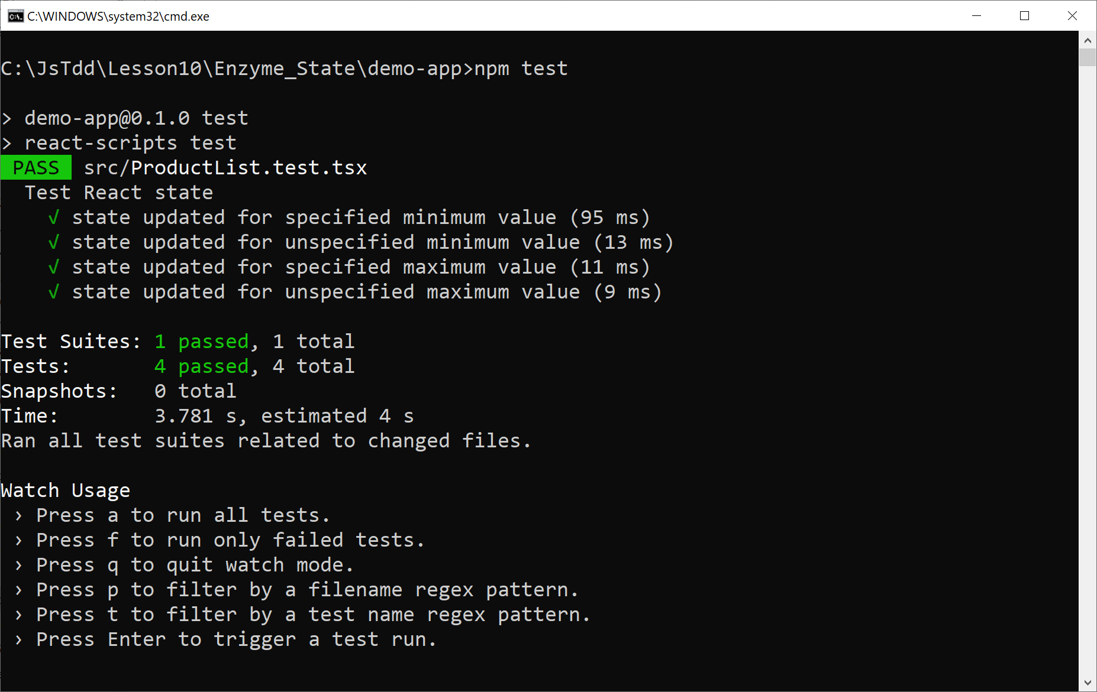
Running the Tests
Run all the tests as follows:
npm test

Slide 88
Lesson 10: Going Further with Testing React Applications
10.8 Testing React Effect Hooks in Enzyme

Slide 89
Overview
React enables a component to register code to be executed after the component has been rendered
This mechanism is called an effect hook
You can define an effect hook as follows:
function someComponent() {
React.useEffect(() => {
console.log('Hello from this effect hook')
})
…
return <SomeContent />
}

Slide 90
Defining Dependencies for an Effect Hook
React.useEffect() takes an optional 2nd parameter
An array of dependencies
The effect hook will only be invoked if a dependency has changed
Example:
function someComponent() {
React.useEffect(() => {
console.log('Hello from this effect hook')
}, [min, max])
…
return <SomeContent />
}

Slide 91
Example Application
Let's take a look at the example application:
Enzyme_EffectHooks/demo-app
Take a look at the ProductList component
Receives a property named onRangeChanged, which represents a callback function
ProductList defines an effect hook
Dependent on min, max state
Invokes the onRangeChanged callback

Slide 92
How to Test State in Enzyme
You can't interact directly with effect hooks in Enzyme
Effect hooks are an internal mechanism managed by React
But you can detect if an effect hook has invoked a callback:
Define a mock "callback" function
Render the component, passing the mock callback into the component
const callback = jest.fn();
const wrapper = mount(
<ProductList products={products}
onRangeChanged={callback}/>);
const callback = jest.fn();
const wrapper = mount(
<ProductList products={products}
onRangeChanged={callback}/>);
const callback = jest.fn();
const wrapper = mount(
<ProductList products={products}
onRangeChanged={callback}/>);

Slide 93
Example Test 1
Here's our first test:
it('effect hook triggered when min changes', () => {
const callback = jest.fn();
const wrapper =
mount(<ProductList products={products}
onRangeChanged={callback} />);
wrapper.find('#min').simulate(
'change', { target: { value: '100' }});
expect(callback).toHaveBeenCalledWith(
'Range changed: min=100, max=1000000');
});
ProductList.test.tsx

Slide 94
Example Test 1
Here's our first test:
Create a mock callback function and pass it to the ProductList component
it('effect hook triggered when min changes', () => {
const callback = jest.fn();
const wrapper =
mount(<ProductList products={products}
onRangeChanged={callback} />);
wrapper.find('#min').simulate(
'change', { target: { value: '100' }});
expect(callback).toHaveBeenCalledWith(
'Range changed: min=100, max=1000000');
});
ProductList.test.tsx

Slide 95
Example Test 1
Here's our first test:
Simulate the user entering a value of 100 in the "min" text box
it('effect hook triggered when min changes', () => {
const callback = jest.fn();
const wrapper =
mount(<ProductList products={products}
onRangeChanged={callback} />);
wrapper.find('#min').simulate(
'change', { target: { value: '100' }});
expect(callback).toHaveBeenCalledWith(
'Range changed: min=100, max=1000000');
});
ProductList.test.tsx

Slide 96
Example Test 1
Here's our first test:
Verify that the component's effect hook has invoked the callback function correctly
it('effect hook triggered when min changes', () => {
const callback = jest.fn();
const wrapper =
mount(<ProductList products={products}
onRangeChanged={callback} />);
wrapper.find('#min').simulate(
'change', { target: { value: '100' }});
expect(callback).toHaveBeenCalledWith(
'Range changed: min=100, max=1000000');
});
ProductList.test.tsx

Slide 97
Example Test 2
Here's our second test, which tests the effect hook for "max":
it('effect hook triggered when max changes', () => {
const callback = jest.fn();
const wrapper =
mount(<ProductList products={products}
onRangeChanged={callback} />);
wrapper.find('#max').simulate(
'change', { target: { value: '500' }});
expect(callback).toHaveBeenCalledWith(
'Range changed: min=0, max=500');
});
ProductList.test.tsx

Slide 98
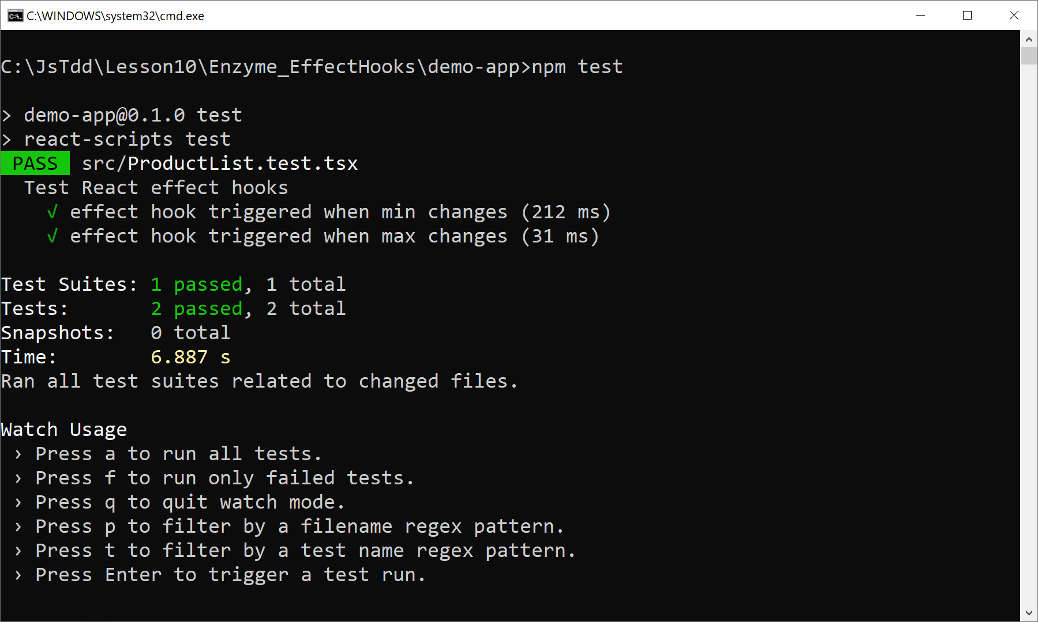
Running the Tests
Run all the tests as follows:
npm test

Slide 99
Lesson 10: Going Further with Testing React Applications
10.9 Using React Testing Library

Slide 100
Overview
We've seen how to test React applications by using Enzyme
Can access component implementation details
Now we'll see how to use React Testing Library, which is based on Testing Library
Cannot access component implementation details

Slide 101
Example Application
Here's the example application:
ReactTestingLibrary/demo-app
Take a look at the following files:
package.json
ProductList.tsx
Now take a look at the test file:
ProductList.test.tsx

Slide 102
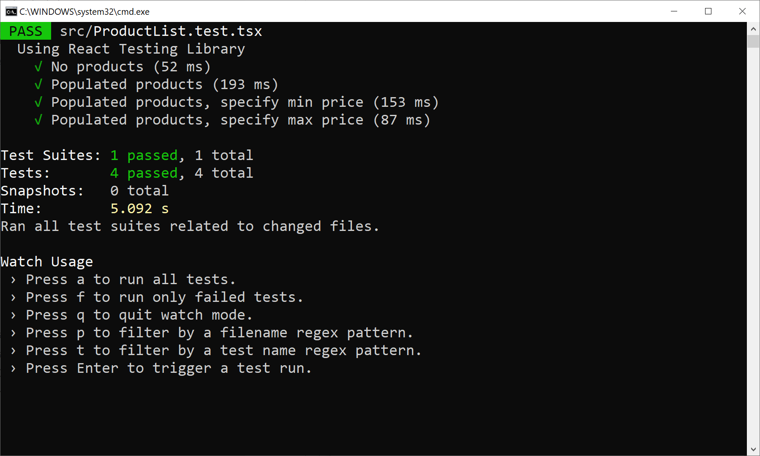
Running the Tests
Run all the tests as follows:
npm test

