Slide 1
Lesson 11: Getting Started with Testing Angular Applications
11.1 Getting started with Angular
11.2 Creating an Angular application
11.3 Defining tests for a simple class
11.4 Defining comprehensive tests for a class
11.5 Understanding Angular components
11.6 Testing a component
11.7 Going further with component testing

Slide 2
Lesson 11: Getting Started with Testing Angular Applications
11.1 Getting Started with Angular

Slide 3
Overview of Angular
Angular is a client-side framework from Google
Makes it easier to develop large-scale rich web apps
How does Angular help?
Client-side data binding
No need for low-level DOM manipulation
Supports dependency injection and services
Angular versions
Angular.js
Angular 2 and above

Slide 4
Overview of Angular CLI
Angular CLI is a command-line interface tool that you can use to create a new Angular application
Scaffolds a complete template application
Generates config files, including test config
Reinforces best practices for file names, etc.
Angular CLI also has commands to generate artifacts in a standard way
Components, services, directives, etc.

Slide 5
Getting Angular CLI
Angular CLI is a Node.js application
So you need to install Node.js or Yarn on your machine first
You can install Angular CLI as follows:
To see the version of Angular CLI installed on your computer:
npm install -g @angular/cli
ng version

Slide 6
Angular CLI Capabilities
Once you've installed Angular CLI, it enables you to:
Create a new app
Add artifacts to the app
Serve an app
Build an app into bundled files
At the time of writing, Angular CLI creates Angular v12 apps
The version is incremented every 6 months

Slide 7
Lesson 11: Getting Started with Testing Angular Applications
11.2 Creating an Angular application

Slide 8
Creating an Application by Using Angular CLI
You can create an Angular application by using Angular CLI
Run the following command from the command line:
You'll be asked a few questions:
Add Angular routing? (choose No)
Stylesheet format? (choose CSS)
See Example1/HelloWorld
ng new HelloWorld

Slide 9
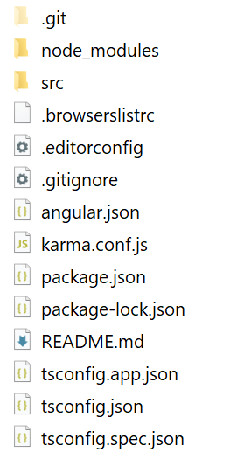
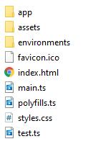
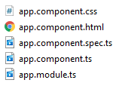
Reviewing the Application
Angular CLI creates a fully functional Angular app with minimalistic functionality:
src folder
src/app folder

Slide 10
Serving the Application
To build the application and serve in memory
Go to the application folder and run this command:
Default host is localhost
Use --host for a different host
Default port is 4200
Use --port for a different port
ng serve

Slide 11
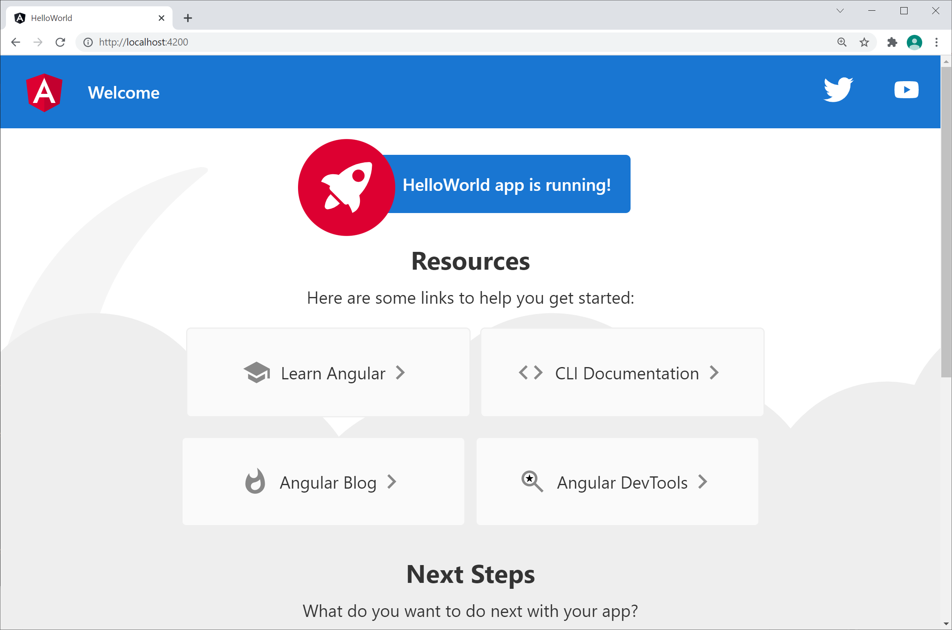
Viewing the Application
To view the application, browse to http://localhost:4200

Slide 12
Lesson 11: Getting Started with Testing Angular Applications
11.3 Defining tests for a simple class

Slide 13
Overview
When you create an application using Angular CLI, it automatically sets up an environment for testing
By default:
Angular uses Jasmine to write tests
Angular uses Karma to run the tests
For the example for this section, see:
Example2/HelloWorld

Slide 14
The Testing Environment
package.json includes various test dependencies:
package.json also defines a script to run tests:
"devDependencies": {
"jasmine-core": "~3.8.0",
"@types/jasmine": "~3.8.0",
"karma": "~6.3.0",
"karma-chrome-launcher": "~3.1.0",
"karma-coverage": "~2.0.3",
"karma-jasmine": "~4.0.0",
"karma-jasmine-html-reporter": "~1.7.0",
…
}
package.json
"scripts": {
"test": "ng test",
…
},
package.json

Slide 15
Generating a Class to Test
You can use Angular CLI to generate many kinds of artifact
For example, to generate a simple class:
Generates 2 files in the src/app folder:
Code file: bank-account.ts
Test file: bank-account.spec.ts
ng g class bank-account

Slide 16
Implementing the Class
Let's implement simple functionality in our class:
Note that Angular uses TypeScript, not JavaScript
export class BankAccount {
constructor(private _name: string = '',
private _balance: number = 0.0) {}
deposit(amount: number) {
this._balance += amount;
}
withdraw(amount: number) {
this._balance -= amount;
}
get balance() {
return this._balance;
}
}
src/app/bank-account.ts

Slide 17
Reviewing the Auto-Generated Test Code
Angular CLI generated the following test code for our class:
Notes:
Angular uses ECMAScript modules
Angular tests uses Jasmine
import { BankAccount } from './bank-account';
describe('BankAccount', () => {
it('should create an instance', () => {
expect(new BankAccount()).toBeTruthy();
});
});
src/app/bank-account.spec.ts

Slide 18
Running Tests
You can use Angular CLI to run tests as follows:
What this does:
Builds the application code
Starts Karma, i.e., the test runner app
Runs all tests, as defined in src/tests.js
Opens a browser and shows the test results
Re-runs tests automatically if you edit any code
ng test --watch

Slide 19
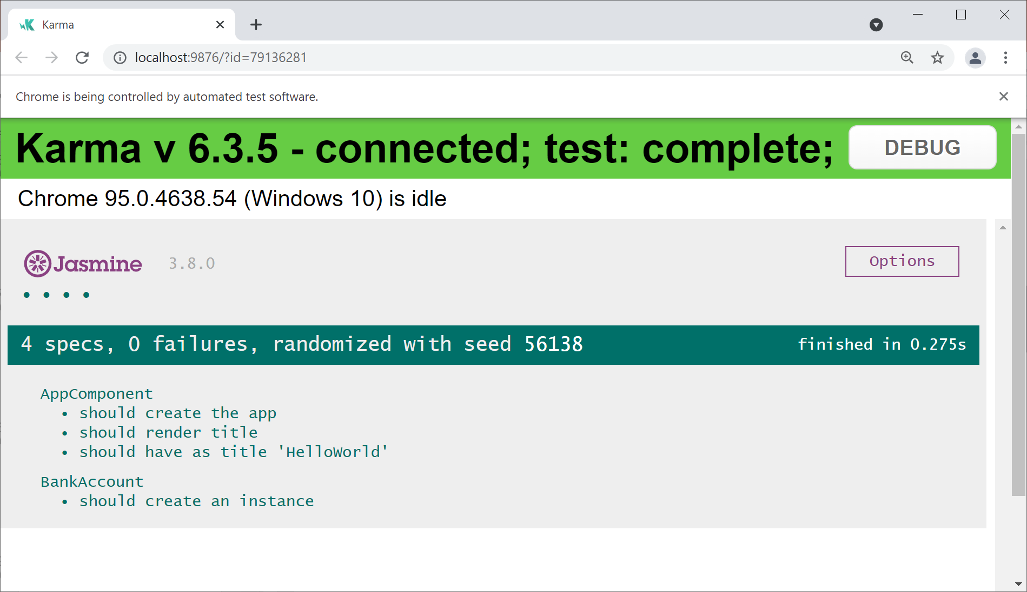
Viewing the Test Results
Here are the results of the test spec(s):

Slide 20
Lesson 11: Getting Started with Testing Angular Applications
11.4 Defining comprehensive tests for a class

Slide 21
Reminder of our BankAccount Class
Here's a reminder of our simple BankAccount class:
See Example3/HelloWorld
export class BankAccount {
constructor(private _name: string = '',
private _balance: number = 0.0) {}
deposit(amount: number) {
this._balance += amount;
}
withdraw(amount: number) {
this._balance -= amount;
}
get balance() {
return this._balance;
}
}
src/app/bank-account.ts

Slide 22
Implementing Comprehensive Tests
Here's a comprehensive set of tests for our class:
import { BankAccount } from './bank-account';
describe('BankAccount', () => {
let acc1: BankAccount;
beforeEach(() => {
acc1 = new BankAccount('Andy', 1000);
});
it('deposit works', () => {
acc1.deposit(200);
expect(acc1.balance).toBe(1200);
});
it('withdraw works', () => {
acc1.withdraw(200);
expect(acc1.balance).toBe(800);
});
});
src/app/bank-account.spec.ts

Slide 23
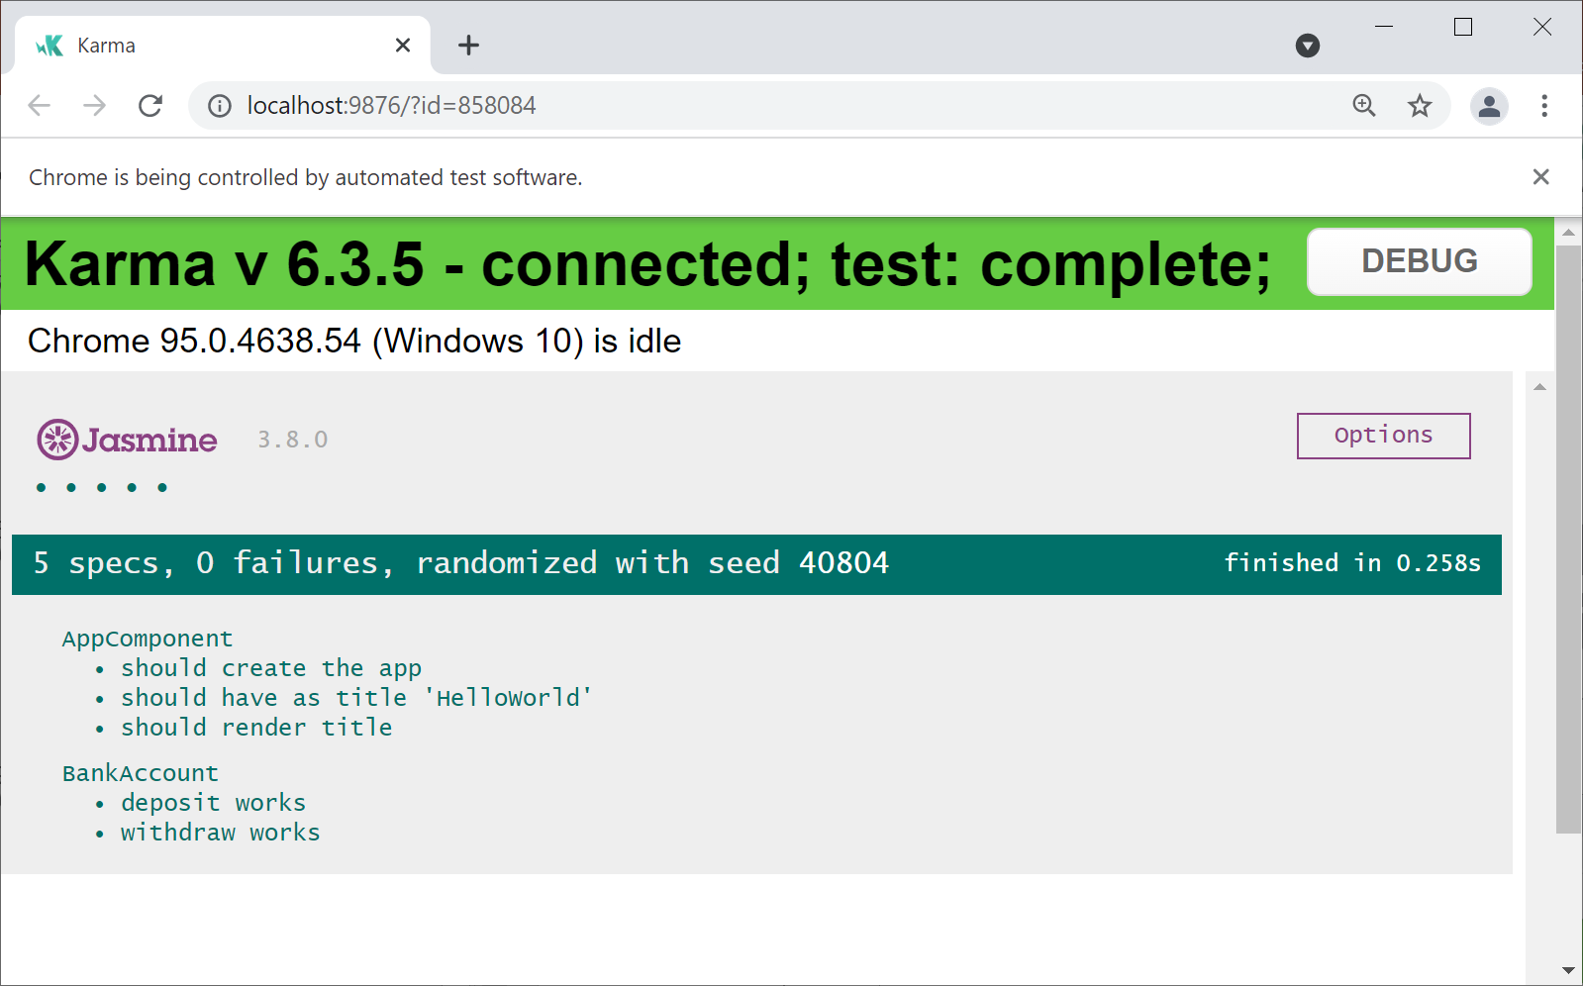
Running the Tests and Viewing Results
Run the tests as follows:
ng test --watch

Slide 24
Lesson 11: Getting Started with Testing Angular Applications
11.5 Understanding Angular components

Slide 25
Overview
In an Angular app, a component is a class that renders HTML
The app initially has one component named AppComponent
In this section we'll see how to generate new components
To represent particular parts of the UI
Example for this section:
Example4/HelloWorld

Slide 26
Generating a New Component
You can use Angular CLI to generate a new component:
Generates 4 files in the src/app/header folder:
header.component.ts
header.component.html
header.component.css
header.component.spec.ts
ng g component header

Slide 27
Viewing the Component Source Code
Here's the source code for our component, as generated by Angular CLI:
import { Component, OnInit } from '@angular/core';
@Component({
selector: 'app-header',
templateUrl: './header.component.html',
styleUrls: ['./header.component.css']
})
export class HeaderComponent implements OnInit {
constructor() { }
ngOnInit(): void { }
}
src/app/header/header.component.ts

Slide 28
Viewing the Component HTML and CSS Files
Here's the HTML template for our component:
Here's the style sheet for our component:
It's empty at the moment!
<p>header works!</p>
src/app/header/header.component.html
src/app/header/header.component.css

Slide 29
Understanding Angular Modules
In Angular, component classes are bundled into a module
This is how Angular is aware of all the components in the app
Here's the module definition in our app:
import { NgModule } from '@angular/core';
import { BrowserModule } from '@angular/platform-browser';
import { AppComponent } from './app.component';
import { HeaderComponent } from './header/header.component';
@NgModule({
declarations: [AppComponent, HeaderComponent],
imports: [BrowserModule],
providers: [],
bootstrap: [AppComponent]
})
export class AppModule { }
src/app/app.module.ts

Slide 30
Using a Component
Recall our header component looks like this:
You use the selector attribute to create an instance of the component in another page
@Component({
selector: 'app-header',
templateUrl: './header.component.html',
styleUrls: ['./header.component.css']
})
export class HeaderComponent implements OnInit {
constructor() { }
ngOnInit(): void { }
}
src/app/header/header.component.ts
<div class="content">
<span>{{title}} app is running!</span>
<app-header></app-header>
</div>
src/app/app.component.html

Slide 31
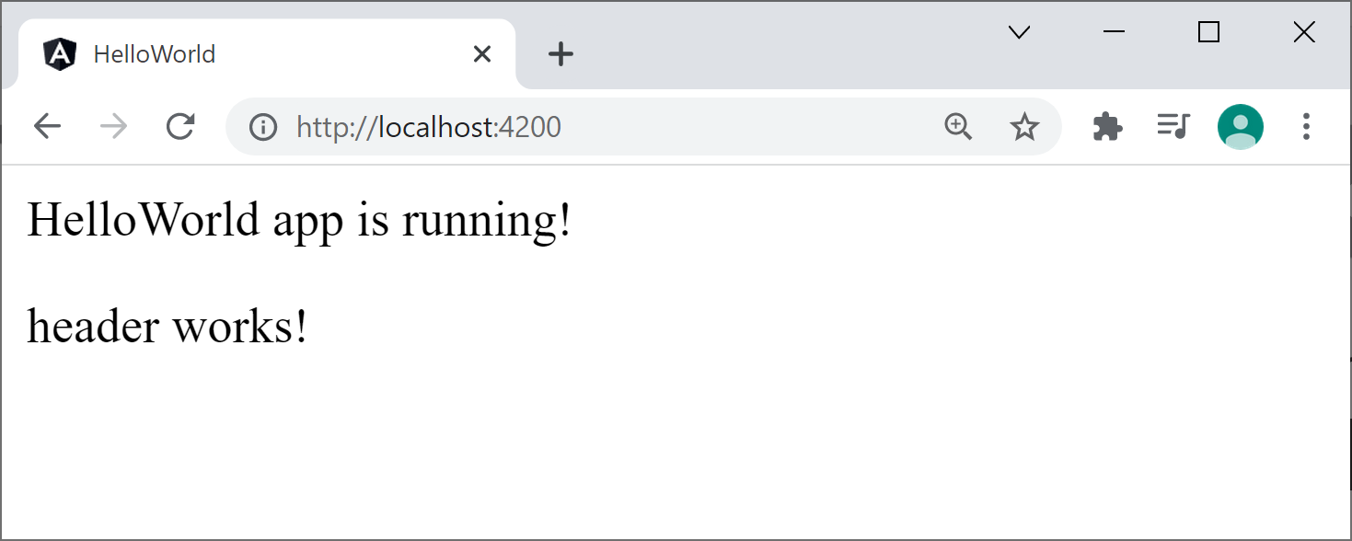
Build and Serving the Application
Build and serve the application as normal:
Browse to http://localhost:4200
Note that it creates and renders an instance of our header component
ng serve

Slide 32
Lesson 11: Getting Started with Testing Angular Applications
11.6 Testing a component

Slide 33
Overview
Angular enables you to define tests for each component in the application
Does the component have the correct state?
Does it render the correct HTML?
Does it handle user events correctly?
Example for this section:
Example4/HelloWorld

Slide 34
Reviewing Tests for a Component
When you generate a component by using Angular CLI, it also generates a test spec for the component
For example, it generates the following test spec for the header component:
Let's take a look at the details…
import { ComponentFixture, TestBed } from '@angular/core/testing';
import { HeaderComponent } from './header.component';
describe('HeaderComponent', () => {
…
});
src/app/header/header.component.spec.ts

Slide 35
Reviewing Tests for a Component
describe('HeaderComponent', () => {
let component: HeaderComponent;
let fixture: ComponentFixture<HeaderComponent>;
beforeEach(async () => {
await TestBed.configureTestingModule({
declarations: [ HeaderComponent ]
})
.compileComponents();
});
beforeEach(() => {
fixture = TestBed.createComponent(HeaderComponent);
component = fixture.componentInstance;
fixture.detectChanges();
});
it('should create', () => {
expect(component).toBeTruthy();
});
});
Here is the full set of tests for HeaderComponent
src/app/header/header.component.spec.ts

Slide 36
Reviewing Tests for a Component
describe('HeaderComponent', () => {
let component: HeaderComponent;
let fixture: ComponentFixture<HeaderComponent>;
beforeEach(async () => {
await TestBed.configureTestingModule({
declarations: [ HeaderComponent ]
})
.compileComponents();
});
beforeEach(() => {
fixture = TestBed.createComponent(HeaderComponent);
component = fixture.componentInstance;
fixture.detectChanges();
});
it('should create', () => {
expect(component).toBeTruthy();
});
});
describe('HeaderComponent', () => {
let component: HeaderComponent;
let fixture: ComponentFixture<HeaderComponent>;
beforeEach(async () => {
await TestBed.configureTestingModule({
declarations: [ HeaderComponent ]
})
.compileComponents();
});
beforeEach(() => {
fixture = TestBed.createComponent(HeaderComponent);
component = fixture.componentInstance;
fixture.detectChanges();
});
it('should create', () => {
expect(component).toBeTruthy();
});
});
TestBed creates an Angular test module, and tells it about the HeaderComponent class
src/app/header/header.component.spec.ts

Slide 37
Reviewing Tests for a Component
describe('HeaderComponent', () => {
let component: HeaderComponent;
let fixture: ComponentFixture<HeaderComponent>;
beforeEach(async () => {
await TestBed.configureTestingModule({
declarations: [ HeaderComponent ]
})
.compileComponents();
});
beforeEach(() => {
fixture = TestBed.createComponent(HeaderComponent);
component = fixture.componentInstance;
fixture.detectChanges();
});
it('should create', () => {
expect(component).toBeTruthy();
});
});
describe('HeaderComponent', () => {
let component: HeaderComponent;
let fixture: ComponentFixture<HeaderComponent>;
beforeEach(async () => {
await TestBed.configureTestingModule({
declarations: [ HeaderComponent ]
})
.compileComponents();
});
beforeEach(() => {
fixture = TestBed.createComponent(HeaderComponent);
component = fixture.componentInstance;
fixture.detectChanges();
});
it('should create', () => {
expect(component).toBeTruthy();
});
});
For each component in the test module, its HTML template is compiled into JavaScript code
src/app/header/header.component.spec.ts

Slide 38
Reviewing Tests for a Component
describe('HeaderComponent', () => {
let component: HeaderComponent;
let fixture: ComponentFixture<HeaderComponent>;
beforeEach(async () => {
await TestBed.configureTestingModule({
declarations: [ HeaderComponent ]
})
.compileComponents();
});
beforeEach(() => {
fixture = TestBed.createComponent(HeaderComponent);
component = fixture.componentInstance;
fixture.detectChanges();
});
it('should create', () => {
expect(component).toBeTruthy();
});
});
describe('HeaderComponent', () => {
let component: HeaderComponent;
let fixture: ComponentFixture<HeaderComponent>;
beforeEach(async () => {
await TestBed.configureTestingModule({
declarations: [ HeaderComponent ]
})
.compileComponents();
});
beforeEach(() => {
fixture = TestBed.createComponent(HeaderComponent);
component = fixture.componentInstance;
fixture.detectChanges();
});
it('should create', () => {
expect(component).toBeTruthy();
});
});
Ask TestBed to create an instance of our component,
so we can test it
The component instance is actually wrapped in a ComponentFixture
src/app/header/header.component.spec.ts

Slide 39
Reviewing Tests for a Component
describe('HeaderComponent', () => {
let component: HeaderComponent;
let fixture: ComponentFixture<HeaderComponent>;
beforeEach(async () => {
await TestBed.configureTestingModule({
declarations: [ HeaderComponent ]
})
.compileComponents();
});
beforeEach(() => {
fixture = TestBed.createComponent(HeaderComponent);
component = fixture.componentInstance;
fixture.detectChanges();
});
it('should create', () => {
expect(component).toBeTruthy();
});
});
describe('HeaderComponent', () => {
let component: HeaderComponent;
let fixture: ComponentFixture<HeaderComponent>;
beforeEach(async () => {
await TestBed.configureTestingModule({
declarations: [ HeaderComponent ]
})
.compileComponents();
});
beforeEach(() => {
fixture = TestBed.createComponent(HeaderComponent);
component = fixture.componentInstance;
fixture.detectChanges();
});
it('should create', () => {
expect(component).toBeTruthy();
});
});
Tell Angular to re-evaluate data binding expressions in the component's HTML template
src/app/header/header.component.spec.ts

Slide 40
Reviewing Tests for a Component
describe('HeaderComponent', () => {
let component: HeaderComponent;
let fixture: ComponentFixture<HeaderComponent>;
beforeEach(async () => {
await TestBed.configureTestingModule({
declarations: [ HeaderComponent ]
})
.compileComponents();
});
beforeEach(() => {
fixture = TestBed.createComponent(HeaderComponent);
component = fixture.componentInstance;
fixture.detectChanges();
});
it('should create', () => {
expect(component).toBeTruthy();
});
});
describe('HeaderComponent', () => {
let component: HeaderComponent;
let fixture: ComponentFixture<HeaderComponent>;
beforeEach(async () => {
await TestBed.configureTestingModule({
declarations: [ HeaderComponent ]
})
.compileComponents();
});
beforeEach(() => {
fixture = TestBed.createComponent(HeaderComponent);
component = fixture.componentInstance;
fixture.detectChanges();
});
it('should create', () => {
expect(component).toBeTruthy();
});
});
This is a simple test
It asserts that the component
instance has been created
successfully
src/app/header/header.component.spec.ts

Slide 41
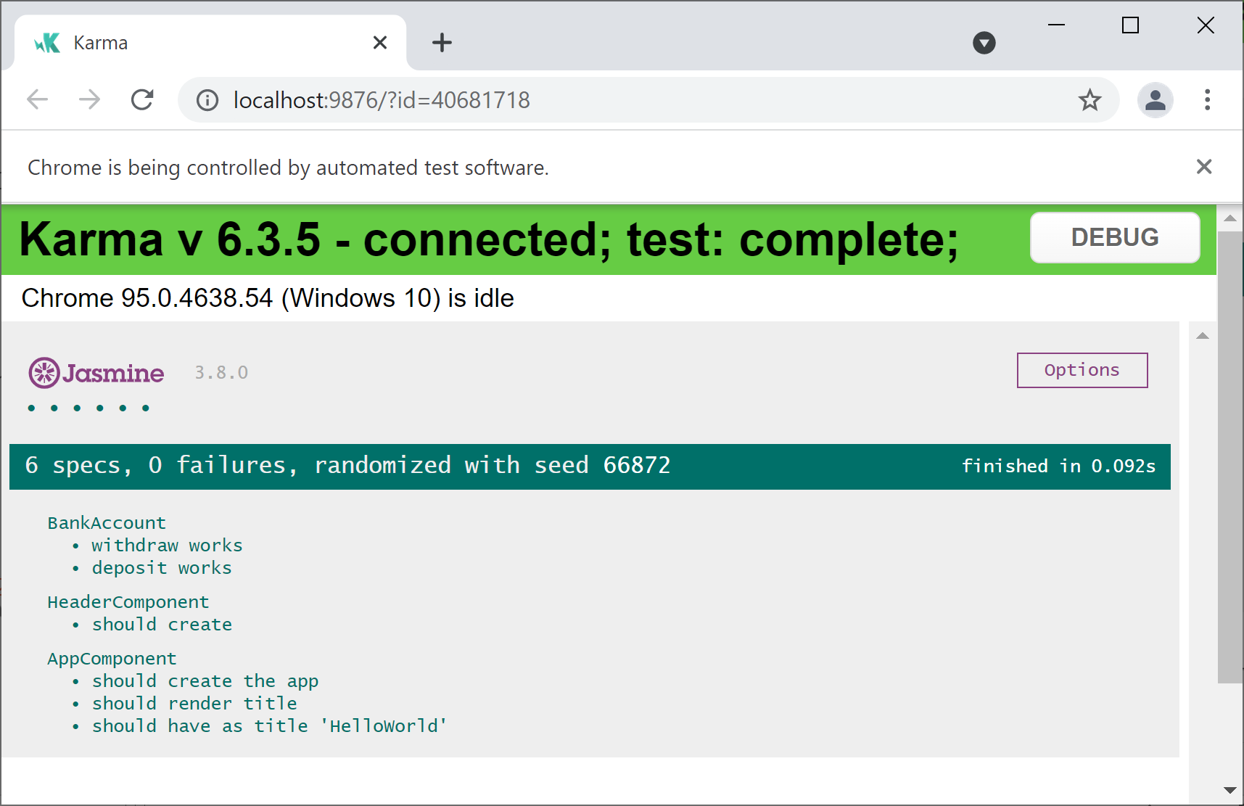
Running the Tests and Viewing Results
Run the tests as normal:
ng test --watch

Slide 42
Lesson 11: Getting Started with Testing Angular Applications
11.7 Going further with component testing

Slide 43
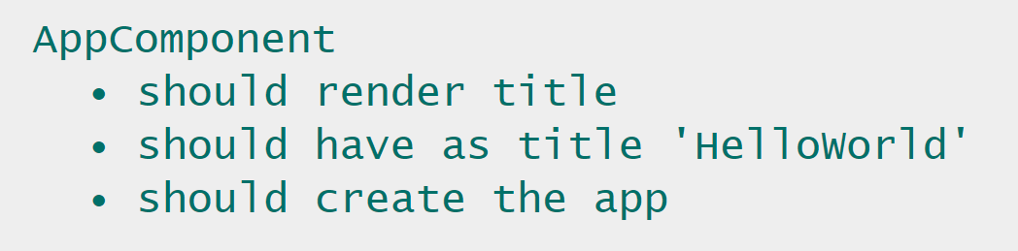
Overview
In the previous session we showed the code and tests for a simple component name HeaderComponent
See Example4/HelloWorld
When we ran the tests, it also displayed test results for AppComponent:

Slide 44
Understanding Application Component Tests
Let's take a closer look at the tests for AppComponent…
In the src/app directory, let's review the following files:
app.component.ts
app.component.html
app.component.spec.ts

