Slide 1
Lesson 12: Going Further with Testing Angular Applications
12.1 Testing a component that has state and functions
12.2 Component DOM testing
12.3 Testing a component that has child components
12.4 Defining a Component that has Inputs and Outputs
12.5 Testing a component that has inputs and outputs
12.6 Testing the parent of a component that has inputs and outputs
12.7 Defining a service
12.8 Testing a service
12.9 Defining a pipe
12.10 Testing a pipe

Slide 2
Lesson 12: Going Further with Testing Angular Applications
12.1 Testing a component that has state and functions

Slide 3
Overview
Some components are relatively straightforward
  A few instance variables, containing values for data binding
  A few simple event handlers, to modify the state
You can test such components just as you'd test a simple class
  Create a component object manually
  Invoke methods to simulate user interactions (i.e., events)
  Assert the component object's state afterwards
We'll see how to do this is this section
  See Example1/DemoApp

Slide 4
Example Component
Here's a simple "toggle switch" component:
@Component(…)
export class ToggleswitchComponent {
public isOn = false;
clicked() {
this.isOn = !this.isOn;
}
get status() {
return `Toggleswitch is ${this.isOn ? 'on' : 'off'}`;
}
get buttonLabel() {
return `TURN ${this.isOn ? 'OFF' : 'ON'}`;
}
}
toggleswitch.component.ts
<p>
<span>{{status}}</span>&nbsp;
<button (click)="clicked()">{{buttonLabel}}</button>
</p>
toggleswitch.component.html

Slide 5
Testing the Component
Here's how we can test the component:
describe('ToggleswitchComponent', () => {
let comp: ToggleswitchComponent;
beforeEach(() => {
comp = new ToggleswitchComponent();
});
it('ToggleswitchComponent off initially', () => {
expect(comp.isOn).toBe(false);
expect(comp.status).toBe('Toggleswitch is off');
expect(comp.buttonLabel).toBe('TURN ON');
});
it('ToggleswitchComponent is on after 1 click', () => {
comp.clicked();
expect(comp.isOn).toBe(true);
expect(comp.status).toBe('Toggleswitch is on');
expect(comp.buttonLabel).toBe('TURN OFF');
});
…
});
toggleswitch.component.spec.ts

Slide 6
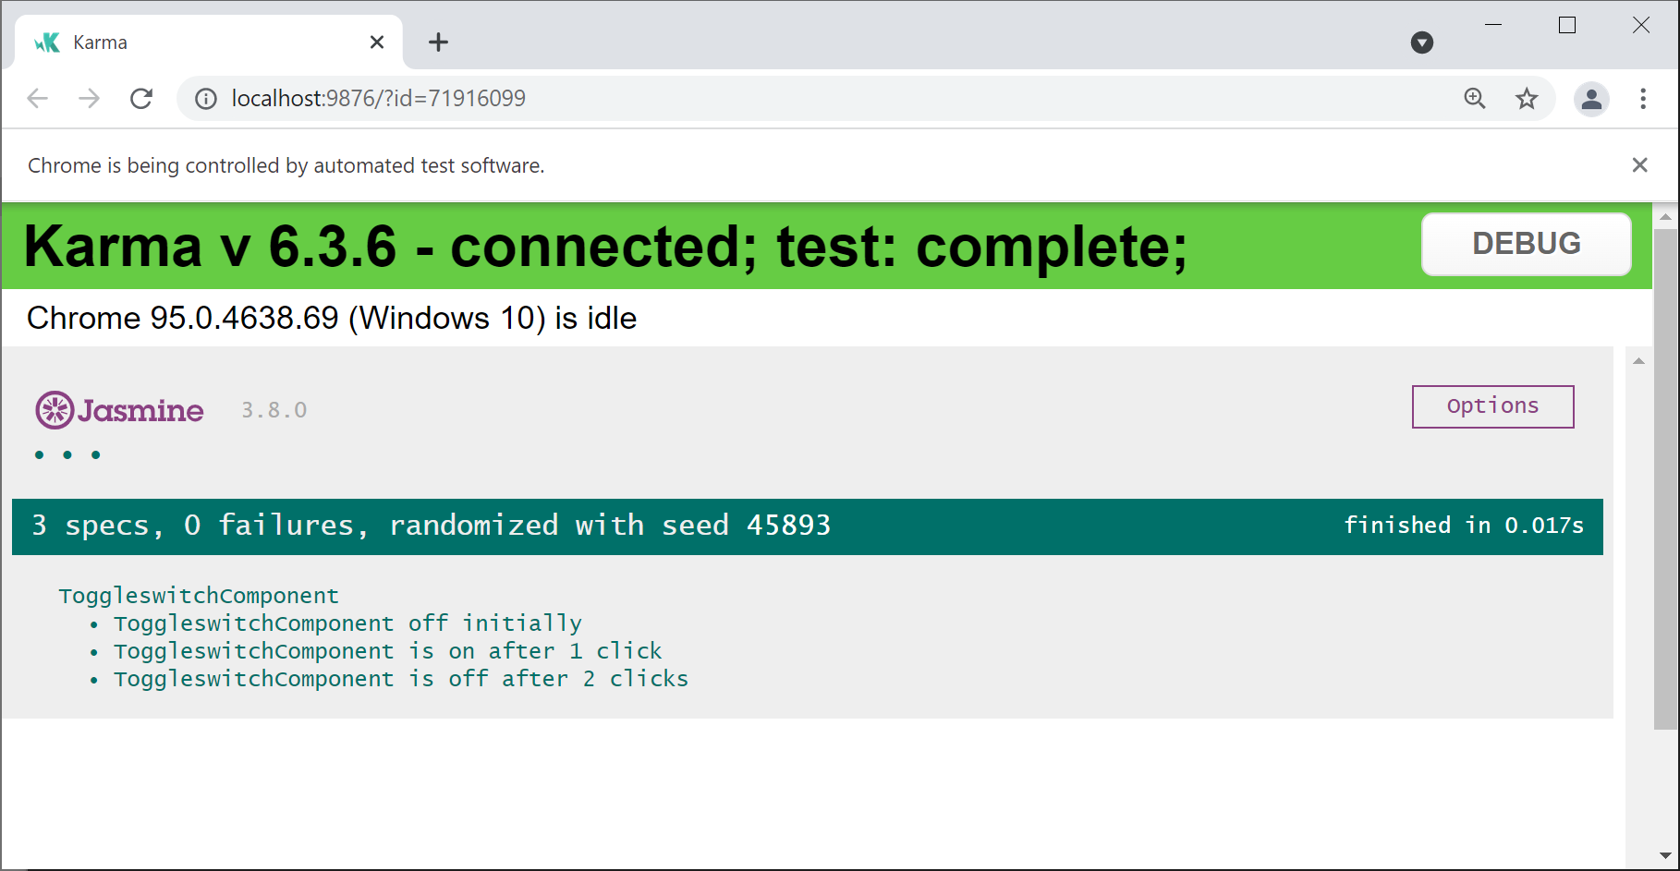
Running the Tests
Let's run the tests for the "toggle switch" component:
ng test --include=**/toggleswitch.component.spec.ts --watch

Slide 7
Lesson 12: Going Further with Testing Angular Applications
12.2 Component DOM testing

Slide 8
Overview
In this section we'll test a component in context in a DOM tree
  How does a component interact with the DOM?
We'll use the following Angular test classes
to help us write our tests:
  TestBed
  ComponentFixture
Example for this section:
  Example1/DemoApp

Slide 9
Example Component
Here's a simple "banner" component:
Let's see how to test the component…
@Component(…)
export class BannerComponent {
title = 'croeso pawb!';
uppercase = false;
clickTitle() {
this.uppercase = !this.uppercase;
if (this.uppercase)
this.title = this.title.toUpperCase();
else
this.title = this.title.toLowerCase();
}
}
banner.component.ts
<h1 (click)="clickTitle()">{{title}}</h1>
banner.component.html

Slide 10
Testing the Component: Step 1
Configure an Angular testing module
Compile the component's HTML into JS
describe('BannerComponent', () => {
beforeEach(async () => {
await TestBed.configureTestingModule({
declarations: [ BannerComponent ]
})
.compileComponents();
});
…
}
describe('BannerComponent', () => {
beforeEach(async () => {
await TestBed.configureTestingModule({
declarations: [ BannerComponent ]
})
.compileComponents();
});
…
}
describe('BannerComponent', () => {
beforeEach(async () => {
await TestBed.configureTestingModule({
declarations: [ BannerComponent ]
})
.compileComponents();
});
…
}
banner.component.spec.ts

Slide 11
Testing the Component: Step 2
Create an instance of the component
  Wrapped in a ComponentFixture,
  which provides access to the component
  plus its DOM tree
Perform data binding on the component
describe('BannerComponent', () => {
let component: BannerComponent;
let fixture: ComponentFixture<BannerComponent>;
beforeEach(() => {
fixture = TestBed.createComponent(BannerComponent);
component = fixture.componentInstance;
fixture.detectChanges();
});
…
}
describe('BannerComponent', () => {
let component: BannerComponent;
let fixture: ComponentFixture<BannerComponent>;
beforeEach(() => {
fixture = TestBed.createComponent(BannerComponent);
component = fixture.componentInstance;
fixture.detectChanges();
});
…
}
describe('BannerComponent', () => {
let component: BannerComponent;
let fixture: ComponentFixture<BannerComponent>;
beforeEach(() => {
fixture = TestBed.createComponent(BannerComponent);
component = fixture.componentInstance;
fixture.detectChanges();
});
…
}
banner.component.spec.ts

Slide 12
Testing the Component: Step 3
For our component, get the root element
in its DOM tree
Get specific content within the element
Assert the content is correct
describe('BannerComponent', () => {
…
it('should have <h1> with "croeso pawb!"', () => {
const bannerElement = fixture.nativeElement as HTMLElement;
const h1 = bannerElement.querySelector('h1');
expect(h1?.textContent).toEqual('croeso pawb!');
});
}
describe('BannerComponent', () => {
…
it('should have <h1> with "croeso pawb!"', () => {
const bannerElement = fixture.nativeElement as HTMLElement;
const h1 = bannerElement.querySelector('h1');
expect(h1?.textContent).toEqual('croeso pawb!');
});
}
describe('BannerComponent', () => {
…
it('should have <h1> with "croeso pawb!"', () => {
const bannerElement = fixture.nativeElement as HTMLElement;
const h1 = bannerElement.querySelector('h1');
expect(h1?.textContent).toEqual('croeso pawb!');
});
}
describe('BannerComponent', () => {
…
it('should have <h1> with "croeso pawb!"', () => {
const bannerElement = fixture.nativeElement as HTMLElement;
const h1 = bannerElement.querySelector('h1');
expect(h1?.textContent).toEqual('croeso pawb!');
});
}
banner.component.spec.ts

Slide 13
Testing the Component: Step 4
Get <h1> element in our component DOM
Dispatch a click event to <h1>
Tell Angular to perform data binding
Assert component's DOM has been updated
describe('BannerComponent', () => {
…
it('should handle click event and display title in u/c', () => {
const bannerElement = fixture.nativeElement as HTMLElement;
const h1 = bannerElement.querySelector('h1');
h1?.dispatchEvent(new Event('click'));
fixture.detectChanges();
expect(h1?.textContent).toEqual('CROESO PAWB!');
});
}
describe('BannerComponent', () => {
…
it('should handle click event and display title in u/c', () => {
const bannerElement = fixture.nativeElement as HTMLElement;
const h1 = bannerElement.querySelector('h1');
h1?.dispatchEvent(new Event('click'));
fixture.detectChanges();
expect(h1?.textContent).toEqual('CROESO PAWB!');
});
}
describe('BannerComponent', () => {
…
it('should handle click event and display title in u/c', () => {
const bannerElement = fixture.nativeElement as HTMLElement;
const h1 = bannerElement.querySelector('h1');
h1?.dispatchEvent(new Event('click'));
fixture.detectChanges();
expect(h1?.textContent).toEqual('CROESO PAWB!');
});
}
describe('BannerComponent', () => {
…
it('should handle click event and display title in u/c', () => {
const bannerElement = fixture.nativeElement as HTMLElement;
const h1 = bannerElement.querySelector('h1');
h1?.dispatchEvent(new Event('click'));
fixture.detectChanges();
expect(h1?.textContent).toEqual('CROESO PAWB!');
});
}
describe('BannerComponent', () => {
…
it('should handle click event and display title in u/c', () => {
const bannerElement = fixture.nativeElement as HTMLElement;
const h1 = bannerElement.querySelector('h1');
h1?.dispatchEvent(new Event('click'));
fixture.detectChanges();
expect(h1?.textContent).toEqual('CROESO PAWB!');
});
}
banner.component.spec.ts

Slide 14
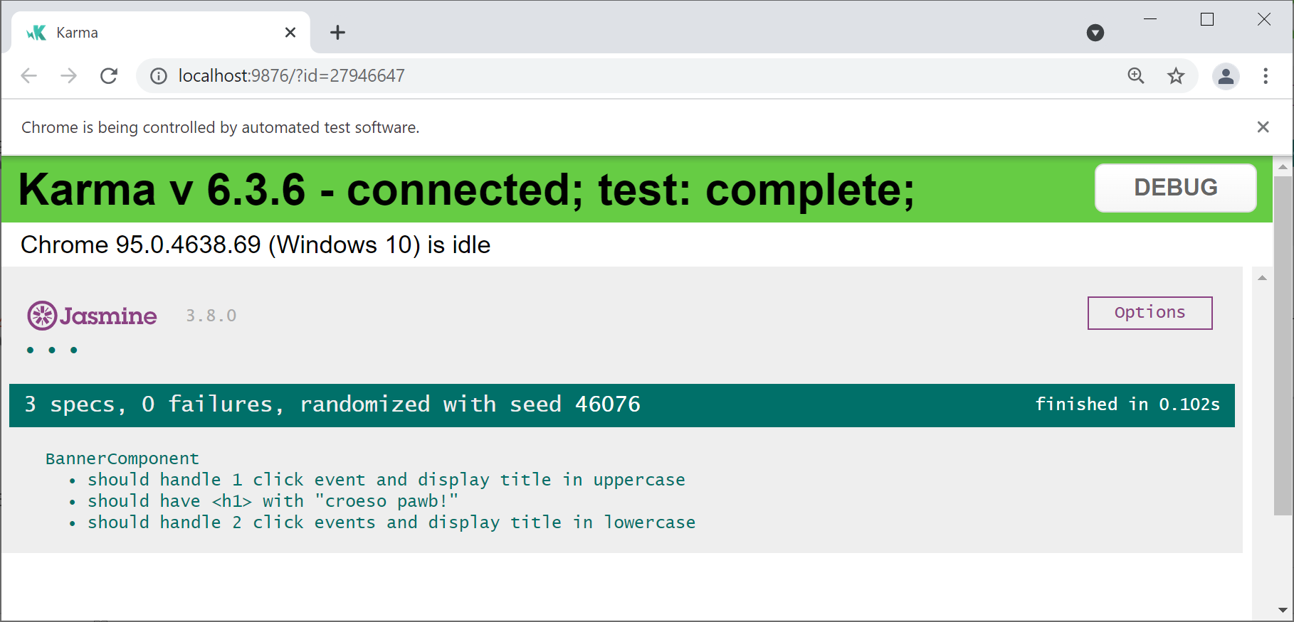
Running the Tests
Let's run the tests for the "banner" component:
ng test --include=**/banner.component.spec.ts --watch

Slide 15
Lesson 12: Going Further with Testing Angular Applications
12.3 Testing a component that has child components

Slide 16
Overview
A component's HTML template can contain child components
  Typically the child components are irrelevant to us
  when we're testing the parent component
How can we test the parent component,
without having to predict the HTML
for all its child components?
We'll see how to do this in this section
  See Example1/DemoApp

Slide 17
Example Component
In our demo app, the HTML template for AppComponent
renders 2 child components:
You can see these child components
when you run the application:
<app-toggleswitch></app-toggleswitch>
<app-banner></app-banner>
<h2>Resources</h2>
…
app.component.html
ng serve

Slide 18
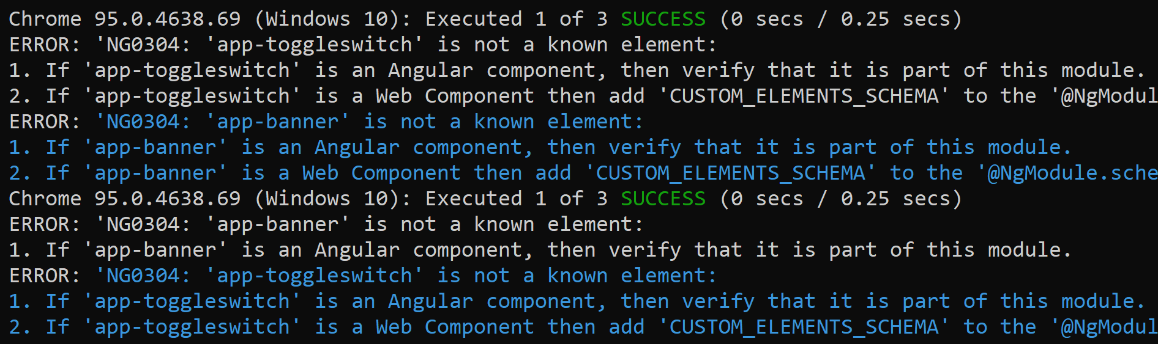
First Attempt to Test AppComponent
Let's see what happens when we test AppComponent:
When TestBed compiles the HTML template
for AppComponent, it doesn't recognize
<app-banner> or <app-toggleswitch>
ng test --include=**/app.component.spec.ts --watch

Slide 19
Stubbing Child Components
Define stub child component classes
Add the stub classes to the testing module
import { Component } from '@angular/core';
@Component({selector: 'app-toggleswitch', template: ''})
class ToggleswitchStubComponent {}
Component({selector: 'app-banner', template: ''})
class BannerStubComponent {}
describe('AppComponent', () => {
beforeEach(async () => {
await TestBed.configureTestingModule({
declarations: [
AppComponent,
ToggleswitchStubComponent,
BannerStubComponent
],
}).compileComponents();
});
…
import { Component } from '@angular/core';
@Component({selector: 'app-toggleswitch', template: ''})
class ToggleswitchStubComponent {}
Component({selector: 'app-banner', template: ''})
class BannerStubComponent {}
describe('AppComponent', () => {
beforeEach(async () => {
await TestBed.configureTestingModule({
declarations: [
AppComponent,
ToggleswitchStubComponent,
BannerStubComponent
],
}).compileComponents();
});
…
import { Component } from '@angular/core';
@Component({selector: 'app-toggleswitch', template: ''})
class ToggleswitchStubComponent {}
Component({selector: 'app-banner', template: ''})
class BannerStubComponent {}
describe('AppComponent', () => {
beforeEach(async () => {
await TestBed.configureTestingModule({
declarations: [
AppComponent,
ToggleswitchStubComponent,
BannerStubComponent
],
}).compileComponents();
});
…
app.component.spec.ts

Slide 20
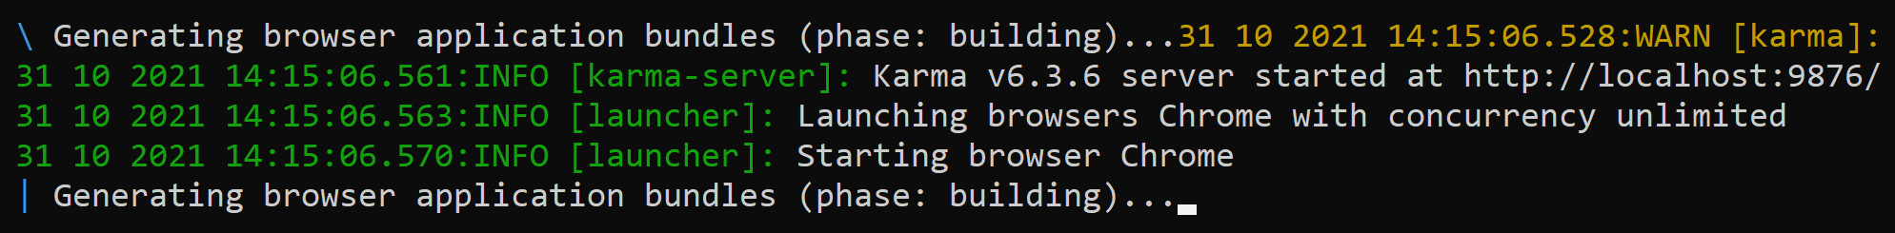
Testing AppComponent Again
Let's see what happens when we test AppComponent now:
TestBed now recognizes the tags
<app-banner> and <app-toggleswitch>
TestBed creates instances of the stub classes
and renders their dummy HTML templates
ng test --include=**/app.component.spec.ts --watch

Slide 21
Lesson 12: Going Further with Testing Angular Applications
12.4 Defining a component that has inputs and outputs

Slide 22
Overview
Imagine you have an app with a hierarchy of components…
High-level component:
  Gets data from somewhere, e.g., REST
  Passes the data to a low-level component,
  to be rendered appropriately
Low-level component:
  Receives input from parent and renders it
  Can notify parent of important events

Slide 23
Example Application
Let's see an app that has a hierarchy of components:
  Example2/DemoApp
Run the app as normal:
The app has 2 components:
  High-level: AppComponent
  Low-level: ProductComponent
ng serve

Slide 24
Defining Basic Classes and Interfaces
We've defined a simple Product class
  Holds info about a product
We've also defined a Sale interface
  Holds info about a sale, i.e., when the user
  clicks the 'Buy' button for a product
export class Product {
constructor(
public description: string,
public category: string,
public price: number) {}
}
product.ts
export interface Sale {
productDescription: string;
quantity: number;
};
sale.ts

Slide 25
Defining the ProductComponent Class
import { Component, Input, Output, EventEmitter } from '@angular/core';
import { Product } from '../product';
import { Sale } from '../sale';
@Component({
selector: 'app-product',
templateUrl: './product.component.html',
styleUrls: ['./product.component.css']
})
export class ProductComponent {
@Input()
product!: Product;
@Output()
sale: EventEmitter<Sale> = new EventEmitter();
clicked() {
let eventData: Sale = {
productDescription: this.product.description,
quantity: 1
};
this.sale.emit(eventData);
}
}
Here's our low-level ProductComponent
class definition
product/product.component.ts

Slide 26
Defining the ProductComponent Class
import { Component, Input, Output, EventEmitter } from '@angular/core';
import { Product } from '../product';
import { Sale } from '../sale';
@Component({
selector: 'app-product',
templateUrl: './product.component.html',
styleUrls: ['./product.component.css']
})
export class ProductComponent {
@Input()
product!: Product;
@Output()
sale: EventEmitter<Sale> = new EventEmitter();
clicked() {
let eventData: Sale = {
productDescription: this.product.description,
quantity: 1
};
this.sale.emit(eventData);
}
}
ProductComponent
receives a Product object as an input
This object will be passed in as a parameter from the parent component
product/product.component.ts

Slide 27
Defining the ProductComponent Class
import { Component, Input, Output, EventEmitter } from '@angular/core';
import { Product } from '../product';
import { Sale } from '../sale';
@Component({
selector: 'app-product',
templateUrl: './product.component.html',
styleUrls: ['./product.component.css']
})
export class ProductComponent {
@Input()
product!: Product;
@Output()
sale: EventEmitter<Sale> = new EventEmitter();
clicked() {
let eventData: Sale = {
productDescription: this.product.description,
quantity: 1
};
this.sale.emit(eventData);
}
}
ProductComponent
emits an event called sale
This event will be handled by the parent component
product/product.component.ts

Slide 28
Defining the ProductComponent Class
import { Component, Input, Output, EventEmitter } from '@angular/core';
import { Product } from '../product';
import { Sale } from '../sale';
@Component({
selector: 'app-product',
templateUrl: './product.component.html',
styleUrls: ['./product.component.css']
})
export class ProductComponent {
@Input()
product!: Product;
@Output()
sale: EventEmitter<Sale> = new EventEmitter();
clicked() {
let eventData: Sale = {
productDescription: this.product.description,
quantity: 1
};
this.sale.emit(eventData);
}
}
ProductComponent emits a sale event whenever the user clicks 'Buy' for a product
product/product.component.ts

Slide 29
Defining the ProductComponent Template
<div class="productItem">
<h3>{{product.description }}</h3>
<div>Category: {{ product.category }}</div>
<div>Price: £ {{ product.price }}</div>
<button (click)="clicked()">Buy</button>
</div>
Here's the HTML template for ProductComponent
product/product.component.html

Slide 30
Defining the ProductComponent Template
<div class="productItem">
<h3>{{ product.description }}</h3>
<div>Category: {{ product.category }}</div>
<div>Price: £ {{ product.price }}</div>
<button (click)="clicked()">Buy</button>
</div>
ProductComponent
displays details for a product
product/product.component.html

Slide 31
Defining the ProductComponent Template
<div class="productItem">
<h3>{{ product.description }}</h3>
<div>Category: {{ product.category }}</div>
<div>Price: £ {{ product.price }}</div>
<button (click)="clicked()">Buy</button>
</div>
ProductComponent
handles the click event for the 'Buy' button
product/product.component.html

Slide 32
Defining AppComponent
import { Component } from '@angular/core';
import { Product } from './product';
import { Sale } from './sale';
@Component(…)
export class AppComponent {
products: Array<Product> = [];
sales: Array<string> = [];
constructor() {
this.products = [
new Product('65 inch UHDTV', 'TV/Audio', 1800),
new Product('Carving skis', 'Sports equipment', 350),
new Product('Ski boots', 'Sports equipment', 150)
];
}
saleHandler(event: Sale) {
const msg = `${event.productDescription} [${event.quantity}]`;
this.sales.push(msg);
}
}
Here's our high-level AppComponent class definition
app.component.ts

Slide 33
Defining AppComponent
import { Component } from '@angular/core';
import { Product } from './product';
import { Sale } from './sale';
@Component(…)
export class AppComponent {
products: Array<Product> = [];
sales: Array<string> = [];
constructor() {
this.products = [
new Product('65 inch UHDTV', 'TV/Audio', 1800),
new Product('Carving skis', 'Sports equipment', 350),
new Product('Ski boots', 'Sports equipment', 150)
];
}
saleHandler(event: Sale) {
const msg = `${event.productDescription} [${event.quantity}]`;
this.sales.push(msg);
}
}
AppComponent holds the data for all the products
app.component.ts

Slide 34
Defining AppComponent
import { Component } from '@angular/core';
import { Product } from './product';
import { Sale } from './sale';
@Component(…)
export class AppComponent {
products: Array<Product> = [];
sales: Array<string> = [];
constructor() {
this.products = [
new Product('65 inch UHDTV', 'TV/Audio', 1800),
new Product('Carving skis', 'Sports equipment', 350),
new Product('Ski boots', 'Sports equipment', 150)
];
}
saleHandler(event: Sale) {
const msg = `${event.productDescription} [${event.quantity}]`;
this.sales.push(msg);
}
}
AppComponent handles sale events from child components (i.e., from ProductComponents)
app.component.ts

Slide 35
Defining the AppComponent Template
<h1>Products</h1>
<div *ngFor="let p of products">
<app-product
[product]="p"
(sale)="saleHandler($event)">
</app-product>
</div>
<h1>Sales</h1>
<ul>
<li *ngFor="let s of sales">
{{s}}
</li>
</ul>
Here's the HTML template for AppComponent
app.component.html

Slide 36
Defining the AppComponent Template
<h1>Products</h1>
<div *ngFor="let p of products">
<app-product
[product]="p"
(sale)="saleHandler($event)">
</app-product>
</div>
<h1>Sales</h1>
<ul>
<li *ngFor="let s of sales">
{{s}}
</li>
</ul>
AppComponent loops through all the products
app.component.html

Slide 37
Defining the AppComponent Template
<h1>Products</h1>
<div *ngFor="let p of products">
<app-product
[product]="p"
(sale)="saleHandler($event)">
</app-product>
</div>
<h1>Sales</h1>
<ul>
<li *ngFor="let s of sales">
{{s}}
</li>
</ul>
<app-product>
Creates and renders a ProductComponent
for a product
app.component.html

Slide 38
Defining the AppComponent Template
<h1>Products</h1>
<div *ngFor="let p of products">
<app-product
[product]="p"
(sale)="saleHandler($event)">
</app-product>
</div>
<h1>Sales</h1>
<ul>
<li *ngFor="let s of sales">
{{s}}
</li>
</ul>
[product]
Passes an input parameter into ProductComponent
app.component.html

Slide 39
Defining the AppComponent Template
<h1>Products</h1>
<div *ngFor="let p of products">
<app-product
[product]="p"
(sale)="saleHandler($event)">
</app-product>
</div>
<h1>Sales</h1>
<ul>
<li *ngFor="let s of sales">
{{s}}
</li>
</ul>
(sale)
Handles the sale event from ProductComponent
app.component.html

Slide 40
Defining the AppComponent Template
<h1>Products</h1>
<div *ngFor="let p of products">
<app-product
[product]="p"
(sale)="saleHandler($event)">
</app-product>
</div>
<h1>Sales</h1>
<ul>
<li *ngFor="let s of sales">
{{s}}
</li>
</ul>
Display all sales in a list
app.component.html

Slide 41
Lesson 12: Going Further with Testing Angular Applications
12.5 Testing a component that has inputs and outputs

Slide 42
Defining a Component with Inputs and Outputs
Here's a reminder of our ProductComponent class
  See Example2/DemoApp
Let's see how to test ProductComponent…
import { Component, Input, Output, EventEmitter } from '@angular/core';
import { Product } from '../product';
import { Sale } from '../sale';
@Component(…)
export class ProductComponent {
@Input()
product!: Product;
@Output()
sale: EventEmitter<Sale> = new EventEmitter();
…
}
product/product.component.ts

Slide 43
Setting the Component's @Input Property
Here's how to set the component's @Input property:
  Set the @Input property explicitly, to simulate
  receiving a value from the parent component
  Tell Angular to perform data binding
describe('ProductComponent', () => {
let component: ProductComponent;
let fixture: ComponentFixture<ProductComponent>;
let product: Product;
beforeEach(() => {
fixture = TestBed.createComponent(ProductComponent);
component = fixture.componentInstance;
product = new Product('Bose sound system', 'TV/Audio', 450);
component.product = product;
fixture.detectChanges();
});
…
});
describe('ProductComponent', () => {
let component: ProductComponent;
let fixture: ComponentFixture<ProductComponent>;
let product: Product;
beforeEach(() => {
fixture = TestBed.createComponent(ProductComponent);
component = fixture.componentInstance;
product = new Product('Bose sound system', 'TV/Audio', 450);
component.product = product;
fixture.detectChanges();
});
…
});
describe('ProductComponent', () => {
let component: ProductComponent;
let fixture: ComponentFixture<ProductComponent>;
let product: Product;
beforeEach(() => {
fixture = TestBed.createComponent(ProductComponent);
component = fixture.componentInstance;
product = new Product('Bose sound system', 'TV/Audio', 450);
component.product = product;
fixture.detectChanges();
});
…
});
product/product.component.spec.ts

Slide 44
Testing the Component Renders HTML Correctly
Here's how to test that the component renders the correct HTML:
  Get the native HTML element for the component
  Get all children of an element with class product
  Assert the children display correct product info
describe('ProductComponent', () => {
…
it('should render product details', () => {
const componentElem: HTMLElement = fixture.nativeElement;
const divChildren = componentElem.querySelectorAll('.product > *');
expect(divChildren[0]?.textContent).toMatch('Bose sound system');
expect(divChildren[1]?.textContent).toMatch('TV/Audio');
expect(divChildren[2]?.textContent).toMatch('450');
});
…
});
describe('ProductComponent', () => {
…
it('should render product details', () => {
const componentElem: HTMLElement = fixture.nativeElement;
const divChildren = componentElem.querySelectorAll('.product > *');
expect(divChildren[0]?.textContent).toMatch('Bose sound system');
expect(divChildren[1]?.textContent).toMatch('TV/Audio');
expect(divChildren[2]?.textContent).toMatch('450');
});
…
});
describe('ProductComponent', () => {
…
it('should render product details', () => {
const componentElem: HTMLElement = fixture.nativeElement;
const divChildren = componentElem.querySelectorAll('.product > *');
expect(divChildren[0]?.textContent).toMatch('Bose sound system');
expect(divChildren[1]?.textContent).toMatch('TV/Audio');
expect(divChildren[2]?.textContent).toMatch('450');
});
…
});
describe('ProductComponent', () => {
…
it('should render product details', () => {
const componentElem: HTMLElement = fixture.nativeElement;
const divChildren = componentElem.querySelectorAll('.product > *');
expect(divChildren[0]?.textContent).toMatch('Bose sound system');
expect(divChildren[1]?.textContent).toMatch('TV/Audio');
expect(divChildren[2]?.textContent).toMatch('450');
});
…
});
product/product.component.spec.ts

Slide 45
Handling the Component's @Output Property
Here's how to handle the component's @Output property:
  Subscribe to the sale event from the component
  Simulate a button click, which triggers a sale event
  Assert the component emits a correct sale event
describe('ProductComponent', () => {
…
it('should emit a sale event when button clicked', () => {
let saleEmitted! : Sale;
component.sale.subscribe((sale: Sale) => saleEmitted = sale);
const componentElem: HTMLElement = fixture.nativeElement;
const button = componentElem.querySelector('button');
button?.click();
expect(saleEmitted?.productDescription).toBe('Bose sound system');
expect(saleEmitted?.quantity).toBe(1);
});
});
describe('ProductComponent', () => {
…
it('should emit a sale event when button clicked', () => {
let saleEmitted! : Sale;
component.sale.subscribe((sale: Sale) => saleEmitted = sale);
const componentElem: HTMLElement = fixture.nativeElement;
const button = componentElem.querySelector('button');
button?.click();
expect(saleEmitted?.productDescription).toBe('Bose sound system');
expect(saleEmitted?.quantity).toBe(1);
});
});
describe('ProductComponent', () => {
…
it('should emit a sale event when button clicked', () => {
let saleEmitted! : Sale;
component.sale.subscribe((sale: Sale) => saleEmitted = sale);
const componentElem: HTMLElement = fixture.nativeElement;
const button = componentElem.querySelector('button');
button?.click();
expect(saleEmitted?.productDescription).toBe('Bose sound system');
expect(saleEmitted?.quantity).toBe(1);
});
});
describe('ProductComponent', () => {
…
it('should emit a sale event when button clicked', () => {
let saleEmitted! : Sale;
component.sale.subscribe((sale: Sale) => saleEmitted = sale);
const componentElem: HTMLElement = fixture.nativeElement;
const button = componentElem.querySelector('button');
button?.click();
expect(saleEmitted?.productDescription).toBe('Bose sound system');
expect(saleEmitted?.quantity).toBe(1);
});
});
product/product.component.spec.ts

Slide 46
Lesson 12: Going Further with Testing Angular Applications
12.6 Testing the parent of a component that has inputs and outputs

Slide 47
Defining a Component with Inputs and Outputs
Here's a reminder of our ProductComponent class
  See Example2/DemoApp
@Component(…)
export class ProductComponent {
@Input()
product!: Product;
@Output()
sale: EventEmitter<Sale> = new EventEmitter();
…
}
product/product.component.ts

Slide 48
Defining the Parent Component
Here's the parent component, i.e., AppComponent
  Holds data for a bunch of products
Let's see how to test AppComponent…
@Component(…)
export class AppComponent {
products: Array<Product> = [];
sales: Array<string> = [];
…
}
app.component.ts

Slide 49
Testing AppComponent
Here's how to get started testing AppComponent:
  Define a stub class for the child component
  Load the stub class into the testing module
@Component({selector: 'app-product', template: ''})
class ProductStubComponent {
@Input()
product!: Product
@Output()
sale: EventEmitter<Sale> = new EventEmitter();
};
describe('AppComponent', () => {
beforeEach(async () => {
await TestBed.configureTestingModule({
declarations: [ AppComponent, ProductStubComponent ],
}).compileComponents();
});
…
});
@Component({selector: 'app-product', template: ''})
class ProductStubComponent {
@Input()
product!: Product
@Output()
sale: EventEmitter<Sale> = new EventEmitter();
};
describe('AppComponent', () => {
beforeEach(async () => {
await TestBed.configureTestingModule({
declarations: [ AppComponent, ProductStubComponent ],
}).compileComponents();
});
…
});
@Component({selector: 'app-product', template: ''})
class ProductStubComponent {
@Input()
product!: Product
@Output()
sale: EventEmitter<Sale> = new EventEmitter();
};
describe('AppComponent', () => {
beforeEach(async () => {
await TestBed.configureTestingModule({
declarations: [ AppComponent, ProductStubComponent ],
}).compileComponents();
});
…
});
app.component.spec.ts

Slide 50
Testing AppComponent
Test AppComponent creates child components correctly:
  Create AppComponent (which has 3 products)
  Tell Angular to perform data binding
  Assert child components are created correctly
import { By } from '@angular/platform-browser';
…
describe('AppComponent', () => {
…
it(`should have correct number of ProductComponent children`, () => {
const fixture = TestBed.createComponent(AppComponent);
fixture.detectChanges();
let productComponentTags = fixture.debugElement
.queryAll(By.css('app-product'));
expect(productComponentTags.length).toBe(3);
});
});
import { By } from '@angular/platform-browser';
…
describe('AppComponent', () => {
…
it(`should have correct number of ProductComponent children`, () => {
const fixture = TestBed.createComponent(AppComponent);
fixture.detectChanges();
let productComponentTags = fixture.debugElement
.queryAll(By.css('app-product'));
expect(productComponentTags.length).toBe(3);
});
});
import { By } from '@angular/platform-browser';
…
describe('AppComponent', () => {
…
it(`should have correct number of ProductComponent children`, () => {
const fixture = TestBed.createComponent(AppComponent);
fixture.detectChanges();
let productComponentTags = fixture.debugElement
.queryAll(By.css('app-product'));
expect(productComponentTags.length).toBe(3);
});
});
import { By } from '@angular/platform-browser';
…
describe('AppComponent', () => {
…
it(`should have correct number of ProductComponent children`, () => {
const fixture = TestBed.createComponent(AppComponent);
fixture.detectChanges();
let productComponentTags = fixture.debugElement
.queryAll(By.css('app-product'));
expect(productComponentTags.length).toBe(3);
});
});
app.component.spec.ts

Slide 51
Lesson 12: Going Further with Testing Angular Applications
12.7 Defining a service

Slide 52
Overview
What is a service?
  A class that offers functionality for use by components
How is a service object created?
  Angular creates a service object automatically,
  by default as a singleton object
How do you use a service in a component?
  Declare a service as a constructor parameter
  Angular automatically injects a service object

Slide 53
Generating a Service
You can use Angular CLI to generate a service:
Generates 2 files in the src/app folder:
  Code file: product.service.ts
  Test file: product.service.spec.ts
See the following example folder:
  Example3/DemoApp
ng g service product

Slide 54
Implementing Service Functionality
Let's implement simple functionality in our service class:
Note the @Injectable decorator
  Indicates Angular will create a service instance
  and "provide it" at the root (module) level
import { Injectable } from '@angular/core';
import { Product } from './product';
@Injectable({
providedIn: 'root'
})
export class ProductService {
getProducts() : Array<Product> {
return [
new Product('UHDTV', 'TV/Audio', 1800),
new Product('Skis', 'Sports equipment', 350),
new Product('Ski boots', 'Sports equipment', 150)
];
}
}
import { Injectable } from '@angular/core';
import { Product } from './product';
@Injectable({
providedIn: 'root'
})
export class ProductService {
getProducts() : Array<Product> {
return [
new Product('UHDTV', 'TV/Audio', 1800),
new Product('Skis', 'Sports equipment', 350),
new Product('Ski boots', 'Sports equipment', 150)
];
}
}
product.service.ts

Slide 55
Injecting and Using a Service in a Component
Here's how to inject and use a service in a component:
Declare a service as a constructor parameter
  Angular automatically injects a service object
import { ProductService } from './product.service';
…
@Component(…)
export class AppComponent {
products: Array<Product> = [];
sales: Array<string> = [];
constructor(productService: ProductService) {
this.products = productService.getProducts();
}
…
}
import { ProductService } from './product.service';
…
@Component(…)
export class AppComponent {
products: Array<Product> = [];
sales: Array<string> = [];
constructor(productService: ProductService) {
this.products = productService.getProducts();
}
…
}
app.component.ts

Slide 56
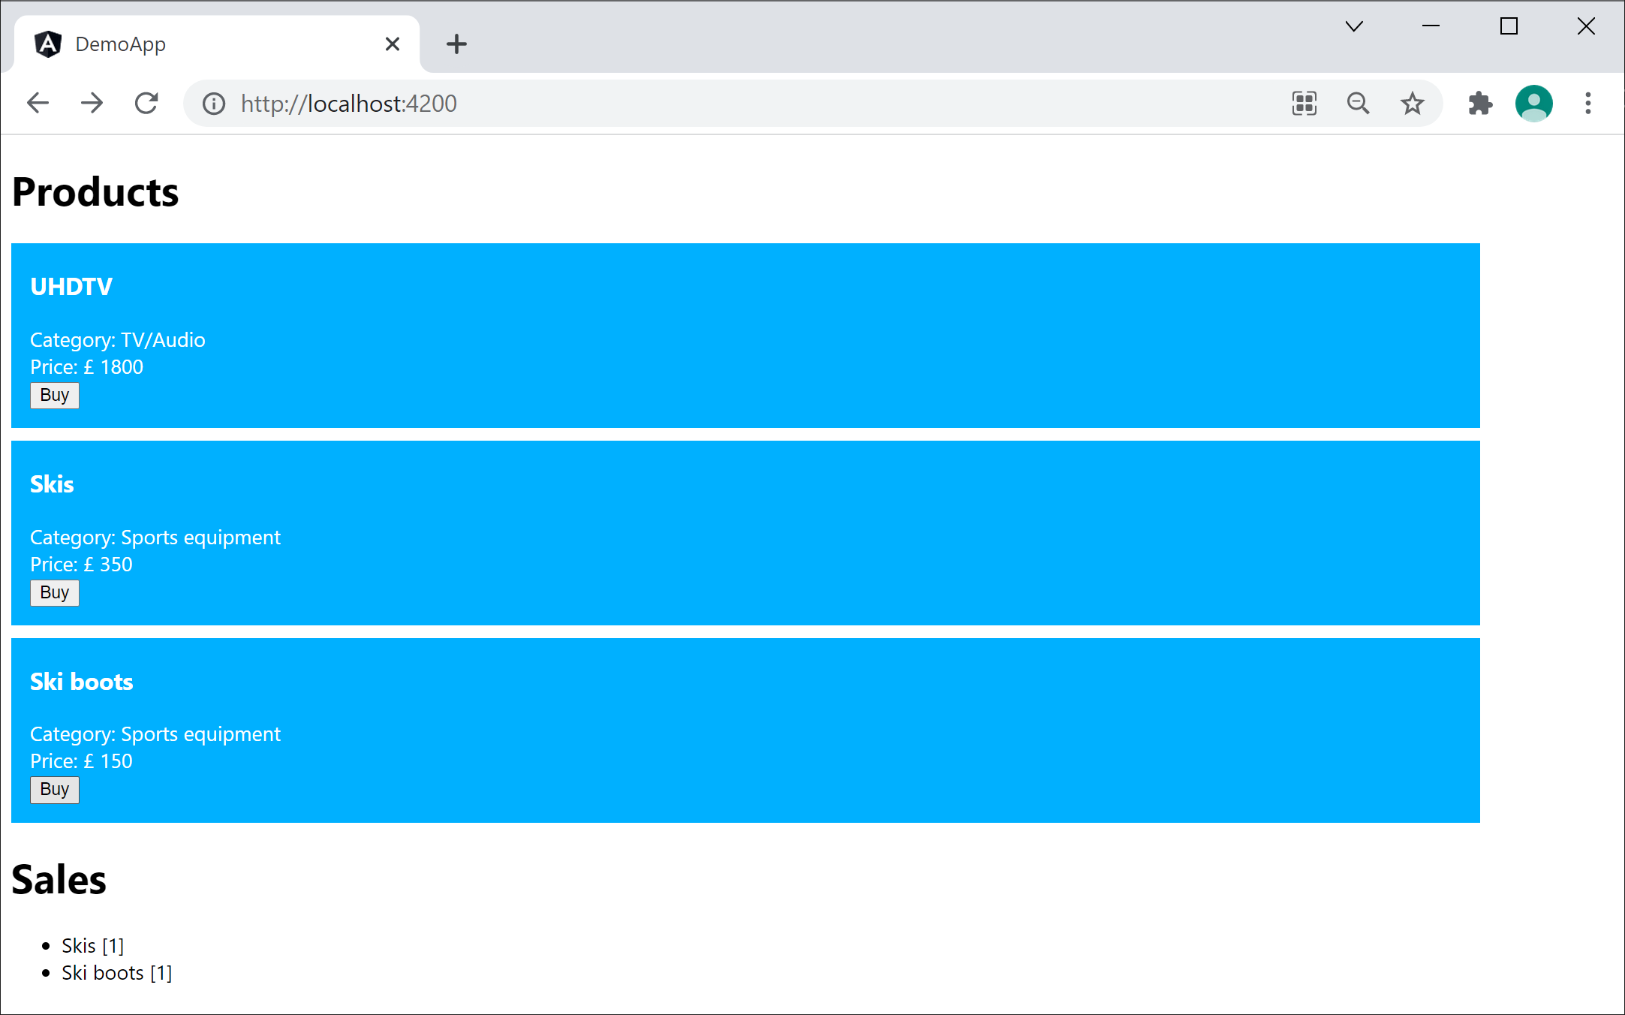
Running the Application
Run the application as normal, to verify all is in order:
ng serve

Slide 57
Lesson 12: Going Further with Testing Angular Applications
12.8 Testing a service

Slide 58
Reminder of our Service Class
Here's a reminder of our ProductService class
  See Example3/DemoApp
Let's see how to test ProductService…
import { Injectable } from '@angular/core';
…
@Injectable({
providedIn: 'root'
})
export class ProductService {
getProducts() : Array<Product> {
return [
new Product('UHDTV', 'TV/Audio', 1800),
new Product('Skis', 'Sports equipment', 350),
new Product('Ski boots', 'Sports equipment', 150)
];
}
}
product.service.ts

Slide 59
Testing the Service
Here's how we can test ProductService:
  Angular automatically creates the service
  instance and loads it into the test module
  TestBed.inject() gets a reference
import { TestBed } from '@angular/core/testing';
import { ProductService } from './product.service';
describe('ProductService', () => {
let service: ProductService;
beforeEach(() => {
TestBed.configureTestingModule({});
service = TestBed.inject(ProductService);
});
it('should be created', () => {
expect(service).toBeTruthy();
});
});
import { TestBed } from '@angular/core/testing';
import { ProductService } from './product.service';
describe('ProductService', () => {
let service: ProductService;
beforeEach(() => {
TestBed.configureTestingModule({});
service = TestBed.inject(ProductService);
});
it('should be created', () => {
expect(service).toBeTruthy();
});
});
import { TestBed } from '@angular/core/testing';
import { ProductService } from './product.service';
describe('ProductService', () => {
let service: ProductService;
beforeEach(() => {
TestBed.configureTestingModule({});
service = TestBed.inject(ProductService);
});
it('should be created', () => {
expect(service).toBeTruthy();
});
});
product.service.spec.ts

Slide 60
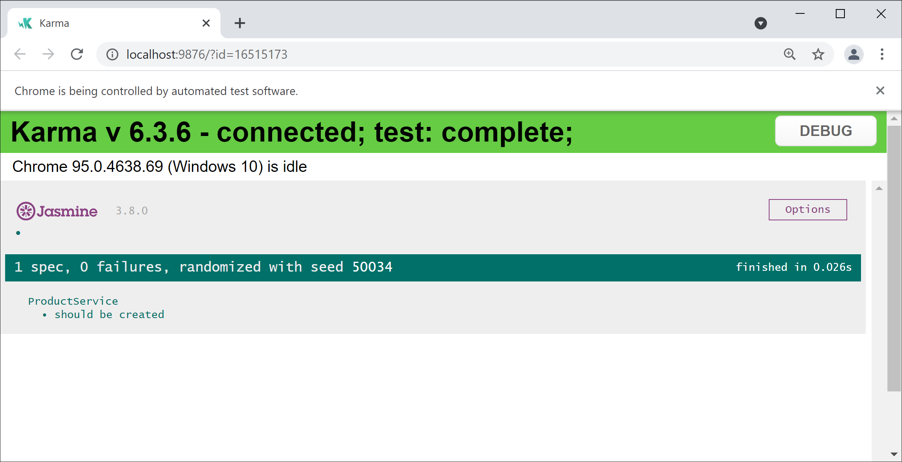
Testing the Service
Run the tests for the service as follows:
ng test --include=**/product.service.spec.ts --watch

Slide 61
Testing a Component that uses the Service
To test a component that uses a service:
  Angular automatically creates the service
  instance and loads it into the test module
  Angular automatically injects the service
  when it creates a component
describe('AppComponent', () => {
beforeEach(async () => {
await TestBed.configureTestingModule({
declarations: [ AppComponent, … ],
}).compileComponents();
});
it(`should have injected ProductService`, () => {
const fixture = TestBed.createComponent(AppComponent);
const app = fixture.componentInstance;
expect(app).toBeTruthy();
});
});
describe('AppComponent', () => {
beforeEach(async () => {
await TestBed.configureTestingModule({
declarations: [ AppComponent, … ],
}).compileComponents();
});
it(`should have injected ProductService`, () => {
const fixture = TestBed.createComponent(AppComponent);
const app = fixture.componentInstance;
expect(app).toBeTruthy();
});
});
describe('AppComponent', () => {
beforeEach(async () => {
await TestBed.configureTestingModule({
declarations: [ AppComponent, … ],
}).compileComponents();
});
it(`should have injected ProductService`, () => {
const fixture = TestBed.createComponent(AppComponent);
const app = fixture.componentInstance;
expect(app).toBeTruthy();
});
});
app.component1.spec.ts

Slide 62
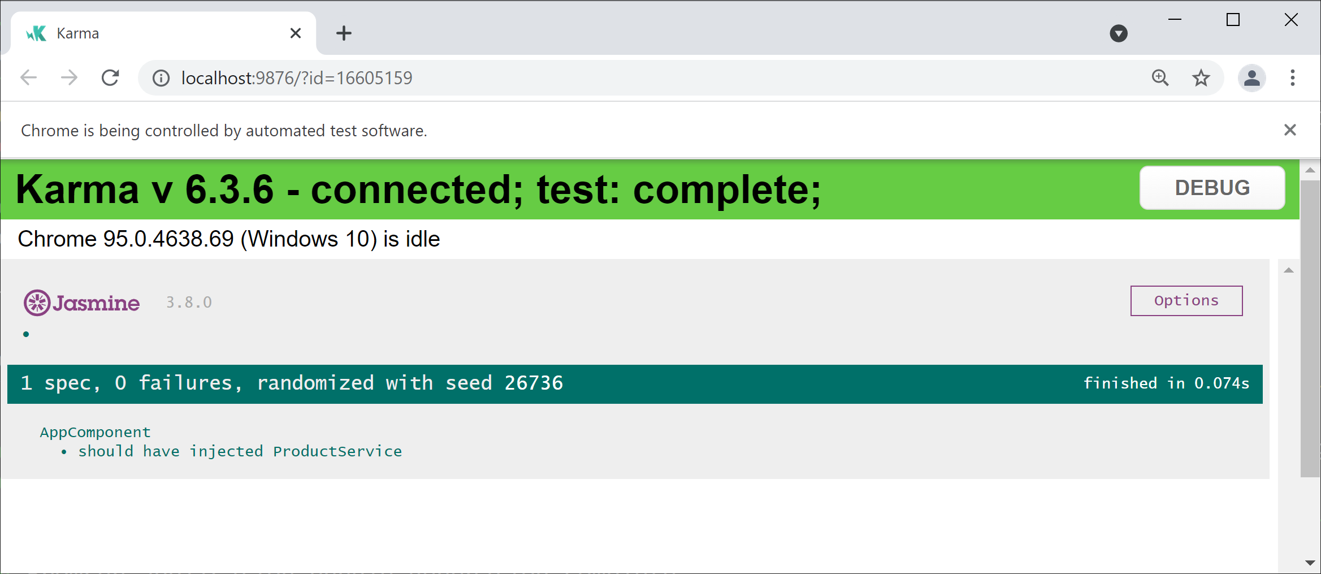
Testing a Component that uses the Service
Run the tests for the component as follows:
ng test --include=**/app.component1.spec.ts --watch

Slide 63
Using a Spy Object for a Service
We are currently performing integration testing
  The component receives a real ProductService object
It's also possible to perform unit testing
  Create a mock product service object
  Inject the mock service into components
  Specify results for mock service functions
In Angular terminology, a mock object
is known as a spy

Slide 64
Using a Spy Object for a Service
Here's how to create and register a spy object for a service:
Create a spy object for a service, and specify
the functions you want to spy on
Tell Angular to use the spy object for injection
describe('AppComponent', () => {
const spy = jasmine.createSpyObj('ProductService',
['getProducts']);
beforeEach(async () => {
await TestBed.configureTestingModule({
declarations: [ AppComponent, … ],
providers: [{provide: ProductService,
useValue: spy}]
}).compileComponents();
});
…
});
describe('AppComponent', () => {
const spy = jasmine.createSpyObj('ProductService',
['getProducts']);
beforeEach(async () => {
await TestBed.configureTestingModule({
declarations: [ AppComponent, … ],
providers: [{provide: ProductService,
useValue: spy}]
}).compileComponents();
});
…
});
describe('AppComponent', () => {
const spy = jasmine.createSpyObj('ProductService',
['getProducts']);
beforeEach(async () => {
await TestBed.configureTestingModule({
declarations: [ AppComponent, … ],
providers: [{provide: ProductService,
useValue: spy}]
}).compileComponents();
});
…
});
app.component2.spec.ts

Slide 65
Using a Spy Object for a Service
You can mock functions on the spy object as follows:
describe('AppComponent', () => {
…
it(`should use mock ProductService`, () => {
const dummyProducts = [
new Product('Prod1', 'Cat1', 111),
new Product('Prod2', 'Cat2', 222)
];
spy.getProducts.and.returnValue(dummyProducts);
const fixture = TestBed.createComponent(AppComponent);
fixture.detectChanges();
const prods = fixture.debugElement
.queryAll(By.css('app-product'));
expect(prods.length).toBe(2);
});
});
app.component2.spec.ts

Slide 66
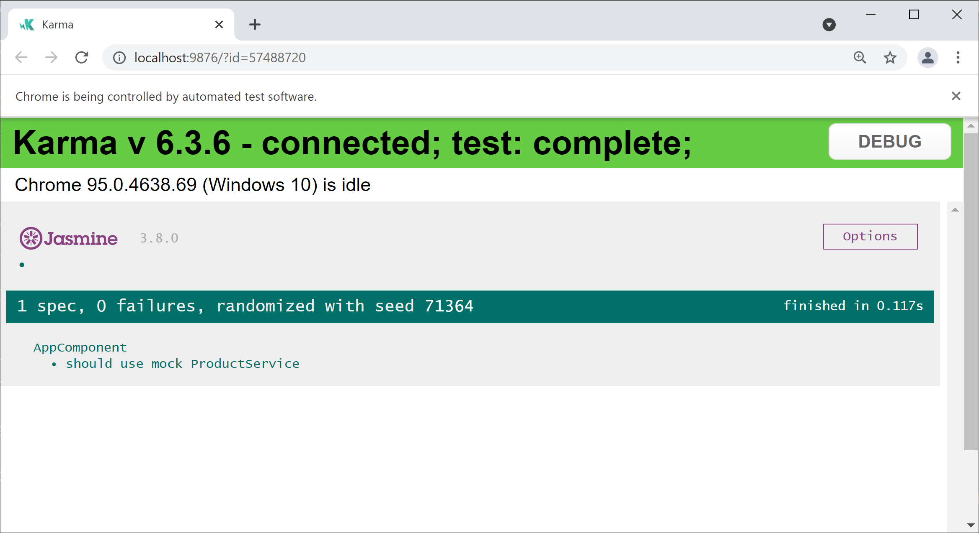
Testing a Component that uses a Spy Object
Run the tests for the component as follows:
ng test --include=**/app.component2.spec.ts --watch

Slide 67
Lesson 12: Going Further with Testing Angular Applications
12.9 Defining a pipe

Slide 68
Overview
A pipe is a class that transforms content in an HTML template
You can use a pipe as follows:
Angular has various built-in pipes,
which you can use as follows:
{{ expression | pipeName : param1 : param2 : ... paramN }}
{{ fullname | uppercase }}
{{ salary | currency }}
{{ joined | date : 'hh:mm:ss a' }}

Slide 69
Generating a Pipe
You can use Angular CLI to generate a new pipe:
Angular CLI generates 2 files in the src/app folder:
  Code: flexi-titlecase.pipe.ts
  Test: flexi-titlecase.pipe.spec.ts
Angular CLI also registers the pipe
in the testing module
See Example4/DemoApp
ng g pipe flexi-titlecase

Slide 70
Implementing Pipe Functionality
Let's implement simple functionality in our pipe:
import { Pipe, PipeTransform } from '@angular/core';
@Pipe({
name: 'flexititlecase'
})
export class FlexiTitlecasePipe implements PipeTransform {
transform(value: string, upperLower: string): string {
if (upperLower !== 'upper' && upperLower !== 'lower')
return value;
let words:string[] = value.split(' ');
for (var i = 0; i < words.length; i++) {
if (upperLower === 'upper') …
else …
}
return words.join(' ');
}
}
flexi-titlecase.pipe.ts

Slide 71
Using the Pipe in a Component
Here's how to use the pipe in a component:
@Component(…)
export class AppComponent {
fullname = 'andrew carl olsen';
}
app.component.ts
<p>
{{ fullname }}
</p>
<p>
{{ fullname | flexititlecase : 'upper' }}
</p>
<p>
{{ fullname | flexititlecase : 'lower' }}
</p>
app.component.html

Slide 72
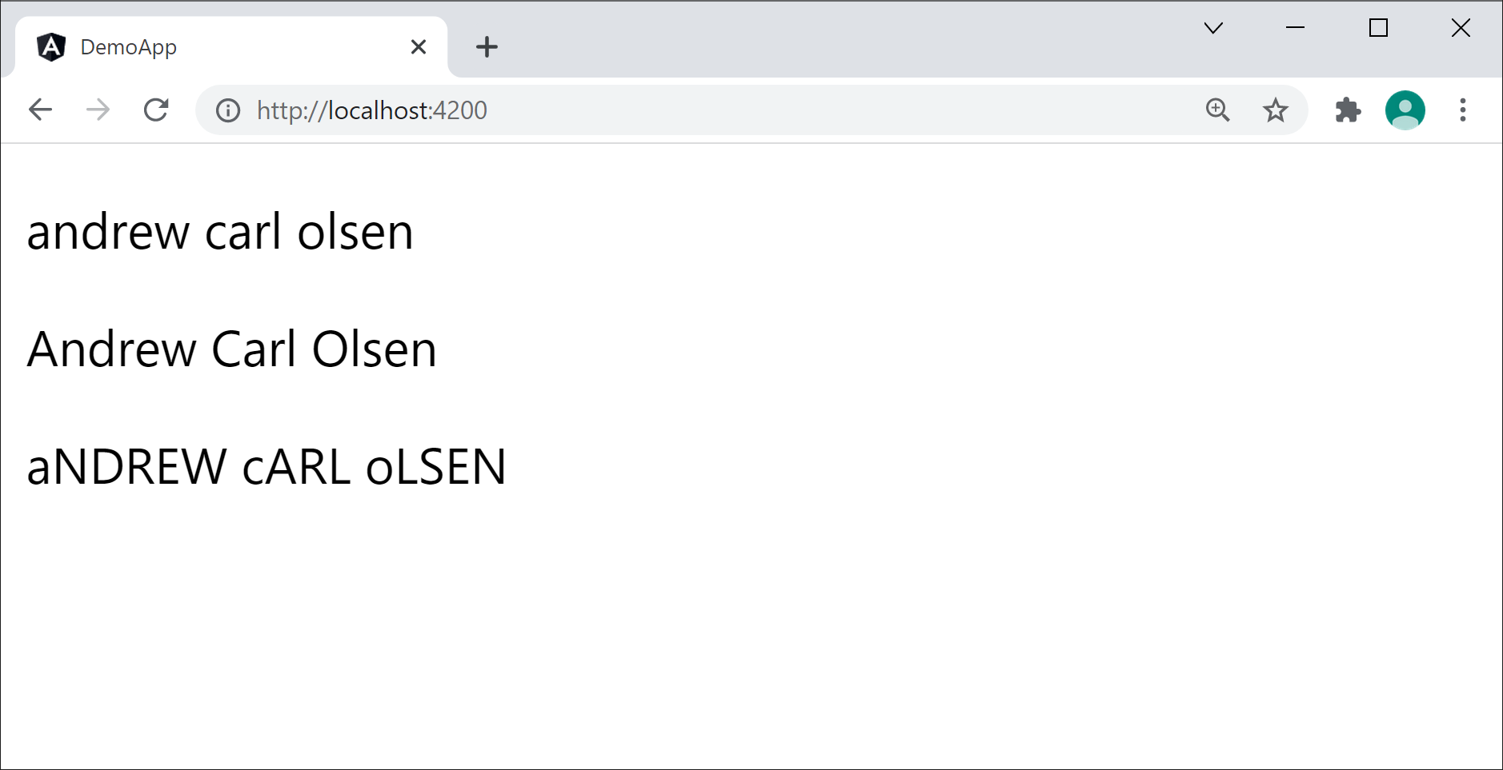
Running the Application
Run the application as normal, to verify all is in order:
ng serve

Slide 73
Lesson 12: Going Further with Testing Angular Applications
12.10 Testing a pipe

Slide 74
Reminder of our Pipe Class
Here's a reminder of our FlexiTitlecasePipe class
  See Example4/DemoApp
import { Pipe, PipeTransform } from '@angular/core';
@Pipe({
name: 'flexititlecase'
})
export class FlexiTitlecasePipe implements PipeTransform {
transform(value: string, upperLower: string): string {
if (upperLower !== 'upper' && upperLower !== 'lower')
return value;
let words:string[] = value.split(' ');
for (var i = 0; i < words.length; i++) {
if (upperLower === 'upper') …
else …
}
return words.join(' ');
}
}
flexi-titlecase.pipe.ts

Slide 75
Testing the Pipe
Here's how we can test FlexiTitlecasePipe:
  Create a pipe object directly
  Call transform() and check the result
import {FlexiTitlecasePipe} from './flexi-titlecase.pipe';
describe('FlexiTitlecasePipe', () => {
let pipe: FlexiTitlecasePipe;
beforeEach(() => {
pipe = new FlexiTitlecasePipe();
})
it('pipe converts to upper title case', () => {
let result = pipe.transform('ant bat cat', 'upper');
expect(result).toBe('Ant Bat Cat');
});
…
});
import {FlexiTitlecasePipe} from './flexi-titlecase.pipe';
describe('FlexiTitlecasePipe', () => {
let pipe: FlexiTitlecasePipe;
beforeEach(() => {
pipe = new FlexiTitlecasePipe();
})
it('pipe converts to upper title case', () => {
let result = pipe.transform('ant bat cat', 'upper');
expect(result).toBe('Ant Bat Cat');
});
…
});
import {FlexiTitlecasePipe} from './flexi-titlecase.pipe';
describe('FlexiTitlecasePipe', () => {
let pipe: FlexiTitlecasePipe;
beforeEach(() => {
pipe = new FlexiTitlecasePipe();
})
it('pipe converts to upper title case', () => {
let result = pipe.transform('ant bat cat', 'upper');
expect(result).toBe('Ant Bat Cat');
});
…
});
flexi-titlecase.pipe.spec.ts

Slide 76
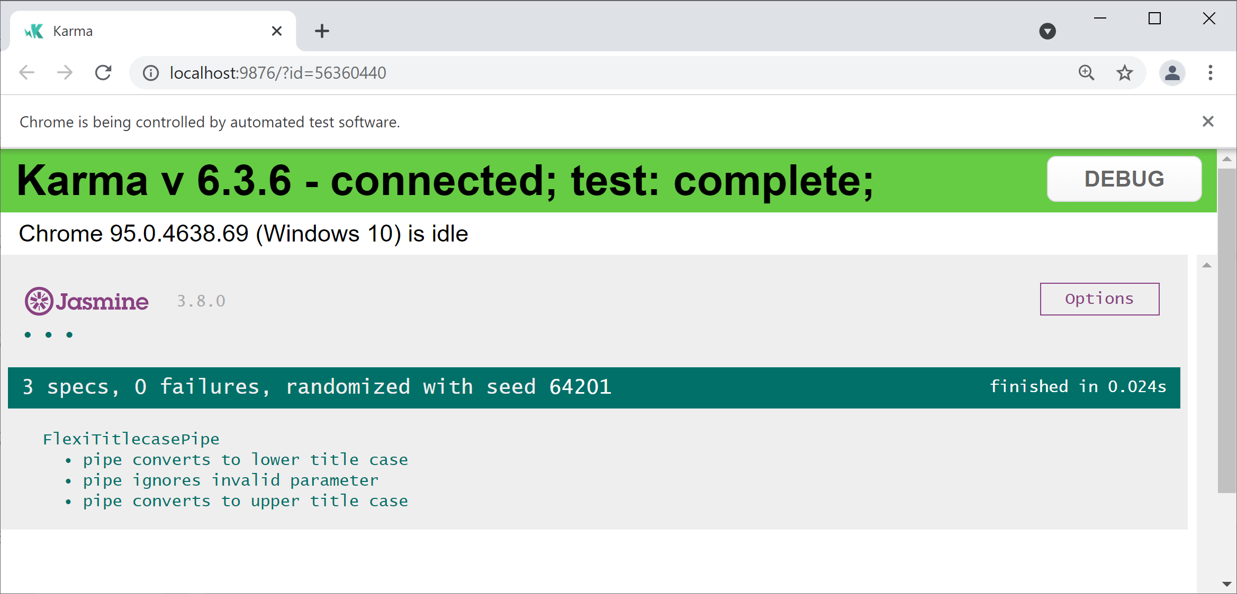
Testing the Pipe
Run the tests for the pipe as follows:
ng test --include=**/flexi-titlecase.pipe.spec.ts --watch

Slide 77
Testing a Component that uses the Pipe
To test a component that uses a pipe:
Load the pipe into the test module
Create a component, trigger data binding,
and assert the HTML is rendered correctly
describe('AppComponent', () => {
beforeEach(async () => {
await TestBed.configureTestingModule({
declarations: [ AppComponent, FlexiTitlecasePipe ],
}).compileComponents();
});
it('renders the correct HTML via the pipe', () => {
const fixture = TestBed.createComponent(AppComponent);
fixture.detectChanges();
const ps = fixture.nativeElement.querySelectorAll('p');
expect(ps[0].textContent).toMatch('andrew carl olsen');
expect(ps[1].textContent).toMatch('Andrew Carl Olsen');
expect(ps[2].textContent).toMatch('aNDREW cARL oLSEN');
});
});
describe('AppComponent', () => {
beforeEach(async () => {
await TestBed.configureTestingModule({
declarations: [ AppComponent, FlexiTitlecasePipe ],
}).compileComponents();
});
it('renders the correct HTML via the pipe', () => {
const fixture = TestBed.createComponent(AppComponent);
fixture.detectChanges();
const ps = fixture.nativeElement.querySelectorAll('p');
expect(ps[0].textContent).toMatch('andrew carl olsen');
expect(ps[1].textContent).toMatch('Andrew Carl Olsen');
expect(ps[2].textContent).toMatch('aNDREW cARL oLSEN');
});
});
describe('AppComponent', () => {
beforeEach(async () => {
await TestBed.configureTestingModule({
declarations: [ AppComponent, FlexiTitlecasePipe ],
}).compileComponents();
});
it('renders the correct HTML via the pipe', () => {
const fixture = TestBed.createComponent(AppComponent);
fixture.detectChanges();
const ps = fixture.nativeElement.querySelectorAll('p');
expect(ps[0].textContent).toMatch('andrew carl olsen');
expect(ps[1].textContent).toMatch('Andrew Carl Olsen');
expect(ps[2].textContent).toMatch('aNDREW cARL oLSEN');
});
});
app.component.spec.ts

Slide 78
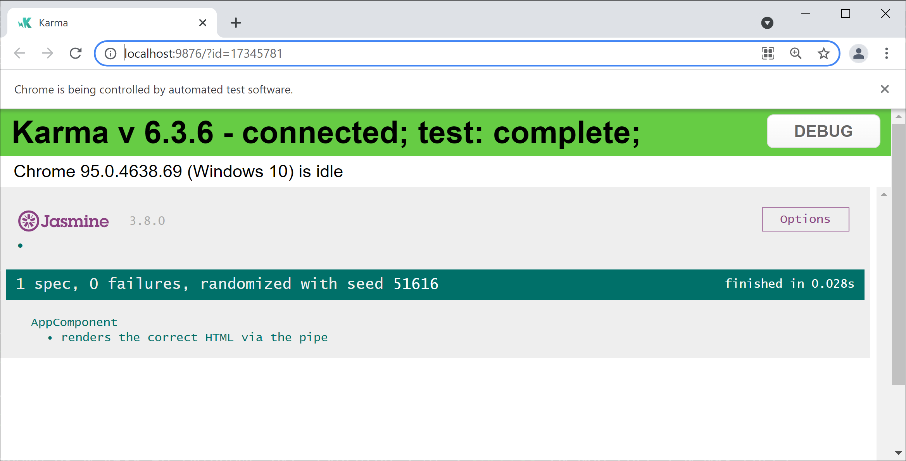
Testing a Component that uses the Pipe
Run the tests for the component as follows:
ng test --include=**/app.component.spec.ts --watch

