Slide 1
Components
Overview
Class components
Functional components

Slide 2
Section 1: Overview
The story so far…
A more modular approach…
Defining components in React

Slide 3
The Story So Far…
The examples so far have created a monolithic dollop of React elements in one giant block of code
Not feasible in a real application - too much content!
let prodList = React.createElement('ul', … … … )
let shopList = React.createElement('ul', … … … )
const retailer = React.createElement('div', null,
React.createElement('h1', null, 'Catalog'),
prodList,
React.createElement('h1', null, 'Shops'),
shopList
)
const root = ReactDOM.createRoot(document.getElementById('root'))
root.render(retailer)

Slide 4
A More Modular Approach…
Divide-and-conquer
Partition the UI into a bunch of components
Each component is responsible for one part of the UI
Benefits of the component approach
Each component is relatively small and focussed
Easier to develop
Potential reuse
Easier to test

Slide 5
How to Define Components in React
There are several ways to develop components in React
Via classes and inheritance - see Section 2
Via functional components - see Section 3
In earlier versions or React, you could also create a component using React.createClass()
But this is deprecated nowadays

Slide 6
Section 2: Class Components
Overview
Example scenario
Example data
Component classes in our example
Creating/rendering the App component

Slide 7
Overview
React has a class named React.Component
Has common capabilities needed by all components
E.g. render elements for a component
To define your own component as a class:
Define a class that inherits from React.Component
Override render() to render component's elements
Use this.props to access component's properties

Slide 8
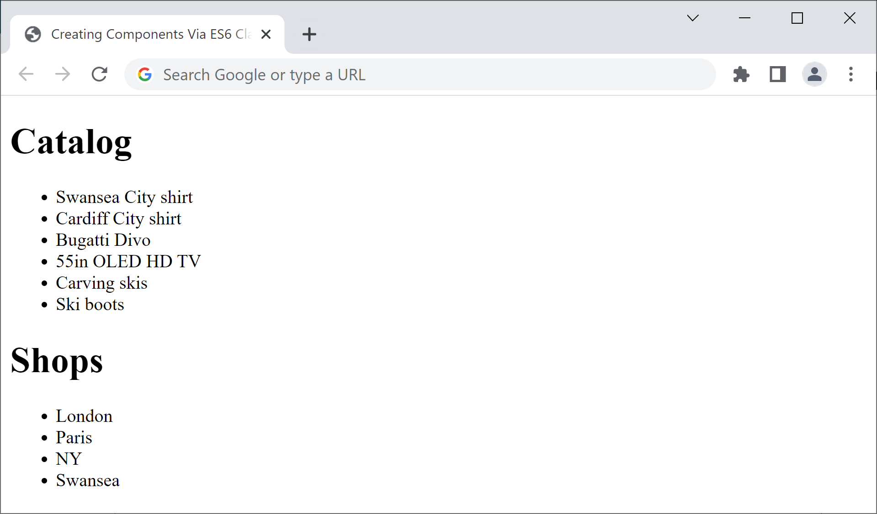
Example Scenario
ClassComponents.html has several components
The overall web page
is an App component
This list is an ItemsList component instance
This list is also an ItemsList component instance

Slide 9
Example Data
Here's the familiar data for our components
const products = [
'Swansea City shirt',
'Cardiff City shirt',
…
]
const shops = [
'London',
'Paris',
…
]

Slide 10
Component Classes in our Example
class App extends React.Component {
render() {
return React.createElement('div', null,
React.createElement('h1', null, 'Catalog'),
React.createElement(ItemsList, {items: products}, null),
React.createElement('h1', null, 'Shops'),
React.createElement(ItemsList, {items: shops}, null)
)
}
}
class ItemsList extends React.Component {
render() {
return React.createElement('ul', null,
this.props.items.map((item, i) => React.createElement('li', {key:i}, item))
)
}
}

Slide 11
Creating/Rendering the App Component
We create/render the App component as the root React element as follows:
const app = React.createElement(App, null, null)
const root = ReactDOM.createRoot(document.getElementById('root'))
root.render(app)

Slide 12
Section 3: Functional Components
Overview
Functional components in our example
Creating/rendering the App component
Recommendations

Slide 13
Overview
Now we're going to see how to define components as functional components
This is usually simpler than defining class components
See FunctionalComponents.html
A functional component:
Is just a function (i.e. not a class)
Receives properties as a function parameter (an object)
Creates/returns a React element, which React will render

Slide 14
Components in our Example
function App() {
return (
React.createElement('div', null,
React.createElement('h1', null, 'Catalog'),
React.createElement(ItemsList, {items: products}, null),
React.createElement('h1', null, 'Shops'),
React.createElement(ItemsList, {items: shops}, null),
)
)
}
function ItemsList(props) {
return (
React.createElement(
"ul",
null,
props.items.map((item, i) => React.createElement("li", { key: i }, item))
)
)
}

Slide 15
Creating/Rendering the App Component
We create/render the App component as the root React element as follows (same as before ☺):
const app = React.createElement(App, null, null)
const root = ReactDOM.createRoot(document.getElementById('root'))
root.render(app)

Slide 16
Recommendations
Most modern React code uses functional components
Easier than class components
Support several new techniques (e.g. effect hooks)
So we'll focus on functional components from now on
We'll also show how to achieve the same effects using class components, for the sake of completeness

Slide 17
Summary
Overview
Class components
Functional components

