Slide 1
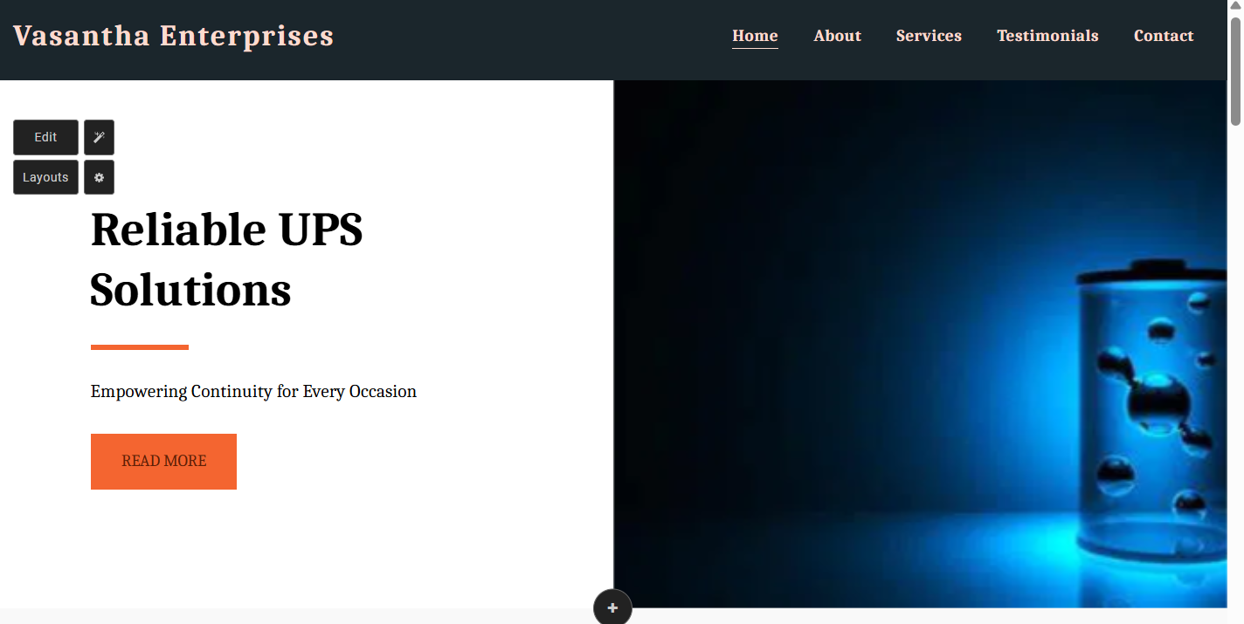
Company name
Menu bar
(Home/about/Services/Our Clients/contact us
Company logo
(Your Trusted Partner for UPS, Solar UPS, and Battery Services)
Insert image no 1

Slide 2
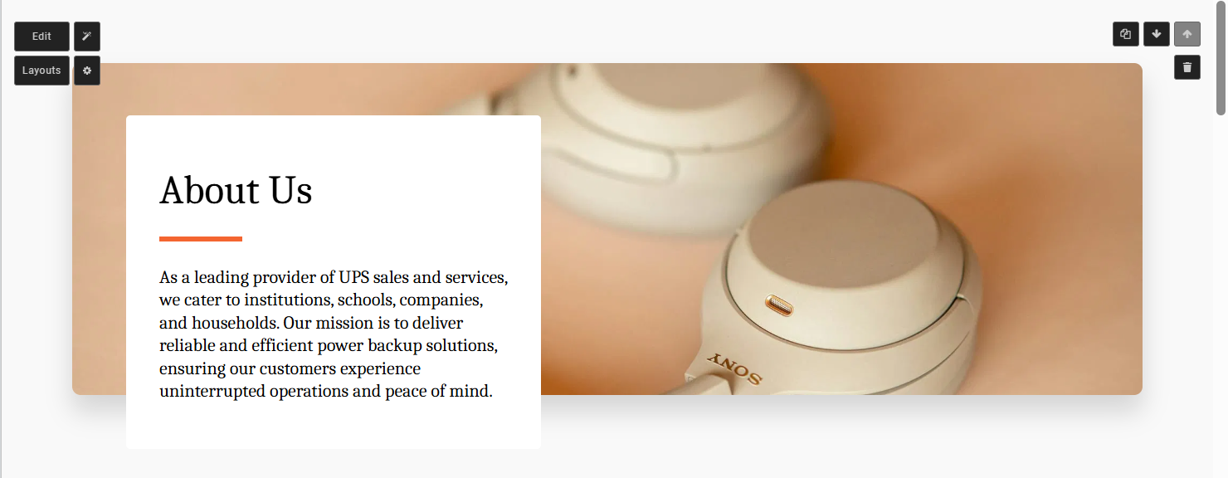
About Us – Vasantha Enterprises
Welcome to Vasantha Enterprises, your trusted partner in reliable power backup solutions since 2017. Founded with a vision to deliver excellence in energy solutions, we have been dedicated to meeting the dynamic power needs of homes, industries, institutions, and offices.
At Vasantha Enterprises, innovation and sustainability drive everything we do. We specialize in a wide range of services, including:
Lift UPS: Advanced backup systems for uninterrupted elevator operations, ensuring safety and convenience.
Solar UPS: Eco-friendly energy solutions that combine sustainability with cutting-edge technology.
Annual Maintenance Contracts (AMC): Tailored maintenance packages to ensure your power systems run smoothly and efficiently.
Scrap Battery Management: Responsible disposal and buyback programs that promote environmental stewardship.
Over the years, we have built a reputation for delivering high-quality products and exceptional customer service. Our expert team combines technical expertise with a customer-first approach, ensuring that every solution is designed to meet your unique requirements. Whether it’s a customized UPS for your office, a solar power system for your home, or ongoing maintenance support for your industry, we are here to power your aspirations.
What sets us apart is our unwavering commitment to reliability, innovation, and environmental responsibility. We believe in empowering our clients by providing not just solutions but long-term value.
Choose Vasantha Enterprises as your partner for all power backup needs and join a growing community of satisfied customers who trust us to keep their operations running seamlessly. Let’s work together to create a future that’s powered by efficiency, sustainability, and trust.
Contact us today and experience the Vasantha Enterprises difference!
Insert image no 2

Slide 3
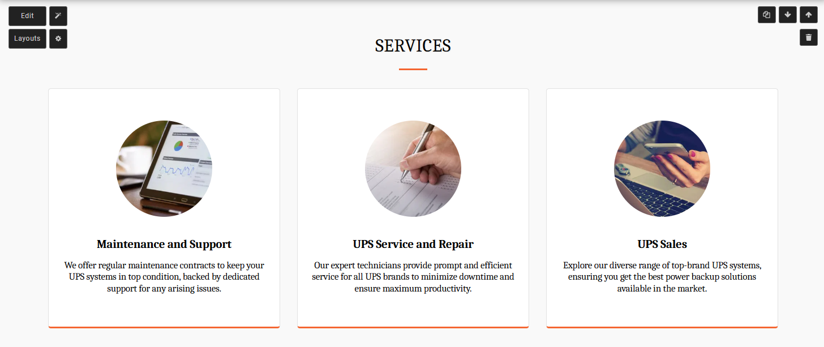
1. Annual Maintenance Contracts (AMC)
Our AMC services ensure that your power backup systems are always in top condition, minimizing downtime and maximizing efficiency. We offer:
Diagnostics: Regular inspections to detect potential issues before they escalate.
Repairs: On-site and remote support to fix problems promptly.
Replacements: Genuine spare parts and components for reliable performance.
Customized Plans: Tailored contracts for institutions, offices, and industries to meet their unique needs.
2. Scrap Battery Management
We provide eco-friendly solutions for managing old and used batteries, contributing to a greener environment. Our process includes:
Buyback Offers: Competitive pricing for your scrap batteries.
Safe Disposal: Adherence to environmental standards for battery recycling.
Sustainable Practices: Helping clients transition to eco-friendly power solutions.
3. Installation and After-Sales Support
At Vasantha Enterprises, we ensure seamless integration and operation of your power systems. Our services include:
Professional Installation: End-to-end setup of UPS systems to ensure optimal performance.
Comprehensive Training: Guidance on system usage and basic troubleshooting.
Ongoing Support: 24/7 customer assistance for any technical issues.
4. Commission for Upgrading to New UPS Systems
We help customers upgrade their old UPS systems and benefit from modern, efficient models:
Old UPS Trade-In: Get value for your existing UPS when upgrading to a new system.
Discounts and Commissions: Attractive incentives for exchanging old systems.
Smooth Transition: Hassle-free transfer from old to new systems with professional guidance.
5. Old UPS Services and Repairs
Extend the life of your existing UPS systems with our expert repair and maintenance services:
System Diagnostics: Identify and fix issues with aging UPS systems.
Cost-Effective Repairs: Affordable solutions to restore functionality.
Performance Optimization: Enhance the efficiency of your old UPS systems.
IMAGE 3
IMAGE 4
IMAGE 5
IMAGE 6
IMAGE 7

Slide 4
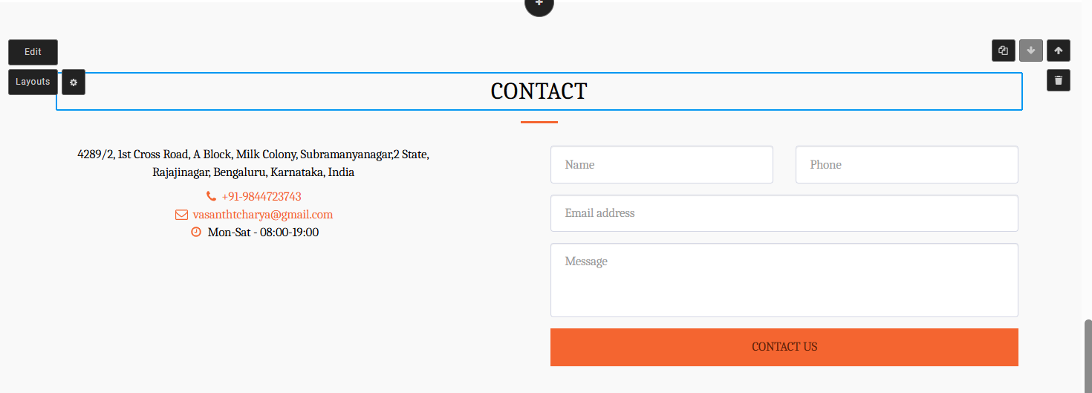
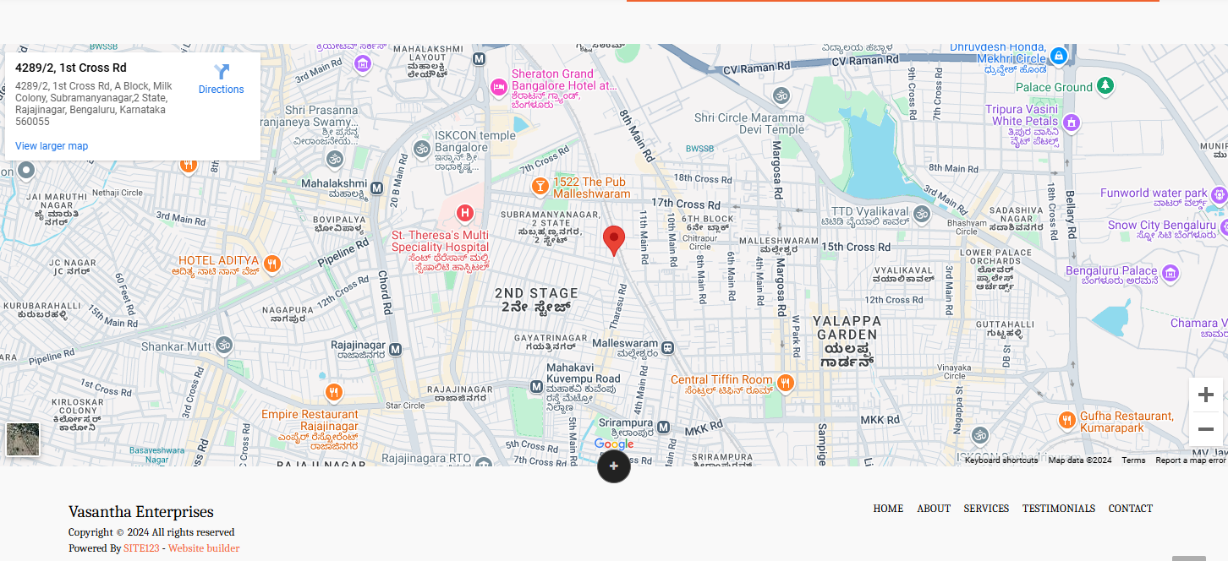
OUR CLIENT
Use all the image named in the new folder
Contact us

