Slide 1
AUDIO CLASSIFICATION USING DEEPLEARNING
NAME : VASANTHAKRISHNAN R
NM-id : au711721243120
KGISL INSTITUTE OF TECHNOLOGY
3/21/2024 Annual Review

Slide 2
PROJECT TITLE
Audio classification using deeplearning
3/21/2024 Annual Review

Slide 3


AGENDA
The project aims to create a deep learning model for audio classification using the UrbanSound8K dataset by extracting features from audio files and training a model to categorize them into predefined classes.
3/21/2024 Annual Review

Slide 4

PROBLEM STATEMENT
Automatic sound classification in urban environments is important for various applications such as urban planning, noise pollution monitoring, and public safety. However, manual classification is time-consuming and subjective. Therefore, there is a need for an automated system to classify urban sounds accurately and efficiently. Convolutional neural networks (CNNs) have been shown to improve the accuracy of urban sound classification by using raw sound waveforms and reducing the number of parameters. CNNs can be trained to distinguish the source of noise disturbance, which can benefit urban livability. Other approaches for audio classification include using Gaussian mixture models, which are based on unsupervised machine learning algorithms, and LDA topic models, which can be used as a classification model input. These methods can improve the accuracy and efficiency of audio classification in various applications.
3/21/2024 Annual Review

Slide 5

PROJECT OVERVIEW
The project aims to create a deep learning model for urban sound classification, including preprocessing audio data, extracting features, building a neural network, training it, and evaluating performance. Categories include "car horn," "dog bark," "siren," etc.
3/21/2024 Annual Review

Slide 6

WHO ARE THE END USERS?
The end users of this urban sound classification project are urban planners, environmental agencies, and public safety authorities. The system can help urban planners understand noise patterns, environmental agencies monitor noise pollution, and public safety authorities detect emergency situations. The system can distinguish the source of noise disturbance and classify environmental sounds into categories.
3/21/2024 Annual Review

Slide 7

YOUR SOLUTION AND ITS VALUE PROPOSITION
The proposed solution is an automated urban sound classification system using a deep learning model. The system can accurately classify urban sounds based on their audio features, saving time and effort compared to manual methods. It also provides real-time analysis of urban soundscapes, allowing for timely interventions in case of emergencies or abnormal noise levels.
3/21/2024 Annual Review

Slide 8

THE WOW IN YOUR SOLUTION
Our solution impresses with its precise classification of diverse urban sounds, boasting high precision and recall rates. Its strong generalization to new data and real-time processing capabilities make it a potent tool for urban sound analysis.
3/21/2024 Annual Review

Slide 9
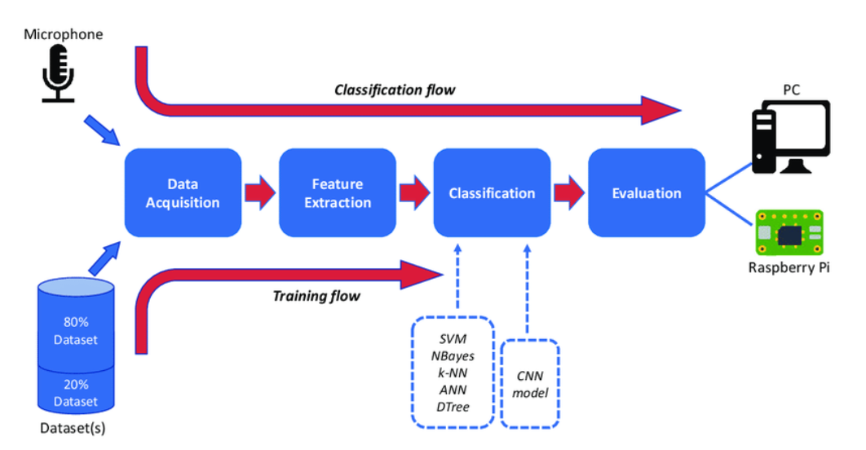
MODELLING
Description of the deep learning model architecture.
Explanation of model training and evaluation processes.
3/21/2024 Annual Review

Slide 10
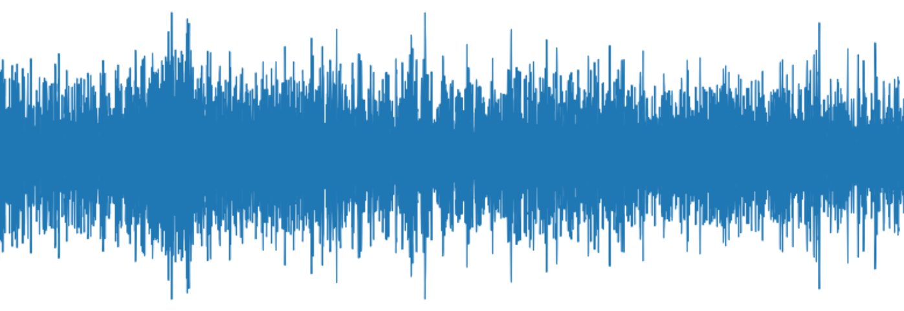
RESULTS
This project proposal outlines the objectives, target users, and key features of our audio classification solution for urban sounds. By addressing the problem of manual classification and providing an automated, efficient solution, our project aims to make a positive impact in urban planning, environmental monitoring, and public safety.
https://drive.google.com/file/d/1wDxSm4ehezQvvZquK51Qy3lqHlcUwDUU/view?usp=drive_link

