Slide 1
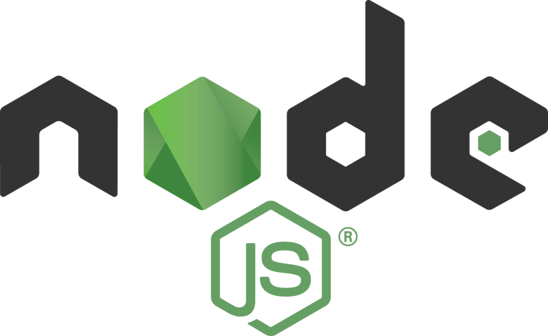
Vasantha Kumar
17 October 2019

Slide 2
Introduction
Node JS is a server side programming language.
It executes JavaScript outside browser.
It combined Google’s V8 Engine, Event Driven and Asynchronous
(non blocking) I/O API.
It is an open-source and cross-platform language
It is written by Ryan Dahl in 2009. Latest version is 12.12.

Slide 3
Why Node JS
Asynchronous and Event driven – never waits for an API to return data, so handles huge requests.
Built on Google’s V8 – very fast in code execution.
It is single threaded – so do not occupy more 12memory.
Large data’s can be sent in chunks.
Uses JavaScript – Easy to Learn, huge community support, more number of modules, develop using Typescript.

Slide 4
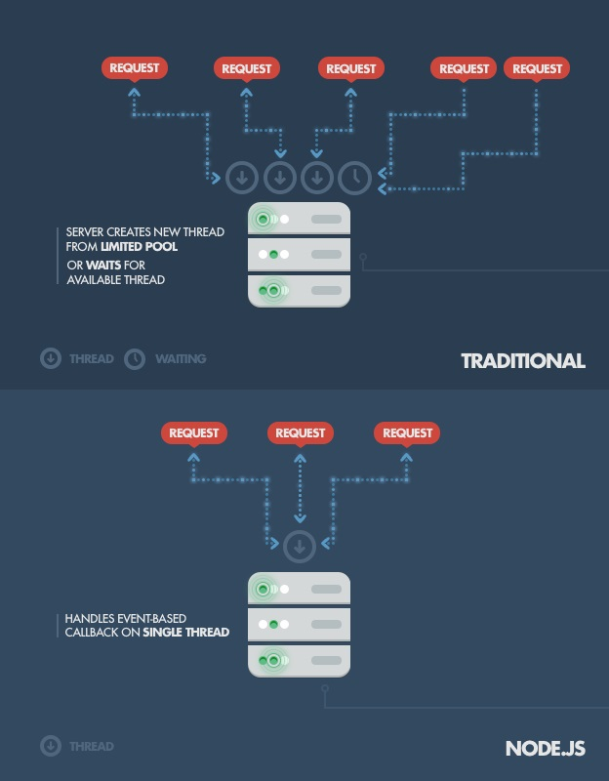
Traditional vs Node JS

Slide 5
Traditional vs Node JS

Slide 6
Where to use Node JS
I/O bound Applications – Image Uploads / Read-Write Files / DB Operations.
Data Streaming Applications – Trading Applications / Video / Audio streaming.
Data Intensive Real Time Applications – Server Process Monitoring apps / Online Video / Audio Meetings / Gaming.
JSON API based Applications – General Purpose Web Applications.

Slide 7
Where not to use Node JS
As it is single threaded – any CPU intensive task / heavy computational – will block the incoming request. Ex. Search Algorithms, Video / Audio Content Conversion, Heavy Mathematical Computations

Slide 8
How to set-up Node JS Dev Environment
Node JavaScript Runtime Environment:
Download and Install: https://nodejs.org/en/download
This will install Node JSRE and a package manager called Node Package Manager (NPM)
Any Code Editor
Verify the installation by executing the below commands in terminal
node –-version / node –v
npm –-version / npm -v

Slide 9
Node REPL
REPL stands for Read Eval Print Loop
Read − Reads user's input, parses, and stores in memory.
Eval − Takes and evaluates the data structure.
Print − Prints the result.
Loop − Loops the above command until the user presses ctrl-c twice
REPL Commands
.help − list of all commands.
.break / .clear− exit from multiline expression.
.save filename − save the current Node REPL session to a file.
.load filename − load file content in current Node REPL
session.
Ctrl+D – execute the script

Slide 10
Node REPL – Sample Code
function welcome(name) {
return ‘Hello ‘+name;
}
welcome (‘World!’);
.exit;
var x = 0;
do {
x++;
console.log('x is ', x);
} while(x<5);
Return;
.exit;

Slide 11
Exercises
1. 1_httpserver
2. 2_querystring
3. 3_httprequest
4. 4_httppost

Slide 12
Node Package Manager (NPM)
A Command line utility which helps to install third party Node JS Packages, version and dependency management.
It helps in searching for the packages in https://www.npmjs.com/
Some of the important commands:
  npm init – creates a package.json file – which has meta data about the project, modules and other dev dependencies required for the project and the entry point of the project.
  npm install <modulename> --save - installs the specified module and save the module information in package.json file
  npm uninstall <modulename> - uninstalls the specified module
  npm update <modulename> - updates the specified module
  npm search <modulename> - search for the specified module
  npm run-script <scriptname> - runs the specified script

Slide 13
NPM Commands - Examples
  npm init
  npm install express --save
  npm uninstall express
  npm update express
  npm search express
  npm run-script build

Slide 14
Package.json - Sample
  { “name": "ex2",
  "version": "1.0.0",
  "description": "",
  "main": "index.js",
  "scripts": {
  "test": "echo \"Error: no test specified\" && exit 1",
  "build": "tsc",
  "start-project": "nodemon index.js"
  },
  "author": "",
  "license": "ISC",
  "dependencies": {
  "express": "^4.17.1"
  },
  "devDependencies": {
  "nodemon": "^1.19.3"
  }
  }

Slide 15
Session 2
24 October 2019

Slide 16
Sample REST API in Node JS
  listposts – GET – get all the posts
  addpost – POST – add a new post
  updatepost – PUT – update an existing post
  /id – GET – show details of a post

Slide 17
Module Exports
A module encapsulates related code into a single unit of code.
Moving all related functions into a file.
Modules can be imported using require(‘modulepath’)
Sample Program (6_rest_apis_exported.js)

Slide 18
Callback / Asynchronous
A callback function is called at the completion of a given task.
Node makes heavy use of callbacks.
All the APIs of Node are written in such a way that they support callbacks.
Sample Program (7_read_file_sync_async.js)

Slide 19
Events
As soon as Node starts its server, it simply initiates its variables, declares functions and then simply waits for the event to occur.
In an event-driven application, there is generally a main loop that listens for events, and then triggers a callback function when one of those events is detected.
Whenever an event gets fired, its listener function starts executing.
Sample Program (8_events.js)

Slide 20
File System
File I/O using simple wrappers around standard POSIX functions.
fs.open(path, flags[, mode], callback) // open file for operation
Flags can be r, r+, rs, rs+, w, wx, w+, wx+, a, ax, a+, ax+
fs.stat(path, callback) //get file information
fs.writeFile(filename, data, callback) // write a file
fs.read(fd, offset, length, position, callback) // read a file
fs.close(fd, callback) //close an opened file
fs.ftruncate(fd, len, callback) //truncate a file
fs.unlink(path, callback) //delete a file
fs.mkdir(path, callback)//create a directory
fs.readdir(path, callback)//read a directory
fs.rmdir(path, callback) //remove a directory
Sample Programs: (file-system-module/*)

Slide 21
Streams
Streams are objects that allow us to read data from a source or write data to a destination continuously.
Types of streams are
  Readable − Stream which is used for read operation.
  Writable − Stream which is used for write operation.
  Duplex − Stream which can be used for both read and write operation.
  Transform − A type of duplex stream where the output is computed based on input.
Available Events
  data − This event is fired when there is data is available to read.
  end − This event is fired when there is no more data to read.
  error − This event is fired when there is any error receiving or writing data.
  finish − This event is fired when all the data has been flushed to underlying system.
Sample Programs: (streams/*)

Slide 22
Global Objects - Sample
Node.js global objects are global in nature and they are available in all modules.
We do not need to include these objects in our application, rather we can use them directly.
__filename & __dirname
setTimeout(cb, ms) & clearTimeout(t)
setInterval(cb, ms) & clearInterval(t)
console
Sample Program: (11_global-objects.js)

Slide 23
Utility Modules - Sample
OS Module - Provides basic operating-system related utility functions.
Path Module - Node.js path module is used for handling and transforming file paths.
DNS Module - Node.js dns module is used to do actual DNS lookup
Sample Program: (12_utility-module/*)

Slide 24
Useful NPM Modules
Nodemon – Monitors the JS file for changes and recompile it
Sample Program: 13_nodemon-sample
Http-Server – Acts as a web server and serves the files
Sample Program: 14_httpserver-sample
Forever – CLI which helps to run the Node JS files and keep tracks the logs
Sample Code: forever start app.js

Slide 25
Session 3
31 October 2019

Slide 26
Express JS - Introduction
Very popular widely used Node JS Framework
Helps to quickly develop Node JS applications
Allows to setup middlewares to respond http requests.
Define routing table which is used to perform based on http method and URL
Dynamically render html pages
Latest version is 5

Slide 27
Typescript - Setup
Installation:
npm install typescript –save-dev
Successful installation can be verified by : tsc --version
tsconfig.json file can be created by: tsc –-init
Important options to be updated are
  outDir
  rootDir
  moduleResolution
Sample Code: 15_typescript

Slide 28
Basic Express & Typescript - Setup
Create a Node JS Project
npm init
Install Express JS:
npm install express @types/express –save
Install typescript, ts-node, nodemon
npm install typescript ts-node nodemon --save-dev
Initialize typescript configuration options:
tsc –-init
Sample Code: 16_typescript

Slide 29
Query Strings
Query strings can be read by the following method
express.Request.query.queryparameter
URL: http://localhost:8070/products?productId=123&productPrice=100
Code: req.query.productId
Sample Code: 17_querystring

Slide 30
Query Parameters
Query Parameters can be read by the following method
express.Request.params.queryparameter
URL: http://localhost:8070/products/123/100
Route Definition: app.get(‘/products/:productId/:productPrice’, cb())
Code: req.params.productId
Sample Code: 18_queryparams

Slide 31
Process Data from Request Body
BodyParser NPM module needs to be installed
npm install body-parser
We need to use bodyparser’s json() to read json data and urlencoded method to read form-url encoded.
Finally data can be accessed as given below
Code: express.Request.body.productId
Sample Code: 19_requestbody

Slide 32
Sample REST API using Express JS
  posts – GET – get all the posts
  posts – POST – add a new post
  posts/:postId – PUT – update an existing post
  posts/:postid – GET – show details of a post
  Sample Code: 20_restapi_express

Slide 33
Router in Express JS
Top level express object has a router method to create a router instance
Once router object created we can add middlewares and http method routes.
Router.all()
Router.METHOD()
Router.route()
Router.use()
Router.param()
Sample Code: 21_routers

Slide 34
Session 4
5 November 2019

Slide 35
Request Object in Express JS
Request object contains the below properties
  Req.baseurl
  Req.body
  Req.hostname
  Req.ip
  Req.method
  Req.originalUrl
  Req.path
  Req.params
  Req.protocol
  Req.query
  Req.route
Sample Code: 22_requests

Slide 36
Response Object in Express JS
Response object contains the below methods
  Res.append()
  Res.attachment()
  Res.download()
  Res.end()
  Res.format()
  Res.get()
  Res.json()
  Res.redirect()
  Res.render()
  Res.send()
  Res.sendFile(), Res.sendStatus(), Res.set(), Res.status(), res.typ()
Sample Code: 23_response

Slide 37
Render HTML Pages in Express JS
HTML Pages can be rendered as given below:
res.render(‘html file path’);
In order to display the dynamic content template engines are very useful
At runtime template engine replaces variables in a template file with actual values.
Some popular template engines supported in Express JS are
Pug, Mustache, EJS and Jade
Sample Code: 24_renderhtmlpages

Slide 38
Middlewares in Express JS
Middleware functions are functions that have access to the request object (req), the response object (res), and the next middleware function in the application’s request-response cycle. The next middleware function is commonly denoted by a variable named next.
Execute any code.
Make changes to the request and the response objects.
End the request-response cycle.
Call the next middleware function in the stack.

Slide 39
Middlewares in Express JS
An Express application can use the following types of middleware:
Application-level middleware
Router-level middleware
Error-handling middleware
Built-in middleware
Third-party middleware
Sample Code: 25_middlewares

Slide 40
Communicate with Mongo DB
MongoDB is a NoSQL database / Document Based DB.
Data stored in JSON formats
Download and Install MongoDB server from https://www.mongodb.com/download-center/community
Install Mongoose which is an Object Data Modelling for MongoDB.
npm install mongoose --save
Sample Code: 26_mongodb & 27_mongdb_modular

Slide 41
References
Official Documentations:
Typescript: https://www.typescriptlang.org/
Node JS: https://nodejs.org/en/
NPM: https://www.npmjs.com/
Express JS: https://expressjs.com/
MongoDB: https://www.mongodb.com/
Mongoose: https://mongoosejs.com/

Slide 42
References
Other Documentations:
https://www.w3schools.com/nodejs/default.asp
https://www.tutorialspoint.com/nodejs/index.htm
https://tutorialedge.net/typescript/typescript-mongodb-beginners-tutorial/
https://www.youtube.com/watch?v=zRo2tvQpus8
https://www.youtube.com/watch?v=ATUvAQZaTbM
https://www.youtube.com/watch?v=M3BM9TB-8yA

