Slide 1
CEM AX Retail Plus
CEM Business Solutions

Slide 2

About Us
Established in 2003
97.7% Customer Satisfaction
12 offices in 8 International Locations
ISO 9001-2008 Certification
Only regional company with CfMD Certification
265 Customers in 19 Industries
Good CSR & Value System
Development Centre in India
Services to
1.Channel
2.End users

Slide 3
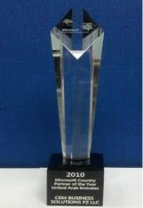


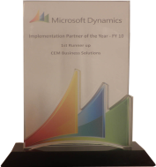






CEM – Microsoft Dynamics Awards
2013 (So far)
2012
2011
2010
2009
Microsoft Dynamics Awards
Invited Member of
Microsoft Partner Council (MPC)
Partner Advisory Board (PAB)
Enterprise Product Group (EPG)
Member of Microsoft Dynamics AX Council Program
CEM AX Payroll earns CfMD Certification
2012 Microsoft President’s Club Member
Fastest growing Company
Microsoft Best Marketing Partner
Microsoft Best Implementation Partner
2011 Microsoft President’s Club Member
2010 Microsoft Country Partner
Microsoft Best Implementation Partner
2009 Microsoft President’s Club Member
Microsoft Best Implementation Partner
Microsoft Best Sales Partner

Slide 4









Offices
USA
UK
India
UAE
Singapore
Qatar
Kuwait
Oman
12 Offices in 8 International locations

Slide 5
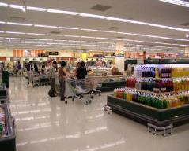


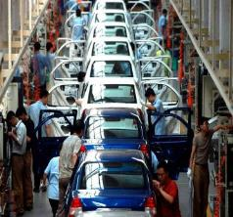


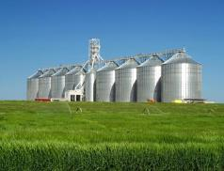


Industries
Construction
Project Services
Facility Management
Food & Beverage
Agriculture
Aviation
Automotive
Marine
Oil & Gas
Insurance
Banking
Manufacturing
Real Estate
Health & Fitness
Transportation
Trade & Logistics
Retail
Equipment Rental
Telecom

Slide 6
CEM AX Retail Plus - Introduction
CEM AX Retail Plus
End-to-end retail
solution that connects
people, information,
and processes across your
organization
Connect critical
point-of-sale (POS) and headquarters processes
with Enterprise Resource
Planning (ERP) and financials
CEM AX Retail plus offers retail centric components such as OTB, Butchery processes, Demand planning,
Footprint analysis etc.

Slide 7
Retail – Industry Challenges
Maintenance of large inventory levels at stores and distribution centres
Lack of insights on department, product and store performance
Management
of shortened time-to-market (manufacturing to retail)
Handling complex transactions, couponing and special offers
Identification
and analysis of customer trends
Tracking loyalty, transactions and returns

Slide 8
Retail - Overview
Supplier trade agreements control
Price check systems
Digital display interface
Weigh scale (Veg/Meat) integration
POS Zero downtime fuzzy logic
Advance
workflow
Loyalty
schemes
Online shopping cart
Check sum
Inter branch stock visibility, blocking & delivery
Off line data sync with authentication
A4
printing
3 decimals
Add on
Gift
card
Return goods control
Customer Service through POS

Slide 9
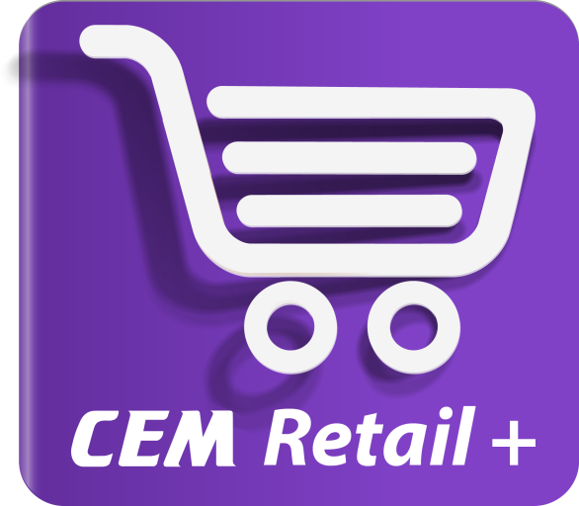
CEM AX Retail Plus

Slide 10
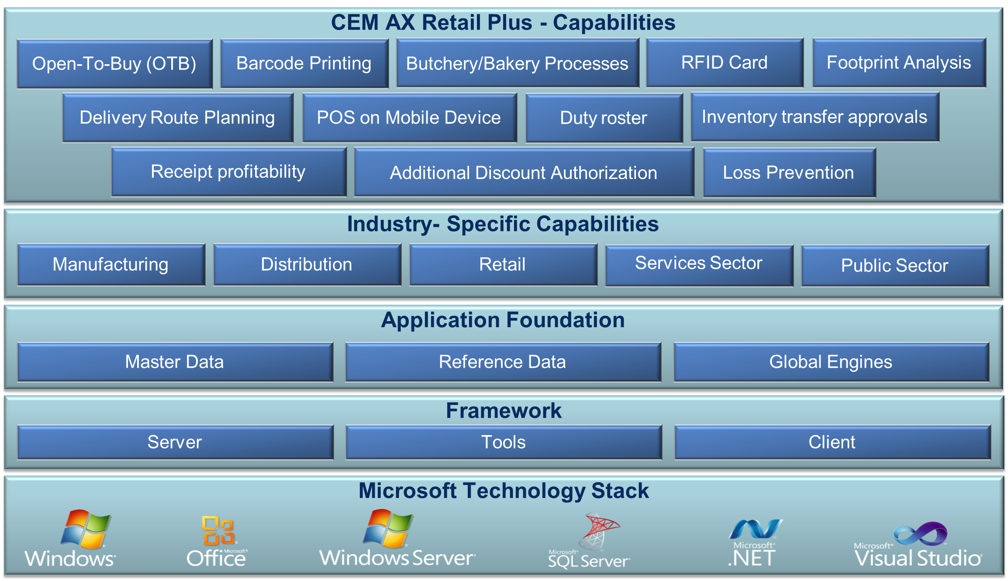
Solution Overview – CEM AX Retail Plus

Slide 11
CEM AX Retail Plus – Key Features
Open to Buy (OTB)
Barcode
Printing
Butchery
/Bakery processes
Customer Service
Inventory Transfer Approvals
Footprint Analysis
Receipt wise Profitability
Inventory optimiser
Duty
Rosters
Loss
Prevention
RFID
Cards
Staff Management
Discount Authorisation
Demand Planning
POS on
Tabs
Delivery Route Planning

Slide 12
Open To Buy (OTB) – CEM AX Retail Plus
Open To Buy (OTB) is a financial
budget for retail merchandise. It facilitates the planning of the merchandise, sales and purchases
Assists on how much to buy, and provides benchmarks for evaluating progress and adjusting future plans
Gives a clear view on sales budget, export/import, clearing budgets,
retail purchase plan etc.
Determines the availability of the inventory, through inventory on hand, in transit and outstanding orders

Slide 13
Barcode Printing – CEM AX Retail Plus
Barcode printing
tracks the number and code of an item
Items can be analyzed name wise and barcode wise separately
Barcode scanner will be integrated with POS terminal
Creates invoice using
POS terminal

Slide 14
Butchery/Bakery Process – CEM AX Retail Plus
Defines the
stocks used for the
process
BOM can be
maintained for an
item which can be
sold at POS
After declaring the
finished goods in the
system, it can be
transferred from
bakery to sales
Finished goods can be accounted by the system based on the defined
BOM (Raw Materials)

Slide 15
Customer Service – CEM AX Retail Plus
Services offered to customers will be created from POS
and further analyzed on completing the service
Services such as maintenance,
repair services, fitting and
alignment originates from POS
Value of the service
offered to the customer against revenue
can be analyzed
Machine-wise, technician-wise
effort can be tracked against
workshop orders and the cost of the services can be achieved

Slide 16
Inventory Optimizer – CEM AX Retail Plus
Enables users to
choose service level
for single items, item groups or the whole organization
Helps managers to evaluate the
performance of various factors in the
inventory system
Defines the optimal
safety stock levels for every stock keeping
item in every location
Lets users gather reports on potential stock-outs, late deliveries, high forecasting errors and slow movers
Through order proposals, the system automatically shows historical sales, inventory levels and forecasts

Slide 17
Staff Management – CEM AX Retail Plus
Staff can be recruited
globally from the
Head Office and can be assigned to the
respective stores
Effectively manage
staff’s labor costs, productivity, and
minimize compliance risk
Duty Roster helps retailer to track employees work shift schedules and smoothen the
operations of a store
Roles and
Responsibilities
can be defined to the
staff through POS

Slide 18
Delivery Route Planning – CEM AX Retail Plus
Takes same day orders
and dynamically assigns
them to existing or
new routes to meet customer time-frames
while minimizing costs
Optimizes the
routes by
time and distance
Continuous tracking on the best routes to minimize costs, right up to the time
the trucks are released
for delivery
After the delivery appointment time is taken, it allows planners/warehouse/store operations to understand how routes are being built for the picking cycle to begin earlier
Maps the route, delivery
time for customers, and
gives you an alert if the scheduled delivery fails

Slide 19
POS On Mobile Device – CEM AX Retail Plus
POS on a mobile
device allows you to service customers anywhere, at any time
Helps customers enjoy a simple, cost-effective mobile payment solution, gives best POS system experience and increases operation performance
Shorten the lines and better serve your customers during busy shopping periods
Store employees can review customer information, perform item look-ups, and determine quantity on hand, out of stock items in order to save-the-sale
Enables store managers to spend more time on the sales floor, improving productivity and profitability
Conducts sales transactions, secure payments and print customer receipts

Slide 20
Demand Planning – CEM AX Retail Plus
Allows purchasing and inventory departments calculate demands based on historical data, sales forecasts, average trends and seasonal fluctuations
Generates demand plans based on preferred
stock levels set on a company
Delivers visibility into
the gross requirement inquiry directly from the supply plan
Streamline and accelerate supply-side processes with automated purchase/work orders

Slide 21
Discount Authorisation – CEM AX Retail Plus
Instant pricing
requests can be
generated from retail stores
Approved prices
will flow to the POS
for that particular transaction
Approval mechanism
can be configured for pricing requests

Slide 22
Duty Rosters – CEM AX Retail Plus
Helps retailer to track employees’ work
shift schedules and smoothen the operations of a store
Manages the store operations during day/night shifts
As an informative
tool, assists HR in
keeping a track of employees during the audit process
Tracks staff strength, shifts of employees for a specific period, (weekly/monthly) and checks the break time of each employee
Helps the Department/floor manager to view the entire store activity, department/section wise

Slide 23
Inventory Transfer Approvals – CEM AX Retail Plus
Stock transfers
between each of the locations can be
tracked
Approval mechanism
can be configured
for stock transfers
Overview of
stock transfer
approvals can be analysed
Stock Transfer Order, delivery document will be created in the supplying Plant in order to supply goods to the requesting location

Slide 24
Footprint Analysis – CEM AX Retail Plus
Footprint analysis/people counter is used at the
entrance of a building to record the total
number of visitors
Enables to take report
on the customers who
raise invoice
against the visitors
It is used for
queue management
and
customer tracking
Assists retailers in
tracking the less/more traffic hours and accordingly allocate
staffs at work

Slide 25
Receipt wise Profitability – CEM AX Retail Plus
Profitability can be tracked receipt wise, store wise, POS wise
Item wise profit
and loss are
analyzed
Average ticket value
and profitability ratio can be analyzed

Slide 26
RFID Card – CEM AX Retail Plus
Helps retailer track the
loyal customer and tag
those who walk-in
regularly to the store
Acquires the consumer personal details, which is linked into system and
shows the consumer purchase history
Consumers receive accrue
loyalty benefits, updates on new product launch, promotions etc.
Optimizes customer route through
online shopping and at store by
providing details on offer or
availability of the product
Helps Line manager walk to
the specific segment where
a consumer belongs

Slide 27
Loss Prevention – CEM AX Retail Plus
Prevents unintentional and intentional
loss in the store, analyzes transactional data from the retail system and
identifies abnormal trends in data
Multiple investigation tools like graphs, reports, adhoc queries can be
integrated to video surveillance to
find incidents
Identifies unauthorized accounts and invalid returns through
POS systems
Allows analysts to identify more incidents, prioritize the worst cases through flexible reporting
View incidents that are automatically collected
and organized according to different level of severity

Slide 28



CEM Team
Over millions hours of Dynamics experience
Committed to ‘Timely & Quality’ delivery
Qualified people from premium institutes
Onsite / Offshore experience
Incentivized for FTR (First time Right)
Sub contractor experience with large MNCs

Slide 29

Why CEM?
Domain expertise in 19 Industry Verticals
97.7% Customer Satisfaction
End-to-end service from implementation to support
Over Million hours of Microsoft Dynamics experience
24x7 Operations
Successful timely project completion
265 Happy Customers
Proven “Sure Step Methodology”
Microsoft Dynamics ‘Best Implementation Partner’ 3 years in a row
Lower TCO (Total cost of ownership)
by blended model

Slide 30

Contact Us
United States
50 Tice Blvd, Suite 340
Woodcliff Lake, NJ 07677
Tel : +1 (201) 391-5345
4944 Sunrise Blvd. Suite B-4,
Fair Oaks, CA 95628
Tel : +1 916 799 4029
United Kingdom
4 Morel Mews, Dagenham RM8
1 BW Essex
Tel : +44 207 993 6483
Singapore
10 Anson Road,
#26-04 International Plaza,
Singapore 079903
Tel : +65 9757 576
United Arab Emirates
119, Building No. 10, Dubai
Internet City, P.O. Box 502270,
Dubai, U.A.E. Tel : +971 4 3911683
1403, AI Zahra Tower,
King Faisal Street, Sharjah, U.A.E.
Tel : +971 6 5734700
Kuwait
P.O. Box 36350, AI Rass 24754, Kuwait,
Tel : +965 - 22622063
Qatar
P.O. Box #51, Doha Qatar
Tel: +974 300 75 145
Oman
Opening Shortly
India
No:85, Babu Street, Vellala,
Teynampet, Chennai 600 086
Tel : +91 44 33083800

Slide 31
Thank You

