Slide 1
CEM Project Pro
CEM Business Solutions

Slide 2

About us
Established in 2003
97.7% Customer Satisfaction
12 offices in 8 International locations
ISO 9001-2008 Certification
Only regional company with CfMD Certification
265 Customers in 19 industries
Good CSR & value system
Development Centre in India
Service to Channel and End users

Slide 3
Business Consulting Services
Business Consulting Services
Business Consulting
Implementation
Outsourcing
Staffing
Need Analysis
Business Process Re-engineering
Project Management
Yield analysis
Optimization
ERP
CRM
Business Intelligence
HR & Payroll
Time & Attendance
Cloud Solutions
Offshore development
Customizations
Reports development
Data migration
Dashboards
Onsite & Offsite Manpower Deployment
Formation of CEM Cloud Services

Slide 4




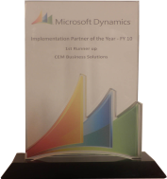






CEM – Microsoft Dynamics Awards
2013 (So far)
2012
2011
2010
2009
Microsoft Dynamics Awards
Invited Member of
Microsoft Partner Council (MPC)
Partner Advisory Board (PAB)
Enterprise Product Group (EPG)
Member of Microsoft Dynamics AX Council Program
CEM AX Payroll earns CfMD Certification
2012 Microsoft President’s Club Member
Fastest growing Company
Microsoft Best Marketing Partner
Microsoft Best Implementation Partner
2011 Microsoft President’s Club Member
2010 Microsoft Country Partner
Microsoft Best Implementation Partner
2009 Microsoft President’s Club Member
Microsoft Best Implementation Partner
Microsoft Best Sales Partner

Slide 5









Offices
USA
UK
India
UAE
Singapore
Qatar
Kuwait
Oman
12 Offices in 8 International locations

Slide 6


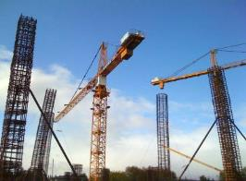






Industries
Construction
Project Services
Facility Management
Food & Beverage
Agriculture
Aviation
Automotive
Marine
Oil & Gas
Insurance
Banking
Manufacturing
Real Estate
Health & Fitness
Transportation
Trade & Logistics
Retail
Equipment Rental
Telecom
Notes:
Microsoft Dynamics AX 2012 R2 - HCM
Drive HR Impact (Core HRMS)
Personnel Actions and Workflow
Users will be given the option to configure AX to require a more formal way to create new positions and edit positions, with the additional option of AX Workflow as part of the formal action, plus a way to view a history of actions in HR.
For creating one position or multiple positions
For editing position fields, except the position worker assignment field. You can multi-select positions to edit and then edit multiple fields on the position.
Position Budgeting
Tracking of Budget/Cost information in HR - for Position Salary Budget and Position Expended/Position benefit budgets (via Position budget grid)
Ability to create a staging environment for planning next years budget prior to integration with Budget planning.
Integration to budgeting solution (via Budget plan generation- Generate from position forecasting)
Expand on Dimension functionality for integration to budget control (by allowing the budget for a position to be split by more than one position)
Budget generation from position forecasting will generate budget plan lines that will support the ability to:
View and modify the results of multiple forecasts in budget plan scenarios in Budget planning
View and modify budgeted information by budget period
Approved plan amounts are used to create budget register entries in Dynamics AX budget control which then provides the user with the ability to:
View budget to actuals for salaries and benefits using Budget control statistics
View budget to actuals by position when position is used as a financial dimension
Maintain Positions
Copy an existing position as a way to Mass create positions
Mass edit position attributes which includes the ability to Mass expire positions
Mass terminate workers
Add a means to "freeze" or block worker assignments to a position (adding a Available for assignment datetime field)
Benefits Eligibility
Provides an eligibility engine for Benefits. Employees will be eligible for a set of benefits based on the rules of this engine.
Accessing and exercising benefit eligibility rules to determine worker eligibility
Screenings
Screening types like drug or medical, can be setup and associated to Jobs. Results recorded for the worker and can setup as reoccurring so it auto sets up the next screening.
Enhanced Role Centers
Role Center for HR Manager where you could get Injury & Illness Incidents for the month, year, and last year
Or Staffing Manager, where you could see Average days to Recruit for each Department or Applicants by Source
And Training and Development Manager, where you could see information about Open Courses or how many people have taken a particular course
U.S. Payroll
Including HR and Payroll integration
Ceridian Tax Filing Service
Manage Talent (Talent Management)
Tests and Qualifications
Setup of Qualification Test Types, which would be added as defaults on Job and Position, and carried into Recruitment process; i.e., required Tests & minimum scores
Compensation
Enable mass adjustments of compensation structures

Slide 7
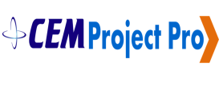
CEM Project Pro

Slide 8
Introduction - CEM Project Pro
Project Pro offers an agile
workflow, letting the contractor collect/prepare report and multitude of analysis within a short span of time
Project Pro can be integrated
with existing modules such as fixed
assets, Inventory, project accounting,
budget validation
Give profits to both
top management as well
as the planners
provides insights on
S Curve, Progress monitoring, WBS Summary, Root cause analysis etc.
Execute projects more efficiently, handle lengthy, tough projects, not just on time but on budget

Slide 9
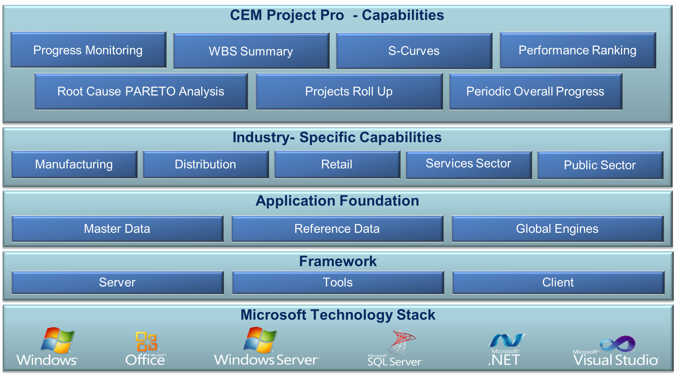
Solution Overview – CEM Project Pro

Slide 10

Features - CEM Project Pro
Progress
Monitoring
WBS Summary
Performance
Ranking
Root cause PARETO analysis
Periodic overall Progress
Projects roll up
for a particular activity
S curve

Slide 11
Progress Monitoring – CEM Project Pro
Monitors the
progress of a project against time, resources
and performance
schedules
Tracks whether the project running on schedule is
within the planned costs
Keeps track of implementation
process and checks
performance against
pre determined plans
Periodic checking
of progress of work
against the targets laid down to ensure timely completion of
the project
Helps in re-assigning
the staff, recruiting temporary staff to meet the time schedule
Helps in re-budgeting
the project, avoiding expenses under unnecessary heading
Helps in rescheduling the project, if the project
runs behind the schedule
Identifies the lagging
areas requiring timely attention and action
during the execution
of the project

Slide 12
WBS Summary – CEM Project Pro
Organize and subdivide the
total scope of a project using WBS graphical display
Relates all project phases thereby effectively planning, executing, controlling and reporting of the project
Summarizes an entire project and may serve as a starting point for contractors
to develop their own
contract-specific WBS
Helps project manager
identify work
buckets to derive the
list of activities
Helps in defining
the project organization chart that identifies who reports to whom within the project
WBS hierarchical
methodology includes all project phases, critical
decision points, and other activities required

Slide 13
Performance Ranking – CEM Project Pro
Using WBS models,
the success and performance of a project can be evaluated
Performance of the projects are ranked more consistently across different projects that can
assist in ensuring greater project success
Project performance is ranked for each project
against stakeholders’ specific requirements
for that project
Performance of the
project is ranked with measures of cost over run, schedule over run and combined success rating

Slide 14
S curve – CEM Project Pro
S curve calculates the cumulative expenditure of man hours,
output and cost against the
overall project plan
Identifies the lagging task
against completed task for resolution
S curve can be analyzed for
man hours vs. time,
cost vs. time etc.
Quickly access where the projects
stand in terms of completion, deadline and budget

Slide 15
Projects roll up for a particular activity – CEM Project Pro
Times and costs associated
with the lowest level WBS work packages are estimated and later added or rolled-up to yield the costs for higher level units
Helps you to quickly view the scheduled finish dates – the date that a task is scheduled to be completed. This date is based on the task's start date, duration, calendars, and predecessor
Views the selected subtasks
whose information is consolidated into the summary task.
Designate subtasks by using the Project outlining feature

Slide 16
Periodic Overall Progress – CEM Project Pro
Periodically calculates the
progress of the project
whether it is going on budget,
on time
It offers in-program and
connected solutions for
keeping project plans current
Keeping the managers
updated on the project
progress by automated mails
Updates the completion
percentage of multiple tasks, start/completion dates,
and provide estimates for completing tasks

Slide 17
Root cause PARETO analysis – CEM Project Pro
Helps in looking at causes of problems to stimulate
thinking and
organize thoughts
Analyses a series of
variances, risks, or defect that
may exist in and around
the project or any specific or particular component
of that project
Attempts to review the
actual root causes/unique underlying factors, that may lead
to an unfavourable result
Helps address issues
existing in the background that may differ slightly from the obvious ones

Slide 18
Integration To Other Modules - CEM Project Pro
Fixed assets
FA code creation wizard
Budget Validation
Purchase Request – An item level and item group level
Project Accounting
Productivity codes – to measure activity performance and grading
Validations in change orders based on contracts terms
Project specific document number sequences
Inventory
Additional Item categories
Item master creation wizard
Virtual warehouse for tracking in transit
Customer restrictions to merge multiple purchase requested into one purchase order
Other Enhancements
Payment authorization for all custom module transactions
Integration enhancement between Fixed Assets, Payables and other Custom Modules
Export to excel facility for reports
Role–specific dashboards & Record based security
100+ reports on financials, cost controls, project metrics

Slide 19



CEM Team
Over a millions hours of Dynamics experience
Committed to ‘Timely & Quality’ delivery
Qualified people from premium institutes
Onsite / Offshore experience
Incentivized for FTR (First time Right)
Sub contractor experience with large MNCs

Slide 20

Why CEM
Domain expertise in 19 industry verticals
97.7% Customer Satisfaction
End-to-end service from implementation to support
Over Million hours of Microsoft Dynamics experience
24x7 Operations
Successful timely project completion
265
happy customers
Proven “Sure Step Methodology”
Microsoft Dynamics Best Implementation Partner, 3 years in a row
Lower TCO (Total cost of ownership)
by blended model
Notes:
Microsoft Dynamics AX 2012 R2 - HCM
Drive HR Impact (Core HRMS)
Personnel Actions and Workflow
Users will be given the option to configure AX to require a more formal way to create new positions and edit positions, with the additional option of AX Workflow as part of the formal action, plus a way to view a history of actions in HR.
For creating one position or multiple positions
For editing position fields, except the position worker assignment field. You can multi-select positions to edit and then edit multiple fields on the position.
Position Budgeting
Tracking of Budget/Cost information in HR - for Position Salary Budget and Position Expended/Position benefit budgets (via Position budget grid)
Ability to create a staging environment for planning next years budget prior to integration with Budget planning.
Integration to budgeting solution (via Budget plan generation- Generate from position forecasting)
Expand on Dimension functionality for integration to budget control (by allowing the budget for a position to be split by more than one position)
Budget generation from position forecasting will generate budget plan lines that will support the ability to:
View and modify the results of multiple forecasts in budget plan scenarios in Budget planning
View and modify budgeted information by budget period
Approved plan amounts are used to create budget register entries in Dynamics AX budget control which then provides the user with the ability to:
View budget to actuals for salaries and benefits using Budget control statistics
View budget to actuals by position when position is used as a financial dimension
Maintain Positions
Copy an existing position as a way to Mass create positions
Mass edit position attributes which includes the ability to Mass expire positions
Mass terminate workers
Add a means to "freeze" or block worker assignments to a position (adding a Available for assignment datetime field)
Benefits Eligibility
Provides an eligibility engine for Benefits. Employees will be eligible for a set of benefits based on the rules of this engine.
Accessing and exercising benefit eligibility rules to determine worker eligibility
Screenings
Screening types like drug or medical, can be setup and associated to Jobs. Results recorded for the worker and can setup as reoccurring so it auto sets up the next screening.
Enhanced Role Centers
Role Center for HR Manager where you could get Injury & Illness Incidents for the month, year, and last year
Or Staffing Manager, where you could see Average days to Recruit for each Department or Applicants by Source
And Training and Development Manager, where you could see information about Open Courses or how many people have taken a particular course
U.S. Payroll
Including HR and Payroll integration
Ceridian Tax Filing Service
Manage Talent (Talent Management)
Tests and Qualifications
Setup of Qualification Test Types, which would be added as defaults on Job and Position, and carried into Recruitment process; i.e., required Tests & minimum scores
Compensation
Enable mass adjustments of compensation structures

Slide 21

Contact Us
United States
50 Tice Blvd, Suite 340
Woodcliff Lake, NJ 07677
Tel : +1 (201) 391-5345
4944 Sunrise Blvd.
Suite B-4,Fair Oaks,
CA 95628
United Kingdom
4 Morel Mews, Dagenham RM8
1 BW Essex
Tel : +44 207 993 6483
Singapore
10 Anson Road,
#26-04 International Plaza,
Singapore 079903
Tel : +65 9757 5768
United Arab Emirates
119, Building No. 10, Dubai Internet City, P.O. Box 502270, Dubai, U.A.E.
Tel : +971 43911683
1403, Al Zahraa Tower , King
Faisal Street, Sharjah, U.A.E.
Tel : +971 6 5734700
Kuwait
P.O. Box 36350, AI Rass 24754,
Kuwait,
Tel : +965 - 22622063
Qatar
P.O. Box #51, Doha Qatar
Tel: +974 300 75 145
Oman
Opening Shortly!
India
No:85, Babu Street, Vellala,
Teynampet, Chennai 600 086
Tel : +91 44 33083800

Slide 22
Thank you

