Slide 1
Predicting Insurance Claim Severity
A decision-support model for earlier reserve review
Project question
BLUF
Can machine learning predict final claim cost well enough to help claims staff prioritize review?
Use the score to prioritize human review after validation; do not use it alone to set reserves or assign adjusters.
Audience: Claims executives
Vasantha Perugu
MSDS 696 – Practicum II
Regis University
1

Slide 2
Historical claim data can become a review-priority list.
The model helps decide which files deserve attention first.
1
Historical claim data
Anonymized features + final loss
→
2
Model score
Estimated cost + severity rank
→
3
Human review list
Claims for earlier reserve attention
Project objective
Business context
Test whether available claim information can identify claims that deserve earlier reserve review.
Review time is limited. Missing high-loss claims creates the greatest reserve risk.
Vasantha Perugu | MSDS 696 Practicum II | Regis University
2

Slide 3
Bottom line: useful for review priority, not automated decisions.
The model adds signal, but human review and newer-claim validation are still required.
55.5%
30.2%
85.4%
of severe claims captured
in the top 10% review list
lower average miss
than the median rule of thumb
of very high-severity claims
were under predicted
Recommendation
Keep off-limits
Validate on newer claims first. If the result holds, use the score to support claims staff review.
Do not use the prediction alone to set reserves, approve claims, settle claims, or assign adjusters.
Vasantha Perugu | MSDS 696 Practicum II | Regis University
3

Slide 4
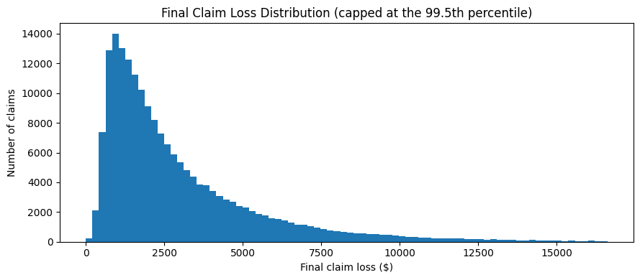
High-loss claims are the main reserve-risk concern.
A typical claim does not show the full risk; the expensive tail matters most.
$2,116
median claim loss
$6,402
90th percentile
claim loss
Business meaning
Reserve review should focus on the claims most likely to land in the high-cost tail.
Vasantha Perugu | MSDS 696 Practicum II | Regis University
4

Slide 5
The data supports prioritization, not full claims automation.
I limited the conclusion to what this anonymized dataset can support.
Can support
Keep human-controlled
• Predicting final claim loss
• Ranking claims by expected cost
• Building a queue for earlier human review
• Final reserve amount
• Adjuster assignment
• Approval, settlement, or claim outcome decisions
Practical claim
The model can support review prioritization, not replace claims decisions.
Vasantha Perugu | MSDS 696 Practicum II | Regis University
5

Slide 6
The selected model cut the average miss by 30.2%.
That shows the claim features contain useful signal.
Average prediction miss, lower is better
30.2%
Selected model
$1,254
lower average miss than
the median rule of thumb
Median rule of thumb
$1,796
Interpretation
The model beats a simple benchmark. But average miss is only the first question; operational safety matters too.
Holdout test: 37,664 claims; development: 150,654 claims; total history: 188,318. Method: ridge regression with leakage-controlled target encoding.
Vasantha Perugu | MSDS 696 Practicum II | Regis University
6

Slide 7
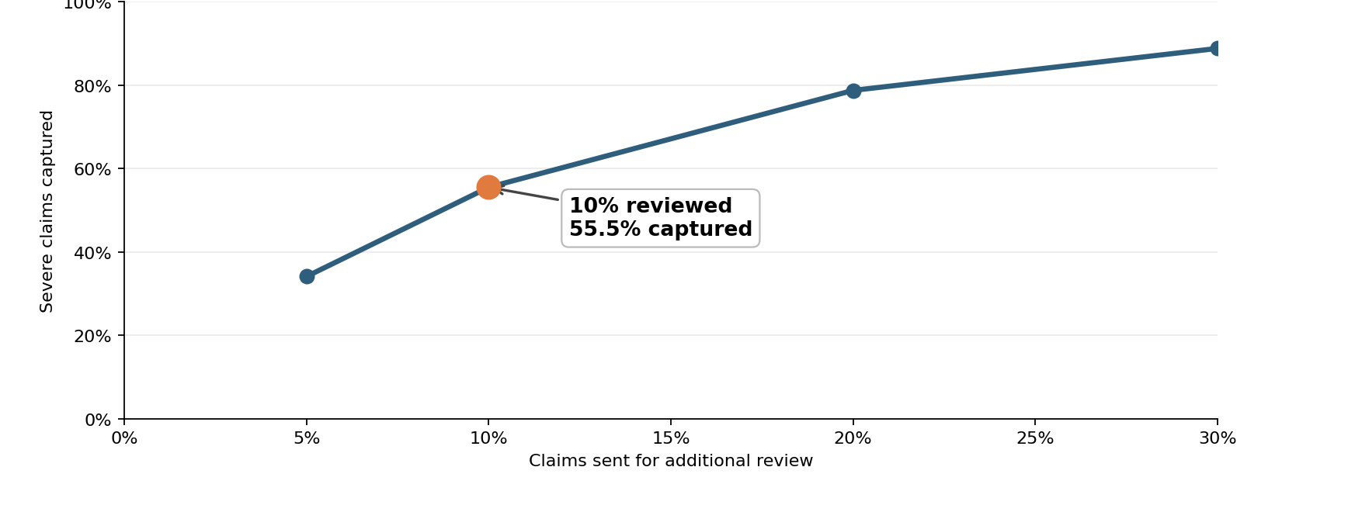
The top 10% review list captured 55.5% of severe claims.
This is the strongest business result from the project.
2,090
severe claims captured
in the top 10% review list
55.5%
severe-claim capture
at 10% review capacity
Severe claim = actual loss at or above the training-set 90th percentile.
Vasantha Perugu | MSDS 696 Practicum II | Regis University
7

Slide 8
The review list still missed 1,676 severe claims.
That is why existing rules and human judgment should stay in place.
At the 10% review cutoff
Captured severe claims: 55.5%
Missed severe claims: 1,676
What this means
Recommended use
The score helps choose what to review first. It does not prove that lower-ranked claims are safe to ignore.
Keep existing rules, reviewer overrides, and escalation paths in place.
A better review queue is not a replacement for controls.
Vasantha Perugu | MSDS 696 Practicum II | Regis University
8

Slide 9
The model ranks claims better than it predicts exact reserve dollars.
Higher scores generally meant higher losses, but very high claims were often underpredicted.
$8,979
average actual loss
in the Very High band
85.4%
of very high-severity claims
were under predicted
Decision meaning
Use the score to say “review this earlier,” not “this is the final reserve.”
Vasantha Perugu | MSDS 696 Practicum II | Regis University
9

Slide 10
Validate on newer claims before operational use.
The model should be tested out of time before it enters a live process.
1
Validate on newer claims
Use fields available at initial reporting.
→
2
Run a small review pilot
Send highest-ranked claims to extra review.
→
3
Monitor misses and overrides
Track severe claims missed before expanding.
Guardrail
Do not use the score alone to set reserves, approve claims, settle claims, or assign adjusters.
If validation does not hold, the model should remain an analysis project.
Vasantha Perugu | MSDS 696 Practicum II | Regis University
10

Slide 11
Final recommendation
Use the score as a human-review signal.
The project creates a practical review workflow while keeping the model’s limits clear.
Project outcome
• Built and tested a reproducible claim-severity model
• Cut the average miss by 30.2% versus the median rule of thumb
• Captured 55.5% of severe claims in a 10% review queue
• Still missed 1,676 severe claims, so existing controls must stay in place
Recommended next step
Validate on newer claims, then use the score only as an additional signal for human reserve review.
Vasantha Perugu | MSDS 696 Practicum II | Regis University
11

