Slide 1
Predicting Insurance Claim Severity
A decision-support model for earlier reserve review
Project Question
Can machine learning predict final claim cost well enough to help claims staff prioritize review?
Vasantha Perugu
MSDS 696 – Practicum II
Regis University
Vasantha Perugu | MSDS 696 Practicum II | Regis University
1
Notes:
Slide 1. Today I am presenting my final project on predicting insurance claim severity. Severity means the final claim cost to the insurer. My bottom-line answer is positive but careful: yes, the model can help prioritize human reserve review after validation; no, it should not automatically set reserves or assign adjusters. The purpose is decision support, not claims automation.

Slide 2
Historical claim data can become a review-priority list.
The model helps decide which files deserve attention first.
1
Historical claim data
Anonymized features + final loss
2
Model score
Estimated cost + severity rank
3
Human review list
Claims for earlier reserve attention
Project objective
Business context
Test whether available claim information can identify claims that deserve earlier reserve review.
Review time is limited. Missing high-loss claims creates the greatest reserve risk.
Vasantha Perugu | MSDS 696 Practicum II | Regis University
2
Notes:
Slide 2. The workflow is simple. I start with historical Allstate claim data, including anonymized features and the final loss amount. The model gives each claim an estimated cost and a rank. That rank becomes a review-priority list. In plain English, the model does not decide the claim. It helps decide what to review first.

Slide 3
Bottom line: useful for review priority, not automated decisions.
The model adds signal, but human review and newer-claim validation are still required.
55.5%
30.2%
85.4%
of severe claims captured
lower average error
of very high-severity claims
in the top 10% review list
than the median baseline
were underpredicted
Recommendation
Keep off-limits
Validate the model on newer claims first. If the result holds, use the score to support claims staff review.
Do not use the prediction alone to set reserves, approve claims, settle claims, or assign adjusters.
Vasantha Perugu | MSDS 696 Practicum II | Regis University
3
Notes:
Slide 3. This is the main answer. The model is useful as a human-review signal. It improved average error by 30.2 percent and captured 55.5 percent of severe claims when only the top 10 percent of claims were sent to review. But it also underpredicted many very high-severity claims, so I would not use it by itself to set reserves or assign adjusters.

Slide 4
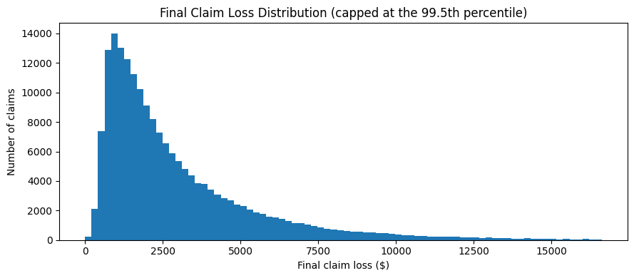
High-loss claims are the main reserve-risk concern.
A typical claim does not show the full risk; the expensive tail matters most.
$2,116 median
$2,116
median claim loss
$6,402
90th percentile claim loss
Business meaning
Reserve review should focus on the claims most likely to land in the high-cost tail.
Vasantha Perugu | MSDS 696 Practicum II | Regis University
4
Notes:
Slide 4. Claim losses are very uneven. Most claims are closer to the lower-cost range, but a smaller group becomes much more expensive. The red marker shows the median claim loss of about 2,116 dollars. The 90th percentile was about 6,402 dollars. That tail is the reserve-risk problem: a few high-cost claims can create a much larger business impact than many normal claims.

Slide 5
The right use is prioritization, not full claims automation.
I limited the conclusion to what this anonymized dataset can support.
Can support
Keep human-controlled
• Predicting final claim loss
• Ranking claims by expected cost
• Building a queue for earlier human review
• Final reserve amount
• Adjuster assignment
• Approval, settlement, or claim outcome decisions
Practical claim
Use the model as an extra review signal, not as a replacement for claims expertise.
Vasantha Perugu | MSDS 696 Practicum II | Regis University
5
Notes:
Slide 5. This slide sets the boundary. The dataset can support prediction, ranking, and a review queue. But the model should not decide the final reserve amount, pick an adjuster, or make approval and settlement decisions. The practical claim is narrower and safer: the score can be one additional signal for review prioritization.

Slide 6
I tested the model on claims it did not train on.
The reported results come from the held-out validation set.
188,318 total claims
Allstate historical data
150,654 development claims
Used to build the model
37,664 validation claims
Held out for final testing
Selected model
Plain-English version
Ridge regression with log-transformed loss and leakage-controlled target encoding.
A stable model that compares patterns across similar claims without letting the answer leak into training.
Vasantha Perugu | MSDS 696 Practicum II | Regis University
6
Notes:
Slide 6. I used 188,318 historical claims. I built the model with 150,654 claims and tested it on 37,664 held-out claims. That means the results shown in the presentation come from claims the model did not train on. The selected model was Ridge regression with a log-transformed loss target and leakage-controlled target encoding. In simpler terms, it is a stable model, and I took steps to prevent the answer from leaking into the training process.

Slide 7
The selected model reduced average error by 30.2%.
That shows the claim features contain useful signal.
Validation MAE, lower is better
30.2%
Selected model
$1,254
improvement over the strongest constant baseline
Median baseline
$1,796
Interpretation
The model beats a simple benchmark. But average error is only the first question; operational safety matters too.
Vasantha Perugu | MSDS 696 Practicum II | Regis University
7
Notes:
Slide 7. The first result is average prediction error. The median baseline had an MAE of 1,796 dollars. The selected model reduced that to 1,254 dollars, which is a 30.2 percent improvement. This tells me the claim features contain useful signal. But average error alone is not enough for an operational decision, so I also looked at severe-claim capture and underprediction risk.

Slide 8
The top 10% review list captured 55.5% of severe claims.
This is the strongest business result from the project.
Business meaning
A small review queue finds a much larger share of severe claims than random selection.
Use the rank to decide what should be reviewed earlier.
Severe claim = actual loss at or above the training-set 90th percentile. Holdout sample: 37,664 claims.
Vasantha Perugu | MSDS 696 Practicum II | Regis University
8
Notes:
Slide 8. This is the strongest practical result. When I ranked the validation claims and reviewed only the top 10 percent, the model captured 55.5 percent of all severe claims. A random 10 percent review would find about 10 percent. So the model clearly improves the review order and helps focus limited review time where it is more likely to matter.

Slide 9
The review list still missed severe claims.
That is why existing rules and human judgment should stay in place.
At the 10% review cutoff:
Captured severe claims: 55.5%
Missed severe claims: 1,676
What this means
Recommended use
The score helps choose what to review first. It does not prove that lower-ranked claims are safe to ignore.
Keep existing rules, reviewer overrides, and escalation paths in place.
Vasantha Perugu | MSDS 696 Practicum II | Regis University
9
Notes:
Slide 9. The same result also has an important limitation. At the 10 percent review cutoff, the model still missed 1,676 severe claims. So the score cannot tell the claims team which files are safe to ignore. Existing rules, reviewer judgment, overrides, and escalation paths still need to stay in place.

Slide 10
The model ranks claims better than it predicts exact dollars.
Higher predicted bands generally had higher actual claim losses.
Decision meaning
Use the score to say “review this earlier,” not “this is the final cost.”
Vasantha Perugu | MSDS 696 Practicum II | Regis University
10
Notes:
Slide 10. Another useful finding is that the model is better at ranking claims than predicting the exact final dollar amount. Higher predicted review bands generally had higher actual losses, and the ranking relationship was 0.707. That supports using the score for prioritization. It does not support using the prediction as the final reserve amount.

Slide 11
Very high-severity claims remain the biggest limitation.
This is the main reason the prediction should not become an automatic reserve amount.
85.4%
$5,707
$5,513
of very high-severity claims were underpredicted
average shortfall when underprediction happened
MAE on very high-severity validation claims
Why this matters
Recommended use
A large miss on an expensive claim creates more business risk than a small miss on a normal claim.
Do not use the model prediction as the reserve amount. Use high scores to trigger extra review.
Vasantha Perugu | MSDS 696 Practicum II | Regis University
11
Notes:
Slide 11. This is the biggest caution. For very high-severity claims, which are above the training-set 95th percentile, the model underpredicted 85.4 percent of the time. When underprediction happened, the average shortfall was about 5,707 dollars. That is why I do not recommend using the prediction as the reserve amount. The safer use is to trigger extra review.

Slide 12
Validate on newer claims before operational use.
The model should be tested out of time before it enters a live process.
1
Validate on newer claims
Use only fields available at initial reporting.
2
Run a small review pilot
Send highest-ranked claims to extra review.
3
Monitor misses and overrides
Track severe claims missed before expanding.
Guardrail
Do not use the score alone to set reserves, approve claims, settle claims, or assign adjusters.
If validation does not hold, the model should remain an analysis project.
Vasantha Perugu | MSDS 696 Practicum II | Regis University
12
Notes:
Slide 12. My next step would be validation on newer claims before any operational use. I would check whether the error, ranking, calibration, and severe-claim capture still hold over time. Then I would run a small review pilot and monitor misses and overrides. The guardrail is clear: do not use the score alone to set reserves, approve claims, settle claims, or assign adjusters.

Slide 13
Final recommendation
Use the score as a human-review signal.
The project creates a practical review workflow while keeping the model’s limits clear.
Project outcome
• Built and tested a reproducible claim-severity model
• Reduced MAE by 30.2% versus the median baseline
• Captured 55.5% of severe claims in a 10% review queue
Recommended next step
Validate on newer claims, then use the score only as an additional signal for human reserve review.
Vasantha Perugu | MSDS 696 Practicum II | Regis University
13
Notes:
Slide 13. My final recommendation is to use the score as an additional signal for human reserve review. The project shows that the model can improve average accuracy and concentrate severe claims near the top of a review list. It should not set reserves or replace human judgment. After model selection, I also generated final test predictions and completed the project checks.

