Slide 1
The Evolution of Artificial Intelligence
From Early Research to Modern AI systems
Vasanth Geethan Raju
AIML-500: Machine Learning Fundamentals

Slide 2
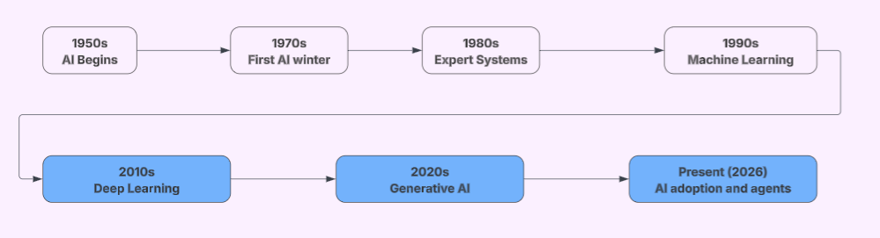
AI History At a glance

Slide 3
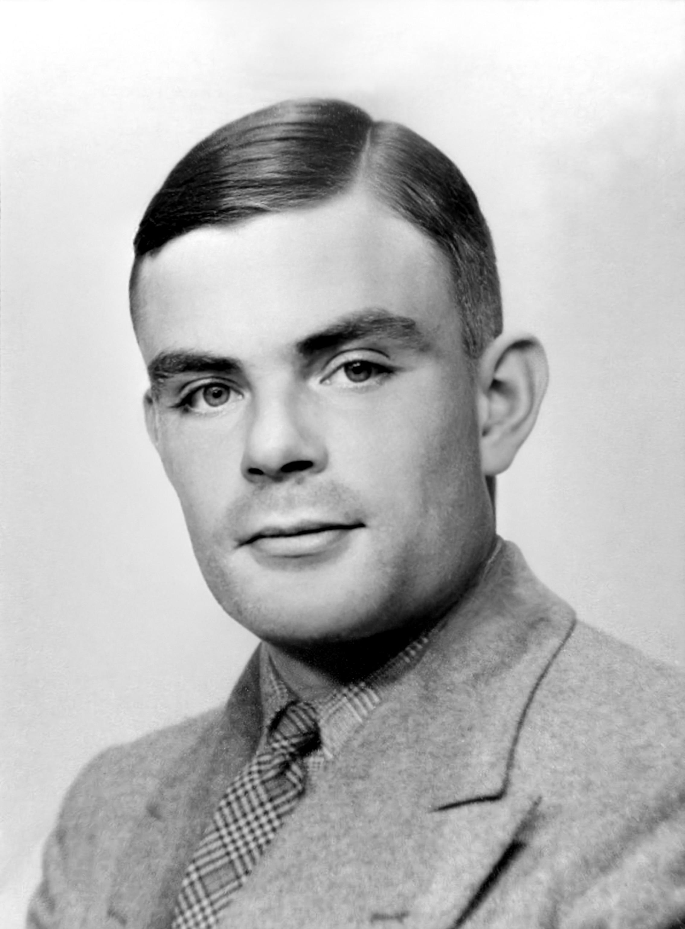
The Birth of AI (1950-1966)
1950: Alan Turing
Proposed the Imitation Game, later called the Turing Test, to explore whether machines could demonstrate intelligent behavior
1956: Dartmouth Conference
John McCarthy and other researchers helped establish AI as a formal field of study
1958: Frank Rosenblatt
Developed the Perceptron, an early neural network that could learn simple classification patterns
1966: ELIZA
Joseph Weizenbaum's chatbot demonstrated how computers could simulate conversation using programmed rules

Slide 4
AI Winters and Expert Systems (1970–1993)
1974-1980: First AI Winter
AI research lost funding because early systems could not meet ambitious expectations. Computing resources were also limited
1980s: Expert Systems Boom
Rule-based programs helped solve specialized problems in medicine and business, creating renewed interest in AI
1986: Neural Networks Return
Research by Rumelhart, Hinton, and Williams popularized backpropagation for training multilayer neural networks
1987-1993: Second AI Winter
Expert systems were expensive to maintain and often too limited, causing another decline in investment and interest

Slide 5
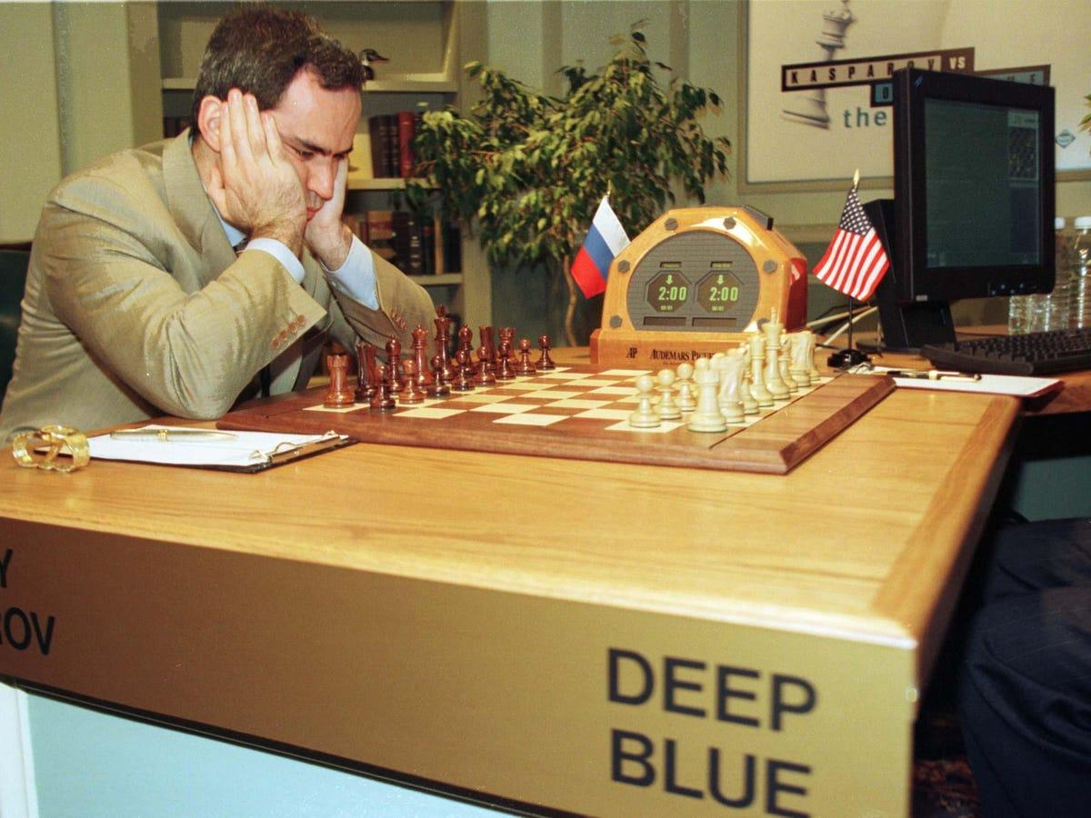
AI's Potential (1997–2011)
1997: IBM Deep Blue
Defeated world chess champion Garry Kasparov, demonstrating the power of specialized algorithms combined with high-speed computing
2000s: Machine Learning Expands
Growing digital datasets and improved computing helped machine learning become useful for spam filtering, search engines, and recommendations
2011: IBM Watson
Won the television quiz show Jeopardy!, showing progress in language processing and question answering

Slide 6
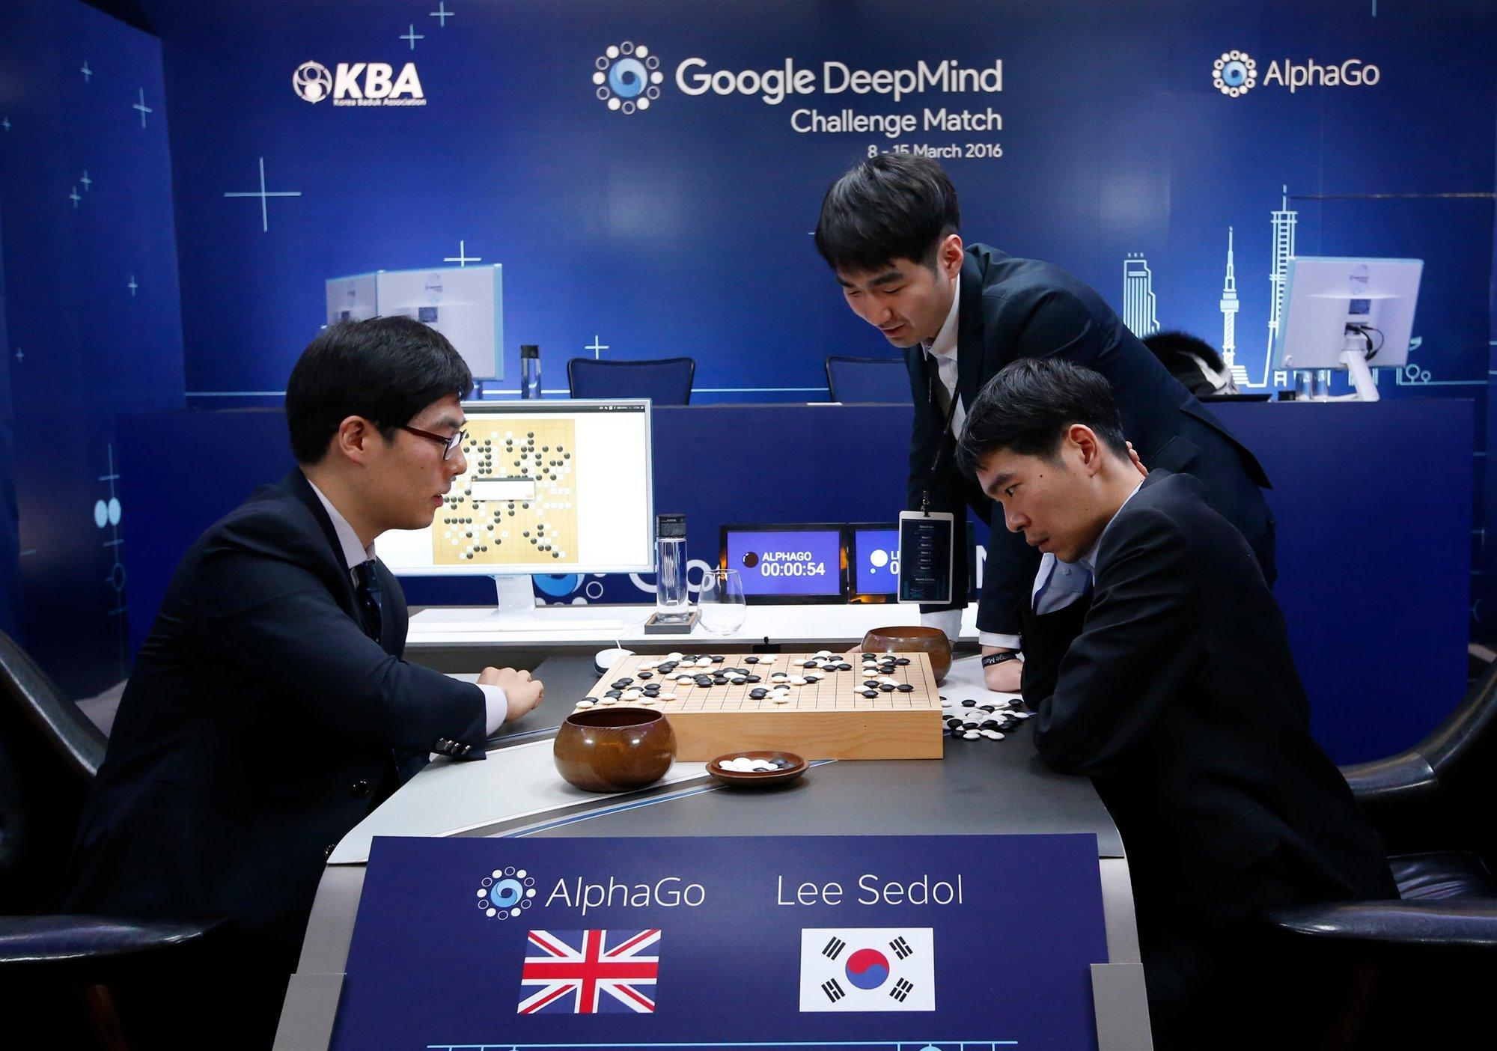
The Deep learning revolution (2012–2017)
2012: AlexNet
Alex Krizhevsky, Ilya Sutskever, and Geoffrey Hinton demonstrated a major improvement in image recognition using deep neural networks and GPUs
2016: AlphaGo
Google DeepMind's AlphaGo defeated Go champion Lee Sedol, showing the power of deep learning combined with reinforcement learning and search
2017: Transformers
Researchers introduced the Transformer architecture, which uses attention mechanisms and later became central to large language models

Slide 7
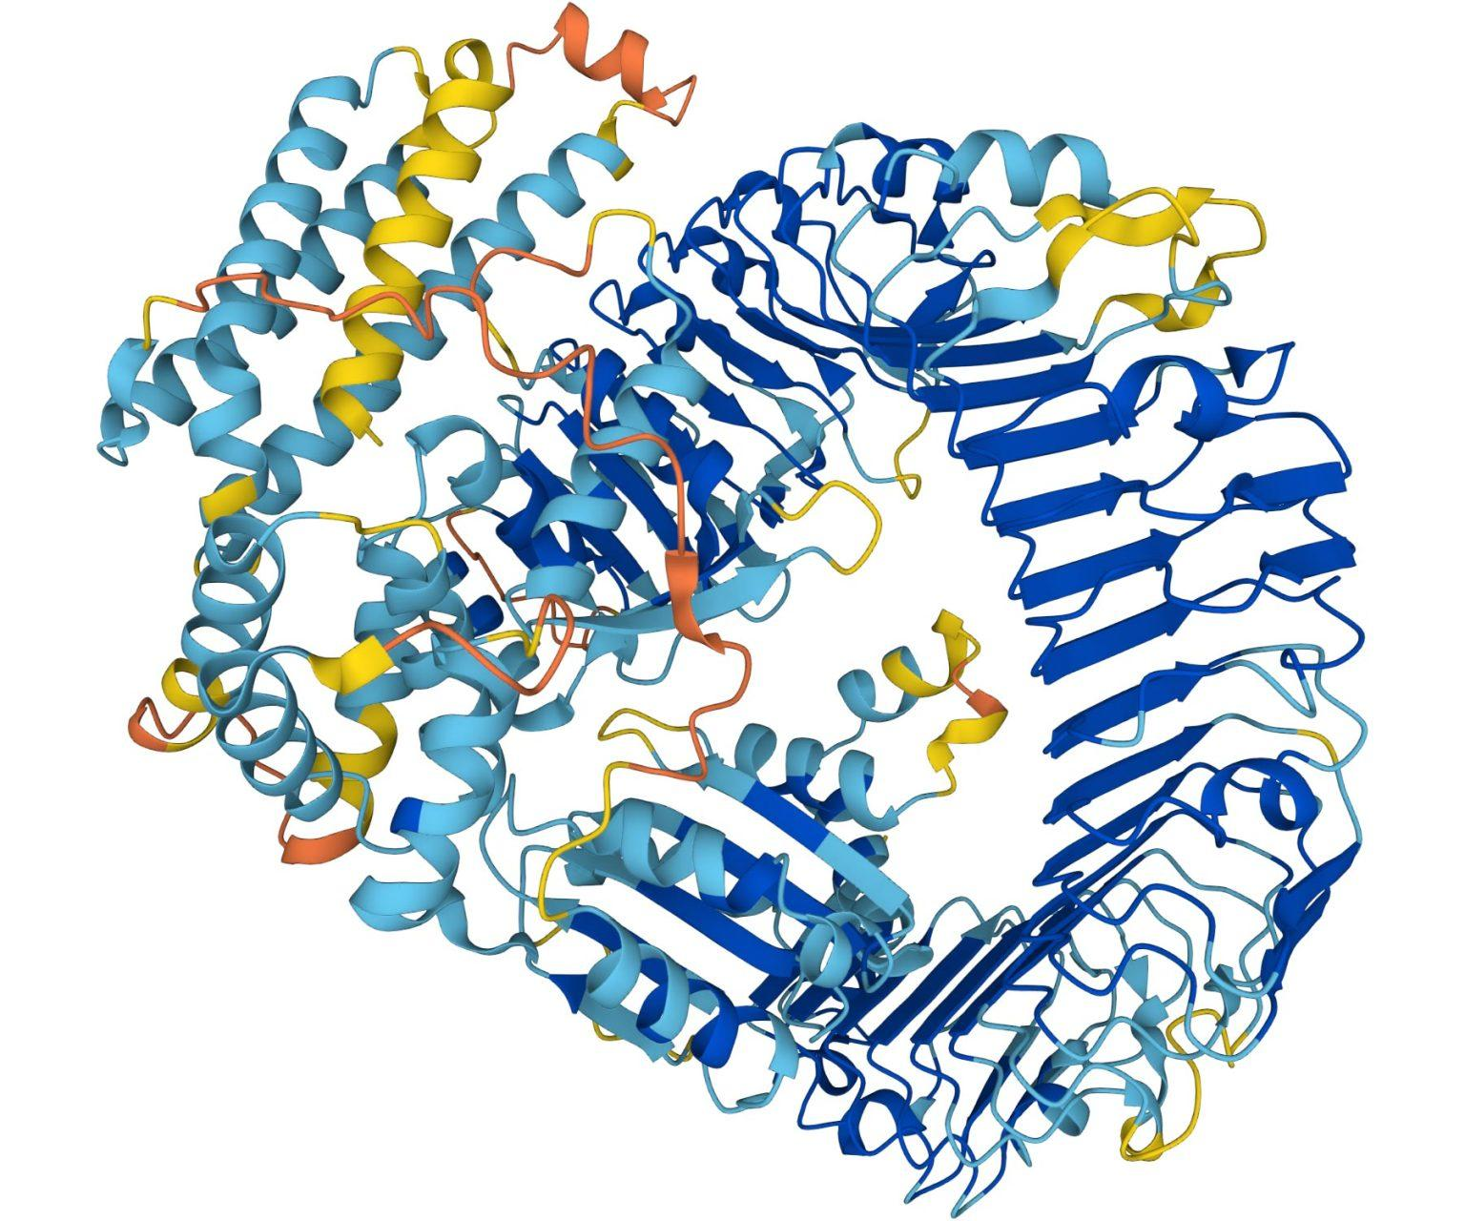
Generative AI becomes mainstream (2020–2023)
2020: GPT-3
OpenAI demonstrated a large language model that could generate text and perform different language tasks from prompts
2020: AlphaFold 2
Google DeepMind achieved a major breakthrough in predicting protein structures, helping advance biological research
2022: ChatGPT
OpenAI released ChatGPT on November 30, making conversational generative AI accessible to the public
2023: GPT-4
More capable language models expanded AI applications in writing, coding, analysis, and multimodal tasks

Slide 8
AI at Everyday work (2024–present)
2024
The Nobel Prize in Chemistry recognized David Baker for computational protein design and Demis Hassabis and John Jumper for AI-based protein structure prediction
2025
AI became increasingly integrated into business workflows, software development, healthcare, and research
Present (2026)
AI agents and advanced models continued expanding, although reliable autonomy and human oversight remain important challenges

Slide 9
Key Companies, People, & contributions
Company/Researchers | Major Contribution
IBM | Deep Blue, Watson, and practical AI systems
NVIDIA | GPU hardware that helped accelerate deep learning
Google / DeepMind | Transformers, AlphaGo, AlphaFold, Gemini
OpenAI | GPT models and ChatGPT
Anthropic | Claude language models
Meta | Llama models and open-weight AI research
Stanford and other universities | Foundational research and AI evaluation

Slide 10
How AI changed Different Industries
Healthcare
AI helps analyze medical images, supports research, and assists with drug discovery
Software Development
AI assists developers with coding, debugging, documentation, and testing
Business and Finance
AI helps detect fraud, forecast demand, and automate repetitive work
Education
AI supports personalized learning, tutoring, and research assistance

Slide 11
Conclusion
AI has evolved from simple rule-based systems to advanced models that learn, reason in limited ways, and generate content
The AI winters showed that progress depends on realistic expectations, sufficient computing power, and better algorithms
Deep learning, GPUs, cloud computing, and Transformers made modern AI applications possible
AI is becoming part of everyday work, but people still need to verify its results and use it responsibly

Slide 12
Research references
IBM. (2024). The history of artificial intelligence. https://www.ibm.com/think/topics/history-of-artificial-intelligence
Stanford Institute for Human-Centered Artificial Intelligence. (2026). Artificial intelligence index report 2026. https://hai.stanford.edu/assets/files/ai_index_report_2026.pdf
Vaswani, A., et al. (2017). Attention is all you need. arXiv. https://arxiv.org/abs/1706.03762
OpenAI. (2022, November 30). Introducing ChatGPT. https://openai.com/index/chatgpt
Nobel Prize Outreach. (2024). The Nobel Prize in Chemistry 2024: Press release. https://www.nobelprize.org/prizes/chemistry/2024/press-release/

Slide 13
Image References
Encyclopaedia Britannica. (n.d.). Alan Turing [Photograph]. https://www.britannica.com/biography/Alan-Turing
Holmes, A. (2020, February 24). The chess grandmaster who was beaten by a computer predicts that AI will 'destroy' most jobs [Photograph by Reuters]. https://www.businessinsider.com/chess-grandmaster-gary-kasparov-ai-artificial-intelligence-destroy-jobs-prediction-2020-2
Hern, A. (2016, March 15). AlphaGo: Its creator on the computer that learns by thinking [Photograph by Lee Jin-man/AP]. The Guardian. https://www.theguardian.com/technology/2016/mar/15/alphago-what-does-google-advanced-software-go-next
EMBL-EBI. (2022, July 29). DeepMind AI powers major scientific breakthrough: AlphaFold generates 3D view of the protein universe [Illustration credited to Karen Arnott/EMBL-EBI]. SciTechDaily. https://scitechdaily.com/deepmind-ai-powers-major-scientific-breakthrough-alphafold-generates-3d-view-of-the-protein-universe/

