Slide 1
MS3001D: ECONOMICS CSED
QUALITATIVE INTERVIEW PROJECT
SEVAKULA JYOTHI BILLA AMULYA BHUKYA VASANTH KUMAR B180359CS B180404CS B180441CS
PACHIGALLA BHARATH TEJA CHEERALA NAVEEN KUMAR
B180953CS B180383CS
VASANTH KUMAR

Slide 2
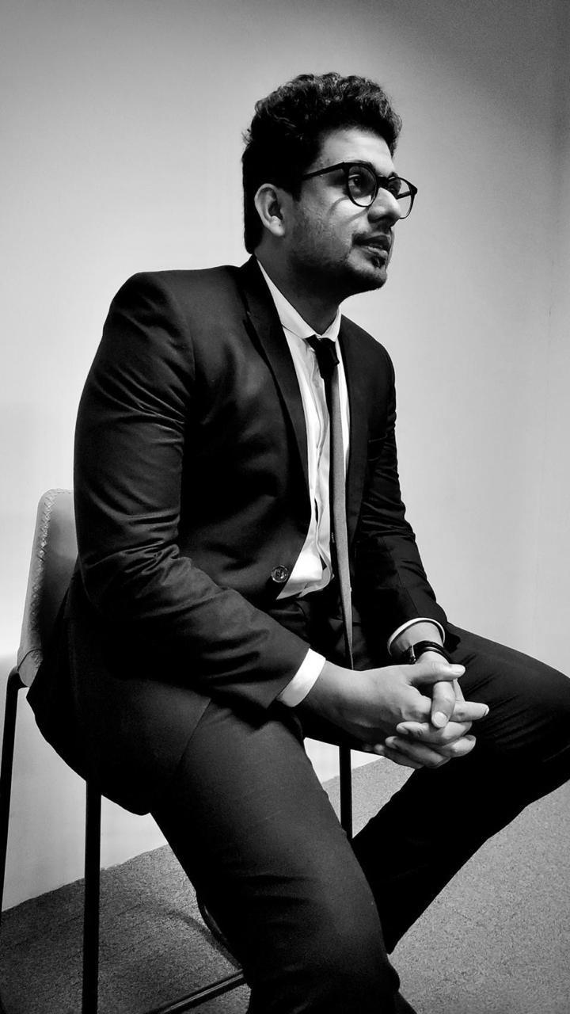
OUR ENTREPRUNER Owner and CEO of iskew Learning Managing Director of insight Jobguru
VASANTH KUMAR

Slide 3
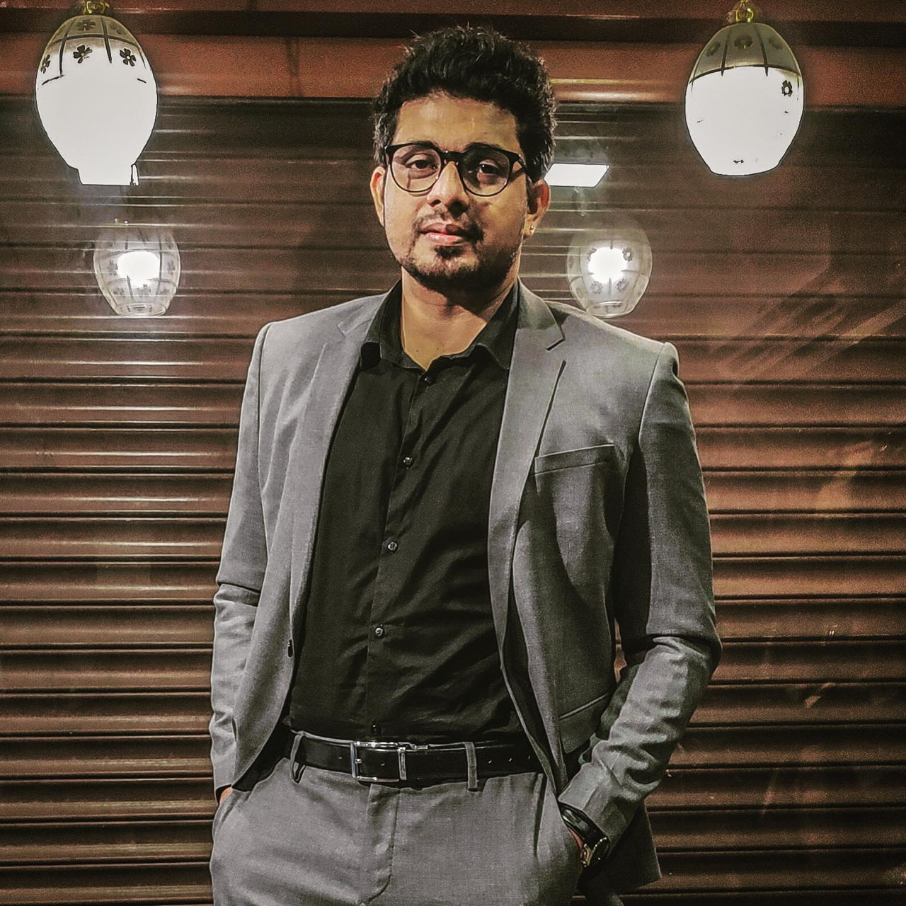
Why we are Interviewing him?
We were trained by him in our orientation program which was conducted when we joined NITC, We thought that the training domain would be unique and like we could get an idea of service based company.
VASANTH KUMAR

Slide 4
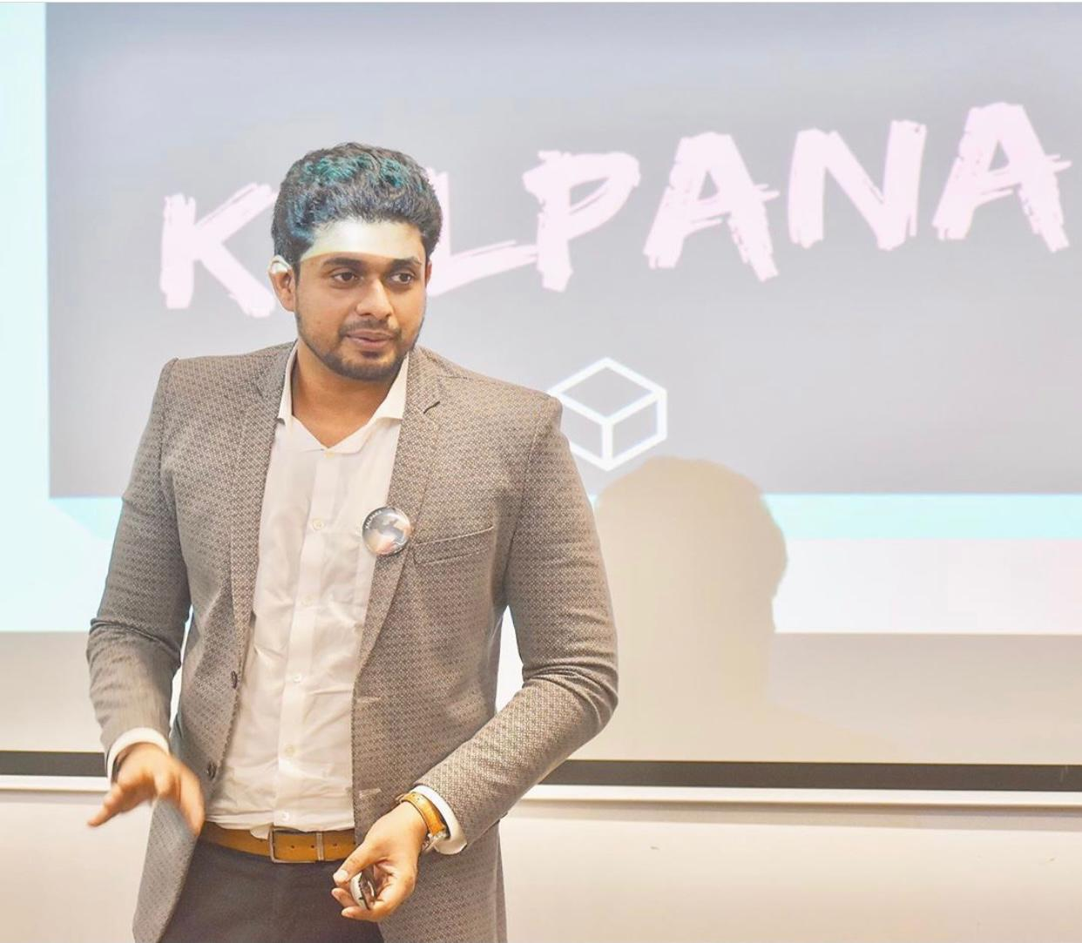

iSkew Learning
VASANTH KUMAR

Slide 5

JYOTHI

Slide 6
Table of contents
OVERVIEW
JOURNEY
SERVICES
REWARDS
SLOGANS
TEAM
CONCLUSION
NAVEEN KUMAR

Slide 7
OVERVIEW
Iskew learning is a Virtual learning platform founded by Mr.Renjit Ravi Keshav who is an accomplished entrepreneur in the field of Human Resources for Professional Skill Development.
His another startup, Insight Gob Guru was founded in the year 2008, and currently holds 53% of market share in the Education Training Industry in Kerala
AMULYA

Slide 8
TIMELINE
1
2
3
4
Part Time Journalist
Account Manger
Insight Jobguru
iSkew Learning
NAVEEN KUMAR

Slide 9

PART TIME JOURNALIST
Started his career as a part-time journalist in WebDunia
He is a member of empaneled team of Republic TV and Times Now News Channels
AMULYA

Slide 10

ACCOUNT MANGER
Started his next career path as an Associate Accounts Manager at RR Donnelly & Sons, Chennai
Left his job during 2008 recession period
BHARATH TEJA

Slide 11

FIRST COMPANY
Started in 2008
Managing Director since 10 years
Trained more than 1lakh+ students
BHARATH TEJA

Slide 12

SECOND COMPANY
Started in 2020 with a new mode
CEO of the company
The company Motto
-Door to Learning
BHARATH TEJA

Slide 13
SERVICES
Business Writing Skills
Email Etiquette
Leadership Excellence
English Communication SKills
Time Management
Stress Management
Voice & Accent Neutralization
AMULYA

Slide 14
Interpersonal Skills
Public Speaking
Networking & Personal Branding
Online Content Writing
Database Management
AMULYA

Slide 15
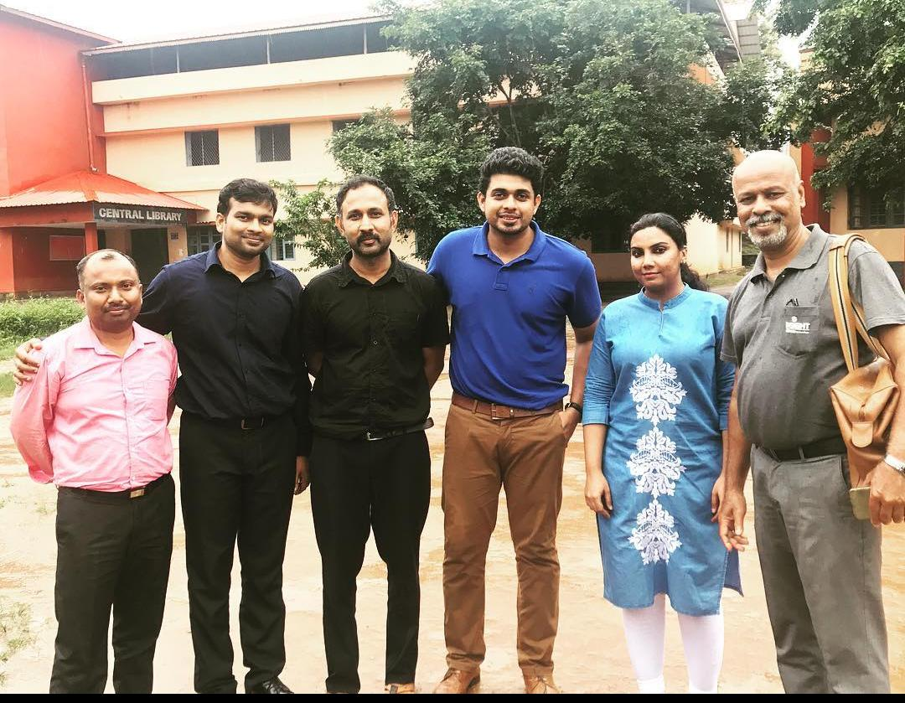
THE TEAM
AMULYA

Slide 16
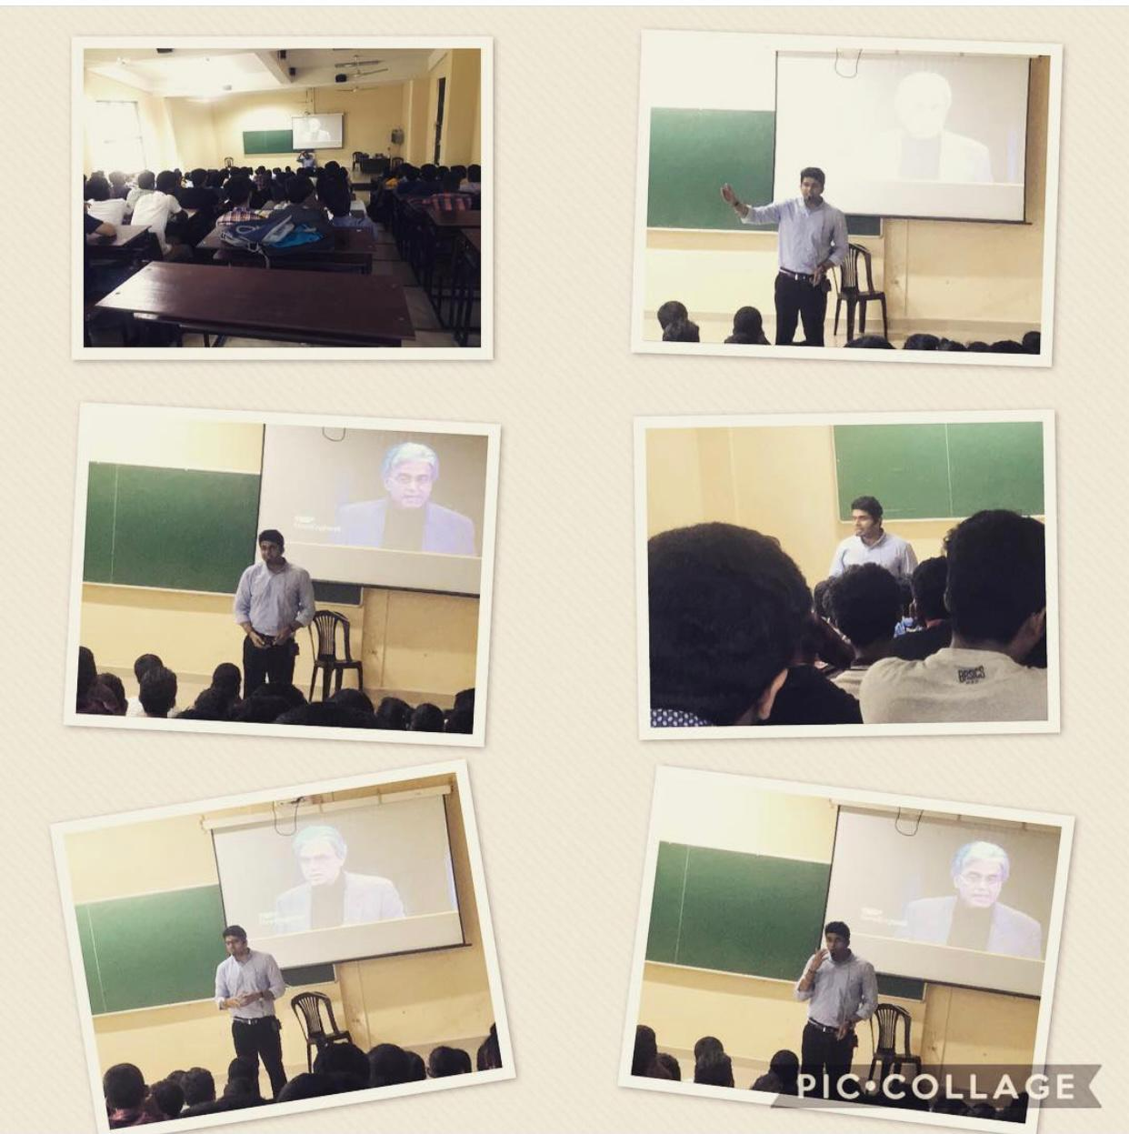
Glimpses of Mr. Renjith working at NITC
JYOTHI

Slide 17
REWARDS
He won the National Level Award for Leadership in Education – 2017 in New Delhi for his entrepreneurial stint with Insight Job Guru.
Renjit has received an honour from Shri.Vijendra Singh Rowath, IAS, Collector, UTLD, Lakshadweep for imparting Employability Skill Development Session for students in association with Labour, Employment & Training Department.
JYOTHI

Slide 18
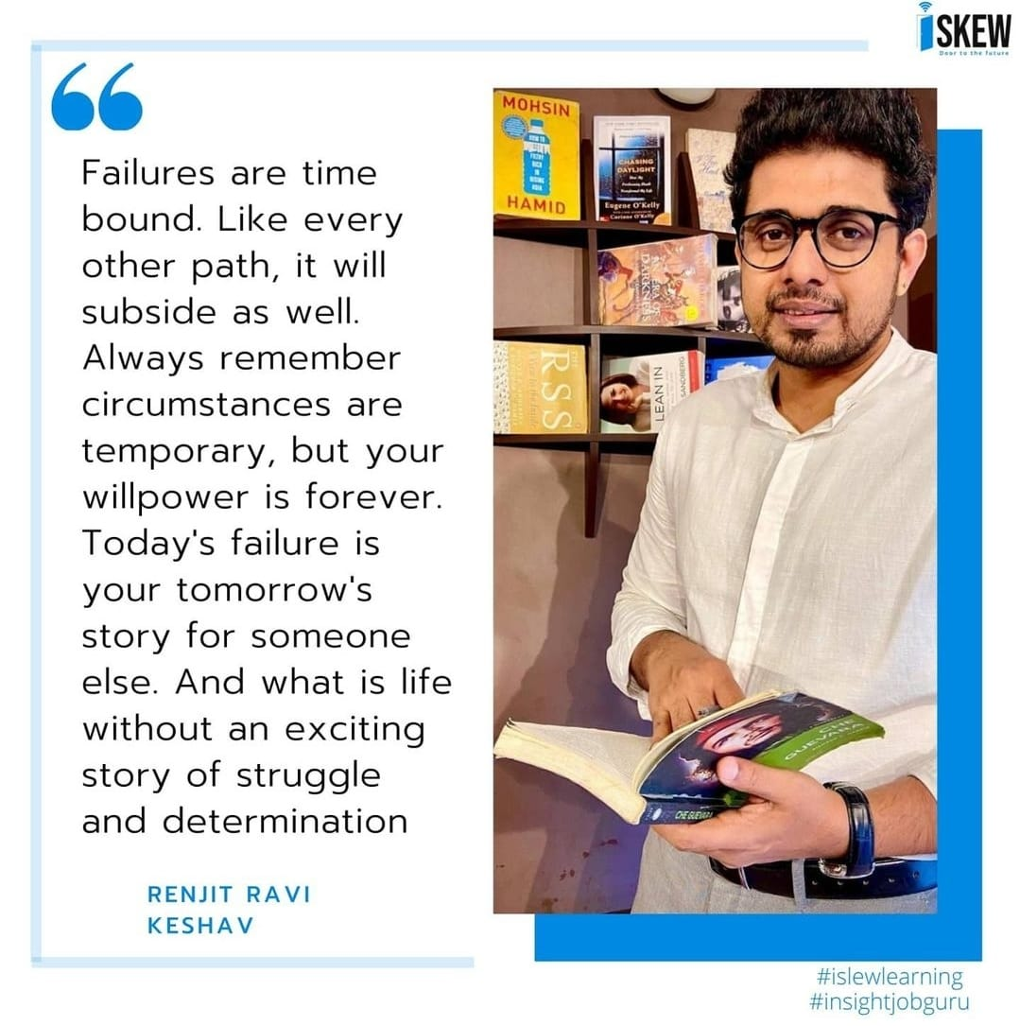
You can find more at
https://www.renjitkeshav.com/slogans
JYOTHI

Slide 19


