Slide 1

Blueprint for Smart Water Fountains
Smart water fountains are a new and innovative approach to traditional drinking fountains. They use advanced technology to monitor water quality in real-time, provide customizable water temperature options, and can be integrated with smart devices. They offer many advantages over traditional fountains and have the potential to revolutionize our public spaces.

Slide 2
Benefits of Smart Water Fountains
1
Encouraging Hydration and Improving Public Health
2
Reducing Water Wastage and Promoting Sustainability
3
Enhancing User Experience with Advanced Features
Smart water fountains can be customized to include additional features, such as hydration tracking and reminders, bottle filling stations, and accessibility options.
Smart water fountains can provide clean and safe drinking water to everyone, promoting healthy hydration habits. They can also monitor water quality to ensure it is safe for consumption.
Smart water fountains can be designed to reduce water wastage and environmental impact. They can be integrated with sensors and timers to control water flow and detect leaks.

Slide 3
Key Features of Smart Water Fountains
Real-Time Monitoring of Water Quality
Customizable Water Temperature Options
Integration with Smart Devices for User Convenience
Smart water fountains can monitor water quality in real-time to ensure safe and clean drinking water. Sensors can detect contaminants and send alerts if there are any issues.
Smart water fountains can offer customizable water temperature options, including hot, cold, and ambient temperatures. This can provide a more pleasant drinking experience for users.
Smart water fountains can be integrated with smart devices, such as phones and watches, to provide a more convenient user experience. This can include features such as automatic filling or reminders to drink more water.

Slide 4
Installation and Maintenance
Smart water fountains require specific installation and maintenance procedures to ensure optimal performance and safety.
Steps for Installing Smart Water Fountains
Assessing the location and ensuring proper plumbing and electrical connections.
Preparing the installation site and mounting the fountain.
Connecting the water and power supply.
Testing the system and ensuring proper operation.
Regular Maintenance and Cleaning Procedures
Regularly cleaning the fountain to prevent bacterial growth.
Replacing any worn or damaged components.
Testing and calibrating sensors and other technology.
Troubleshooting Common Issues
Common issues can include leaks, low water pressure, and component failure.
Ensuring immediate repairs can prevent more significant problems and damage.

Slide 5
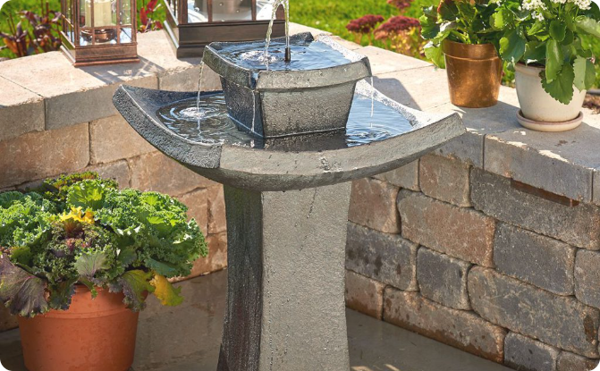
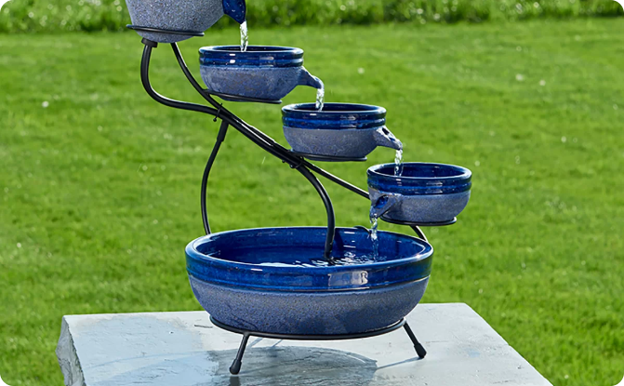
Case Studies
Successful Implementation of Smart Water Fountains in Urban Areas
Positive Impact on Water Consumption Patterns and User Satisfaction
Many cities have successfully implemented smart water fountains in their public spaces, improving access to clean drinking water and promoting sustainability.
Studies have shown that smart water fountains can change water consumption patterns and increase user satisfaction with public drinking fountains.

Slide 6
Future Developments and Challenges
1
Potential Advancements in Smart Water Fountain Technology
2
Addressing Security and Privacy Concerns
3
Overcoming Financial and Logistical Barriers
Smart water fountains collect and store sensitive data, requiring careful consideration of security and privacy concerns.
Implementation of smart water fountains requires significant financial investment and logistical planning, which can present barriers to more widespread adoption.
Advancements in technology could improve water quality monitoring, enhance customizable features, and improve user convenience.

Slide 7
Conclusion
Summarizing the Benefits and Potential of Smart Water Fountains
Encouraging Wider Adoption and Integration in Public Spaces
Smart water fountains provide safe and clean drinking water while promoting sustainability and user convenience.
As technology continues to advance, we hope to see more widespread adoption of smart water fountains in public spaces.

