Slide 1
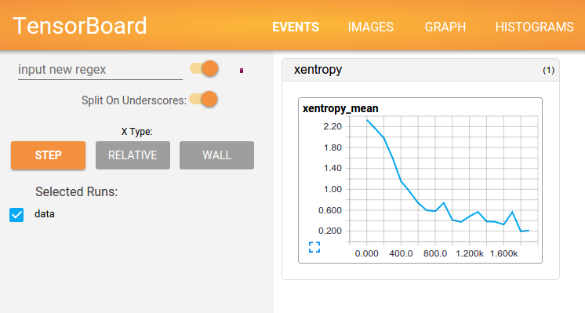
TENSORBOARD -Visualizing Learning
Vasanti Mahajan
Email id: mahajan.v@husky.neu.edu
LinkedIn: https://www.linkedin.com/in/vasantimahajan
Under the guidance of Prof. Srikanth Krishnamurthy

Slide 2
WHAT IS TENSORBOARD?
TensorBoard is a suite of web applications for inspecting and understanding the TensorFlow runs and graphs
It can be used to plot quantitative metrics about the execution of graph and show additional data
It helps in understanding, debugging and optimizing TensorFlow programs
It currently supports five visualizations: scalars, images, audio, histograms, and the graph

Slide 3
HOW DOES IT WORK?
TensorBoard operates by reading TensorFlow events files, which contain summary data that can be generated while running TensorFlow
To understand it better, lets take an example. Let us consider a sample fully connected neural network using the MNIST dataset.
LIFE CYCLE:
Step 1:
Create a TensorFlow graph from where the summary data needs to be collected and decide which nodes need to be annotated.
Suppose we need to record the cost and accuracy, we can collect their scalar_summary and attach it to the nodes that output the cost and accuracy
To visualize the distribution of weights and gradients, we can collect the histogram_summary and attach it to the gradient outputs and variable that holds the weight

Slide 4
HOW DOES IT WORK? (..cont)
Step 2:
Once the summary nodes are created we can run them to generate summaries. We can combine all of them into a single op that generates the summary data using the summary.merge_all command
Step 3:
Run the merged summary op to generate serialized Summary protobuf with all the summary data using SummaryWriter. The SummaryWriter takes the logdir (directory where all the events are written out) and the graph object.

Slide 5
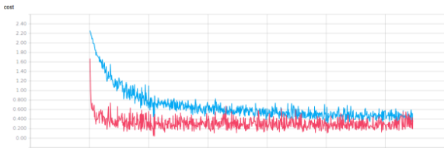
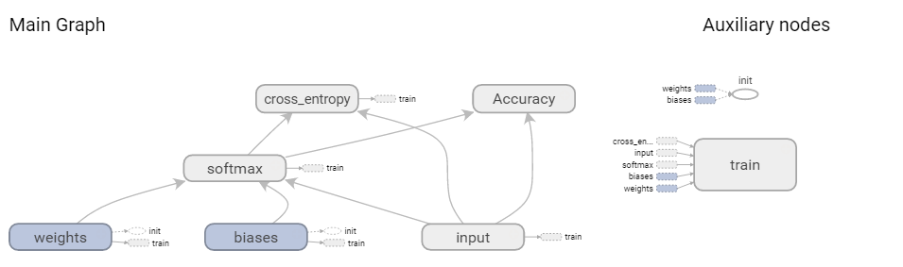
HOW DOES IT WORK? (..cont)
Step 3:
We can now start the TensorBoard to see the cost and accuracy graph in the Events tab. We can have multiple runs of the graph and we need to save the log files into separate folders.
We can now start TensorBoard using the following command:
Navigate to the Events tab to view the graphs of each parameter and the main graph can be seen in the Graph tab

Slide 6
REFERENCES
https://ischlag.github.io/2016/06/04/how-to-use-tensorboard/
https://www.tensorflow.org/how_tos/summaries_and_tensorboard/

Slide 7
CONCLUSION
Thus with the help of TensorBoard we can monitor the output of each tasks and perform sanity checks by emitting events and summaries from the graph. Using this we can compare the model’s training performance across multiple parameter combination and choose the most optimal combination.
To try out an example refer the following link:

