Slide 1
House Price Prediction
Pranavi Vasa

Slide 2
Overview
About Me
Formulation to Data Science problem
Data Collection
Data Exploration and Pre-processing
Exploratory Data Analysis
Feature Engineering
Modelling
Conclusion

Slide 3
Automated System Structure
Formulation to Data Science problem
Predicting the number of requests at a given time and given location.
This is a geo-spatial time series analysis
Data Science Pipeline
Data exploration
Pre-processing
Feature Engineering
Modelling

Slide 4
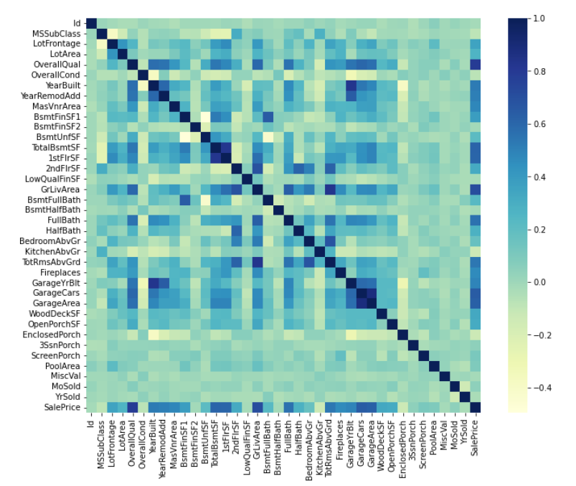
Data Analysis and Feature Engineering
By drawing correlation plot observed some correlations between data.

Slide 5
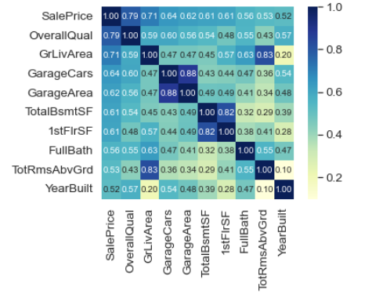
Data Analysis and Feature Engineering
Zooming for high correlated values
Garage Cars and Garage Area represents same area. They are mostly correlated. So we can remove one of the variable. We can keep 'GarageCars' feature as it is more correlated with the target variable.
In general TotalBsmtSF, 1stFlrSF are similar. Here both variables correlate. Wecan keep TotalBsmtSF.
TotRmsAbvGrd, GrLivArea also represents same area and both variables correlate with each other. So considering 'GrLivArea'

Slide 6
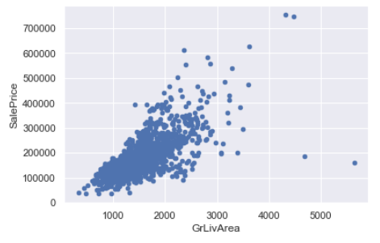
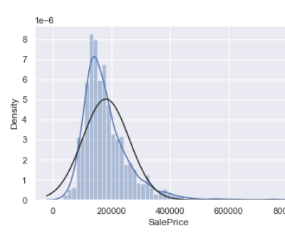
Data Analysis and Feature Engineering
By observing the scatterplot between SalePrice and GrLivArea we can see that bottom right two with extremely large GrLivArea that are of a low price. These values are huge oultliers. Therefore, we can safely delete them.
By Observing density plot for SalePrice we can say that it is right skewed. We can convert the data to normalized data by applying log transformation.

Slide 7
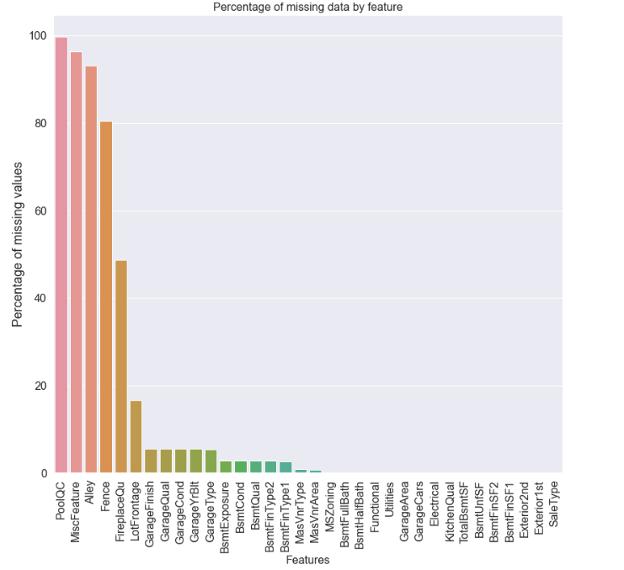
Data Analysis and Feature Engineering
There are missing values in the data. Filled them according to the description of the data.

Slide 8
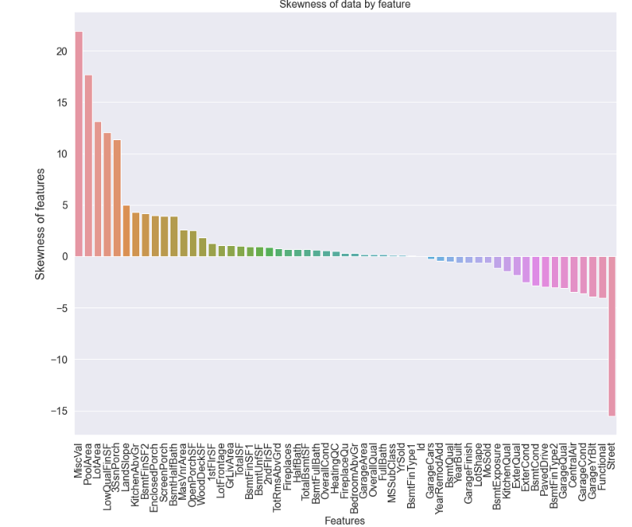
Data Analysis and Feature Engineering
There is skewness in the data. Removed positive skewness by applying log transformation and negative skewness by applying square on the data.

Slide 9
Feature engineering
Replaced some variables value with ‘None’ based on description ('GarageType', 'GarageFinish’)
Replaced some variables value with ‘Mode’ of the variable ('MSZoning', 'Electrical’)
Replaced some values with zero ('GarageYrBlt', 'GarageArea’)
By assuming same neighborhood has same ‘LotFrontage’ replaced missing values by mode in that neighborhood.
Converted some numerical data into categorical data because they are actually categorical data ('MSSubClass', 'OverallCond’)
Included one new variable by adding all floors area.

Slide 10
Modelling
Applied basic regression models. Model scores as follows
Lasso - 0.1111
Gradiant Boosting – 0.1169
ElasticNet – 0.111
Kernel Ridge – 0.8625
Applied simple stacking: Averaged the best fit models.
Score for averaged model – 0.1083
Conclusion
Successfully applied regression models and produced house prices.

Slide 11
Future Work
Produce an API so other people can use my model.
Implement parameter tuning for the models.
Dockerise the model.
Explore more models.

Slide 12
THANKS!
Any questions?

