Slide 1
Prediction of Sales
Pranavi Vasa

Slide 2
Overview
About Me
Formulation to Data Science problem
Data Collection
Data Exploration and Pre-processing
Exploratory Data Analysis
Feature Engineering
Modelling
Conclusion

Slide 3
Automated System Structure
Formulation to Data Science problem
Predicting the probability of sales.
This is a classification problem.
Data Science Pipeline
Data exploration
Pre-processing
Feature Engineering
Modelling

Slide 4
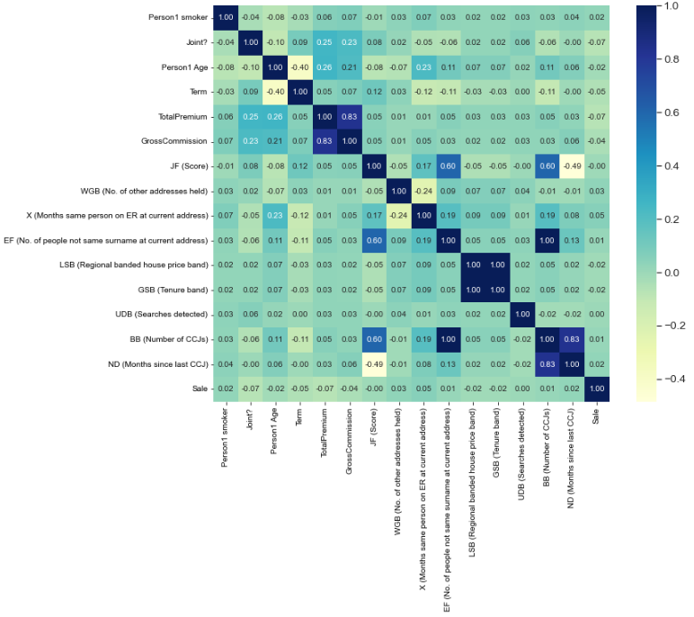
Data Analysis and Feature Engineering
By drawing correlation plot observed some correlations between data.

Slide 5
Data Analysis and Feature Engineering
Answer a part-1:
From Correlation plot we can observe following correlations:
‘GSB (Tenure band)’ and ‘LSB (Regional banded house price band)’ columns highly correlate with each other. Can remove one of the column and retain the other.
‘BB (Number of CCJs)’ and ‘EF (No. of people not same surname at current address)’ columns highly correlate with each other. Can remove one of the column and retain the other.
‘BB (Number of CCJs)’ and ‘ND (Months since last CCJ)’ also correlate with each other.
Answer b:
‘TotalPremium’ and ‘GrossCommission’ also correlate with each other. By this we can say profit entirely depends on premium.

Slide 6
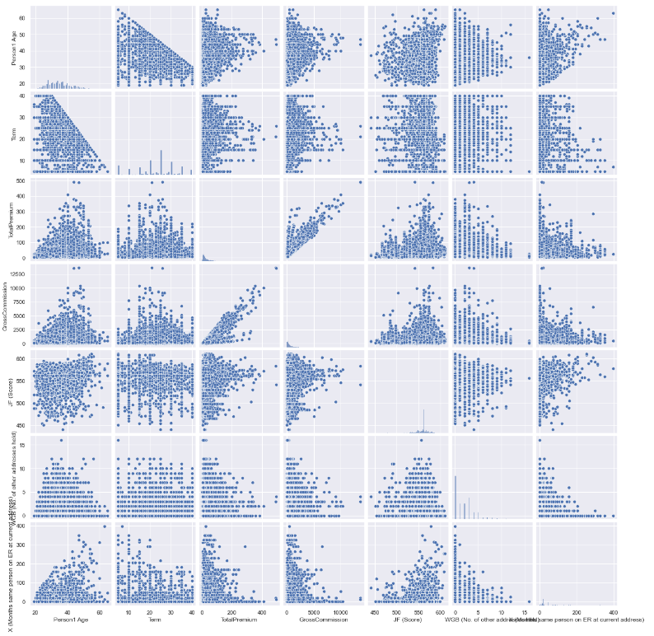
Data Analysis and Feature Engineering

Slide 7
Data Analysis and Feature Engineering
Answer a part-2:
From scatter plot we can observe the following:
‘TotalPremium’ and ‘GrossCommission’ have linear relation ship between them.
By observing the graph between ‘GrossCommission’ and ‘Term’ we can find two data points having large commission. This may impact overall performance of the dataset. Hence considering them as outliers removed the data points related to those two points.

Slide 8
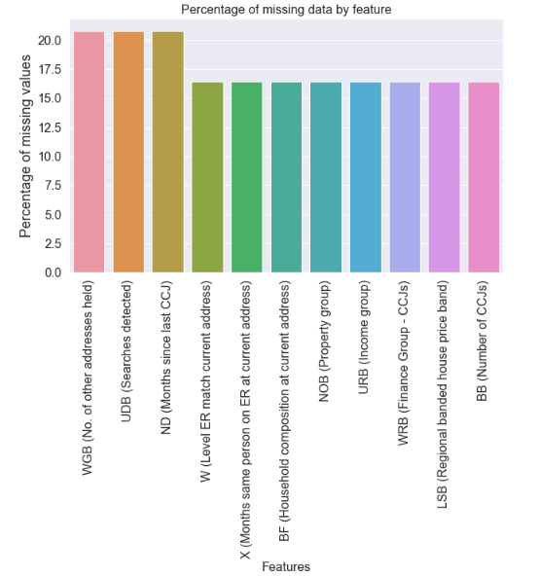
Data Analysis and Feature Engineering
Answer a part-3
There are missing values in the data. Filled them with mode, mean according to the data.

Slide 9
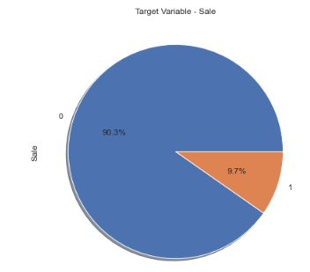
Data Analysis and Feature Engineering
There is imbalance between the classes in the dataset. So balanced the classes by upsampling

Slide 10
Feature engineering
Answer a part-4
Replaced some variables missing values with ‘Mode’
Converted ‘Y/N’ features to 1/0.
Some variables has values like ‘-999997.0’, ‘9999’ treated them as null values and replaced according to the data.
‘NOB (Property group)’, ‘URB (Income group)’ and ‘WRB (Finance Group - CCJs)’ also has {ND}, XX and X. Assumed them as Not disclosed and treated them as null values and replaced them.
‘ND (Months since last CCJ)’ column is missing more than 90% of the data. Hence removed the column.
Converted some categorical data to numerical data by one hot encoding.

Slide 11
Modelling Answer c:
Applied basic regression models. Model F1 scores as follows
Model | F1- Score
Decision Tree | 0.77
SVM | 0.20
Knn | 0.50
Logistic Regression | 0.20
Random Forest | 0.81
Gradient Boosting | 0.26
Conclusion for modelling
Successfully applied classification models and predicted Probability of Sale. ‘Random Forest’ works best for this problem.

Slide 12
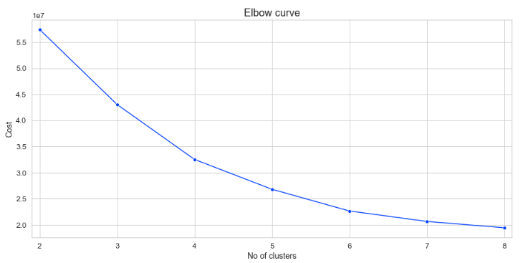
Clustering
Answer d:
Applied clustering on the given data and got the clusters.
From the above elbow curve selected 4 as number of clusters and divided the data into 4 clusters

Slide 13
Future Work
Produce an API so other people can use model.
Implement parameter tuning for the models.
Dockerise the model.
Explore more models.
Explore more options for clustering.

Slide 14
THANKS!
Any questions?

