Slide 1

REAL TIME OBJECT DETECTION THROUGH DEEP LEARNING - SCALED YOLO V4
Ph: 0863-234 300, 301, Fax: 0863-2344305
NRI Institute of Technology
(APPROVED BY AICTE, AFFILIATED TO JNTUK, KAKINADA)
Visadala Road, Perecherla, GUNTUR-522438
Website: nriit.ac.in e-mail: nriit.Guntur@gmail.com
Under the guidance of
G. Sowmya M. Tech
Assistant Professor
Presented by:
18KP1A0594
18KP1A0585
18KP1A0576
Date: 30-JUNE-2022

Slide 2
CONTENTS
Abstract
Introduction
Aim and Objective of the Project
Requirements
Real-World Applications
Real-time Benefits
Social Impact
Algorithms
Existing Algorithm
Proposing Algorithm
Output
Video Streaming
Conclusion
Future Scope

Slide 3
ABSTRACT:
Object detection is an advanced form of image classification where a neural network predicts the objects in an image and points them out in the form of bounding boxes.
Object detection thus refers to the detection and localization of objects in an image that belong to a predefined set of classes. Tasks like detection, recognition, or localization find widespread of applicability in real world scenarios, making object detection (also referred as object recognition) a very important subdomain of Computer Vision which is characterized by its strong capability of feature learning and feature representation compared with the traditional object detection methods.
Real time object detection and tracking are important and challenging tasks in many computer vision applications such as video surveillance, robot navigation and vehicle navigation. Object detection involves detecting the object in sequence of videos.
Every tracking mechanism requires object detection technique either in each frame or when an object appears newly on the video sequence. Object tracking is the process of locating an object or multiple objects using either static or dynamic camera.

Slide 4
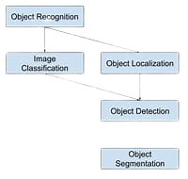
INTRODUCTION
Object detection typically leverage deep learning to produce meaningful results. When humans look at images or video, we can recognize and locate objects of interest within a matter of moments. The goal of object detection to replicate this intelligence using a computer.
Object detection in one of the most basic and central task in computer vision. It’s task is to find all the interested objects in the image and determine the category and location of objects.
It is widely used and has strong practical value and research prospects.

Slide 5
Object detection has already been the significant research direction and the focus in the computer vision, which can be applied in the driverless cars, robotics, video surveillance and pedestrian detection.
The emergence of deep learning technology has changed the traditional modes of object identification and object detection.
In the Image net Large Scale Visual Recognition Challenge(ILSVRC) 2012, a global contest about computer vision, the Alex Net won the championship, which was the first successful deep convolution network in image recognition and its top5 accuracy surpassed the runner-up by 10%.
Moreover, the methods of deep learning topped the list in succeeding the LSVRCs.
Deep learning is a subset of machine learning, which is essentially a neural network with three or more layers. These neural networks attempt to mimic the human brain by learning from large amount of data.
Neural networks, also known as Artificial Neural Networks (ANNs) or Simulated Neural Networks (SNNs), are a subset of machine learning and are at the heart of deep learning algorithms. Their name and structure are inspired by the human brain, mimicking the way that biological neurons signal to one another.

Slide 6
AIM AND OBJECTIVE OF THE PROJECT
AIM:
The project focuses on developing a model for detecting the objects in frame either it will be in image or video format, in order to resolve the issues occurred in previous ones such as
Speed
Accuracy
Learning capabilities
Error rate
OBJECTIVE:
The range of object detection is sky rocketing on daily basis in everyday life. The intent of our project is developing a model to detect objects with fast processing, high accuracy and more learning capabilities.
It can be achieved by implementing a deep learning algorithm named YOLO algorithm which stands for You Only Look Once.

Slide 7
REQUIREMENTS
Software Requirements:
Operating System: Windows 7 Ultimate or above
Linux
MAC OS
Packages: matplotlib, numpy, CV2, Python Imaging Library(PIL)
Software: Google colaboratary, Kaggle
Coding Languages: Python, JavaScript
Hardware Requirements:
Processor: Intel i3 or above and AMD 3000 or above Series
Ram: 4gb DDR4 or higher
Storage: 512gb SSD
GPU: Integrated or dedicated GPU’s
Web cam: Standard webcam

Slide 8
REAL -WORLD APPLICATIONS
Crowd Counting
For heavily populated areas such as shopping malls, airports, city squares and theme parks this application performs unbelievably well. Generally, this object detection application proves to be helpful to large enterprises and municipalities for tracking road traffic, violation of laws and number of vehicles passing in a particular time frame.
Self-Driving Cars
The primary reason behind the success of autonomous vehicles is real-time object detection artificial intelligence based models. These systems allow us to locate, identify and track the objects around them, for the purpose of safety and efficiency.

Slide 9
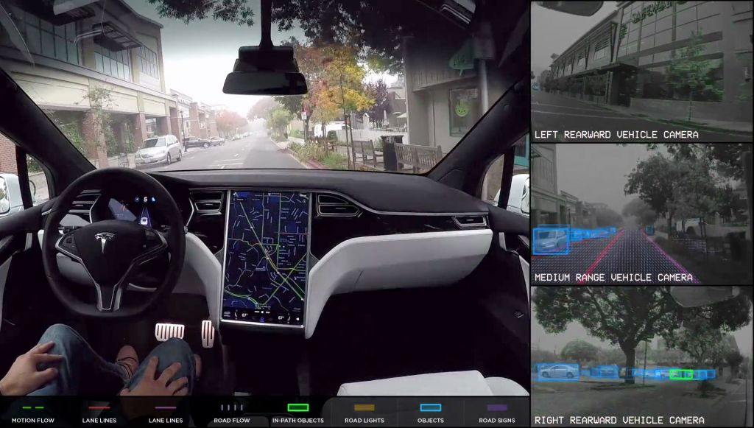
This Photo by Unknown Author is licensed under CC BY-SA-NC

Slide 10
Video Surveillance
Real-time object detection and tracking the movements of objects allow video surveillance cameras to track the record of scenes of a particular location such as an airport. This state-of-art technique accurately recognizes and locates several instances of a given object in the video. In real-time, as the object moves through a given scene or across the particular frame, the system stores the information with real-time tracking feeds.
Anomaly detection
There are several anomaly detection applications available for different industries which use object detection. For instance, in agriculture, object detection models can accurately recognize and find the potential instances of plant disease. With the help of this, farmers will get notified and they will be able to prevent their crops from such threats.
As another example, this model has been used to identify the skin infections and symptomatic lesions. Some applications are already built for skin care and acne treatment using object detection models.

Slide 11
REAL-WORLD BENEFITS
As long as there is only one object, image classification techniques can be used. But if anyone met with multiple objects, that’s when the concept of object detection comes into play. By building rectangular boxes around the object of interest which can help the machine to recognize the object each box contains. Also, indicate the exact location of objects using this method.
Object detection applications are limitless, but they generally identify and detect the real-objects such as human beings, buildings, cars and many more.
Object detection is completely inter-linked with other similar computer vision techniques such as image segmentation and image recognition that assist us to understand and analyze the scenes in videos and images.
Nowadays, several real-world use cases are implemented in the market of object detection which makes a tremendous impact on different industries.

Slide 12
SOCIAL IMPACT
Social Distancing
The term that has taken the world by storm and is transforming the way we live. The way of living has been forced the people by the fastest growing pandemic the world ever seen called COVID-19. As per World Health Organization(WHO) guidelines everyone should maintain social distance in order to the spread of corona virus and it can be maintained by object detection.
Traffic Controlling
Nowadays every traffic signal are being observed by traffic control room which results in reduction of traffic violation. In addition to that by installing this kind softwares will be more helpful in emergency purposes like in the clearance for VIP conveys and ambulances by detecting and intimating to the near traffic authorities which results in successful passing of conveys.

Slide 13
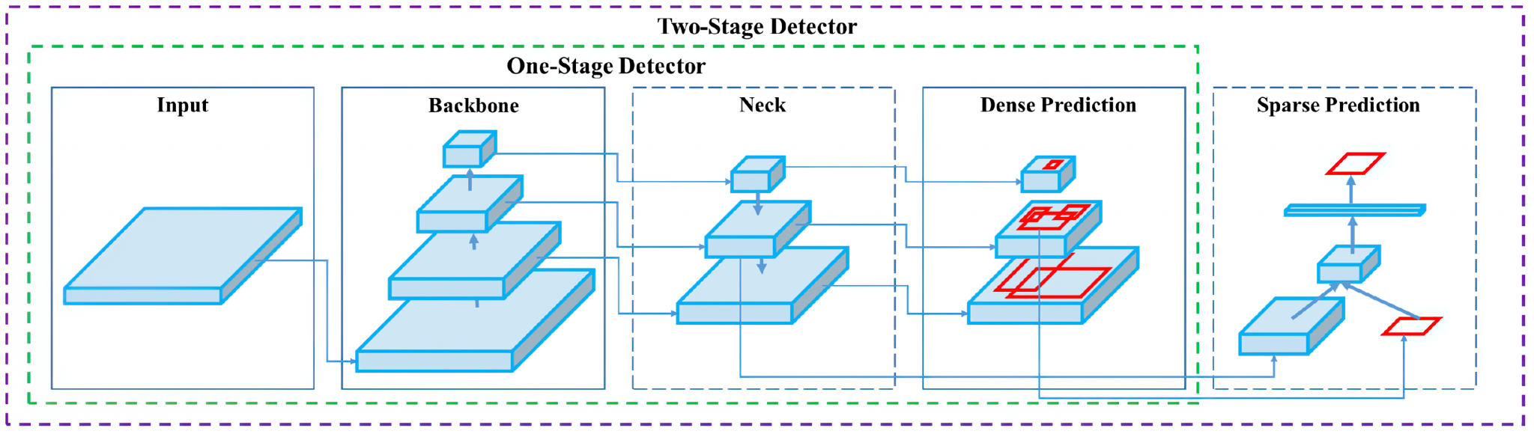
ALGORITHMS
Basically, object detector algorithm consists of four different components. They are
Input: The input to the detector can be an image or video based on the use cases specified in the research.
Backbone: The backbone of the object detector contains models, these models can be Resnet, Dense net, VGG.
Neck: The neck in the detector acts as an extra layer, which goes in parallel to the backbone and the head.
Head: The head is the network that is in charge of the detection of objects based on bounding boxes.

Slide 14
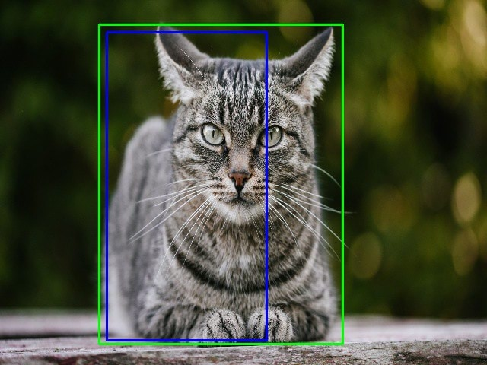
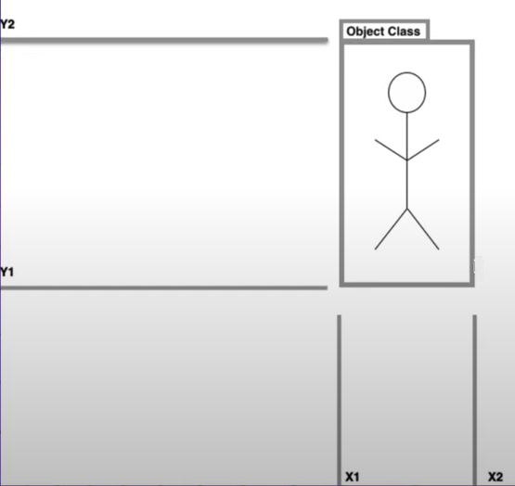
Generally, The detectors create bounding boxes around the objects in the image or in a particular frame of a video as shown below.
Ground truth bounding box.
Predicted bounding box.

Slide 15
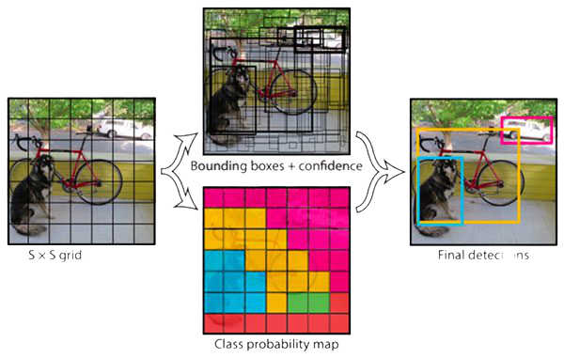
The two common evaluation metrics are Intersection Over Union(IOU) and Average Precision(AP).
The IOU is the overlap between ground truth bounding boxes and the predicted bounding boxes.
The resulting value is a number between 0 and 1. The higher the number, the higher they overlap.
Mean Average Precision (MAP) is a metric to measure the performance efficiency.

Slide 16
EXISTING ALGORITHMS
Convolutional Neural Networks(CNN):
A Convolutional Neural Network (Conv Net/CNN) is a deep learning algorithm which can take in an input image, assign importance to various aspects/objects in the image and be able to differentiate one from the other. The pre-processing required in a CNN is much lower as compared to other classification algorithms. While in primitive methods filters are hand-engineered with enough training, CNN have the ability to learn these filters/characteristics.
Kernel
Detector
Stride
Padding
Pooling
Flatten

Slide 17
Region-based Convolutional Neural Network(R-CNN):
R-CNN is the convolutional neural network based on the region proposal brought up in 2014 by Girshick. The principle of R-CNN is that it utilizes the region segmentation method of selective search to extract 2000 regions just from an image. The MAP of R-CNN object detection reaches 58.5% that is considerably lifted up compared with the former methods.
Selective Search:
Sub-segmentation- candidate regions.
Greedy algorithm- recursively combine similar regions into larger ones.
Generated regions- final candidate region proposal.
Problems:
Takes huge amount of time – 47 seconds for each image.
Fixed method.
Object detection is slow.

Slide 18
Single Short Detector(SSD):
Single Short Detector is similar to YOLO which takes only one shot to detect multiple objects present in an image using multi box. It is significantly faster in speed and high-accuracy object detection algorithm. A quick comparison between speed and accuracy of different object detection models on VOC2007 SSD300: 59FPS with MAP 74.3%.
Though it is similar to YOLO algorithm, SSD is more preferrable for the tiny size objects.

Slide 19
PROPOSING ALGORITHM
You Only Look Once(YOLO):
YOLO models are also single-shot models. The original proposal was to predict bounding boxes and class probabilities from an image, in a single evaluation using a single neural network. The first model would process 45 frames per second in real-time using features from the entire image to predict bounding boxes.
Challenges in initial implementation
Only predict one class.
Inefficiency in small objects.
YOLO Version | Year of Release | Developers | Change/Modification
YOLO V1 | 2016 | Joseph Redmon | Unified, Real-time Detection
YOLO V2 | 2017 | Joseph Redmon, Ali Farhadi | Better, Faster, Stronger
YOLO V3 | 2018 | Joseph Redmon, Ali Farhadi | An incremental improvement
YOLO V4 | April 2020 | Alexey Bochkovsky | Optimal speed and Accuracy
YOLO V5 | May 2020 | Glenn Jocher | Similar to YOLOV4

Slide 20
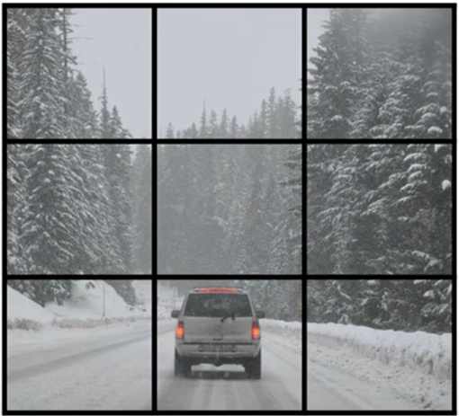



Detection:
c1. Pedestrian
c2. Car
c3. Motorcycle
Pc
bx
by
bh
bw
c1
c2
c3
pc
bx
by
bh
bw
c1
c2
c3
0
?
?
?
?
?
?
?0
?
?
?
?
?
?
?
0
?
?
?
?
?
?
?
1
bx
by
bh
bw
0
1
0
$$y=$$
$$y=$$
$$y=$$
y is 3x3x2x8
pc
pc
y is 3x3x16

Slide 21
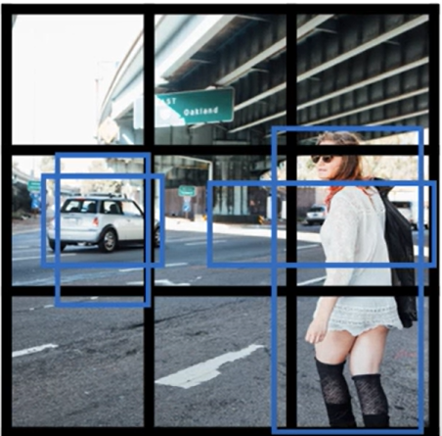
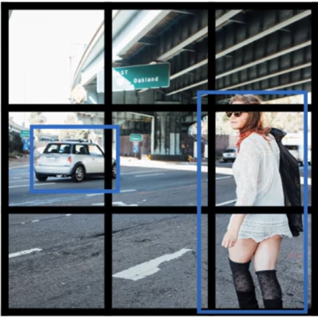
Testing:
➔
Each grid – 2 predicted bounding boxes
Low probability predictions
For each bounding box compare with class to generate final prediction

Slide 22
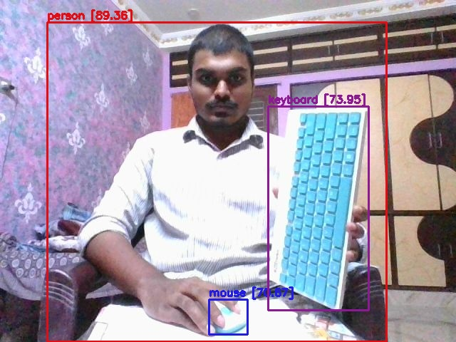
OUTPUT:

Slide 23
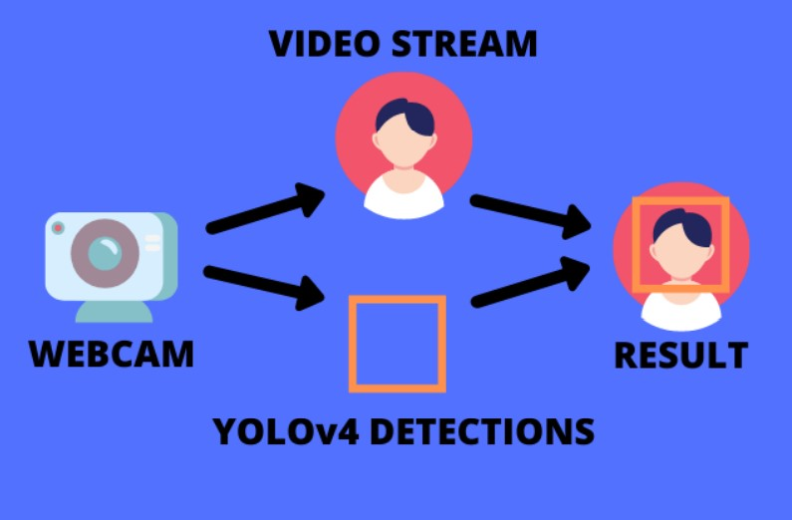
VIDEO STREAMING:
Web cam as input
Each frame into YOLO model
New overlay image that contains bounding box of detections.
Overlay bounding box image back into next frame of our video.

Slide 24
CONCLUSION:
Deep learning has gained tremendous success in image classification tasks. Our architecture, deep learning which is based on YOLO algorithm works as feature extractor eliminating the need to apply processing technique. The predefined dataset has successfully helped to conduct experiments and the accuracies are astonishing due to dataset and model we implemented in this project.
The project developed on google Colab will be useful to any kind of person out there with any device to detect the objects.

Slide 25
FUTURE SCOPE:
The future perspective of the approach is to detect vast number of objects which can be done by COCO (Common Objects in Context) dataset under Microsoft proprietorship and to infuse the presented technique into a mobile application so, that it proves to be a great utility for a people with zero knowledge on technologies.
The application areas that can be beneficial through the proposed approach include in achieving level 05 self-driving cars, agricultural purpose (detecting crop diseases and suggesting proper medical advisory), autonomous traffic monitoring.

Slide 26
Thank You!

