Slide 1
Final Project Power BI
Vasavi Ramesh
Deep Azure
Dr. Zoran B. Djordjević

Slide 2
Introduction
Power BI is a suite of business analytics tools that deliver insights throughout your organization. Connect to hundreds of data sources, simplify data prep, and drive ad hoc analysis. Produce beautiful reports, then publish them for your organization to consume on the web and across mobile devices. Everyone can create personalized dashboards with a unique, 360-degree view of their business. And scale across the enterprise, with governance and security built-in.
Data can be loaded from different sources:
My Organization - Data published by others within your organization to Office365 groups.
Online Services - Data from online services like JIRA, GitHUb etc.
Files – Reports, Workbooks or data from excel, Power BI Desktop(.PBIX file) or from CSV files
Databases – Azure SQL Database, Spark on Azure HDInsight etc.

Slide 3
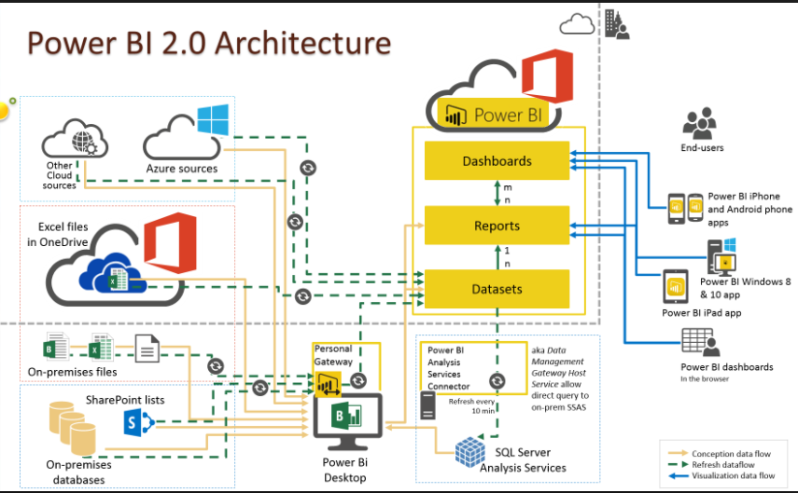

Slide 4
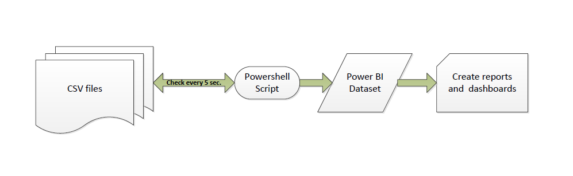
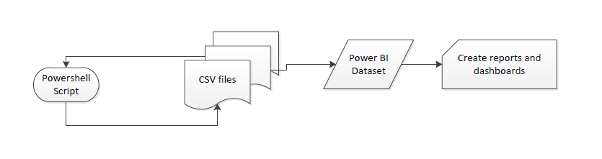
Overview of demo

Slide 5
Pros and Cons
Pros:
Visualizations are easy to create and there is a wide variety of visualizations that can be downloaded from the marketplace within Power BI app.
Reports and dashboards can be easily refreshed with every data refresh.
Cons:
Documentation on calling Power BI API using PowerShell is limited.
The Power BI API does not allow refresh of dataset if the dataset was created within the Power BI App instead of being created via the API.

Slide 6
YouTube URLs, GitHub URL, Last Page
Two minute (short): https://youtu.be/rxLlbJBK3AY
15 minutes (long): https://youtu.be/UjSxATsSgrw
GitHub Repository with all artifacts: https://github.com/vasaviramesh/AzureLearning/tree/master/FinalProject

