Slide 1

Delivery_Partners_Analysis Dashboard
- Created By Usha Ramachandran
Powered By

Slide 2
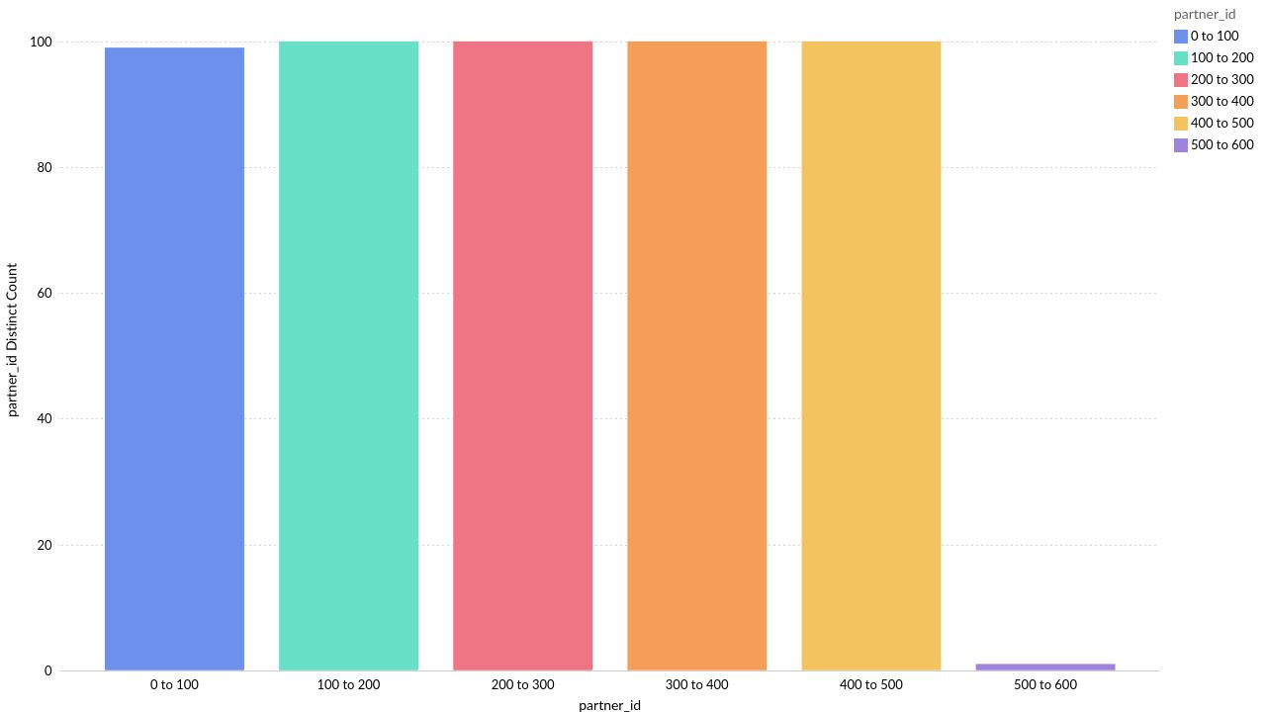
Distribution of partner_id over different ranges
Powered By

Slide 3
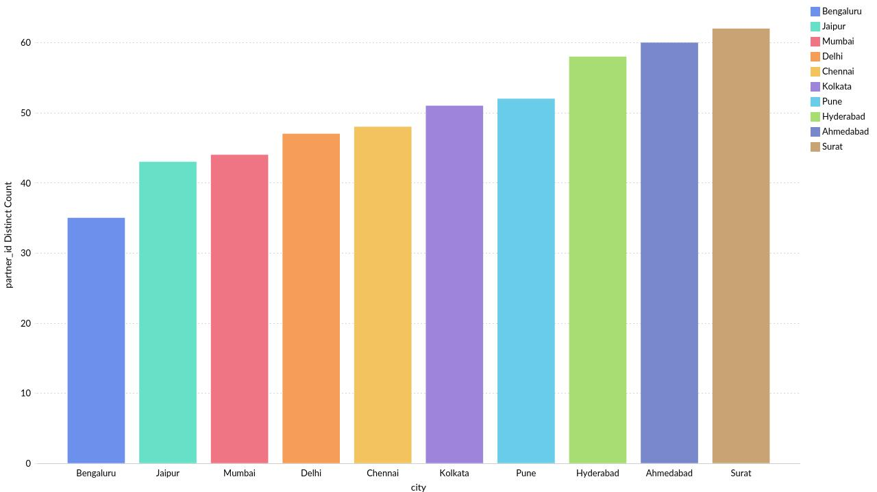
City-wise partner_id
Powered By

Slide 4
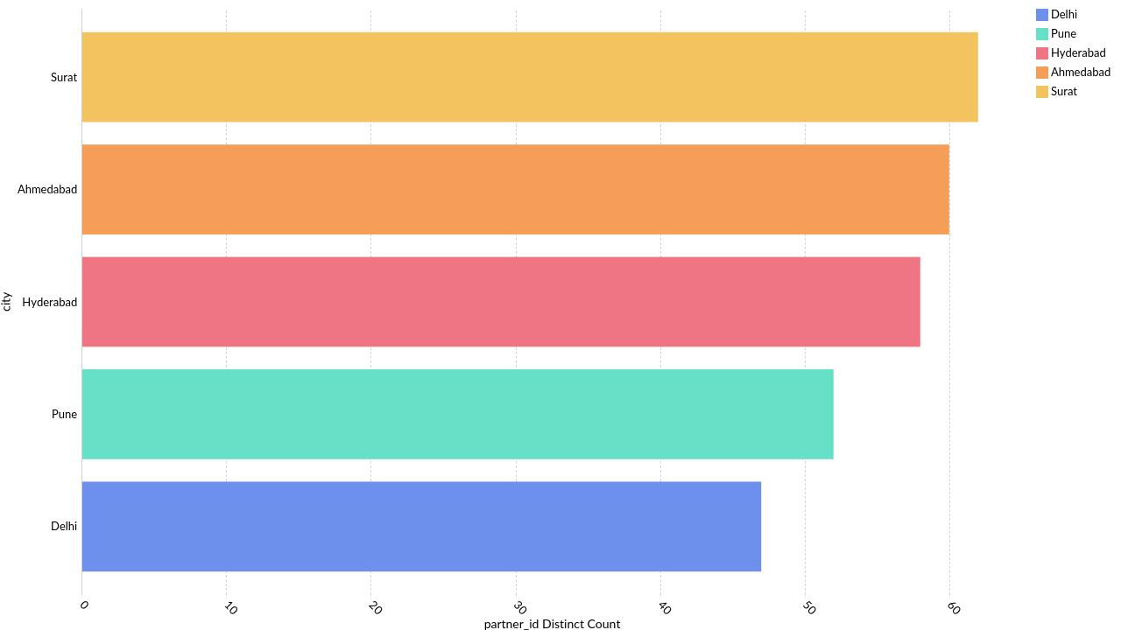
Top 5 city by partner_id
Powered By

Slide 5
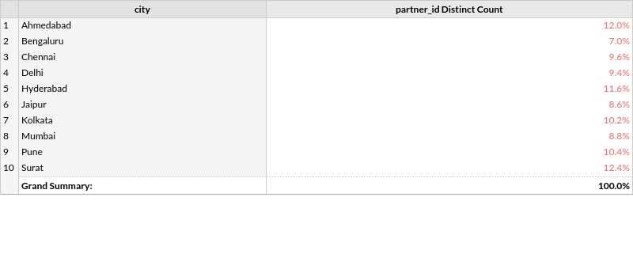
Partner_id by city
Powered By

Slide 6
Thank you
Powered By

