Slide 1


Presented in June 6th (BD – P5) By:
Diogo Silva – LEI – 89348
Vasco Ramos – LEI – 88931

Slide 2




Key Aspects
A full fledged gaming DB
- Our data base contains varied data on several games, publishers, developers, tournments and more!
Organize your library with lists
- Place games into one of several lists (Playing, Plan-To-Play, Completed, Wishlist & Dropped) to better organize and categorize them! Games can posteriorly be moved between lists by the user.
Write reviews
- Share your thoughts on games with other people by reviewing and publishing a game review!
More!
- As you’ll soon see…

Slide 3
The Demo

Slide 5
SQL Programming

Slide 6
Stored Procedures
Adding/Removing
- Games,Developers,Publishers,etc…
Filtering
- by Genre, Franchise, etc…
Search
- by Name or Game (in case of Tournments)
Login
Change User Info
- change Password, email, promote to admin, etc…

Slide 7
User-Defined Functions
Gather game info/details
Check if user has game in library
Check if game is in given list
Add game/franchise & game/developer row to corresponding tables

Slide 8
Triggers
On add
- Check if we’re trying to add a duplicate developer, game, etc…
Update # of games in franchise
- by Genre, Franchise, etc…

Slide 9
Transactions
- ADD GAME (stored procedure)
- ADD USER (trigger)
- ADD GAME TO LIST (stored procedure)
Diria que é mais fácil por a do user por ser mais pequena, mas your choice

Slide 10
Indices
Tournement
- To make filtering by gameId faster
Note:
- SQL-Server automatically indexes Unique parameters (which are the ones we use to filter/search)

Slide 11
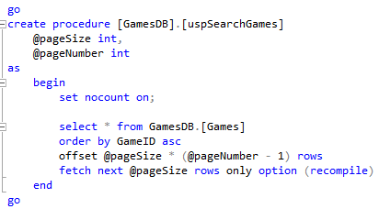
Paging
Why?
- To lessen the load and time taken on information loading
Where?
- On the main info pages (games, developers, franchises, publishers & tournments) we load 10 items per page

Slide 12




Other stuff
Image encoding
- To represent images in our DB we encoded them in base64 (and decoded them when showcasing them in the interface)
Ordering and filtering of parameters
- When viewing information in our interface we implemented both a way to filter and order the parameters in various ways
Password encryption
- To increase the security level of our DB we encoded all passwords using both hashing and SALT
B64

Slide 13
The End

