Slide 1
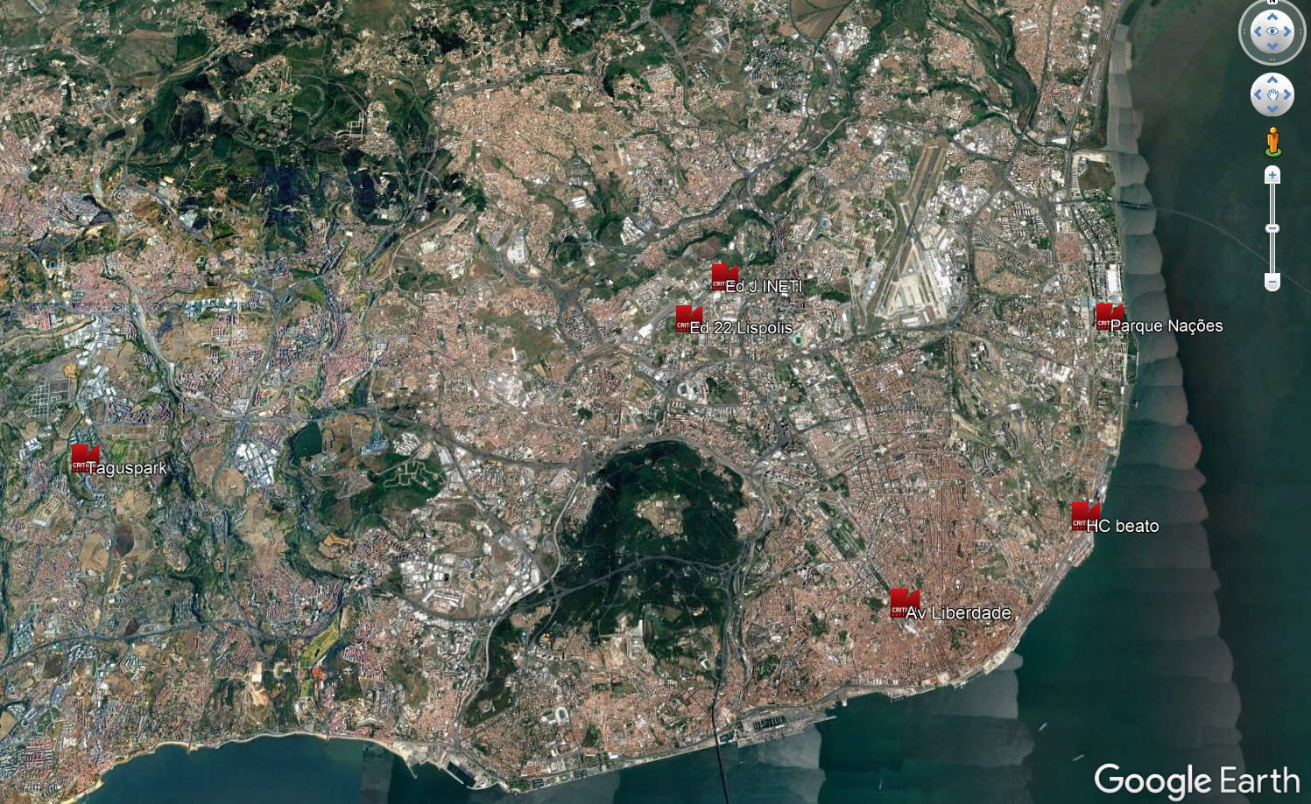



Average time in mins
Average time in mins
21
21
54
24
24
52
Average time in mins
Average time in mins
28
28
53
Average time in mins
23
23
61
25
25
56
Average time in mins
25
26
36

