Slide 1
Computação Paralela Mest. Engenharia Computacional Mest. Int. Engenharia Computacional
Ano letivo 2022/2023
Rui Costa, Nuno Lau

Slide 2
Apresentação
Computação Paralela (2022/2023)
Escolaridade:
1h TP / semana 2h P / semana
Docentes (aulas TP e P):
Rui Costa Nuno Lau
americo.costa@ua.pt nunolau@ua.pt
Física (13.3.32.2) IEETA (IRIS Lab / 2.07)
Página web em elearning.ua.pt
login: utilizador universal
Slides adaptados da bibliografia

Slide 3
Objetivos
Identificar e classificar os diferentes modelos e os diferentes níveis da programação paralela
Reconhecer programas suscetíveis de ser paralelizados e escolher a melhor abordagem
Desenvolver, depurar e otimizar um programa paralelo
Utilizar eficazmente clusters computacionais

Slide 4
Programa (Aulas TeoricoPráticas)
Computação paralela de alto desempenho
Modelos de programação paralela
OpenMP
CUDA
MPI
Otimização

Slide 5
Programa (Aulas Práticas)
As aulas práticas seguem uma filosofia do saber fazer e visam a realização de pequenos trabalhos sobre os diferentes assuntos.
Paralelização com threads
Extensões multimédia de processadores
OpenMP
CUDA
MPI

Slide 6
Avaliação
Componente TeoricoPrática
Teste final (durante época de exames)
Nota mínima: 8
Componente Prática
2 trabalhos
50%.TP1 + 50%.TP2
Nota mínima: 8
Nota final
NF = 40%.CTP + 60%.CP

Slide 7
Trabalhos
Efetuar uma implementação precisa dos problemas propostos
Os trabalhos são desenvolvidos também fora das aulas práticas
O plágio será fortemente penalizado

Slide 8
Bibliografia
Rauber and G. Rünger, Parallel Programming: for Multicore and Cluster Systems, 2nd edition, Springer, 2013.
Hager and G. Wellein, Introduction to High Performance Computing for Scientists and Engineers, CRC Press, 2010.
J. Quinn, Parallel Programming: in C with MPI and OpenMP, McGraw-Hill, 2003.
S. Pacheco, Parallel Programming with MPI, Morgan Kaufmann, 1997.
Cheng, M. Grossman, and T. McKercher, Professional CUDA C Programming, Wrox, 2014.

Slide 9
Questões?

Slide 10
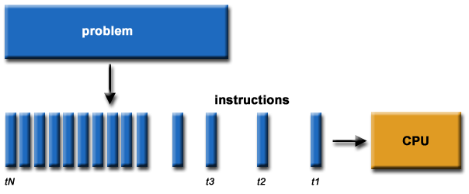
What is Parallel Computing? (1)
Traditionally, software has been written for serial computation:
To be run on a single computer having a single Central Processing Unit (CPU);
A problem is broken into a discrete series of instructions.
Instructions are executed one after another.
Only one instruction may execute at any moment in time.
Acknowledgement: This lecture is based on slides by Florent Nolot, “Introduction to Parallel Computing”, Université de Reims Champagne-Ardenne

Slide 11
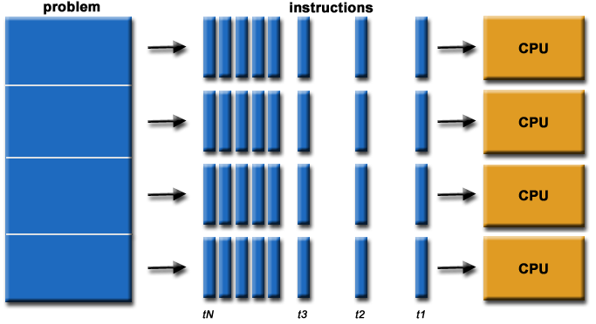
What is Parallel Computing? (2)
In the simplest sense, parallel computing is the simultaneous use of multiple compute resources to solve a computational problem.
To be run using multiple CPUs
A problem is broken into discrete parts that can be solved concurrently
Each part is further broken down to a series of instructions
Instructions from each part execute simultaneously on different CPUs/Cores

Slide 12
Parallel Computing: Resources
The compute resources can include:
A single computer with multiple processors/cores
A single computer with (multiple) processor(s) and some specialized computer resources (GPU, FPGA …)
An arbitrary number of computers connected by a network
A combination of the above

Slide 13
Parallel Computing: The computational problem
The computational problem usually demonstrates characteristics such as the ability to be:
Broken apart into discrete pieces of work that can be solved simultaneously
Execute multiple program instructions at any moment in time
Solved in less time with multiple compute resources than with a single compute resource

Slide 14
Parallel Computing: what for? (1)
Parallel computing is an evolution of serial computing that attempts to emulate what has always been the state of affairs in the natural world:
many complex, interrelated events happening at the same time, yet within a sequence.
Some examples:
Planetary and galactic orbits
Weather and ocean patterns
Tectonic plate drift
Rush hour traffic in Paris
Automobile assembly line
Daily operations within a business
Building a shopping mall
Ordering a hamburger at the drive through.

Slide 15
Parallel Computing: what for? (2)
Traditionally, parallel computing has been considered to be "the high end of computing" and has been motivated by numerical simulations of complex systems and "Grand Challenge Problems" such as:
Weather and climate
Chemical and nuclear reactions
Biological, human genome
Geological, seismic activity
Mechanical devices - from prosthetics to spacecraft
Electronic circuits
Manufacturing processes

Slide 16
Parallel Computing: what for? (3)
Commercial applications are providing an equal or greater driving force in the development of faster computers. These applications require the processing of large amounts of data in sophisticated ways. Example applications include:
Parallel databases
Data mining
Machine learning
Oil exploration
Web search engines, web based business services
Computer-aided diagnosis in medicine
Management of national and multi-national corporations
Advanced graphics and virtual reality, particularly in the entertainment industry
Networked video and multi-media technologies
Collaborative work environments
Ultimately, parallel computing is an attempt to maximize the infinite but seemingly scarce commodity called time

Slide 17
Why Parallel Computing? (1)
This is a legitime question!
Parallel computing is complex on any aspect!
The primary reasons for using parallel computing:
Save time and/or money
wall clock time
using multiple "cheap" computing resources instead of paying for time on a supercomputer
Solve larger problems
Provide concurrency (do multiple things at the same time)

