Slide 1
Computação Paralela Mest. Engenharia Computacional Mest. Int. Engenharia Computacional
Ano letivo 2022/2023
Rui Costa, Nuno Lau

Slide 2
Why Parallel Computing? (1)
This is a legitime question!
Parallel computing is complex on any aspect!
The primary reasons for using parallel computing:
Save time and/or money
wall clock time
using multiple "cheap" computing resources instead of paying for time on a supercomputer
Solve larger problems
Provide concurrency (do multiple things at the same time)

Slide 3
Why Parallel Computing? (2)
Other reasons might include:
Taking advantage of non-local resources
using available compute resources on a wide area network, or even the Internet when local compute resources are scarce.
Example: SETI@Home
Overcoming memory constraints
single computers have very finite memory resources. For large problems, using the memories of multiple computers may overcome this obstacle.

Slide 4
Limitations of Serial Computing
Both physical and practical reasons pose significant constraints to simply building ever faster serial computers:
Transmission speeds
the speed of a serial computer is directly dependent upon how fast data can move through hardware. Absolute limits are the speed of light (30 cm/ns) and the transmission limit of copper wire (9 cm/ns). Increasing speeds necessitate increasing proximity of processing elements
Limits to miniaturization
processor technology is allowing an increasing number of transistors to be placed on a chip. However, even with molecular or atomic-level components, a limit will be reached on how small components can be
Economic limitations
it is increasingly expensive to make a single processor faster. Using a larger number of moderately fast commodity processors to achieve the same (or better) performance is less expensive

Slide 5
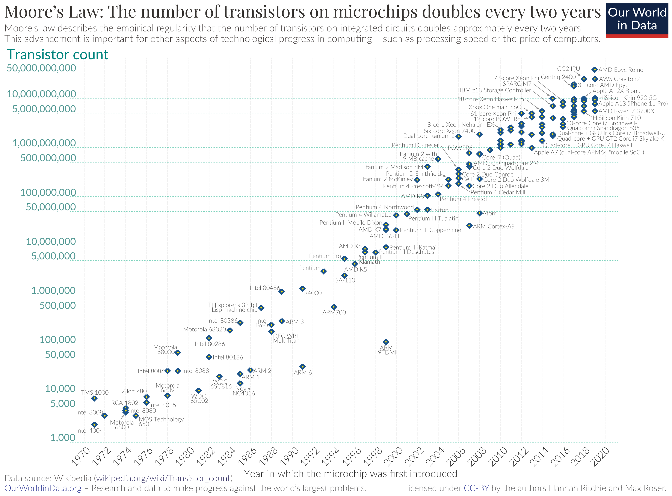
Moore’s Law
The number of transistors on integrated circuits doubles approx every 2 years
Chip performance double every 18-24 months
Power consumption is proportional to frequency
Clock speed saturates at 3 to 4 GHz.
End of free lunch
Future is parallel!

Slide 6
Moore’s Law

Slide 7
The Future
during the past 20 years, the trends indicated by ever faster networks, distributed systems, and multi-processor computer architectures (even at the desktop level) clearly show that parallelism is the future of computing.
Mixing general purpose solutions (your PC…) and very specialized solutions as GPGPU from Nvidia, Tensor Processing Units from Google, Vision Processing Unit …

Slide 8
Who and What? (1)
Top500.org provides statistics on parallel computing users
Charts that follow are just a small sample
Some things to note:
Sectors may overlap
For example, Research may be classified Academic. Respondents have to choose between the two.

Slide 9
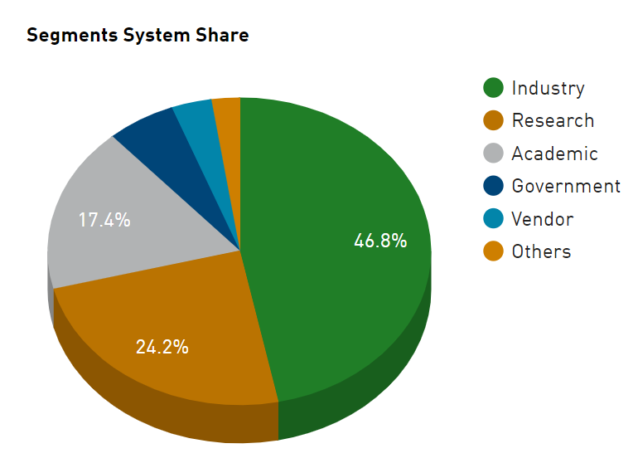
Who and What? (2)

Slide 10
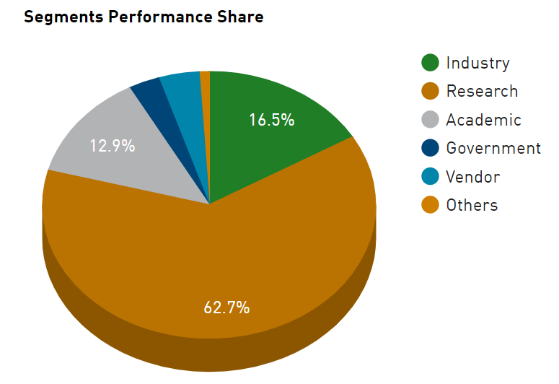
Who and What? (3)

Slide 11
Von Neumann Architecture
For over 60 years, virtually all computers have followed a common machine model known as the von Neumann computer. Named after the Hungarian mathematician John von Neumann.
A von Neumann computer uses the stored-program concept. The CPU executes a stored program that specifies a sequence of read and write operations on the memory.

Slide 12
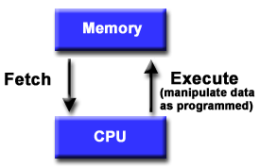
Basic Design
Basic design
Memory is used to store both program and data instructions
Program instructions are coded data which tell the computer to do something
Data is simply information to be used by the program
A central processing unit (CPU) gets instructions and/or data from memory, decodes the instructions and then sequentially performs them.

Slide 13
Flynn's Classical Taxonomy
There are different ways to classify parallel computers. One of the more widely used classifications, in use since 1966, is called Flynn's Taxonomy.
Flynn's taxonomy distinguishes multi-processor computer architectures according to how they can be classified along the two independent dimensions of Instruction and Data. Each of these dimensions can have only one of two possible states: Single or Multiple.

Slide 14
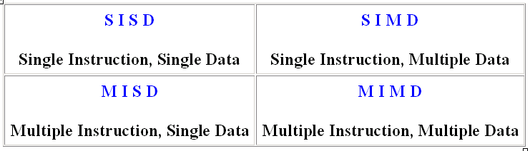
Flynn Matrix
The matrix below defines the 4 possible classifications according to Flynn

Slide 15
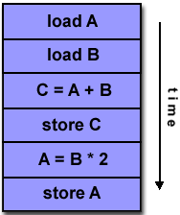
Single Instruction, Single Data (SISD)
A serial (non-parallel) computer
Single instruction: only one instruction stream is being acted on by the CPU during any one clock cycle
Single data: only one data stream is being used as input during any one clock cycle
Deterministic execution
This is the oldest and until recently, the most prevalent form of computer
Examples:
PCs with one core, single CPU workstations and mainframes

Slide 16
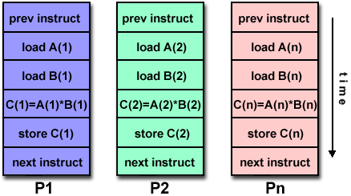
Single Instruction, Multiple Data (SIMD)
A type of parallel computer
Single instruction: All processing units execute the same instruction at any given clock cycle
Multiple data: Each processing unit can operate on a different data element
This type of machine typically has an instruction dispatcher, a very high-bandwidth internal network, and a very large array of very small-capacity instruction units.
Best suited for specialized problems characterized by a high degree of regularity, such as image processing.
Synchronous (lockstep) and deterministic execution
Two varieties: Processor Arrays and Vector Pipelines
Examples:
Processor Arrays: Connection Machine CM-2, Maspar MP-1, MP-2
Vector Pipelines: IBM 9000, Cray C90, Fujitsu VP, NEC SX-2, Hitachi S820, MMX, SSE

Slide 17
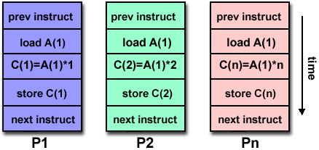
Multiple Instruction, Single Data (MISD)
A single data stream is fed into multiple processing units.
Each processing unit operates on the data independently via independent instruction streams.
Few actual examples of this class of parallel computer have ever existed. One is the experimental Carnegie-Mellon C.mmp computer (1971) that was capable of this type of processing.
Some conceivable uses might be:
multiple frequency filters operating on a single signal stream
Multiple cryptography algorithms attempting to crack a single coded message.

Slide 18
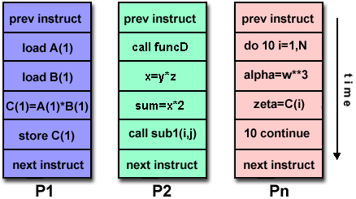
Multiple Instruction, Multiple Data (MIMD)
Currently, the most common type of parallel computer. Most modern computers fall into this category.
Multiple Instruction: every processor may be executing a different instruction stream
Multiple Data: every processor may be working with a different data stream
Execution can be synchronous or asynchronous, deterministic or non-deterministic
Examples:
most current PCs and supercomputers, networked parallel computer "grids" and multi-processor SMP computers.

Slide 19
Some General Parallel Terminology
Like everything else, parallel computing has its own "jargon". Some of the more commonly used terms associated with parallel computing are listed below. Most of these will be discussed in more detail later.
Task
A logically discrete section of computational work. A task is typically a program or program-like set of instructions that is executed by a processor.
Parallel Task
A task that can be executed by multiple processors safely (yields correct results)
Serial Execution
Execution of a program sequentially, one statement at a time. In the simplest sense, this is what happens on a one processor machine. However, virtually all parallel tasks will have sections of a parallel program that must be executed serially.

Slide 20
Parallel Execution
Execution of a program by more than one task, with each task being able to execute the same or different statement at the same moment in time.
Shared Memory
From a strictly hardware point of view, describes a computer architecture where all processors have direct (usually bus based) access to common physical memory. In a programming sense, it describes a model where parallel tasks all have the same "picture" of memory and can directly address and access the same logical memory locations regardless of where the physical memory actually exists.
Distributed Memory
In hardware, refers to network based memory access for physical memory that is not common. As a programming model, tasks can only logically "see" local machine memory and must use communications to access memory on other machines where other tasks are executing.

Slide 21
Communications
Parallel tasks typically need to exchange data. There are several ways this can be accomplished, such as through a shared memory bus or over a network, however the actual event of data exchange is commonly referred to as communications regardless of the method employed.
Synchronization
The coordination of parallel tasks in real time, very often associated with communications. Often implemented by establishing a synchronization point within an application where a task may not proceed further until another task(s) reaches the same or logically equivalent point.
Synchronization usually involves waiting by at least one task, and can therefore cause a parallel application's wall clock execution time to increase.

Slide 22
Granularity
In parallel computing, granularity is a qualitative measure of the ratio of computation to communication.
Coarse: relatively large amounts of computational work are done between communication events
Fine: relatively small amounts of computational work are done between communication events
Observed Speedup
Observed speedup of a code which has been parallelized, defined as:
wall-clock time of serial execution
wall-clock time of parallel execution
One of the simplest and most widely used indicators for a parallel program's performance.

Slide 23
Parallel Overhead
The amount of time required to coordinate parallel tasks, as opposed to doing useful work. Parallel overhead can include factors such as:
Task start-up time
Synchronizations
Data communications
Software overhead imposed by parallel compilers, libraries, tools, operating system, etc.
Task termination time
Massively Parallel
Refers to the hardware that comprises a given parallel system - having many processors. The meaning of many keeps increasing, but nowadays it can reach millions of processors

Slide 24
Scalability
Refers to a parallel system's (hardware and/or software) ability to demonstrate a proportionate increase in parallel speedup with the addition of more processors. Factors that contribute to scalability include:
Hardware - particularly memory-cpu bandwidths and network communications
Application algorithm
Parallel overhead related
Characteristics of your specific application and coding

