Slide 1
Computação Paralela Mest. Engenharia Computacional Mest. Int. Engenharia Computacional
Ano letivo 2022/2023
Rui Costa, Nuno Lau

Slide 2
Parallel Computer Memory Architectures

Slide 3
Memory architectures
Shared Memory
Distributed Memory
Hybrid Distributed-Shared Memory

Slide 4
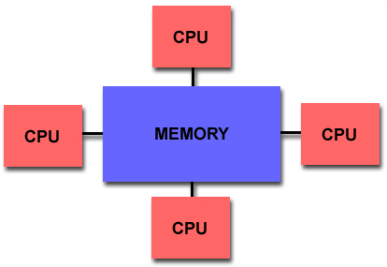
Shared Memory
Shared memory parallel computers vary widely, but generally have in common the ability for all processors to access all memory as global address space.
Multiple processors can operate independently but share the same memory resources.
Changes in a memory location effected by one processor are visible to all other processors.
Shared memory machines can be divided into two main classes based upon memory access times: UMA and NUMA.

Slide 5
Shared Memory : UMA vs. NUMA
Uniform Memory Access (UMA):
Most commonly represented today by Symmetric Multiprocessor (SMP) machines
Identical processors
Equal access and access times to memory
Sometimes called CC-UMA - Cache Coherent UMA. Cache coherent means if one processor updates a location in shared memory, all the other processors know about the update. Cache coherency is accomplished at the hardware level.
Non-Uniform Memory Access (NUMA):
Often made by physically linking two or more SMPs
One SMP can directly access memory of another SMP
Not all processors have equal access time to all memories
Memory access across link is slower
If cache coherency is maintained, then may also be called CC-NUMA - Cache Coherent NUMA

Slide 6
Shared Memory: Pro and Con
Advantages
Global address space provides a user-friendly programming perspective to memory
Data sharing between tasks is both fast and uniform due to the proximity of memory to CPUs
Disadvantages:
Primary disadvantage is the lack of scalability between memory and CPUs. Adding more CPUs can geometrically increases traffic on the shared memory-CPU path, and for cache coherent systems, geometrically increase traffic associated with cache/memory management.
Programmer responsibility for synchronization constructs that insure "correct" access of global memory.
Expense: it becomes increasingly difficult and expensive to design and produce shared memory machines with ever increasing numbers of processors.

Slide 7
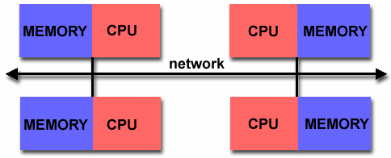
Distributed Memory
Like shared memory systems, distributed memory systems vary widely but share a common characteristic. Distributed memory systems require a communication network to connect inter-processor memory.
Processors have their own local memory. Memory addresses in one processor do not map to another processor, so there is no concept of global address space across all processors.
Because each processor has its own local memory, it operates independently. Changes it makes to its local memory have no effect on the memory of other processors. Hence, the concept of cache coherency does not apply.
When a processor needs access to data in another processor, it is usually the task of the programmer to explicitly define how and when data is communicated. Synchronization between tasks is likewise the programmer's responsibility.
The network "fabric" used for data transfer varies widely, though it can can be as simple as Ethernet.

Slide 8
Distributed Memory: Pro and Con
Advantages
Memory is scalable with number of processors. Increase the number of processors and the size of memory increases proportionately.
Each processor can rapidly access its own memory without interference and without the overhead incurred with trying to maintain cache coherency.
Cost effectiveness: can use commodity, off-the-shelf processors and networking.
Disadvantages
The programmer is responsible for many of the details associated with data communication between processors.
It may be difficult to map existing data structures, based on global memory, to this memory organization.
Non-uniform memory access (NUMA) times

Slide 9
Hybrid Distributed-Shared Memory
Summarizing a few of the key characteristics of shared and distributed memory machines
Comparison of Shared and Distributed Memory Architectures
Architecture | CC-UMA | CC-NUMA | Distributed
Examples | SMPs Sun Vexx DEC/Compaq SGI Challenge IBM POWER3 | Bull NovaScale SGI Origin Sequent HP Exemplar DEC/Compaq IBM POWER4 (MCM) | Cray T3E Maspar IBM SP2 IBM BlueGene
Communications | MPI Threads OpenMP shmem | MPI Threads OpenMP shmem | MPI
Scalability | to 10s of processors | to 100s of processors | to 1000s of processors
Draw Backs | Memory-CPU bandwidth | Memory-CPU bandwidth Non-uniform access times | System administration Programming is hard to develop and maintain
Software Availability | many 1000s ISVs | many 1000s ISVs | 100s ISVs

Slide 10
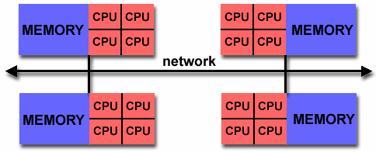
Hybrid Distributed-Shared Memory
The largest and fastest computers in the world today employ both shared and distributed memory architectures.
The shared memory component is usually a cache coherent SMP machine. Processors on a given SMP can address that machine's memory as global.
The distributed memory component is the networking of multiple SMPs. SMPs know only about their own memory - not the memory on another SMP. Therefore, network communications are required to move data from one SMP to another.
Current trends seem to indicate that this type of memory architecture will continue to prevail and increase at the high end of computing for the foreseeable future.
Advantages and Disadvantages: whatever is common to both shared and distributed memory architectures.

Slide 11
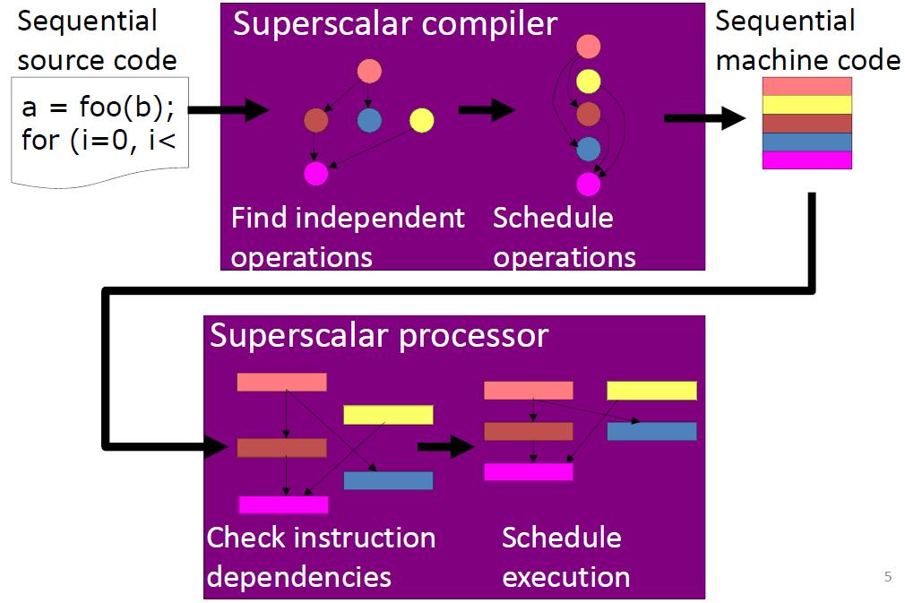
Superscalar Compiler and Processor

Slide 12
Multimedia extensions
Extensions to the base ISA that allow a form of vector computation
“Vectors” are implemented in dedicated registers
MMX: 64 bits
SSE: 128 bits
AVX: 256 bits
AVX-512: 512 bits
Registers of N bits may be used as vectors of 2x(N/2) elements, 4x(N/4) elements, etc.
One multimedia instruction applies simultaneously to all elements of a register

Slide 13
Multimedia extensions
MMX
57 instructions added to Pentium
Extended MMX
SSE
Pentium III
71 instructions (52 FP SIMD, 19 MMX)
SSE2
144 new instructions (Pentium 4)
128 bit registers
Cache-control
SSE3
13 new instructions (Pentium 4 - 2004)
Horizontal processing of values in a register
SSSE3
32 new instructions (Core)
SSE4
54 instructions (Penryn - 2008)

Slide 14
Multimedia extensions
3D Now!
AMD
45 instructions (21 FP SIMD, 19 MMX, 5 DSP)
AltiVec
Motorola
162 instructions
AVX
Sandy Bridge – 2011
256 bit registers
Instructions with 3 operands
AVX2
Haswell New Instructions, 2013
Broadcast/permute operations on data elements
Vector shift instructions with variable-shift count per data element
Instructions to fetch non-contiguous data elements from memory
AVX-512
Proposed in 2013, First Processor 2016
512 bit registers
Several extensions: Foundation, Prefetch, Vector Neural Network, etc.

Slide 15
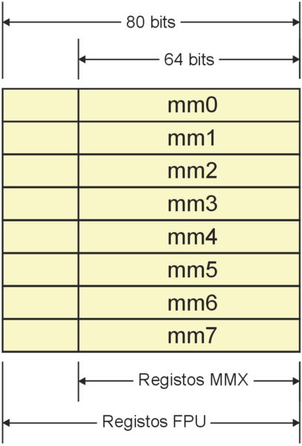
MMX registers
8 registers of 64 bits
MM0, MM1, …,MM7
Are implemented on the same hardware as the FP registers: ST0, …, ST7
This allowed to mantain compatibility with existing operating systems

Slide 16
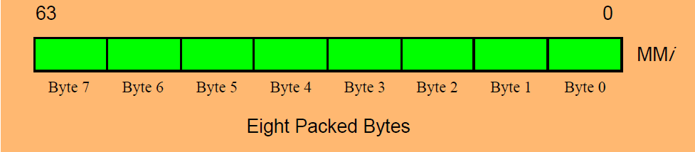
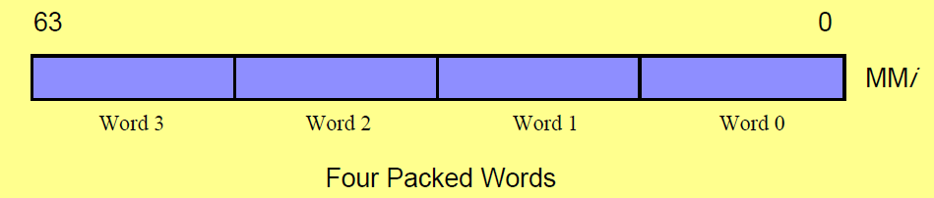
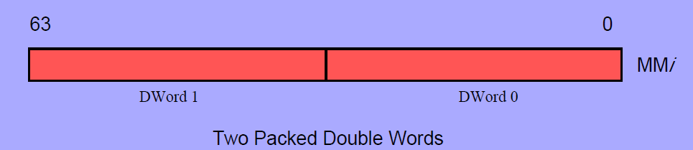
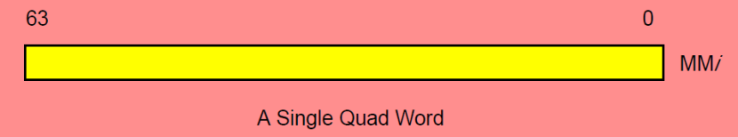
MMX data types
8 bytes array
4 words array (16 bit/word)
2 double words array (32 bits)
Quadword (64 bits)

Slide 17
MMX instructions
Data transfer
Move data between registers, memory and MMX registers
movd (32 bits) and movq (64 bits)
Conversion
Converts larger data types to smaller data types and vice-versa
Packed arithmetic
Comparisons
Logic operations
Shift and Rotate
EMMS
Prepares the processor to execute FP code again

Slide 18
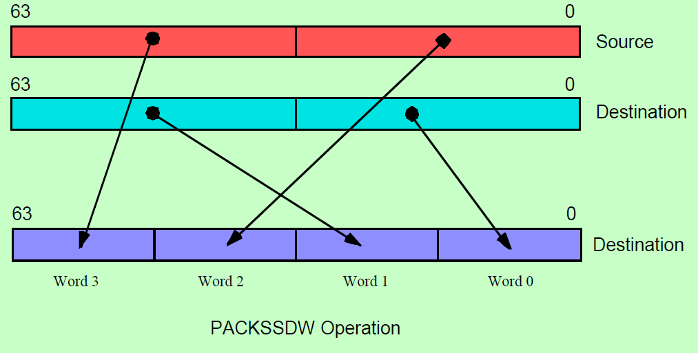
MMX instructions
Convertion

Slide 19
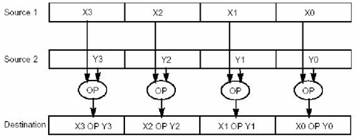
MMX instructions
Packed arithmetic
SIMD: Single Instruction Multiple Data
paddb (8bit), paddw (16bit), paddd (32bit)
paddb, paddsb (signed saturation), paddusb (unsigned saturation)

Slide 20
MMX instructions
Packed Arithmetic | Wrap Around | Signed Sat | Unsigned Sat
Addition | PADD | PADDS | PADDUS
Subtraction | PSUB | PSUBS | PSUBUS
Multiplication | PMULL/H
Multiply & add | PMADD
Shift right Arithmetic | PSRA
Compare | PCMPcc
Conversions | Regular | Signed Sat | Unsigned Sat
Pack |  | PACKSS | PACKUS
Unpack | PUNPCKL/H
Logical Operations | Packed | Full 64-bit
And |  | PAND
And not |  | PANDN
Or |  | POR
Exclusive or |  | PXOR
Shift left | PSLL | PSLL
Shift right | PSRL | PSRL
Transfers and Memory Operations | 32-bit | 64-bit
Register-register move | MOVD | MOVQ
Load from memory | MOVD | MOVQ
Store to memory | MOVD | MOVQ
Miscellaneous
Empty multimedia state | EMMS

Slide 21
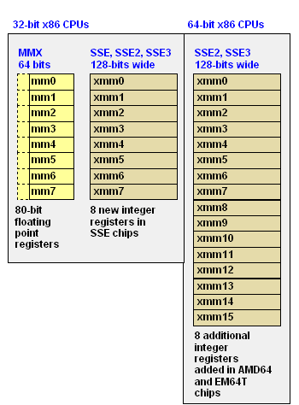
SSE/SSE2 data types
8 registers of 128 bits
XMM0, …, XMM7
4 FPs simple precision (SSE)
2 FPs double precision (SSE2)
16 bytes (SSE2)
8 words (SSE2)
4 double words (SSE2)
1 inteiro 128bit (SSE2)

Slide 22
Sum arrays
Code:
int A[size], B[size], C[size];
…
for (i = 0 ; i < size ; i++)
C[i] = A[i] + B[i];
Parallelism?

Slide 23
Sum arrays
movdqa (%eax,%edx,4), %xmm0 # load A[i] to A[i+3]
movdqa (%ebx,%edx,4), %xmm1 # load B[i] to B[i+3]
paddd %xmm0, %xmm1 # CCCC = AAAA + BBBB
movdqa %xmm1, (%ecx,%edx,4) # store C[i] to C[i+3]
addl $4, %edx # i += 4
movdqa (%eax,%edx,4), %xmm0
mov: transferência
dq: double quad
a: align
(%eax,%edx,4): eax + 4*edx

Slide 24
Sum elements of an array
Code:
int A[size], total=0;
…
for (i = 0 ; i < size ; i++)
total += A[i];
Parallelism?

Slide 25
Sum elements of an array
Restructured code:
int A[size], temp[4], total;
temp[0]=temp[1]=temp[2]=temp[3]=0;
for (i = 0 ; i < size ; i+=4) {
temp[0] += A[i]; temp[1] += A[i+1];
temp[2] += A[i+2]; temp[3] += A[i+3];
}
total = temp[0]+temp[1]+temp[2]+temp[3];
Parallelism?

Slide 26
Internal product of 2 vectors
Code:
int A[size], B[size], iprod;
…
for (i = 0 ; i < size ; i++)
iprod += A[i]*b[i];
Parallelism?

Slide 27
Internal product of 2 vectors
Loop unrolled code:
int A[size], B[size], iprod=0;
for (i = 0 ; i < size ; i+=3) {
iprod += A[i]*B[i];
iprod += A[i+1]*B[i+1];
iprod += A[i+2]*B[i+2];
}
Parallelism?

Slide 28
Internal product of 2 vectors
Loop unrolled code:
int A[size], B[size], iprod=0;
for (i = 0 ; i < size ; i+=3) {
temp0 = A[i]*B[i];
temp1 = A[i+1]*B[i+1];
temp2 = A[i+2]*B[i+2];
iprod += temp0 + temp1 + temp2
}
Parallelism?

Slide 29
SSE with unrolled loop
Internal product of 2 vectors (a and b)
length6 = (size/24)*24
for(; i < length6; i += 24){
__asm__ volatile
(// instruction comment
"\n\t movdqa 0x00(%0),%%xmm2 \t#" "\n\t movdqa 0x10(%0),%%xmm3 \t#"
"\n\t movdqa 0x20(%0),%%xmm4 \t#” "\n\t movdqa 0x30(%0),%%xmm5 \t#"
"\n\t movdqa 0x40(%0),%%xmm6 \t#” "\n\t movdqa 0x50(%0),%%xmm7 \t#"
"\n\t mulps 0x00(%1),%%xmm2 \t#” "\n\t mulps 0x10(%1),%%xmm3 \t#"
"\n\t mulps 0x20(%1),%%xmm4 \t#” "\n\t mulps 0x30(%1),%%xmm5 \t#"
"\n\t mulps 0x40(%1),%%xmm6 \t#” "\n\t mulps 0x50(%1),%%xmm7 \t#"
"\n\t addps %%xmm2,%%xmm0 \t#” "\n\t addps %%xmm3,%%xmm0 \t#"
"\n\t addps %%xmm4,%%xmm0 \t#” "\n\t addps %%xmm5,%%xmm0 \t#"
"\n\t addps %%xmm6,%%xmm0 \t#” "\n\t addps %%xmm7,%%xmm0 \t#"
:
:"r" (a+i), // %0
"r" (b+i) // %1
);
}

Slide 30
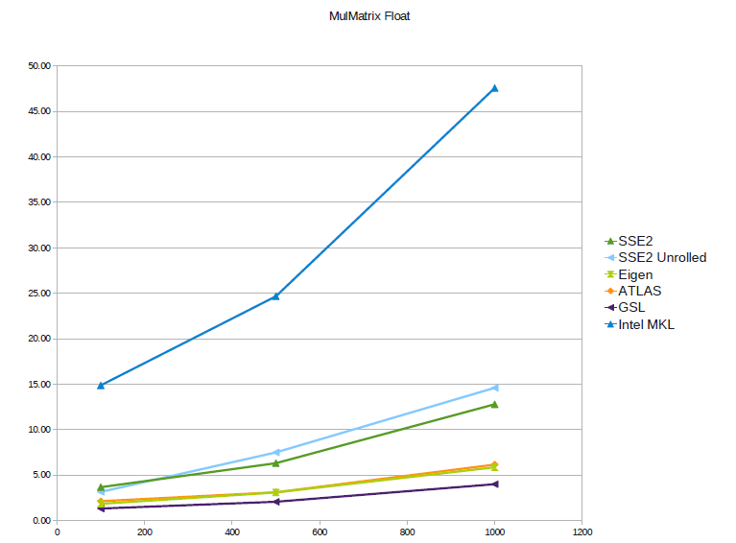
SSE with loop unrolling
Comparison with other libraries

