Slide 1
Computação Paralela Mest. Engenharia Computacional Mest. Int. Engenharia Computacional
Ano letivo 2022/2023
Rui Costa, Nuno Lau

Slide 2
CUDA
Parallel general purpose computation model
Introduced by NVIDIA in 2006
Allows using the GPU for the execution of general purpose applications
Acknowledgement: This lecture is based on “CUDA C++ Programming Guide”, v11.6, NVIDIA and older versions

Slide 3
CUDA

Slide 4

CUDA

Slide 5
CUDA – CPU and GPU Architecure

Slide 6
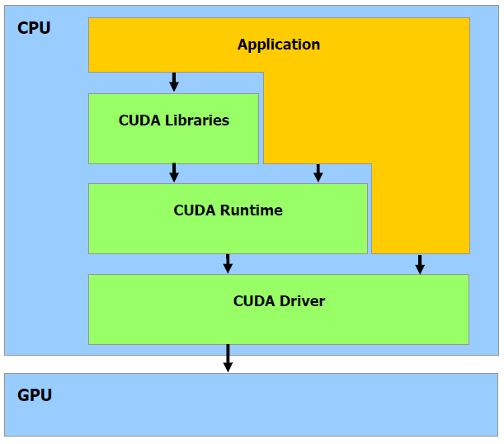
CUDA Architecture

Slide 7
CUDA Computing Applications

Slide 8
CUDA Automatic Scalability

Slide 9
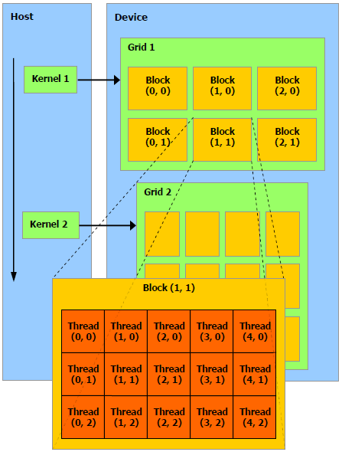
CUDA Kernel, Grid, Block, Thread

Slide 10
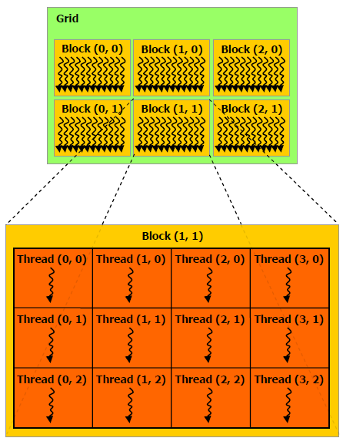
CUDA Grid of Threads

Slide 11
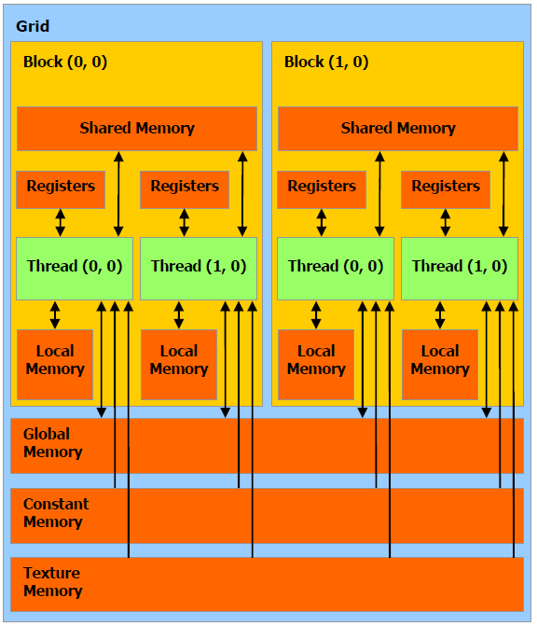
CUDA memory

Slide 12
CUDA memory

Slide 13
CUDA memory

Slide 14
CUDA Compute Capability
Compute Capability 1.x
Global memory (read and write)
Slow and uncached
Requires sequential and aligned 16 byte reads and writes to be fast
Texture memory (read only)
Cache optimized for 2D spatial access pattern
Constant memory
This is where constants and kernel arguments are stored
Slow, but with small cache
Shared memory (16 kb per MP)
Fast, but take care of bank conflicts
Can be used to exchange data between threads in a block
Local memory (used for data that does not fit into registers)
Slow and uncached
Registers
Fastest, scope is thread local

Slide 15
CUDA Compute Capability
Compute Capability 2.x
Global memory (read and write)
Slow, but now with cache
Texture memory (read only)
Cache optimized for 2D spatial access pattern
Constant memory
Slow, but with cache (8 kb)
Shared memory
Fast, but slightly different rules for bank conflicts now
Local memory
Slow, but now with cache
Registers (32768 32-bit registers per MP)

Slide 16
CUDA Compute Capability
Compute Capability 3.x
Global memory (read and write)
Generally cached in L2, but not in L1
Constant memory
Cache shared by all functional units
Shared memory
32 banks with two addressing modes
Local memory
Cached in L1
Compute Capability 5.x
Global memory
Identical to cp 3.x
Shared memory
32 banks organized such that successive 32-bit words map to successive banks
Compute Capability 6.x
Compute Capability 7.x
Compute Capability 8.x

Slide 17
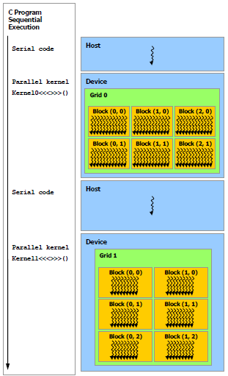
CUDA Heterogeneous Programming

Slide 18
CUDA
Kernel invocation
kernel<<< Dg, Db, Ns, S >>>
Dg is the grid dimension (dim3 type)
Db is the block dimension (dim3 type)
Ns is the number of shared memory bytes
S is the stream

Slide 19
CUDA
Block
threadIdx.x, threadIdx.y, threadIdx.z
Identify the thread in the block
blockDim.x, blockDim.y, blockDim.z
threadID = x+y*Dx+z*Dx*Dy
Threads are executed in warps
32 threads of the same block with consecutive ids
Blocks should have more than 32 threads

Slide 20
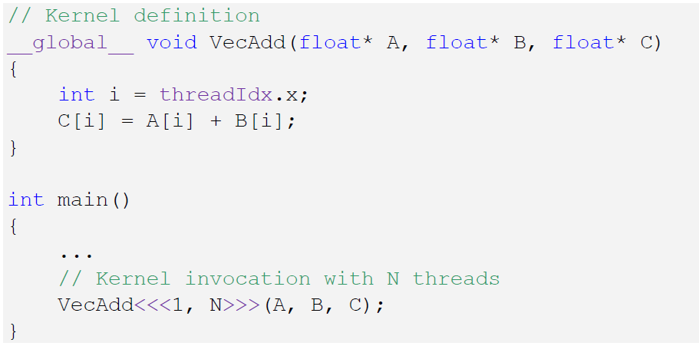
CUDA

Slide 21
CUDA
Grid
blockIdx.x, blockIdx.y, blockIdx.z
Identify the block in the grid
gridDim.x, gridDim.y, gridDim.z

Slide 22
CUDA
__global__
Used to define kernel functions
Called by CPU; Run in GPU
__device__
Used to define device functions
Called by GPU; Run in GPU
__shared__
Used to declare variables that reside in shared memory

Slide 23
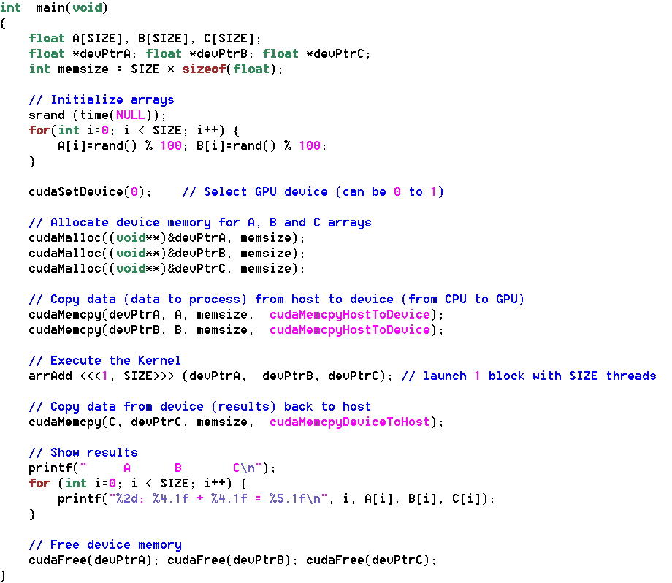
CUDA main()

Slide 24
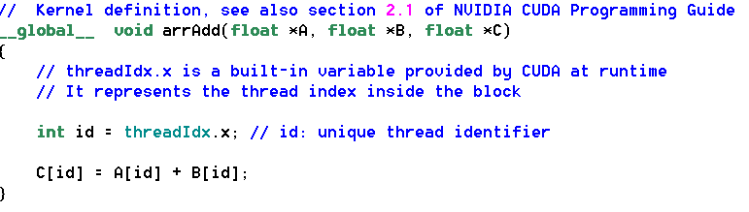
CUDA kernel

