Slide 1
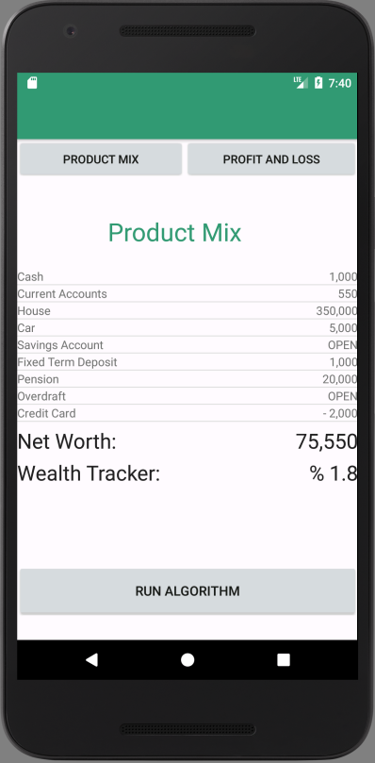
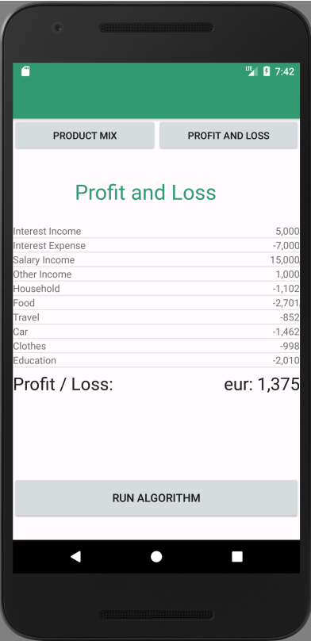
What specific needs does your product/service address?
PSD2 Regulation;
Fitness tracker for financial health;
Allows owner to build the full product mix and cash flow in one HUB.
Enterprise Ireland - Application For Competitive Start Fund Vasily Ogievsky

Slide 2
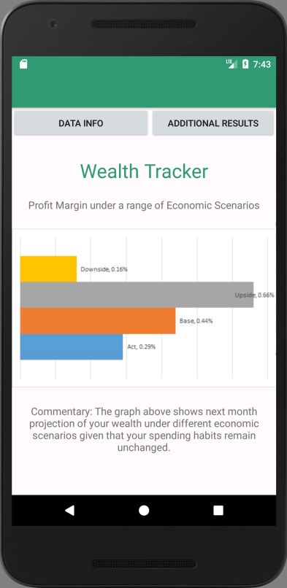
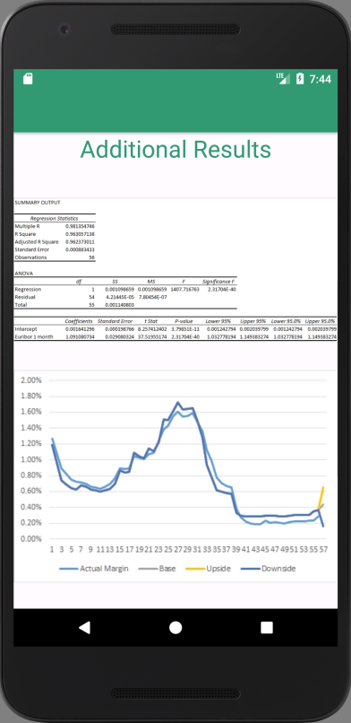
Why would someone be compelled to purchase your offering?
Helps to be more rational about spending;
Tracks history and gives projection of wealth under different market scenarios;
Provides financial education.
Enterprise Ireland - Application For Competitive Start Fund Vasily Ogievsky

Slide 3
What is it about you and/or your management team that makes you capable of executing on this business plan?
Enterprise Ireland - Application For Competitive Start Fund Vasily Ogievsky

Slide 4
What would be the impact of €k on the execution of this business plan?
Start a company;
Develop initial prototype: Design & Algorithm;
Establish business connections
Market the product to business customers: AIB, Bank of Ireland, etc.;
Manage a team.
Enterprise Ireland - Application For Competitive Start Fund Vasily Ogievsky

