Slide 1
Making of a remotely controlled toy car
Phase - 1
Develop a navigation controller webpage to direct the toy car
Make ESP32 as a web server and deploy the page in that.
Based on the use requests, control the relay to move the wheels.
Phase – 2
Save the local wifi address to ThingSpeak(https://thingspeak.com/).
Create a public DNS for the local IP address of the web server using ngrok (https://ngrok.com/) .
Fix a mobile phone on the toy car
Start DATA (3G) network
Start wifi hotspot
Face the camera to the front of the car as a driver view.
Start a video call to your computer or mobile phone.

Slide 2
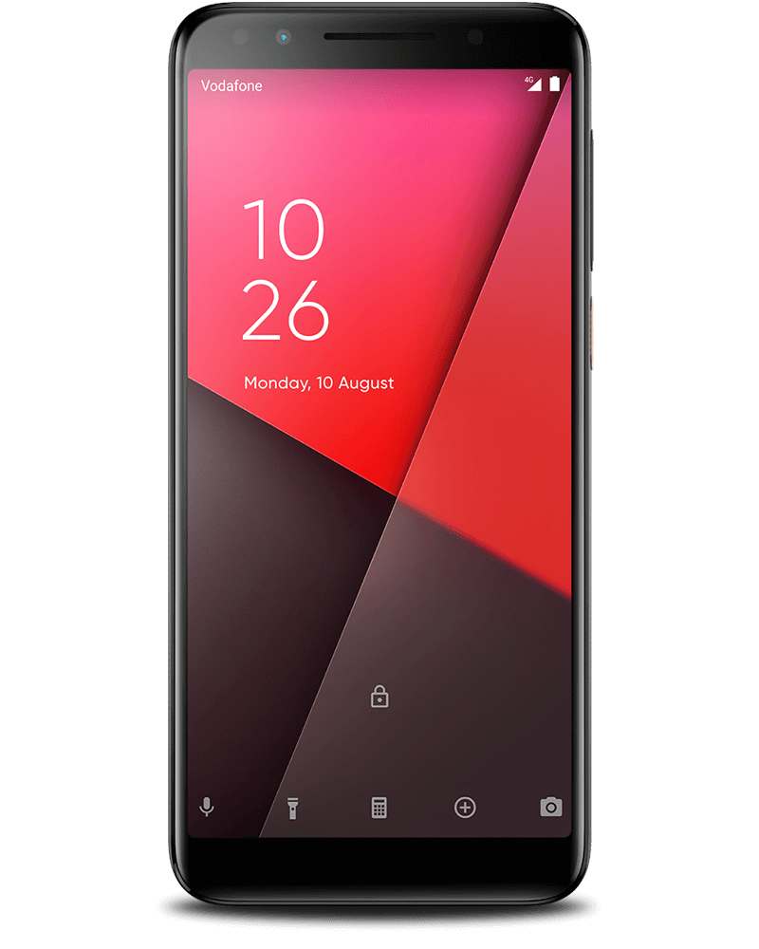




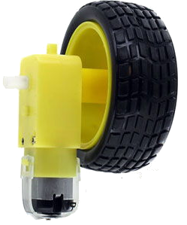
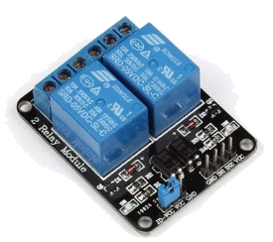
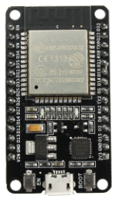
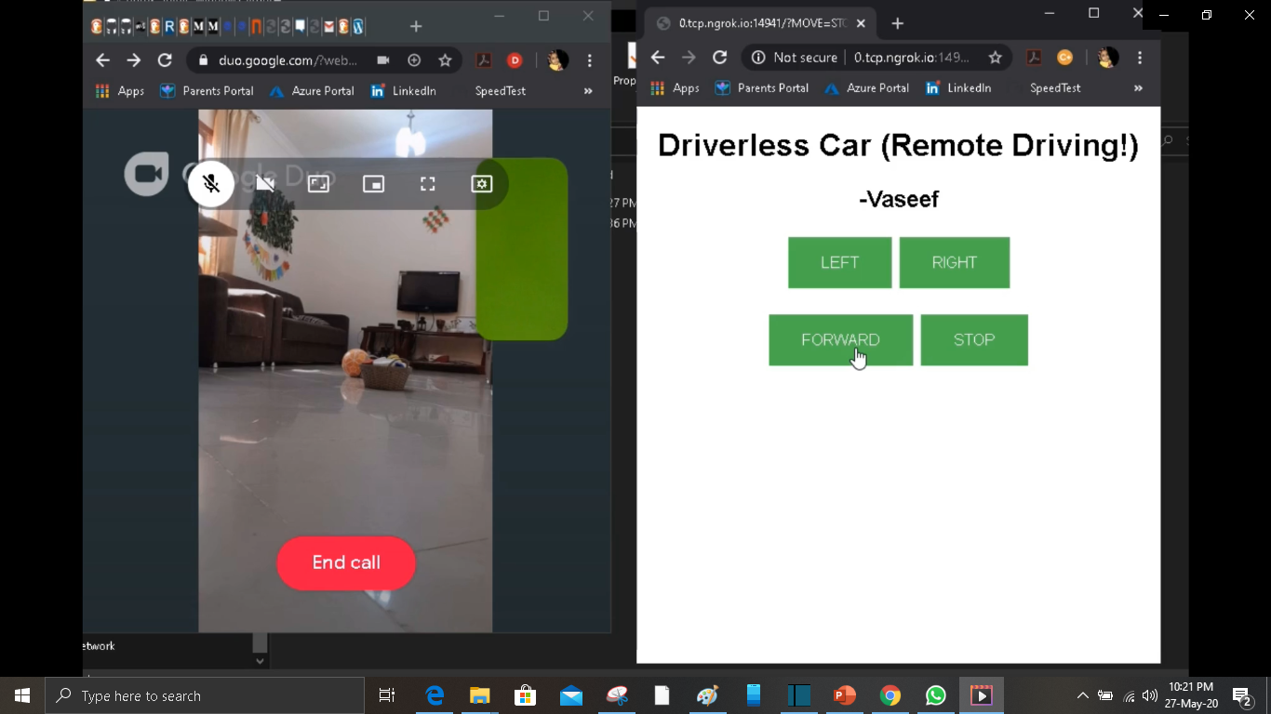
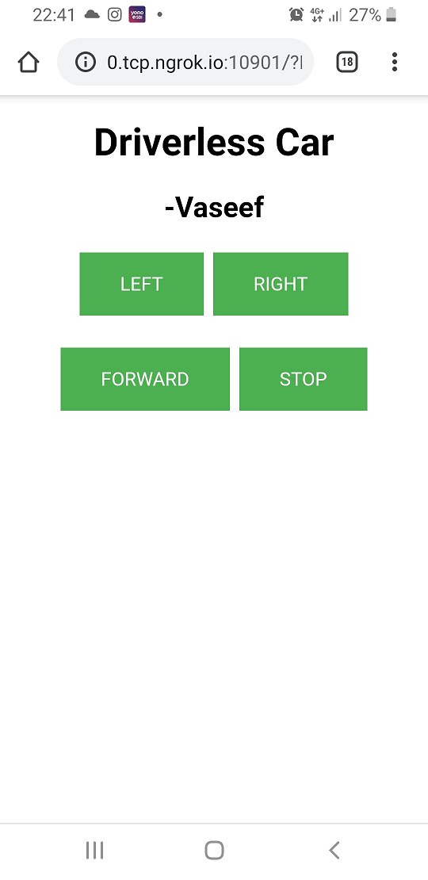
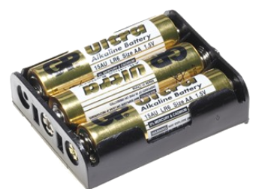
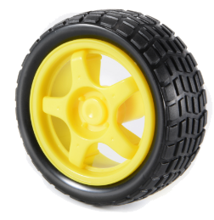
Components
ESP32
Relays
Power supply/battery
Toy motor and wheels.

