Slide 1







KONGU ENGINEERING COLLEGE
PERUNDURAI ERODE-638060
DEPARTMENT OF COMPUTER APPLICATIONS
FINAL MINI PROJECT- REVIEW
TITLE: E-LEARNING MANAGEMENT SYSTEM
TEAM NO-39
Team Members: SELVA J (24MCR095)
SIVASUBRAMANIAN S (24MCR104)
VASHANTHAKUMAR K S (24MCR124)
Team Mentor with Designation and Department:
Dr. A. TAMILARASI
(HEAD OF DEPARTMENT)
MCA DEPARTMENT
In association with:

Slide 2


abstract
This project presents the design and implementation of an interactive e-Learning platform aimed at providing an effective and engaging environment for online education.
The platform is developed using a combination of HTML, CSS, and JavaScript for the frontend to create a responsive and dynamic user interface, while PHP and MySQL are used for the backend to manage user data.
Key features of the platform include personalized user profiles, a secure login and registration system, comprehensive course management, and interactive quizzes to enhance learning outcomes

Slide 3

Existing disadvantages
User Experience issues
Cost considerations
Security and privacy issues
Engagement challenges
Feedback and improvement gaps

Slide 4

PROPOSED ADVANTAGES
Flexibility and Accessibility
Personalized Learning
Centralized Learning
Progress Tracking and Reporting
Continuous Learning
Easy Updates and Maintenance
Integration with Other Tools Global Reach

Slide 5
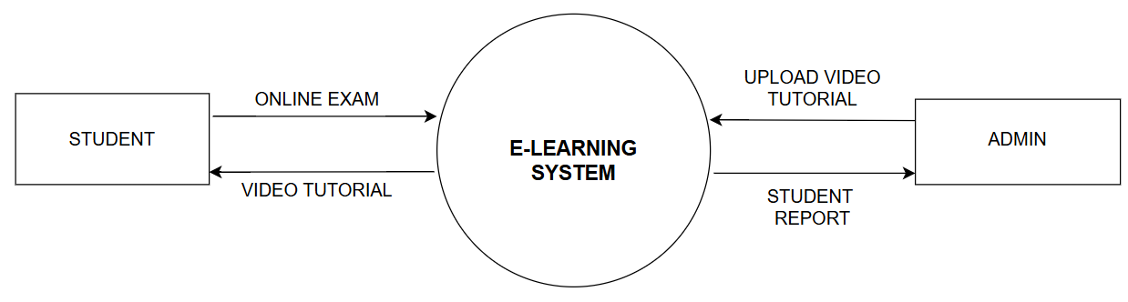
DATA FLOW DIAGRAM LEVEL-0

Slide 6
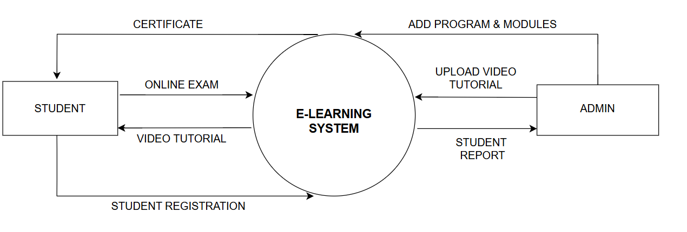
DATA FLOW DIAGRAM LEVEL-1

Slide 7
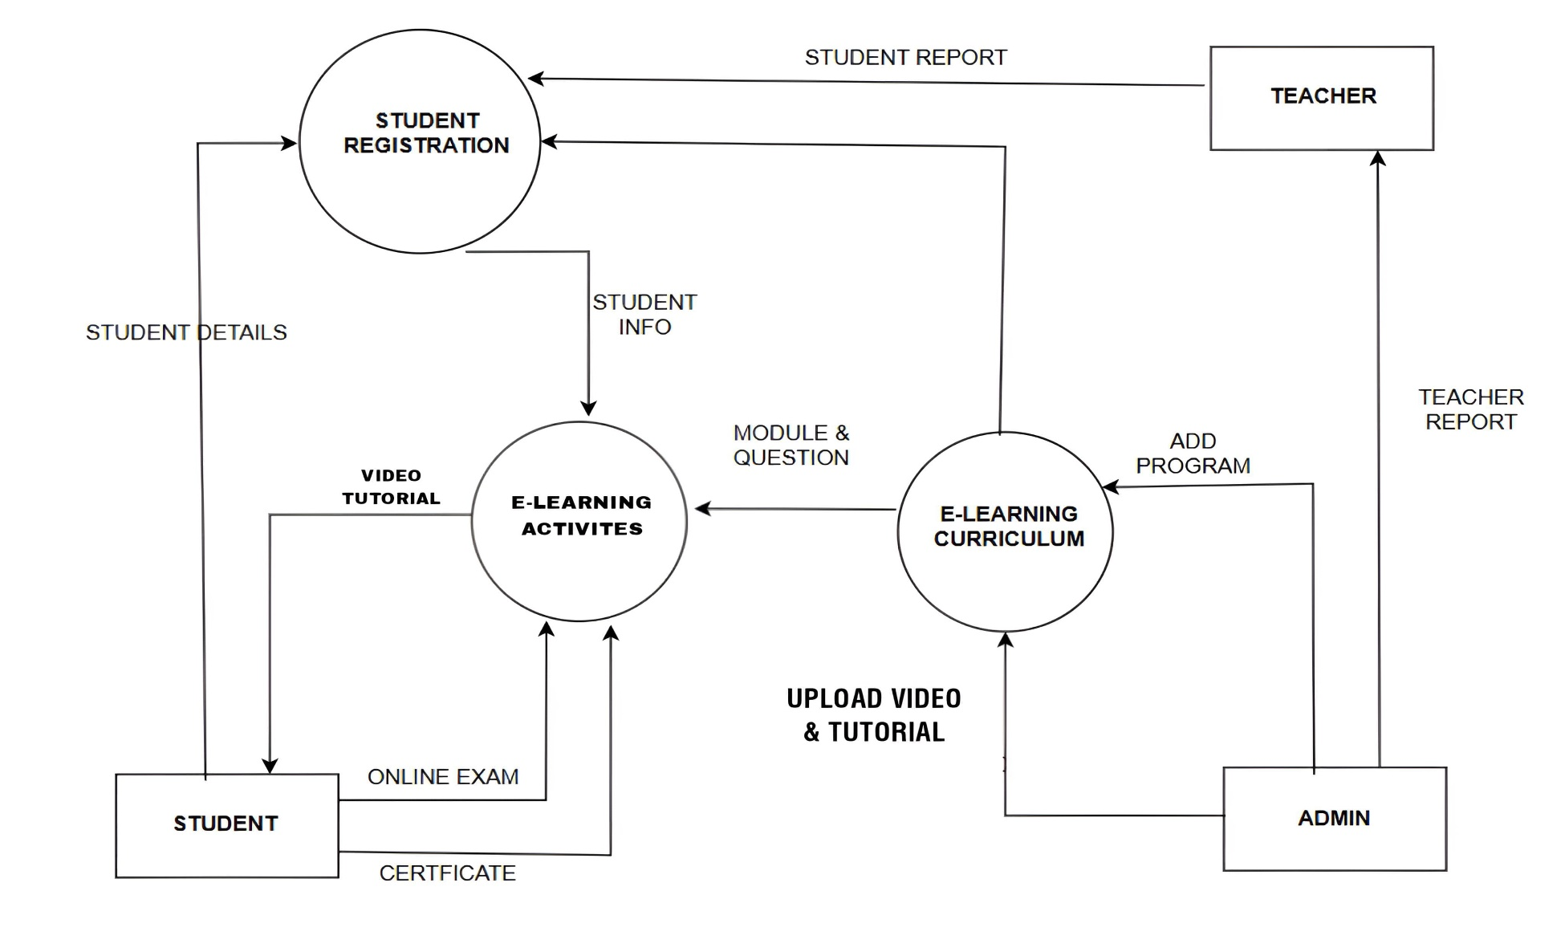
DATA FLOW DIAGRAM LEVEL-2

Slide 8
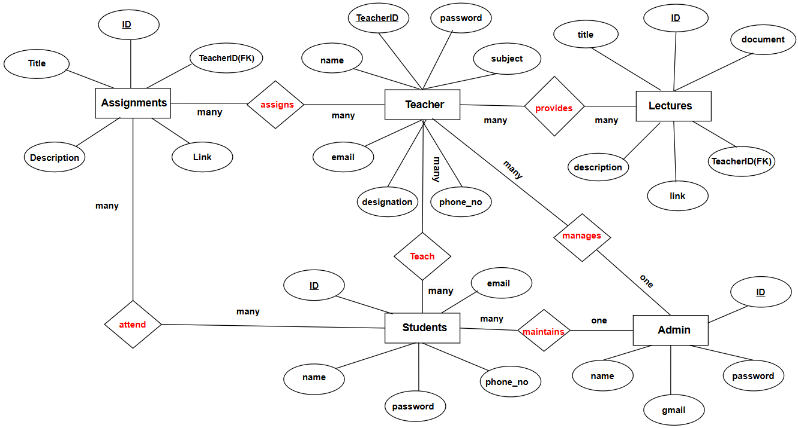
ENTITY RELATIONSHIP DIAGRAM

Slide 9
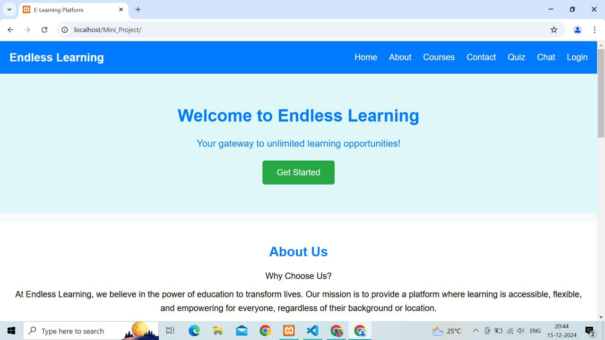
HOME PAGE WINDOW

Slide 10
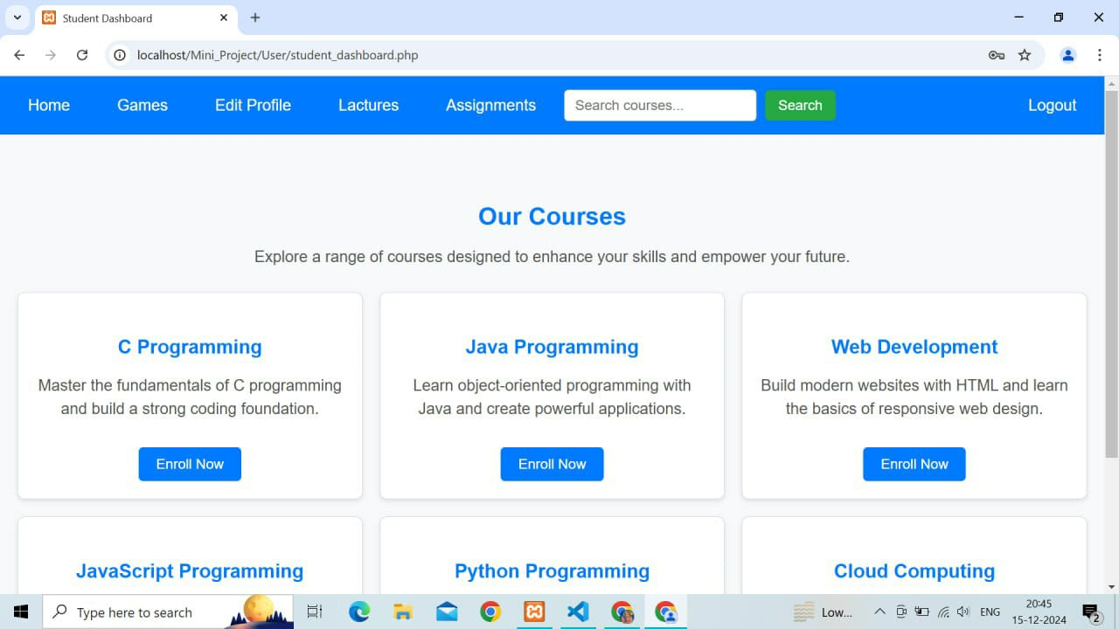
OUR COURSES

Slide 11
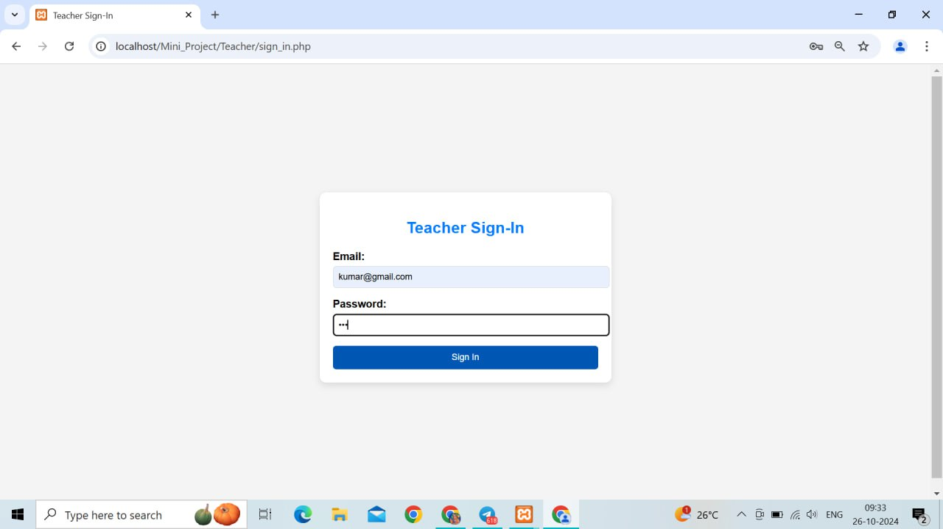
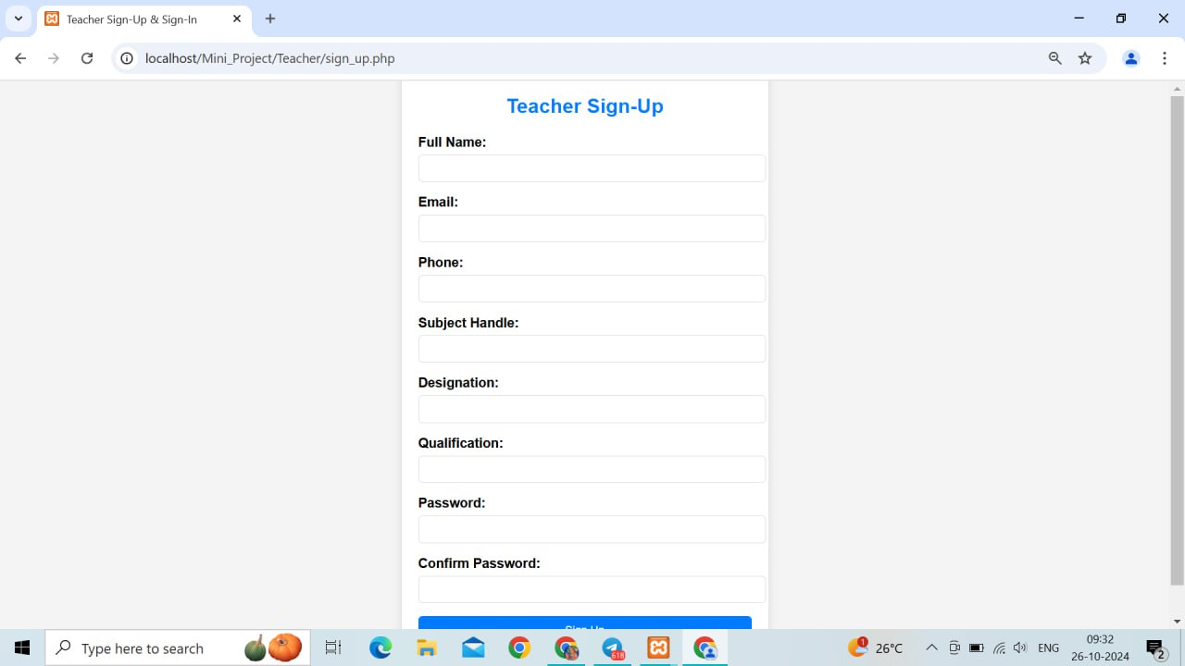
LOGIN AND SIGN UP PAGES

Slide 12
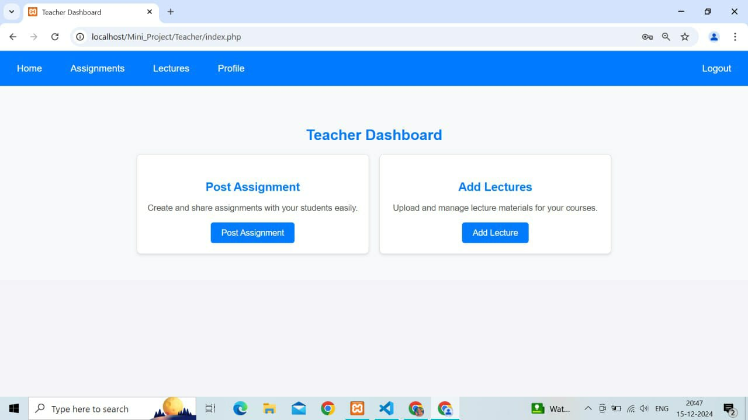
TEACHER DASHBOARD

Slide 13
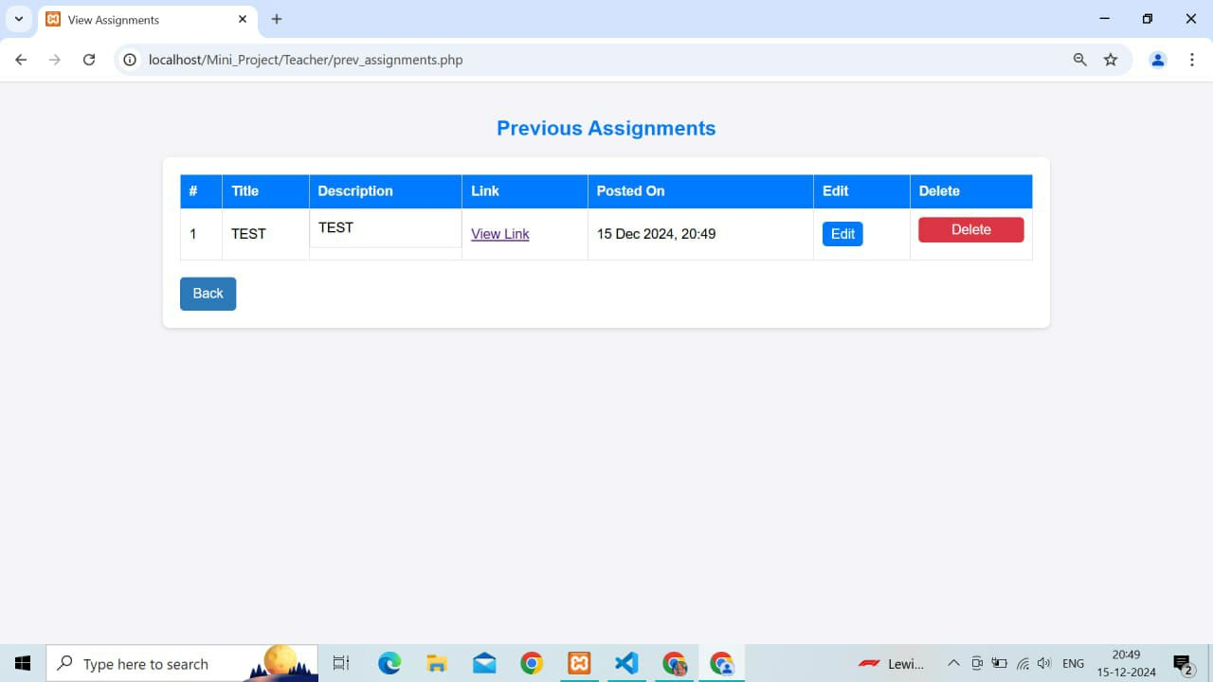
ASSIGNMENTS POST PAGE

Slide 14
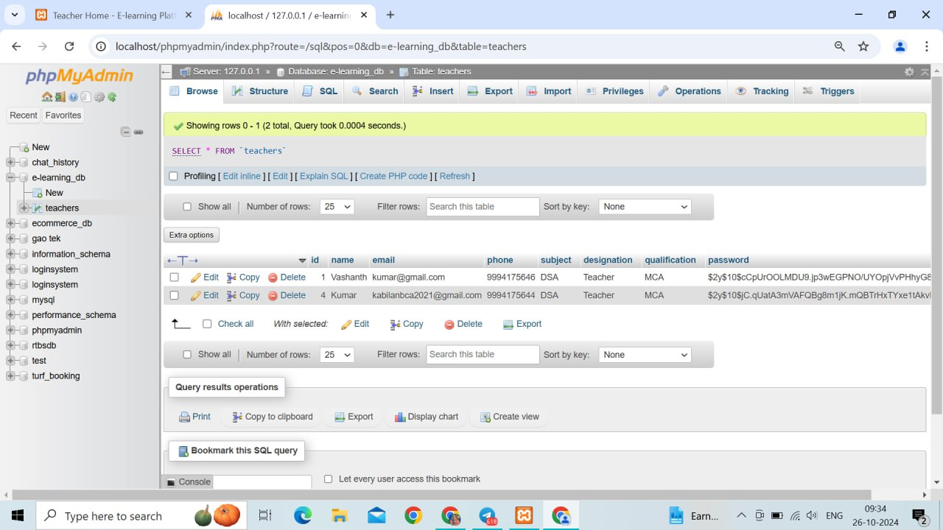
DATABASE CONNECTIVITY

Slide 15
THANK YOU

