Slide 1






KONGU ENGINEERING COLLEGE
PERUNDURAI ERODE-638060
DEPARTMENT OF COMPUTER APPLICATIONS
KEC IDEATHON
AI AUTOMATION FOR HELMET DEDUCTION
PS CATEGORY – HARDWARE
Team Lead: Vashanthakumar K S (24MCR124)
Team Members: Selva J (24MCR095)
Sivasubramanian S(24MCR104)
Technology Readiness Level: TRL -- 1
Team Mentor with Designation and Department:
Dr. A. Tamilarasi M.sc., Mphil., Ph.D., Mtech.,
(Head of Department)
MCA DEPARTMENT
In association with:

Slide 2


abstract
AI Smart Automation for helmet deduction enhancing motorcycle safety through real time helmet detection and vehicle integration. Our innovative solution aims to encourage helmet usage and reduce road accidents.
Our system uses advanced computer vision techniques to detect helmet usage in real-time. The detected data is integrated with the motorcycle's controls to enforce safety protocols. Alerts, throttle control, and restricted mode ensure riders prioritize helmet usage. The mechanism such as helmet deduction, throttle control, restricted mode and alert mechanism. An image processing algorithm, such as YOLO, analyses the captured frames in real-time to detect the presence or absence of a helmet on the rider's head. If a helmet is detected, the system allows normal throttle operation, enabling the rider to maintain regular speed. In the absence of a detected helmet, the system enters restricted mode, limiting the motorcycle's speed to encourage the rider to wear a helmet for safety.

Slide 3
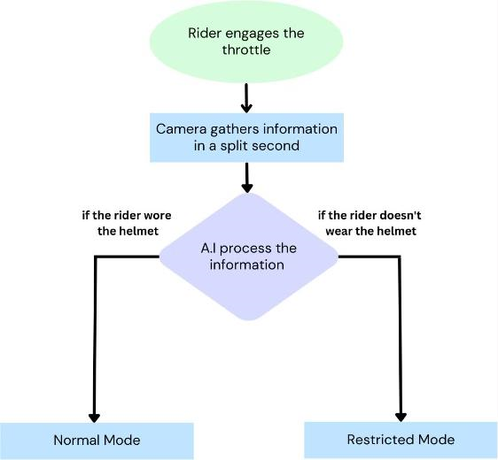
Methodologies
DATA FLOW DIAGRAM :

Slide 4
FEASIBILITY AND VIABILITY
Feasibility of AI Automation for Helmet Detection:
Technology Read lines
Data Availability
Hardware Requirements
Real-time performance
Integration
Viability of AI Automation for Helmet Detection:
Safety Compliance
Cost-benefit analysis
scalability
challenges and limitations
regulatory and ethical considerations

Slide 5
IMPACT AND BENEFITS
Speed Limitation
Start/Stop control
Automatic Braking
Engaging brakes if helmet removal is detected during operation.
Limiting vehicle speed if no helmet is detected.
Preventing vehicle start-up or shutting it down if no helmet is detected.

Slide 6
RESEARCH AND REFERENCE
Books and Articles
Wei Chen, Qingcheng Yu, and Jian Xu (2020). YOLOv5-Based Helmet Detection Algorithm in Construction Site Images
Richard Szeliski : “Computer Vision: Algorithms and Appilcations”
Journals and Conference Papers
Xiaogang Xu, Haozheng Ren (2017). “Automatic Safety Helmet Wearing Detection”
An Efficient Helmet Detection Algorithm for Real-Time Video Monitoring”(2020) by Xueli Ren, Wei Luo and shengli Li
Documentation.
References
Smith, J. (2020). Machine Learning for Autonomous Vehicles: A Practical Guide. Springer.

Slide 7
