Slide 1
SAIL THE SHIP:
Make the Best of Your Student Insurance
Team: Py-oneers
Joanna Chang: joannac2@andrew.cmu.edu
Vashishth Doshi: vbd@andrew.cmu.edu
Zarina Davletova: zdavleto@andrew.cmu.edu
Zhuoyuan Yang: zhuoyuay@andrew.cmu.edu

Slide 2
Agenda
Project Description
Objectives
Data Sources
Demo
Libraries

Slide 3
Project Description
School health insurance SHIP covers a lot of services for students.
Annually we pay about $2,697 for insurance.
Issue : many do not know what services are covered.

Slide 4
Objectives
Learn about total health insurance enrollment at CMU
Ask students from CMU and other schools about their experience with health insurance.
Create survey
Send it to students
Analyze the survey
Create a program to help students to easily learn about services covered by SHIP health insurance.
Create a program that will help student to answer common asked questions about health insurance and its terminology.

Slide 5
Data Sources
University Health Center
Survey (Google Forms) to csv file
Centers for Medicare and Medicaid Services(CMS.gov)
Highmark coverage information
CMU Ship Website - Common Questions

Slide 6
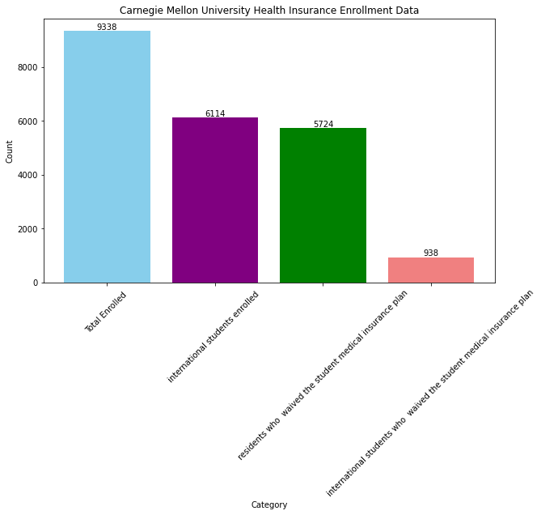

Slide 7
Survey Data and Analysis
Libraries:
pandas
matplotlib.pyplot
plotly.io
plotly.express

Slide 8
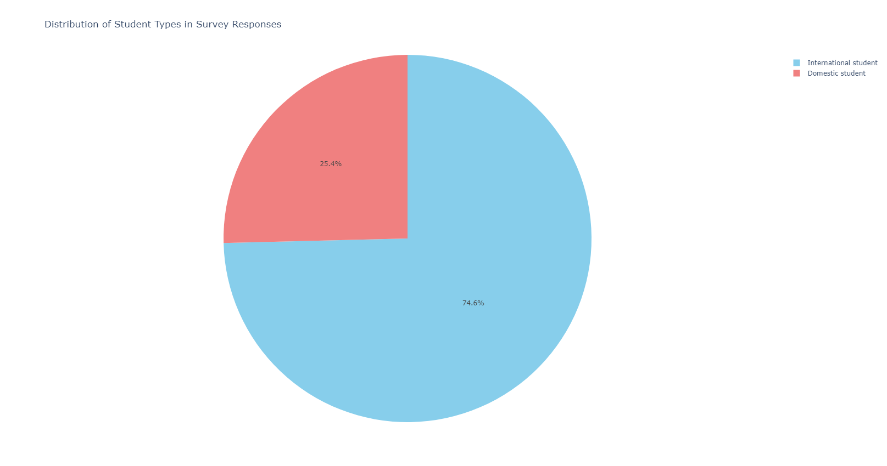
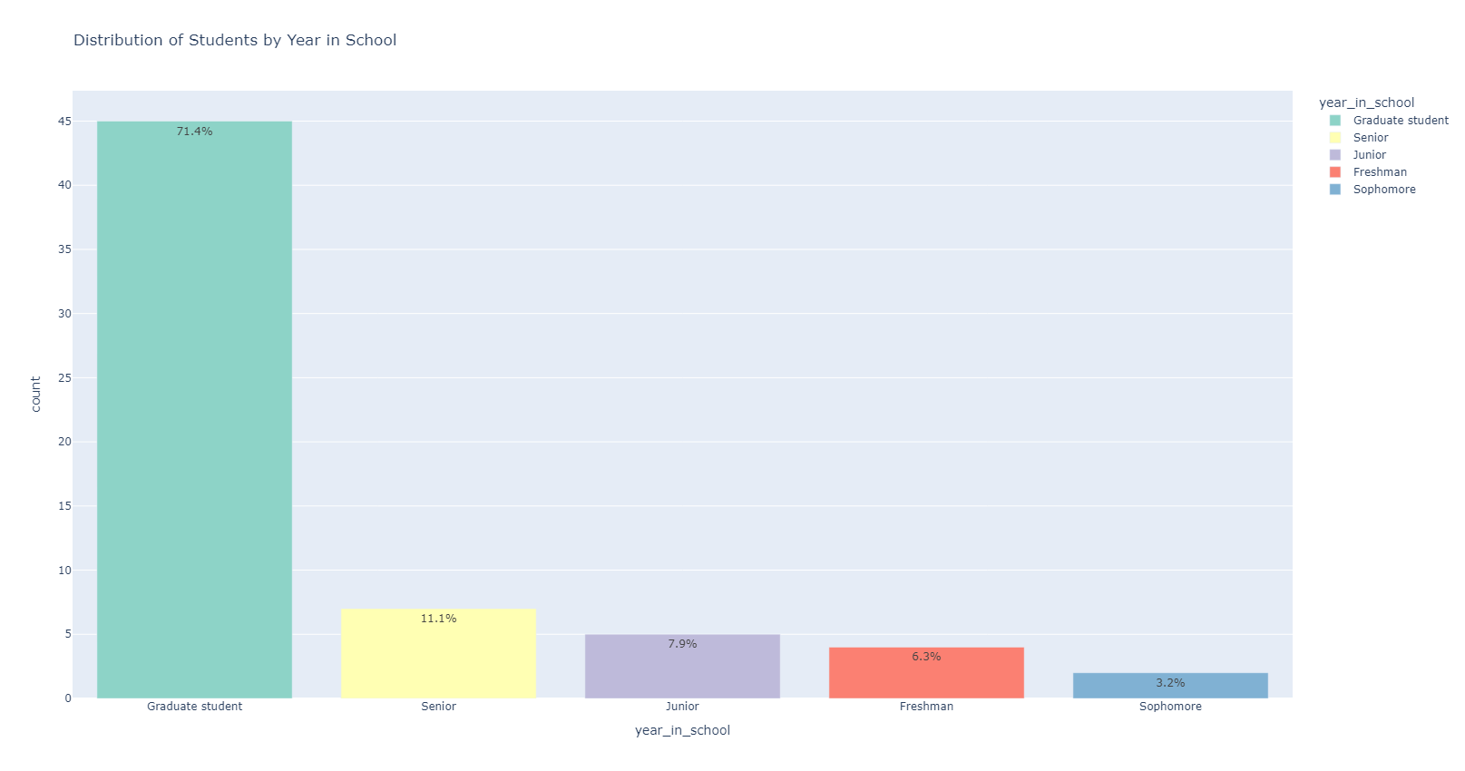

Slide 9
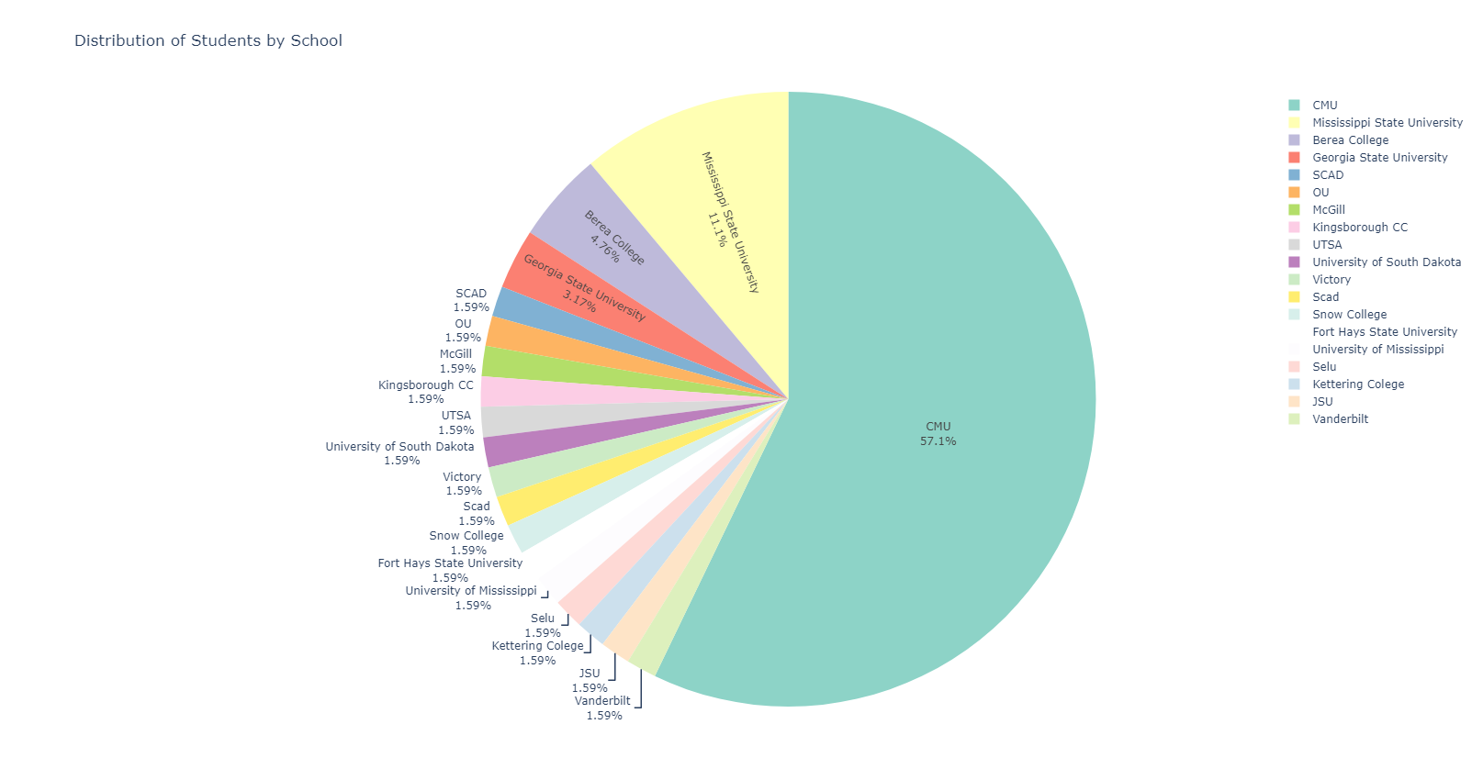
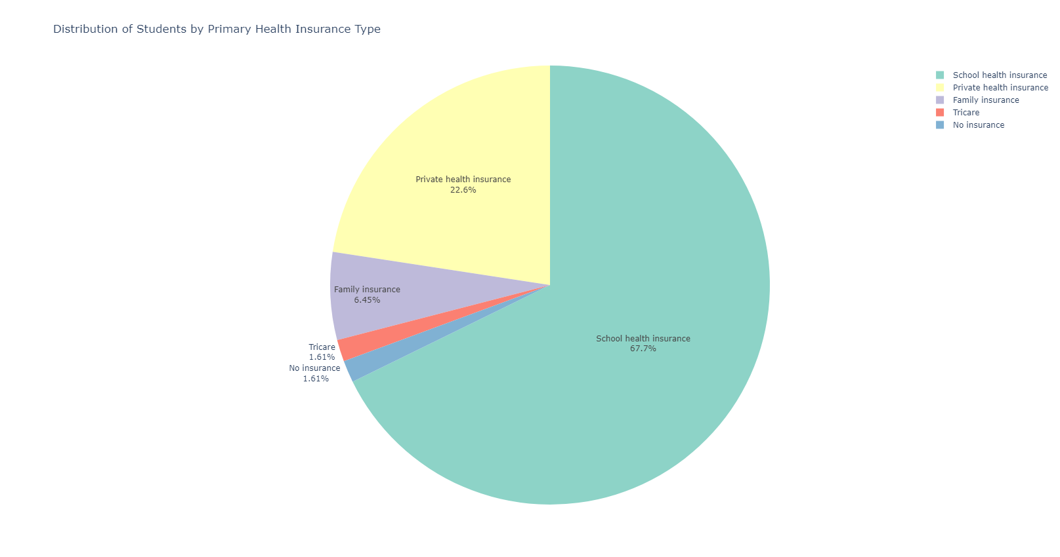

Slide 10
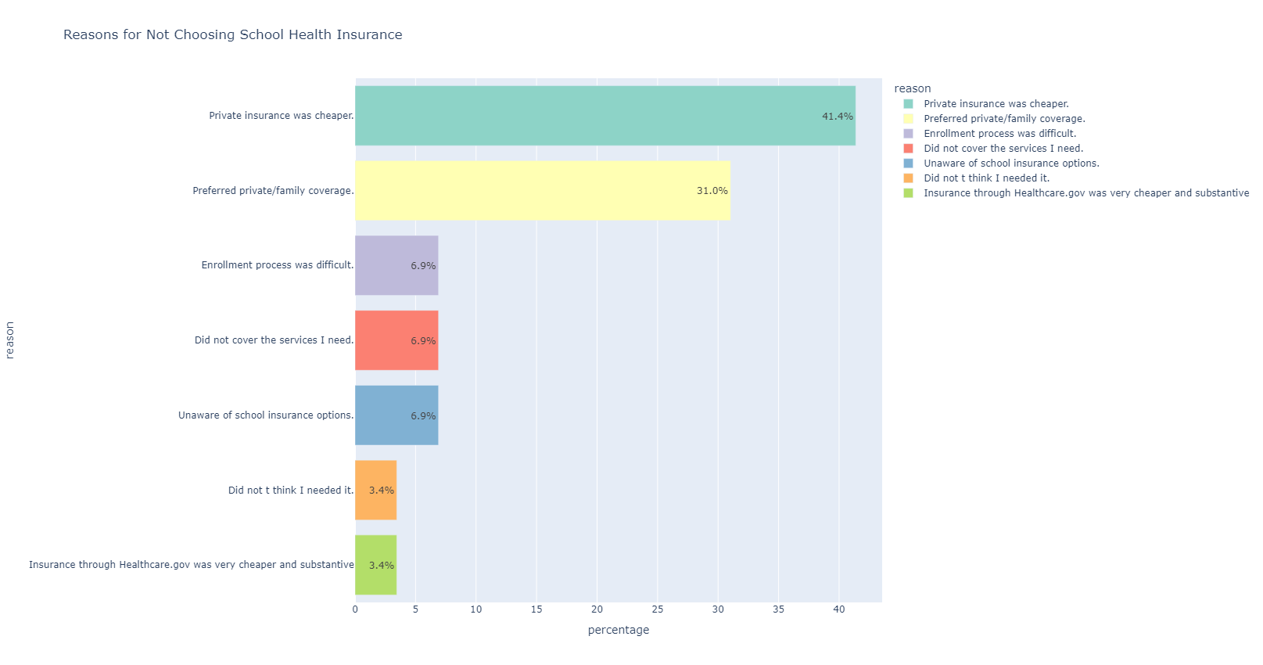

Slide 11
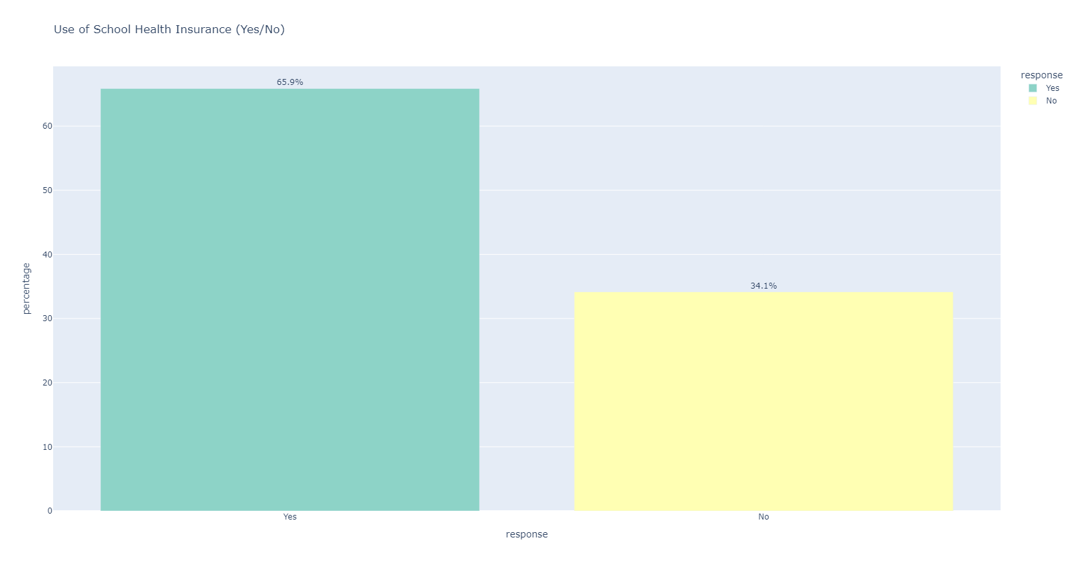

Slide 12
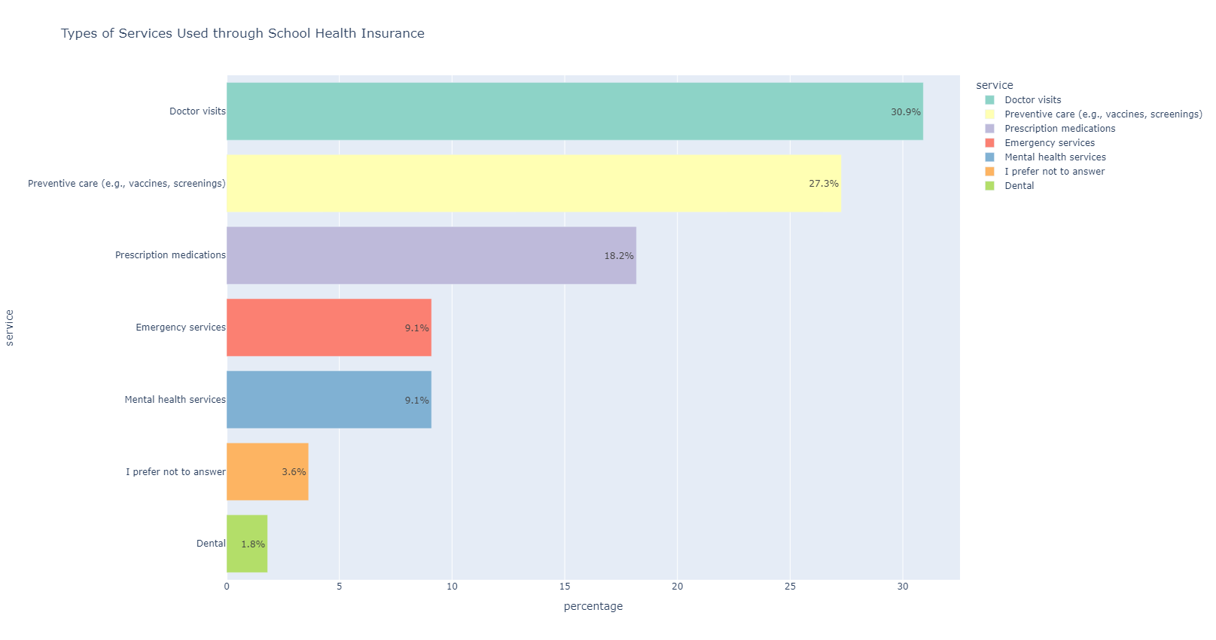

Slide 13
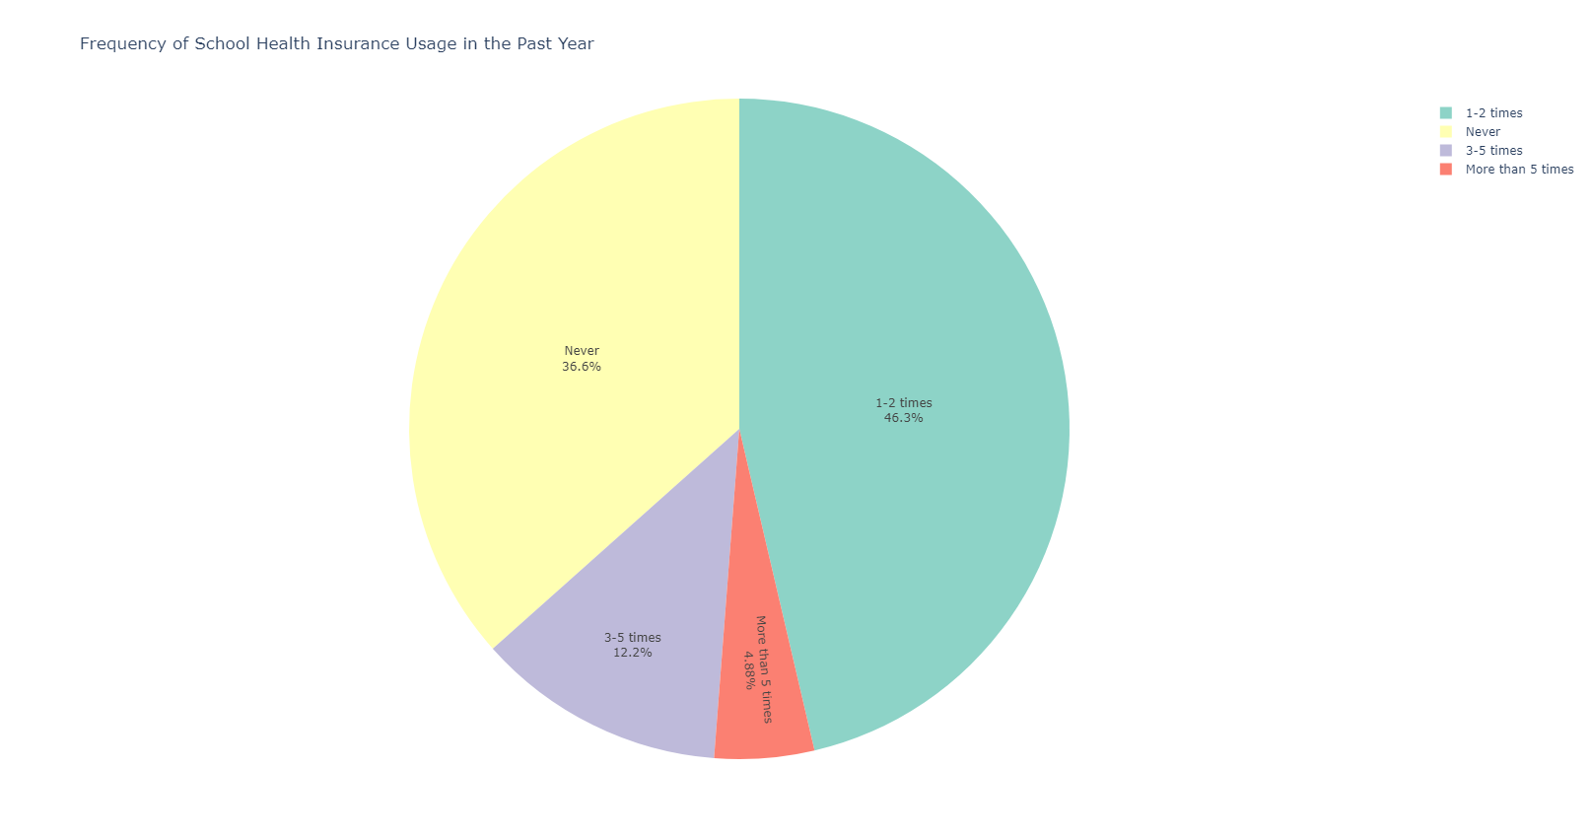
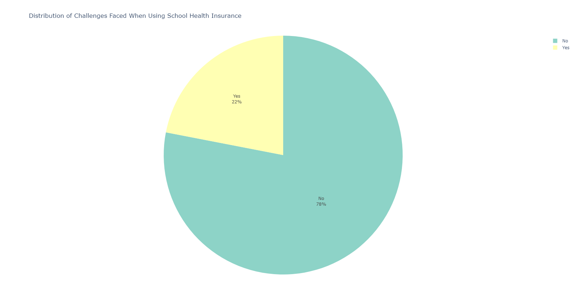

Slide 14
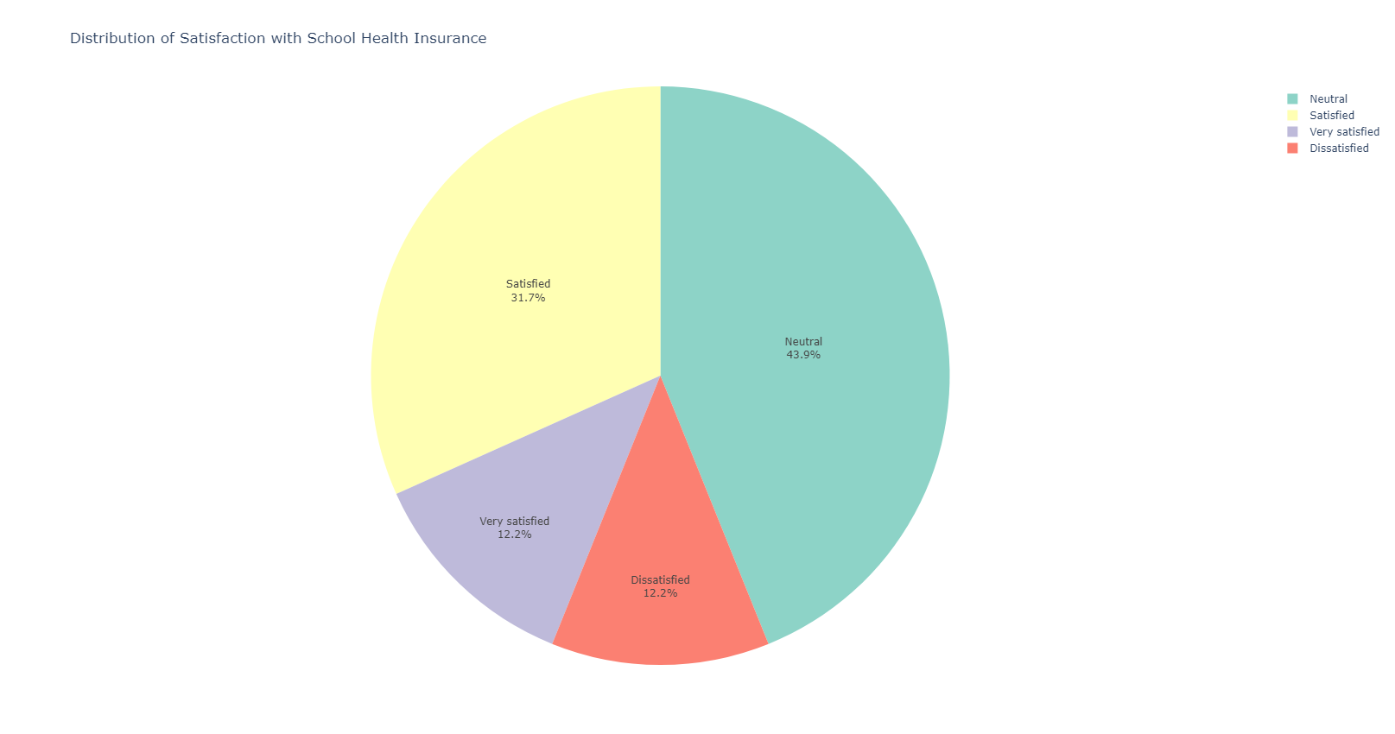
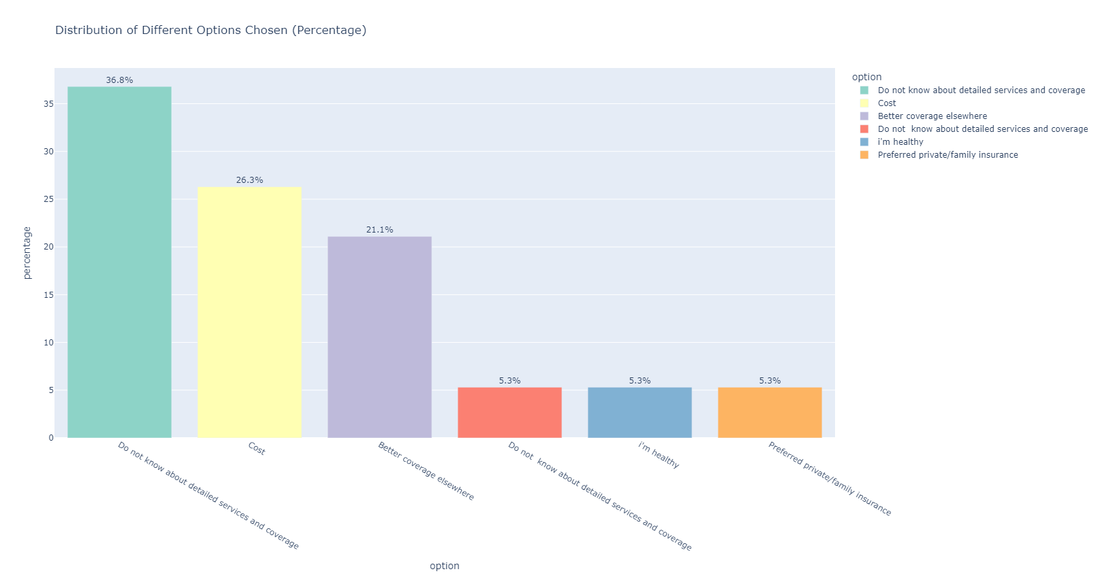

Slide 15
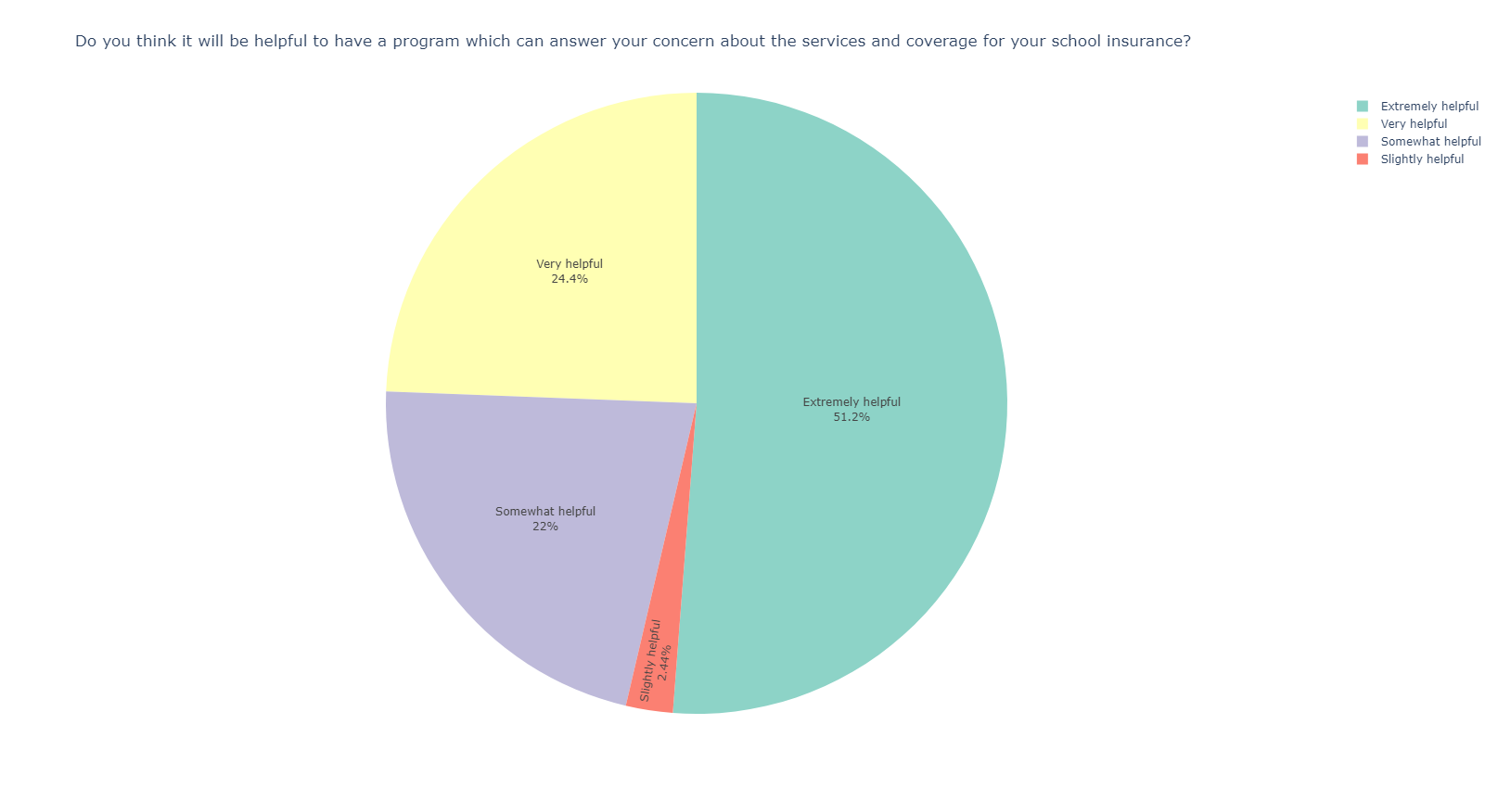

Slide 16
Program 1:
Cost and Coverage Finder

Slide 17

What this program does
Objective: Provide clarity and transparency
Our program helps users:
Search for medical service prices from real healthcare providers.
Check if their insurance will cover the service and at what rate.
Data Reference:
Real-world pricing data for different medical services—— CMS.gov
SHIP insurance coverage —— Highmark documents

Slide 18
Data preparation and processing
Highmark medical plan coverage table: convert the pdf to a csv file, then load the data to a dataframe and store it waiting for the later search
CMS dataset
Selected variables:
HCPCS code：to identify medical services, and products
Billed price: charges that the provider submitted for the service
Medicare allowed amount: the real charge of the service
State\ Zipcode( for filtering purposes only)
Get the data through an API and at the same time filtering it using conditions in the link with Zip Code contains ‘152’ and State in PA
38232 records only for providers in Pittsburgh
Compute the average cost for each HCPCS code, then define a function to match the user input keywords with the dataset
1822 unique codes and the corresponding prices
Users can key in keywords to get the price about matched services
Sort to see what’s the most 50 common services and group them by keywords, to build a menu.
Users can choose by menu to get info about most commonly used services
Techniques:
API calling
File I/O
Libraries:
Requests
JSON
Pandas
Regex
Concurrent.futures(for multi-thread tasks)

Slide 19
User Instructions
Mode 1: Cost for common health services in PA (by menu) Step 1: Select a HCPCS codes category Step 2: Select a specific health services under the category chosen from 1st step Return: (1) Billed Amount: the amount that the healthcare provider charges for the service before any insurance or Medicare adjustments) (2) Medicare Allowed Amount (this is the amount Medicare or insurance deems appropriate for the service)
Mode 2: Highmark health services (by menu) Step 1: Choose a Highmark health services category Step 2: Choose a subcategory Return: Highmark coverage information
Mode 3: Search health services you want to know (by keywords) Step 1: Input a question Return: Highmark coverage information Step 2: Key in a HCPCS code as the list presented Return: (1) Billed Amount, Medicare Allowed Amount (2) Highmark coverage info & Medicare Allowed Amount (SHIP Benefit: how much you save under Highmark)

Slide 20
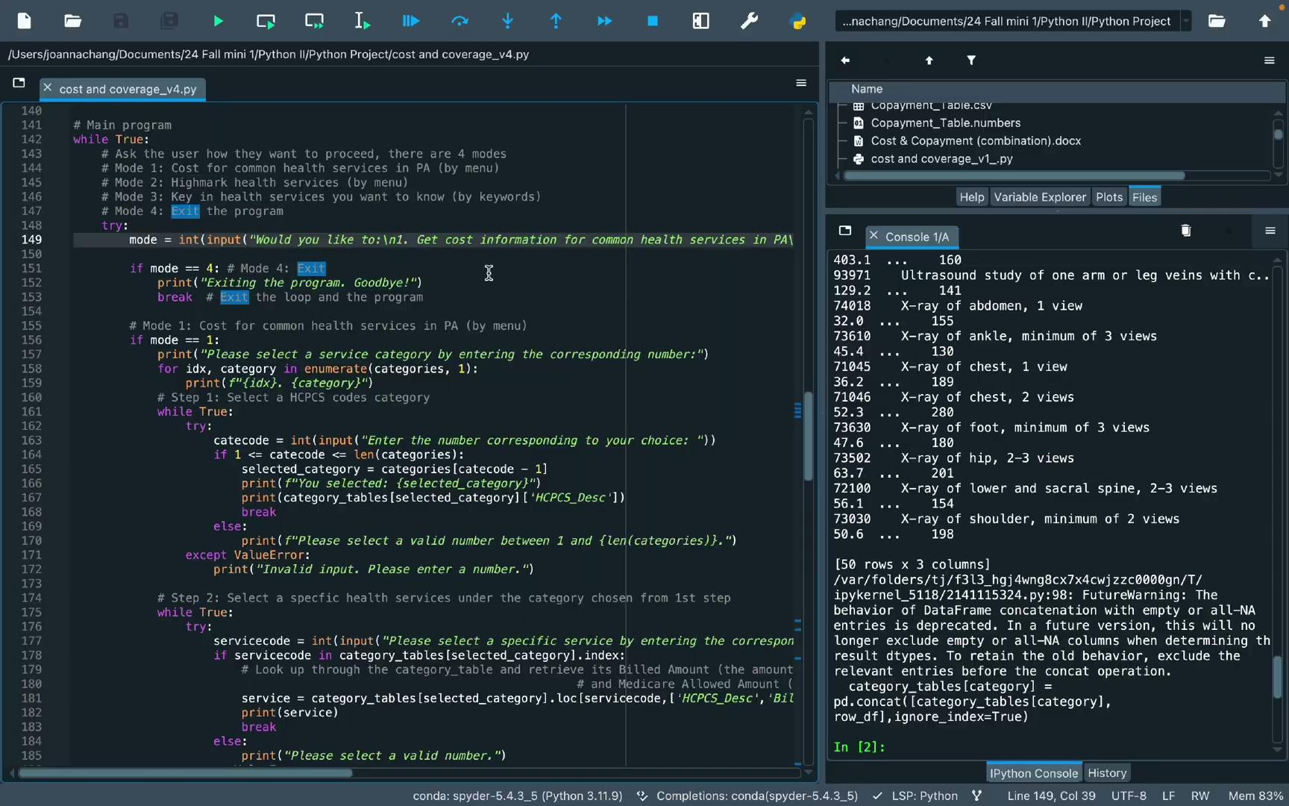
Demo
File Link: https://drive.google.com/file/d/1h1gReqemCAYqyQGyMAq_doJ_M1Rrcl9O/view?usp=share_link

Slide 21
Program 2:
Questions: Answers to how to board the SHIP
Understanding Health Insurance Terminology

Slide 22

What this program does
Objective 1: Answer questions about CMU SHIP
Answer and refer respective contacts to student’s requirements
Answer the questions student may have
Objective 2: Provides meanings of health insurance terminology
Return meanings of health insurance terminologies students may want to ask about.
Data Sources:
Common Contacts, questions from CMU SHIP’s webpage
Health Insurance Terminology from CMS.gov

Slide 23
Program Flow and Functionality
Scrape data (terminology and corresponding meaning) - using web scraping.
Clean data to remove whitespace, other extra characters from the soup using findall, list expressions and modifications
Create dictionary of question index, questions and answers using simple dicts
Allow user to toggle between 3 sections
Section A and B loop to toggle between questions and answers using while loops
Section C to ask user to input terms they want meaning of and return meanings accordingly using while loops and pattern matching using regular expressions.
Objectives met -
Access quick contacts
Access answers to questions
Understand health insurance terminology
Libraries Used
Regex
BeautifulSoup
Requests

Slide 24

Demo
Link

Slide 25
Libraries and Techniques used
pandas
matplotlib.pyplot
plotly.io
plotly.express
requests
json
concurrent.futures
pandas
Re
beautiful soup

Slide 26
Thank you!

