Slide 1
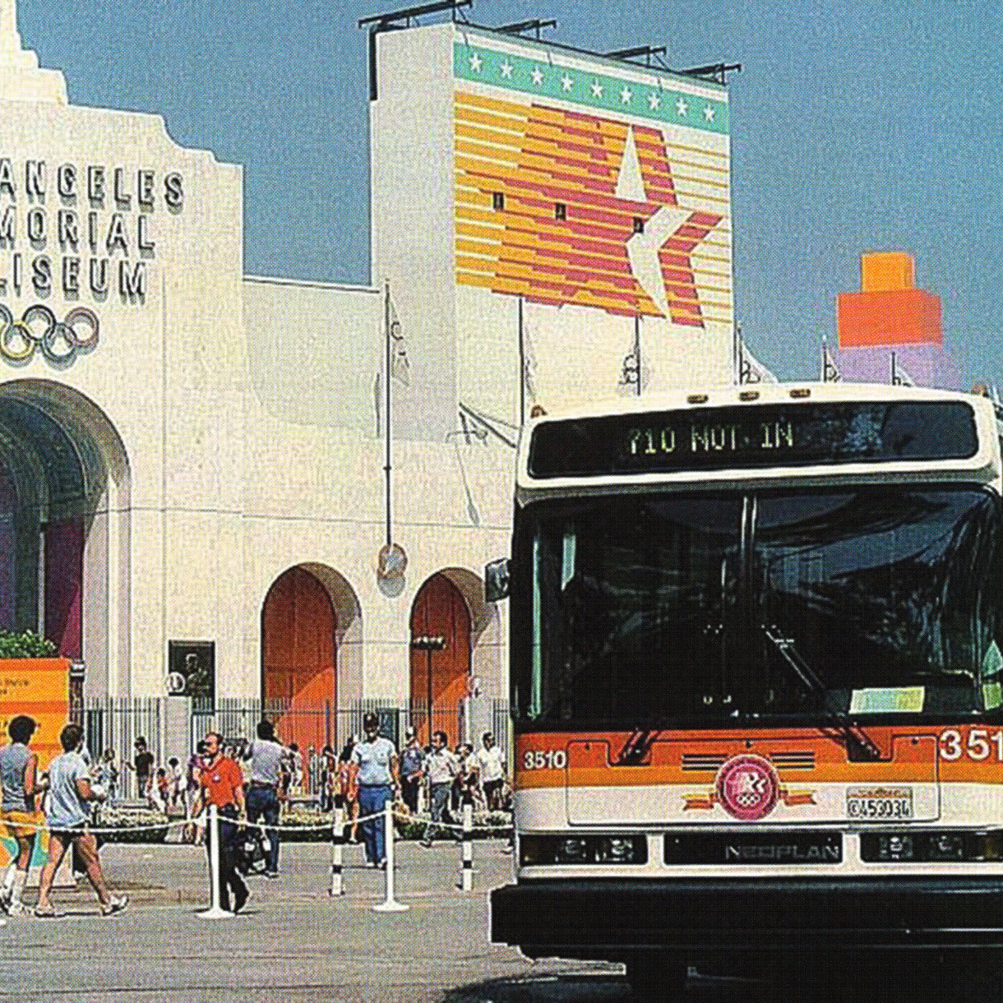
Transit Accessibility Analysis
LA28 Mobility Study
Measuring Transit Accessibility Before & After the 2028 Olympics
"How much and where do Twenty-Eight by '28 projects actually improve access to transit across Los Angeles County?"
GIS Kernel Density Analysis | Dec 07, 2025 Vashishth Doshi (vbd@andrew.cmu.edu)
Source: LA Metro

Slide 2
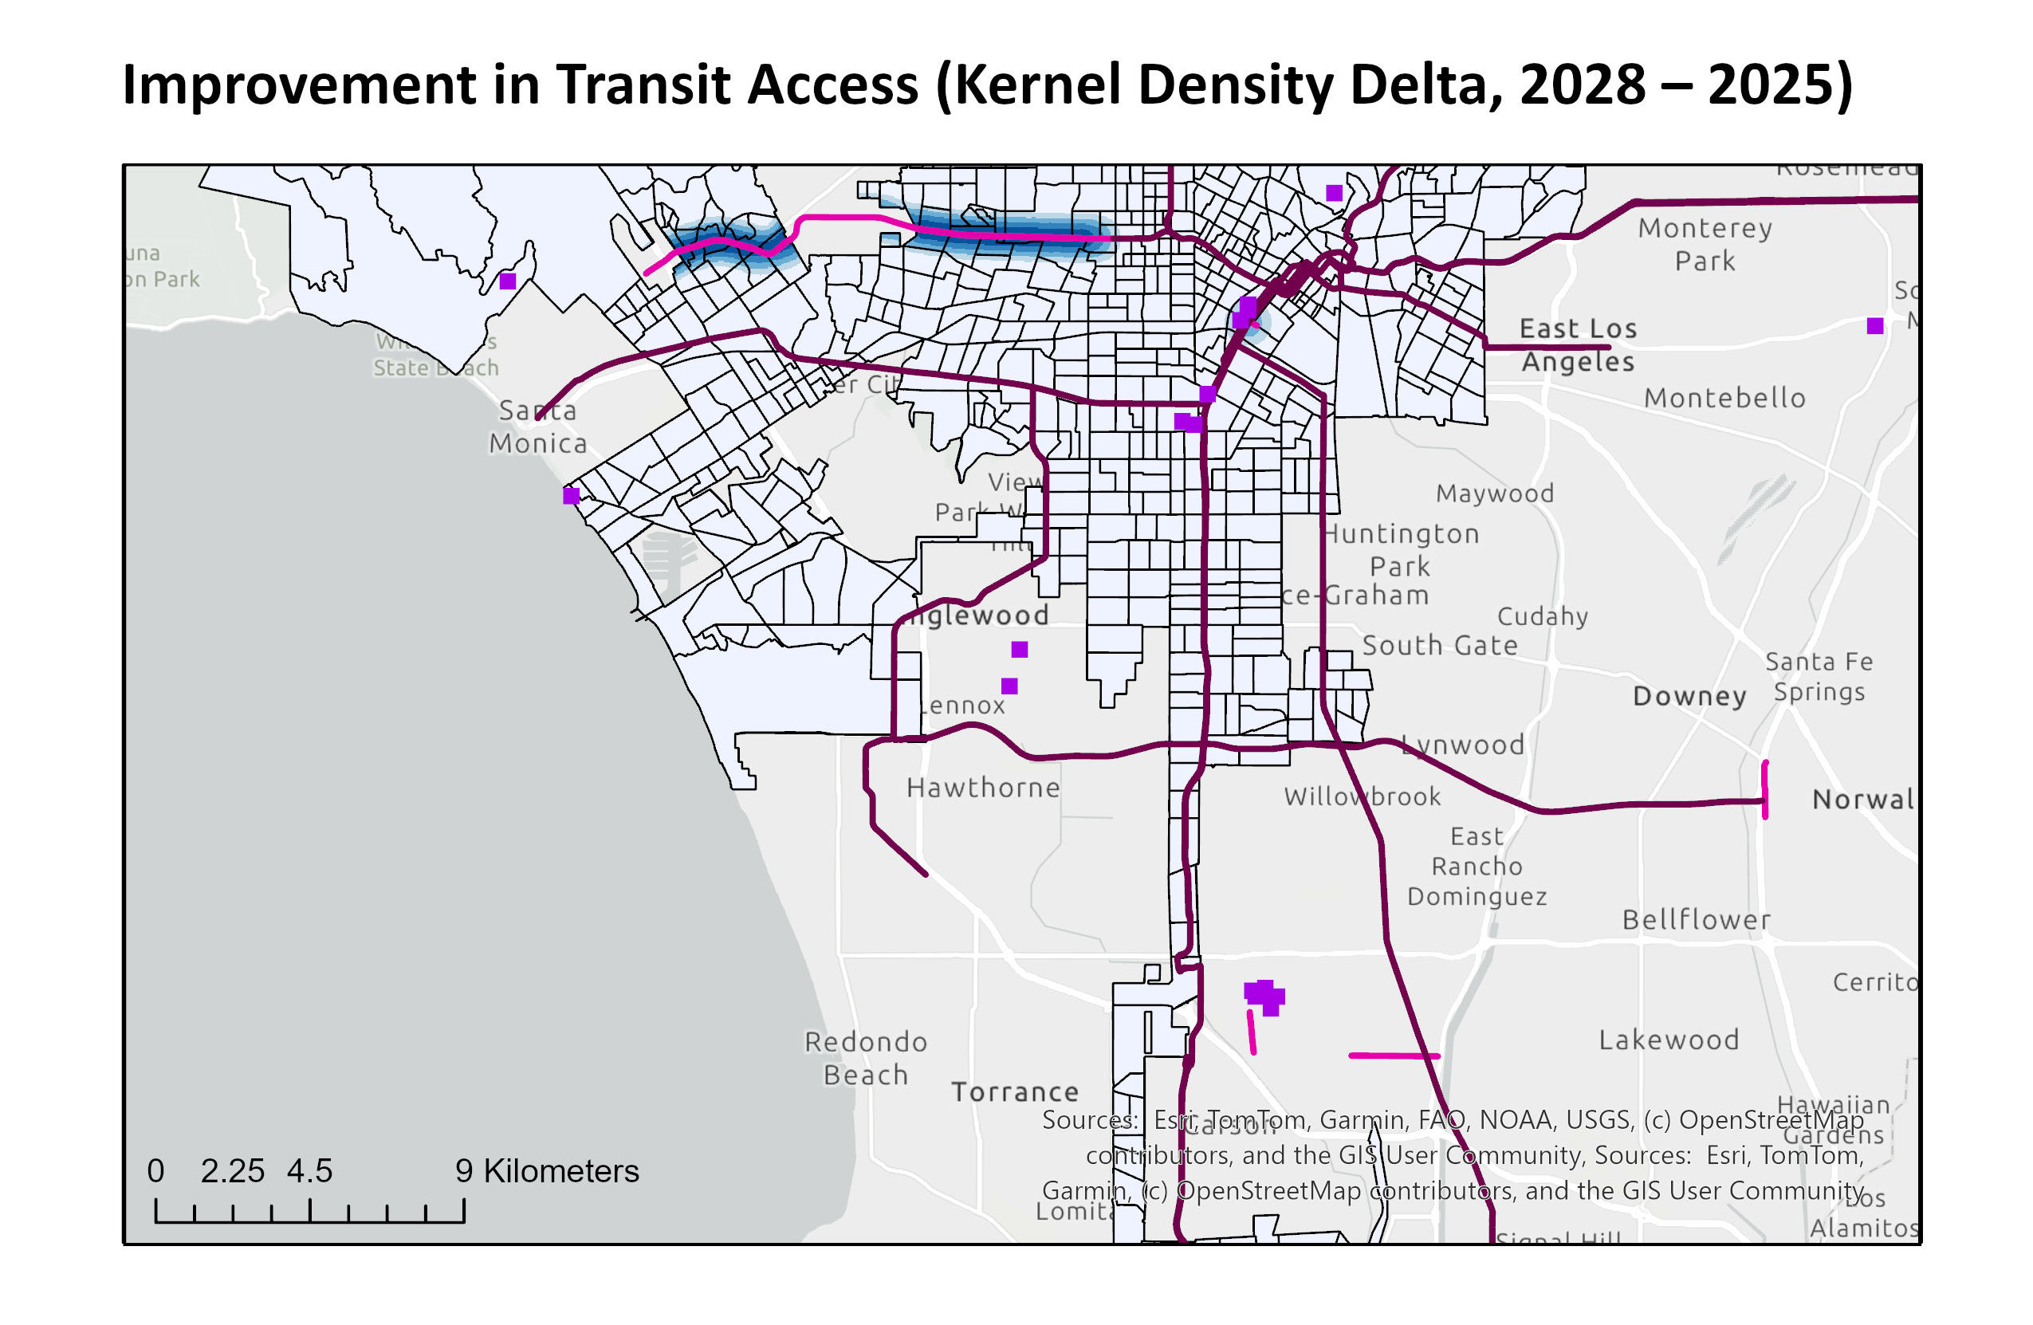
Methods: Kernel Density Analysis
Comparing transit accessibility surfaces: 2025 baseline vs 2028
STEP 1
Map Symbology
Build Scenario Layers
KD Surfaces
Network Lines
Venues
2025 baseline + 2028 improvements (rail, BRT, last-mile)
High Improvement
2025 Metro
Olympic Sites
No Improvement
2028 Projects
STEP 2
Run Kernel Density
800m search radius (~10-15 min walk to transit)
STEP 3
Compute Delta Raster
KD_2028 − KD_2025 = change in accessibility
STEP 4
Zonal Statistics by Tract
Classify tracts: None → Low → Medium → High improvement
Data: LA GeoHub, LA Metro | Analysis: ArcGIS Pro

Slide 3
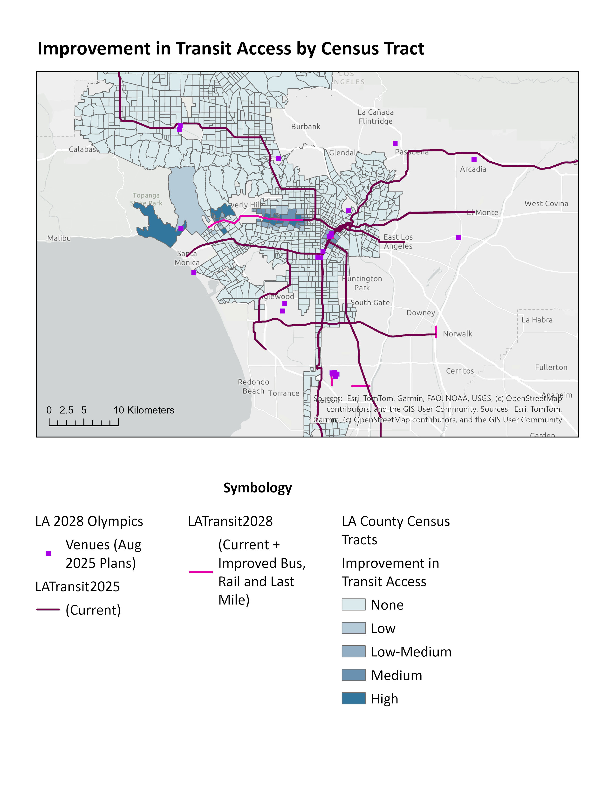
Key Findings –
Strongest gains near new rail corridors – 32% of improved tracts see medium to high imporvements
Improved access for tracts in otherwise underserved areas – new lines is bringing Metro’s network closer to newer neighborhoods
Olympic venues are still away from LA Metro’s network and will need other impetus for mobility ease and efficient access
There is still a lot more to do for LA as a region – only 0.05% of the tracts are seeing access gains via these projects.
Data: LA GeoHub, LA Metro | Author Analysis: ArcGIS Pro, MS Excel

Slide 4


Limitations & Conclusion
LIMITATIONS
CONCLUSION
Proximity, not performance
GIS-based Kernel Density analysis transforms complex transit plans into an intuitive before-and-after accessibility story:
KD measures distance to transit — not frequency, speed, or reliability. "High improvement" tracts may still have infrequent service.
Dark-blue KD surfaces → where transit access sees strongest improvement.
Dark-blue census tracts → who benefits most from new lines
Purple venues + pink/magenta lines → direct LA28 spatial reference
Tracts, not people
Tract-based metrics, not population-weighted. A tract of 50K residents = same as 5K. Future work should weight by population.
Scenario uncertainty
2028 network based on current plans. Real-world delays, budget constraints, or scope changes could shift outcomes.
As LA approaches the Games, analyses like this help ensure Olympic-driven projects deliver on their promise of a lasting, equitable mobility legacy — not a one-time spectacle.

