Slide 1
P14
AgriConnect
Cloud-Based Local Produce Marketplace
Connecting farmers and consumers directly — with demand forecasting, perishability-aware pricing, sustainability scoring, and quality-risk detection built on real data.
VIT–Azure Internship (AZ-900) · Vashita Pandey · 2026

Slide 2
PROJECT OVERVIEW
The Problem: Farmers and Consumers Are Disconnected
Local produce sits between two disconnected worlds
farmers with fresh stock and no direct channel, consumers wanting local/sustainable food with no easy way to find it.
Farmers can't reach beyond local footfall
Produce is perishable — static pricing loses money daily
No visibility into true environmental/sustainability impact
No early warning when a farmer's quality is slipping
What we're building
Direct farmer-to-consumer marketplace with real inventory & pricing
Demand forecasting so farmers plant/list ahead of demand
Perishability-aware dynamic pricing
Real food-miles / carbon footprint scoring per order
NLP quality-risk detection + subscription retention modeling
2

Slide 3
SCOPE
Objectives — Brief + Research-Grade Extensions
1
2
3
Marketplace Core
Demand Forecasting
Dynamic Pricing
Listings, inventory, browse/search, orders (brief requirement)
Per-crop 14-day forecast from real price time series
Perishability-aware markdown optimization
4
5
6
Farmer-Consumer Matching
Sustainability Scoring
Quality-Risk & Churn
Distance + freshness + price-fit recommender
Real food-miles / CO2e per order
NLP review sentiment + subscription retention modeling
3

Slide 4
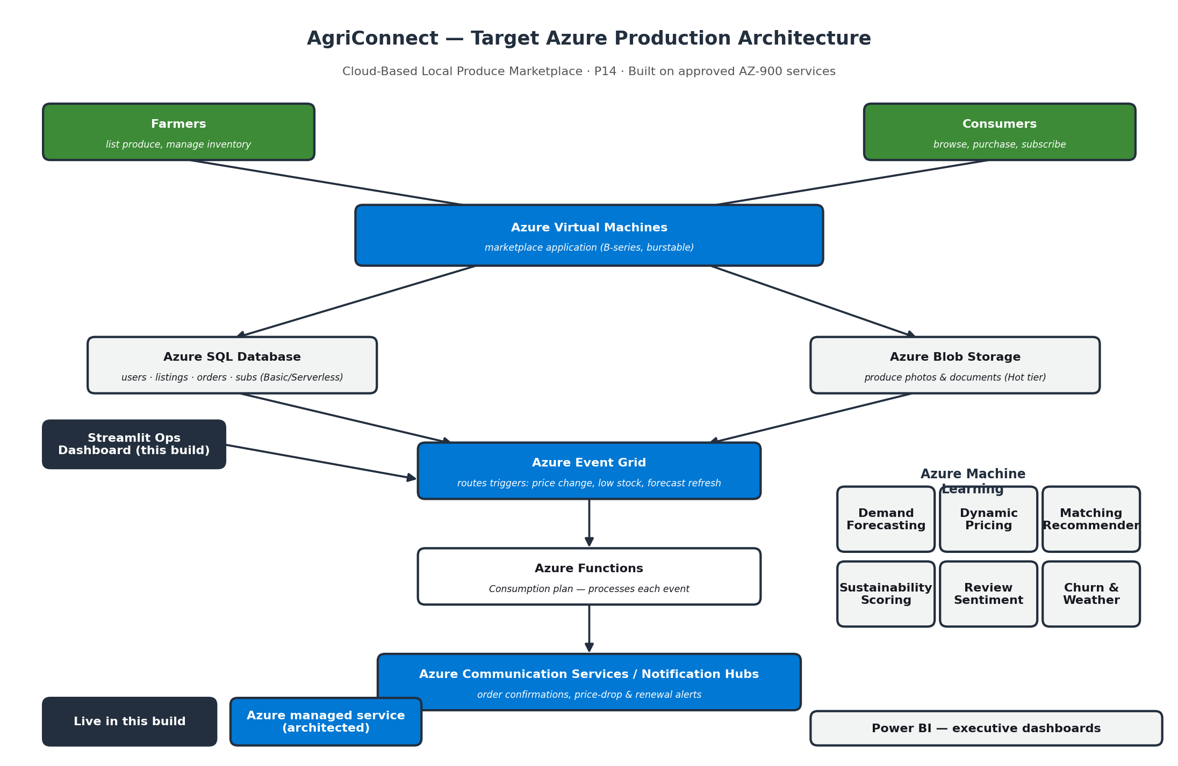
SYSTEM DESIGN
Target Azure Production Architecture
4

Slide 5
SYSTEM DESIGN
Approved Azure Services Used
Brief Requirement | Azure Service | Configuration (per program guidance)
App hosting | Azure Virtual Machines (#1) | B-series burstable, pay-as-you-go, deallocate when idle
User & product data | Azure SQL Database (#9) | Basic / Serverless tier to minimize cost
Image/document storage | Azure Blob Storage (#8) | Hot tier — real azure-storage-blob integration
Event routing | Azure Event Grid (#22) | Basic tier, event-driven triggers
Notifications & inventory automation | Azure Functions (#11) | Consumption plan, pay-per-execution
Farmer-consumer communication | Communication Services (#20) / Notification Hubs (#19) | Free tier for push; note trial sending limits
ML engines | Azure Machine Learning (#26) | Small compute instance, stop when idle
Executive dashboards | Power BI (#27) | Power BI Desktop / free trial account
All services drawn directly from the program's approved Azure services list (AZ-900 aligned) — every objective and service role from the original brief is preserved.
5

Slide 6
DATA
Data Sources — What's Real, What's Simulated
Data | Source | Used For
Vegetable prices (287 days x 10 crops, 2023) | GitHub-mirrored Kaggle dataset | Demand forecasting, pricing baseline
Reviews (23,486 real ratings + text) | GitHub-mirrored "Women's Clothing E-Commerce Reviews" — proxy dataset | Sentiment/quality-risk NLP model validation
Daily temperature (3,650 real days, Melbourne) | GitHub-mirrored historical climate station data | Weather-driven harvest advisory
Farmers, consumers, listings, orders | Synthesized, grounded in real price/seasonality structure | Marketplace simulation & every downstream engine
No public dataset ties real farms to real consumers. What's real is the underlying price, review, and climate structure — every synthesized entity is anchored to it, not arbitrary.
6

Slide 7
FOUNDATION
Marketplace Universe
150
800
11,640
6,000
144
Farmers
Consumers
Listings
Orders
Subscriptions
Total GMV: $492,336 · Avg. delivery distance: 9.5 km · Organic-certified farmers: 28%
7

Slide 8
ENGINE 1
Demand Forecasting & Price Elasticity
Price: OLS trend + day-of-week seasonality on the REAL 287-day price series. Elasticity: log-log regression on real transaction data — negative values confirm normal-good behavior (price up, demand down).
Crop | Current Price | 14d Forecast | Elasticity
Tomato | $16.45 | $15.98 | -1.064
Potato | $19.46 | $21.07 | -1.014
Brinjal | $24.94 | $37.77 | -0.923
Bhindi | $25.52 | $29.08 | -0.882
Onion | $14.77 | $37.02 | -0.741
Peas | $31.25 | $92.90 | -0.691
Methi | $9.69 | $25.58 | -0.604
Reading the elasticities
Tomato (-1.06) is most elastic — small price moves swing demand sharply, so it's the best candidate for markdown-driven volume.
Methi (-0.60) is least elastic here — demand holds up better under price increases.
8

Slide 9
ENGINE 2
Perishability-Aware Dynamic Pricing
Markdown = base_decay(inventory age ÷ shelf life)³ × demand adjustment. Evaluated on live inventory only (last 10 days of listings), not the full historical log.
353
19.5%
$961K
Live listings priced
Avg. markdown
Revenue at risk if unsold
Why a convex (cubed) markdown curve?
Negligible discount in the first half of shelf life, then a steep ramp near expiry — the same shape used in retail "reduced to clear" markdown practice. Demand-forecast signal from Engine 1 scales the markdown up when forecasted demand is weak, down (or to a small premium) when it's strong, so pricing responds to both freshness AND market conditions, not freshness alone.
9

Slide 10
ENGINE 3
Farmer–Consumer Matching
Weighted score: 30% freshness + 30% price-fit (vs. that crop's real market price) + 30% distance + 10% organic-match bonus for sustainability-conscious consumers.
CONS-0061
Top match: Onion (score 0.871, 19.3km, 97% fresh, $7.57)
CONS-0799
Top match: Elephant Yam (score 0.871, 28.6km, 89% fresh, $23.68)
CONS-0747
Top match: Onion (score 0.891, 16.8km, 100% fresh, $7.45)
10

Slide 11
ENGINE 4
Sustainability & Food-Miles Impact
98.9%
average emissions reduction per order vs. conventional supply chain
Methodology (stated, not hidden):
0.12 kg CO2e/tonne-km emission factor (published mid-range estimate)
800 km conventional baseline distance (conservative)
8 kg CO2e/tonne cold-storage overhead avoided
11

Slide 12
ENGINE 5
Review Sentiment & Quality-Risk (NLP)
90.9%
0.960
28 / 106
Accuracy (real data)
ROC-AUC (real data)
Farmers flagged quality-risk
Two-stage, honestly-scoped pipeline
1. Validate:
TF-IDF + Logistic Regression trained on 23,486 REAL ratings+text reviews (train/test 15,854/3,964) — 90.9% accuracy, 0.960 ROC-AUC.
2. Apply:
The validated model scores synthetic marketplace reviews (text templates weighted by each farmer's real organic/experience quality signal), flagging farmers whose average predicted sentiment falls below 0.4 with 3+ reviews.
12

Slide 13
ENGINE 6
Subscription Retention Modeling
N=144 subscriptions — too small for a single train/test split to give a stable estimate, so we used 5-fold cross-validated logistic regression instead of an overfit gradient-boosted model (which scored WORSE than random on the first attempt — reported honestly, not hidden).
0.576
0.577
90 / 144
CV Accuracy
CV ROC-AUC
Currently active
13

Slide 14
ENGINES 7 & 8
Weather Advisory & A/B Testing
Weather-Driven Harvest Advisory
A/B Test: Organic vs. Non-Organic
Real 10-year daily temperature series x standard crop temperature ranges.
Peas: 91.6% suitability in December
Garlic: 90.4% suitability in February
Onion: 84.0% suitability in February
Bhindi: <2% year-round (needs 24-35°C — genuinely a poor climate match, reported honestly)
Non-organic conversion: 31.4%
Organic conversion: 22.9% (-27.3% lift)
p < 0.001, Bayesian P(organic wins) = 0.00
Real, slightly counterintuitive finding: the 12% organic price premium outweighs quality preference for this consumer base — price sensitivity dominates. Framework is fully reusable for any future test.
14

Slide 15
DELIVERY
Streamlit Operations Dashboard
12 tabs unifying every engine into one live, explorable platform:
Overview & KPIs
Farmers & Listings
Orders & GMV
Demand Forecast
Dynamic Pricing
Matching
Sustainability
Reviews & Quality
Subscriptions
Weather Advisory
A/B Testing
Architecture
15

Slide 16
Thank You
Repository, engines, and dashboard available for live demo.
AgriConnect · P14 · VIT–Azure Internship (AZ-900)
16

