Slide 1
VSOWiki comparison with VSTS
This documented focuses on differences between
mediawiki powered VSOWiki and
markdown powered VSTS Wiki

Slide 2
Context
VSO Wiki uses mediawiki VSTS Wiki uses MarkdownIT

Slide 3
Terminology
In this deck, each feature in mediawiki has a description card
It talks about
Feature: <Description of the feature>
Priority: <P1 = Addressed during migration ; P2 = can be implemented after migrating to VSTS Wiki>
Workaround: If the feature is not shipping to VSTS Wiki as part of the migration then how do we light up this feature in VSTS Wiki
Feature: Sectional edits of the page
Priority: P2
Workaround: Full page edits

Slide 4
Scope
2800+ pages
~3000 images
~1000 uncategorized pages
~1k orphan pages (almost same as uncategorized ones)

Slide 5
Edit & View experiences

Slide 6
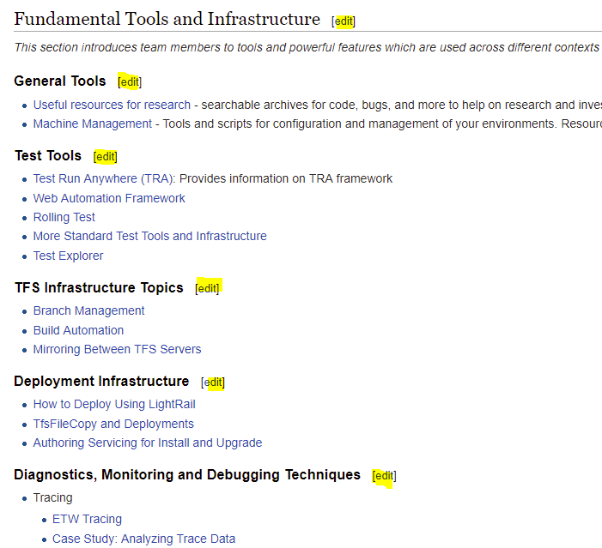
Section wise edit
Feature: Sectional edits of the page
Priority: P2
Workaround: Full page edits

Slide 7
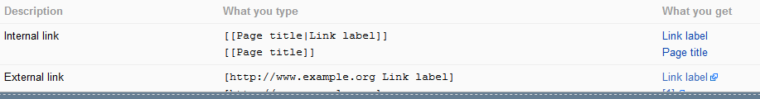
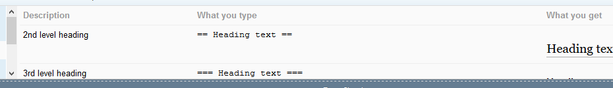
Mediawiki Format
Feature: Mediawiki format is different from markdown
Priority: P2
Workaround: Users need to be educated on markdown format
Links
Headings

Slide 8
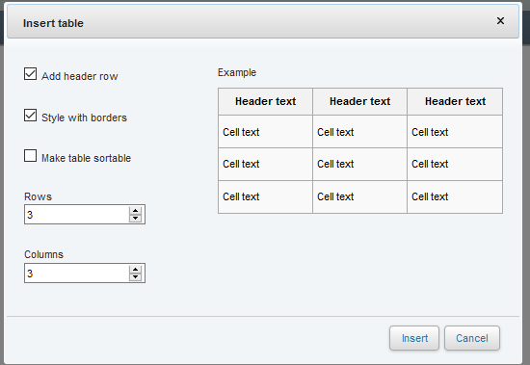
Insert a table
Feature: Insert a table skeleton using a mediawiki dialog
Priority: P2
Workaround: Users can use markdown format to create tables

Slide 9
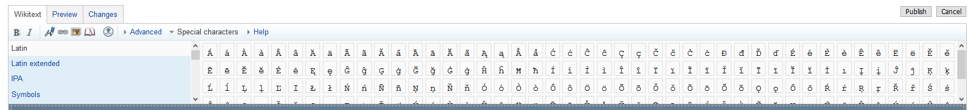
Special characters
Feature: Support for latin characters and symbols. Usage of such symbols is low
Priority: P2
Workaround: None
Some of the special characters in media wiki work in VSTS Wiki
https://mseng.visualstudio.com/VSOnline/_wiki?pagePath=%2FVS.In-Social-Documents%2FWiki-edit-capabilities-(Markdown)%2FMediawiki-equivalent

Slide 10


Text highlighting using HTML tags
Feature: Text highlighting using HTML Tags. Usage is low
Priority: P2
Workaround: None
Works in mediawiki
https://vsowiki.com/index.php?title=Sancha
Not in VSTS Wiki
https://mseng.visualstudio.com/VSOnline/_wiki?pagePath=%2FVS.In-Social-Documents%2FHTML-Support-in-VSTS-Wiki

Slide 11

Templates - headers
Feature: Header templates that display page owners, sponsors, business impact. Feature usage is high but impact is low
Priority: P2
Workaround: Can potentially use HTML metro boxes to show this information. Not sure of the value that these bring to the page viewers.
Business impact
Business owner
{{Template:Playbook Header|Owners=[mailto:pantal pantal] |WGSponsor=[mailto:vscsplaybook vscsplaybook]|DocumentQuality=InProgress|}}
{{Template:Special_Aspect_Table}}
Notes:
Use case: Classification of the document; Moderate business impact etc. Check with Grant Holliday & Buck Hodges

Slide 12
Template - box
Feature: Box templates that display page important information for the user. Usage is high but this is not a migration blocker
Priority: P2
Workaround: Can potentially use HTML metro boxes to show this information. Needs investigation whether we should invest in a similar feature upfront.
{{Template:CriticalBox|Title=LIVE SITE ISSUE?|Message=If you are seeing an issue with any part of Visual Studio Online, then contact [[VSOLS]] and they will follow the process to get the issue looked at.}}
{{Template:InfoBox|Title=DRI GETTING STARTED|Message=[[DRI Getting Started]]}}
Notes:
Use case: warnings and information;
HTML Boxes are good!!

Slide 13
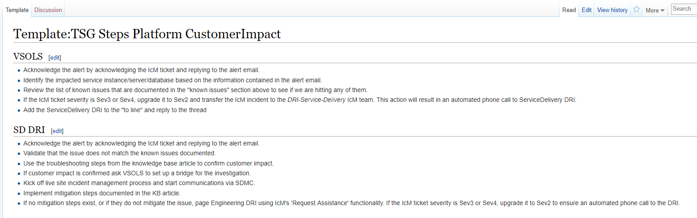
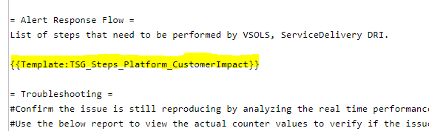
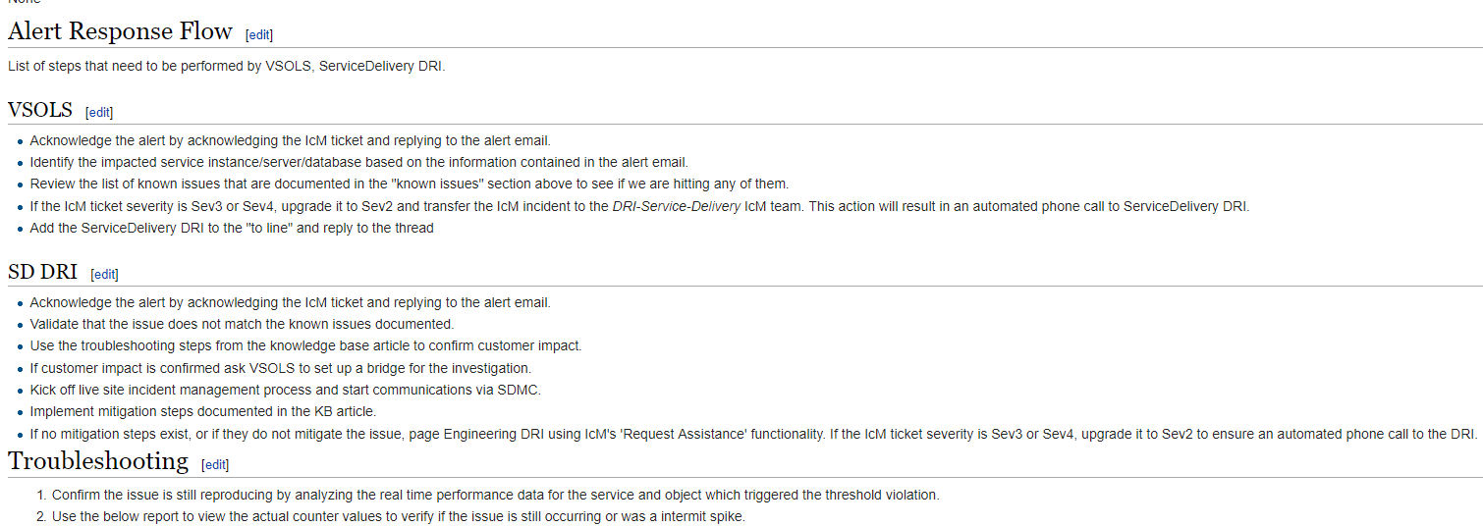
Templates – page content
Feature: Page templates that display entire content of the page as-is in another page. Usage is low.
Priority: P1
Workaround: We will have to support templates in VSTS Wiki to light up this scenario else the migration cost is high and subsequently the maintenance cost is high as well
This template is referenced in several documents:
https://vsowiki.com/index.php?title=Template:TSG_Steps_Platform_CustomerImpact
E.g. in this page when we refer the template,
The content of the template gets embedded in the page as-is.
Notes:
Tom Moore – important requirement

Slide 14
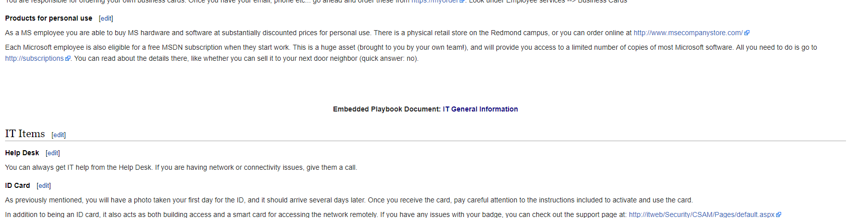
Templates - embedded content
Feature: Embedded content templates that display page content of the page as-is along with a reference of the embedded page. Usage is low. Similar to page content templates. (Transclusions)
Priority: P2
Workaround: Copy paste content of the page in other pages but that is a sub-optimal solution since that would add to the migration effort and maintaining content on VSTS Wiki after the migration
2
Embed one documentation in another - example
Notes:
Currently not sure of the use case

Slide 15
Additional information on templates
Usage of templates shows low usage of embedded pages and high usage of headers, info bars, and page content template

Slide 16
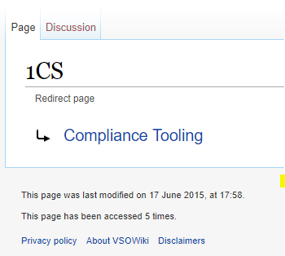
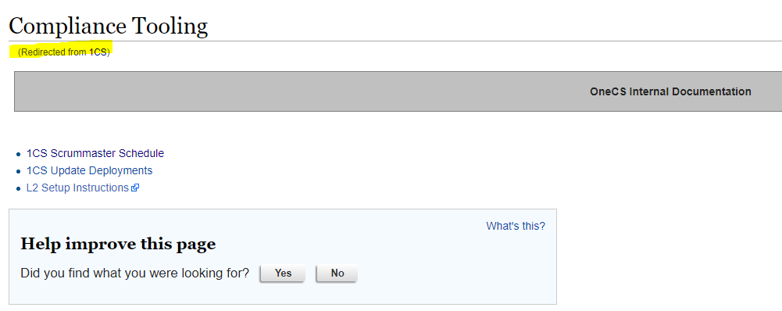
Page redirects / alias
Feature: Add an alias for page redirects. Low usage.
Priority: P1
Workaround: During migration all #REDIRECTION will be converted to page links so that there are no broken links
https://vsowiki.com/index.php?title=Using_CloneInstance_to_generate_a_subset_of_a_repository &
https://vsowiki.com/index.php?title=a point to the same page
Notes:
Usage: Not all VSOWiki users have delete rights therefore people wanted to rename instead of DELETE.
Reach out to authors to validate whether this needs clean up.

Slide 17
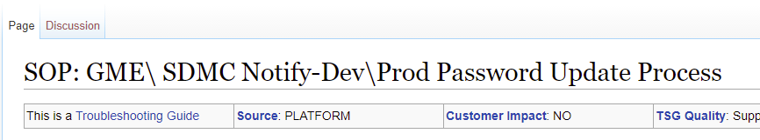
Page names
Feature: Some pages contain “:”, “\” , “:”
Priority: P1
Workaround: We will support ASCII characters of special characters that VSTSWiki does not support yet
Notes:
This may cause page breaks!! VSTS Wiki is coming up with a first class experience to manage page breaks.
Vashita can check the impact!!

Slide 18
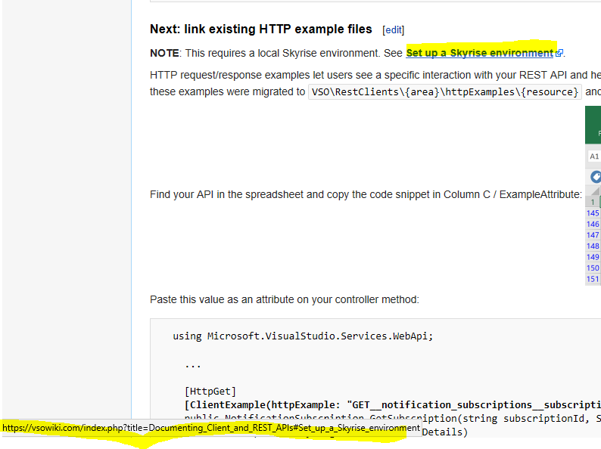
Links and deep links
Feature: Links and deep links that are referenced as absolute links in VSOWiki
Priority: P1
Workaround: During migration we will move all absolute and relative mediawiki links to relative links in VSTSWiki

Slide 19
External links
Feature: There could be sharepoint wikis or other documentation that references vsowiki pages
Priority: P1
Workaround:
We will setup an Azure website that redirects vsowiki to VSTSWiki
VSOwiki will stay read only for 12 months
That will give content owners the opportunity to cleanup the VSOwiki links
There will be a banner on VSOWiki indicating that it is read only and that it will be deprecated in xx months

Slide 20
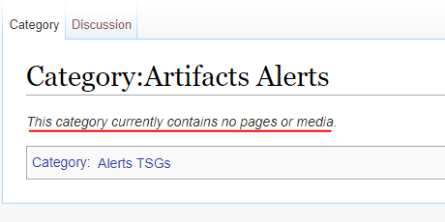
Empty category pages
Feature: Empty category pages
Priority: P1
Workaround: VSTS Wiki will show a page associated with an empty category page. There is no concept of empty pages in VSTS Wiki

Slide 21
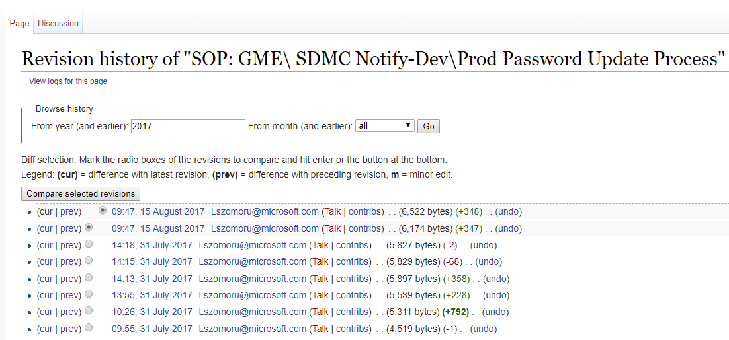
Page history
Feature: Page history
Priority: P1
Workaround: During migration page history will be lost. History will be tracked post migration

Slide 22
Content organization

Slide 23
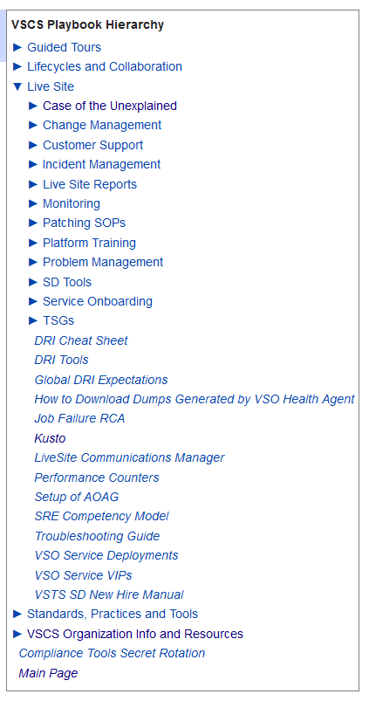
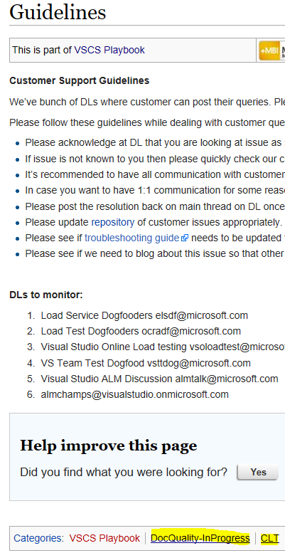
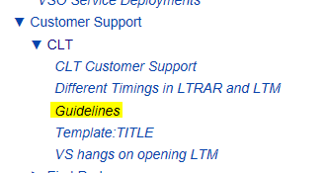
Page hierarchy
Feature: Page hierarchy is created based on page categories. It is a graph as against a linear tree as in VSTS Wiki.
Priority: P1
Workaround: During migration, we need to create a TOC based on the page categories. Uncategorized pages show up in a separate hierarchy called “Uncategorized”
Already
supported

Slide 24
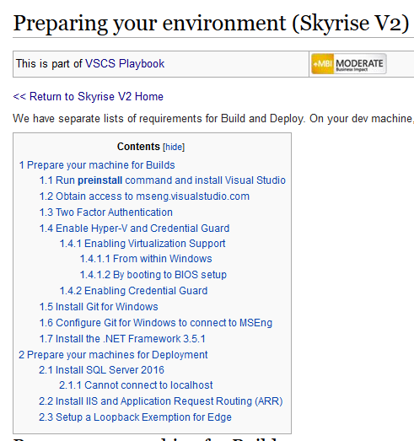
In-built TOC
Feature: In-page TOC is created for each page based on section names
Priority: P2
Workaround: Adding this to our backlog but this is not a migration blocker. Also support the _NOTOC_ tag that will allow to not show the automated table of content
Not on the
backlog

Slide 25
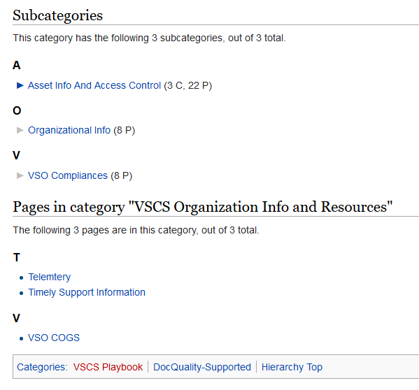
Categories and sub-categories
Feature: Each page gets a category or a sub-category
Priority: P2
Workaround: Categories and subcategories are taken care in the wiki tree view. Adding lightweight Tags is on our backlog but will not come until migration
[[Category:Incident Management]]
[[Category:DRI]]

Slide 26
Collaboration experience

Slide 27
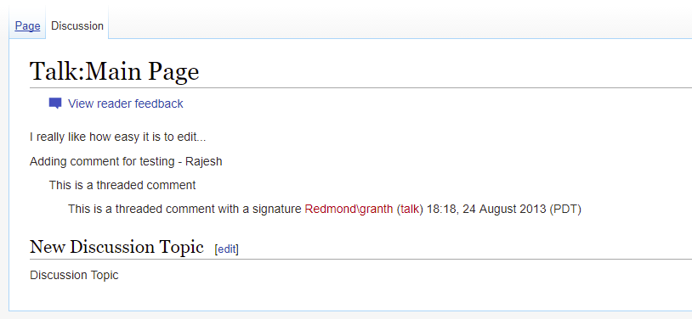
Discussions for each page
Feature: Each page has a discussions page where users can add comments. This has low usage
Priority: P2
Workaround: Adding comments to Wiki page is on our backlog but it wont be implemented until migration.

Slide 28
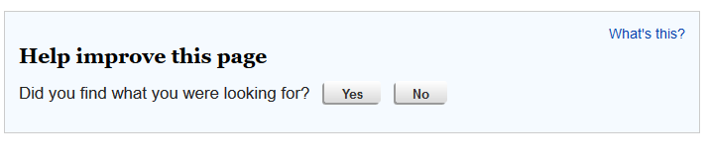
Help to improve this page
Feature: This dialog is integrated with “Discussions”.
Priority: P2
Workaround: Page comments should take care of this requirement. Will not be available until migration.

Slide 29
Management

Slide 30
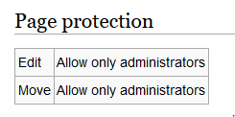
Page level ACLs
Feature: Only VSOWiki home page is restricted for edit by all. Not a requirement
Priority: P2
Workaround: None
Control edit access for each page

Slide 31
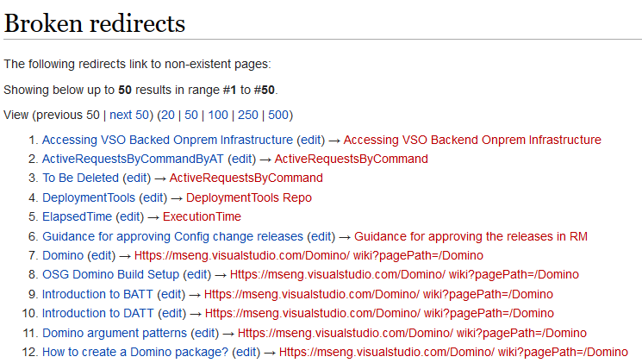
Broken links
Feature: Enumeration of all pages that have a broken link. Low usage.
Priority: P2
Workaround: On our backlog to help fix broken links of a page more proactively
Single page to manage broken links

Slide 32
Discovery

Slide 33
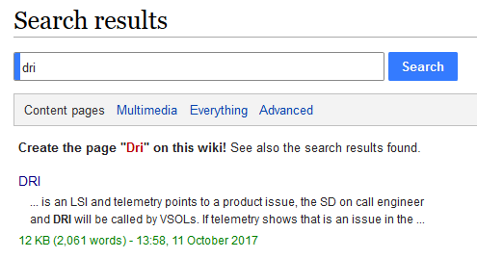
Basic search
Feature: Search pages based on title and content.
Priority: P1
Workaround: Wiki search will be executed before the migration.
Coming up
soon

Slide 34
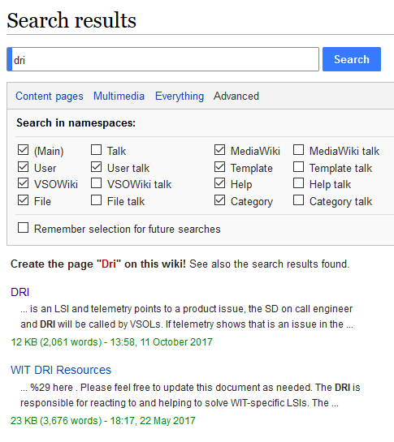
Advanced search capability
Feature: Search for multimedia, users categories, discussions etc. Low usage
Priority: P2
Workaround: None
Search users, files, talks, templates, categories etc.

Slide 35
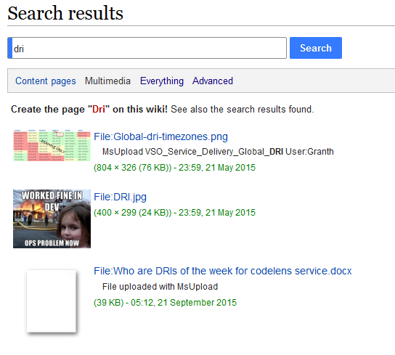
Multimedia
Feature: Search for multimedia. Low usage
Priority: P2
Workaround: None
Media search

Slide 36

Bookmark pages
Feature: Users often bookmark pages.
Priority: P2
Workaround: Adding wiki pages to favorites is on our backlog. Will not be implemented until migration
Add pages to watchlist
Notes:
Would love to see a timeline to that one!! Good to have before the migration.
Favorites and Follow

Slide 37
Analytics
Feature: All analytics is low priority
Priority: P2
Workaround: None

Slide 38
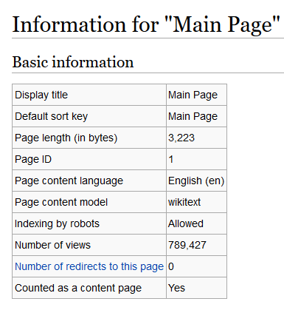
Page level analytics

Slide 39
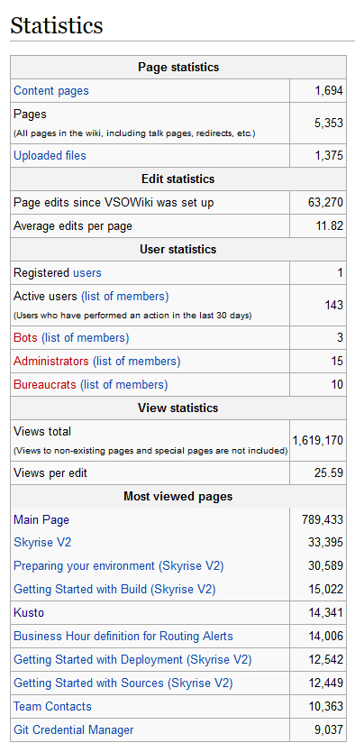
Wiki level stats

Slide 40
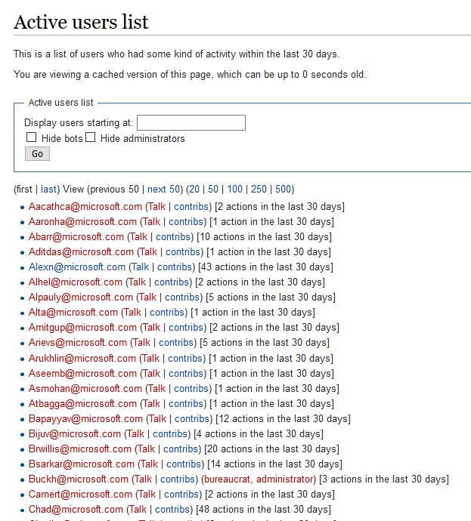
User level stats

Slide 41
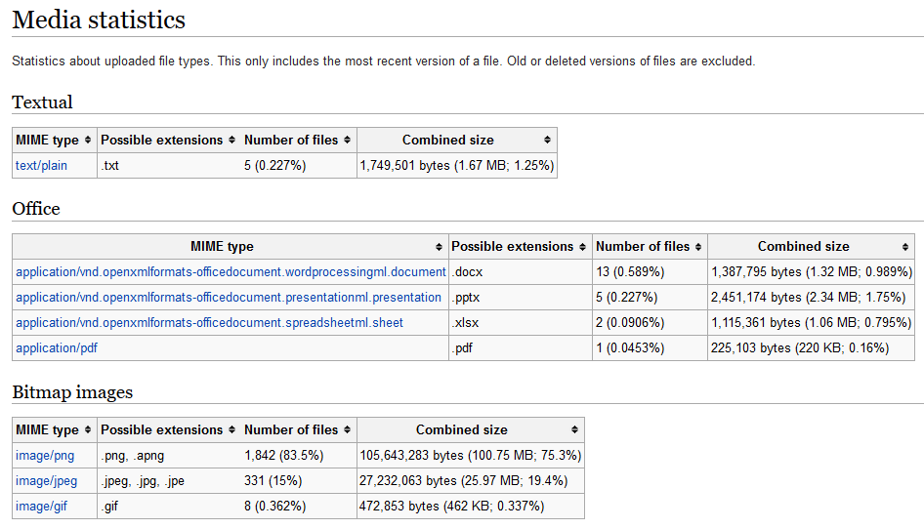
Media stats

Slide 42
What VSTS Wiki offers that Mediawiki does not
Complete list of supported formats by VSTS Wiki –
https://mseng.visualstudio.com/VSOnline/_wiki?pagePath=%2FVS.In-Social-Documents%2FWiki-edit-capabilities-(Markdown)

Slide 43
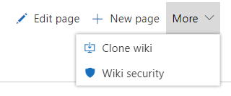
Clone wiki
Feature: DR Strategy
Tool to periodically clone the Wiki repo
Push it on an on-prem environment where the content is accessible and readable just like VSTS Wiki
Tool to ensure the Clone and Push happened successfully based on validation of the timestamp of the last commit or success of the git commands
If needed send notifications to a team who needs to be notified of failures etc.
Clone wiki and update offline.
Consider for DR strategy – Document the strategy

Slide 44
DR strategy for VSOWiki only
Stage 0 outage / regional outage
Import VSTSWiki to an account outside Stage 0.
Tool to ensure periodic sync of content between VSTSWiki and the project
Tool to ensure sync happened successfully
Monitoring
for all scale units
Sync failure
Performance degradation from the synchronization
VSTS / AAD Outage
Tool to periodically clone the Wiki repo – (nearly real time)
Push it on a on-prem environment so that the content is accessible and readable just like VSTS Wiki
Tool to ensure the Clone and Push happened successfully based on validation of the timestamp of the last commit or success of the git commands
If needed send notifications to a team who needs to be notified of failures etc.
In case of AAD outage the markdown files are still available that can be read offline using any markdown renderer such as VSCode

Slide 45
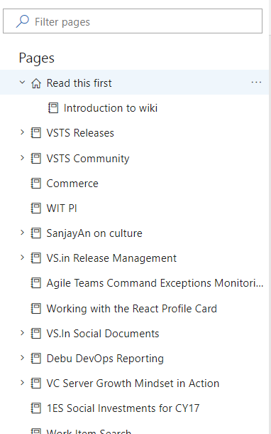
Editable TOC
Feature: Allows to move pages in the hierarchy. Is a value add on top of the existing mediawiki static content hierarchy extension.

Slide 46
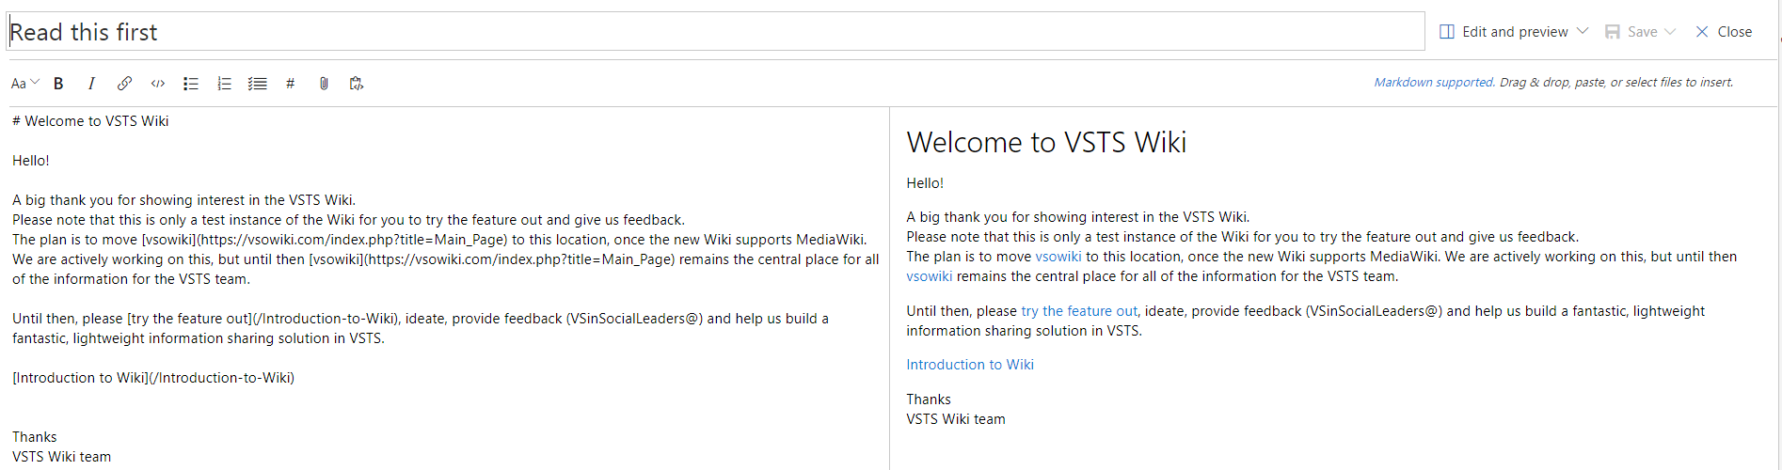
Side by side edit/ preview
Feature: Better editing experience that allows in-line preview

Slide 47
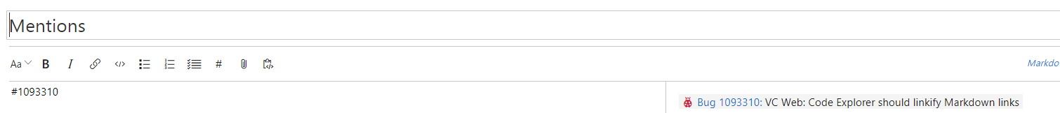
Link work items
Feature: Link work items to wiki pages to write epics, and planning docs,

Slide 48
Other features
Paste using clipboard
Mathematical formulas
Search across accounts
Filter pages based on titles
Offline page updates supporting PRs and other git flows
Click and drag pages to create links
Paste rich content as HTML
Wiki home page to show on the project description page

Slide 49
Asks from content owner

Slide 50
Key asks
Feature priority: Validate the proposal regarding feature priority for mediawiki. Sign off on the features that will not be supported on VSTS Wiki
Content validation: There are ~1700 pages in mediawiki. Out of these 1700, there are several test pages, orphaned pages, unused pages. These need to be cleaned up before the migration.
Category tree: Mediawiki supports a category tree. It is a graph structure where one page can be under multiple categories. VSTS Wiki supports a linear graph therefore we need to transform the category graph into a linear page based tree
DR strategy: Approval on the DR strategy from SD team

Slide 51
Tools
Tool1 – Migration tool that helps migrate all content from mediawiki to VSTSWiki in MD format
Tool2 – DR tool

