Slide 1


ობიექტზე ორიენტირებული პროგრამირება
ლექცია 21

Slide 2
Welcome!
Today:
Final Project
TeamWork
Software Development Processes
Git

Slide 3
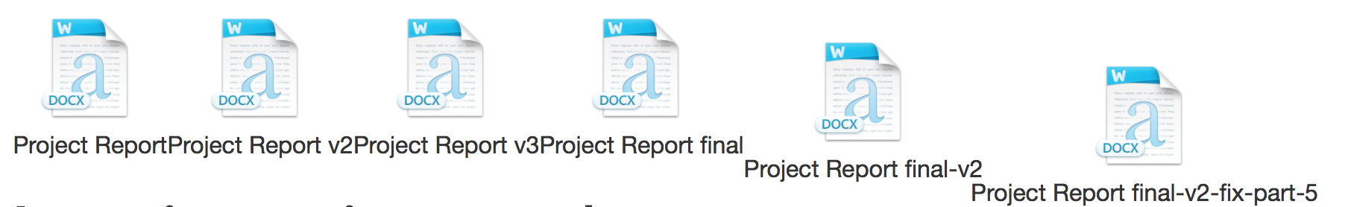
Invention of Version Control

Slide 4
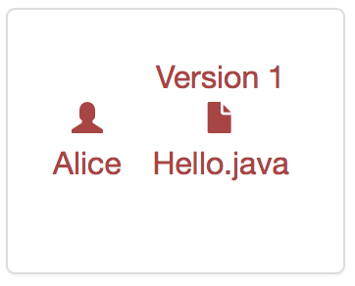
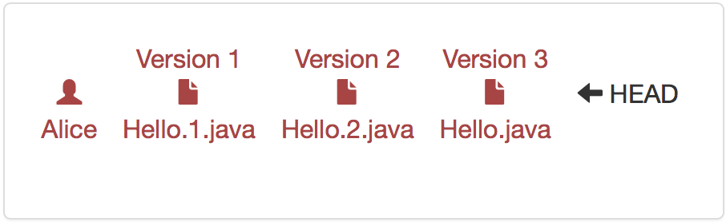
Invention of Version Control

Slide 5
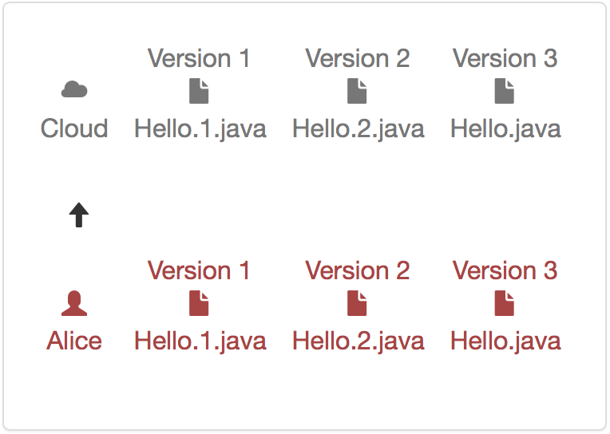
Invention of Version Control

Slide 6
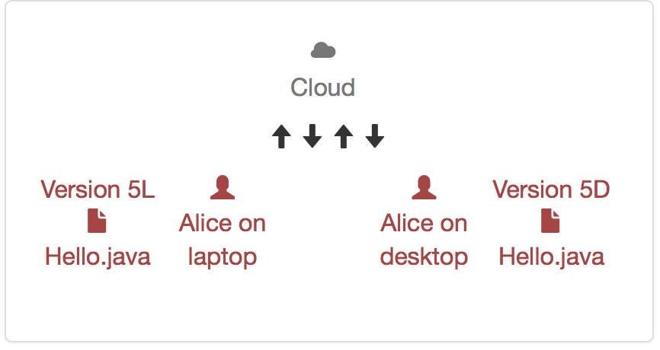
Invention of Version Control

Slide 7
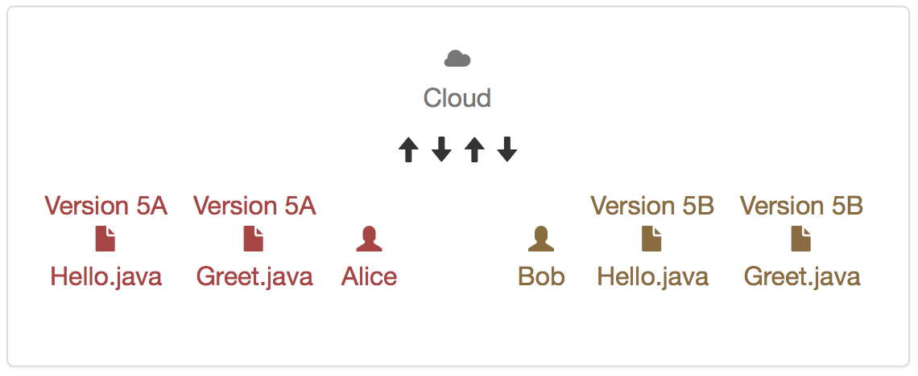
Invention of Version Control

Slide 8
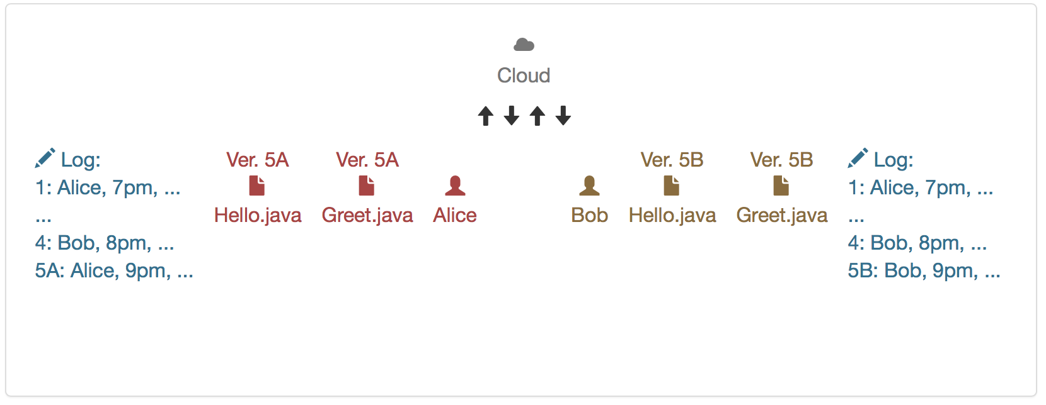
Invention of Version Control

Slide 9
Version Control Terminology
Repository - a local or remote store of the versions in our project
Working copy - a local, editable copy of our project that we can work on
File - a single file in our project
Version or revision - a record of the contents of our project at a point in time
Change or diff - the difference between two versions
Head - the current version

Slide 10
Version Control Features
Reliable - keep versions around for as long as we need them; allow backups
Multiple files - track versions of a project, not single files
Meaningful versions - what were the changes, why where they made?
Revert - restore old versions, in whole or in part
Compare versions
Review history - for the whole project or individual files
Not just for code - prose, images, …

Slide 11
Version Control Features
Merge - combine versions that diverged from a common previous version
Track responsibility - who made that change, who touched that line of code?
Work in parallel - allow one programmer to work on their own for a while (without giving up version control)
Work-in-progress - allow multiple programmers to share unfinished work (without disrupting others, without giving up version control)

Slide 12
Working Together
We use GIT for version control
Each commit should have useful message
Do the code review for every commit
Pair Programming
When multiple people contribute to a commit mention the in the message
Pull before you start working, commit and push frequently
Never break the build!

Slide 13
Code Review
Bugs or potential bugs.
Repetitive code (Don’t Repeat Yourself).
Disagreement between code and specification.
Off-by-one errors.
Global variables, and other too-large variable scopes.
Optimistic, undefensive programming.
Magic numbers.

Slide 14
Code Review
Unclear, messy code.
Bad variable or method names.
Inconsistent indentation.
Convoluted control flow (if and while statements) that could be simplified.
Packing too much into one line of code, or too much into one method.
Failing to comment obscure code.
Having too many trivial comments that are simply redundant with the code.
Variables used for more than one purpose.

Slide 15
Code Review
Misusing essential design concepts.
Incomplete or incorrect specification for a method or class.
Representation exposure for a data abstraction.
Immutable datatypes that expose themselves to change.
Invariants that aren’t really invariant, or aren’t even stated.
Failure to implement the Object contract correctly (equals and hashCode).

Slide 16
Dividing The Work
Every team member must make a contribution to every major component
Contributions:
Writing specifications
Writing tests
Writing implementation code
Fixing bugs
Giving code review
You may not assign one member solely responsible for Data Base or writing tests

Slide 17
Tasks
Team Contract
Understand the problem
Design
Test and implement
Reflection

Slide 18
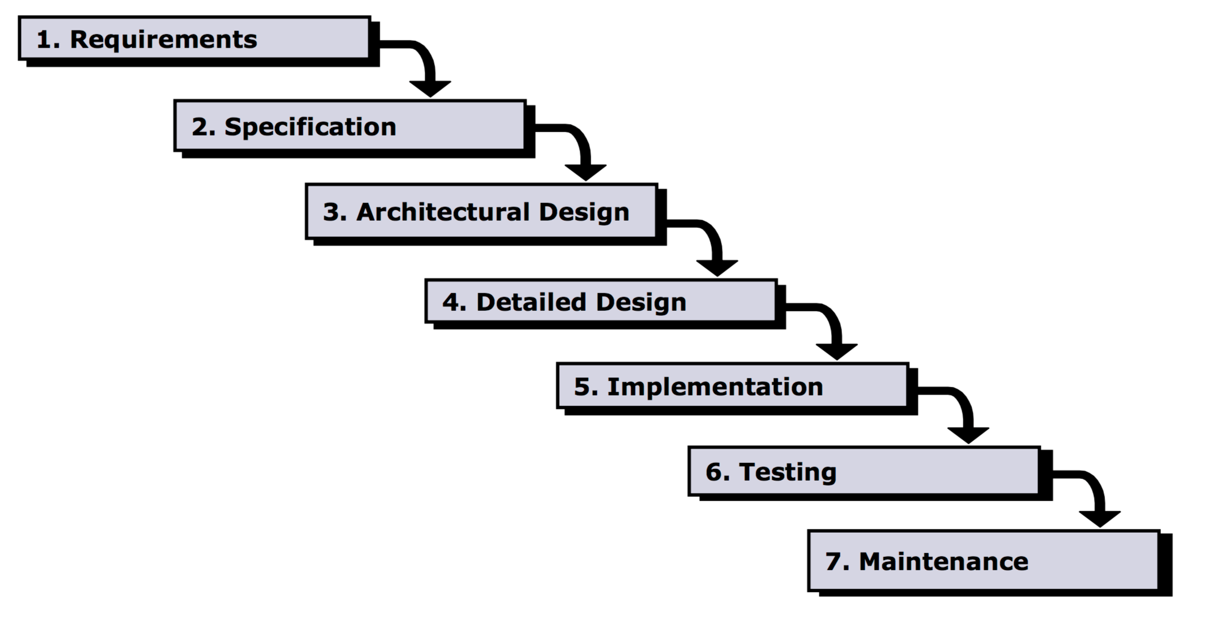
Software Design Processes

Slide 19
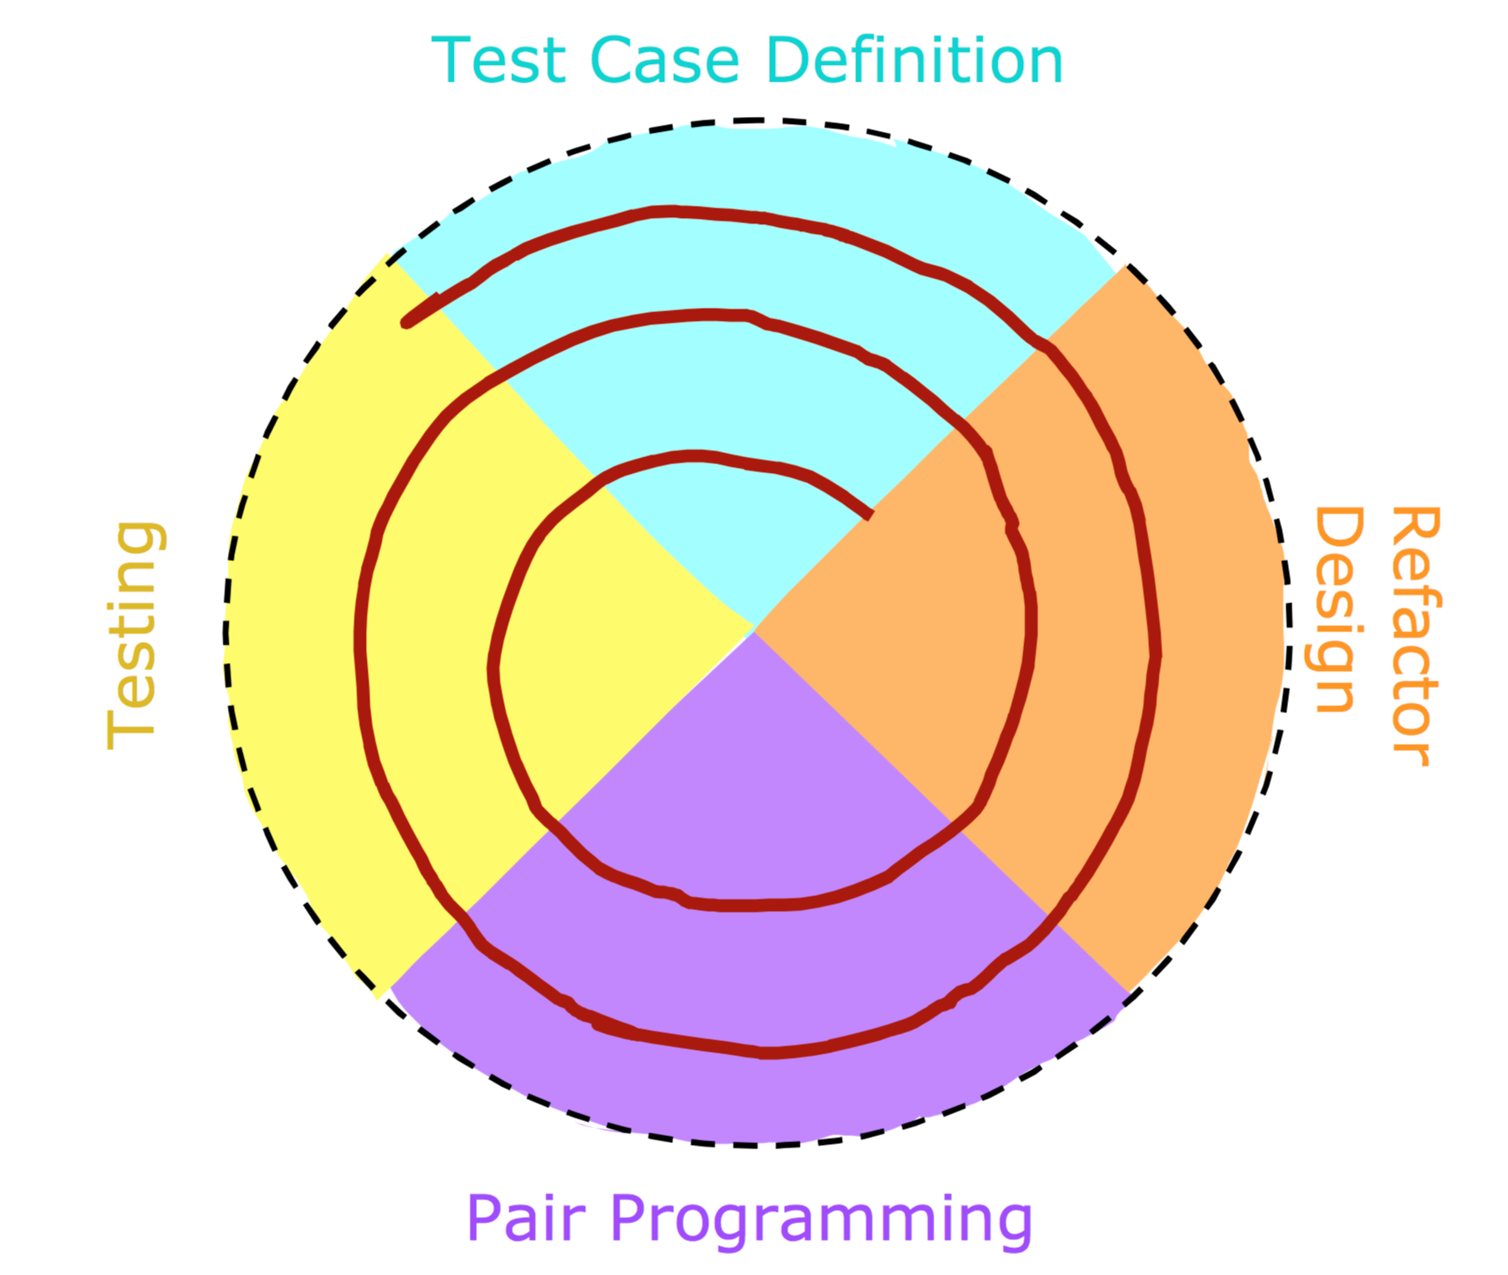
Software Design Processes

Slide 20
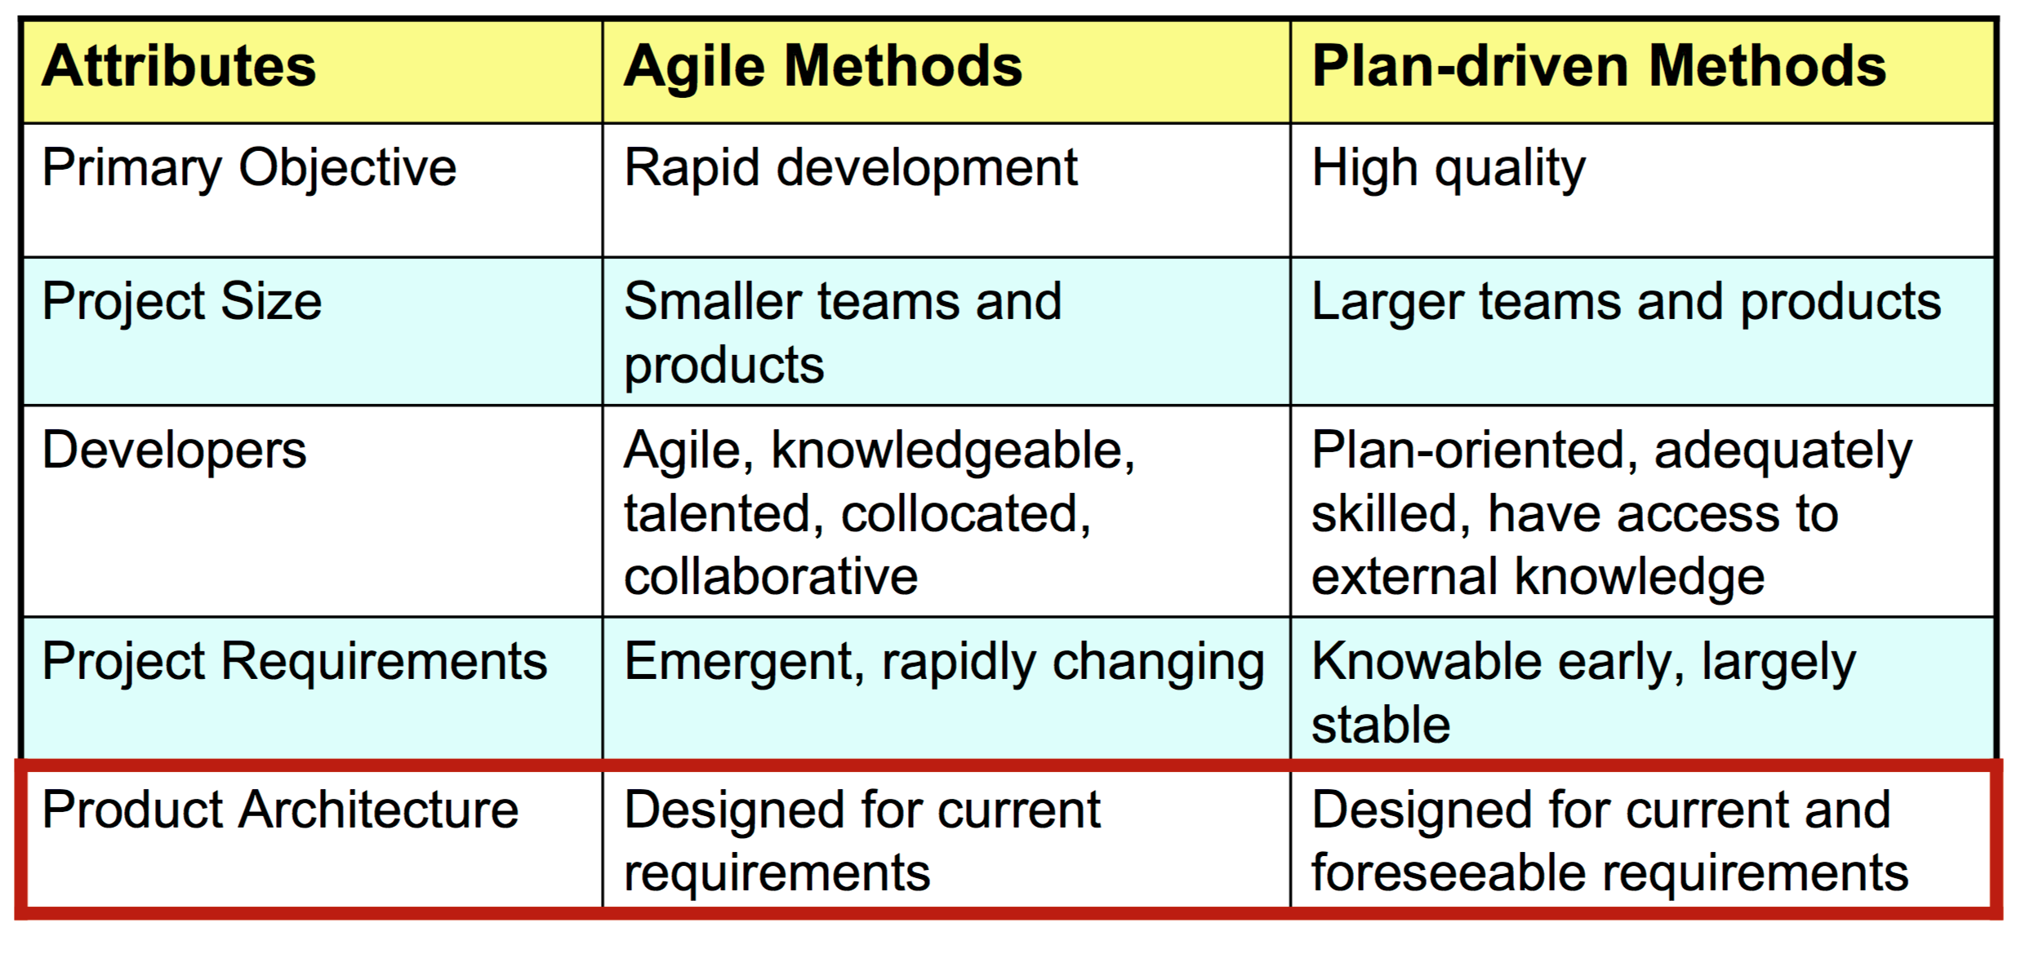
Software Design Processes

Slide 21
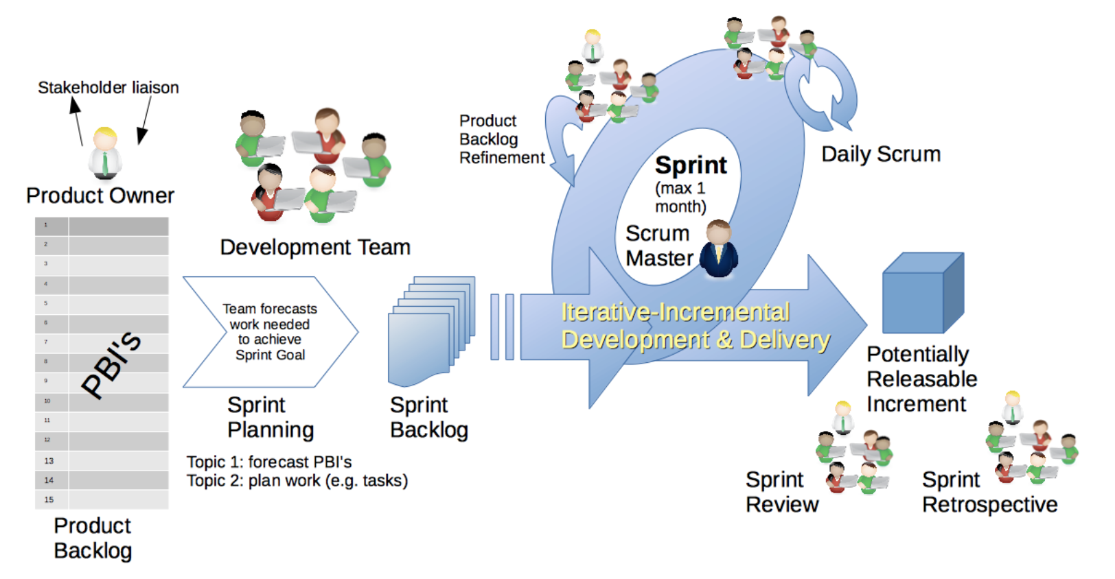
Software Design Processes

Slide 22
Grading
Team Grade(per accepted feature):
Design – 30%
Implementation – 40%
Testing – 30%
Individual Grade:
Team Grade – 40%
Writing specifications – 10%
Writing tests, Fixing bugs – 15%
Writing implementation – 20%
Giving code review – 10%
Reflection – 5%

Slide 23
What is Git?
Repository
A set of commit objects
A set of references called heads
.git directory

Slide 24
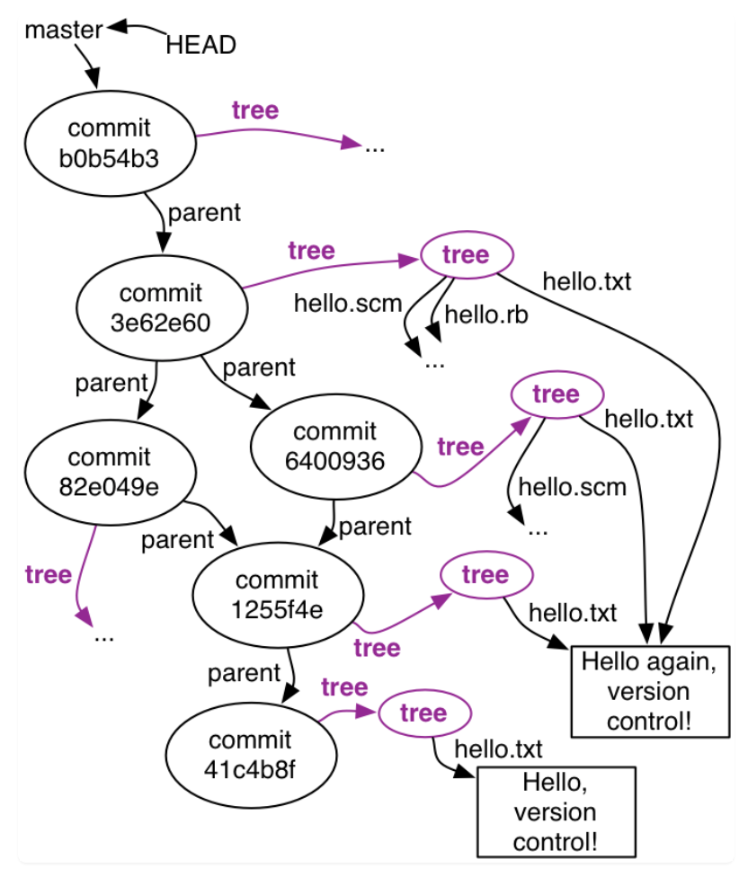
What is Git?

Slide 25
Commit Objects
A set of files (state of a project)
Reference to Parent commit objects
SHA1 name – hash string
Identical commits have same hash
Repository is an acyclic directed graph.

Slide 26
Heads
A head is a simple reference to a commit object
Master
Current head – Aliased to HEAD

Slide 27
Simple commands
git init – initializes repo, creates .git dir
git add – adds modified files
Git automatically adds unchanged files
git commit – create a commit object
git log – all commits from HEAD to initial commit
git status – which files have changed
git diff – diff between HEAD and current state

Slide 28
Standard Workflow
Do some programming
git status to see what files have been changed
git diff [file]
git commit –a –m [message]

Slide 29
Branching
The purpose of Branching
git branch [new-head-name] [reference]
git checkout – switch branches
Points HEAD to the specified commit object
Rewrites all files in the directory.
Commit all changes before changing branch
Tip: master branch always should be in releasable state.

Slide 30
Merging
git merge
Identify common ancestor of current and merge
Determine changes
If no conflicts create new commit with two parent objects
If conflict no commit is created.
Resolving conflicts

Slide 31
Distributed Version Control
git clone
Remote repo references
Remote heads
git fetch
git pull
git push

