Slide 1


ობიექტზე ორიენტირებული პროგრამირება
ლექცია 1

Slide 2
Welcome!
Today:
What should we know?
OOP Overview
Next lecture

Slide 3
What should we know?
Prerequisites:
Programming 1

Slide 4
What should we know?
Prerequisites:
Programming 1
Java
Collections
Maps
Simple GUI

Slide 5
What should we know?
Prerequisites:
Programming 1
Java
Collections
Maps
Simple GUI
Decomposition

Slide 6
What should we know?
Prerequisites:
Programming 1
Java
Collections
Maps
Simple GUI
Decomposition
Some OOP skills
Inheritance
Interfaces

Slide 7
What should we know?
Prerequisites:
Programming 1
Java
Collections
Maps
Simple GUI
Decomposition
Some OOP skills
Inheritance
Interfaces
Debugging

Slide 8
What should we know?
Prerequisites:
Programming 1
Programming 2

Slide 9
What should we know?
Prerequisites:
Programming 1
Programming 2
More OOP stuff
Containers
Templates

Slide 10
What should we know?
Prerequisites:
Programming 1
Programming 2
More OOP stuff
Containers
Templates
Abstraction

Slide 11
What should we know?
Prerequisites:
Programming 1
Programming 2
More OOP stuff
Containers
Templates
Abstraction
Recursion

Slide 12
What should we know?
Prerequisites:
Programming 1
Programming 2
More OOP stuff
Containers
Templates
Abstraction
Recursion
Algorithms and data structures

Slide 13
What should we know?
Prerequisites:
Programming 1
Programming 2
Databases
not a prerequisite, but it will be helpful

Slide 14
OOP Overview
What will we learn?

Slide 15
OOP Overview
What will we learn?
Solid understanding of object-oriented principles

Slide 16
OOP Overview
What will we learn?
Solid understanding of object-oriented principles
Encapsulation

Slide 17
OOP Overview
What will we learn?
Solid understanding of object-oriented principles
Encapsulation
Inheritance

Slide 18
OOP Overview
What will we learn?
Solid understanding of object-oriented principles
Encapsulation
Inheritance
Polymorphism

Slide 19
OOP Overview
What will we learn?
Solid understanding of object-oriented principles
Encapsulation
Inheritance
Polymorphism
Software system design

Slide 20
OOP Overview
What will we learn?
Solid understanding of object-oriented principles
Encapsulation
Inheritance
Polymorphism
Software system design
Pattern design

Slide 21
OOP Overview
What will we learn?
Solid understanding of object-oriented principles
Broaden range of your programming skills

Slide 22
OOP Overview
What will we learn?
Solid understanding of object-oriented principles
Broaden range of your programming skills
multi- threaded programs

Slide 23
OOP Overview
What will we learn?
Solid understanding of object-oriented principles
Broaden range of your programming skills
multi- threaded programs
communication between processes

Slide 24
OOP Overview
What will we learn?
Solid understanding of object-oriented principles
Broaden range of your programming skills
multi- threaded programs
communication between processes
interacting with databases

Slide 25
OOP Overview
What will we learn?
Solid understanding of object-oriented principles
Broaden range of your programming skills
Tackle down big problems

Slide 26
OOP Overview
What will we learn?
Solid understanding of object-oriented principles
Broaden range of your programming skills
Tackle down big problems
You will program a number of large, interesting projects.

Slide 27
OOP Overview
What will we learn?
Solid understanding of object-oriented principles
Broaden range of your programming skills
Tackle down big problems
You will program a number of large, interesting projects.
Learn to find useful information on your own

Slide 28
OOP Overview
What will we learn?
Solid understanding of object-oriented principles
Broaden range of your programming skills
Tackle down big problems
Team work

Slide 29
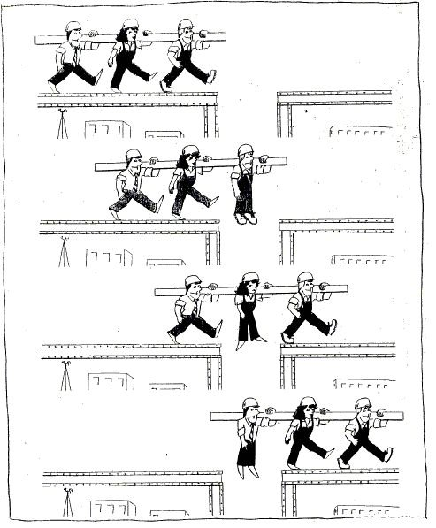
OOP Overview
What will we learn?
Solid understanding of object-oriented principles
Broaden range of your programming skills
Tackle down big problems
Team work

Slide 30
OOP Overview
Administrativa
4 meeting hours per week

Slide 31
OOP Overview
Administrativa
4 meeting hours per week
5 Assignments

Slide 32
OOP Overview
Administrativa
4 meeting hours per week
5 Assignments
Assignments are pretty large and there is no chance you will finish them in a day or two.

Slide 33
OOP Overview
Administrativa
4 meeting hours per week
5 Assignments
Assignments are pretty large and there is no chance you will finish them in a day or two.
NO “late days” !

Slide 34
OOP Overview
Administrativa
4 meeting hours per week
5 Assignments
Class Project

Slide 35
OOP Overview
Administrativa
4 meeting hours per week
5 Assignments
Class Project
Full-scale project

Slide 36
OOP Overview
Administrativa
4 meeting hours per week
5 Assignments
Class Project
Full-scale project
5 person teams

Slide 37
OOP Overview
Administrativa
4 meeting hours per week
5 Assignments
Class Project
Final Exam!

Slide 38
OOP Overview
Administrativa
4 meeting hours per week
5 Assignments
Class Project
Final Exam!
Grading

Slide 39
OOP Overview
Administrativa
4 meeting hours per week
5 Assignments
Class Project
Final Exam
Grading

Slide 40
OOP Overview
Administrativa
4 meeting hours per week
5 Assignments
Class Project
Final Exam!
Grading
Collaboration Policy!

Slide 41
OOP Overview
Administrativa
4 meeting hours per week
5 Assignments
Class Project
Final Exam!
Grading
Collaboration Policy!
If someone looks at your code, or if you look at another student’s code, you have received too much assistance

Slide 42
OOP Overview
Administrativa
4 meeting hours per week
5 Assignments
Class Project
Final Exam!
Grading
Collaboration Policy!
If someone looks at your code, or if you look at another student’s code, you have received too much assistance
Cite your sources

Slide 43
Classroom
Google classroom code:
dqapj4u

Slide 44
Next Lecture
Main method
Call-by-reference vs Call-by-value
Copying objects
Comparing
Multi-Dimensional Array

