Slide 1


პროგრამული უზრუნველყოფის ინჟინერია
ლექცია 18

Slide 2
Welcome!
Today:
HTTP Servlet
Basics Servlet Lifecycle
Request and Response
Session Management

Slide 3
Servlet API
javax.servlet
Support generic, protocol-independent servlets
Servlet (interface)
GenericServlet (class)
ServletRequest and ServletResponse
Provide access to generic server requests and responses
javax.servlet.http
Extended to add HTTP-specific functionality
HttpServlet (extends GenericServlet )
doGet()
doPost()
HttpServletRequest and HttpServletResponse
Provide access to HTTP requests and responses

Slide 4
User Defined Servlets
Inherit from HttpServlet
Override doGet() and doPost()
To handle GET and POST requests
Have no main() method

Slide 5
doGet() and doPost()
protected void doGet(
HttpServletRequest req,
HttpServletResponse resp)
protected void doPost(
HttpServletRequest req,
HttpServletResponse resp)
example

Slide 6
End-to-end process
Client makes a request to a servlet
Web Server
Receives the request
Identifies the request as a servlet request
Passes the request to the servlet container
Servlet Container
Locates the servlet Passes the request to the servlet
Servlet
Executes in the current thread
The servlet can store/retrieve objects from the container
Output is sent back to the requesting browser via the web server
Servlet continues to be available in the servlet container

Slide 7
Servlet Container
Provide web server with servlet support
Execute and manage servlets
E.g., Tomcat
Must conform to the following lifecycle contract
Create and initialize the servlet
Handle zero or more service calls from clients
Destroy the servlet and then garbage collect it
Usually execute all servlets in a single JVM

Slide 8
Loading Servlet
Server calls servlet’s init() method
After the server constructs the servlet instance
and before the servlet handles any requests
init()
Servlet initialization
May be called ...
When the server starts
When the servlet is first requested, just before the service() method is invoked
At the request of the server administrator

Slide 9
Removing Servlets
Server calls the destroy() method
After the servlet has been taken out of service and all pending requests to the servlet have completed or timed out
destroy()
Resources acquired should be freed up
A chance to write out its unsaved cached info
Last step before being garbage collected

Slide 10
Servlet Instance Persistance
Servlets persist between requests as object instances
When servlet is loaded, the server creates a single instance
The single instance handles every request made of the servlet
Improves performance in three ways
Keeps memory footprint small
Eliminates the object creation overhead
Enables persistence
May have already loaded required resources

Slide 11
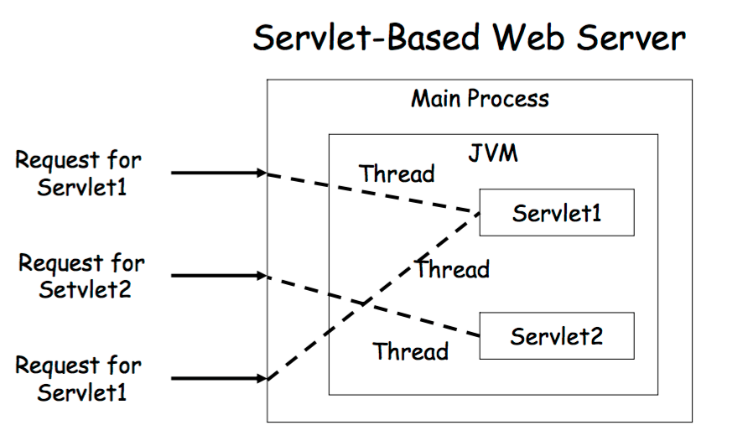
Servlet Thread Model

Slide 12
HTTPServletRequest
Encapsulate all information from the client request
HTTP request header and request body
Methods to retrieve data. Inherited from ServletRequest
getParameter()
getParameterNames()
getParameterValues()
getInputStream()
getReader()

Slide 13
HTTPServletResponce
Encapsulate all data to be returned to client
HTTP response header and response body
Set HTTP response header
Primitive manipulation
setStatus(), setHeader(), addHeader()
Convenience methods
setContentType(), sendRedirect(), sendError()
Set HTTP response Body
Obtain a PrintWriter or ServletOutputStream to return data to the client
getWriter(), getOutputStream()

Slide 14
Get vs Post
GET
All form parameters are embedded in the URL
If you reload, or bookmark and return, the query will get executed a second time with the same parameters
Bad if page is a credit card order confirmation – 2 charges!
Use GET to obtain info

Slide 15
Get vs Post
POST
Form parameters are included in the request body
On reload
Browser will ask if it should re-post
On bookmark and return
Query will proceed with no parameters
Use POST to change state

Slide 16
Session Managmement
Provide state between HTTP requests
Client-side
Cookies
Hidden variables
URL rewriting
User authentication
getRemoteUser()
Provided by HttpServletRequest
Server-side
Servlet’s built-in session tracking

Slide 17
Persistent Cookies
Stored at the browser
As name=value pairs
Browsers limit the size of cookies
Users can refuse to accept them
Attached to subsequent requests to the same server
Servlets can create cookies
Included in the HTTP response header

Slide 18
Adding a Cookie
MaxAge - Given in seconds. If negative, cookie persists until browser exists
Domain - Return cookie to servers matching the specified domain pattern. By default, only return to the server that sent it
Secure flag - Send cookie only on secure channels
HttpServletResponse
addCoockie(Cookie cookie)

Slide 19
Retrieving a Cookie
HttpServletRequest
public Cookie[] getCookies()
Cookie
getName()
getValue()
getDomain()
getSecure()

Slide 20
Builtin Session Tracking
Session tracking API devoted to servlet session tracking
Most servers support session tracking
Through the use of persistent cookies
Able to revert to URL rewriting when cookies fail
Servlet uses the token to fetch session state
Session objects are maintained in memory
Some servers allow them to be written to file system or database as memory fills up or when server shuts down
Items in the session need to be serializable

Slide 21
Session Tracking Basics
Every user of a site is associated with a javax.servlet.http.HttpSession object
To store and retrieve information about the user
Retrieve the current HttpSession object
public HttpSession HttpServletRequest.getSession()
Creates one if no valid session found

Slide 22
Session Attributes
To add data to a session object
public void HttpSession.setAttribute (String name, Object value)
To retrieve an object from a session
public Object HttpSession.getAttribute (String name)
To get the names of all objects in a session
public Enumeration HttpSession.getAttributeNames()
To remove an object from a session
public void HttpSession.removeAttribute (String name)

Slide 23
Session Lifesicle
Sessions do not last forever
Expire automatically due to inactivity
Default 30 min
Explicitly invalidated by servlet
When session expires (or is invalidated)
The HttpSession object and its data values are removed

Slide 24
Setting Session Timeout
Setting default session timeout
Deployment descriptor, web.xml
Applies to all sessions created in the given web application
<session-config>
<session-timeout> 30 <!– minutes -->
</session-timeout>
</session-config>
Configured individually
public void HttpSession.setMaxInactiveInterval
Terminating a session
session.invalidate()
Deletes session related attributes form server
Removes cookie from client

Slide 25
ServletContext
Reference to the web application in which servlets execute
One ServletContext for each app on the server
Allow servlets to access server information
GenericServlet.getServletContex()
Using ServletContext, servlets can
Log events
Obtain URL references to resources
Access to initialization parameters (in web.xml)
Share attributes with other servlets in the context

