Slide 1


პროგრამული უზრუნველყოფის ინჟინერია
ლექცია 19

Slide 2
Welcome!
Today:
Information Sharing
JSP
MVC

Slide 3
Information Sharing
ServletContext
shared by all servlets
getServletContext()
One may store database connection
HttpSession
One session per “user”
getHttpSession()
One may store items in shopping cart
HttpServletRequest
Servlets can forward to other servlets
Request object can be used to pass information
ServletConfig
Config from web.xml - per servlet

Slide 4
Listeners
Who sets the initial values in ServletContext and HttpSession?
Listeners
Will listen for the creation of ServletContext, HttpSession, ServletRequest
Can also listen to attribute changes
HttpSessionListener, HttpSessionAttributeListener

Slide 5
Why JSP?
Goal: Create dynamic web content (HTML, XML, ...) for a Web Application
Goal: Make it easier/cleaner to mix static HTML parts with dynamic Java servlet code

Slide 6
What is JSP?
Mostly HTML page, with extension .jsp
Include JSP tags to enable dynamic content creation
Translation: JSP → Servlet class
Compiled at Request time
(first request, a little slow)
Execution: Request → JSP Servlet's service method

Slide 7
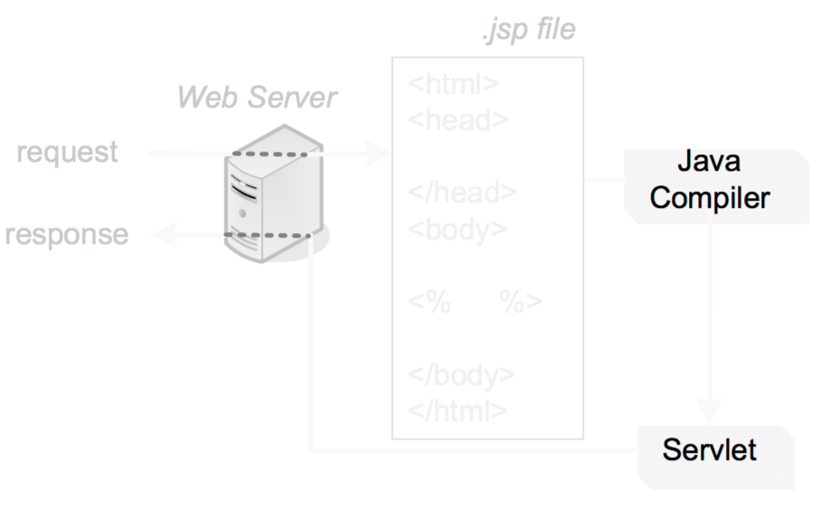
Behind Scenes

Slide 8
Advantages
Code -- Computation
HTML -- Presentation
Separation of Roles
Developers
Content Authors/Graphic Designers/Web Masters
Supposed to be cheaper... but not really...

Slide 9
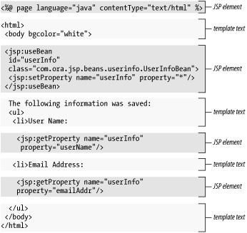
A JSP File

Slide 10
<%@ Directive %>
<%@ page contentType="text/html" %>
<%@ taglib prefix="c" uri=http://java.sun.com/jstl/core %>
<html>
<head>
<title>JSP is Easy</title>
</head>
<body bgcolor="white">
<h1>JSP is as easy as ...</h1>
<%-- Calculate the sum of 1 + 2 + 3 dynamically --%>
1 + 2 + 3 = <c:out value="${1 + 2 + 3}" />
</body>
</html>

Slide 11
<%-- JSP Comment %>
<%@ page contentType="text/html" %>
<%@ taglib prefix="c" uri=http://java.sun.com/jstl/core %>
<html>
<head>
<title>JSP is Easy</title>
</head>
<body bgcolor="white">
<h1>JSP is as easy as ...</h1>
<%-- Calculate the sum of 1 + 2 + 3 dynamically --%>
1 + 2 + 3 = <c:out value="${1 + 2 + 3}" />
</body>
</html>

Slide 12
Template Text
<%@ page contentType="text/html" %>
<%@ taglib prefix="c" uri=http://java.sun.com/jstl/core %>
<html>
<head>
<title>JSP is Easy</title>
</head>
<body bgcolor="white">
<h1>JSP is as easy as ...</h1>
<%-- Calculate the sum of 1 + 2 + 3 dynamically --%>
1 + 2 + 3 = <c:out value="${1 + 2 + 3}" />
</body>
</html>

Slide 13
Scripting Element Tags
<%= expr %>
<%! decl %>
<% code %>

Slide 14
Special Variables
out – gives access to a PrintWriter for the response.
request – gives access to the HttpServletRequest object.
response – gives access to the HttpServletReponse object.
session – gives access to the HttpSession object.
application – gives access to the ServletContext object.
config – gives access to the ServletConfig object.

Slide 15
Model-View-Controller
A Design Pattern
Controller -- receives user interface input, updates data model
Model -- represents state of the world (e.g. shopping cart)
View -- looks at model and generates an appropriate user interface to present the data and allow for further input

Slide 16


Model-View-Controller
JSP
View
Bean
Servlet
Controller
Model

Slide 17
Public class OrderServlet … {
public void doGet(…){
…
if(bean.isOrderValid(…)){
bean.saveOrder(req);
…
forward(“conf.jsp”);
}
}
Servlet
Pure Servlet
public class OrderServlet … {
public void dogGet(…){
if(isOrderValid(req)){
saveOrder(req);
…
out.println(“<html><body>”);
…
}
private void isOrderValid(…){
…
}
private void saveOrder(…){
…
}
}
<html>
<body>
<c:forEach items=“${order}”>
…
</c:forEach>
</body>
</html>
JSP
isOrderValid()
saveOrder()
------------------
private state
Java Bean

