Slide 1
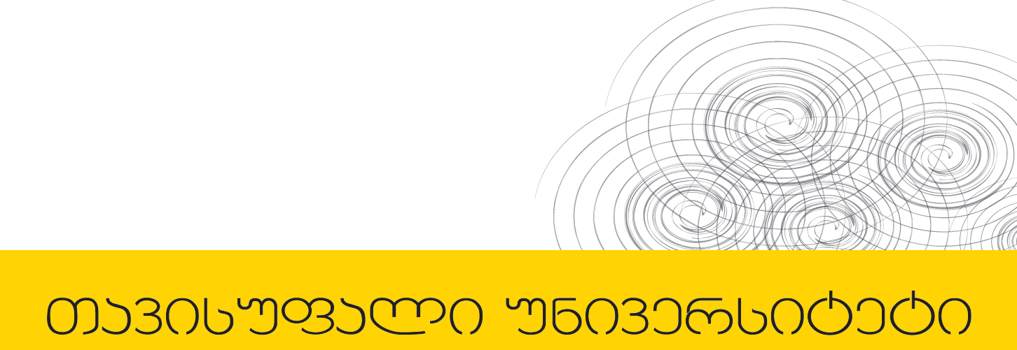

პროგრამული უზრუნველყოფის ინჟინერია
ლექცია 2

Slide 2
Welcome!
Today:
Java
Call-by-reference vs Call-by-value
Copying objects
Comparing
Multi-Dimensional Array

Slide 3
Goal of the course
Learn how to produce software that is:
Safe from bugs
Easy to understand
Ready for change

Slide 4
Java
Safety
Static typing
Memory management
Ubiquity
Java is widely used in industry and education
Libraries and Tools
Java has libraries and frameworks for many things
Excellent, free tools exist for Java development
Why we regret using Java...
Wordy, inconsistent, freighted with legacy baggage from older languages, no interpreter

Slide 5
Call-by-reference vs. Call-by-value
in C++ both ways are acceptable
void incrementOne(int& a) {
a++;
}
void incrementTwo(int a) {
a++;
}
int x = 1; Vs. int x = 1;
incrementOne(x); incrementTwo(x);

Slide 6
Java Call-By-Value with Primitive
public class CallByValueExample {
public static void increment(int a) {
a++;
}
public static void main(String[] args) {
int x = 1;
increment(x);
System.out.println(x);
}
}

Slide 7
Java Call-By-Value with Reference Type
public class CallByValueExample2 {
public static void increment(Point a) {
a.x++;
a.y++;
}
public static void main(String[] args) {
Point p = new Point(1,1);
increment(p);
System.out.println("x=" + p.x + ";y=" + p.y);
}
}

Slide 8
What does this do?
public class CallByValueChange {
public static void change(Point a) {
a = new Point(5,5);
}
public static void main(String[] args) {
Point p = new Point(1,1);
change(p);
System.out.println("x=" + p.x + ";y=" + p.y);
}
}

Slide 9
Copying Objects
Foo x = new Foo(1);
Foo y = new Foo(2);
x = y;
What got copied?

Slide 10
Copying Objects
Foo x = new Foo(1);
Foo y = new Foo(x);
Not the same as
x = y;

Slide 11
Copying Objects
public class MyPoint {
public int x;
public int y;
MyPoint(int x,int y) {
this.x = x;
this.y = y;
}
}

Slide 12
Copying Objects
MyPoint p1 = new MyPoint(5,5);
MyPoint p2 = p1;
p2.x = 15;
What is the value of p1.x and p1.y?

Slide 13
Copying Objects
public class MyPoint {
…
MyPoint(MyPoint p) {
this.x = p.x;
this.y = p.y;
}
}

Slide 14
Copying Objects
MyPoint q1 = new MyPoint(5,5);
MyPoint q2 = new MyPoint(q1);
q2.x = 15;
What is the value of q1.x and q1.y?

Slide 15
Comparing
MyPoint p1 = new MyPoint(5,5);
MyPoint p2 = p1;
Does p1 == p2?
MyPoint q1 = new MyPoint(5,5);
MyPoint q2 = new MyPoint(q1);
Does q1 == q2?

Slide 16
Comparing
Writing equals method in MyPoint class
public class MyPoint {
…
public boolean equals(MyPoint p) {
return (x == p.x) && (y == p.y);
}
}

Slide 17
Comparing
MyPoint q1 = new MyPoint(5,5);
MyPoint q2 = new MyPoint(q1);
What is q1.equals(q2)?

Slide 18
equals() method should be
Reflexive
x.equals(x) is true
Symmetric
x.eqauls(y) is y.equals(x)
Transitive
if x.equals(y) and y.equals(z) then x.equals(z)
Consistent
x.equals(y) is same on every call

Slide 19
Comparing
String s1 = new String(”FreeUni");
String s2 = new String(”FreeUni");
Does s1 == s2?
Does s1.equals(s2)?

Slide 20
Comparing
The default "a.equals(b)" does not do a deep comparison for arrays
Arrays.equals()
Arrays.deepEquals()

Slide 21
Multi-Dimensional Array
String[][] cartoons =
{{"Homer", "Marge", "Bart", "Lisa", "Maggie"},
{"Peter”,"Lois”,"Meg", "Chris", "Stewie", "Brian"}, {"Cartman", "Kenny", "Stan", "Kyle"}};
Unlike C and C++, a 2-d java array is not allocated as a single block of memory
it is implemented as a 1-d array of pointers to 1-d arrays.

Slide 22
Next Lecture
Java Generics
Testing

