Slide 1


პროგრამული უზრუნველყოფის ინჟინერია
ლექცია 25

Slide 2
Welcome!
Today:
Ajax

Slide 3
DOM
<!DOCTYPE html> <html> <head> <title>My title</title> </head> <body> <a href="">My link</a> <h1>My header</h1> </body> </html>

Slide 4
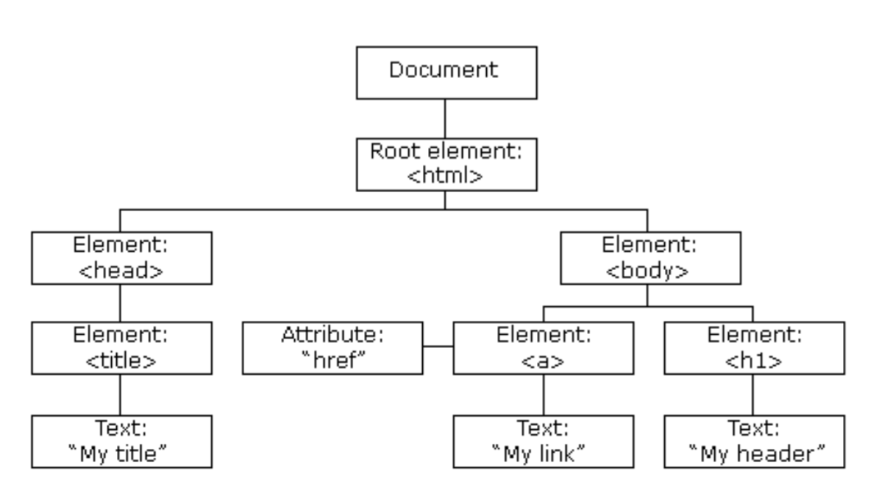
DOM
<!DOCTYPE html> <html> <head> <title>My title</title> </head>
<body> <a href="">My link</a> <h1>My header</h1> </body> </html>

Slide 5
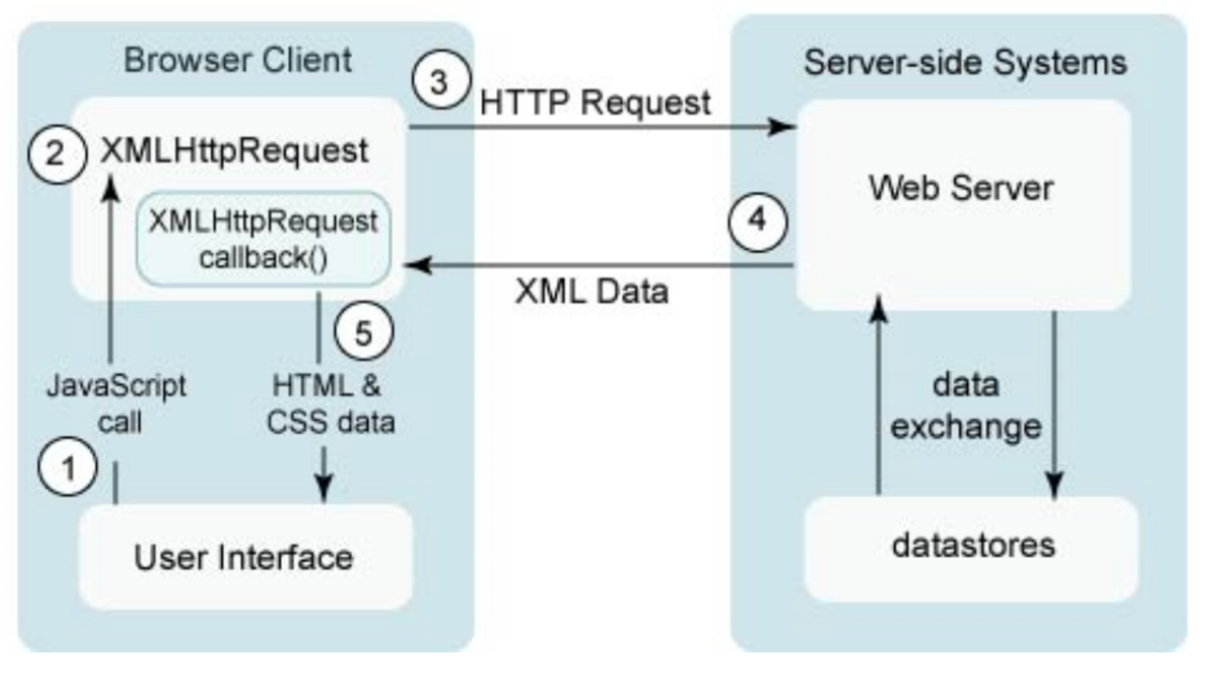
AJAX

Slide 6
XMLHttpRequest
abort()
getAllResponseHeaders()
getResponseHeader(header)
open(method, url)
open(method, url, async)
open(method, url, async, user)
open(method, url, async, user, password)
send()
send(data)
setRequestHeader(header, value)

Slide 7
XMLHttpRequest
onreadystatechange
readyState
0 (unitialized)
1 (open)
2 (sent)
3 (receiving)
4 (loaded)
responseBody
responseText
responseXML
Status
200 (OK)
404 (Not Found)
500 (Internal Server Error)

